Slide 1
Comparison of Various Codes for Particle Interaction with Material
Nikolai Mokhov
CERN Accelerator School
Thessaloniki, Greece
November 11-23, 2018

Slide 2
This Course at CAS-Thessaloniki / Nov. 2018
Nov. 20: Simulation of Particle-Material Interactions:
1. Basics
Nov. 20: Simulation of Particle-Material Interactions:
2. Advanced Implementation in the Monte-Carlo Codes
Nov. 22: Comparison of Various Codes for Particle Interaction with Material

Slide 3
Outline
Input Files
Rules-of-Thumb
A “Dream Code” Features
Code Benchmarking: Microscopic and Macroscopic Levels
Code Intercomarison Campaigns
Participant’s Experience: Short Stories & Feedback

Slide 4
Input Files
The user creates input files that are subsequently read by the code. These files contain info about the problem in areas such as:
Geometry specification with material assignment to the regions
Description of materials
Scoring/tallying definition - “sensitive region” assignment in item (1) or/and geometry-independent mesh/histograms with corresponding lists of functionals
Possible assignment of magnetic and electric fields and other properties affecting particle transport in regions of item (1)
The source term either in a simple parametric form or as an external file
The cutoff energies or/and time of flight (TOF) for particle classes, materials and regions
Possible material/region spatial resolution and pilot steps
Any variance reduction techniques to be applied for various interaction classes, regions, materials etc.

Slide 5
Rules-of-Thumb for MC Code Users
Define and sample the geometry and source well
You cannot recover lost information
Question the stability and reliability of results
Be conservative and cautious with variance reduction biasing
The number of histories run is not indicative of the quality of the results; rather aim at a RMS statistical error less than a few % in the regions of interest
In short runs, try to understand what a combination of variance reduction techniques provides the highest computing efficiency and estimate required total number of histories
Use biasing in particle-, cutoff energy-, space- and material--dependent manner
Minimize the number of unneeded regions and histograms

Slide 6
“A Dream Code” Features
Reliability
Predictive power
Best performance in benchmarking campaigns
Geometry module capabilities in complex accelerator environment with automated beamline and ring lattice creation and implementation in the model (Beamline Builders in MARS15 and FLUKA), with detailed magnet & RF description along with their EM-fields
Particle tracking capabilities, including arbitrary magnetic fields and multi-turn tracking with accelerator codes (PTC, SixTrack, etc)
User friendliness, first of all in geometry model building, but also in a choice of key input parameters (physics list, biasing options, cutoff energies etc.)
Good CPU performance; MPI readiness
Import/export in GDML format; CAD reader

Slide 7
Code Benchmarking
Debugging: The code should calculate what is supposed to calculate
Validation: Results should agree with established (analytic) result for the specific case
Inter-comparison: Two codes should agree if the model is the same
Verification: The code should agree with (reliable) measurements

Slide 8
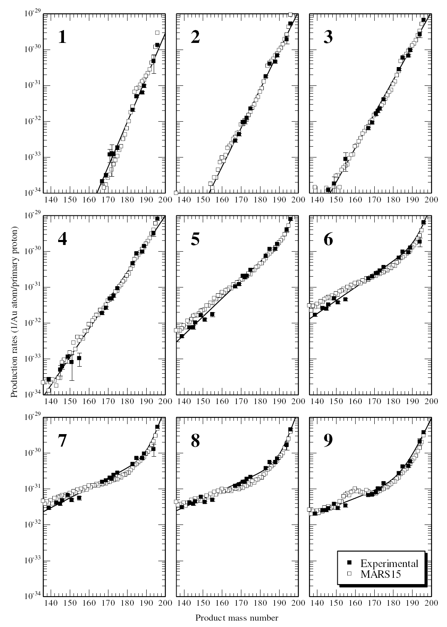
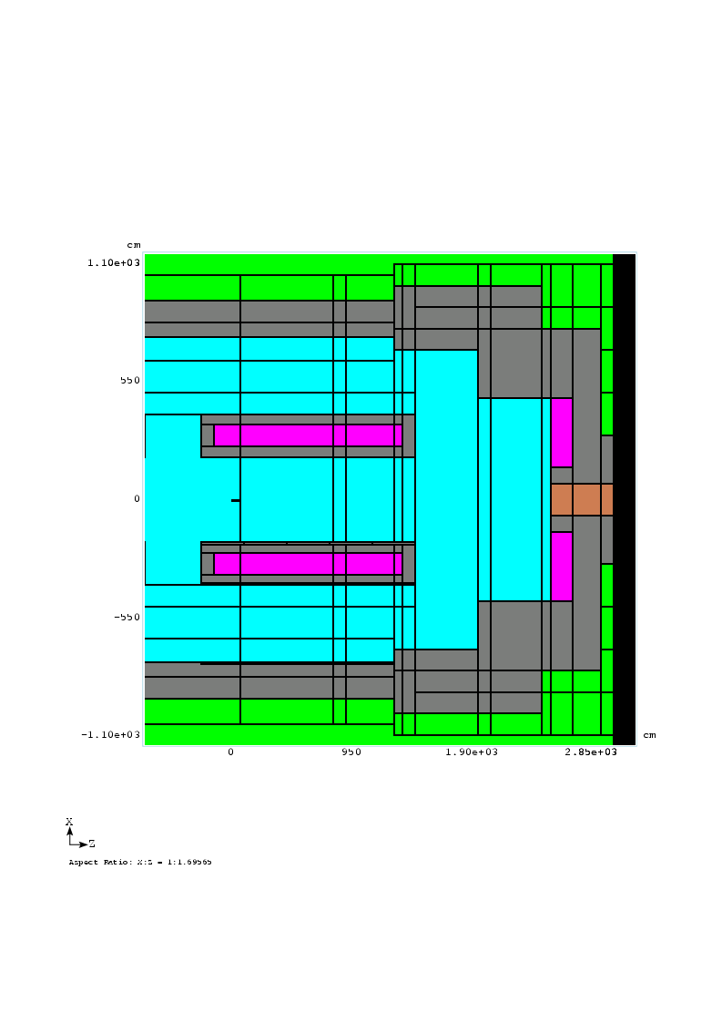
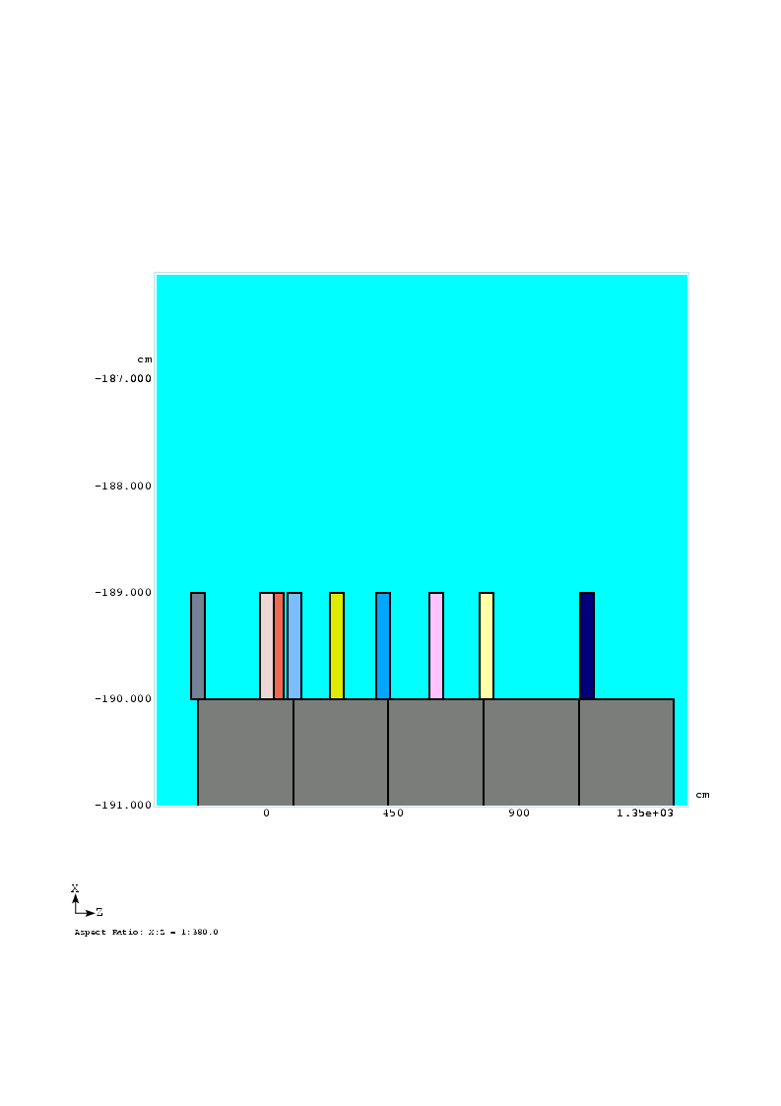
Nuclide Production at 12-GeV K2K Target Station
1
9
Nine gold foil samples
over 12 meters

Slide 9
CERF 120 GeV/c Hadron Beam Facility (1)

Slide 10
CERF 120 GeV/c Hadron Beam Facility (2)

Slide 11
CERF Residual Dose Benchmarking (2005)

Slide 12
CERF Residual Dose Benchmarking (2005)

Slide 13
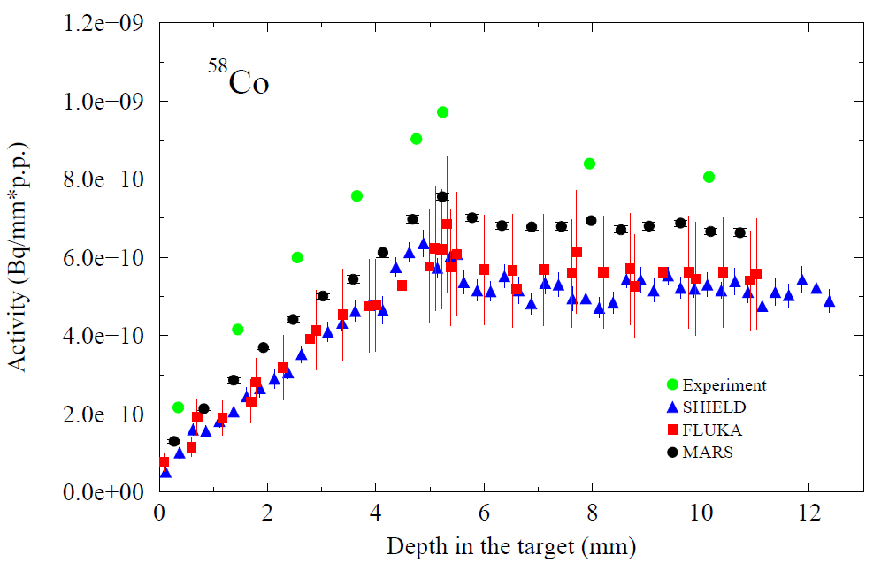
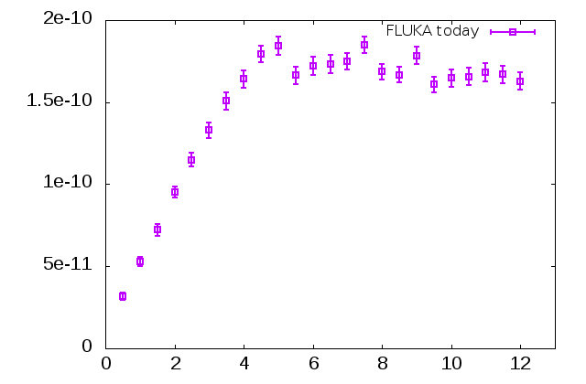
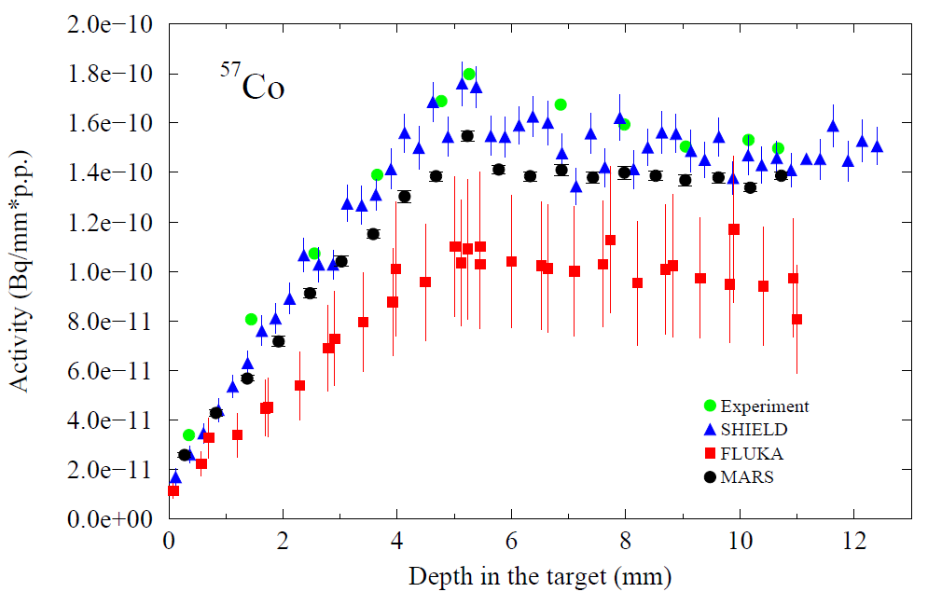
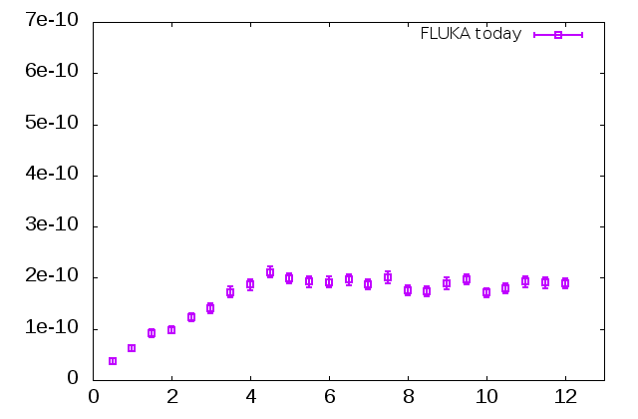
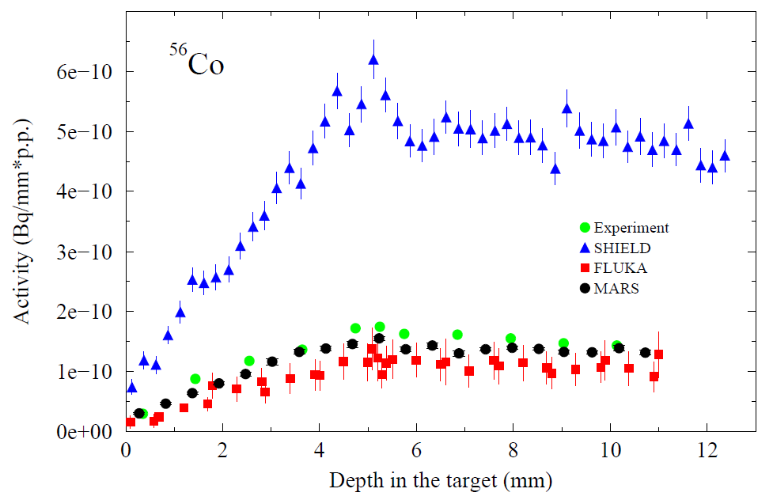
Activity Benchmarking at GSI
500 MeV/n ²³⁸U beam on Cu
[E. Mustafin et al., EPAC 2006, TUPLS141, 1834]

Slide 14
CERN CHARM Facility at 24 GeV/c

Slide 15
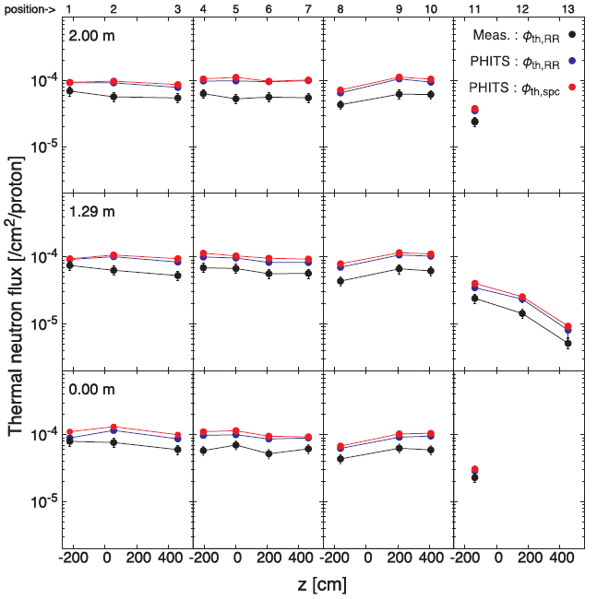
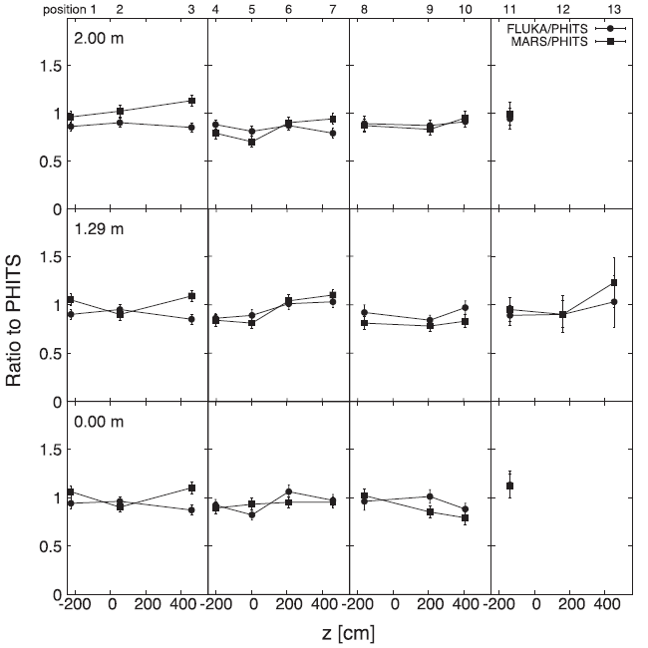
PHITS, FLUKA & MARS vs CHARM 24 GeV/c Data
PHITS & Exp within 50%
FLUKA, PHITS & MARS within 30%
T. Oyama et al., NIM, B434 (2018) 29-36

Slide 16
FLUKA Verification at LHC Betatron Cleaning

Slide 17
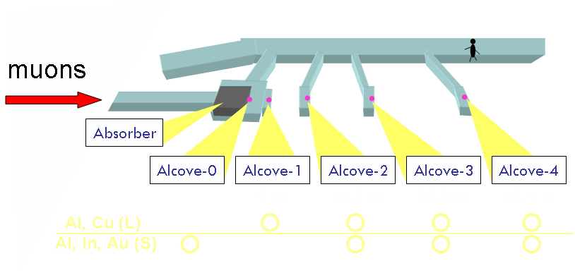
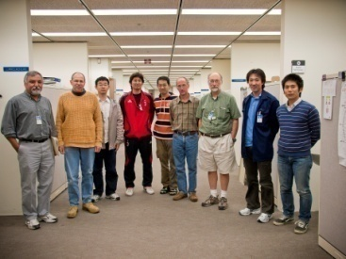
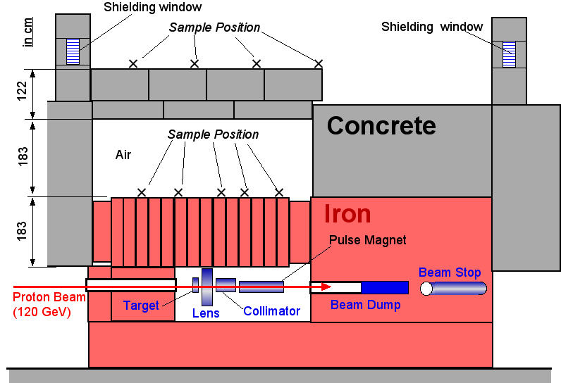
Shielding and Radiation Effect Experiment
JASMIN Japan-FNAL Collaboration:
Shielding and Radiation Effect
Experiments at FNAL
T-972 (2007-2009)
T-993 and T-994 (2009-2012)
Shielding data and code benchmarking;
targets, collimators and thick shields;
radiation effects on instruments and
materials
Example: Muon-induced nuclide production
8 GeV μ⁺
1 m
Target
10 cm
MARS15 vs data by H. Matsumura

Slide 18
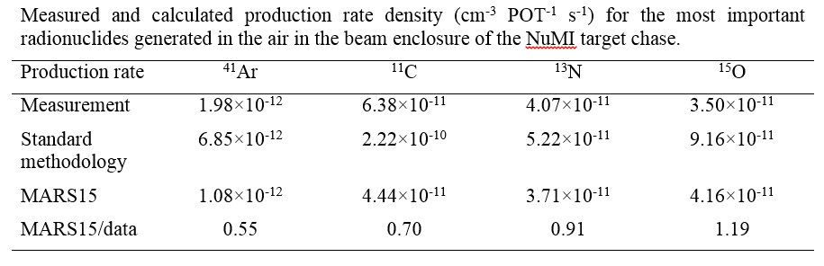
Air Activation at NuMI Neutrino Production Facility
To get more confidence in the MARS15-based LBNF target station design,
a benchmarking campaign on air activation has been recently undertaken at
the Fermilab NuMI target station for 120-GeV beam on target
NIM B414 (2018) 4-10
50%
10-30%

Slide 19
120-GeV Muon Range-out Distance in Dolomite (m)
LBNF 120 GeV
 | All dolomite | Dolomite after absorber
MARS15 | 223.7 | 214.5
FLUKA | 223 | 218
Notes:
All-dolomite FLUKA and MARS models are identical;
MARS statistics 40M muons (8 decades), FLUKA …
2. Absorber model in FLUKA ?
MARS statistics 80M muons (9 decades), FLUKA …

Slide 20
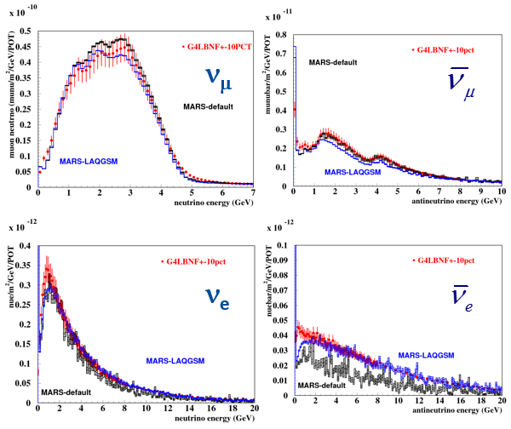
Neutrino Fluxes at Far Detector (1300 km)
Thorough search and elimination of differences in MARS15LBNF and G4LBNF models were performed on the optimized ν-flux: geometry, materials, magnetic fields etc.
ν-fluxes at the Far Detector calculated with MARS15 and Geant4 now agree within 10%. The code related uncertainties were reduced to the differences in the event generators, especially for K⁻ and K⁰ mesons (need data!)

Slide 21
HL-LHC IT FLUKA-MARS Study and Intercomparison
Q1
Q1-Q3 details
MCBX
PRAB (2015)

Slide 22
HL-LHC IT FLUKA-MARS Study and Intercomparison

Slide 23
HL-LHC IT FLUKA-MARS Study and Intercomparison

Slide 24
GEANT4 vs Data
Cu-Lar ATLAS HEC Calorimeter
230 MeV C and Ne on Cu-target

Slide 25
PHITS: 290 MeV/u ¹²C and ¹⁶O on ^{nat}C

Slide 26
PHITS: Neutron Production for 256 MeV p on Thick Targets

Slide 27
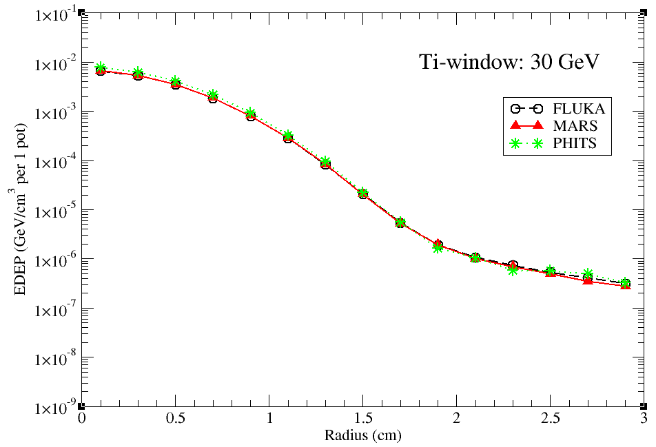
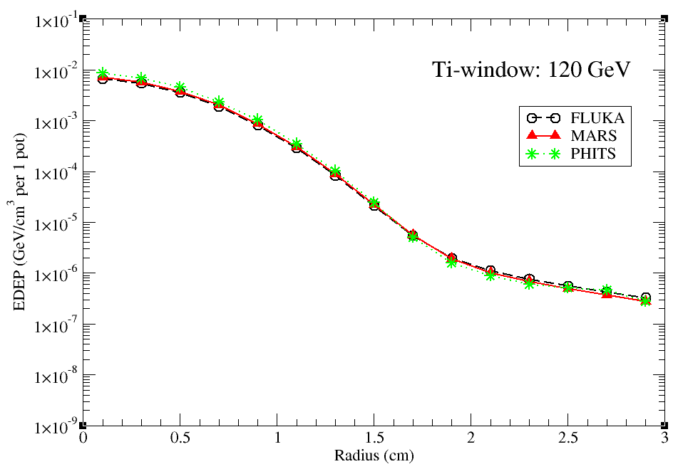
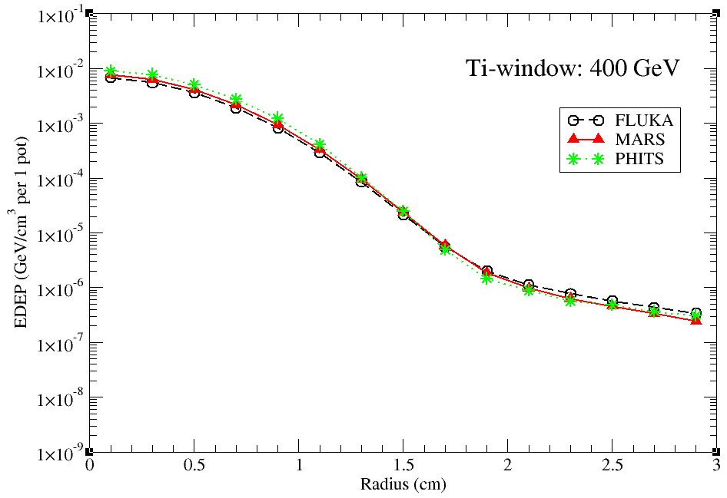
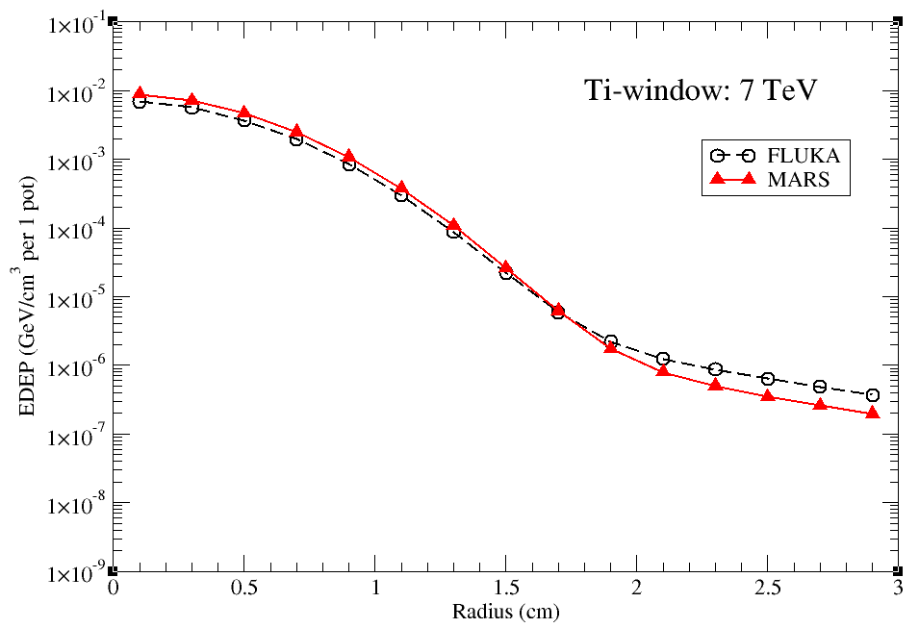
Ti-Window: EDEP @ 30, 120, 400 and 7000 GeV

Slide 28
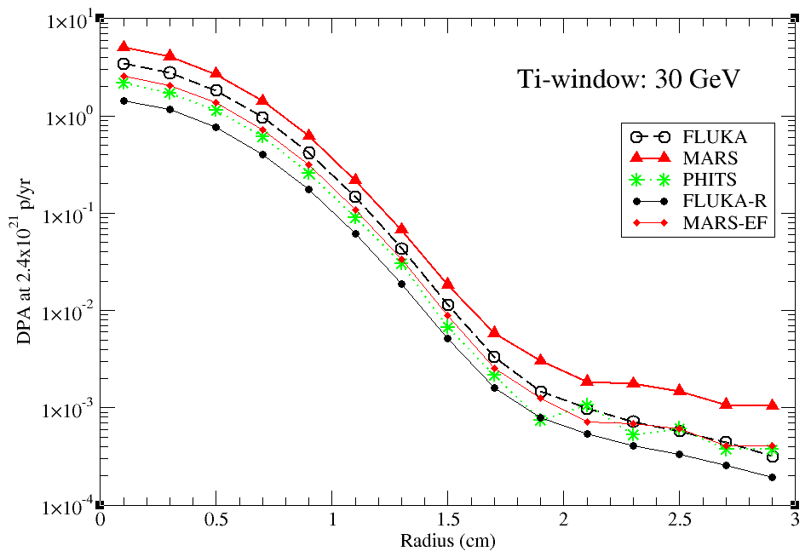
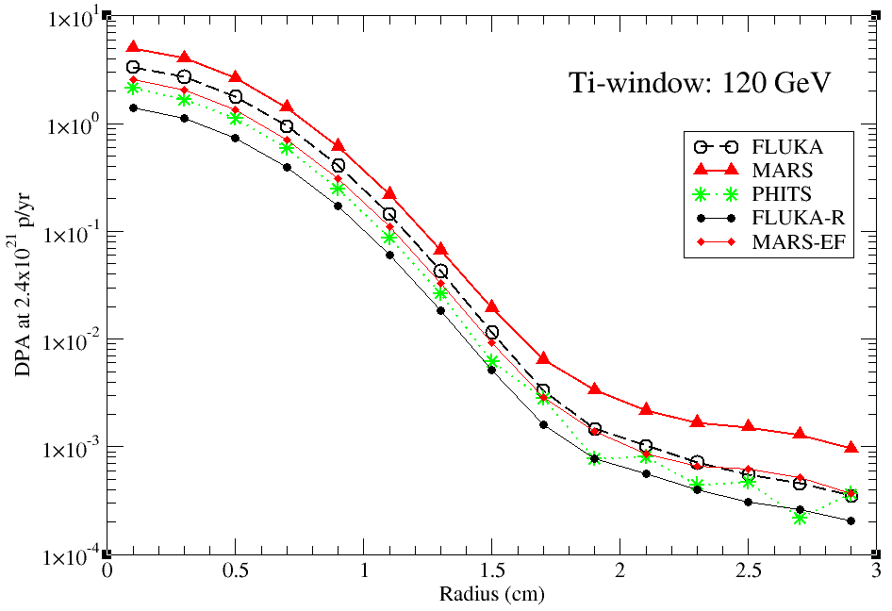

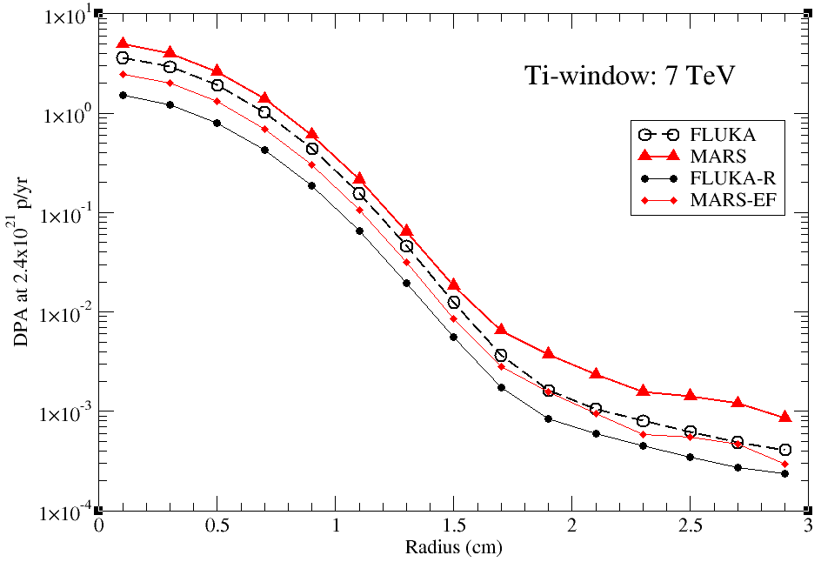
Ti-Window: DPA @ 30, 120, 400 and 7000 GeV

Slide 29
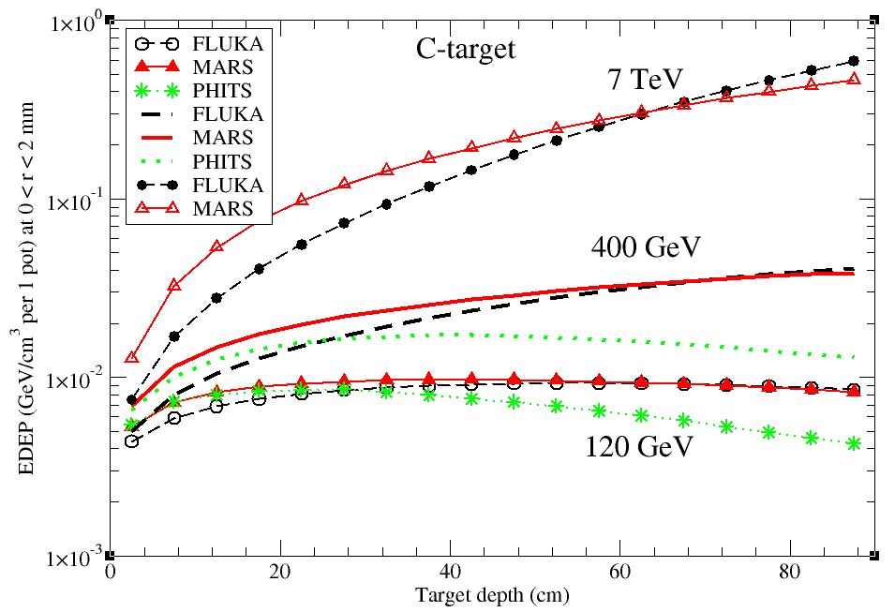
C-Target: EDEP @ 120, 400 and 7000 GeV

Slide 30
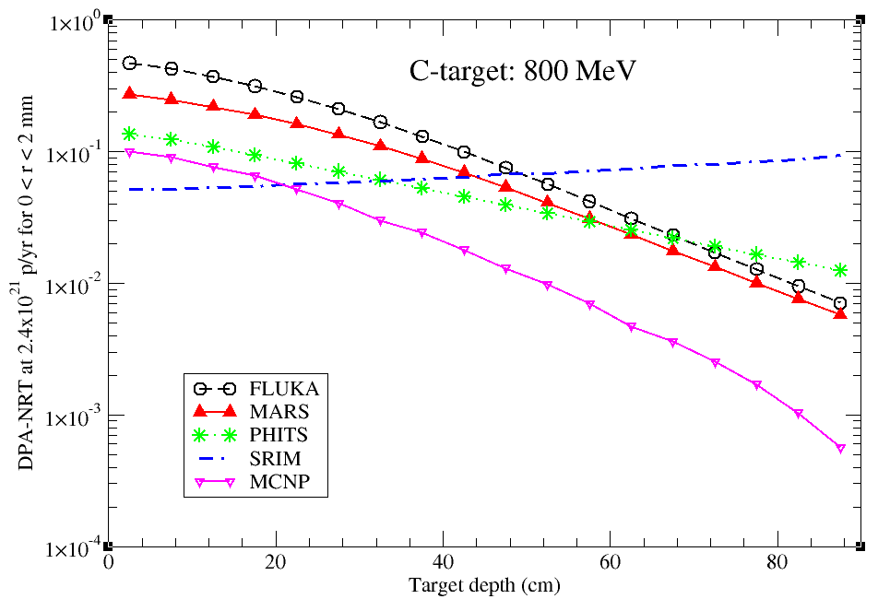
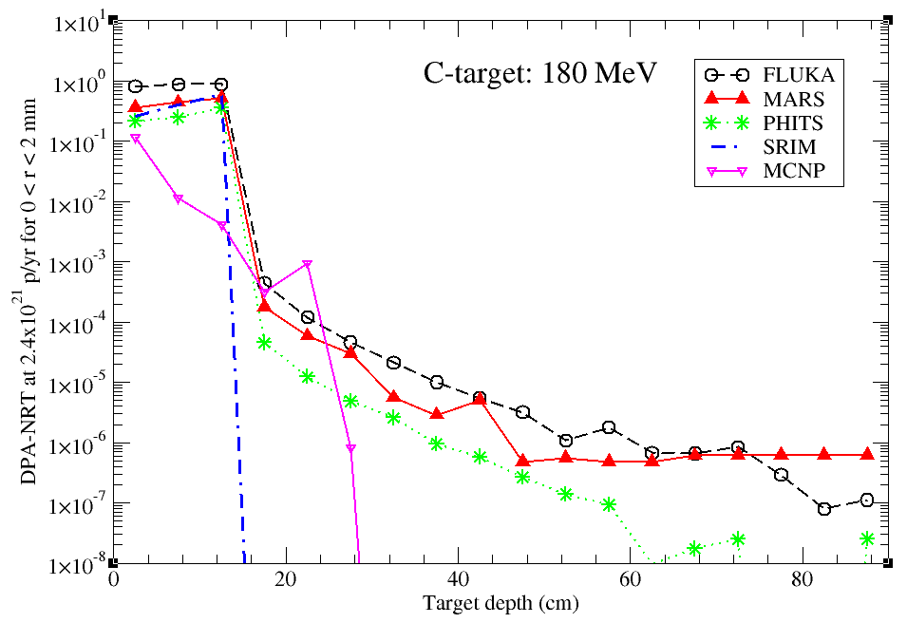
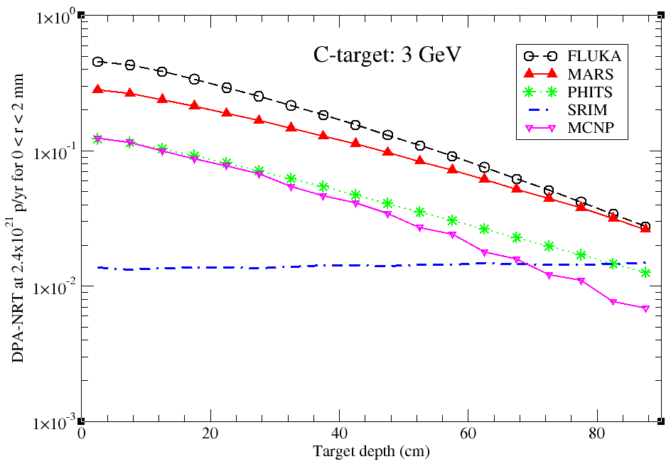
C-Target: DPA @ 180, 800 MeV and 3 GeV

Slide 31
Participant’s Experience: Short Stories & Feedback

