Slide 1


Ion- and Electron-Ion Colliders
Toward full understanding of QCD
Plenary ECFA Meeting
November 16th , 2018
Kick off with HI Experiments (physics goals & detector realization plan)
Detailed Discussion: CERN Townhall Meeting October 2018
Launch in to US Electron Ion Collider and cover all aspects requested in the PECFA invitation
Abhay Deshpande

Slide 2
Complementarity of Probes in Physics
Guido always emphasized:
Standard Model of Physics was developed using e+e-, p+p, and e+p collisions over a wide range in energy…..
I observe that it is also true for QCD
We would not get the full understanding of QCD (The Standard Model of Strong Interactions) without studying it with e+e-, p+p, e+p, e-A, and A+A collisions over a wide range of energies AND also where possible with polarized e, p, and light ion beams.

Slide 3
QCD: The Holy Grail of Quantum Field Theories
QCD : “nearly perfect” theory that explains nature’s strong interactions, is a fundamental quantum theory of quarks and gluon fields
QCD is rich with symmetries:
Chiral, Axial, Scale & P&T symmetries broken by quantum effects: Most of the visible matter in the Universe emerges as a result
Inherent in QCD are the deepest aspects of relativistic quantum field theories: (confinement, asymptotic freedom, anomalies, spontaneous breaking of chiral symmetry) ➔ all depend on non-linear dynamics in QCD
(1) (2) (3)
Gauge “color” symmetry : unbroken but confined
Global “chiral” flavor symmetry: exact for massless quarks
Baryon number and axial charge (massless quarks) conservation
Scale invariance for massless quarks and gluon fields
Discrete C, P & T symmetries

Slide 4
Emergence of spin, mass & confinement, gluon fields
Non-linear Structure of QCD has Fundamental Consequences
Quark (Color) confinement:
  Unique property of the strong interaction
  Consequence of nonlinear gluon self-interactions
  Clues: deconfinement in QGP @ LHC/RHIC & fragmentation/hadronization @ EIC
Strong Quark-Gluon Interactions:
  Confined motion of quarks and gluons – Transverse Momentum Dependent Parton Distributions (TMDs): Measured at an EIC, and used in others including LHC
  Confined spatial correlations of quark and gluon distributions – Generalized Parton Distributions (GPDs): Measured at an EIC, and used elsewhere
Ultra-dense color (gluon) fields:
  Is there a universal many-body structure due to ultra-dense color fields at the core of all hadrons and nuclei?
  To be measured in light ion and asymmetric collisions at LHC/RHIC and at the EIC
  Initial State of Heavy Ion Collisions
LHC/RHIC & EIC are all essential for the deeper understanding of QCD

Slide 5
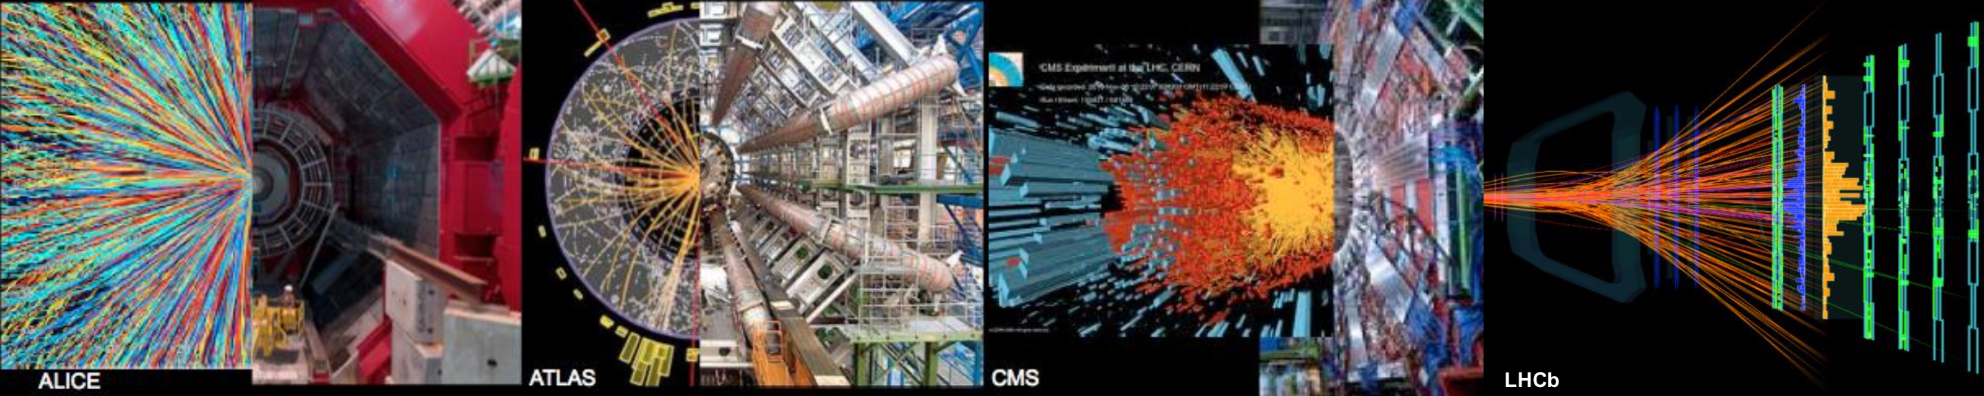
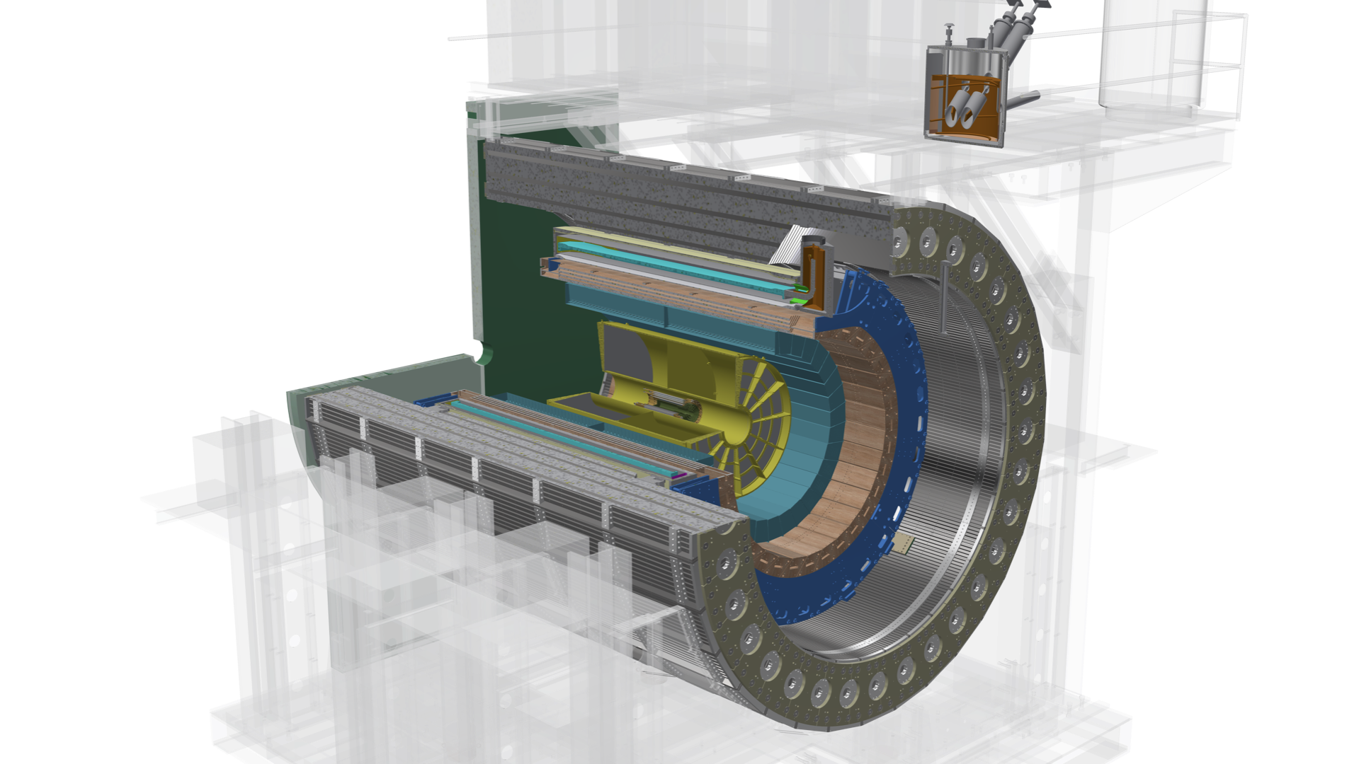
European Strategy for Particle Physics Update 2013:
Europe’s top priority should be the exploitation of the full potential of the LHC, including the high-luminosity upgrade of the machine and detectors with a view to collecting ten times more data than in the initial design, by around 2030. This upgrade program will also provide further exciting opportunities for the study of flavour physics and the quark-gluon plasma.
Nuclear Physics European Collaboration Committee 2017
crucial that all aspects of the LHC heavy-ion program, including manpower support and completion of the detector upgrades, are strongly supported
US Nuclear Science Advisory Committee’s 2015 Long Range Plan
There are two central goals of measurements planned at RHIC, as it completes its scientific mission, and at the LHC: (1) Probe the inner workings of QGP by resolving its properties at shorter and shorter length scales. The complementarity of the two facilities is essential to this goal, as is a state-of-the-art jet detector at RHIC, called sPHENIX. (2) Map the phase diagram of QCD with experiments planned at RHIC.
RHIC provides unique capabilities for QGP studies and to study the proton spin

Slide 6
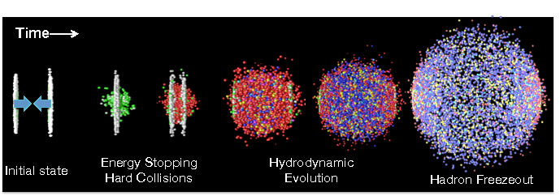
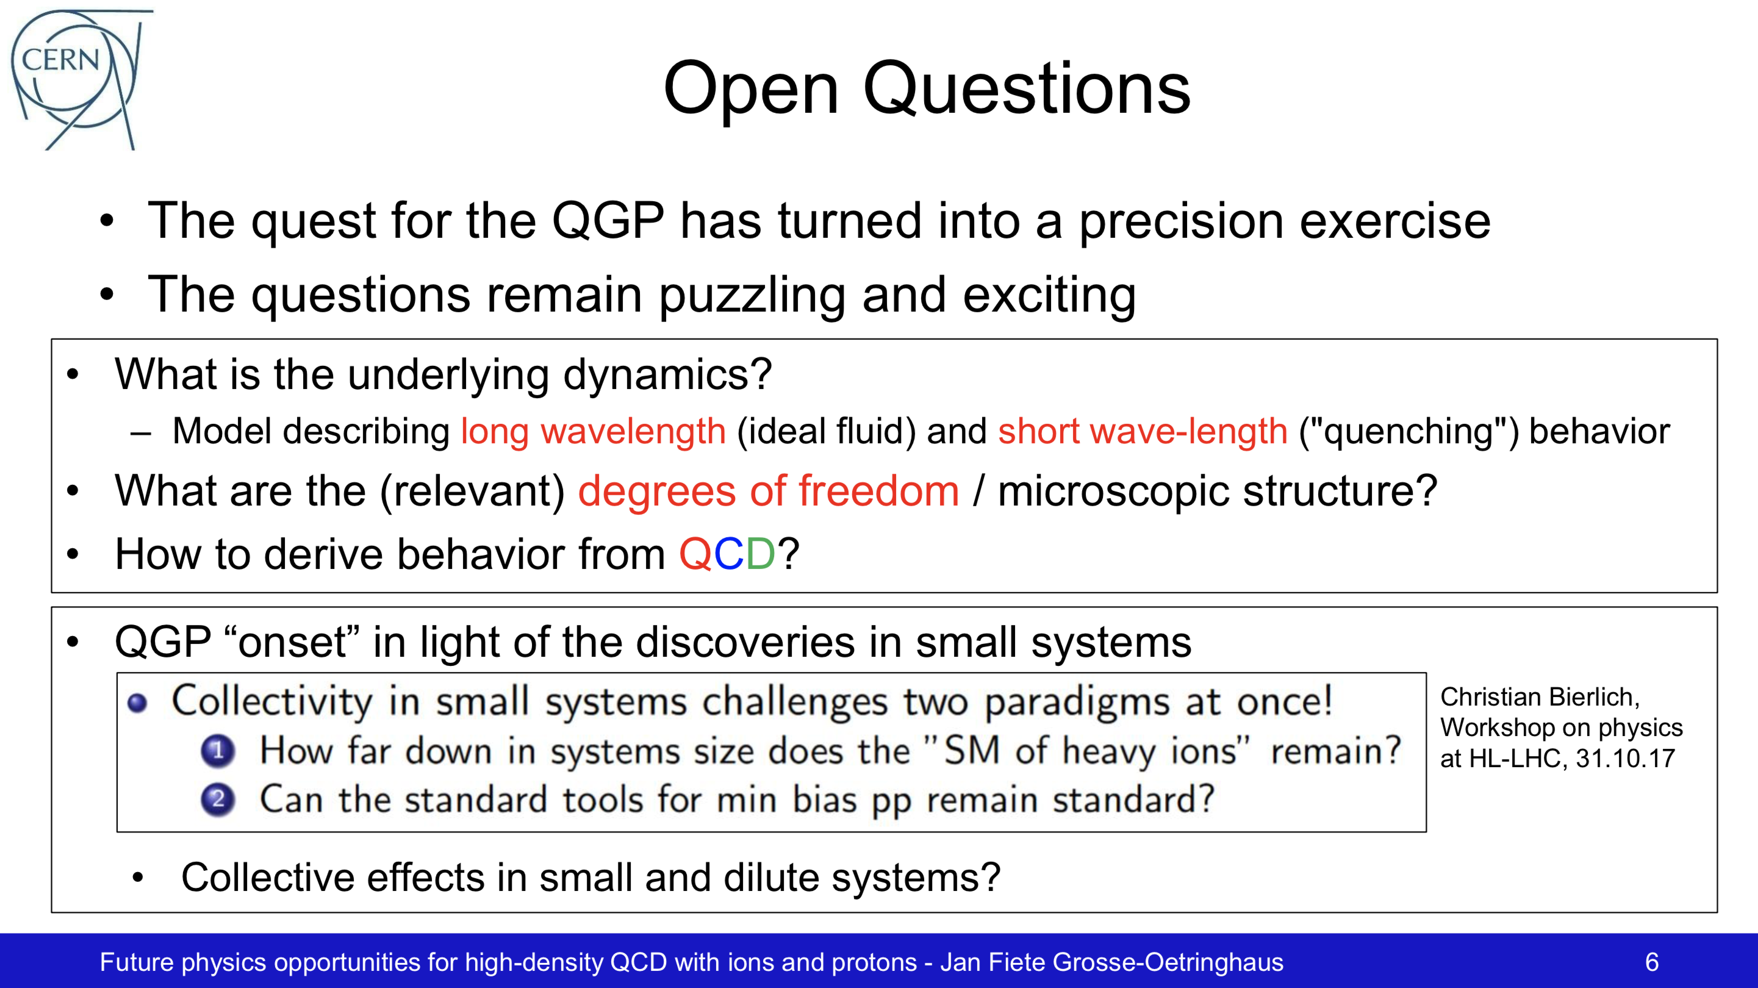
Heavy Ion
Town-meeting
CERN October 2018
Jan Fiete Grosse-Oetringhaus, CERN
D. Morrison, BNL
Jets, jet-structure, quarkonia, and parton energy loss

Slide 7
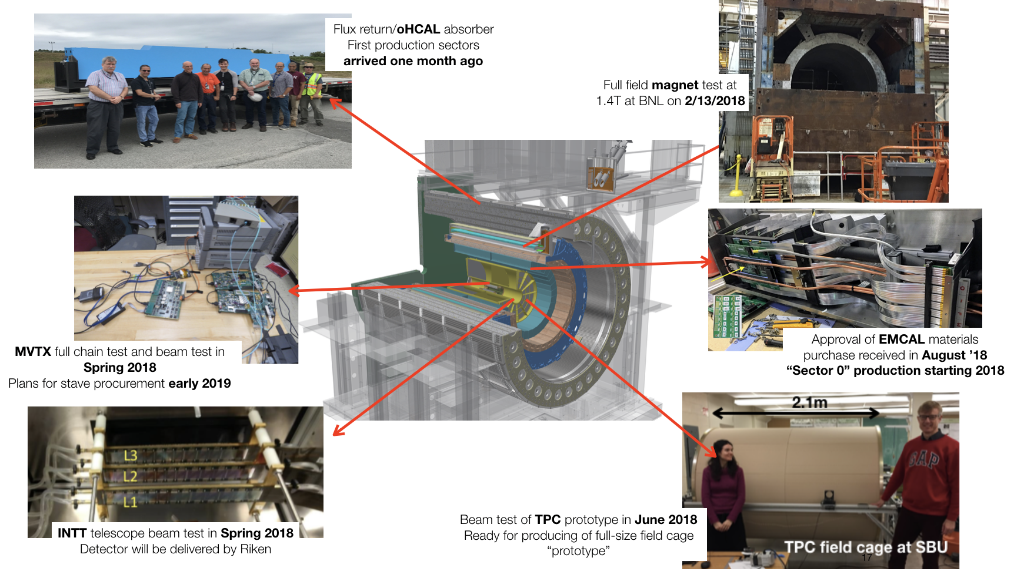
Heavy Ion
Town-meeting
CERN October 2018
Jan Fiete Grosse-Oetringhaus, CERN
D. Morrison, BNL

Slide 8
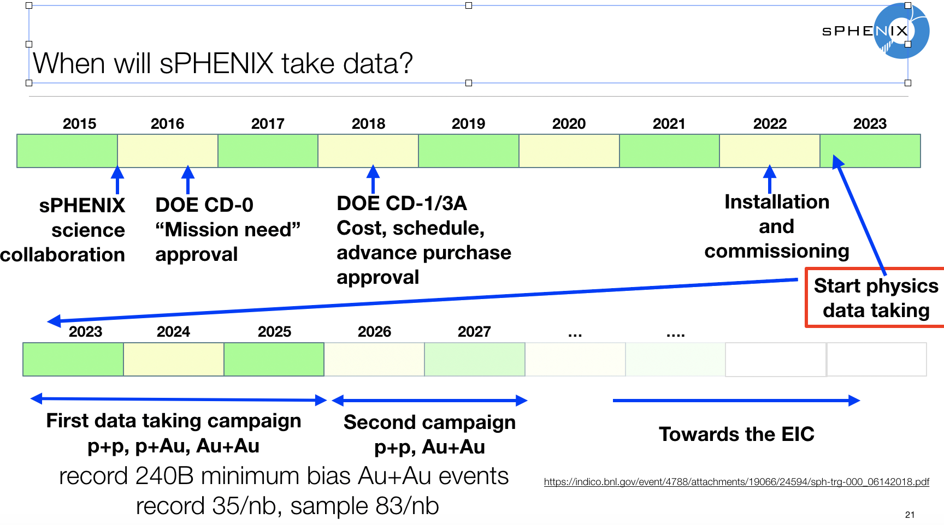
Heavy Ion
Town-meeting
CERN October 2018
Jan Fiete Grosse-Oetringhaus, CERN
D. Morrison, BNL
Jets/structure, quarkonia, and parton energy loss

Slide 9
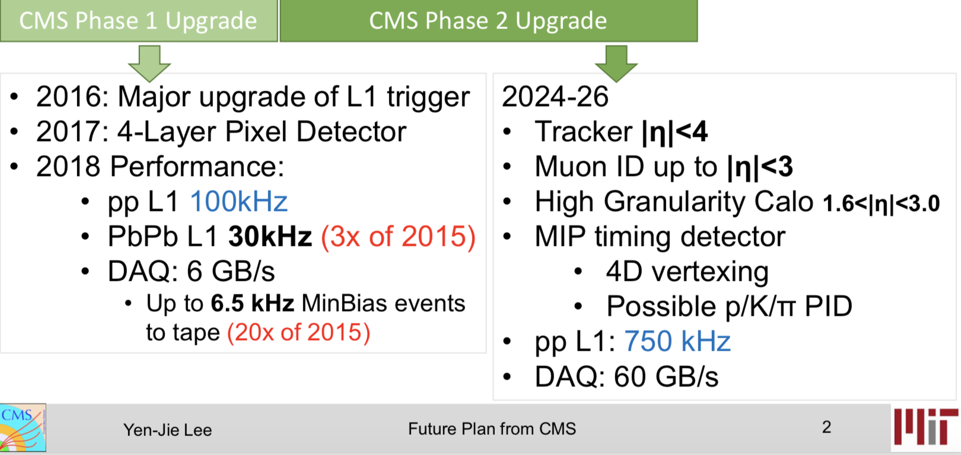
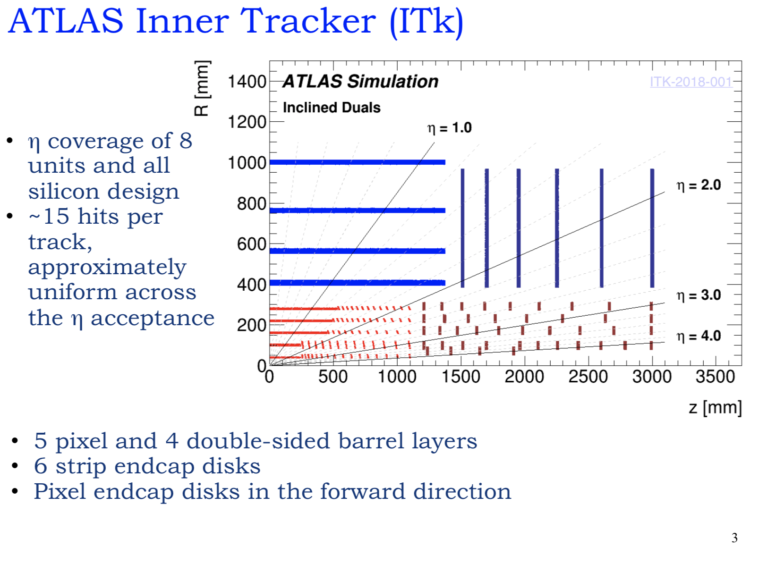
LS4
To be installed before Run 4

Slide 10
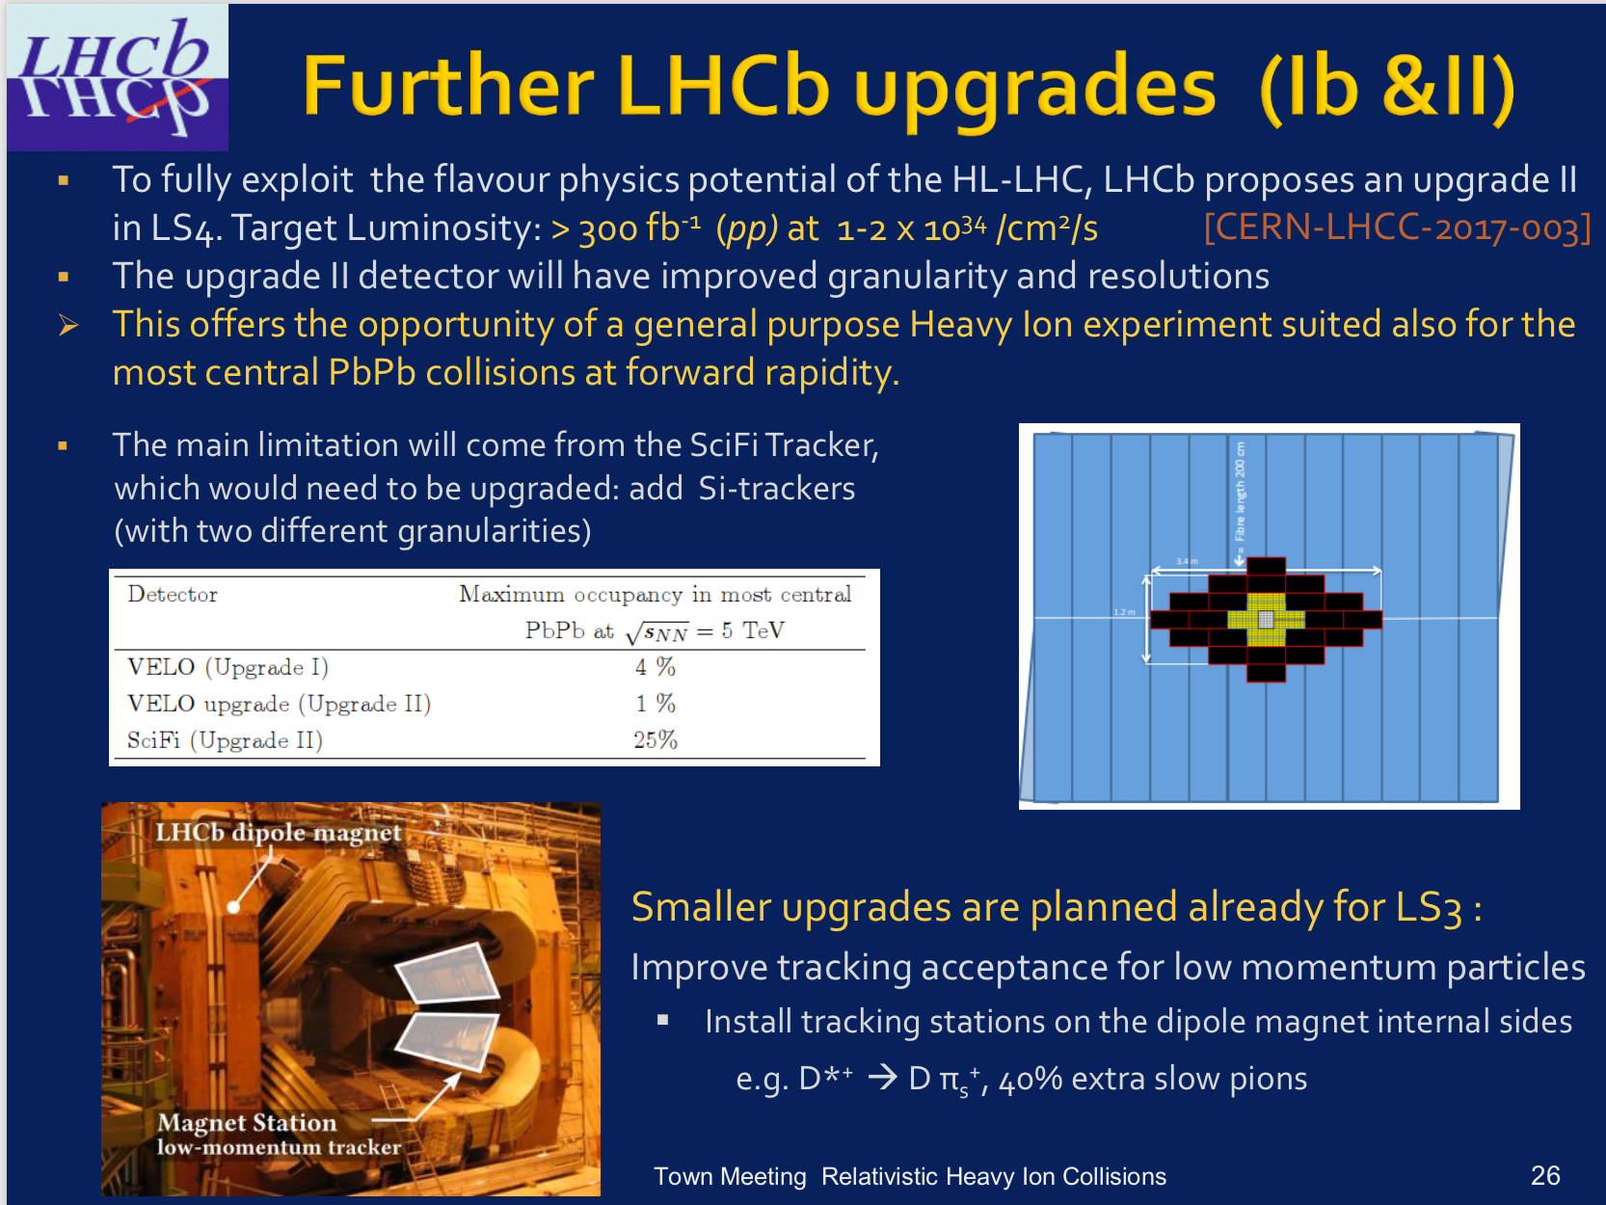
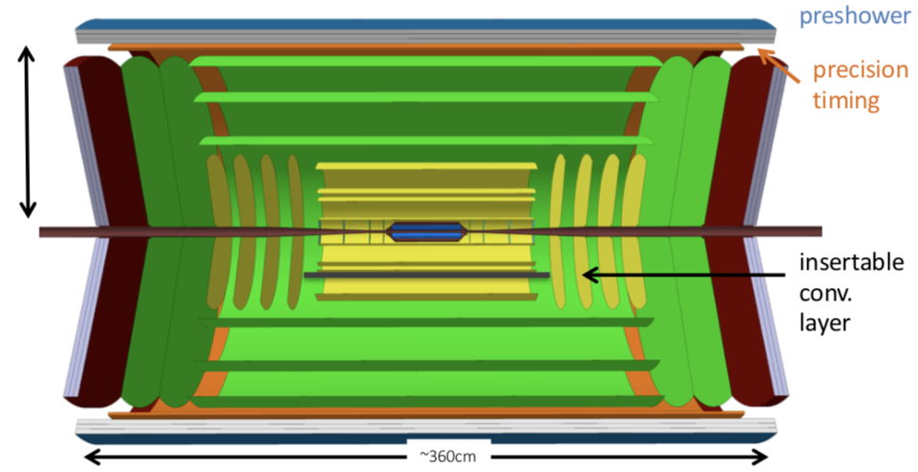
LS4
ALICE all MAPS detector during LS4
ALICE &
LHCb
already planning HI physics beyond 2030+
To be installed before Run 4

Slide 11
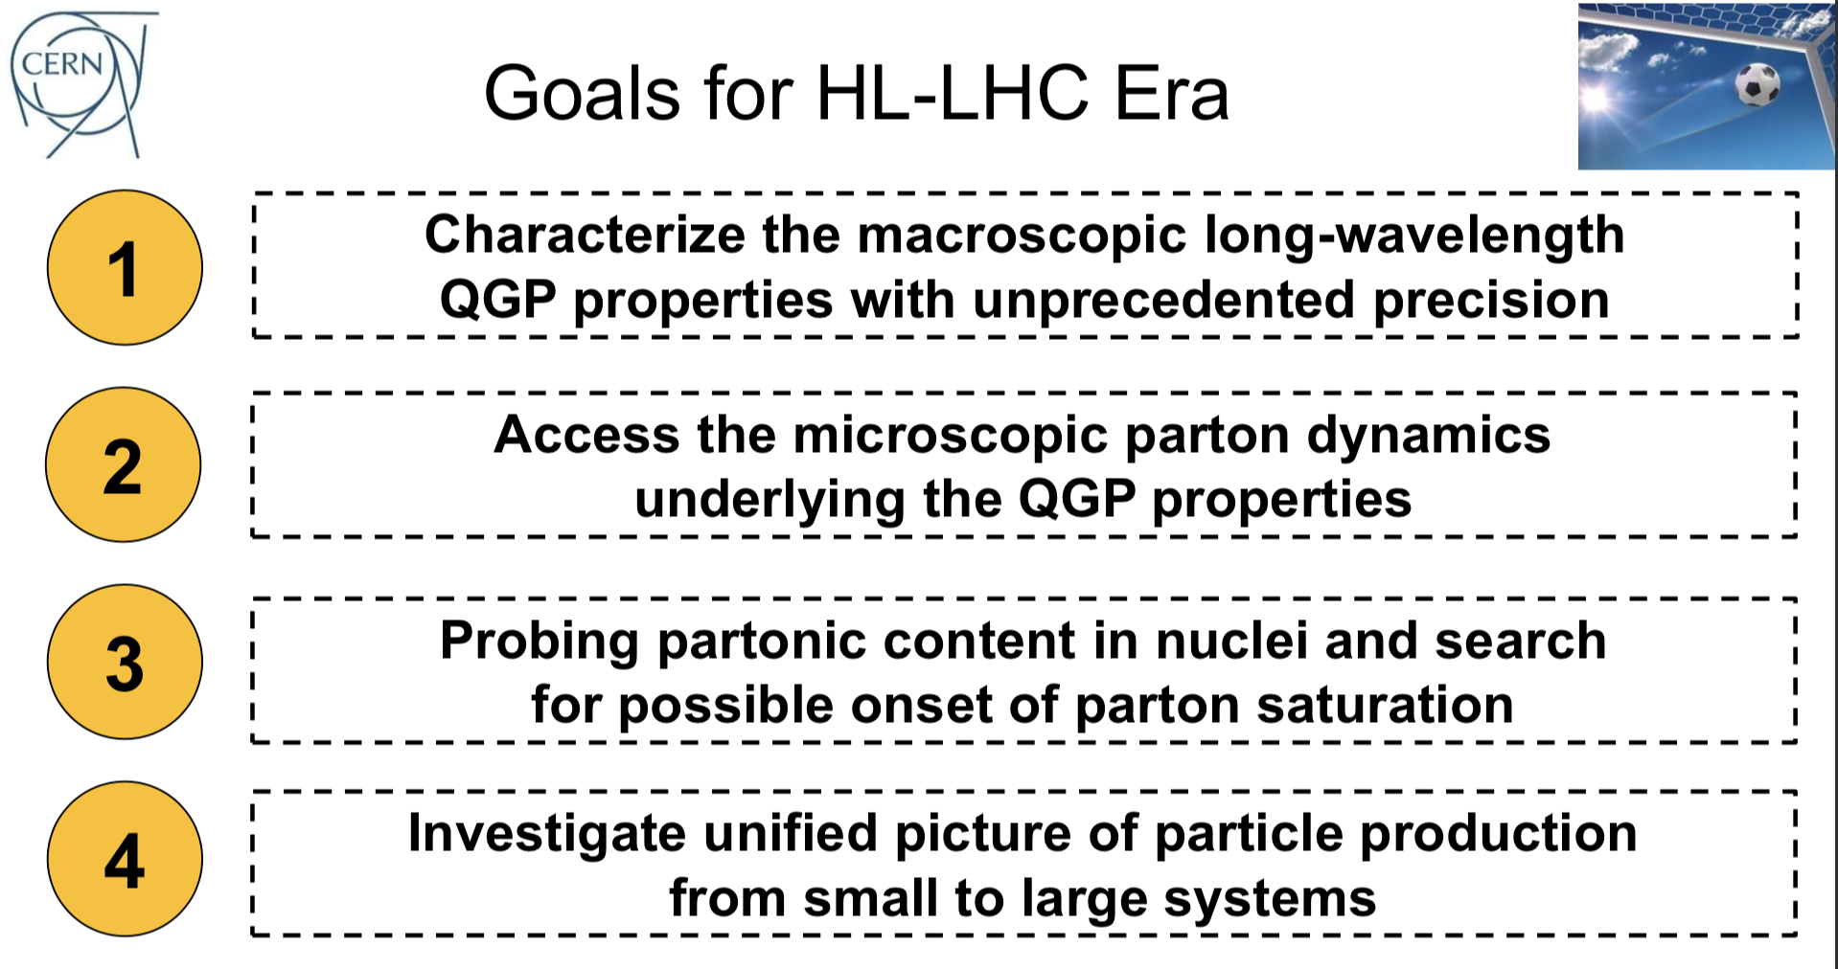
Connections of Heavy Ion Collisions to EIC Physics
Replace
“QGP”
with
”nuclei”
For EIC

Slide 12
Connections of Heavy Ion Collisions to EIC Physics
Replace
“QGP”
with
”nuclei”
For EIC
An explicit goal of the EIC
ALICE Collaboration, Phys. Lett. B719 (2013) 29
CMS

Slide 13

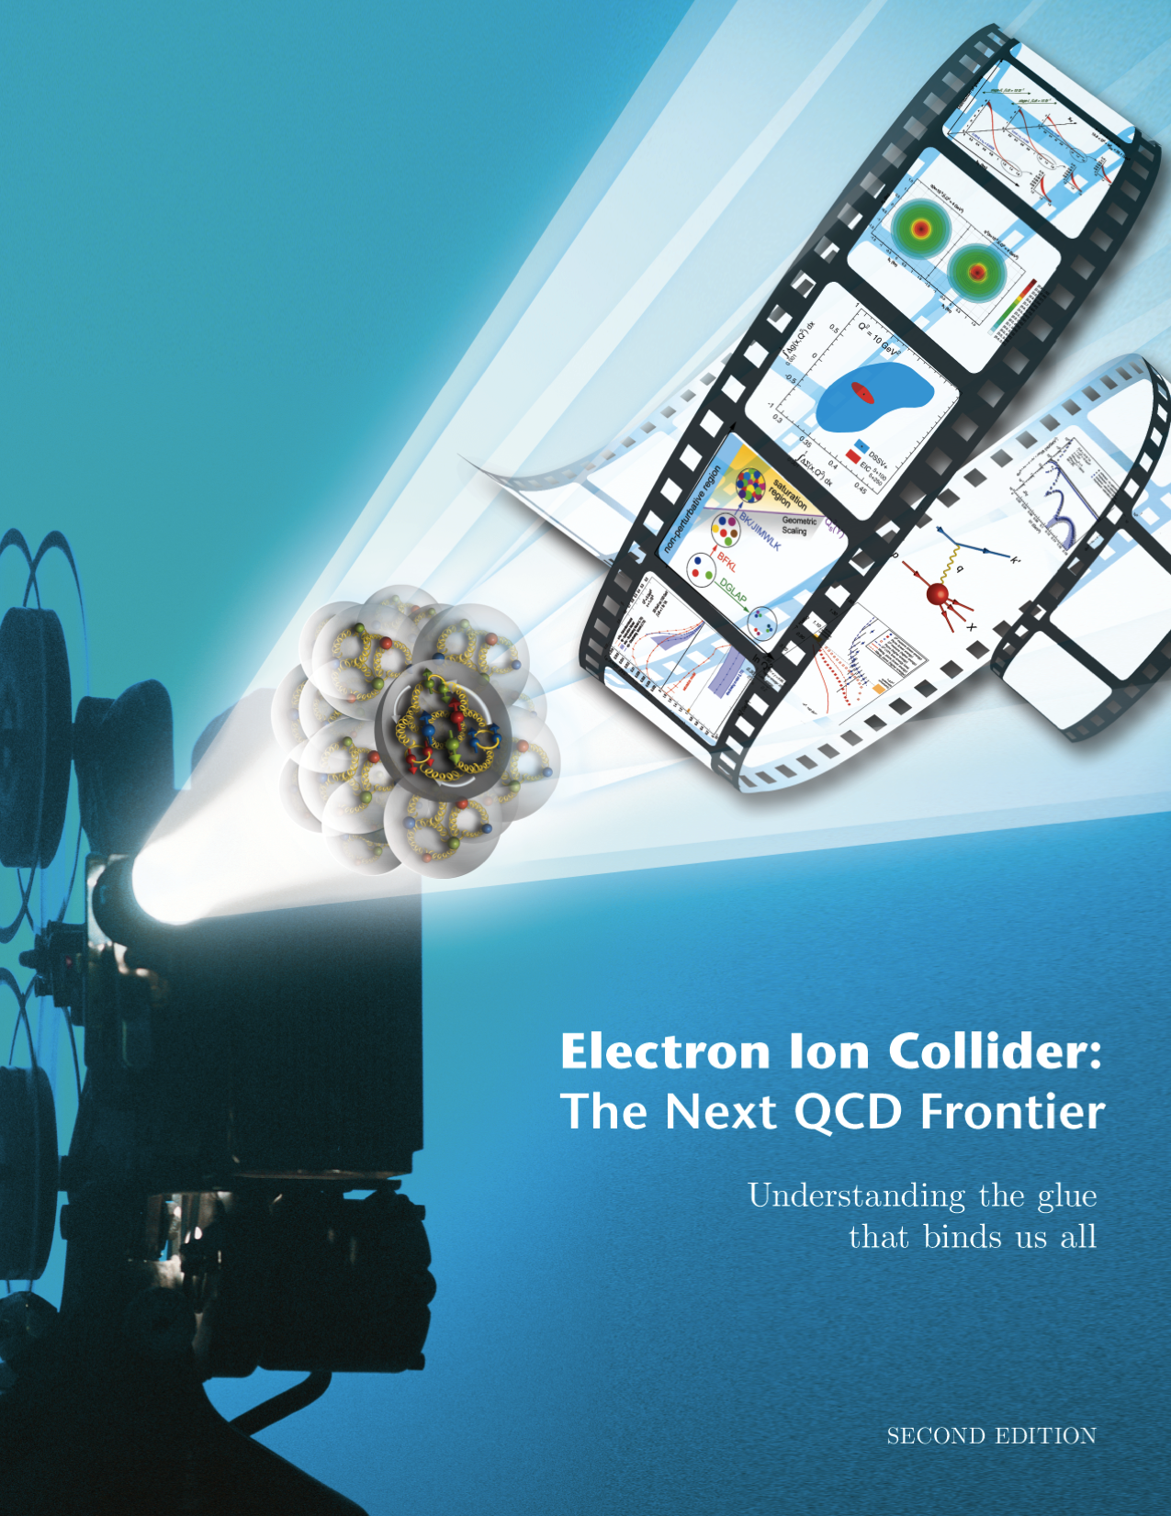

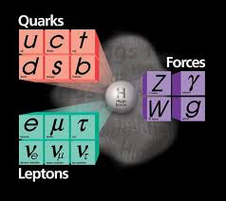

Electron Ion Collider: The next QCD frontier
To precisely understand the universal gluon dynamics in QCD and its consequences in the visible world.
Nuclei
Notes:
Investigate with precision the universal dynamics of gluons

Slide 14
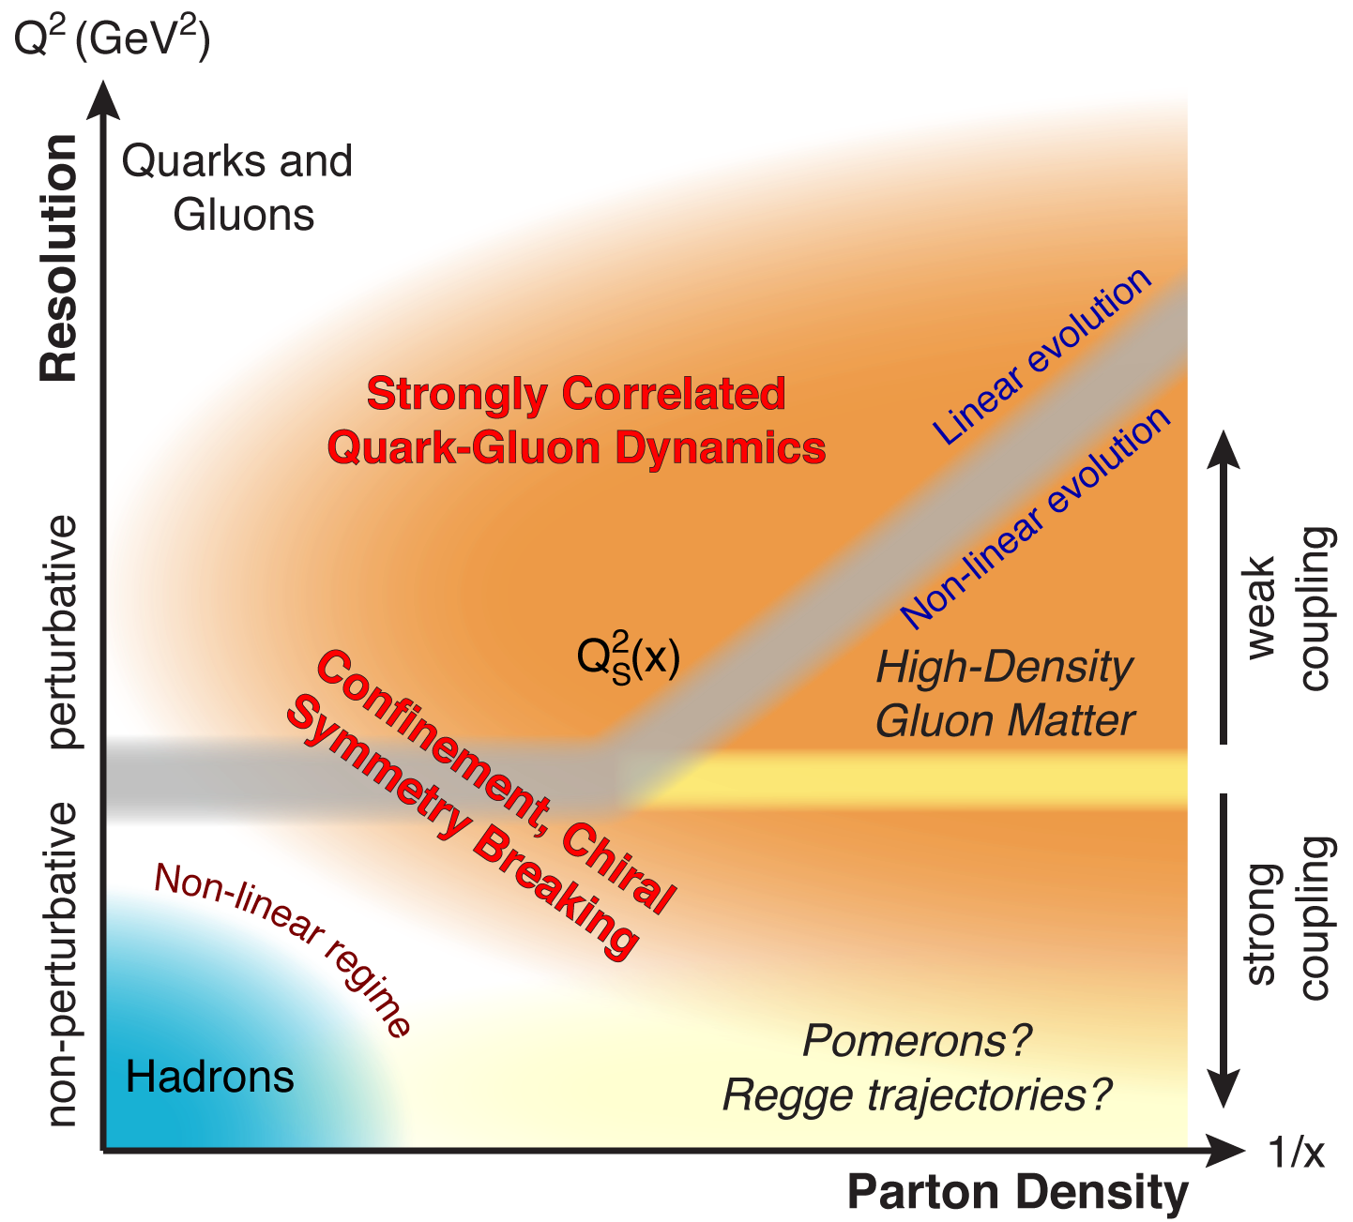
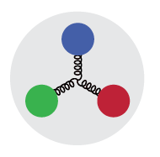
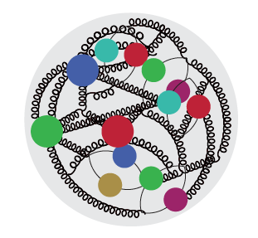

QCD Landscape to be explored by EIC
QCD at high resolution (Q²) —weakly correlated quarks and gluons are well-described
Strong QCD dynamics creates many-body correlations between quarks and gluons
→ hadron structure emerges
EIC will systematically explore correlations in this region.
arXiv: 1708.01527
An exciting opportunity: Observation by EIC of a new regime in QCD of weakly coupled high density matter

Slide 15
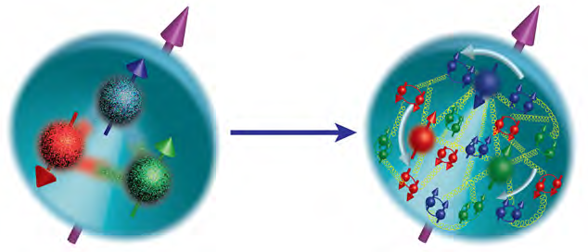
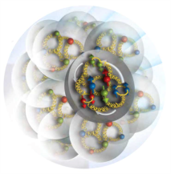
A new facility is needed to investigate, with precision, the dynamics of gluons & sea quarks and their role in the structure of visible matter
How are the sea quarks and gluons, and their spins, distributed in space and momentum inside the nucleon?
How do the nucleon properties emerge from them and their interactions?
How do color-charged quarks and gluons, and colorless jets, interact with a nuclear medium?
How do the confined hadronic states emerge from these quarks and gluons?
How do the quark-gluon interactions create nuclear binding?
How does a dense nuclear environment affect the quarks and gluons, their correlations, and their interactions?
What happens to the gluon density in nuclei? Does it saturate at high energy, giving rise to a gluonic matter with universal properties in all nuclei, even the proton?
gluon
emission
gluon recombination
?
=

Slide 16

The Electron Ion Collider
For e-N collisions at the EIC:
Polarized beams: e, p, d/³He
e beam 5-10(20) GeV
Luminosity L_{ep} ~ 10³³⁻³⁴ cm⁻²sec⁻¹
  100-1000 times HERA
20-100 (140) GeV Variable CoM
2018
eRHIC Design Group
eRHIC pre-CDR
For e-A collisions at the EIC:
Wide range in nuclei
Luminosity per nucleon same as e-p
Variable center of mass energy
World’s first
Polarized electron-proton/light ion
and electron-Nucleus collider
Both designs use DOE’s significant investments in infrastructure
1212.1701.v3
Accardi et al
Eur. Phy. J. A, 52 9(2016)
JLEIC Collaboration
JLEIC Pre-CDR about to be finalized
Notes:
Contrast with HERA could be made more explicit. Table/column presentation.

Slide 17
Uniqueness of EIC among all DIS Facilities
All DIS facilities in the world.

Slide 18
Uniqueness of EIC among all DIS Facilities
All DIS facilities in the world.
However,
if we ask for:
high luminosity & wide range in √s
polarized lepton & hadron beams
nuclear beams
EIC stands out as unique facility …

Slide 19
State of the art Accelerator Technology for EIC
EIC will be one of the most complex collider accelerators ever be built. It will push the envelope on many fronts including high degree of beam polarization, high luminosity, beam cooling, beam dynamics, crab cavities on for both beams, and interaction region with complex magnets integrated with the detectors.
Beam cooling: Absolutely needed to achieve the high collisions luminosity ~ 10³³⁻³⁴ cm⁻²sec⁻¹
  High current multi-pass energy recovery linac (ERL)
  High current unpolarized electron injectors for the ERL
Interaction Region:
  Magnets: challenging magnet designs to meet the required high fields and field free regions
  Crab Cavities: Maximize collisions rates. No experience yet for crab cavities in hadron beams (R&D @ CERN)
Storage Ring Magnets: Challenging high field storage ring magnets needed
Polarized electron source: High bunch charges for ring-ring concept
Simulation Codes: Benchmarking the realistic EIC simulation tools against available data
Ample opportunity for joint accelerator research and development initiatives with Jlab/BNL and other labs around the world. (Details in US EIC Accelerator Paper planned to be submitted to ESPP process next month).
Notes:
Strong hadron cooling
Crab cavities for electrons and hadron faculities
ERL’s for future

Slide 20
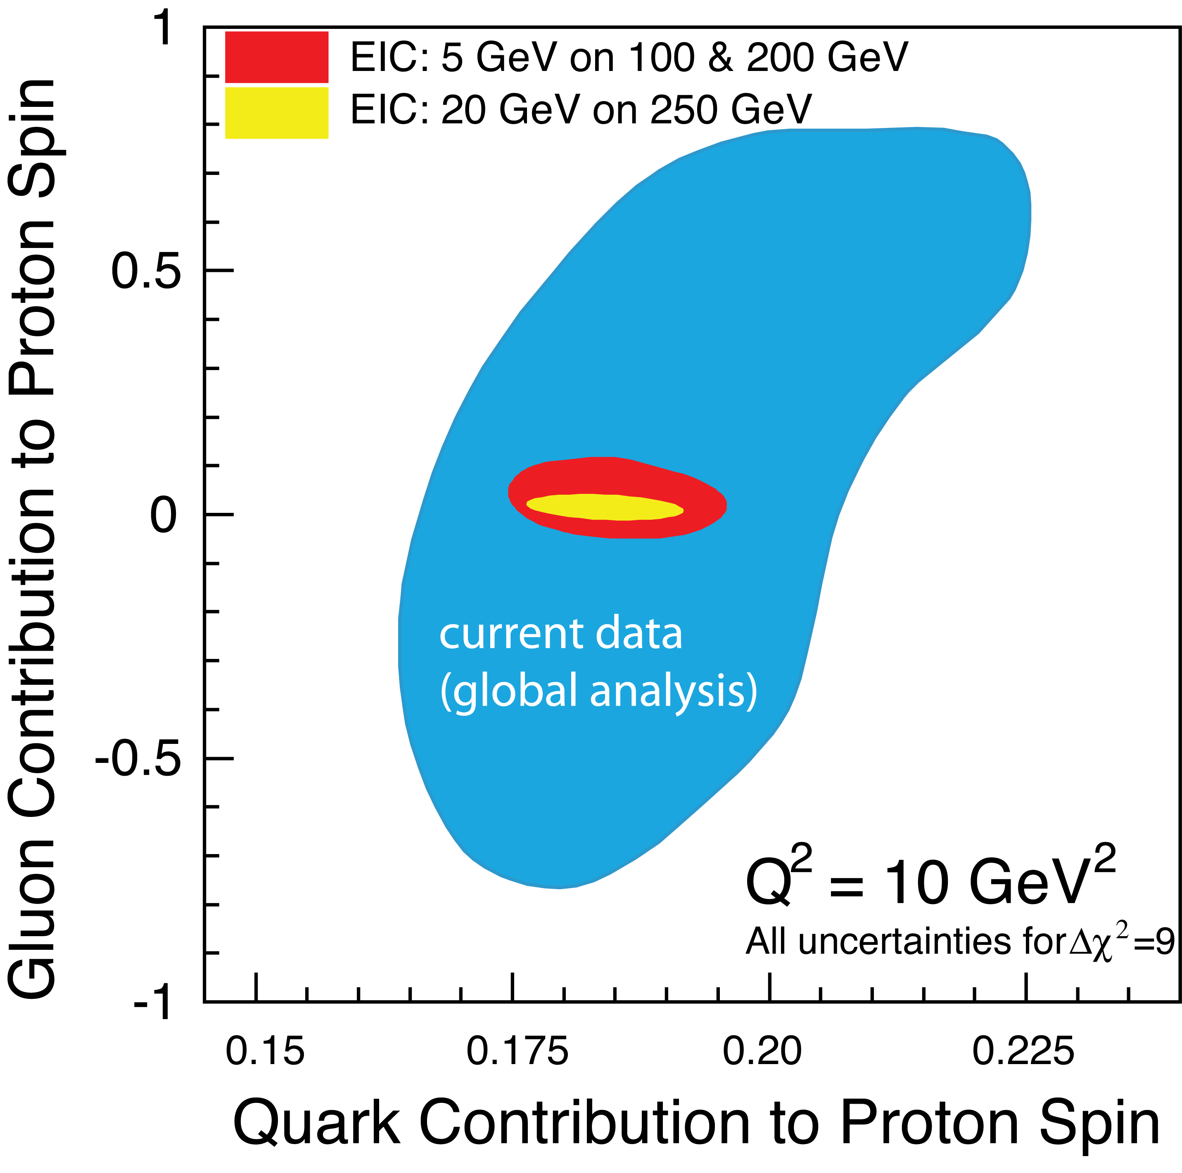
EIC science and required luminosity
2+1D imaging of quarks and gluons, dynamics, and emergence of spin & mass
Gluon imaging in nucleons
Gluons at high energy in nuclei:
(Gluon imaging in nuclei)
Color propagation, neutralization in nuclei & hadronization

Slide 21
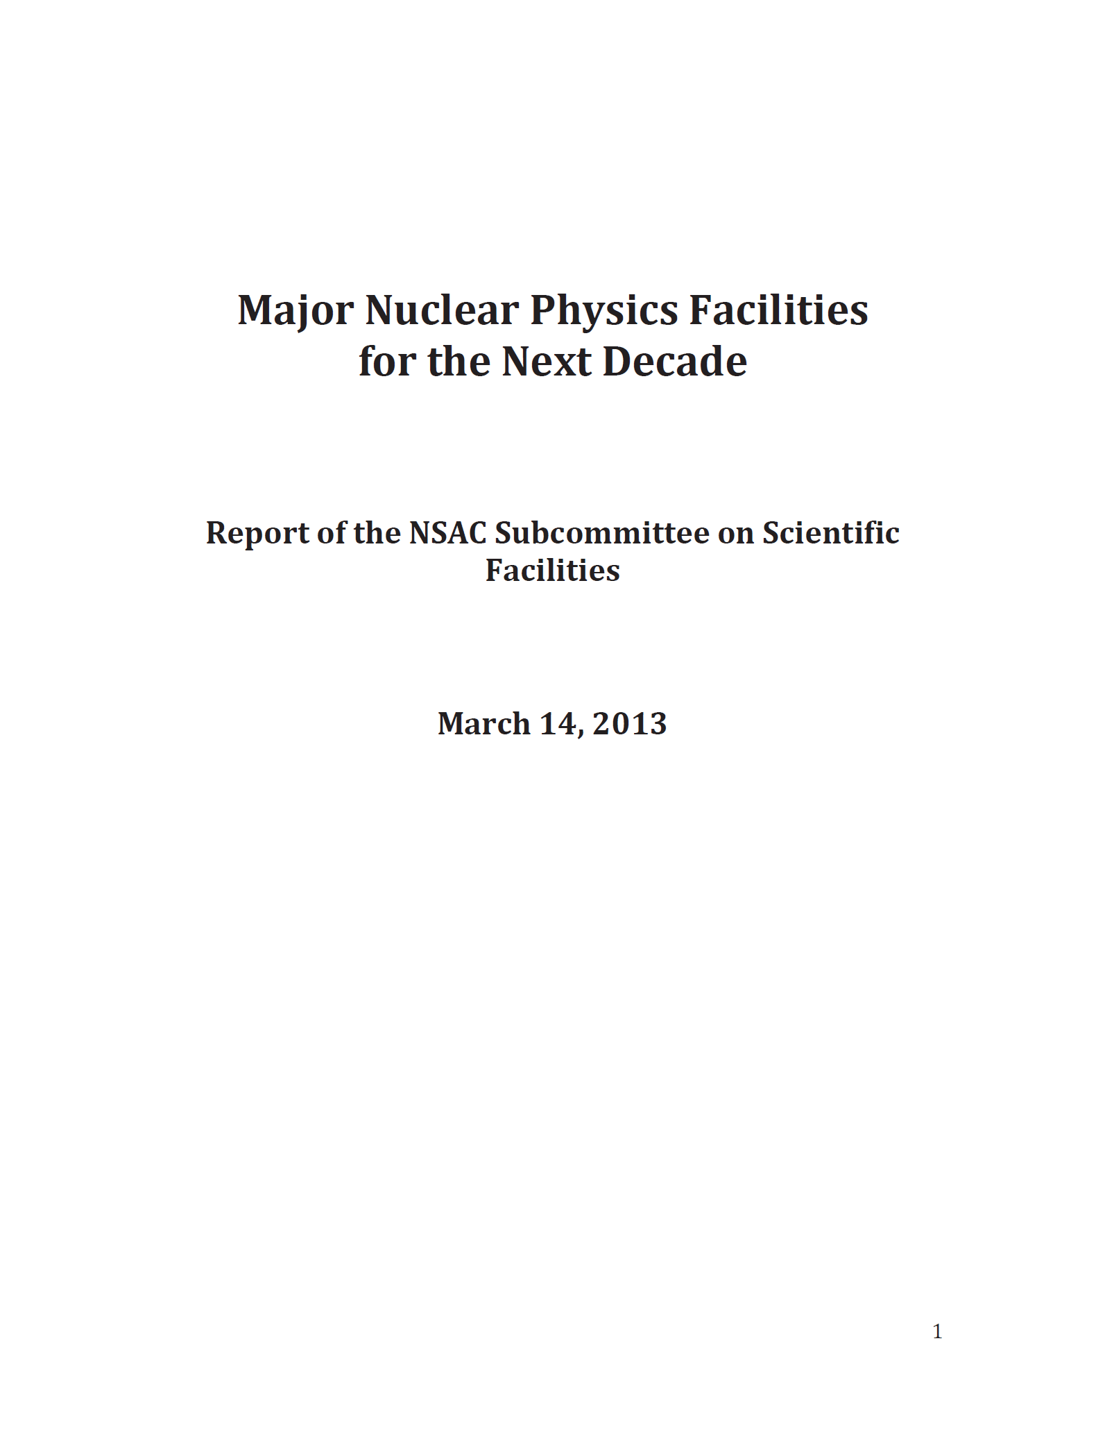
U.S. Electron-Ion Collider Planning 2007-18 (all links included)
2007 NSAC Long-Range Plan
“An Electron-Ion Collider (EIC) with polarized beams has been embraced by the U.S. nuclear science community as embodying the vision for reaching the next QCD frontier”
2013 Electron Ion Collider White Paper (arXiv:1212.1701.v3 from 2014)
(EIC Users Writing committee convened by Jefferson Lab and BNL)
2013 NSAC Subcommittee on Future Facilities
Identified EIC as absolutely central to the nuclear science program of the next decade
2015 NSAC Long Range Plan
“We recommend a high-energy high-luminosity polarized EIC as the highest priority for new facility construction following the completion of FRIB.”
2018 National Academy of Sciences – Assessment of U.S. Based Electron-Ion Collider Science
“…the committee finds a compelling scientific case for such a facility. The science questions that an EIC will answer are central to completing an understanding of atoms as well as being integral to the agenda of nuclear physics today.”

Slide 22
A very strong endorsement of the EIC Science: Compelling, timely and fundamental
July 2018
Finding 1: An EIC can uniquely address three profound questions about nucleons – neutrons and protons – and how they are assembled to form the nuclei of atoms:
How does the mass of the nucleon arise?
How does the spin of the nucleon arise?
What are the emergent properties of dense systems of gluons?
Finding 2: These three high-priority science questions can be answered by an EIC with highly polarized beams of electrons and ions, with sufficiently high luminosity and sufficiently and variable, center-of-mass energy.
Finding 3: An EIC would be a unique facility in the world and would maintain U.S. leadership in nuclear physics
Findings 4-9 go on to support the importance of accelerator research and science, societal impact, support for theory to fully benefit from the data expected from the EIC, and systematic approach of the US NP community in its planning process: EIC after FRIB….
The Full Report

Slide 23
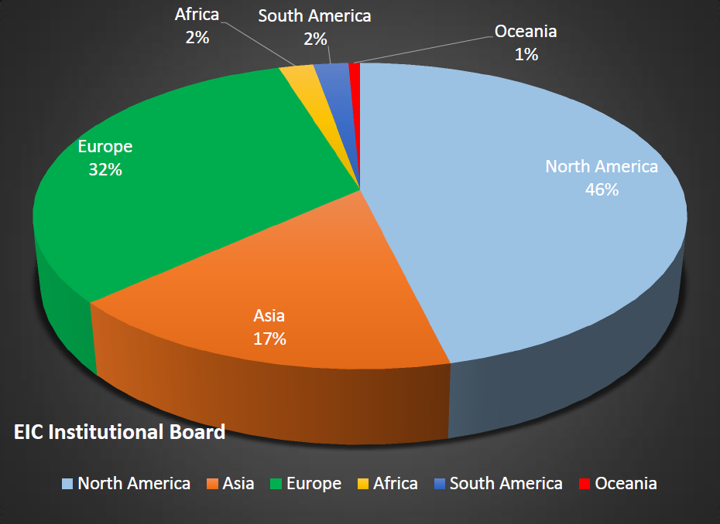
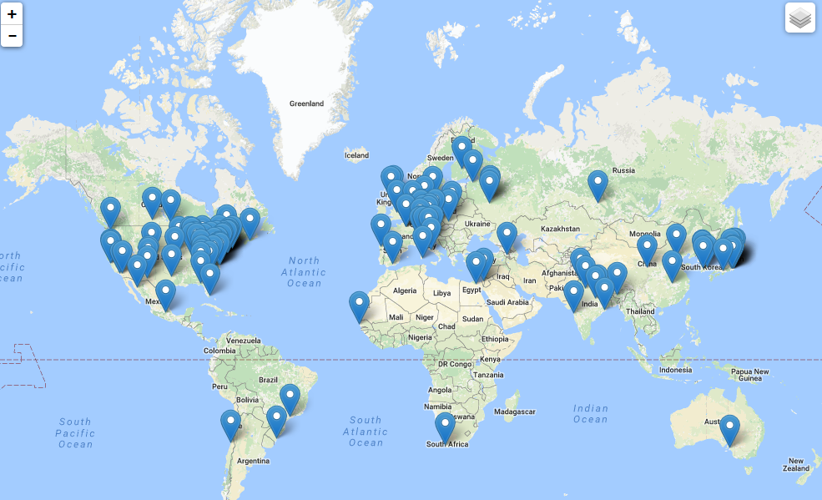
The EIC Users Group: EICUG.ORG
Formally established in 2016
826 Ph.D. Memners vfom 30 countries, 176 institutions
(Significant interest (32%) from Europe)
Map of institution’s locations
EICUG Structures in place and active.
EIC UG Steering Committee (w/ European Representative)
EIC UG Institutional Board
EIC UG Speaker’s Committee (w/European Rep.)
Task forces on:
-- Beam polarimetry
-- Luminosity measurement
-- Background studies
-- IR Design
Annual meetings: Stony Brook (2014), Berkeley (2015), ANL (2016), Trieste (2017), CAU (2018), Paris (2019)
New:
Center for Frontiers in Nuclear Science (at Stony Brook/BNL)
EIC² at Jefferson Laboratory

Slide 24
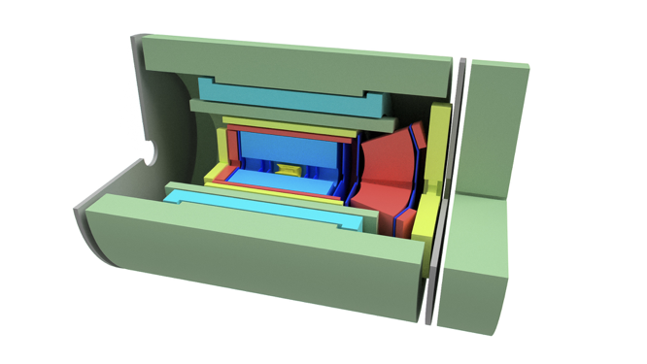
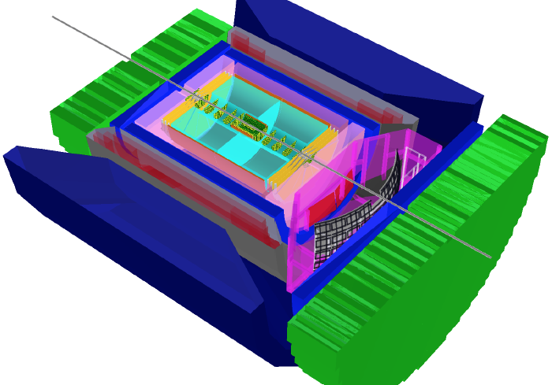
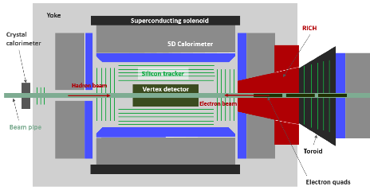
EIC Detector Concepts, others expected to emerge
EIC Day 1 detector, with BaBar Solenoid
BeAST at BNL
Ample opportunity and need for additional contributors and collaborators
TOPSiDE: Time Optimized PID Silicon Detector for EIC
JLEIC Detector Concept, with CLEO Solenoid
Notes:
Argonne National Lab: recently joined the effort and have proposed a new detector concept based on the particle flow in detectors: high precision Si tracker, coupled with high resolution calorimetry.

Slide 25

EIC detector R&D effort
  Laboratory Directed Research & Development Programs (LDRDs) at BNL, JLAB, ANL
  R&D at Belle-II and Panda has some overlap with EIC
  CERN/LHC
    R&D for phase-I upgrades ended, phase-II focus on radiation hardness and rate
    R&D on key common with EIC challenges (PID, EMCal) :→ Opportunity?
  Generic EIC Detector R&D Program (See here)
    Managed since 2011 by BNL, in association with JLab and DOE NP
    Funded by DOE NP, through RHIC operations
    Program non site specific and explicitly open to international participation
    13 (non-US – mostly European) of the 46 institutions have benefited and now European Contingent of EICUGs have successfully acquired European funding (Strong2020: NextDIS)
    Standing EIC Detector Advisory Committee with internationally recognized detector experts
Current: Marcel Demarteau (ANL, Chair), Carl Haber (LBNL), Peter Krizan (Ljubljana), Ian Shipsey (Oxford), Rick Van Berg (UPenn), Jerry Va’vra (SLAC), Glenn Young (JLab)

Slide 26
Path forward for the EIC:
Predictions are especially difficult when it comes to the future
2018 and 2019 enacted budgets
2015 NSAC Long Range Plan made
Strong endorsement by the NAS (July 2018)
BNL and JLab working together with the US DOE towards realizing the project.
Technically driven schedule: the future
  CD0 (critical decision process of the US DOE) in near future
  EIC-Proposal’s Technical & Cost review → Site selection → CD1-3
  According to NSAC LRP 2015 major construction funds (“CD3”) ~2023
  Earliest First collisions in 2029/30
Notes:
$684M de-escalated by (1.02)^3 for 2018 and
$690M de-escalated by (1.02)^4 for 2019

Slide 27

Summary
Robust plans for upgrades: synergetic heavy ion physics at LHC & RHIC next 10-15+ years:
  Characterizing and understanding QGP from small to large wavelength
  Diverse probes/techniques: heavy quarks, jets, energy loss, variation in initial state/energy, and appropriately required detector upgrades at ALICE, ATLAS, CMS and LHCb @ CERN, and a whole new detector sPHENIX@BNL
US EIC project is moving forward: steadily but surely
  Long range plan recommended it for construction in 2015
  National Academy Review positive (timely, compelling and fundamental) in 2018
  International EIC Users Group of 800+ Ph.D.’s now in place: seed for future collaboration
  A significant European contingent (~32%)
  US Department of Energy is anticipated to initiate the realization process (CD-process)
  Could have first collisions late 2020’s (technically driven possible, fiscal always open question)
For the European PP Strategic discussions: A white paper led by EICUG’s European contingent is being prepared. A separate machine design and accelerator R&D white paper for the EIC is being prepared buy BNL and Jefferson Lab together.

Slide 28
Thank you!
Thanks to those who actively helped:
EIC Users Group Steering Committee, Berndt Mueller, Robert McKeown, Rolf Ent, Elke Aschenauer, Dave Morrison, Barbara Erazmus, Federico Antinori, Boris Hippolyte, Richard Milner, and Tapan Nayak
And whose slides/presentations I used from various talks given elsewhere:
Jan Fiete Grosse-Oetringhaus, Yen-Jie Lee, Andrea Dainise, Dominik Derendarz, Burkhard Schmidt

Slide 29
Guideline/Charge from Prof. D’Hondt for this talk:
“As a guideline for the presentation, it is important to inform the community about the realism of the proposed future collider project, from the basic properties of the collider (and detector(s)) to elements of innovation, from physics goals to R&D challenges, from costs and secured budgets to the required individual talents to face the challenges, potential computing requirements and challenges, a timeline including R&D and construction milestones, and the potential formation of scientific collaborations.”
“Surely you can mention the science and technology challenges (and opportunities) of the RHIC and ALICE programmes as a kick-off towards future (or upgraded) colliders. The session will have a focus on future colliders, therefore do not hesitate to place dedicated focus on the US EIC project. Indeed, the electron-proton part of future colliders is covered elsewhere.”

Slide 30
National Academy Committee’s Findings
Finding 1: An EIC can uniquely address three profound questions about nucleons—neutrons and protons—and how they are assembled to form the nuclei of atoms:
  How does the mass of the nucleon arise?
  How does the spin of the nucleon arise?
  What are the emergent properties of dense systems of gluons?
Finding 2: These three high-priority science questions can be answered by an EIC with highly polarized beams of electrons and ions, with sufficiently high luminosity and sufficient, and variable, center-of-mass energy.
Finding 3: An EIC would be a unique facility in the world and would maintain U.S. leadership in nuclear physics.
Finding 4: An EIC would maintain U.S. leadership in the accelerator science and technology of colliders and help to maintain scientific leadership more broadly.
Finding 5: Taking advantage of existing accelerator infrastructure and accelerator expertise would make development of an EIC cost effective and would potentially reduce risk.

Slide 31
National Academy Committee’s Findings
Finding 6: The current accelerator R&D program supported by DOE is crucial to addressing outstanding design challenges.
Finding 7: To realize fully the scientific opportunities an EIC would enable, a theory program will be required to predict and interpret the experimental results within the context of QCD, and furthermore, to glean the fundamental insights into QCD that an EIC can reveal.
Finding 8: The U.S. nuclear science community has been thorough and thoughtful in its planning for the future, taking into account both science priorities and budgetary realities. Its 2015 Long Range Plan identifies the construction of a high-luminosity polarized EIC as the highest priority for new facility construction following the completion of the Facility for Rare Isotope Beams (FRIB) at Michigan State University.
Finding 9: The broader impacts of building an EIC in the United States are significant in related fields of science, including in particular the accelerator science and technology of colliders and workforce development.

Slide 32



NAS Study endorses machine parameters suggested by the 2012 White Paper and 2015 NSAC Long Range Plan

Slide 33
EIC Physics Case
NAS report figure 2.4
NAS report figure 7.1

Slide 34
Critical Decision Process DOE
PED: Project Engineering & Design

Slide 35
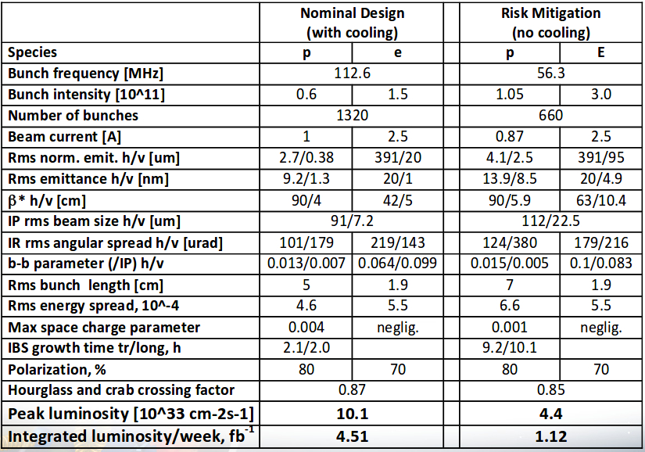
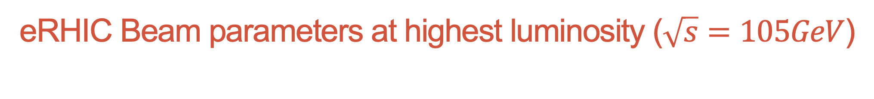
eRHIC Beam parameters at highest luminosity ($\sqrt{s}=105GeV$)
Many bunches (up to 1320)
High beam currents (1A p, 2.5A e)
Flat beams
Short hadron bunches (5cm with cooling, 7cm without)
Crossing angle collisions with crab crossing
High luminosity: 10.1*${10}^{33}{cm}^{−2}\sec^{−1}$with cooling, 4.4*${10}^{33}{cm}^{−2}\sec^{−1}$without
Christophe Montag at the EIC Collaboration Meeting 2018 at Jefferson Lab

Slide 36
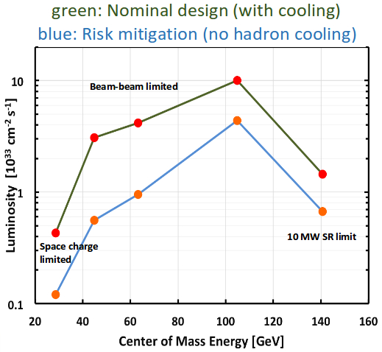
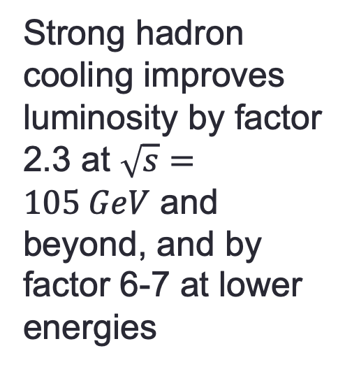
eRHIC: Luminosity versus Center-of-Mass Energy
Strong hadron cooling improves luminosity by factor 2.3 at $\sqrt{s}=105 GeV$ and beyond, and by factor 6-7 at lower energies
Christophe Montag at the EIC Collaboration Meeting 2018 at Jefferson Lab

Slide 37
eRHIC Summary
eRHIC design reaches a peak luminosity of L= 1.05·10³⁴cm⁻²s⁻¹
^{with 2 hour IBS growth times}
However, this can only be achieved with strong hadron cooling, which is beyond state of the art, and is a topic of ongoing R&D.
Without hadron cooling a peak luminosity of
L= 0.44·10³⁴cm⁻²s⁻¹
is reached, with IBS growth times of 9 hours
eRHIC design has progressed very well and a tremendous amount of design work was accomplished.
There are still critical beam dynamic issues which require more effort. They could have an impact on achievable luminosity but do not constitute a risk of missing the EIC White Paper Requirement
While a large amount of work is still ahead to arrive at a Conceptual Design, we believe that the present state of the eRHIC design matches well the expectations of a Pre-Conceptual Design
Christophe Montag at the EIC Collaboration Meeting 2018 at Jefferson Lab

Slide 38
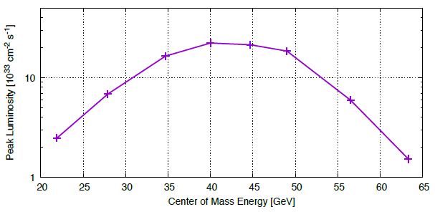
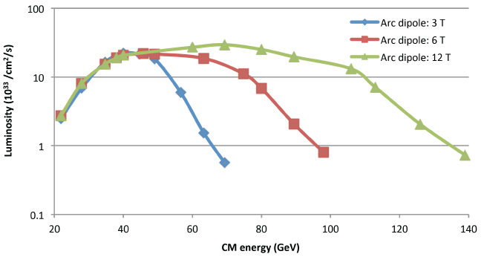
JLEIC e-p Parameters and Luminosity Performance
CM energy | GeV | 21.9 (low) |  | 44.7 (medium) |  | 63.3 (high)
 |  | p | e | p | e | p | e
Beam energy | GeV | 40 | 3 | 100 | 5 | 100 | 10
Collision frequency | MHz | 476 |  | 476 |  | 476
Particles per bunch | 10¹⁰ | 0.98 | 3.7 | 0.98 | 3.7 | 0.98 | 0.93
Beam current | A | 0.75 | 2.8 | 0.75 | 2.8 | 0.75 | 0.71
Polarization | % | 80 | 80 | 80 | 80 | 80 | 75
Bunch length, RMS | cm | 1 | 1 | 1 | 1 | 1 | 1
Norm. emitt., horiz./vert. | μm | 0.3 | 24 | 0.5/ 0.1 | 54/ 10.8 | 0.9/ 0.18 | 432/ 86.4
Horiz, & verti. β* | cm | 8/8 | 13.5/ 13.5 | 6/1.2 | 5.1/1 | 10.5/2.1 | 4/0.8
Vert. beam-beam param. |  | 0.015 | 0.09 | 0.015 | 0.068 | 0.002 | 0.009
Laslett tune-shift |  | 0.06 |  | 0.055 |  | 0.03
Detector space, up/down | m | 3.6/7 | 2.96/2.2 | 3.6/7 | 2.96/2.2 | 3.6/7 | 2.96/2.2
Hourglass(HG) reduction |  | 1 |  | 0.87 |  | 0.86
Lumi./IP, w/HG, 10³³ | cm⁻²s⁻¹ | 2.5 |  | 21.4 |  | 1.7
Beam-beam limit
Space charge limit
Syn. Rad. limit
Reference pCDR design
Similar high performance for electron-ion (e-A) collisions
October 29 – November 1, 2018
Fall 2018 EIC Accelerator Collaboration Meeting
38
Fanglei Lin at EIC Collaboration Meeting at Jefferson Lab 2018

Slide 39
JLEIC Summary
We continued JLEIC design and improved the design performance. Significant progress has been made in many design aspects.
We completed documenting JLEIC self-consistent design with the CM energy up to 65 GeV. This 400-page pCDR has been delivered to lab leadership and reviewed by external visitors.
We explored an alternative baseline design with the CM energy up to 100 GeV. The study shows no show-stopper in all accelerator-associated issues.
Path forward for FY19
  JLEIC with √s = 100 GeV optimization: injector complex, collider ring optimization, filling pattern, bunch parameters, HE electron cooling, etc.
  Continue program development and RD towards CD0
Fanglei Lin at EIC Collaboration Meeting at Jefferson Lab 2018

Slide 40
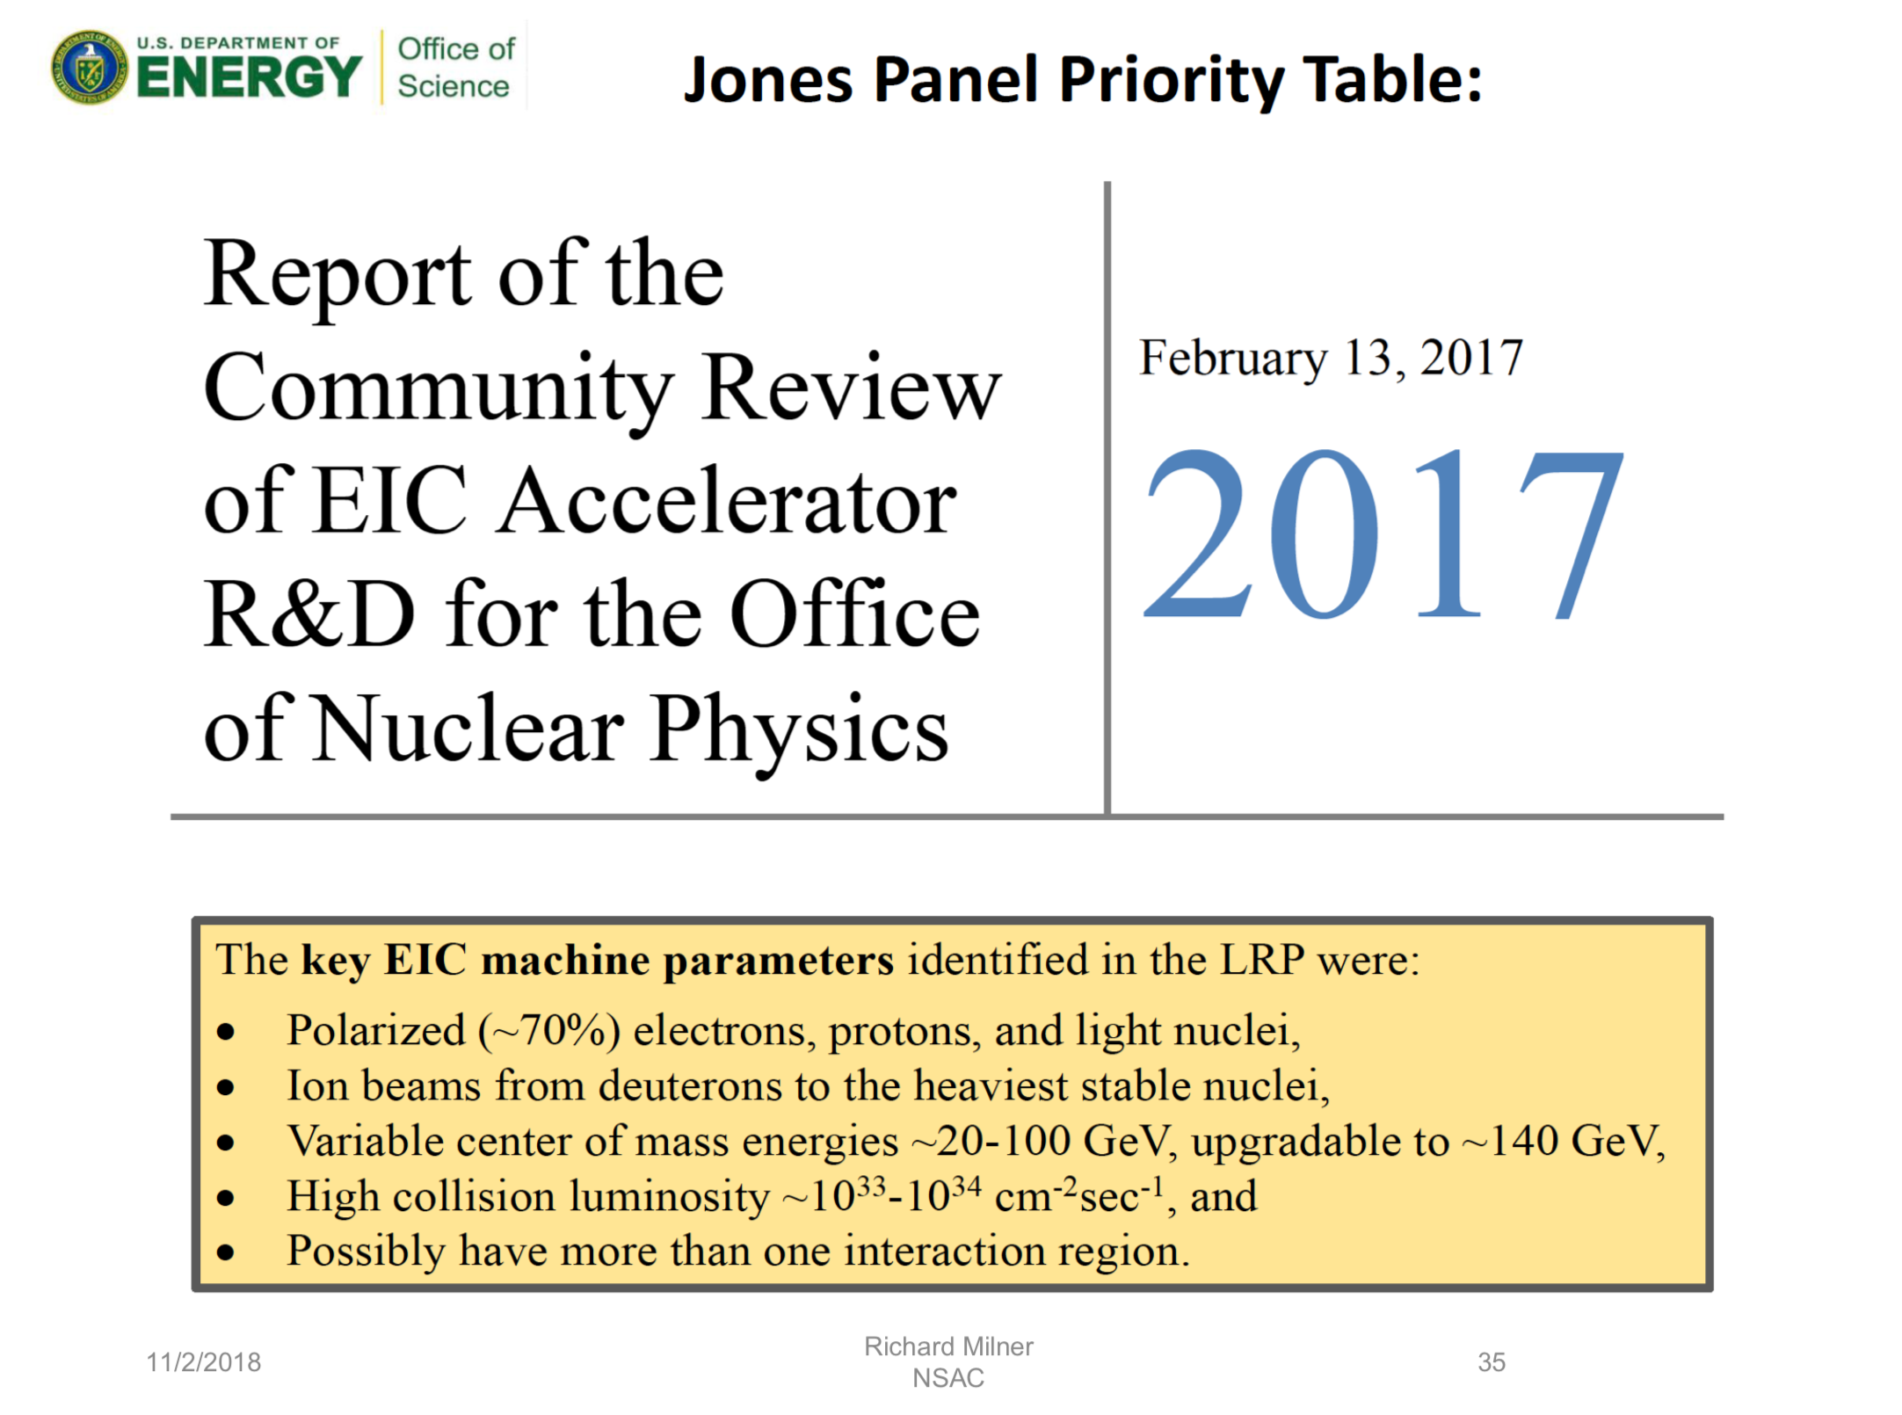
R. Milner at NSAC Nov. 2 2018
Source:
M. Farkhondeh at the
EICUG meeting 2018

Slide 41
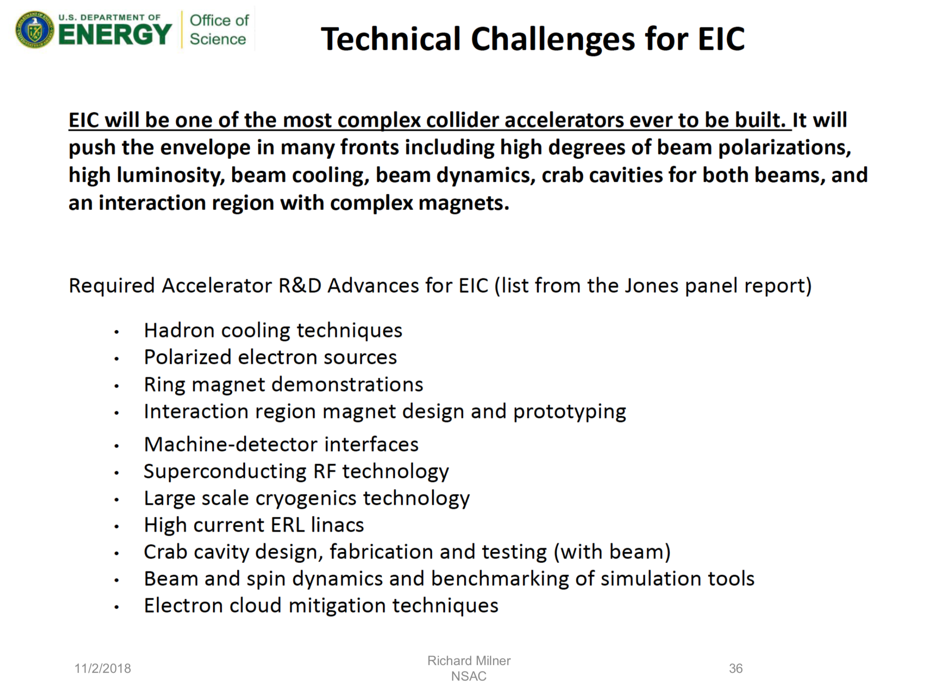
R. Milner at NSAC Nov. 2 2018
Source:
M. Farkhondeh at the
EICUG meeting 2018

Slide 42
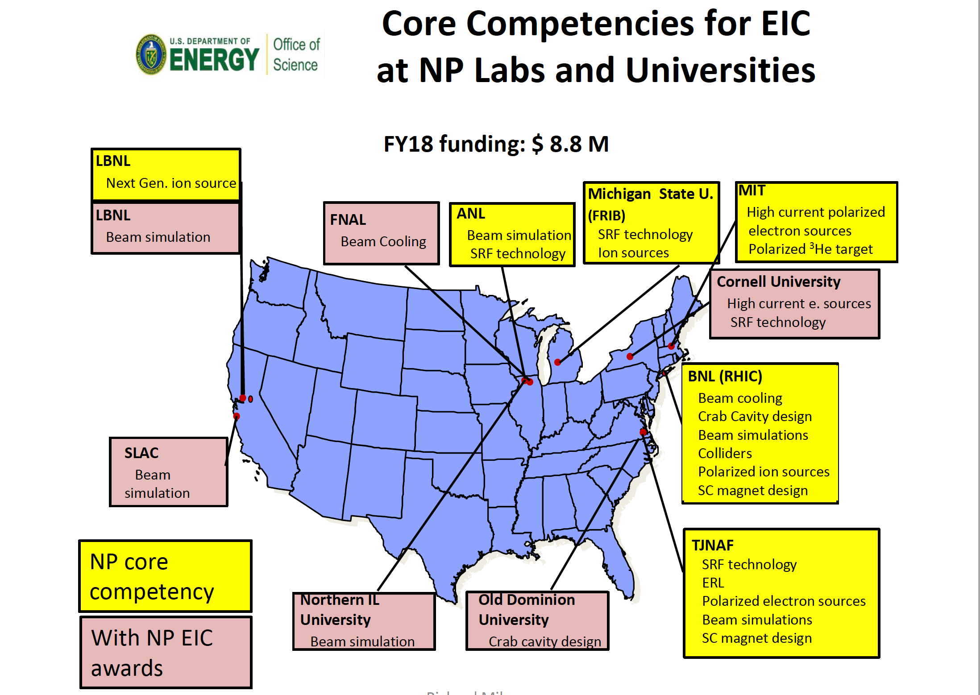
R. Milner at NSAC Nov. 2 2018
Source:
M. Farkhondeh (DOE) at the
EICUG meeting 2018

Slide 43
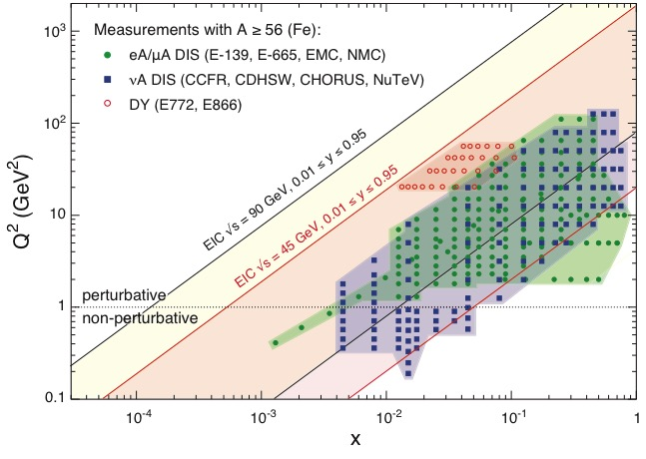
EIC: Kinematic reach & properties
For e-N collisions at the EIC:
Polarized beams: e, p, d/³He
Variable center of mass energy
Wide Q² range → evolution
Wide x range → spanning valence to low-x physics
For e-A collisions at the EIC:
Wide range in nuclei
Lum. per nucleon same as e-p
Variable center of mass energy
Wide x range (evolution)
Wide x region (reach high gluon densities)
Notes:
Minimize words, keep and enhance the figures….

Slide 44
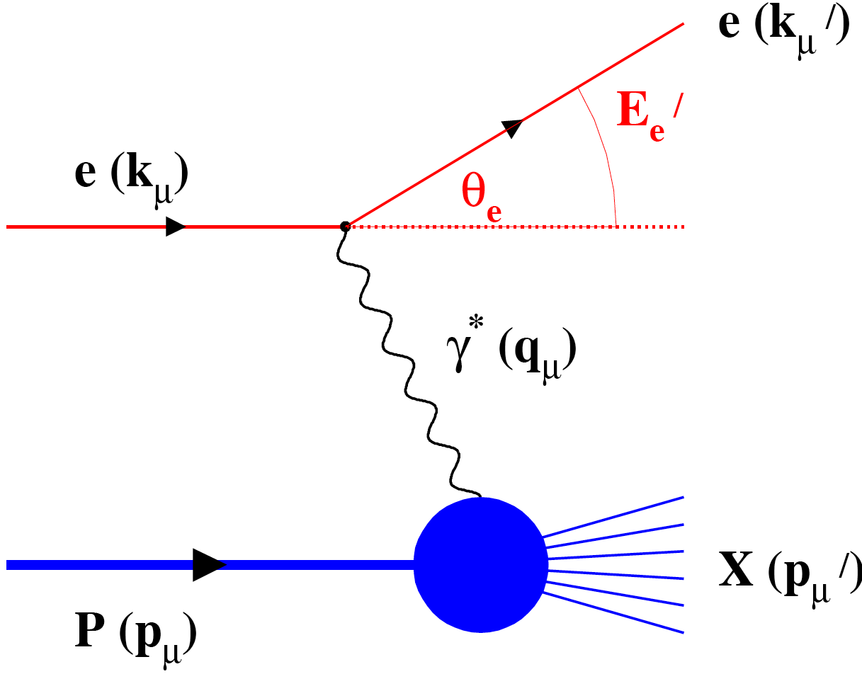
Deep Inelastic Scattering: Precision & Control
Kinematics:
Measure of resolution power
Measure of inelasticity
Measure of momentum fraction of struck quark
with respect to γ
Inclusive events: e+p/A → e’+X
Semi-Inclusive events: e+p/A → e’+h(π,K,p,jet)+X
Exclusive events: e+p/A → e’+ p’/A’+ h(π,K,p,jet)

Slide 45
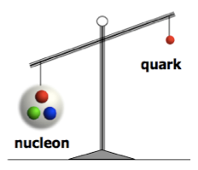
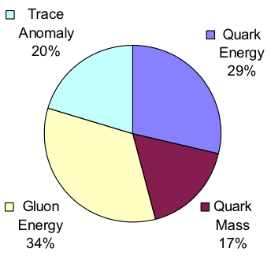
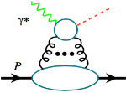
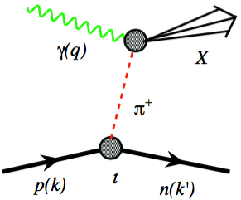
Understanding Nucleon Mass
MeV
Relativistic motion
χ Symmetry Breaking
Quantum fluctuation
GeV
Quark Energy
Gluon Energy
Quark Mass
Trace Anomaly
Mass component separation not yet agreed upon, but much interest in this is emerging
“… The vast majority of the nucleon’s mass is due to quantum fluctuations of quark-antiquark pairs, the gluons, and the energy associated with quarks moving around at close to the speed of light. …”
The 2015 Long Range Plan for Nuclear Science
Preliminary Lattice QCD results:
EIC’s expected contribution in:
Trace anomaly:
J/Ψ, Υ, …
Upsilon production
near the threshold
Quark-gluon energy:
quark-gluon momentum fractions
In nucleon with
DIS and SIDIS
In pions and kaons with Sullivan process
Notes:
Emergent Phenomena like the Spin

Slide 46
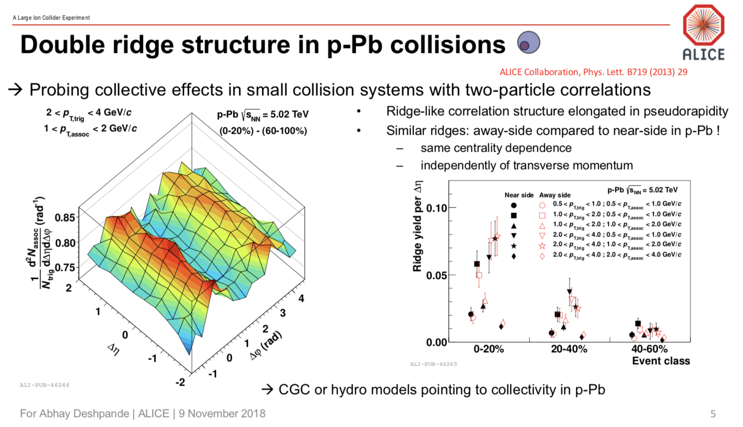

Slide 47
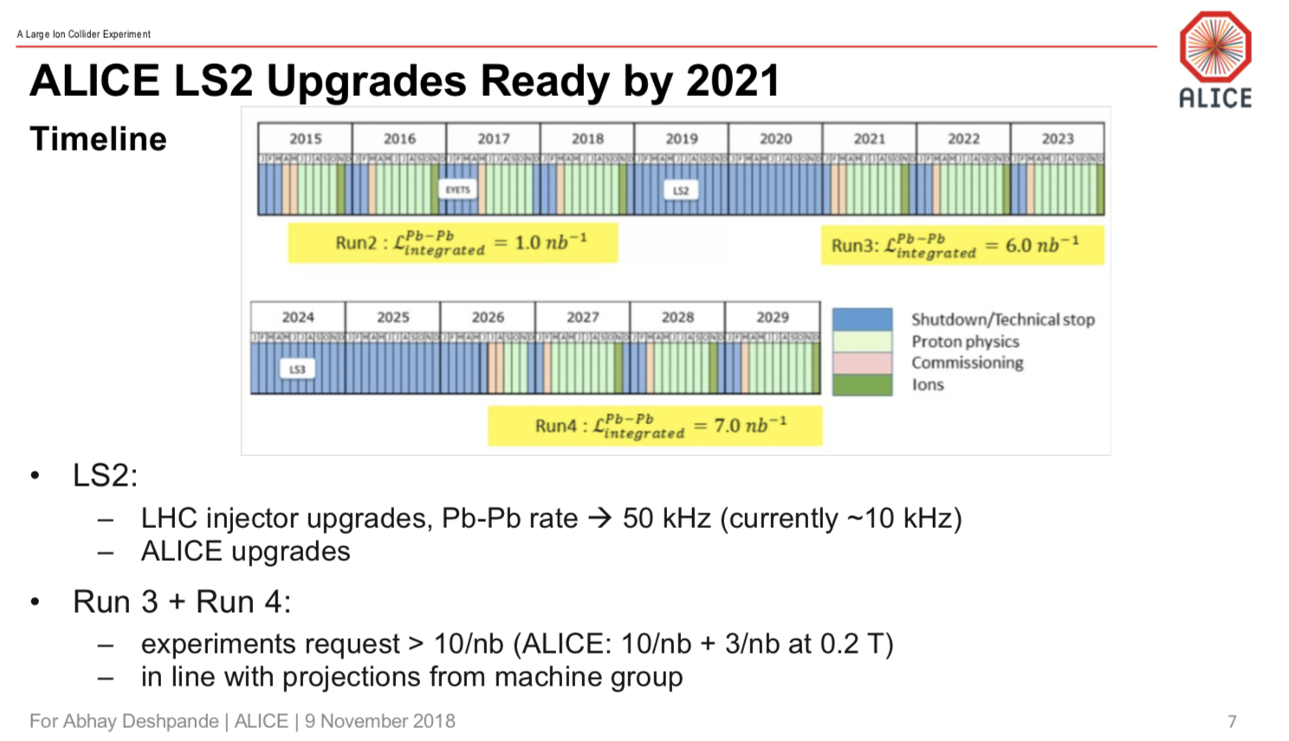

Slide 48
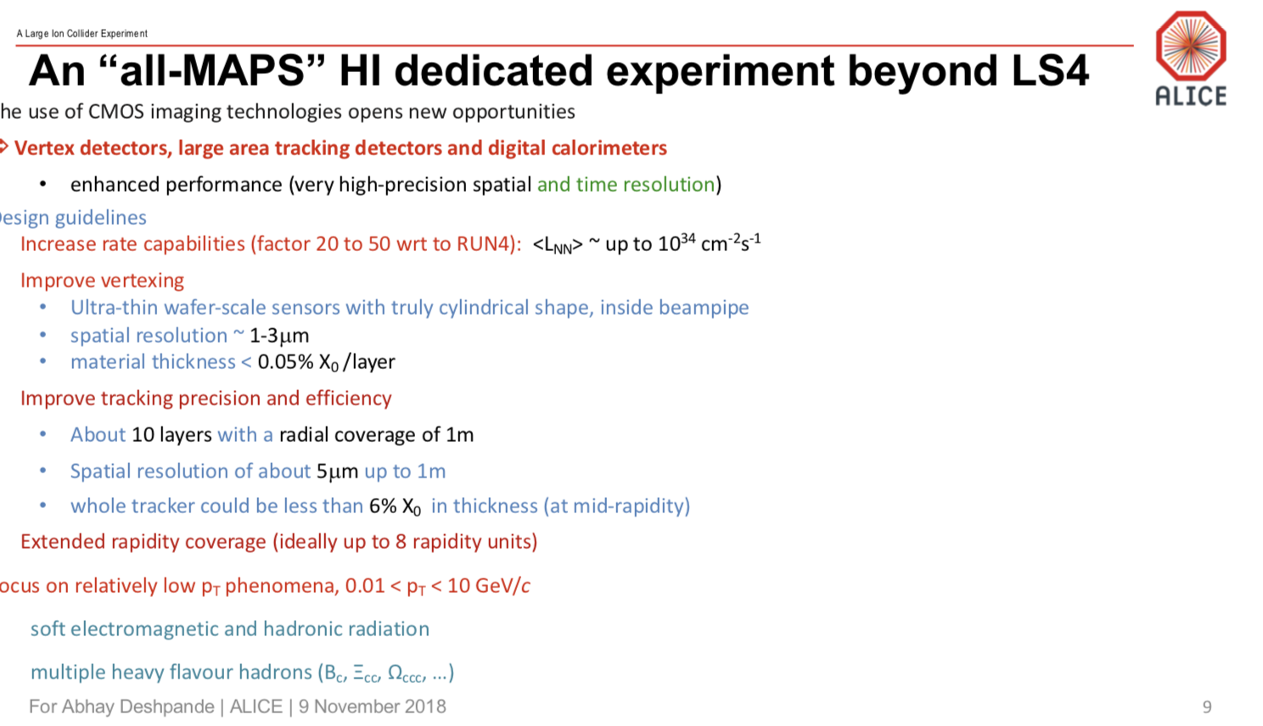

Slide 49
