Slide 1
CompactLight
WP5 Permanent Magnet Undulators: update
Raffaella Geometrante and Mirko Kokole

Slide 2
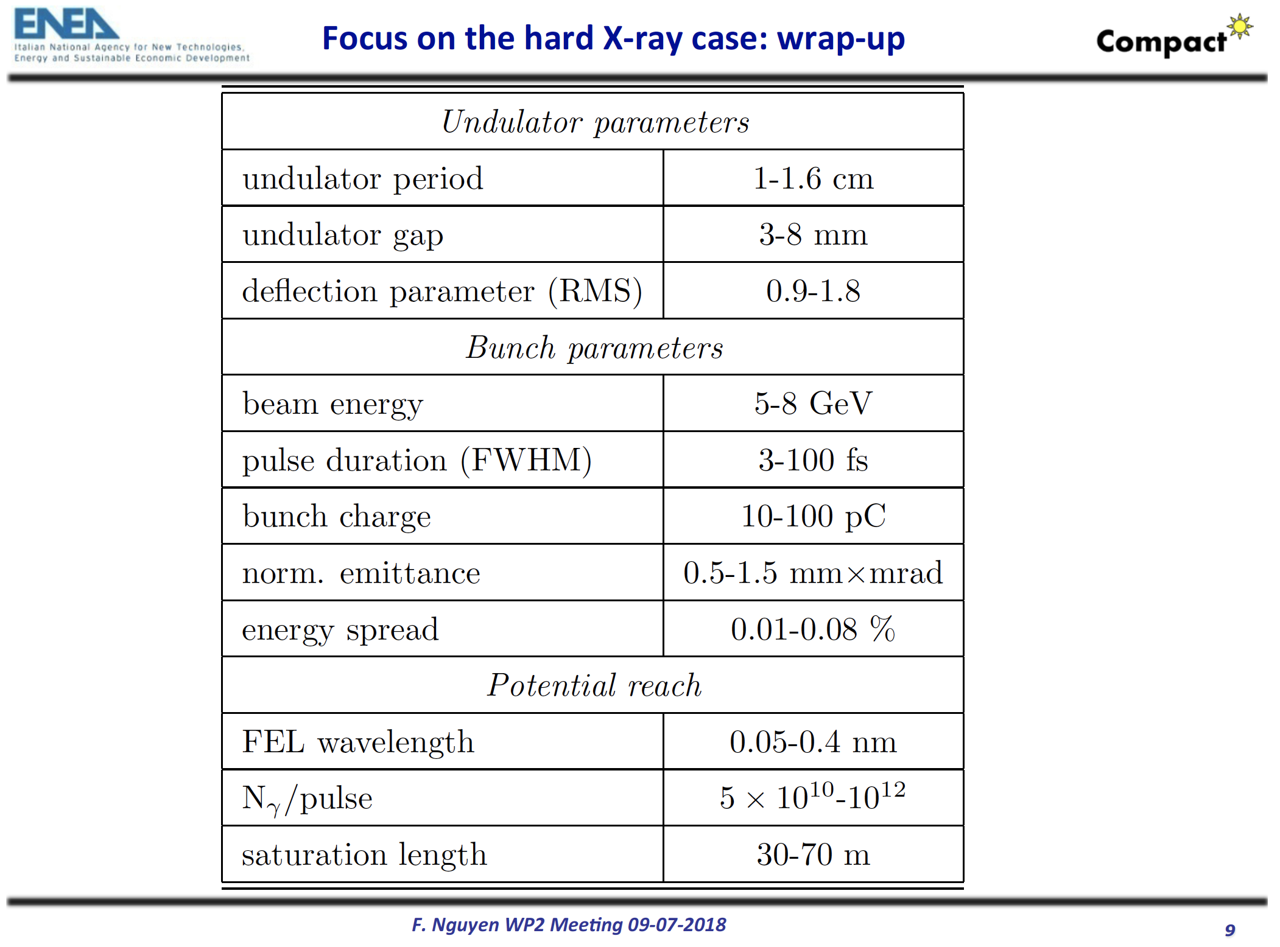

Slide 3
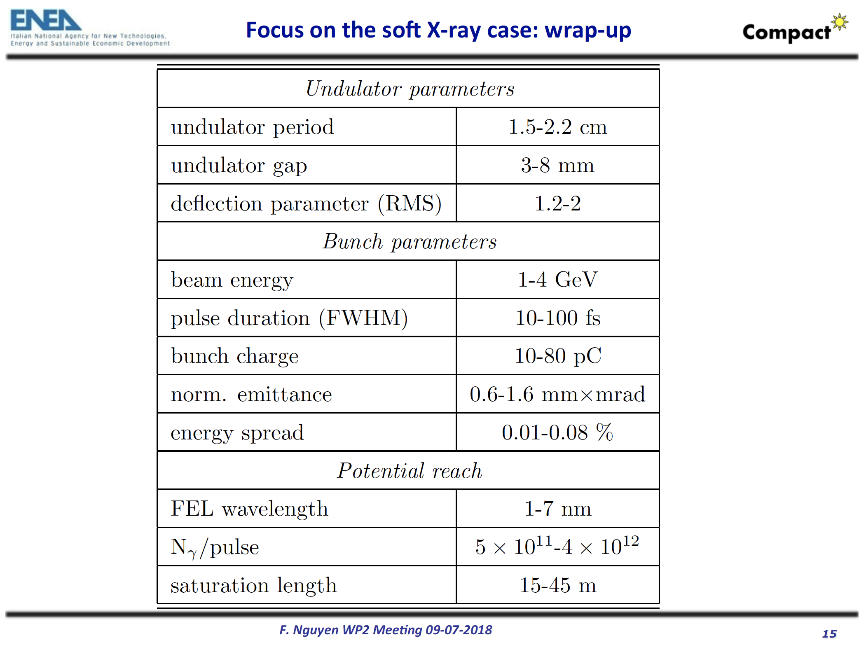

Slide 4
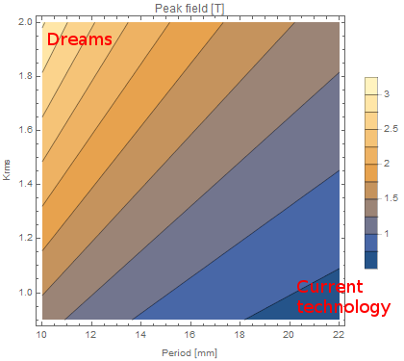
Mirko Kokole

Slide 5
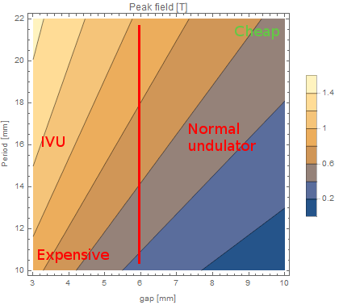
Mirko Kokole

Slide 6
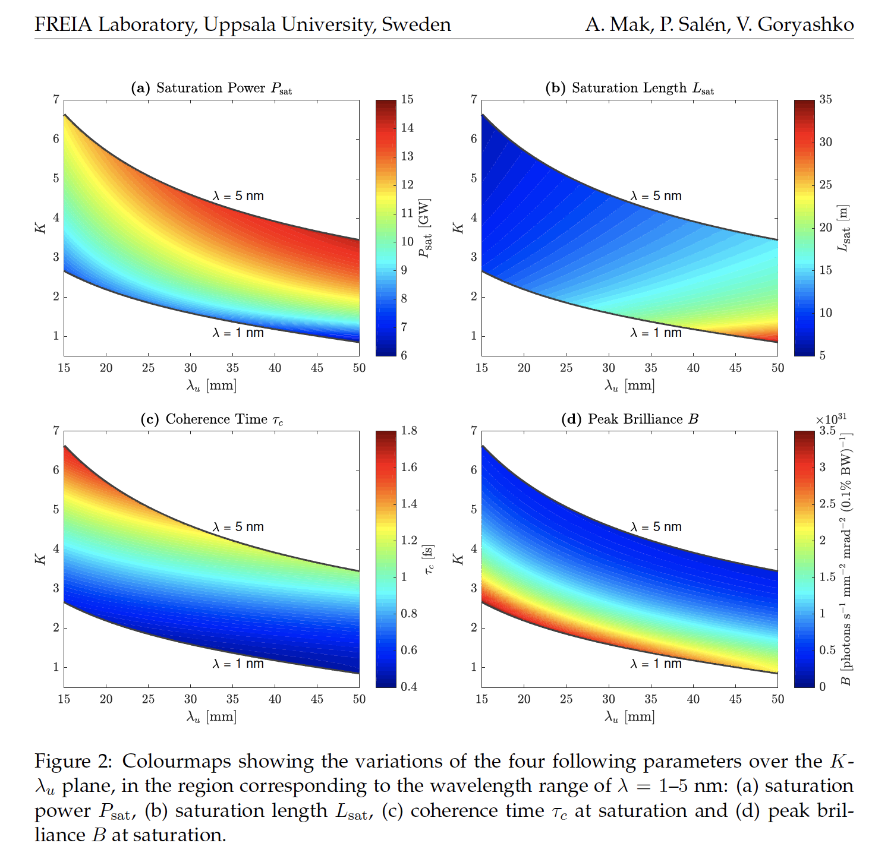
A. Mak, P. Salen, V. Goryashko, Undulator Considerations in the Baseline Design of the MAX IV Soft X-Ray Laser, Paper in the FREIA Report Series are published on internet in PDF-formats. Download from http://uu.diva-portal.org

Slide 7
Bibliography
A. Bernhard and F. Nguyen released a similar document on behalf of the EuPRAXIA
A. Mak, P. Salen, V. Goryashko, Undulator Considerations in the Baseline Design of the MAX IV Soft X-Ray Laser, Paper in the FREIA Report Series are published on internet in PDF-formats. Download from http://uu.diva-portal.org
J. Bahrdt, E. Gluskin, Cryogenic permanent magnet and superconducting undulators, Nuclear Inst. and Methods in Physics Research, A (2018), https://doi.org/10.1016/j.nima.2018.03.069 - ARTICLE IN PRESS
J. Bahrdt, Y. Ivanyushenkov, Short Period Undulators for StoRage Rings and Free Electron Lasers, J. Phys.: Conf. Ser. 425 (2013) 032001, SRI 2012
M. E. Couprie, Insertion device development for a broad range of radiation properties
Proced. 11th International Conference on Synchrotron Radiation Instrumentation, Lyon, July 9-13, 2012 Journal of Physics Conferences Series (SRI2012), 425: art.n° 032012 - (2013)

Slide 8
Bibliography
CRYOGENIC UNDULATORS
M. Calvi, et al., Commissioning results of the U14 cryogenic undulator at SLS, J. Phys. Conf. Ser 425 (2013) 032017-1-4
C. Kitegi et al, Development of cryogenic undulators at SOLEIL, SRI2018
M. Valléau, C. Benabderrahmane, F. Briquez, P. Berteaud, K. Tavakoli, D. Zerbib, L. Chapuis, F. Marteau, O. Marcouillé, T. El Ajjouri, J. Vétéran, G. Sharma, C. Kitégi, M. Tilmont, J. Da Silva Castro, M. H. Nguyen, N. Béchu, P. Rommeluère, M. Louvet, J. M. Filhol, A. Nadji, C. Herbeaux, J. L. Marlats, M. E. Couprie, Development of Cryogenic Undulators with PrFeB magnets at SOLEIL, Journal of Physics : Conferences Series (proceedings of SRI 2015), Vol. 1741, No. 1, p. 020024). AIP Publishing.
M. E. Couprie, F. Briquez, G. Sharma, C. Benabderrahmane, F Marteau, O. Marcouillé, P. Berteaud, T. El Ajjouria, J. Vétéran, L. Chapuis and M. Valléau, Cryogenic undulators, In SPIE Optics+ Optoelectronics (pp. 951204-951204). International Society for Optics and Photonics. May 2015.
C. Benabderrahmane, M. Valléau, A. Ghaith, P. Berteaud, L. Chapuis, F. Marteau, F. Briquez, O. Marcouillé, J.-L. Marlats, K. Tavakoli, A. Mary, D. Zerbib, A. Lestrade, M. Louvet, P. Brunelle, K. Medjoubi, C. Herbeaux, N. Béchu, P. Rommeluere, A. Somogyi, O. Chubar, C. Kitegi, and M. E. Couprie, Development and operation of a Pr2Fe14B based cryogenic permanent magnet undulator for a high spatial resolution x-ray beam line, Phys. Rev. Accel. Beams 20, 033201(2017)

Slide 9
Questions 1/2
What are the driving conditions?
Compactness
Feasibility
Cost
State of the art
Aggressive solutions
Hard X-ray parameter
Soft X-ray parameter

Slide 10
Questions 2/2
Cost Evaluation for different undulator technologies (cost per m)
What about ancillary services?
Circular economy: Maintanance, repair, reuse, remanufacturing, refurbishing, recycling, and upcycling.
Mak, P. Salen, V. Goryashko, Undulator Considerations in the Baseline Design of the MAX IV Soft X-Ray Laser, Paper in the FREIA Report Series are published on internet in PDF-formats. Download from http://uu.diva-portal.org
What are the steps forward?

