Slide 1
Mini Hall probe bench for in-vacuum undulators at PSI
T. Schmidt:: ID group :: Paul Scherrer Institut
XLS WP5 meeting No 6 , September 26th , 2018

Slide 2
Mini Hall probe bench
“in-situ” field measurement and optimization for in-vac undulators
miniaturization of SwissFEL out of vacuum measurement bench
SAFALI based with robot based field correction
collaboration with Senis and University of Malta
Hall sensor and encoder data for direct access to field vs position
wireless data transfer
for in vacuum chamber measurements – not under vacuum
for field optimization without later disassembling
for faster re-shimming of undulators in case of radiation degradation
prototype in test phase

Slide 3
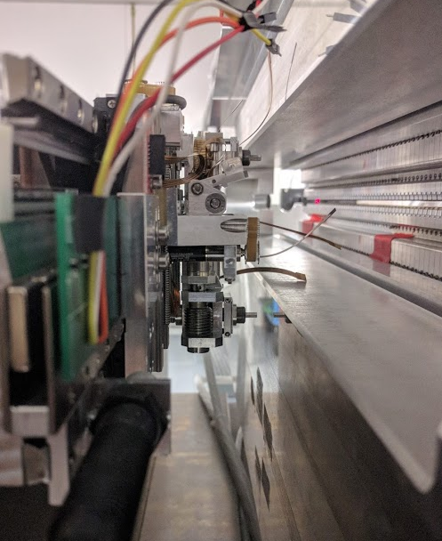
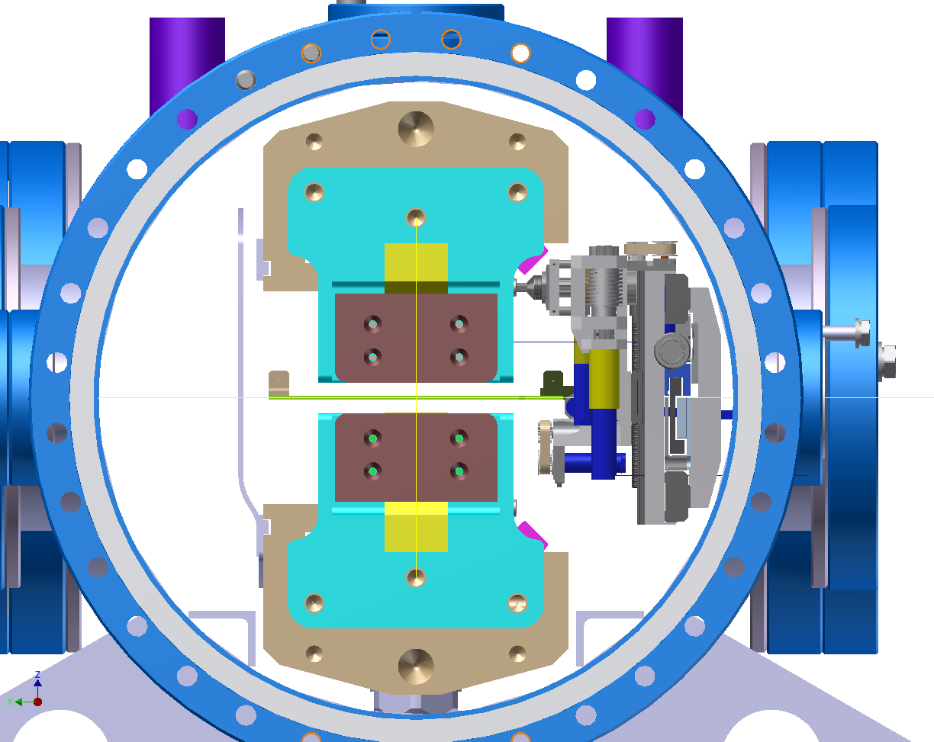
Miniaturized Hall probe bench
Mechanical drawings for magnetic measurement inside of the vacuum chamber.
Prototype bench fixed to a 1m undulator for testing.

Slide 4
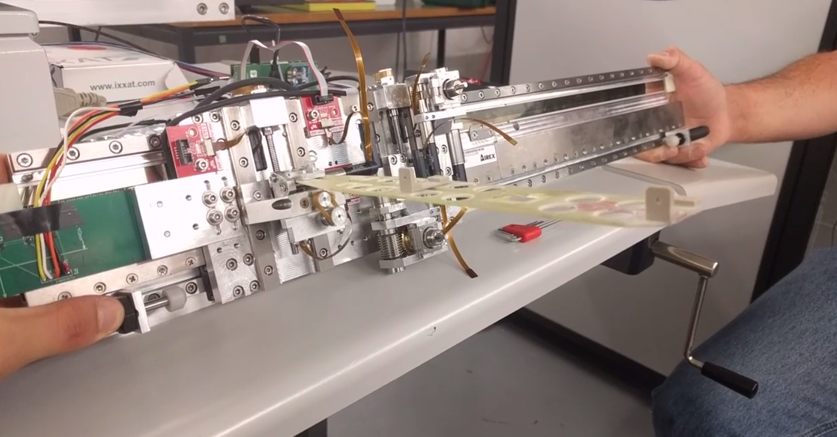
View of the measurement bench with a SENIS hall probe fixed to the holder.

Slide 5
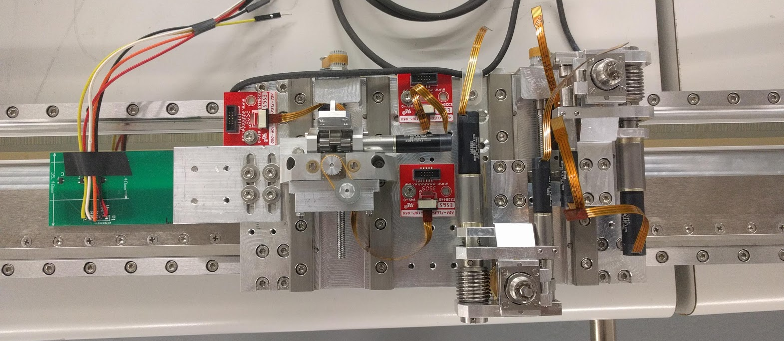
Hall sensor board.
3 Hall effect sensor chips placed in phase with the 3 motor coils used for linear commutation
SENIS hall probe correction.
3 Faulhaber motors used to correct the hall probe position in the horizontal, vertical orientations as well as the angular offset
Automatic adjustment robot
5 Motors:
2 x horizontal position
2 x “Screwdrivers”
1 x vertical position
Heidenhain position encoder
(Endat2.2 protocol)

Slide 6
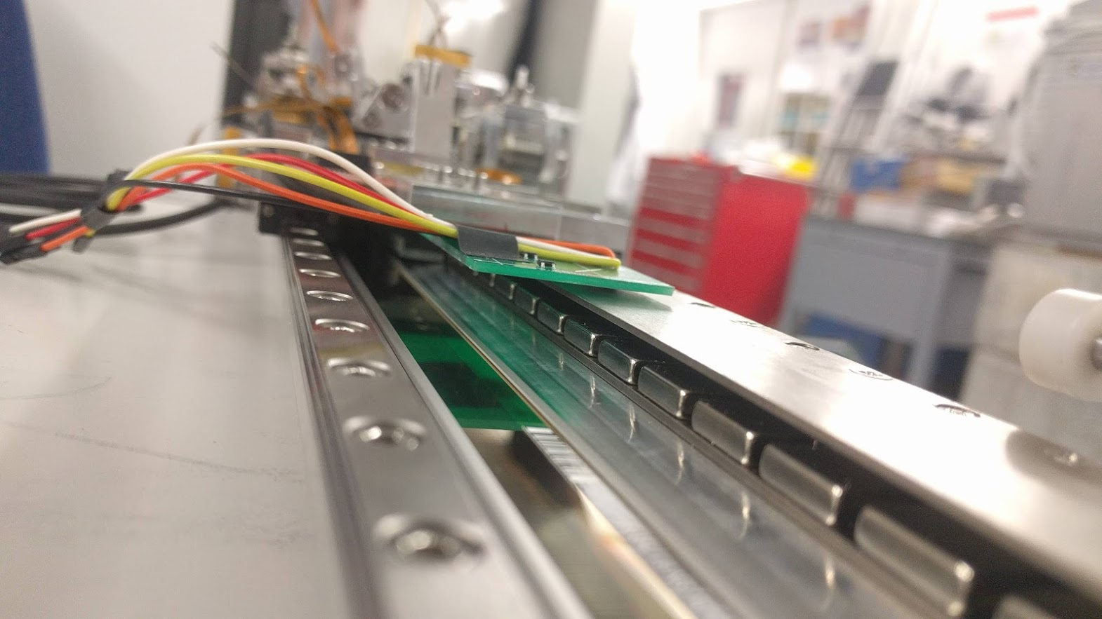
Side view showing the linear motor magnets underneath the hall sensor circuit board.

Slide 7
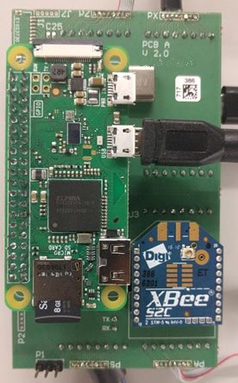
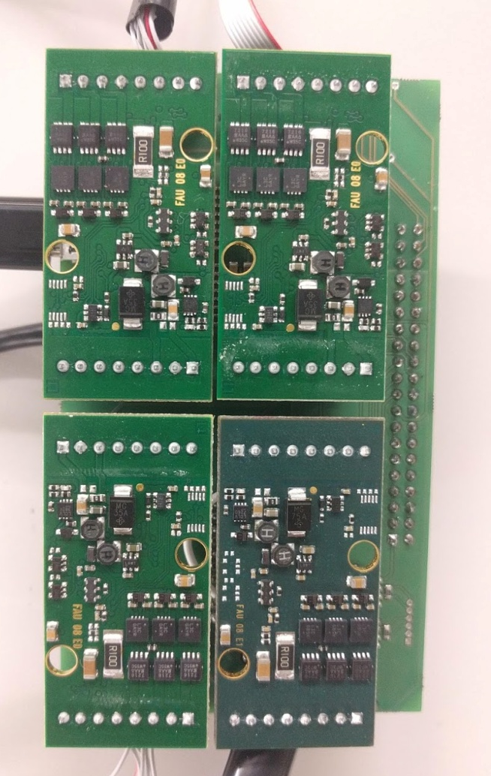
Top and bottom views of the main PCB showing:
Raspberry Pi controller
Zigbee radio module for transmitting PSD sensor values
4 Faulhaber motion controllers.
Other components not visible in the picture include:
Endat controller for reading Heidenhain encoder.
USB & SPI isolators
CAN bus transciever for communication with the Faulhaber controllers
Top
Bottom

