Slide 1
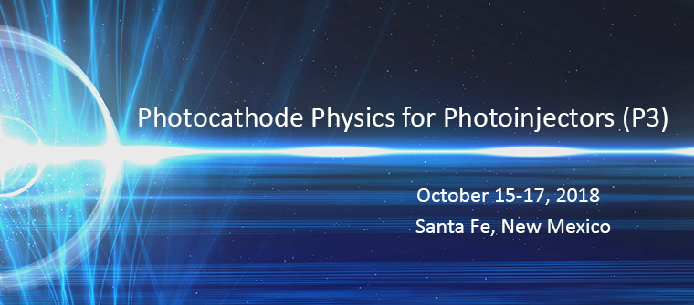
Hilton Buffalo Thunder Resort

Slide 2
Welcome to P3 2018
Organizing Committee
Ivan Bazarov (Cornell University)
Luca Cultrera (Cornell University)
David Dowell (SLAC National Accelerator Laboratory)
Daniele Filippetto (Lawrence Berkeley National Laboratory)
Fay Hannon (Thomas Jefferson National Accelerator Facility)
Carlos Hernandez Garcia (Thomas Jefferson National Accelerator Facility)
Kevin Jensen (Naval Research Laboratory)
Siddharth Karkare (Arizona State University)
John Lewellen (Los Alamos National Laboratory)
Nathan Moody (Los Alamos National Laboratory)
Pietro Musumeci (UCLA)
Howard Padmore (Lawrence Berkeley National Laboratory)
John Smedley (Brookhaven National Laboratory
Theo Vecchione (SLAC National Accelerator Laboratory)
Notes:
I’ve been asked to give highlights of the ongoing and future A&E R&D. A comprehensive view of all R&D would extend well beyond the time allotted so I give an overview that is organized to show the framework we utilize when planning for the future.

Slide 3
Meeting Facility: Exits and Restrooms

Slide 4
Workshop Charge
To explore the current state of the art in accelerator photocathodes, from both a theoretical and a materials science perspective. We aim to establish directions for future research and identify opportunities for collaboration within the community.

Slide 5
Scientific Program: Application Focus
Session 1: Welcome and Overview
Session 2: Application Oriented Research: Low Average Current
Session 3: Application Oriented Research: FEL
Session 4: Application Oriented Research: Spin Polarized Sources
Session 5: Application Oriented Research: High Average Current
Session 6: Application Oriented Research: Cathode Design
Session 7: Operations and Demonstrations: Normal conducting
Session 8: Operations and Demonstrations - Superconducting & DC
Session 9: Theory and Computation
Session 10: Theory and Computation - continued
Session 11: Novel Research and Applications
Session 12: Novel Research and Applications (and concluding discussion)
Review of requirements is provided within each session.
Workshop materials located at: https://indico.cern.ch/event/759878/
  82 total contributions
  14 posters
  68 talks

Slide 6
General Workshop Information
Please wear your workshop nametag to sessions and events
Poster and Networking session: Monday October 15 @ 18:30 – 20:45
Catered dinner and evening presentation: Tuesday October 16 @ 18:30 – 21:00
  Dr. Alan Carr, LANL historian
  Group photo during dinner
Wifi password in conference rooms: “P32018”
Presentations will remain available on Indico unless otherwise specified

Slide 7
Hilton Buffalo Thunder Resort

Slide 8
P3 Announcements: Tuesday October 16
Working lunch topic: “Understanding challenges in photocathode funding”
  Motivating questions:
    Do the large user facilities need our photocathode R&D solutions? How close to success/failure are they without us?
    Do we have a marketing / image problem we need to resolve?
    Can we identify 3-5 (each) near-term and long-term actions we can take?
  Time: 13:00 – 14:00
  Logistics: Per diem hotel food item
  Outcome: An action plan (of some sort)
Catered evening dinner: Dr. Alan Carr, LANL Historian
  Room change: Pueblo 2 meeting room

