Slide 1
Stopping Protons Analysis

Slide 2
goal
To study stopping protons in the SuperFGD using data from the Aug/Sep test beam, analyzing where protons stop in the detector.
By considering the three types of MPPCs separately, build a distribution of the energy deposited in the last cell the proton reaches.
Use the shape of the distribution to check whether there is a saturation effect.

Slide 3
MPPCs in the detector
X
24
MPPC II
MPPC III
MPPC I
Beam
Z
0
15
23
47

Slide 4
Steps
dE/dx
Event Selection.
Treat MPPCs separately.
Obtain relative dE/dx from end point of each event.
Build histogram for energy deposited in the last cell.

Slide 5
Data Sample
0.8 GeV/c Protons.
Magnet ON, 135 A.
Default HG, default LG (55, 55).
Proton trigger ON.

Slide 6
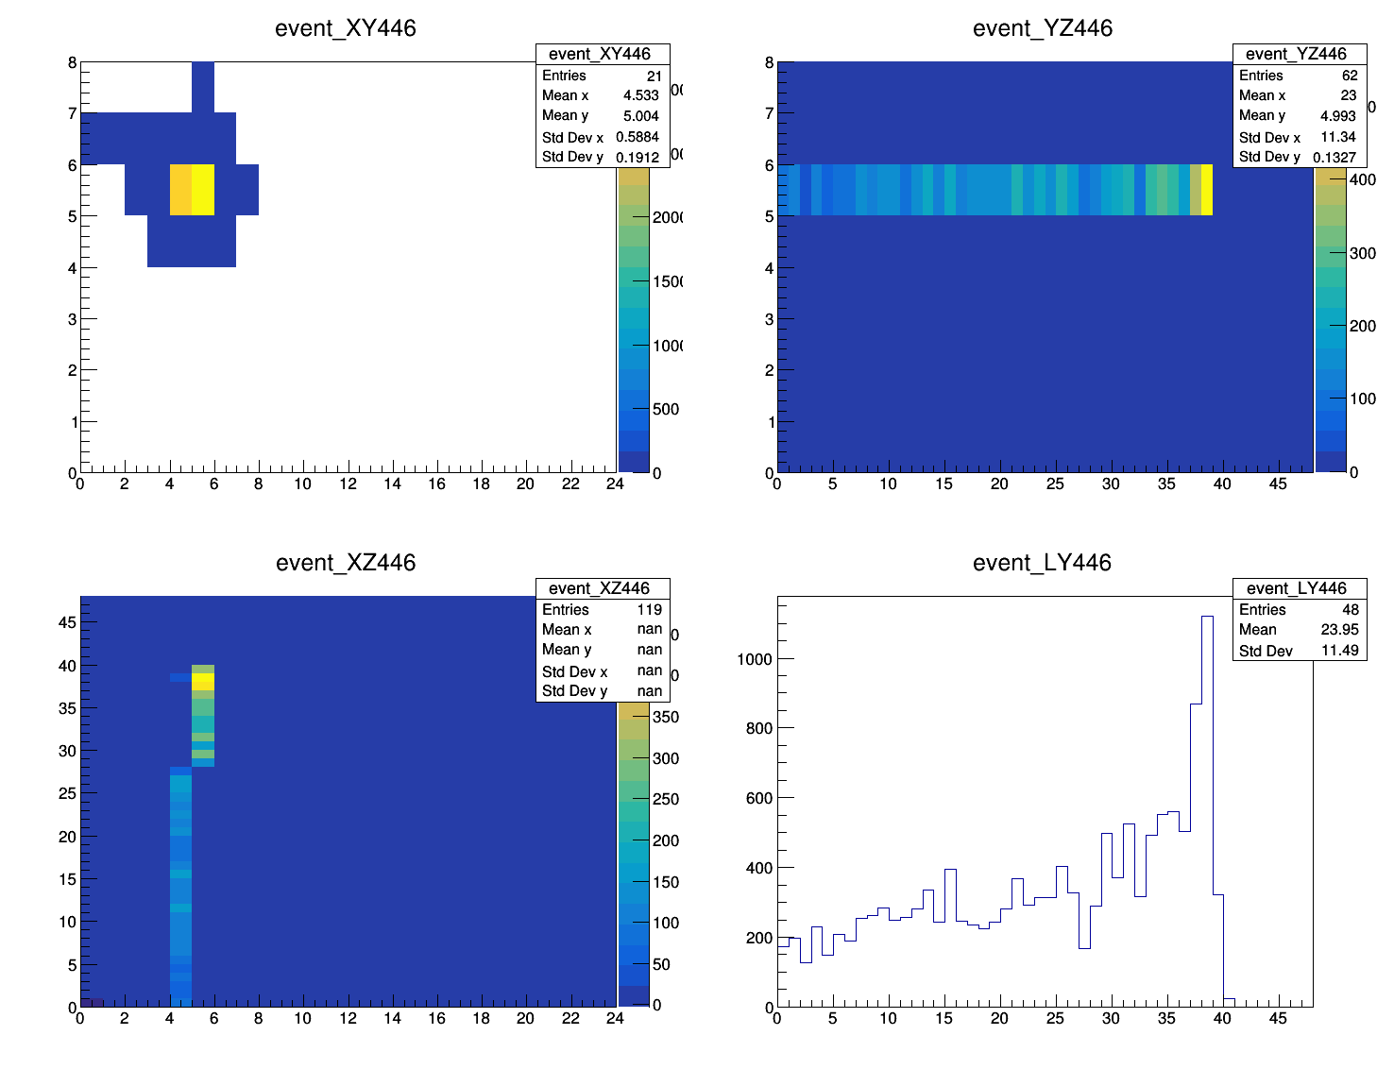
1. Energy deposition
Code by Sasha

Slide 7
2. Event selection
Need to consider different event scenarios.
Which to include, which to discard.

Slide 8
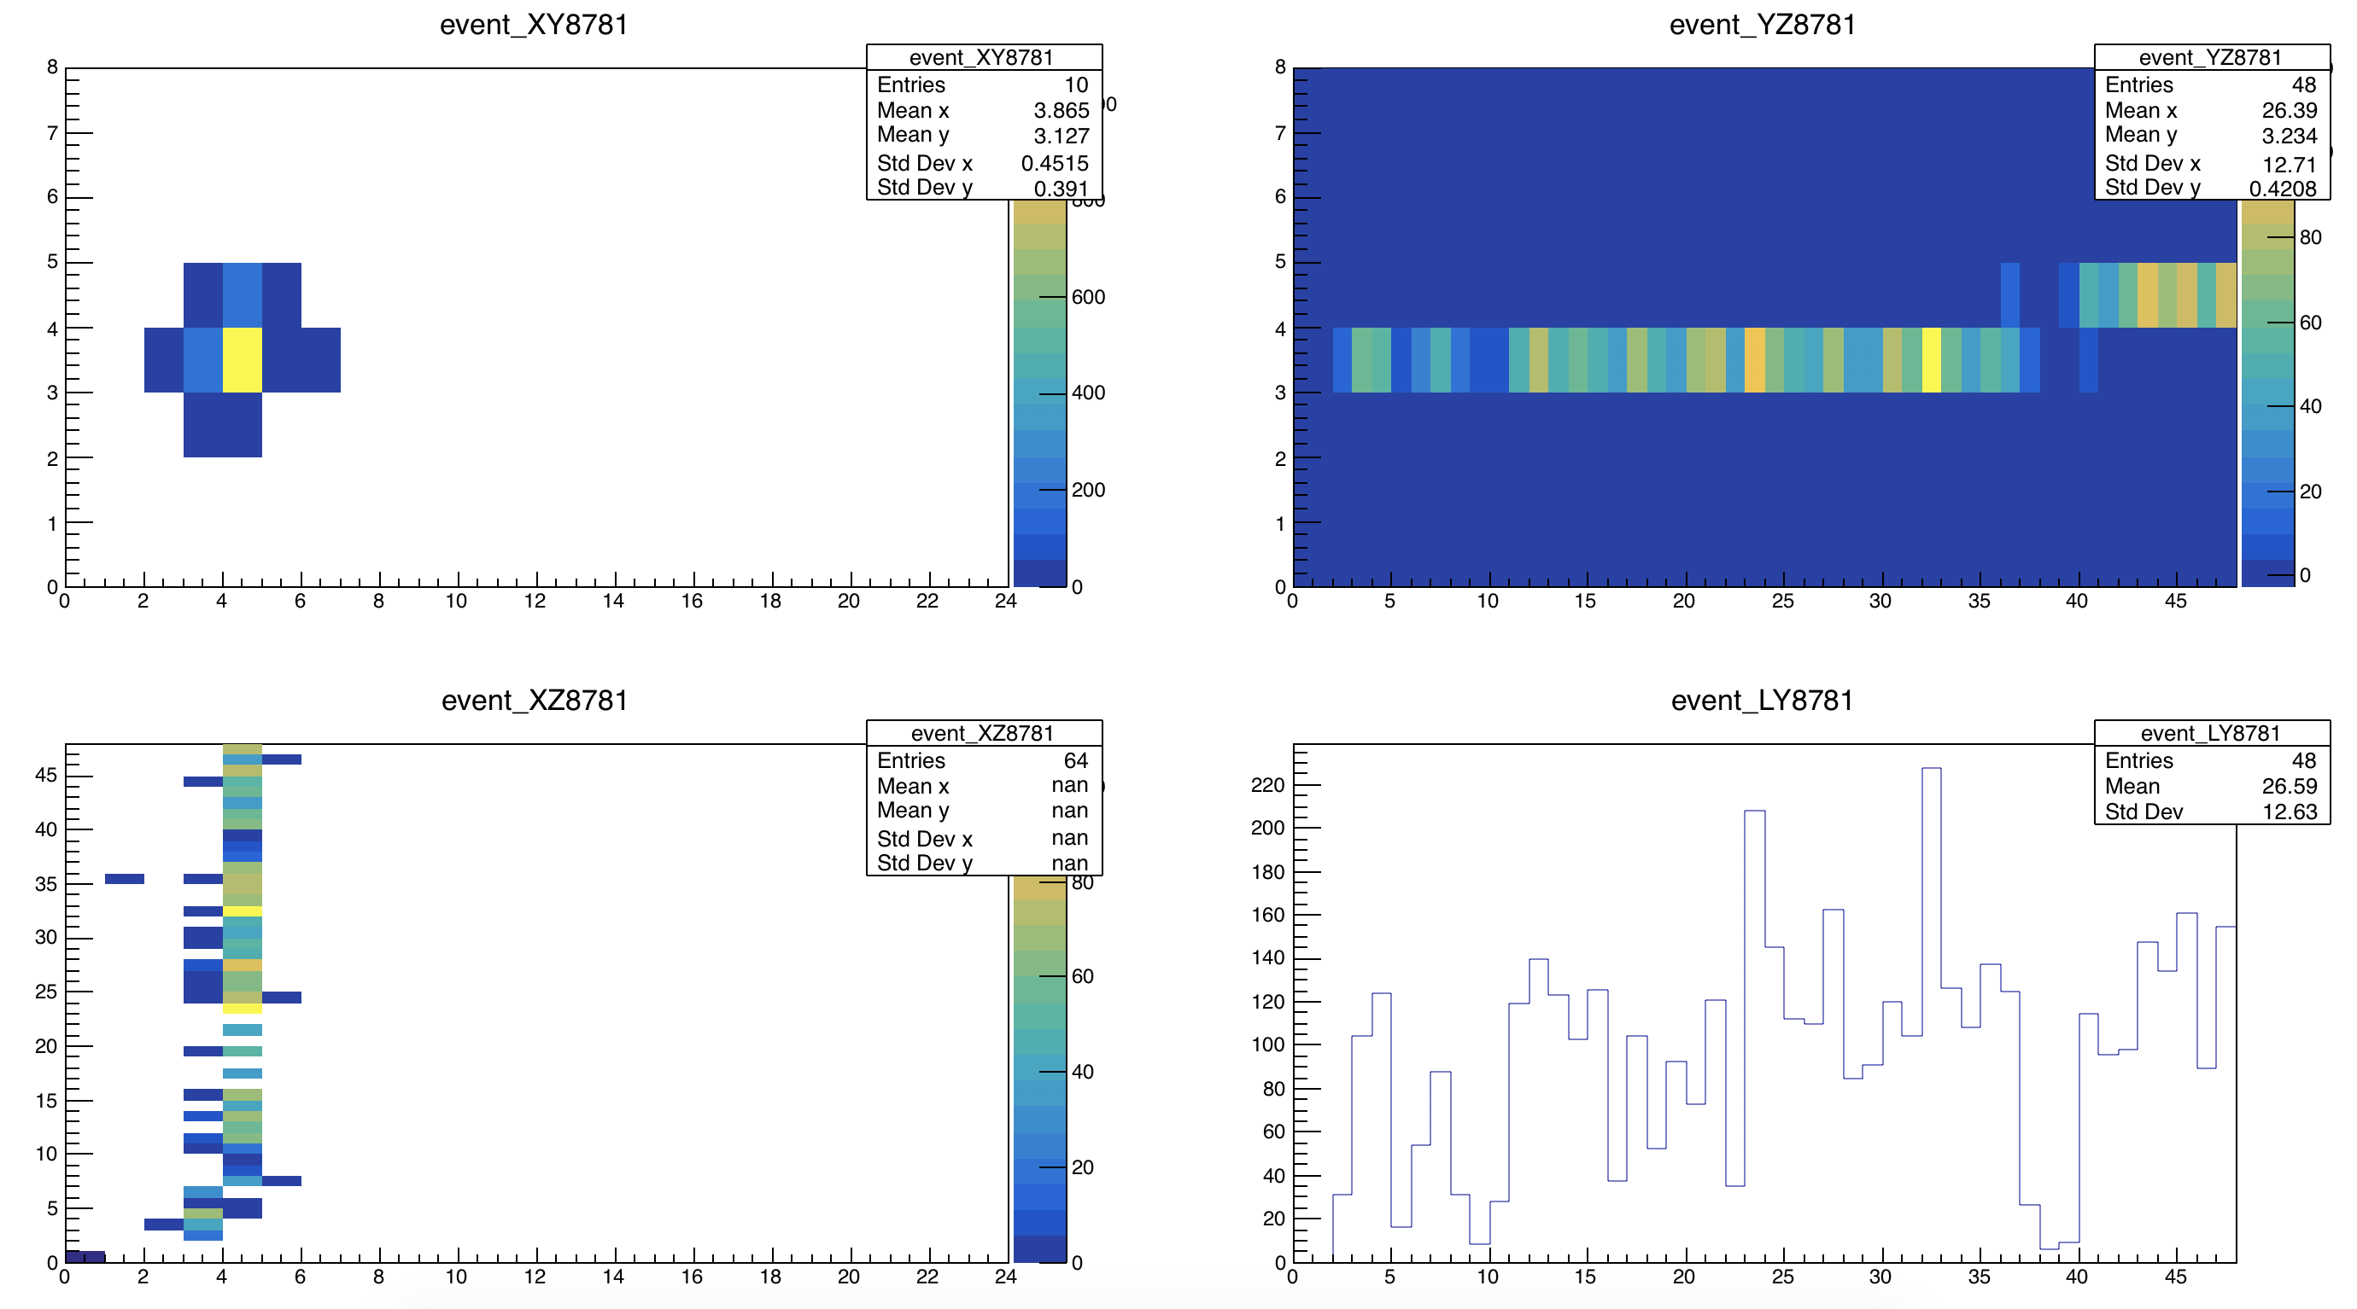
No stop
Cut: No energy deposited in last layer (Z=47)

Slide 9
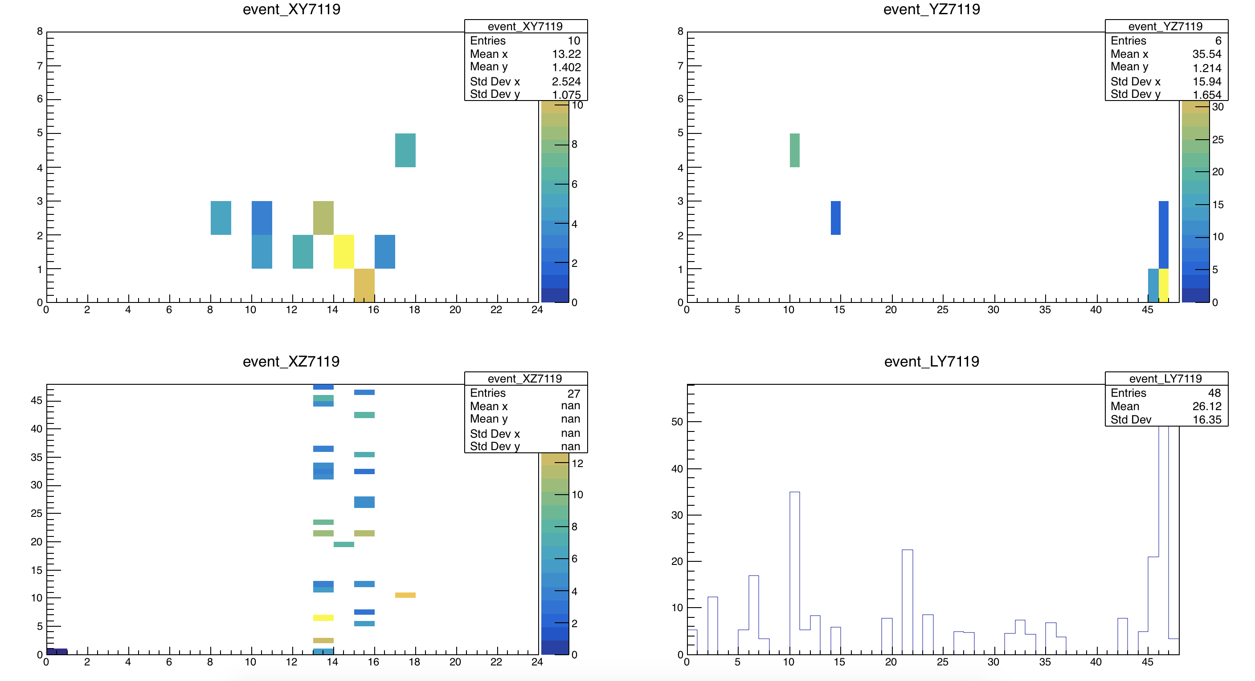
meaningless events
Cut: Energy deposited at the peak > 250 p.e.

Slide 10
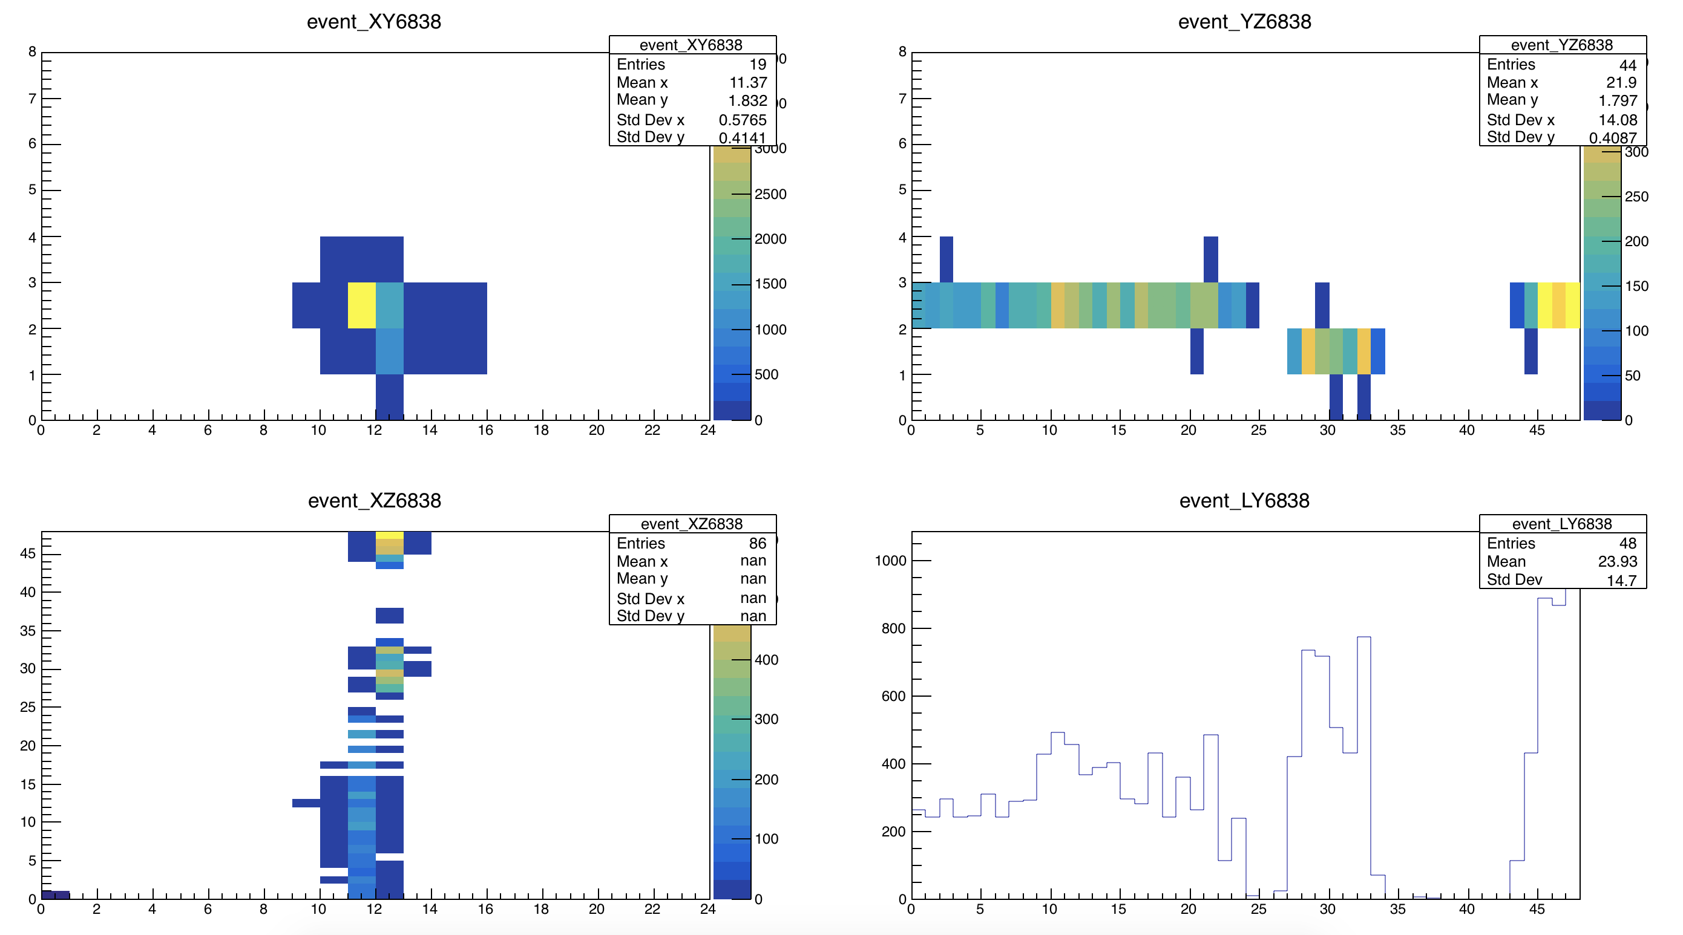
Discontinuities
Cut: Before the peak, max number of allowed layers with ZERO deposited energy is 2.

Slide 11
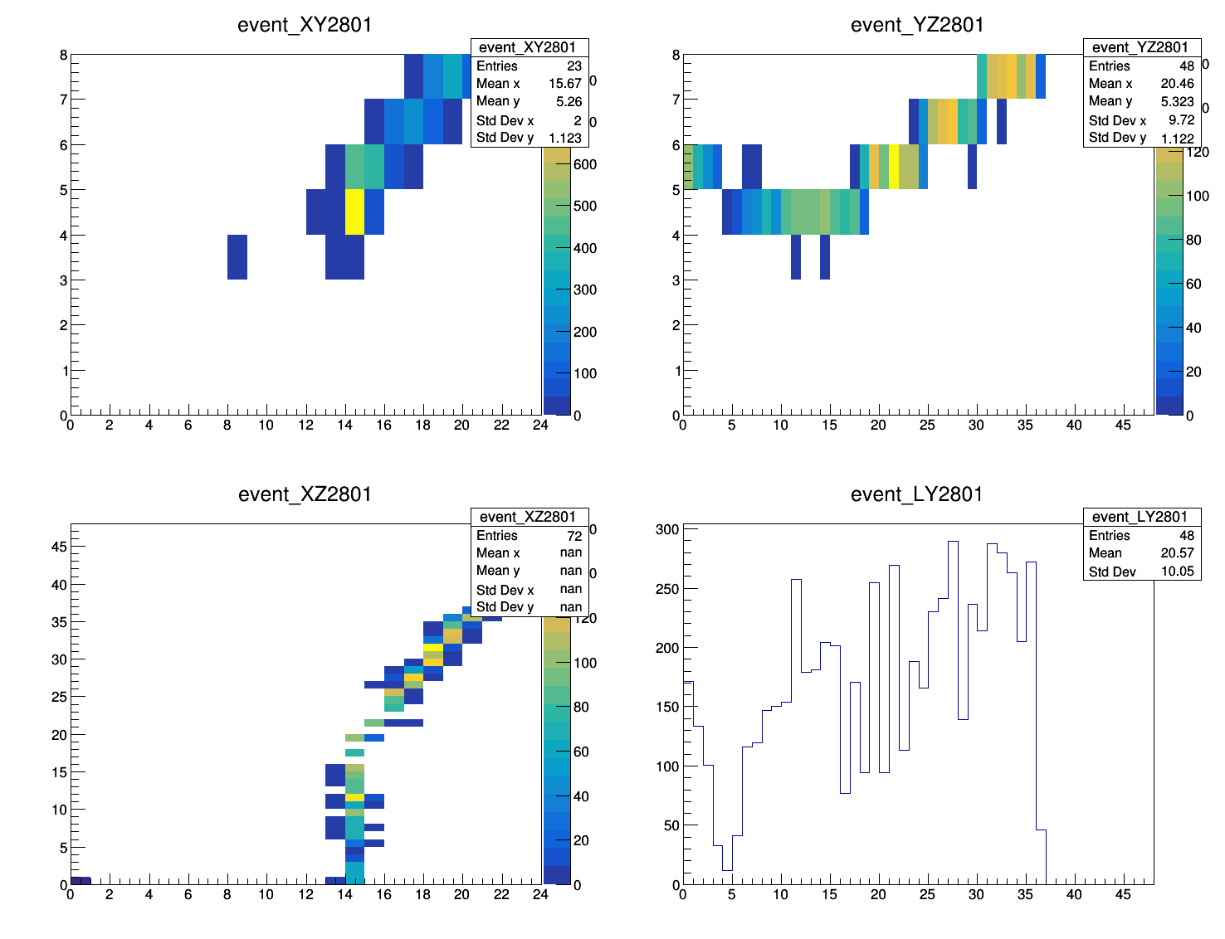
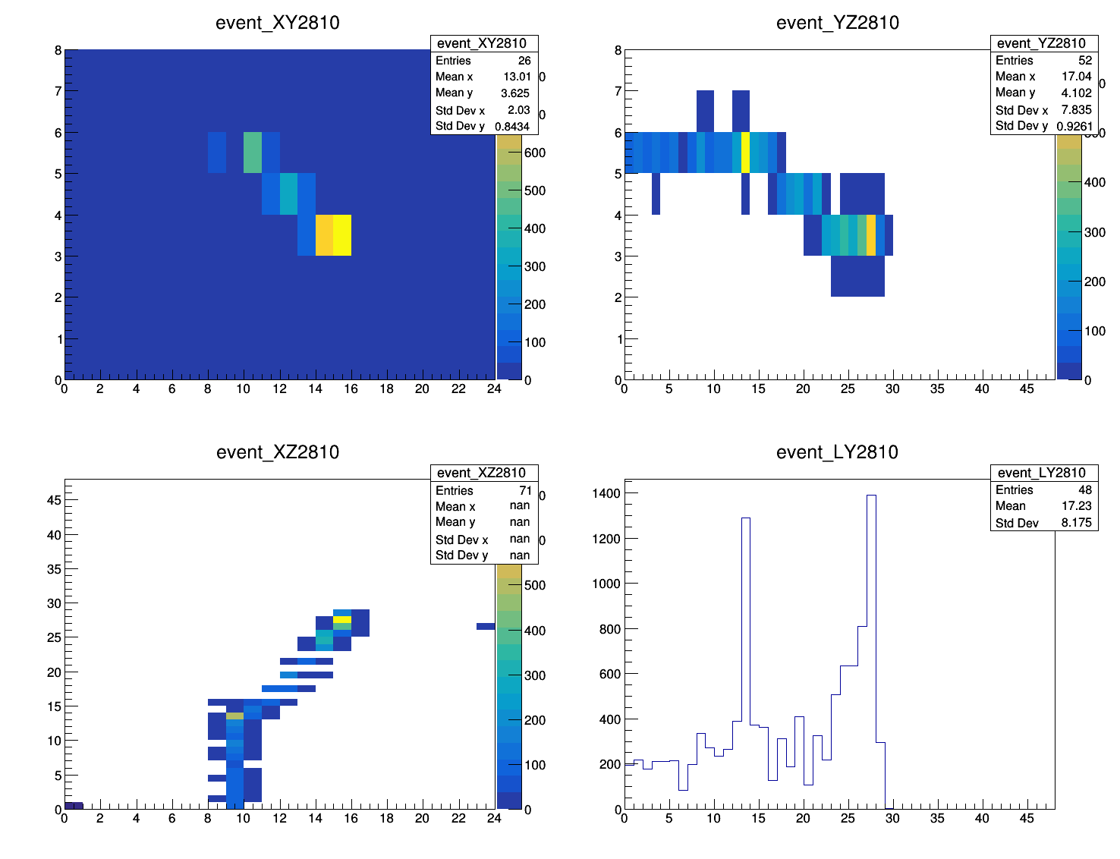
Scatterings, sometimes leaving the detector?
Cut: For the front (XY) view, stdDevX and stdDevY both < 1.0

Slide 12
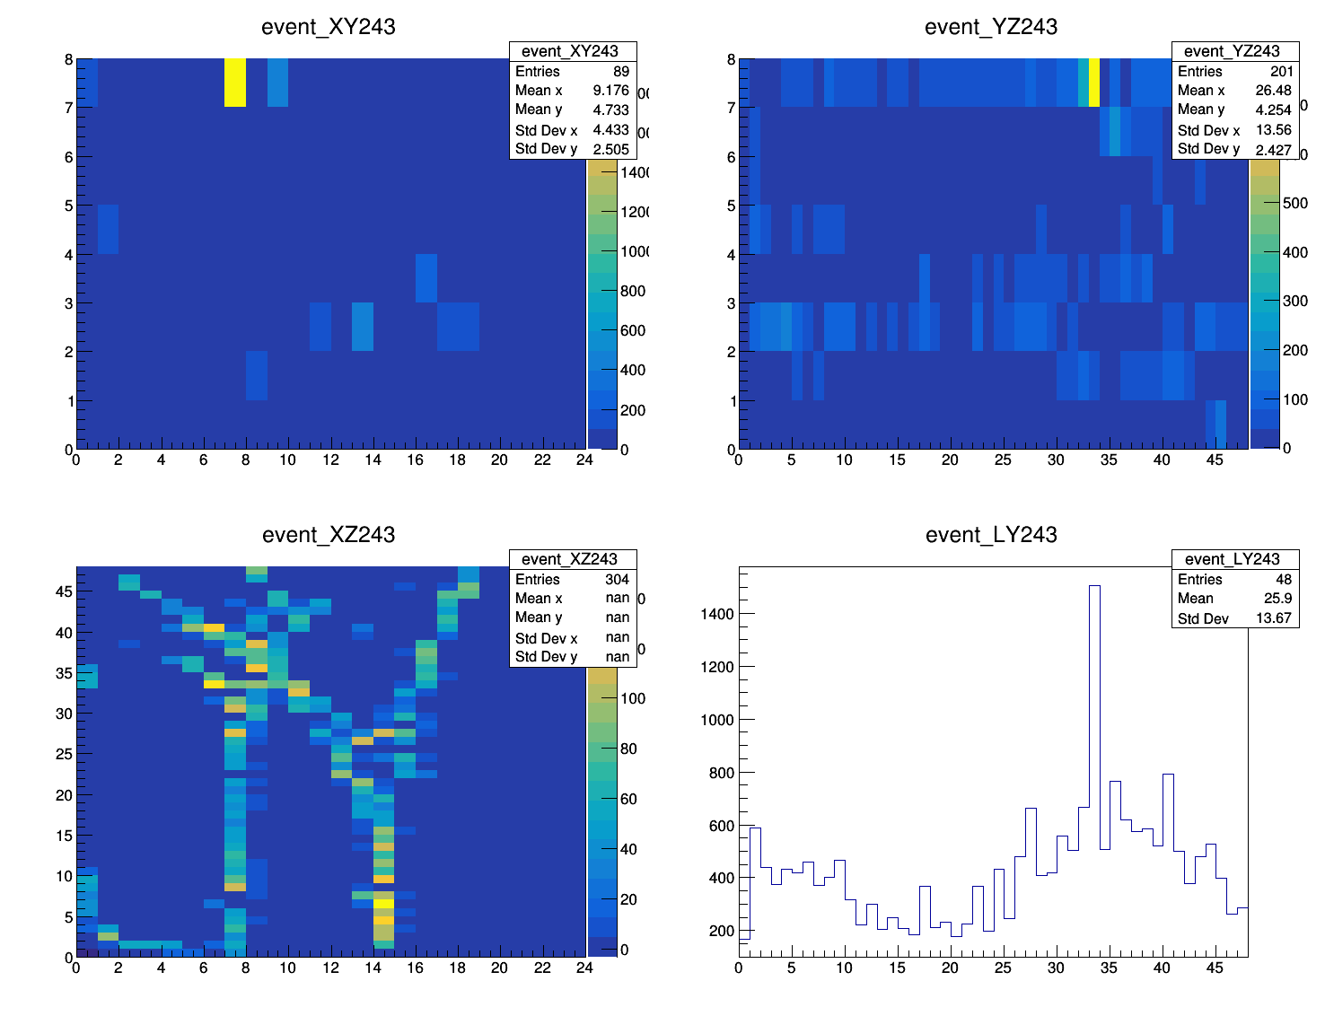
Multiple tracks
Eliminated by previous cut.

Slide 13
First round of applied cuts
Energy deposited at the peak > 250 p.e.
No energy deposited in last layer (Z=47)
Before the peak, max number of allowed layers with ZERO deposited energy is 2.
For the front (XY) view, stdDevX and stdDevY both < 1.0
From 4525 Events → 1908 Events (42% left)

Slide 14
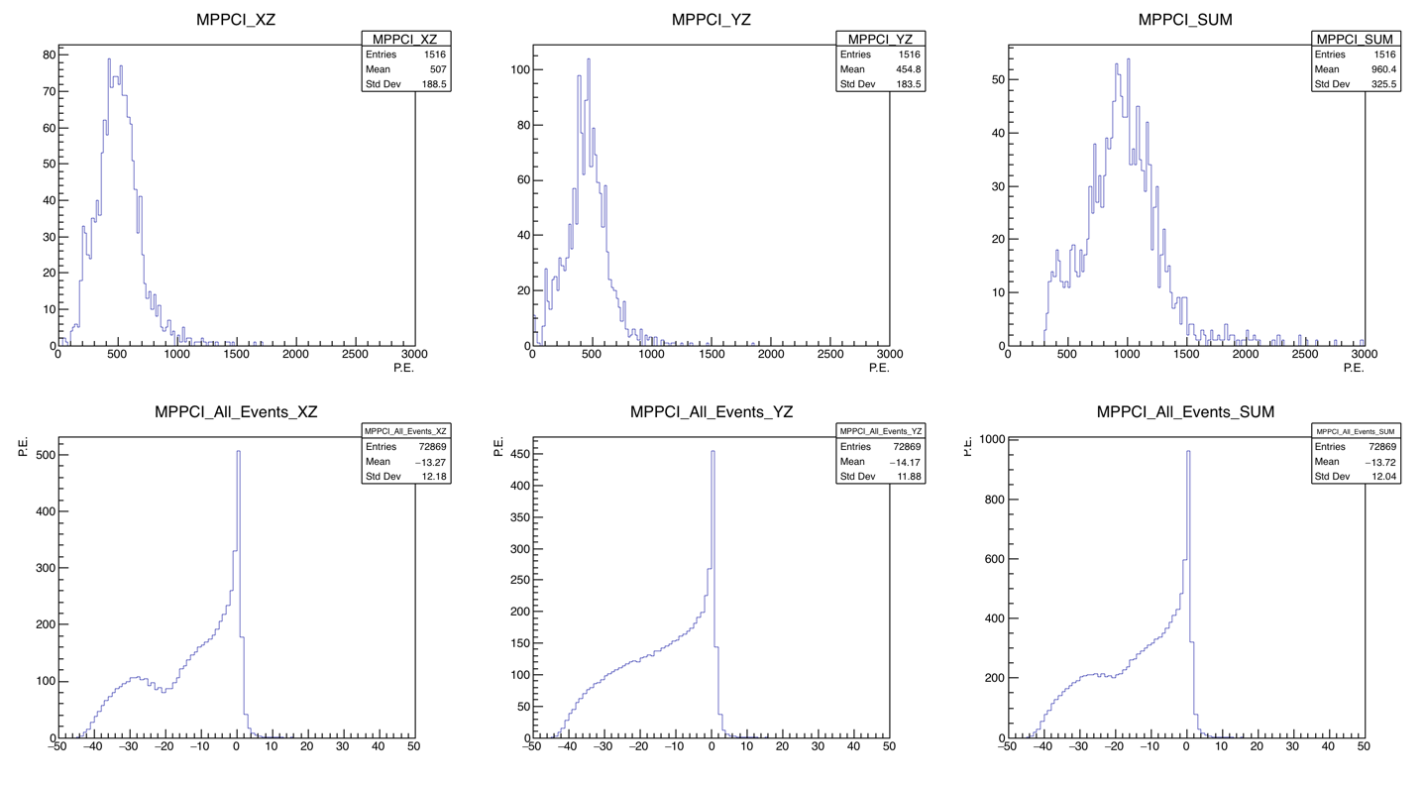

Slide 15
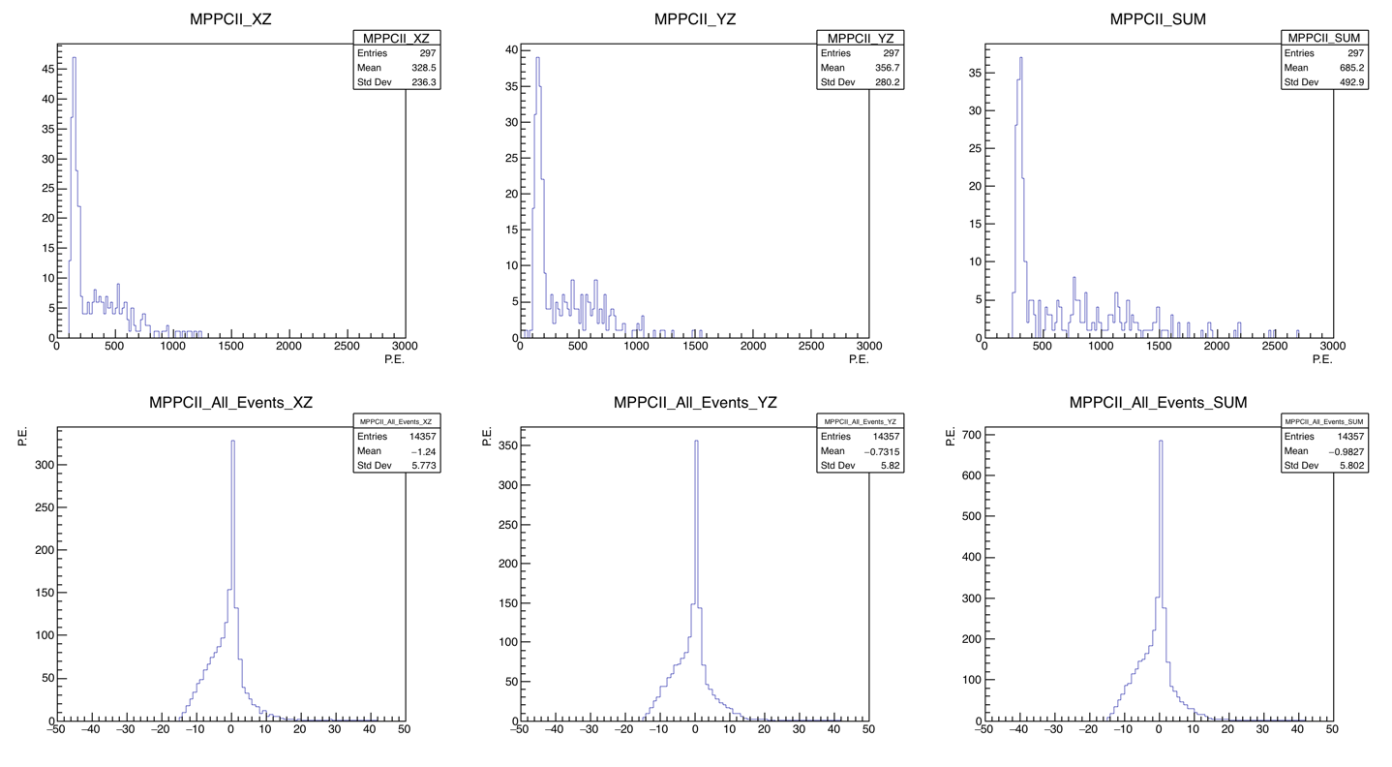

Slide 16
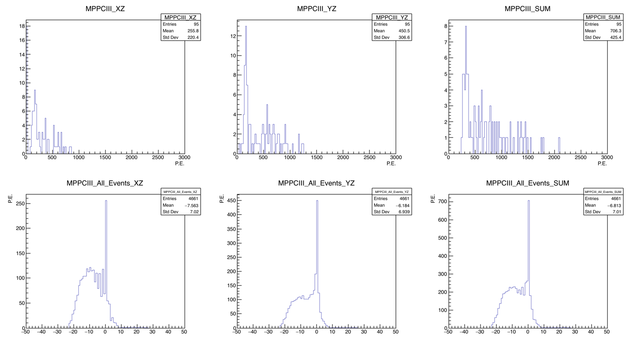

Slide 17
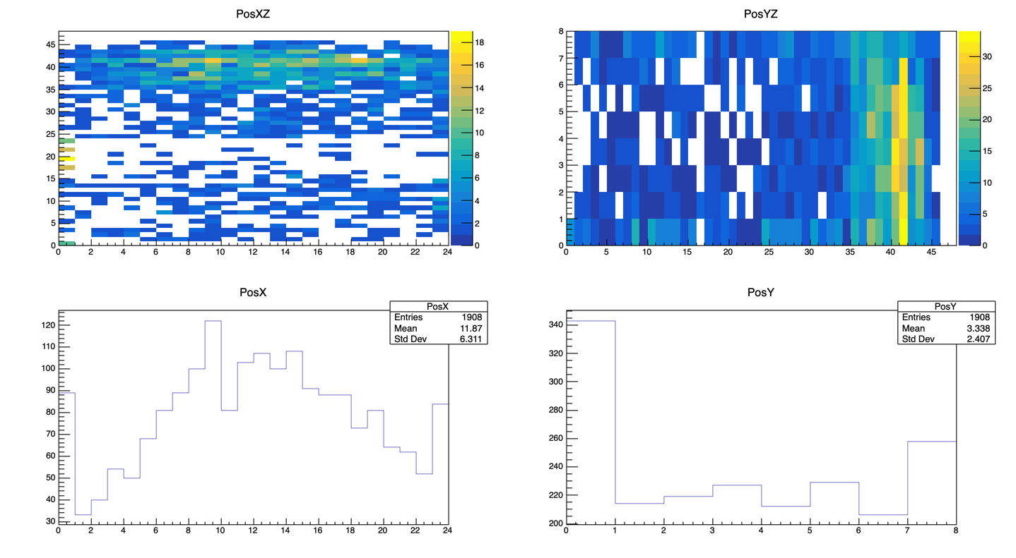
Notes:
Plots of the cell where protons stop (cell with max E) – Before cuts were made to remove events stopping at the very edges of the detector

Slide 18
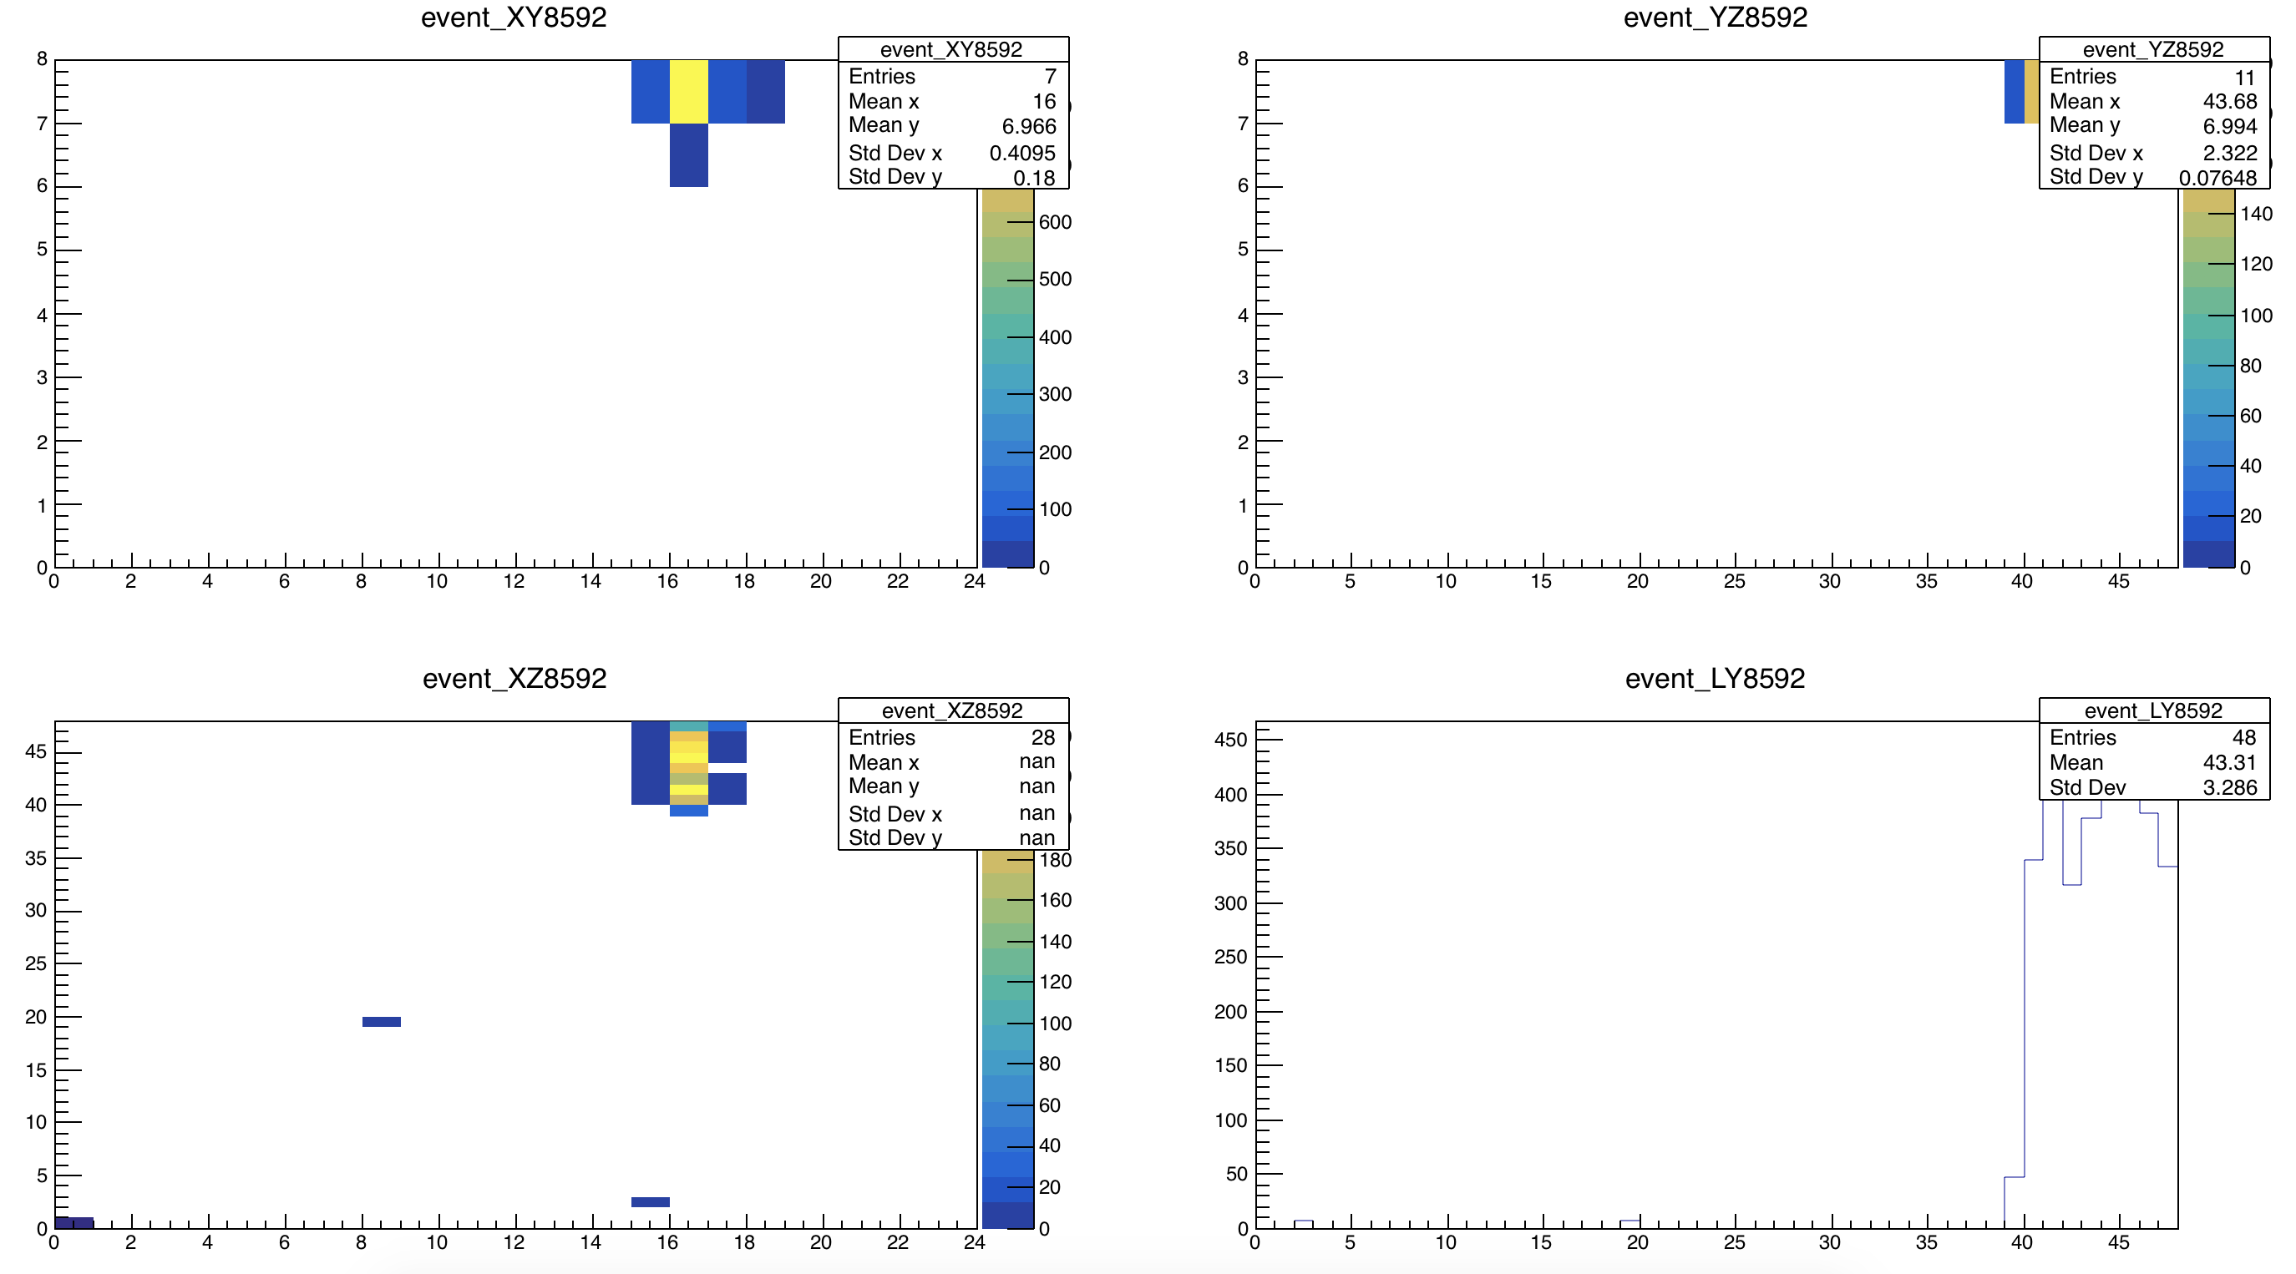
Events at the sides of the detector

Slide 19
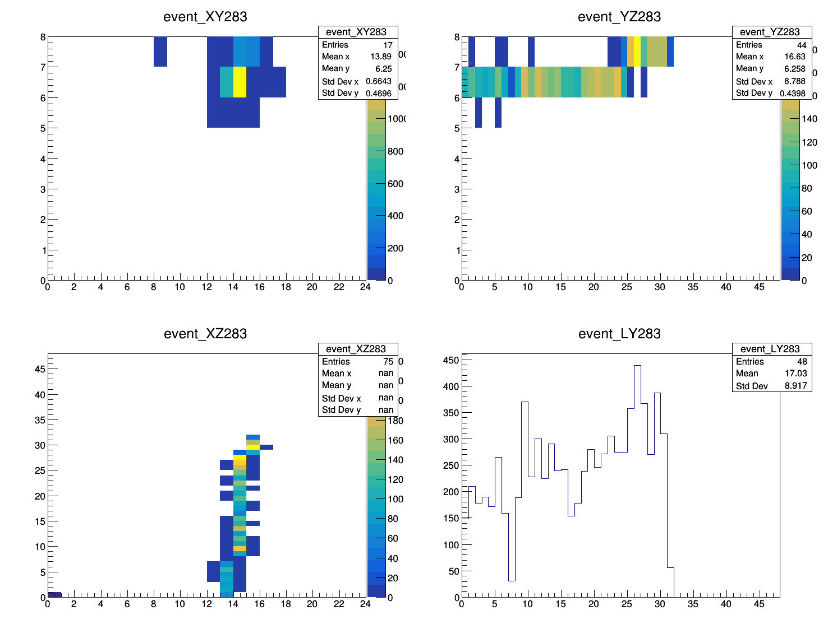
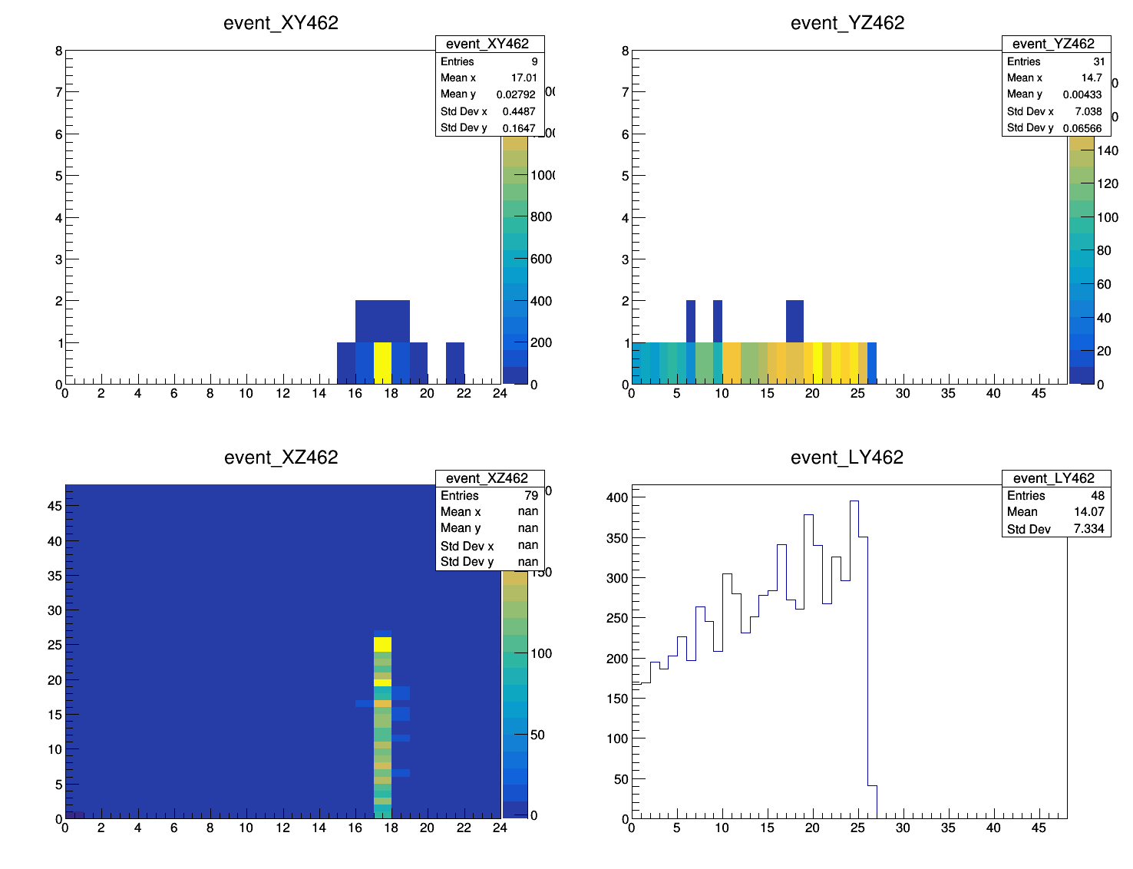
Events that may have escaped the detector
Low energy deposition

Slide 20
Cuts to eliminate events
XatMax != 0 or 23
YatMax != 0 or 7
1908 events → 1199 events (37% lost)

Slide 21
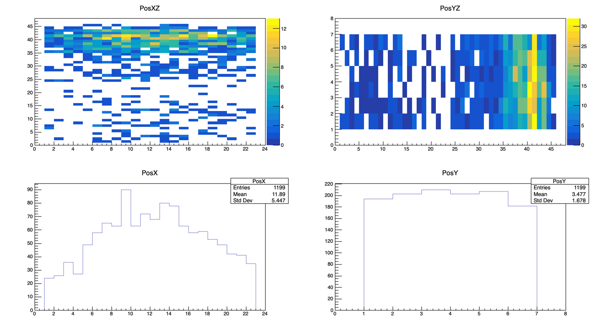

Slide 22
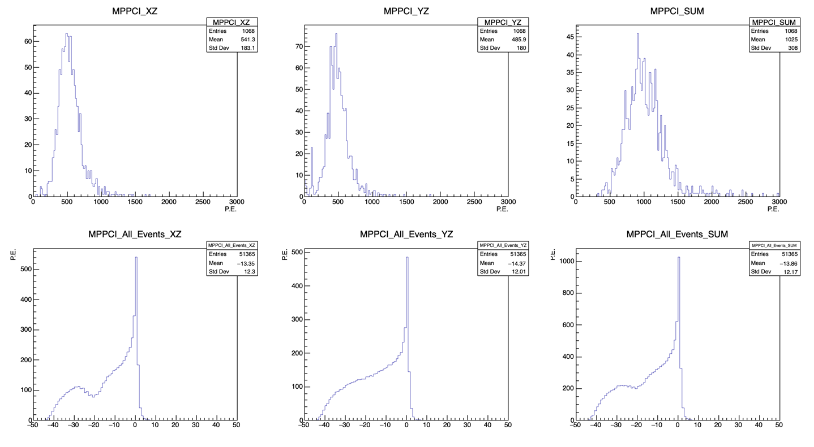

Slide 23
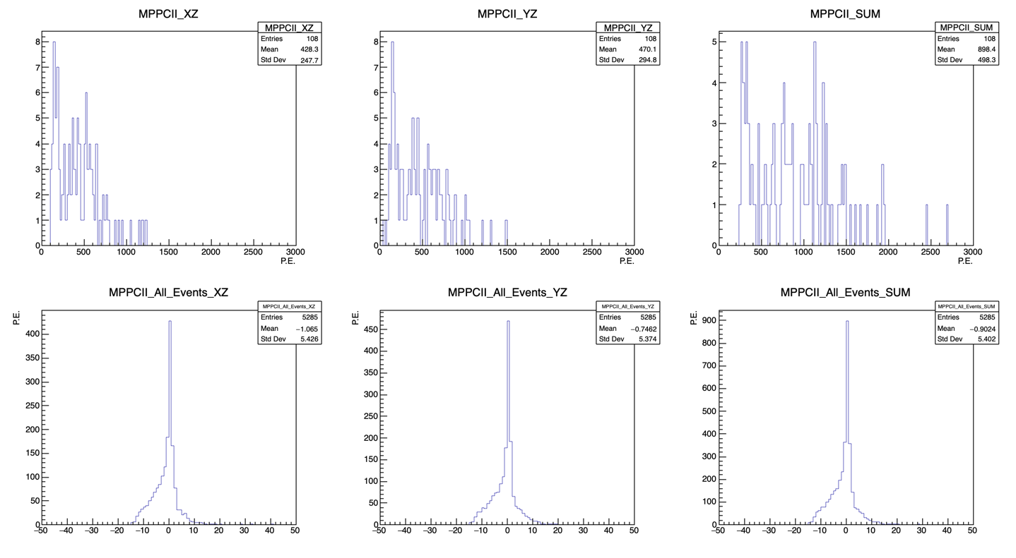

Slide 24
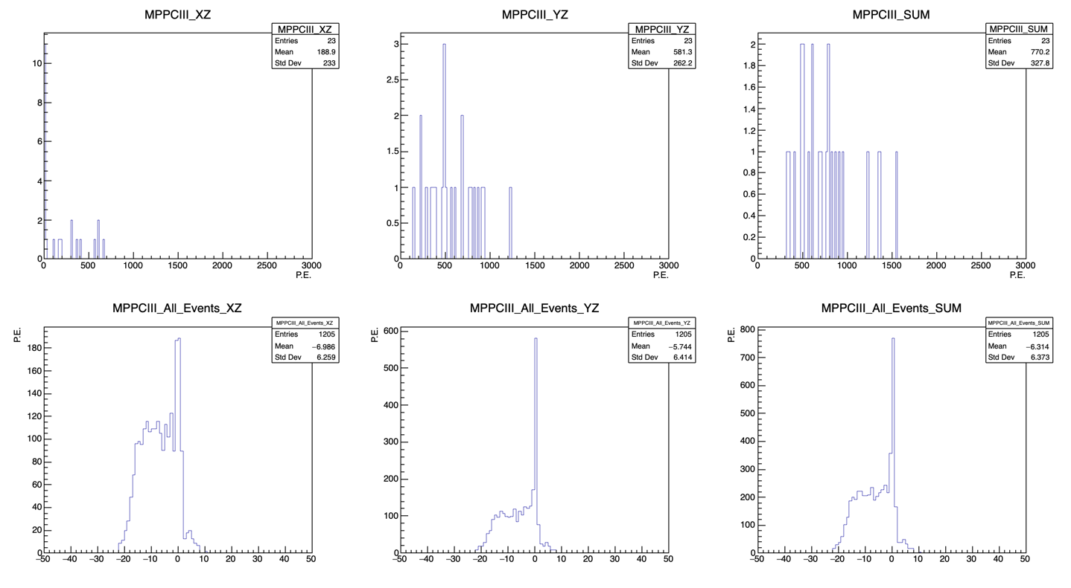

Slide 25
Next
Take a sample with 0.5 GeV/c protons to get more events stopping in the first half of the detector.
  → more statistics for MPPCII and MPPCIII
Do the ADC → p.e conversion outside the Stopping Proton code then test the code with the new branches.

