Slide 1
Design sFGD
Electronics considerations
Rough Sketches
O. Drapier, E. Noah
25 September 2018

Slide 2
Fitting SuperFGD within design envelope
New vertical beams on basket
Beams
Allowed envelope: 2093 mm
MPPC+PCB+Conn.+C+Foam+Plexi
Top View
sFGD total: 2040 mm
Light injection
100 mm
Light tight box
Electronics
Cubes
Space between beams: Can we use it?
Sides should be ok: depending on installation direction: from top or from side
Front/back: only possible if installing from top
2300 mm
192 cubes
192 x 10.25 mm = 1968 mm
(192 x 10 mm = 1920 mm)
ν
192 cubes
192 x 10.25 mm = 1968 mm
(192 x 10 mm = 1920 mm)
100 mm
sFGD electronics: 1800 mm

Slide 3
Fitting SuperFGD within design envelope
New vertical beams on basket
144 FEB to read from left side (top MPPC)
144 FEB to read from right side (top MPPC)
42 FEB to read from left side (front MPPC)
42 FEB to read from right side (front MPPC)
42 FEB to read from left side (left side MPPC)
42 FEB to read from right side (right side MPPC)
Total 456 FEBs (128 ch.)
Total 1824 CITIROCs
Total 58368 MPPCs
Beams
Allowed envelope: 2093 mm
MPPC+PCB+Conn.+C+Foam+Plexi
Top View
sFGD total: 2040 mm
Light injection
100 mm
Light tight box: no cooling
126 mm
Electronics
Cubes
40 mm
Space between beams: Can we use it?
Sides should be ok: depending on installation direction: from top or from side
Front/back: only possible if installing from top
2300 mm
192 cubes
192 x 10.25 mm = 1968 mm
(192 x 10 mm = 1920 mm)
ν
Fiber end with MPPC
Light tight box?
1968 mm
2 mm
6 mm
PCB (black?): MPPC + connectors
40 mm
7 mm
Plastic layer: MPPC/fiber alignment
20 mm
Foam: between carbon
5 mm
Foam: for cube uniformity?
192 cubes
192 x 10.25 mm = 1968 mm
(192 x 10 mm = 1920 mm)
Total: 40 mm
(no margin necessary thanks to foam)
Cubes: what pitch? 10.25 mm?
MPPC pcb (8 x 16)
40 mm
126 mm
Fiber end without MPPC
Light tight box?
100 mm
2 mm
32 mm
5 mm
Plexi for light injection
x12
sFGD electronics: 1800 mm
20 mm
Foam: between carbon
5 mm
Foam: for cube uniformity?
16
Total: 32 mm
(no margin necessary thanks to foam)
8
x24 (or 28 if space between beams)

Slide 4
2.064 m³ requested
2.028 m³ minus one horizontal layer
1.953 m³ minus 3 horizontal layers
New vertical beams on basket
144 FEB to read from left side (top MPPC)
144 FEB to read from right side (top MPPC)
42 FEB to read from left side (front MPPC)
42 FEB to read from right side (front MPPC)
42 FEB to read from left side (left side MPPC)
42 FEB to read from right side (right side MPPC)
Total 456 FEBs (128 ch.)
Total 1824 CITIROCs
Total 58368 MPPCs
Allowed envelope: 2093 mm
Beams
sFGD total: 2040 mm
MPPC+PCB+Conn.+C+Foam+Plexi
Side View
Light injection
sFGD electronics: 1800 mm
Light tight box: no cooling
Electronics
Left side
Cubes
Space between beams: Can we use it?
Sides should be ok: depending on installation direction: from top or from side
Front/back: only possible if installing from top
40 mm
ν
56x10.25 = 574mm
(56x10.0 = 560mm)
Fiber end with MPPC
650 mm requested envelope
2 mm
Light tight box?
6 mm
PCB (black?): MPPC + connectors
40 mm
7 mm
Plastic layer: MPPC/fiber alignment
32 mm
20 mm
Foam: between carbon
5 mm
Foam: for cube uniformity?
Right side
Total: 40 mm
(no margin necessary thanks to foam)
Cubes: what pitch? 10.25 mm?
56 cubes
56 x 10.25 mm = 574 mm
(192 x 10 mm = 560 mm)
Fiber end without MPPC
Light tight box?
2 mm
32 mm
5 mm
Plexi for light injection
20 mm
Foam: between carbon
5 mm
Foam: for cube uniformity?
x7
192 cubes
192 x 10.25 mm = 1968 mm
(192 x 10 mm = 1920 mm)
Total: 32 mm
(no margin necessary thanks to foam)
8
16
x12

Slide 5
2.064 m³ requested
2.028 m³ minus one horizontal layer
1.953 m³ minus 3 horizontal layers
144 FEB to read from left side (top MPPC)
144 FEB to read from right side (top MPPC)
42 FEB to read from left side (front MPPC)
42 FEB to read from right side (front MPPC)
42 FEB to read from left side (left side MPPC)
42 FEB to read from right side (right side MPPC)
Total 456 FEBs (128 ch.)
Total 1824 CITIROCs
Total 58368 MPPCs
Beams
MPPC+PCB+Conn.+C+Foam+Plexi
Front View
Light injection
2300 mm
Light tight box: no cooling
126 mm
126 mm
40 mm
192 x 10.25 = 1968 mm
(192 x 10.0 = 1920 mm)
40 mm
Electronics
Cubes
View from front towards downstream
Space between beams: Can we use it?
Sides should be ok: depending on installation direction: from top or from side
Front/back: only possible if installing from top
40 mm
56 x 10.25 = 574 mm
(56 x 10.0 = 560 mm)
Fiber end with MPPC
650 mm requested envelope
2 mm
Light tight box?
6 mm
PCB (black?): MPPC + connectors
40 mm
7 mm
Plastic layer: MPPC/fiber alignment
32 mm
20 mm
Foam: between carbon
5 mm
Foam: for cube uniformity?
View from back towards upstream
Total: 40 mm
(no margin necessary thanks to foam)
Cubes: what pitch? 10.25 mm?
Fiber end without MPPC
Light tight box?
2 mm
32 mm
5 mm
Plexi for light injection
20 mm
Foam: between carbon
5 mm
Foam: for cube uniformity?
x7
192 cubes
192 x 10.25 mm = 1968 mm
(192 x 10 mm = 1920 mm)
Total: 32 mm
(no margin necessary thanks to foam)
8
16
x12

Slide 6
Envelope for SuperFGD electronics
228 FEB (4 CITIROC/FEB)
Left side
600 mm
228 FEB (4 CITIROC/FEB)
Right side
220 mm
1800 mm

Slide 7
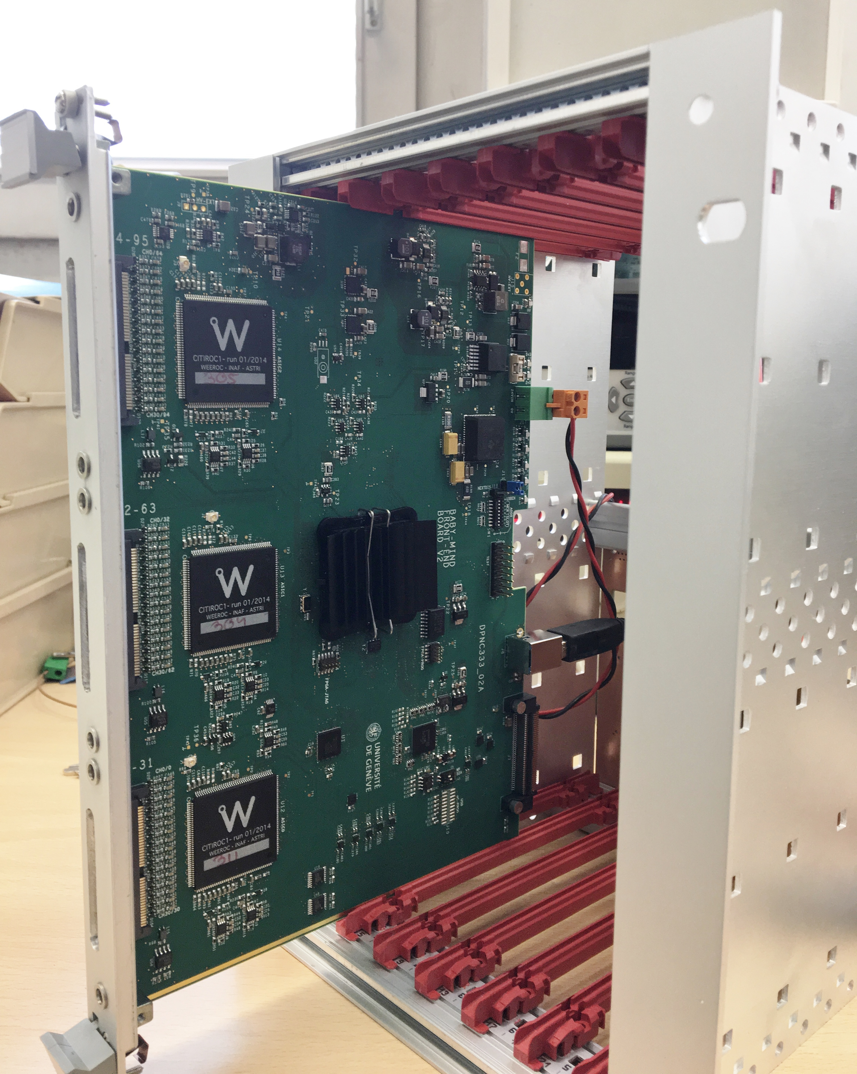
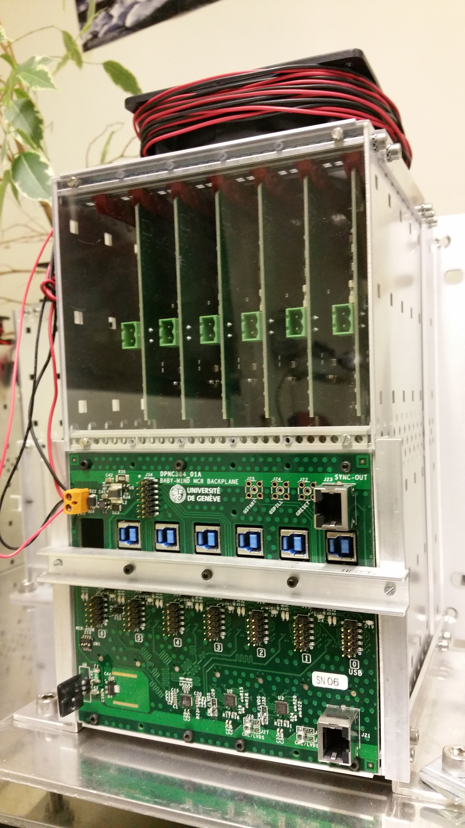
Example implementation: for illustration only!
Connectors to MPPC
Complete re-design of FEB
Backplane
Current FEB:
3 CITIROCs
170 x 235 mm²
SuperFGD FEB:
4 CITIROCs
190 x 190 mm²
235 mm
170 mm
New mechanics with integrated cooling
Complete re-design of backplane
New optical module for DAQ and slow control
Master Clock Board re-design
New Clock and sync. fanouts
New calibration system
New power distribution system
x15 FEBs
600 mm
x15 FEBs
x1 or 2 optical modules per column
x8 columns
cooling
220 mm
1800 mm
228 FEB (4 CITIROC/FEB)

Slide 8
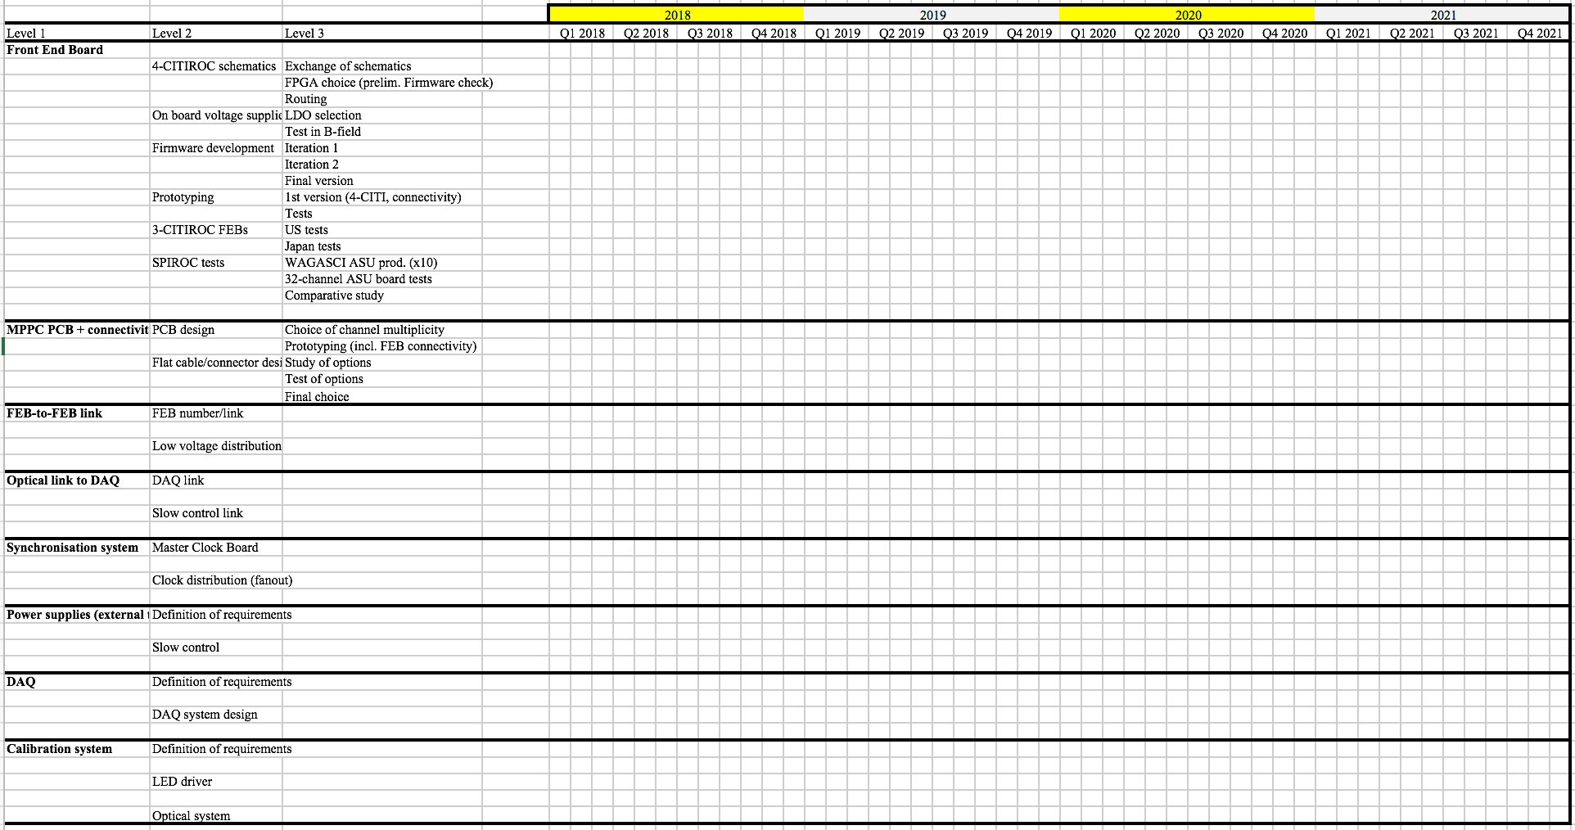
Planning: not yet started!
Will need to know as soon as possible resources...

Slide 9
Summary
Some numbers:
144 FEB to read from left side (top MPPC)
144 FEB to read from right side (top MPPC)
42 FEB to read from left side (front MPPC)
42 FEB to read from right side (front MPPC)
42 FEB to read from left side (left side MPPC)
42 FEB to read from right side (right side MPPC)
Total 456 FEBs (128 ch.)
Total 1824 CITIROCs
Total 58368 MPPCs
Total 2064384 cubes
Total plastic volume: 2.064 m³ (based on 10 mm cube)
Overall design envelope still being defined
  Need to have a first iteration on number of channels
  Exercise done from electronics perspective, now checking with mechanics
Project plan for SuperFGD electronics being defined
  Need to know resources allocated by institutes: this would help a lot…
A lot of information is being extracted from beam tests data
Several challenges to be addressed (e.g. compactness of FEB, connectivity, cooling, power supply distribution, B-field immunity etc…)
MPPC PCB
8x16 = 128 Ch pcb
Matches well multiples of width/depth/height cubes
Could be further segmented based on design constraints e.g. optical/electrical connectivity, light tightness…
x8
x16
56 cubes
192 cubes
Comment for MPPC order with Hamamatsu:
V_op within 150 mV for all MPPCs within one PCB,
V_op within 2-3 V for all MPPCs across whole sFGD,
MPPC reel which is multiple of 128 (e.g. 896 or 1024), can be adapted to 8x8 pcb.
192 cubes
Cube pitch 10.25 mm
used in rough calculations to account for cube-to-cube variations, thermal dilatation etc…
ν

Slide 10
Back-up: reference sketches used

Slide 11
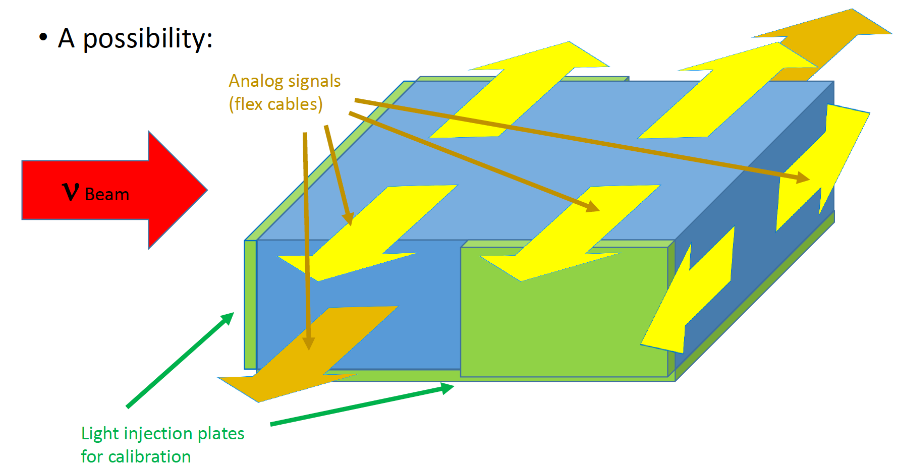
ν beam

Slide 12
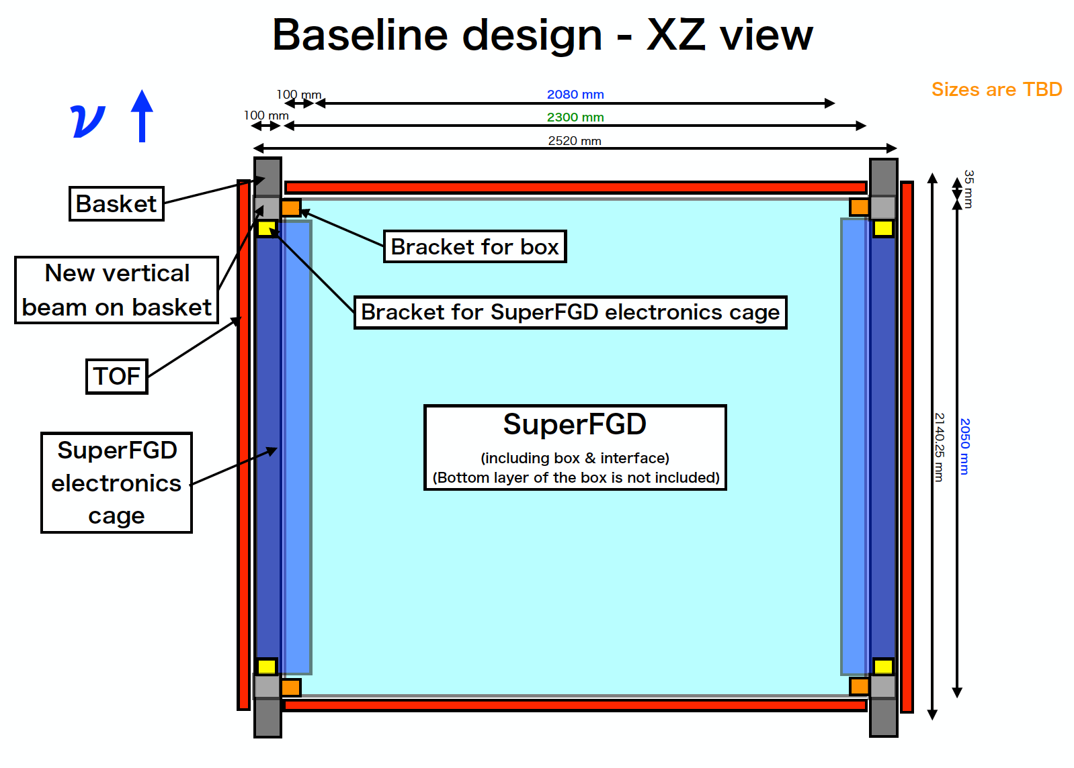
Matsubara-san report at sFGD meeting 18/09/2018
Top View

Slide 13
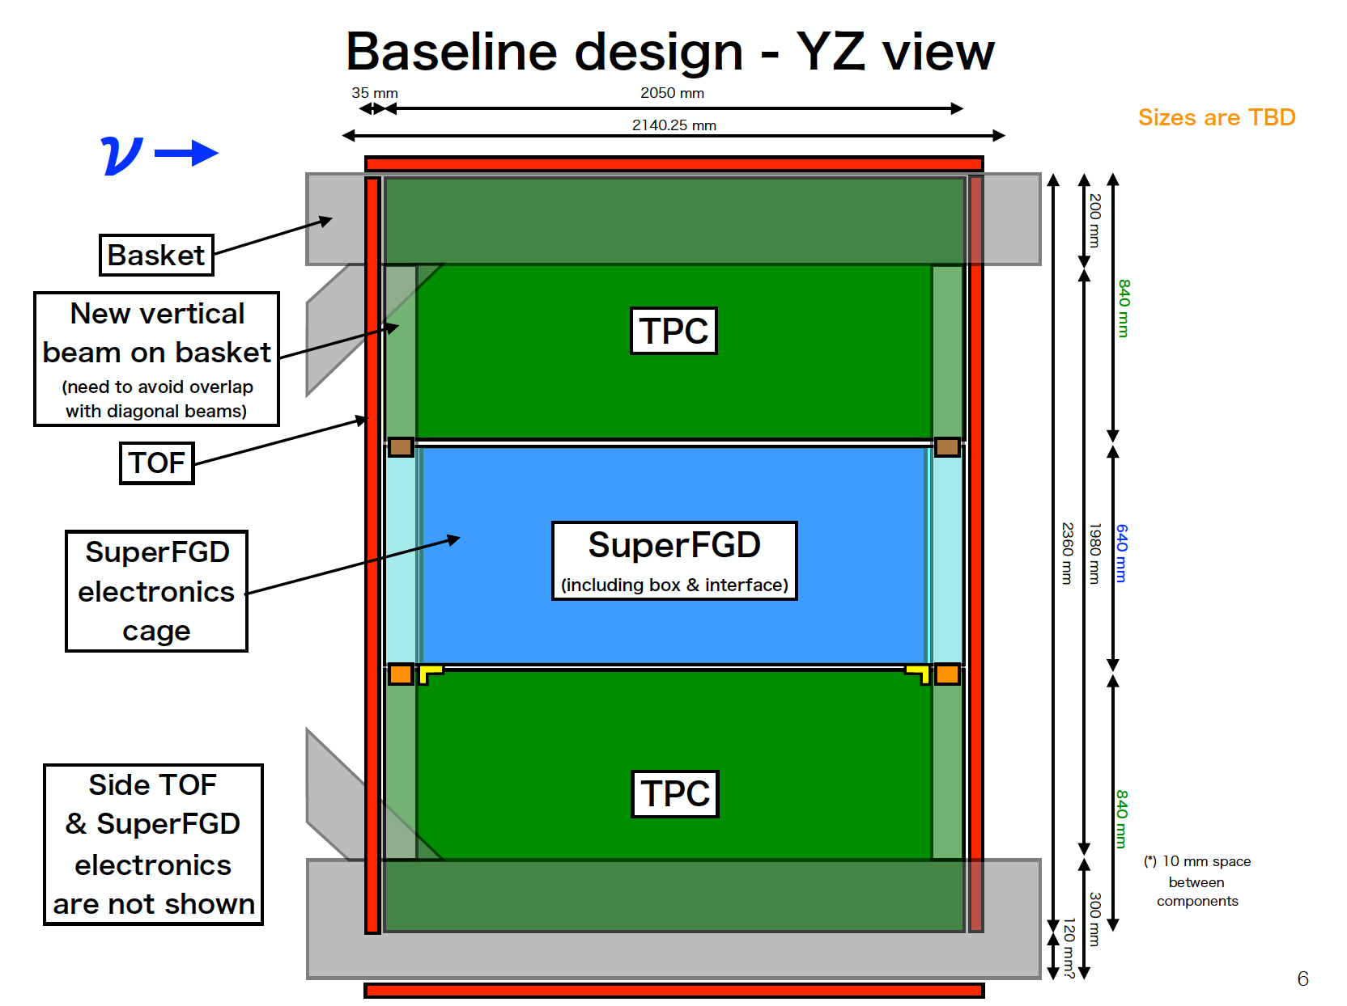
Matsubara-san report at sFGD meeting 18/09/2018
Side View

Slide 14
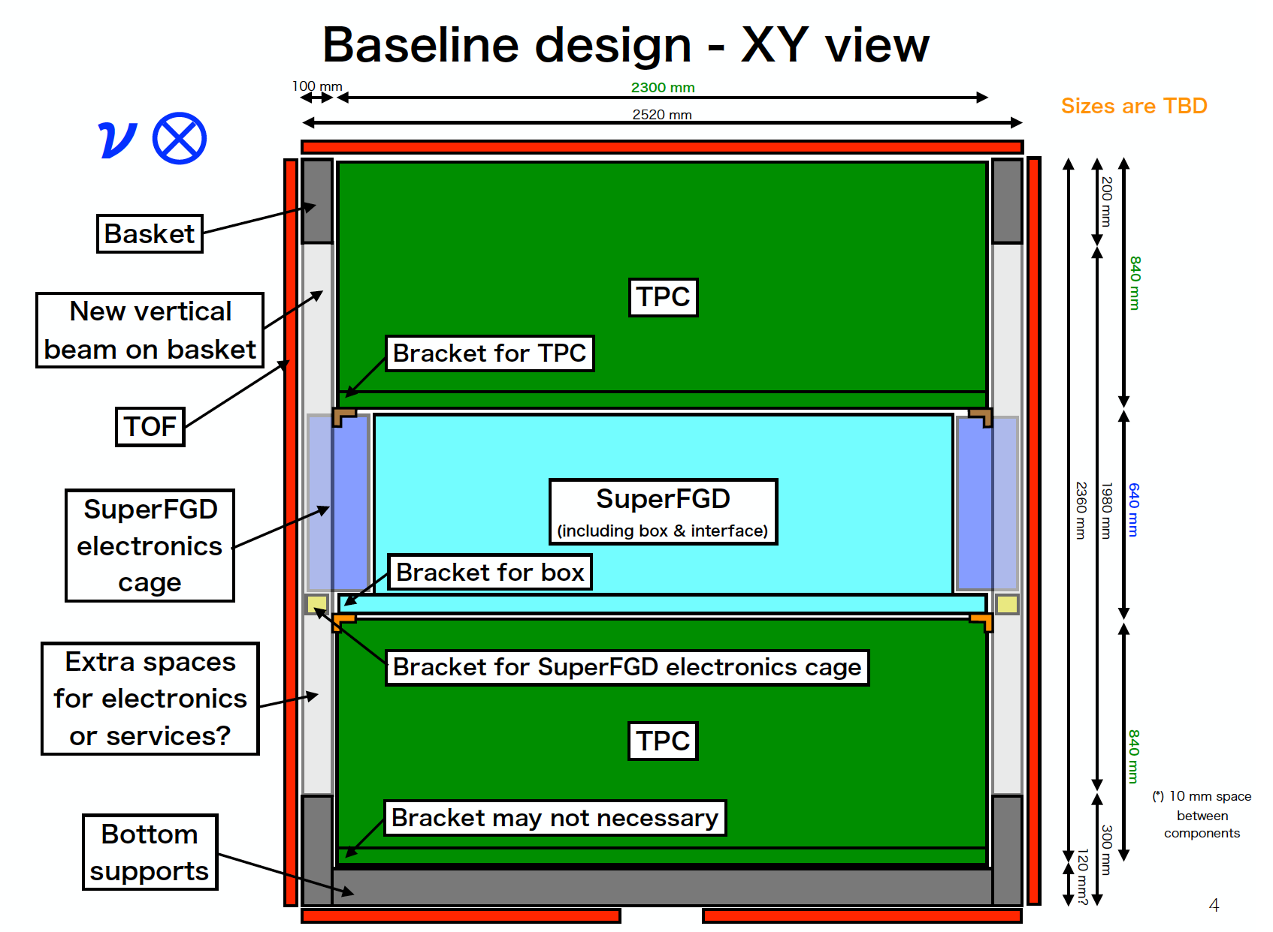
Matsubara-san report at sFGD meeting 18/09/2018
Front View
650 mm safer ?

Slide 15
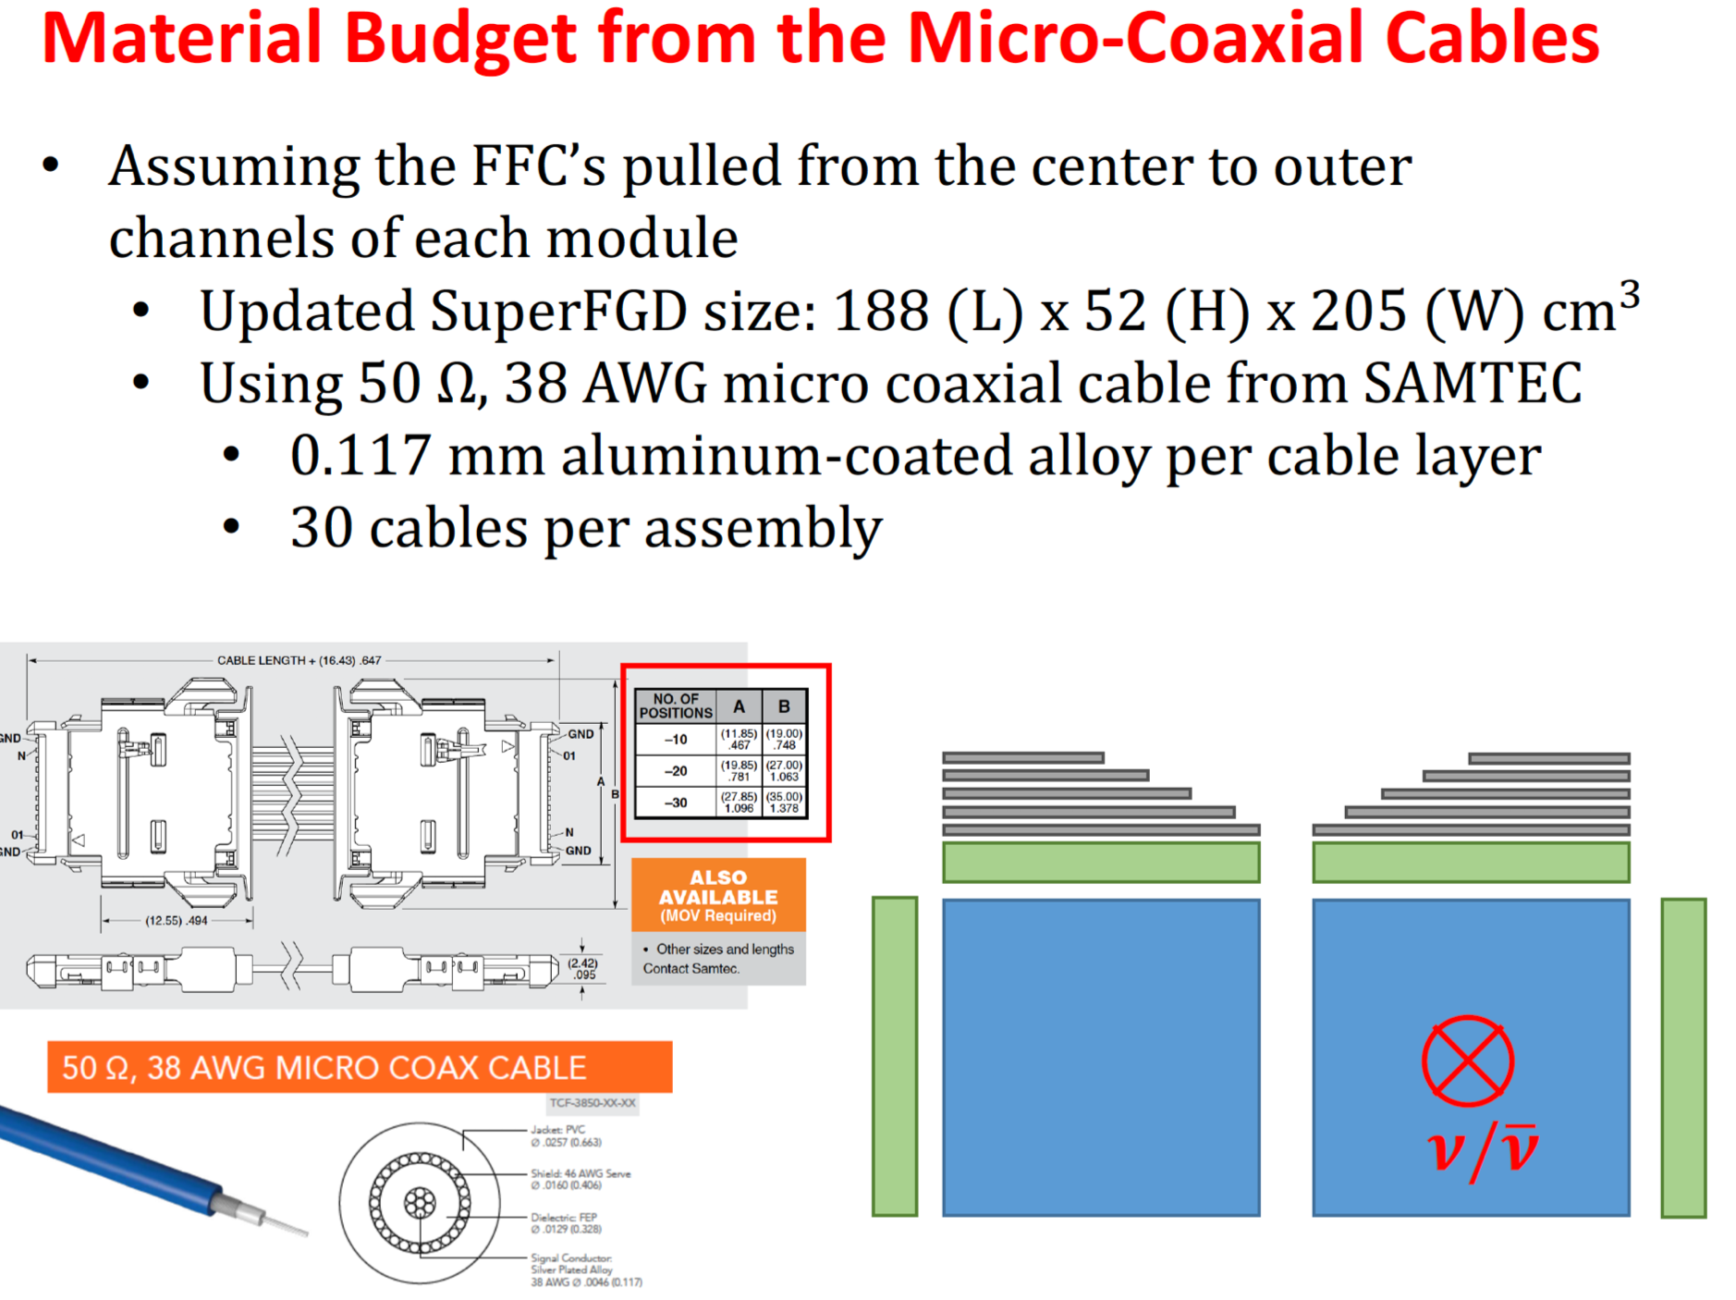
Iwamoto-san report at ND280 meeting 19/09/2018
Needs to change

Slide 16
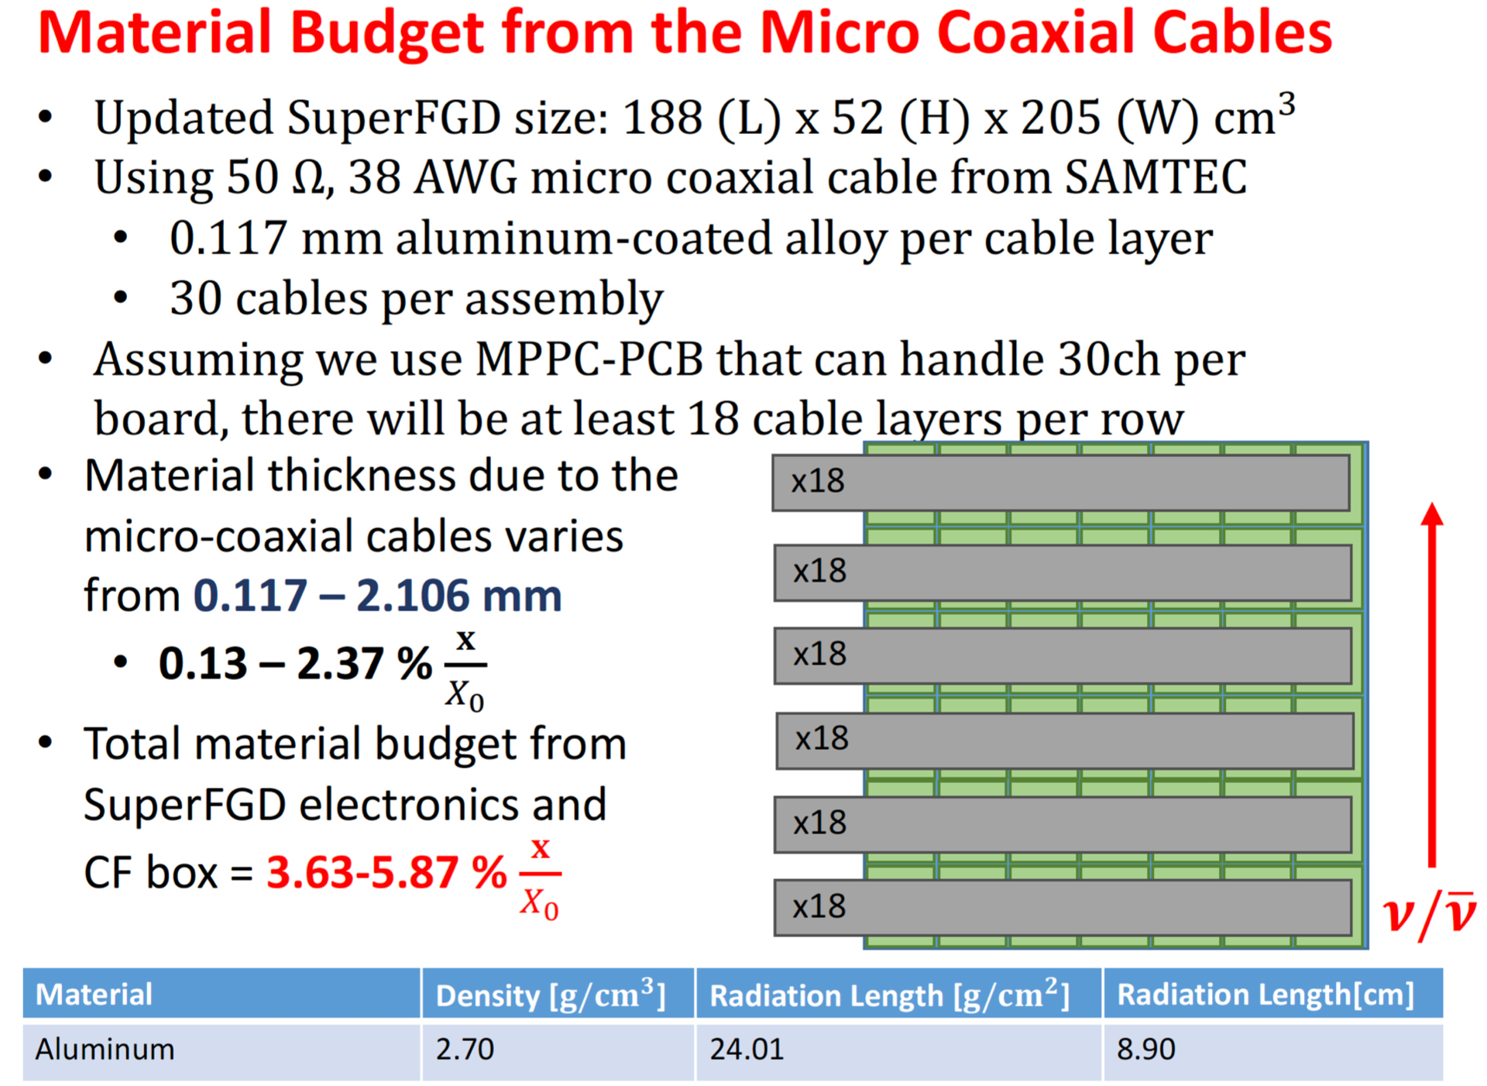
Iwamoto-san report at ND280 meeting 19/09/2018

Slide 17
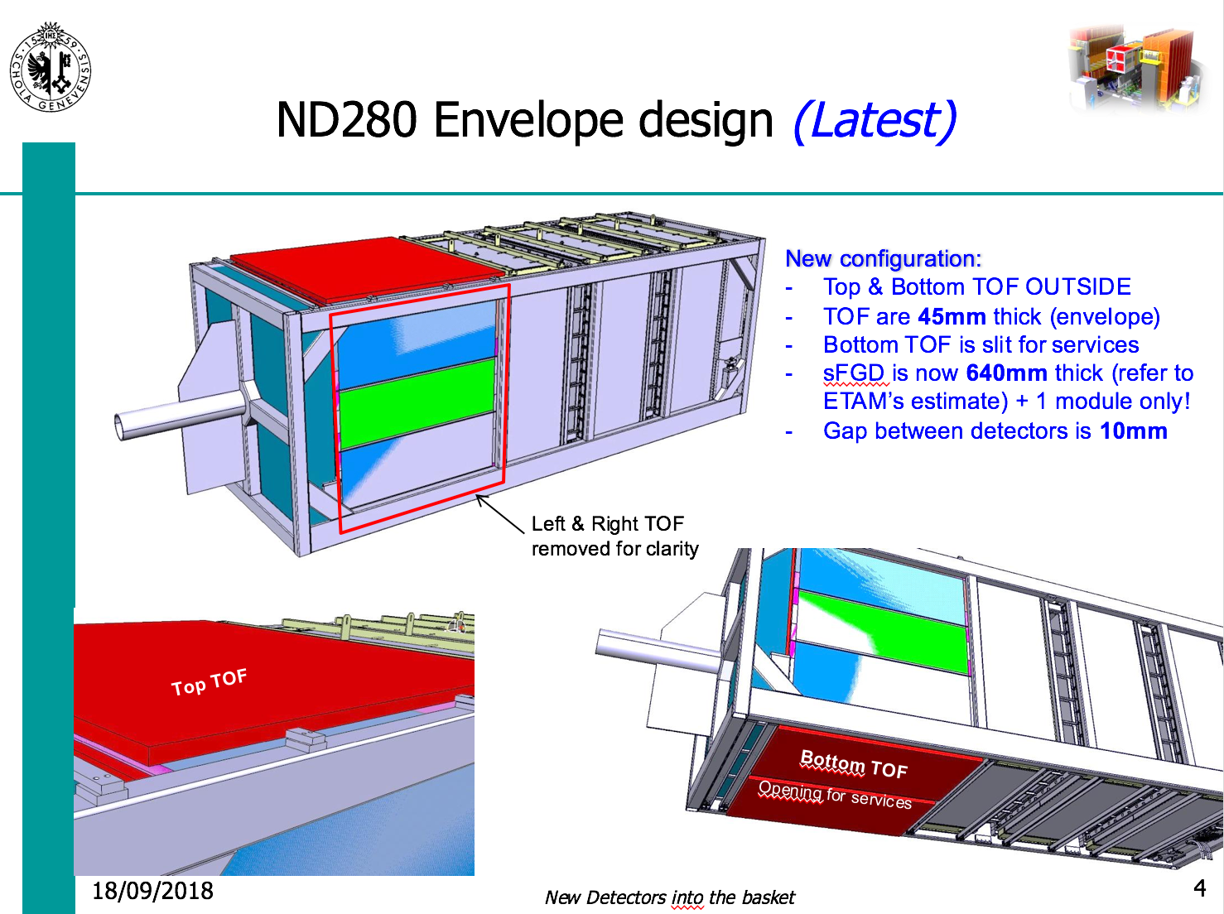
Cadoux report at sFGD mechanics meeting 18/09/2018
650 mm would be better?

Slide 18
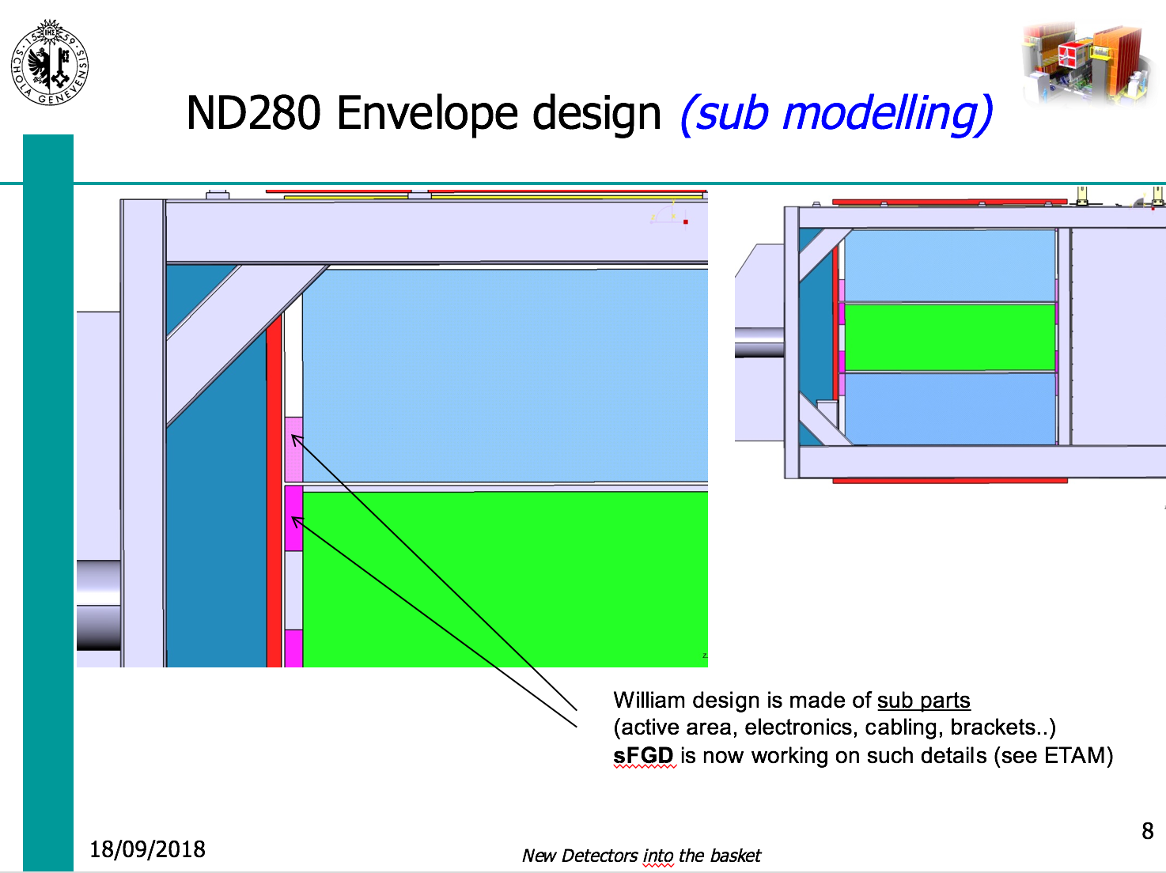
Cadoux report at sFGD mechanics meeting 18/09/2018
Cadoux proposal: need to re-define as global sub-detector envelopes

Slide 19
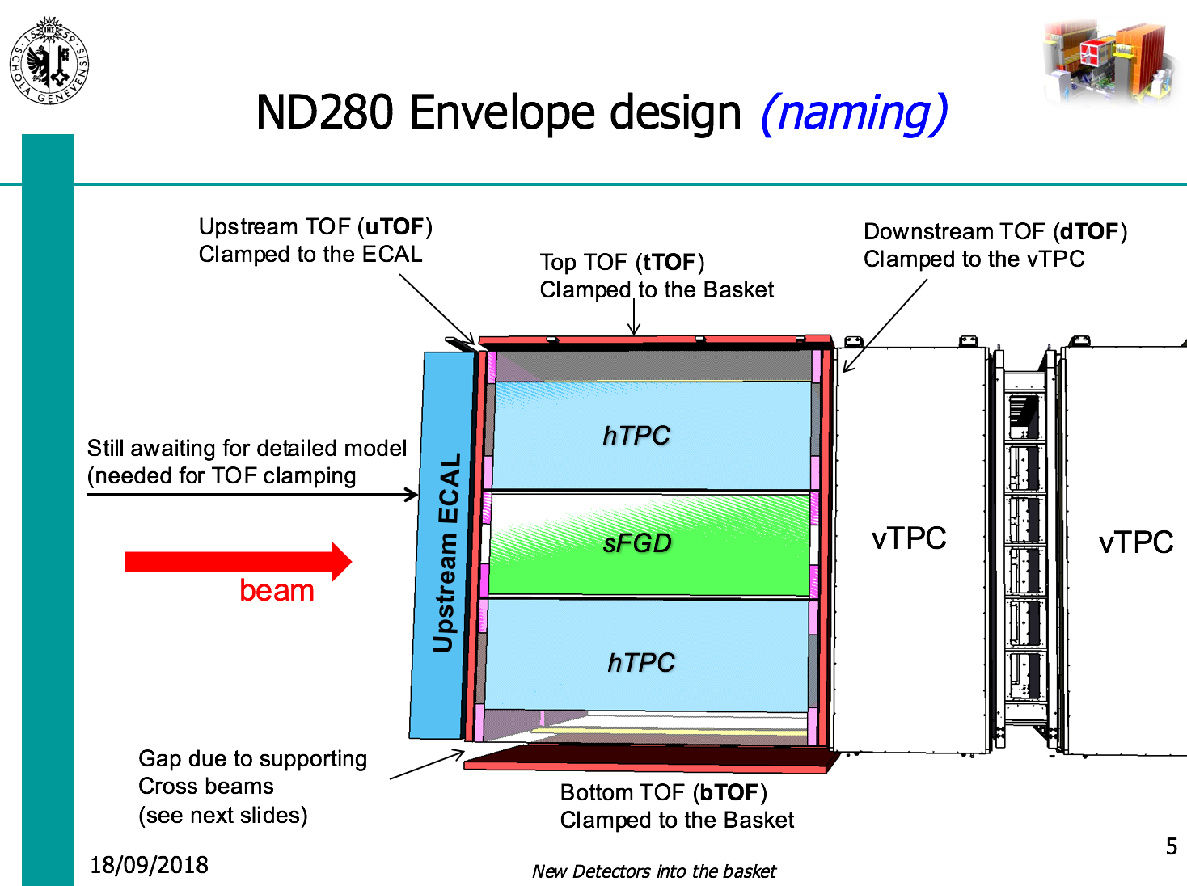
Cadoux report at sFGD mechanics meeting 18/09/2018

Slide 20
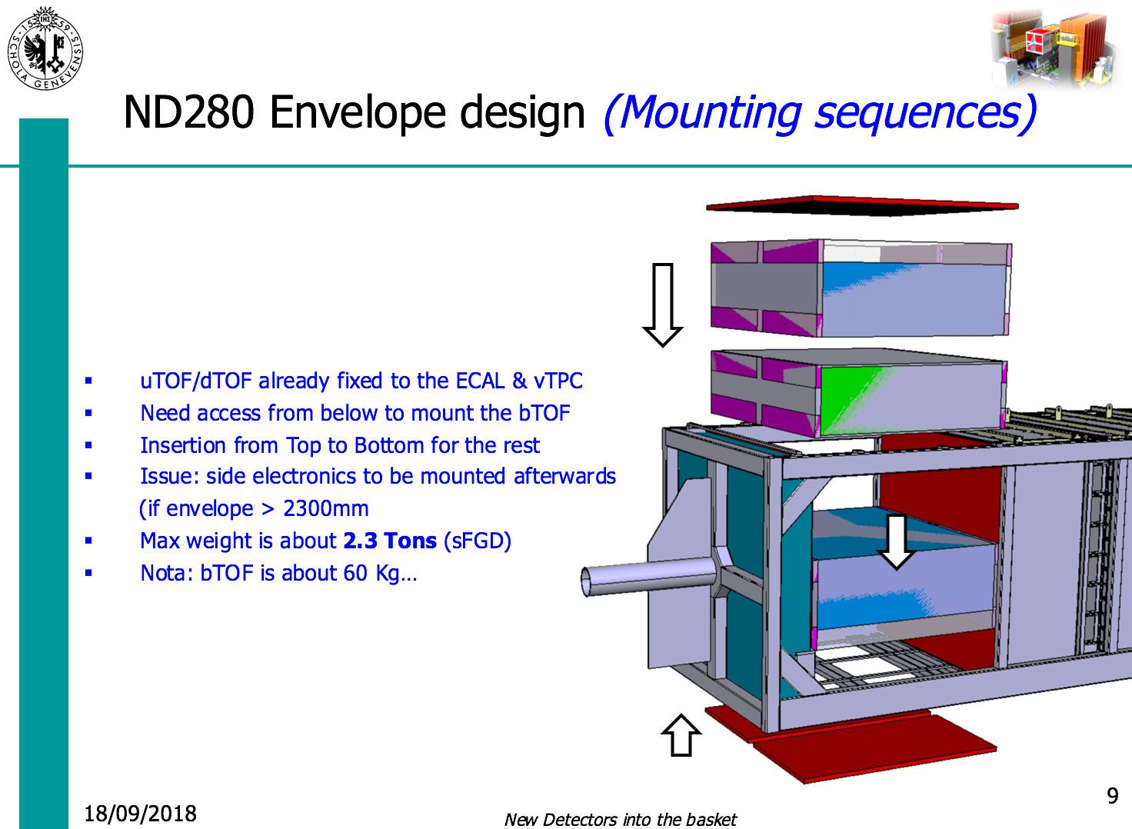
Cadoux report at sFGD mechanics meeting 18/09/2018

Slide 21
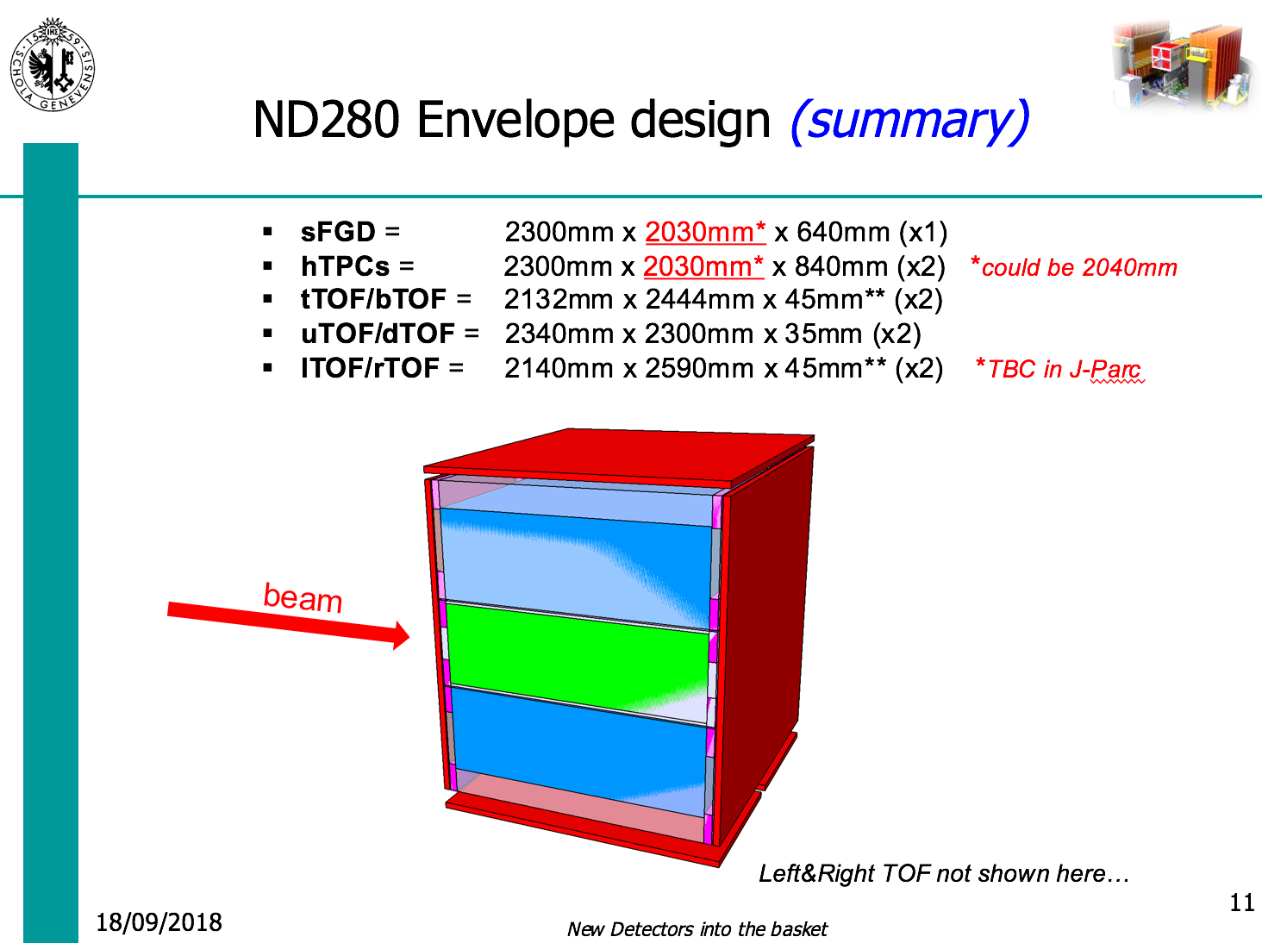
Cadoux report at sFGD mechanics meeting 18/09/2018
2040 mm?
& 650 mm?

Slide 22
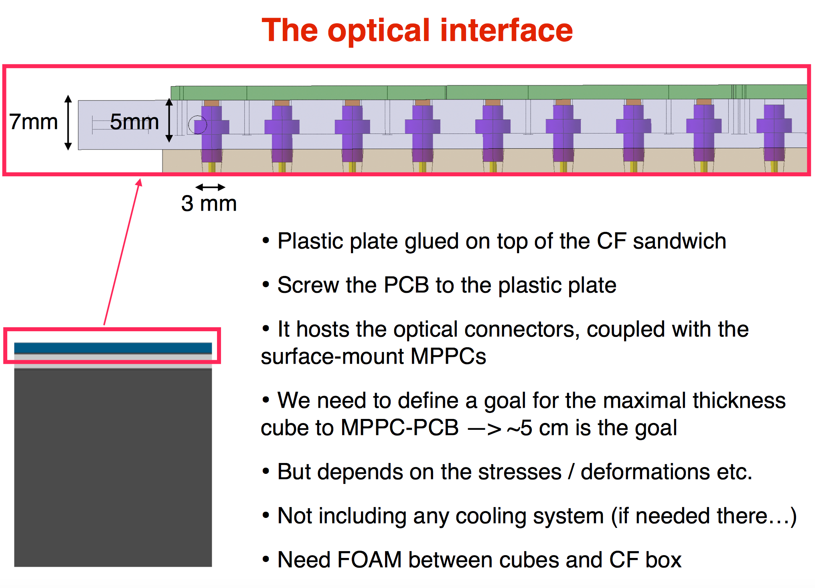
From 25th July 2018 box dimensions

