Slide 1
Weekly Update
2018/09/24
Shuaiyan

Slide 2
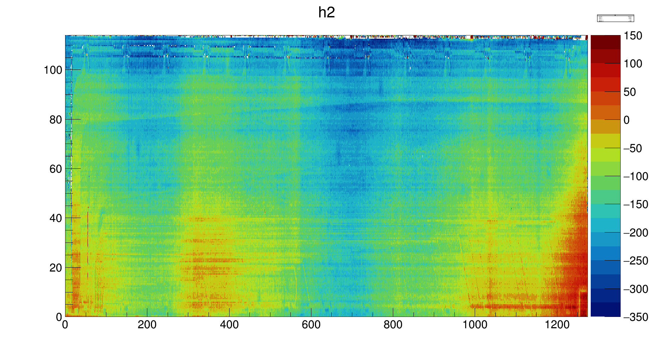
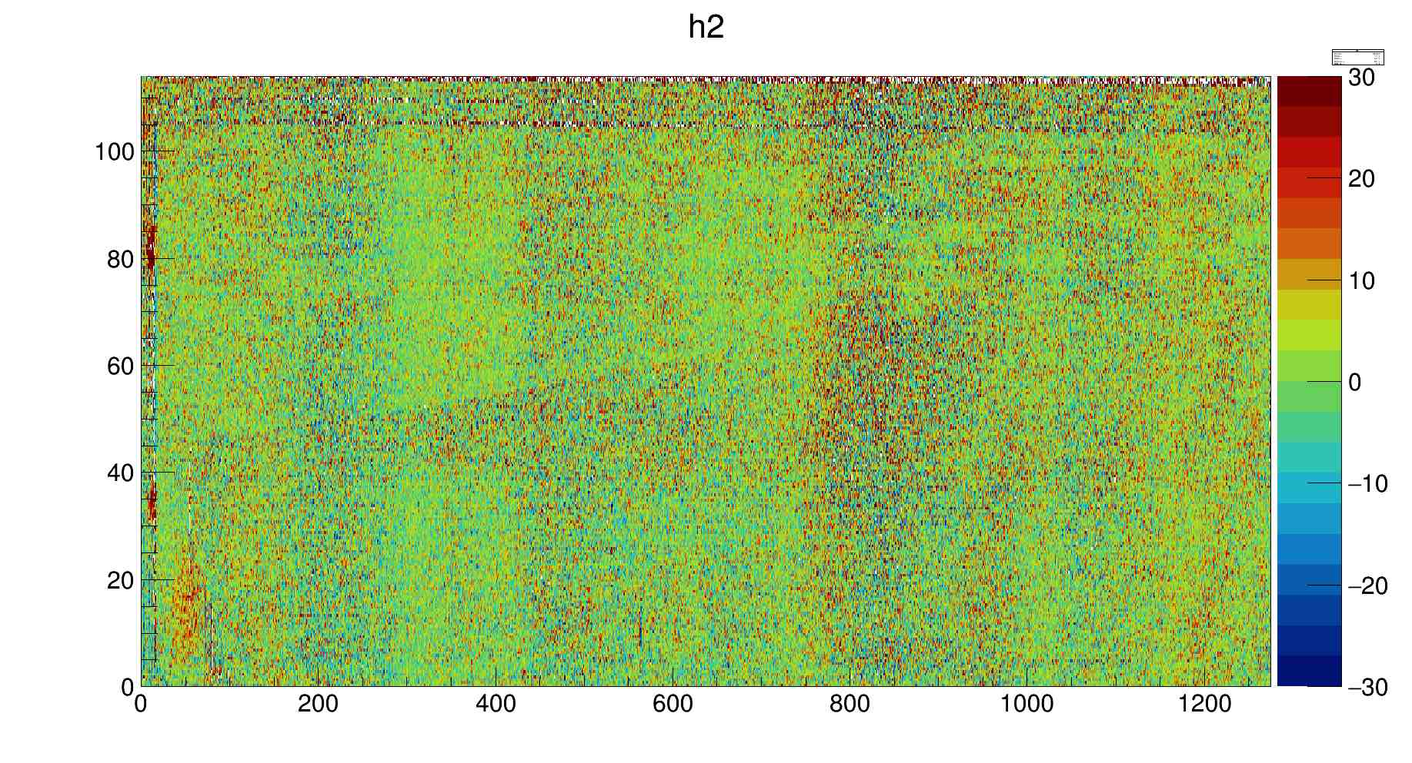
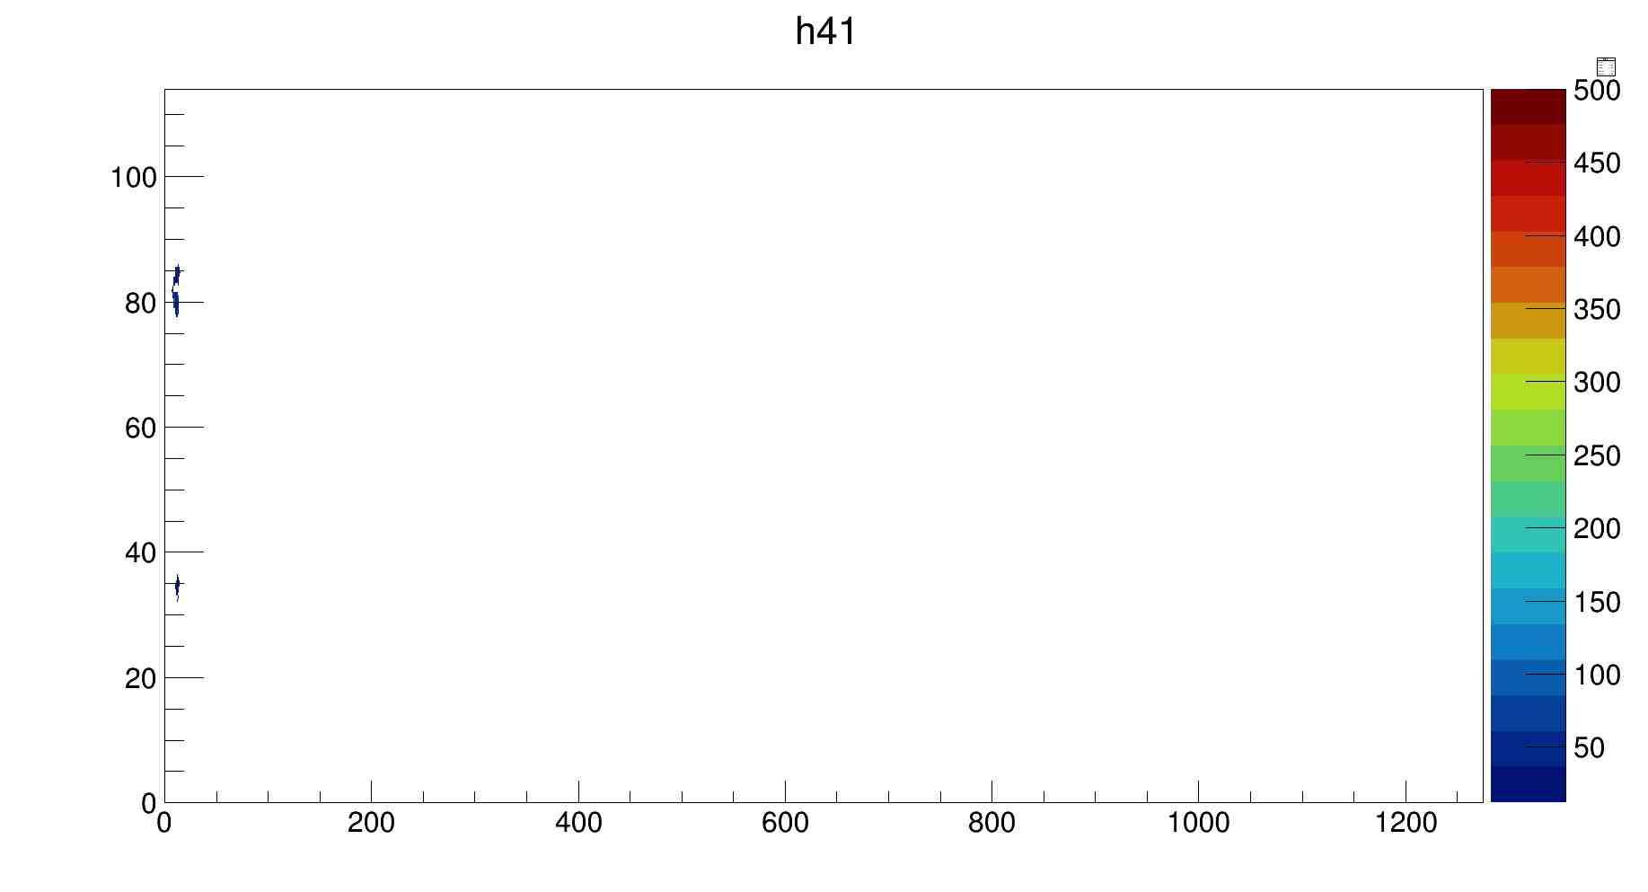
Stave #8 Pressure Test L Side
0 Psi
2
5-0 Psi
Residue RMS :11µm
1
Defect finder
Size 1: 19 pixels
Max Height 53 µm
Size 2: 62 pixels
Max H: 89 µm
2
1

Slide 3
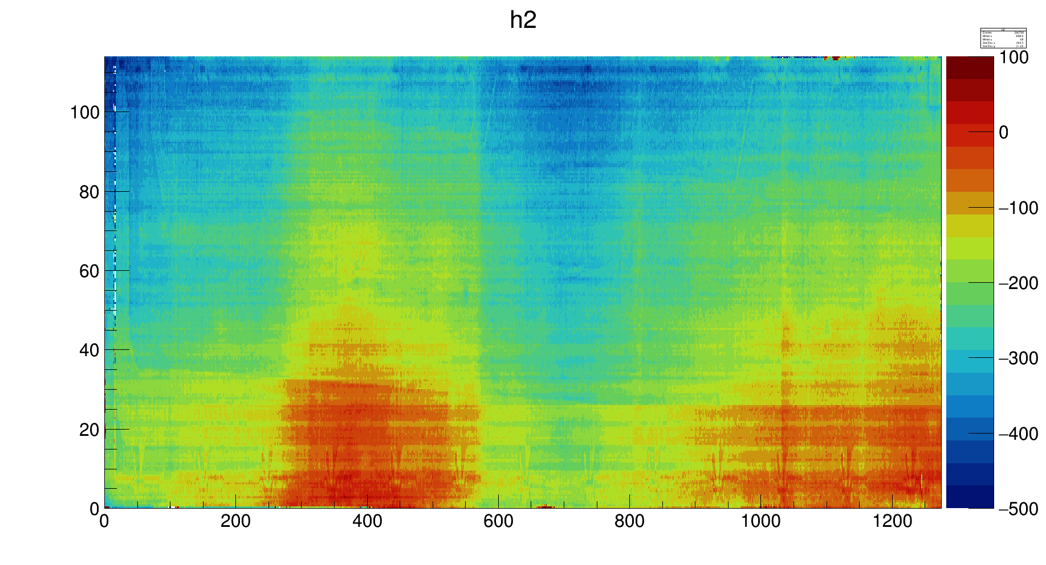
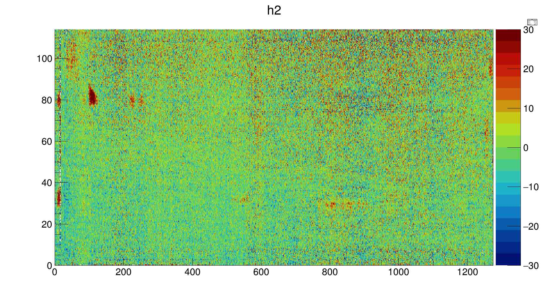
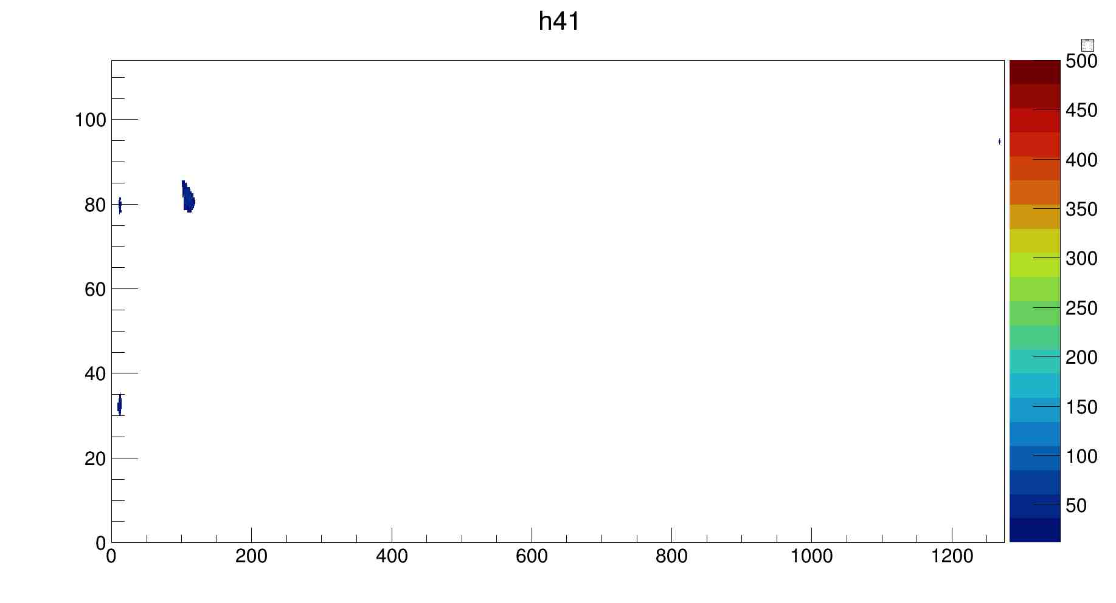
Stave #8 Pressure Test J Side
0 Psi
4
5-0 Psi
Residue RMS: 9µm
3
1
Possible
Defect finder
Size 1: 20 pixels
Max Height 39 µm
Size 2: 38 pixels
Max H: 40 µm
Size 3: 163 pixels
Max Height 67 µm
Size 4: 3 pixels
Max H: 40 µm
2
4
1
3
2

Slide 4
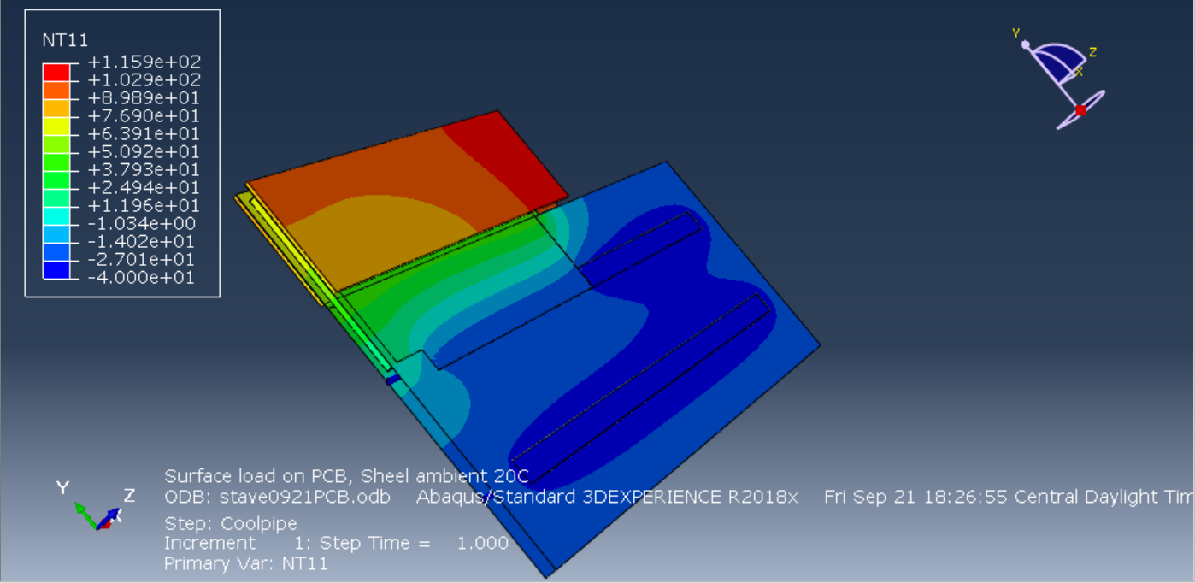
Mini Stave Thermal FEA
Mini stave temperature distribution with heat load at PCB, pipe fluid -40C.

