Slide 1
SPS reference measurements
– status update
K. Li, F. Velotti

Slide 2
Goals
During LS2 there will be ~20 months shutdown for the SPS
Many components and also beam parameters will change significantly
Re-commissioning will be very challenging
  To provide some guidance and to have some means of comparison we need a good snapshot of the situation before LS2
  For this we are collecting a list of reference measurements to be done in every machine – also in the SPS
Presentation of the current list along with the status of the individual measurements – organized according to beam type

Slide 3
Goals
During LS2 there will be ~20 months shutdown for the SPS
Many components and also beam parameters will change significantly
Re-commissioning will be very challenging
  To provide some guidance and to have some means of comparison we need a good snapshot of the situation before LS2
  For this we are collecting a list of reference measurements to be done in every machine – also in the SPS
Presentation of the current list along with the status of the individual measurements – organized according to beam type
Status report:
Where are we?
Are we progressing well?
Are there any critical items that need follow-up/support?

Slide 4
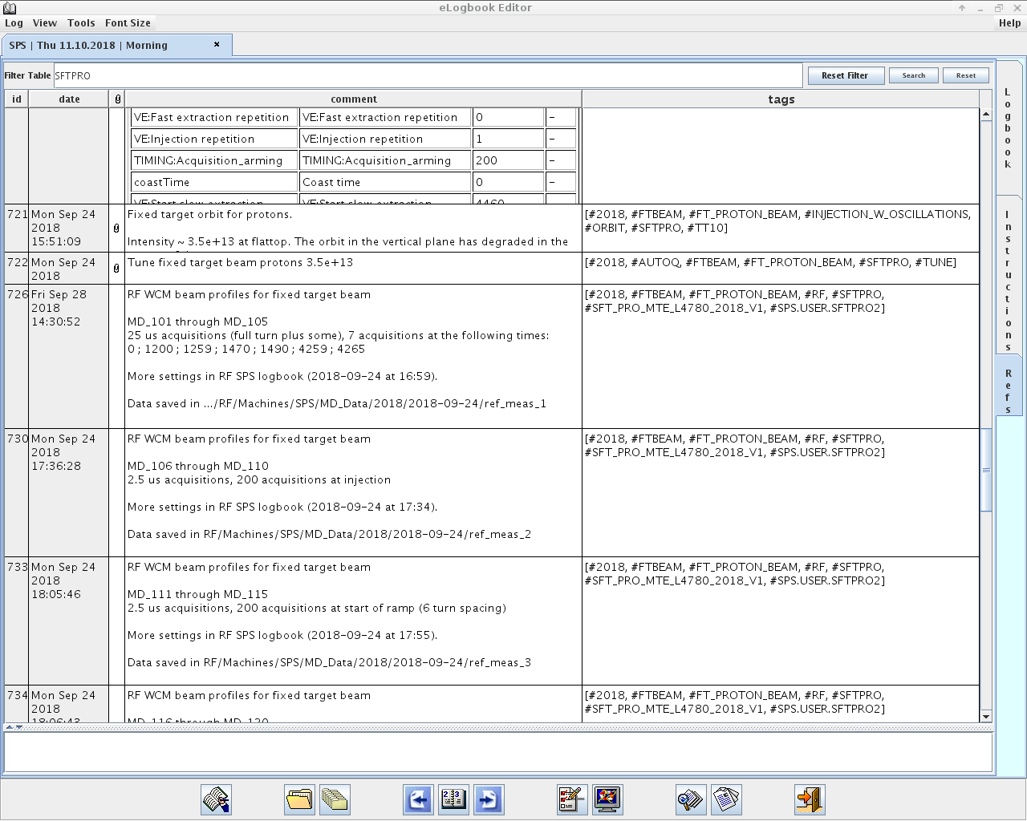
New reference measurement tool
Profited a lot from new tool available from the e-logbook
Tags
Screenshots
Description
Tab accessible from Logbook
Timestamps

Slide 5
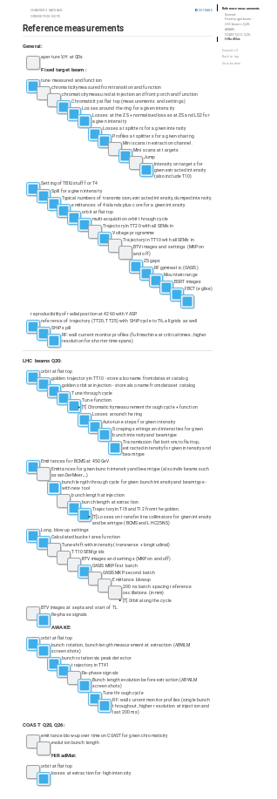
Status of reference measurements
Long list being processed

Slide 6
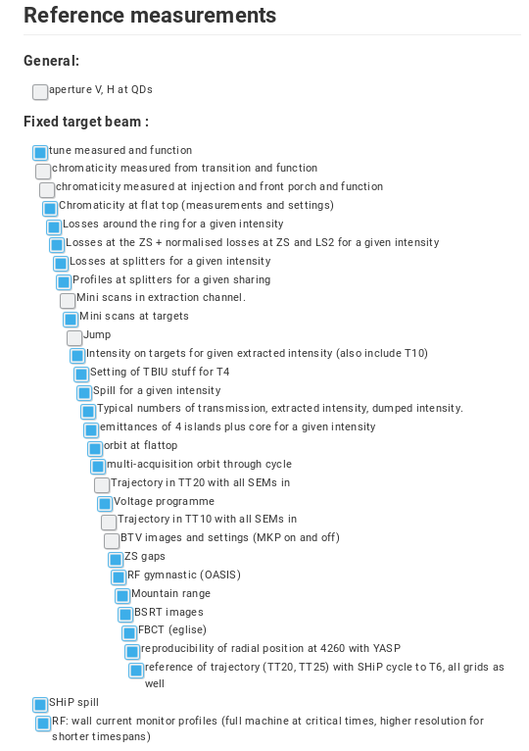
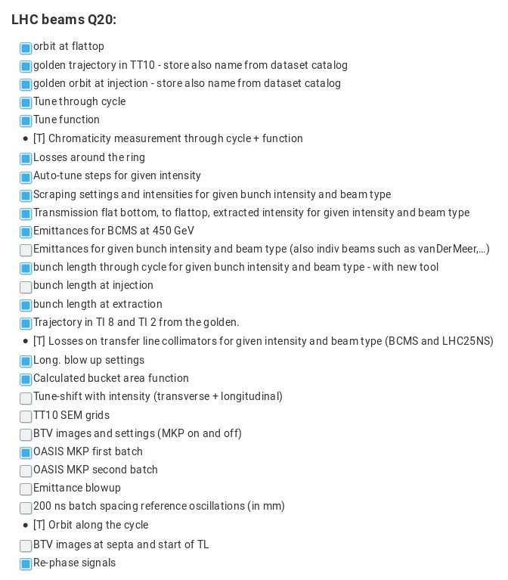
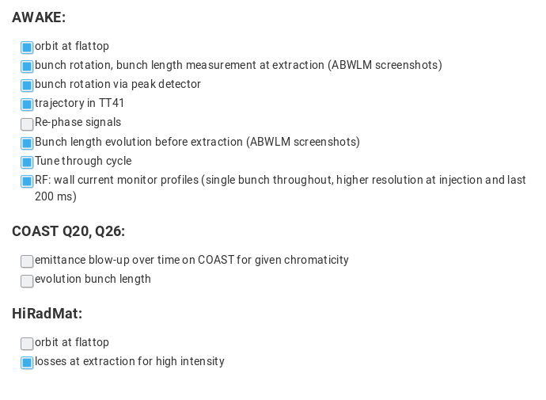
Status of reference measurements

Slide 7
LHC
Measurement | Status | Data source | Comments
Orbit along the cycle
Orbit at flattop
Tune functions & measurements
Chromaticity function & measurements
Transmission, extracted intensity and dump intensity
Losses around the ring for given intensity
Longitudinal beam profiles
BLM thresholds
Golden trajectory in TT10 |  | YASP | Store also name from dataset catalog
Golden orbit at injection |  | YASP | Store also name from dataset catalog
Trajectory in TI 8 and TI 2 from the golden |  | YASP

Slide 8
LHC
Measurement | Status | Data source | Comments
Auto-tune steps for given intensity |  | LSA + logging
Losses on transfer line collimators for given intensity and beam type (BCMS and LHC25NS) |  | Logging
Emittances for given bunch intensity and beam type (also INDIV beams such as vanDerMeer,…) |  | Logging
Emittance blowup through cycle – bunch-by-bunch |  | Logging / acquired data
Emittances for BCMS at 450 GeV
Tune-shift with intensity |  | Logging / acquired data | Transverse + longitudinal – MD time needed
Scraper settings for given bunch intensity and beam type |  | LSA
Losses at extraction |  | Logging

Slide 9
LHC
Measurement | Status | Data source | Comments
TT10 SEM grids |  | Screenshots | Dedicated
BTV images and settings |  |  | Dedicated
BTV images at septa and start of TL |  |  | Dedicated
OASIS MKP 1st batch |  | Screenshots
OASIS MKP 2nd batch |  | Application
200 ns batch spacing reference oscillations (in mm) |  | Application
Long. blow up settings |  | LSA
Calculated bucket area function |  | LSA
Rephasing signals |  | Application & screenshot
Phase profiles |  | FC manual acquisition
Beam loading |  | FC manual acquisition

Slide 10
LHC
Measurement | Status | Data source | Comments
Bunch length through cycle for given bunch intensity |  | Screenshots | With new tool
Bunch length at injection |  |  | Dedicated
Bunch length at extraction |  |  | Dedicated

Slide 11
Fixed Target
Measurement | Status | Data source | Comments
Orbit along the cycle
Orbit at flattop |  | YASP | Dedicated
Tune functions & measurements |  | YASP | Dedicated
Chromaticity function & measurements |  | Logging
Chromaticity at flattop
Transmission, extracted intensity and dump intensity |  | Logging | Need typical variations: normalized losses
Losses around the ring for given intensity |  | Fixed display | Screenshot
Losses at the ZS + normalized losses at ZS and LSS2 for a given intensity |  | Logging
BLM thresholds

Slide 12
Fixed Target
Measurement | Status | Data source | Comments
Trajectory in TT10 with all SEMs in |  | YASP | Dedicated
Trajectory in TT20 with all SEMs in |  | YASP | Dedicated
Losses at splitters for a given intensity |  | Logging | Need typical variations: normalized losses
Profiles at splitters for a given sharing |  | Fixed display | Screenshot
Intensity on targets for given extracted intensity (also include T10) |  | Logging
Emittances of 4 islands plus core for a given intensity |  | Wire scan app | Screen shot
BSRT images
FBCT images
Spill for a given intensity |  | Logging
Mini scans in extraction channel |  | Screenshots
Mini scans at targets |  | Screenshots

Slide 13
Fixed Target
Measurement | Status | Data source | Comments
Voltage programme |  | LSA
RF gymnastic (OASIS + momentum spread distribution) |  | Screenshot + mom distr app
Jump
Mountain range |  | Screenshot | Screen shot
Longitudinal beam profiles |  | Logging
RF wall current monitor profiles |  |  | Full machine at critical times, higher resolution for shorter timespans
Spiral step |  | Screenshot
BTV images and settings (MKP on and off) |  | Screenshot | Dedicated
Setting of TBIU for T4
ZS gaps |  | Logging

Slide 14
Fixed Target
Measurement | Status | Data source | Comments
Reproducibility of radial position at 4260 with YASP |  | YASP
Reference trajectory (TT20, TT25) with SHIP cycle to T6 |  |  | All grids as well
SHIP spill

Slide 15
Awake
Measurement | Status | Data source | Comments
Orbit at flattop
Tunes through cycle
Trajectory in TT41
Rephase signals |  | Application & screenshot
Bunch rotation via peak detector
Bunch length evolution before extraction |  | ABWLM screenshots
Bunch length measurement before extraction |  | ABWLM screenshots
RF wall current monitor profiles |  |  | Single bunch throughout, higher resolution at injection and last 200ms

Slide 16
HiRadMat
Measurement | Status | Data source | Comments
Orbit at flattop
Tune steps for given intensity
Losses at extraction for high intensity

Slide 17
Coast
Measurement | Status | Data source | Comments
Emittance blow-up over time on COAST for given chromaticity
Bunch length evolution |  | Appplication

Slide 18
Conclusions
Completion
  SFT: 72%
  LHC: 60%
  AWAKE: 88%
  HIRADMAT: 67%
  COAST: 0%
Main open points
  BTV images in TLs
  BTV images at injection (1 turn stopper needed)
  Chromaticity function & measurements along cycle with TC
Planning/suggestions?
  Nothing yet for ions
  Still need some dedicated time slots!

Slide 20
Backup

Slide 21
General
Measurement | Status | Data source | Comments
Aperture |  | From measurements
LSS4/LSS6 extraction apertures |  | From measurements
Alignment |  | In checklist
BPM gains |  | YASP
BLM thresholds |  | LSA
Radiation survey
Mains harmonic spectrum |  | Logging
Vacuum pressure around the ring |  | Logging
Reaction times for interlocking: mains trip, hardware interlocked BLMs |  | Screenshots

Slide 22
General
Measurement | Status | Data source | Comments
Orbit along the cycle |  | YASP | Multi-acquisition
Orbit at flattop |  | YASP
Tune functions & measurements |  | LSA + AutoQ
Chromaticity function & measurements |  | LSA + AutoQ
Transmission, extracted intensity and dump intensity |  | Logging/Stats
Losses around the ring for given intensity |  | Logging/Stats
Longitudinal beam profiles |  | FC manual acquisition

Slide 23
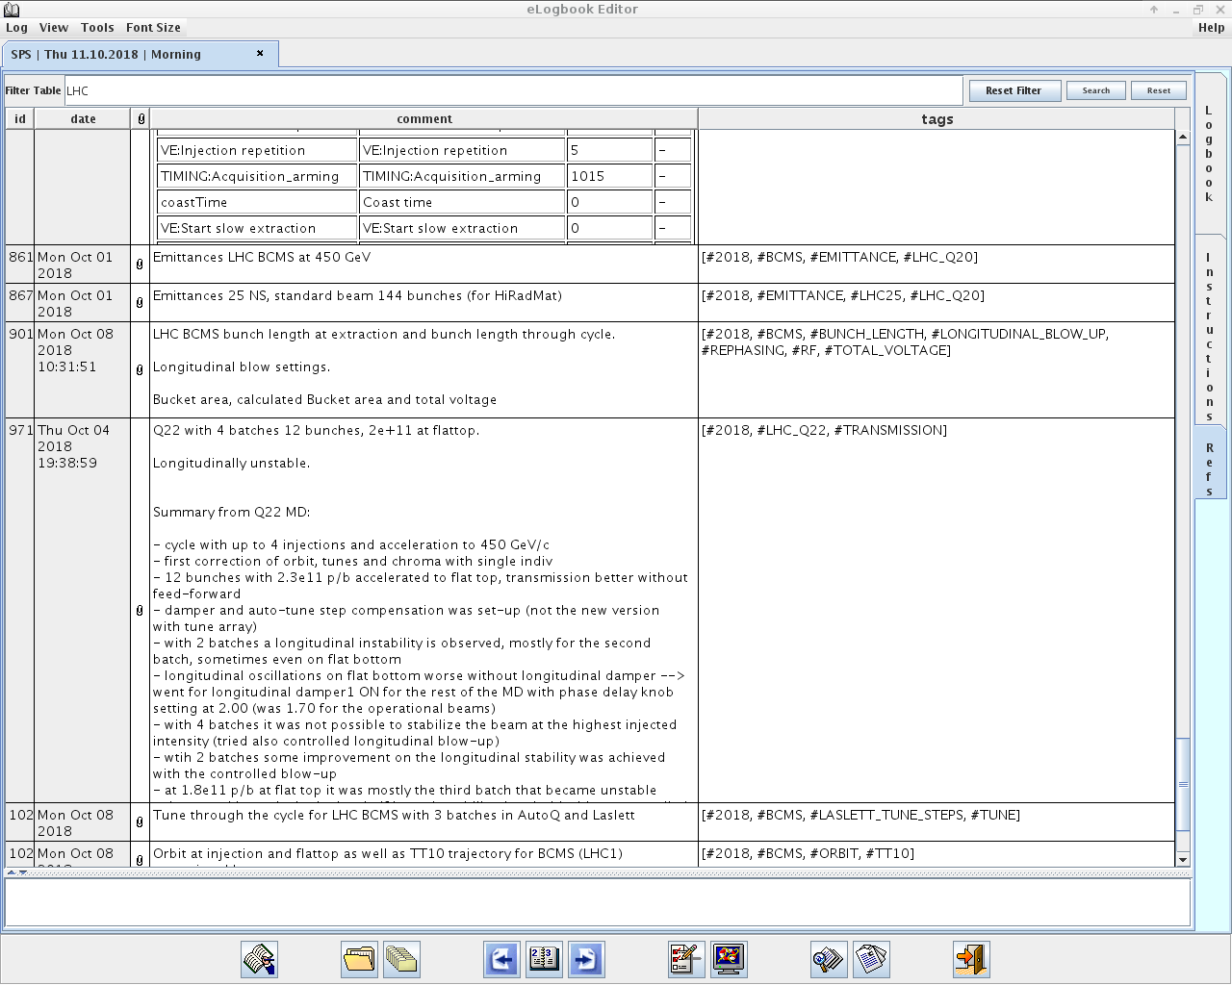
New reference measurement tool
Profited a lot from new tool available from the e-logbook

Slide 24
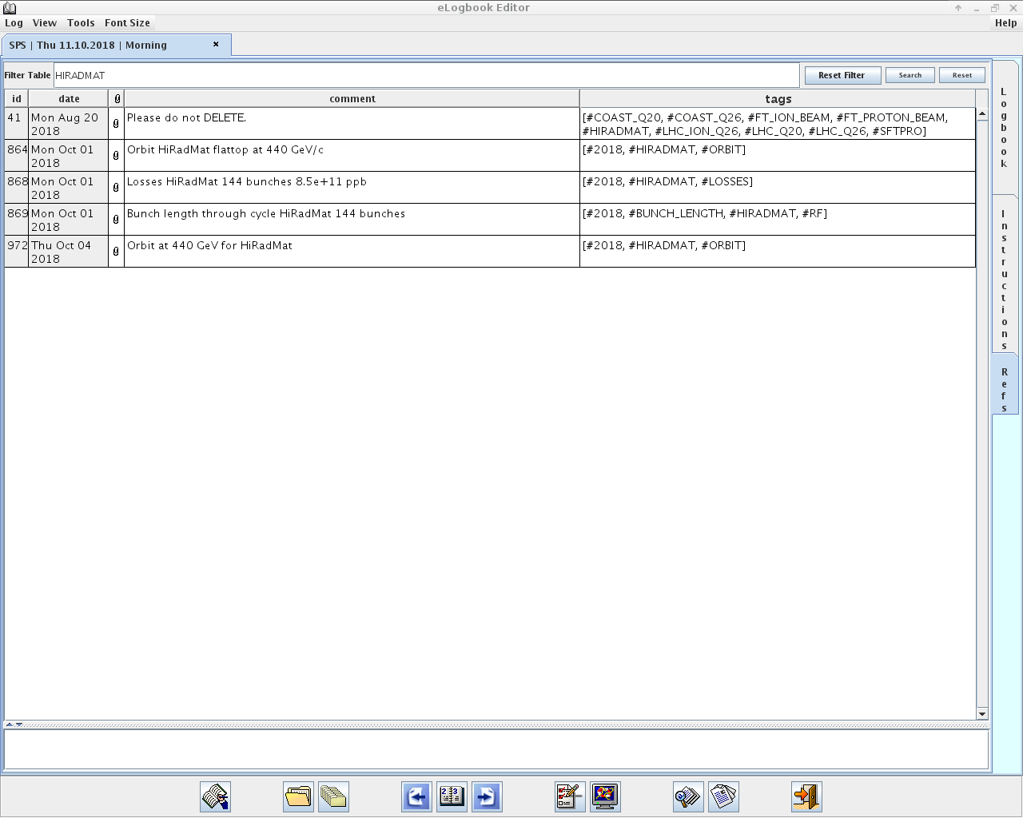
New reference measurement tool
Profited a lot from new tool available from the e-logbook

Slide 25
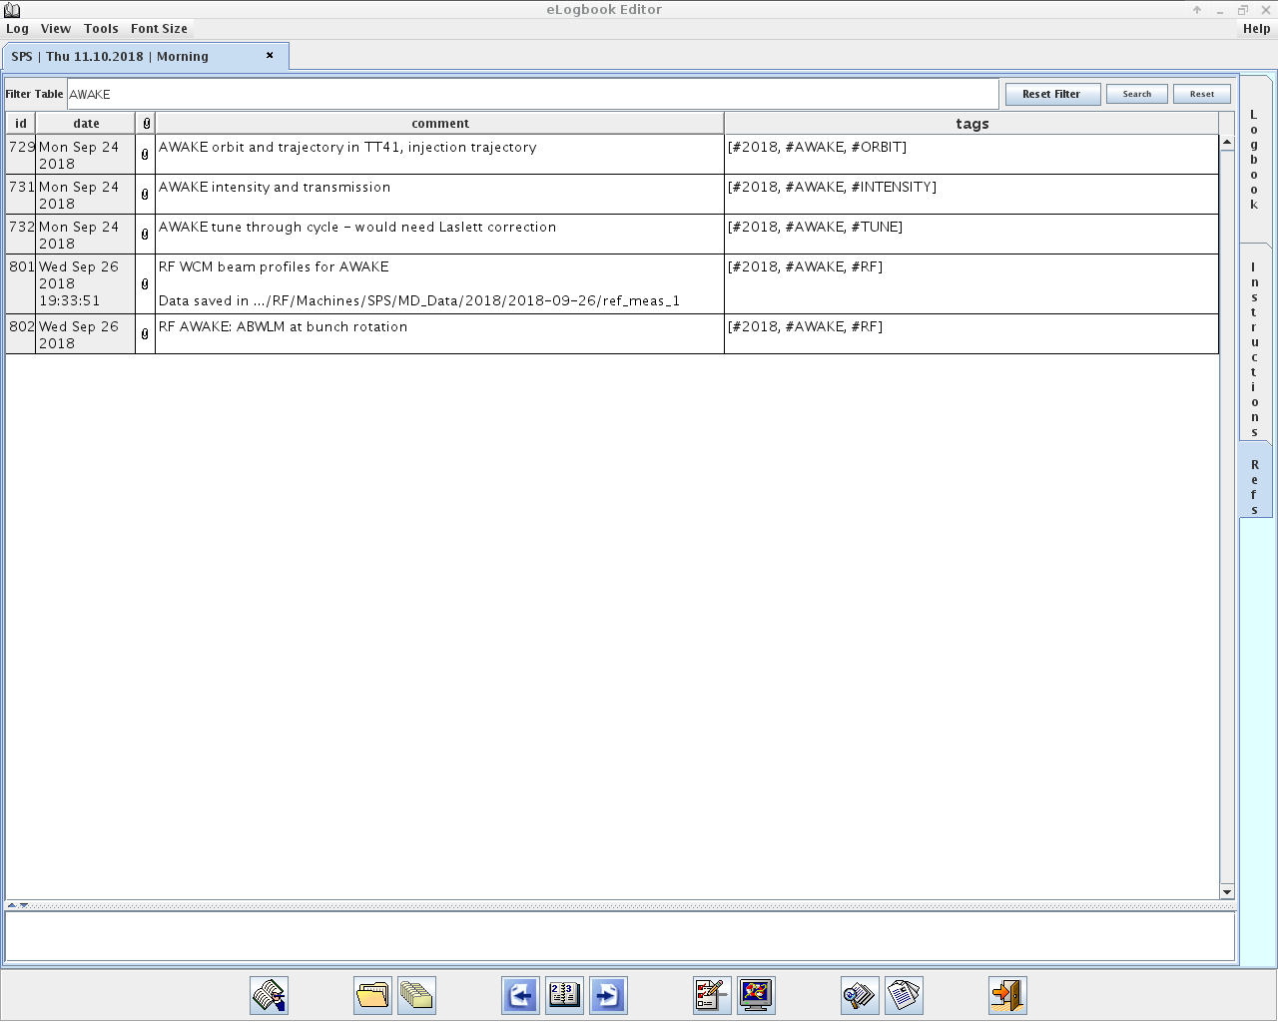
New reference measurement tool
Profited a lot from new tool available from the e-logbook

Slide 26
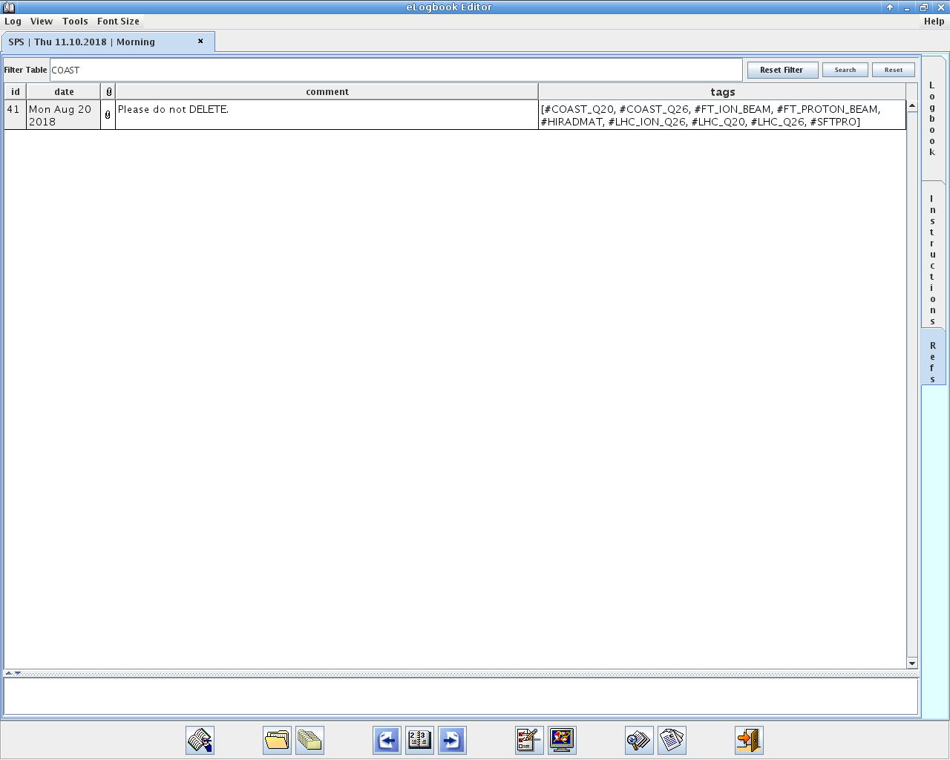
New reference measurement tool
Profited a lot from new tool available from the e-logbook

Slide 27
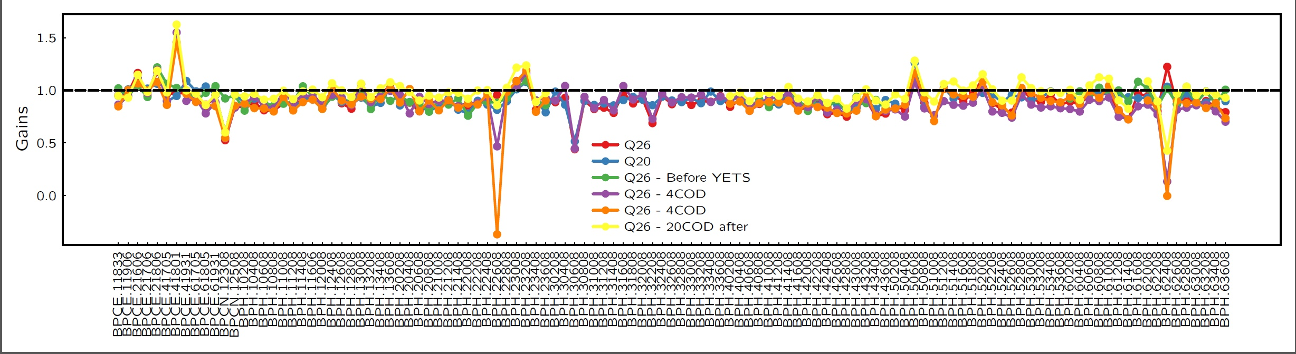
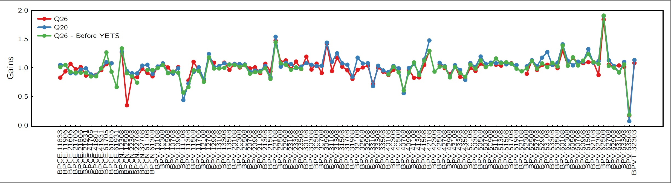
BPM gains

Slide 28
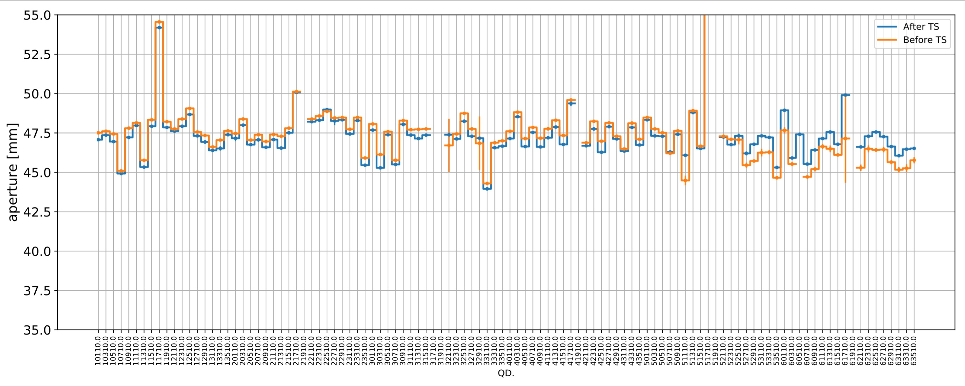

Slide 29
Bunch-by-bunch tune shifts

Slide 30
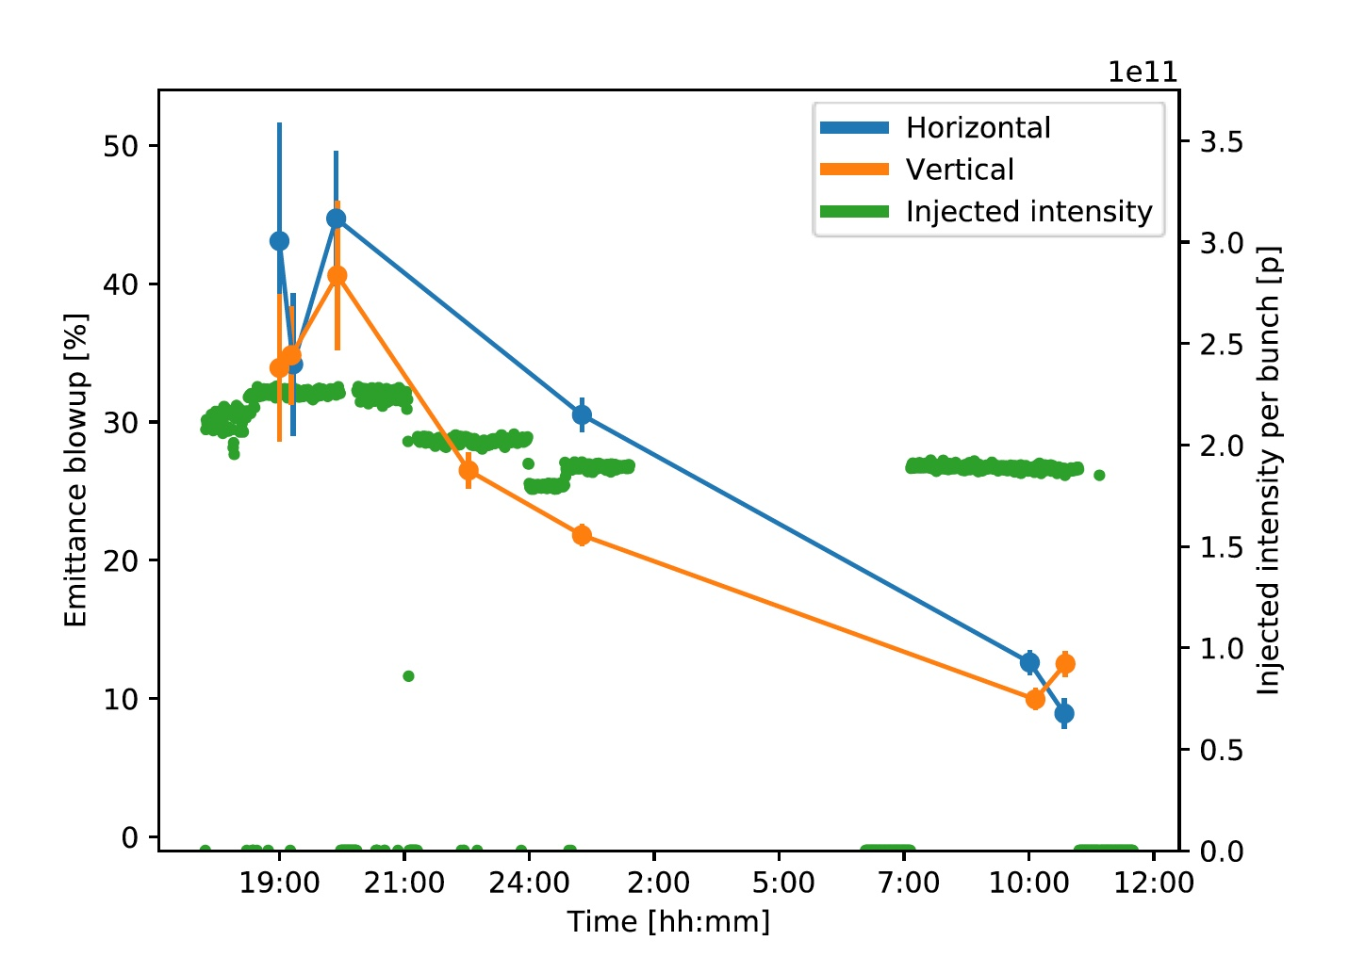
Emittance blow-up evolution

Slide 31
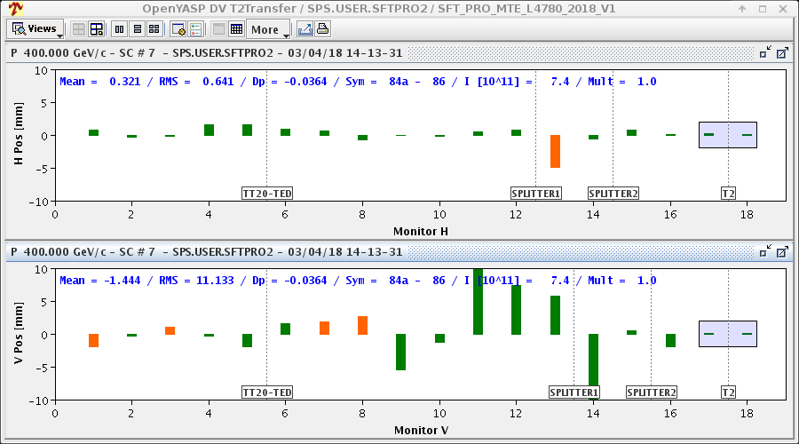
TT20 - T2 TL steering

Slide 32
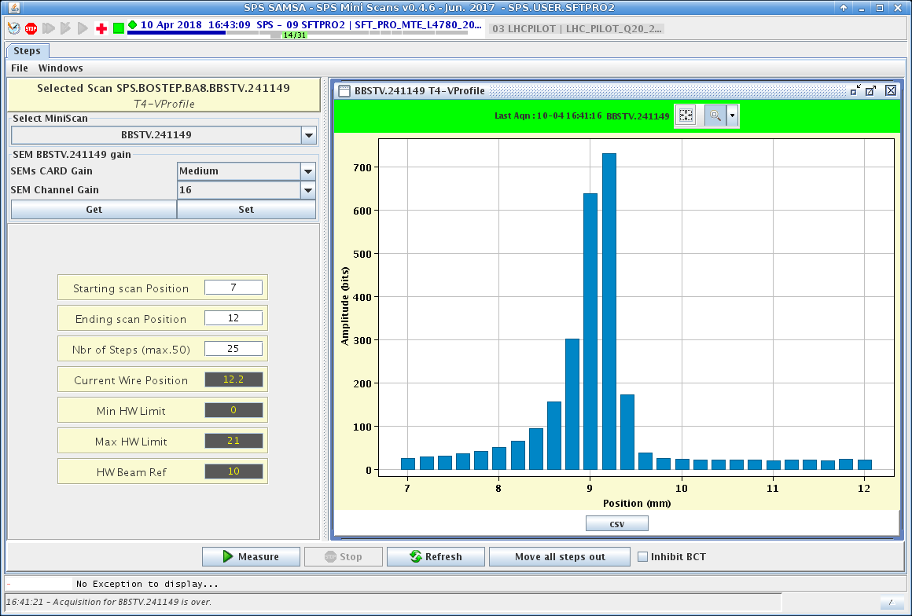
Miniscan profiles T4

Slide 33
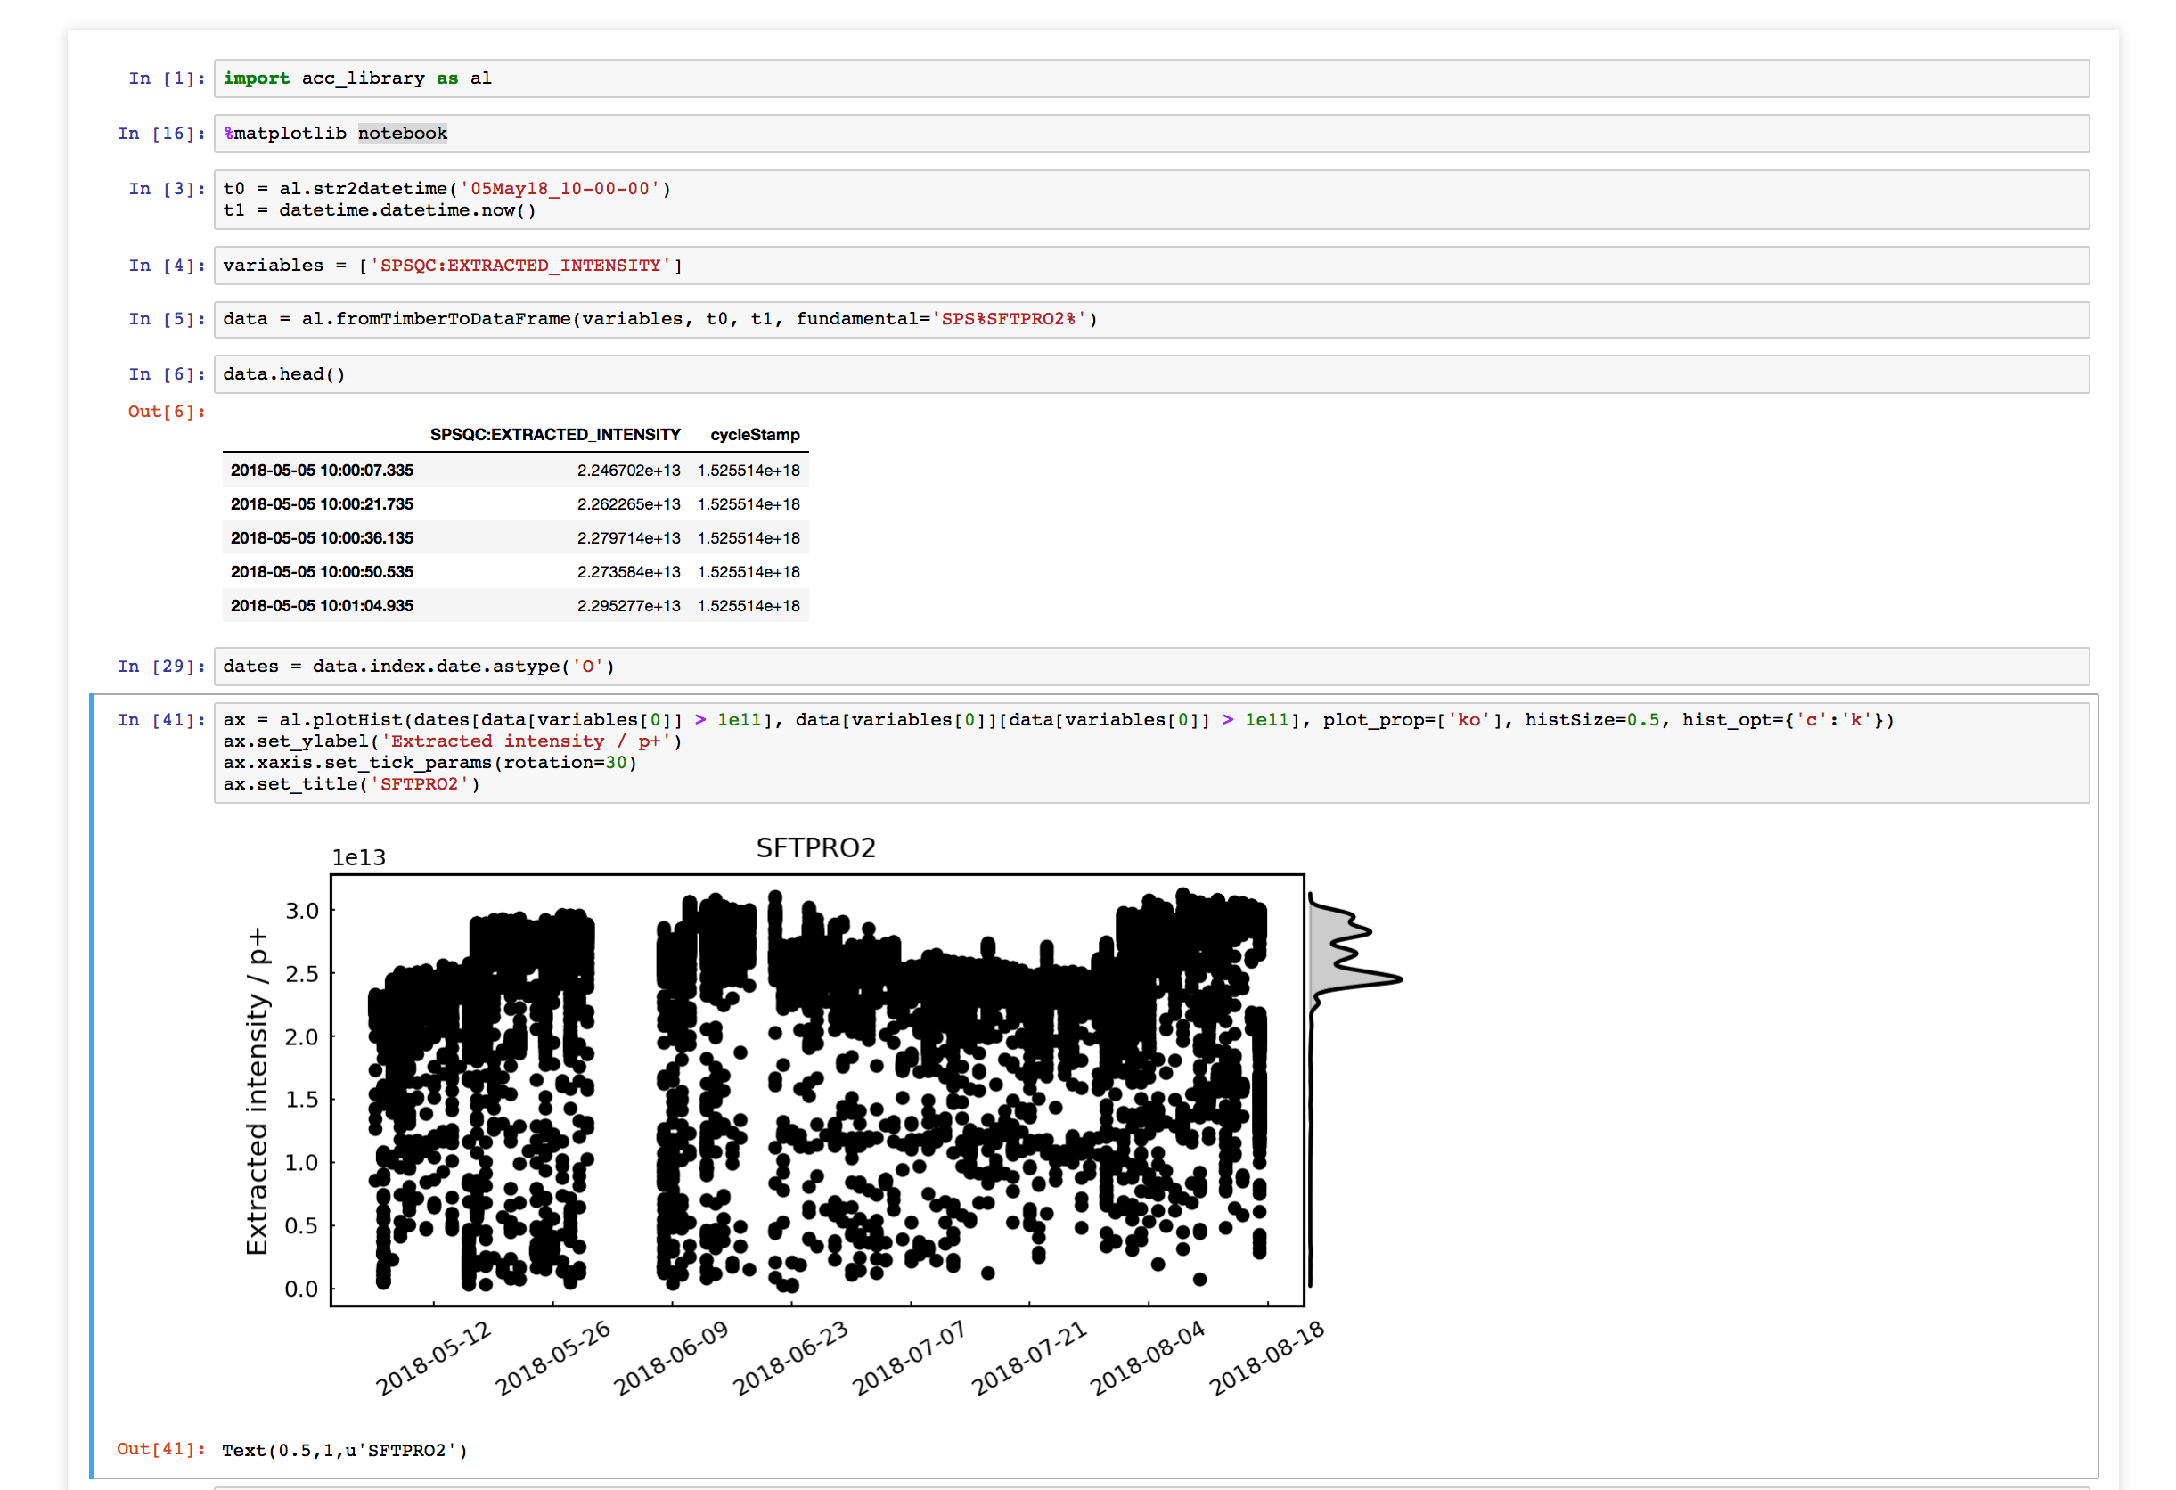
Data types storage and retreival
Lots of data can be retrieved from the Logging Data Base – here, we would like to have plots showing the overall time evolution and displaying a histogram to evaluate some statistical parameters (averages, spread, outliers).
This will be made available via a collection of dedicated Jupyter notebooks:
Francesco

