Slide 1
Data Knowledge Base: progress report
M Golosova¹, M Borodin²
¹NRC “Kurchatov Institute”
²???
ATLAS SW&C Week, DCC meeting, 04/10/2018

Slide 2
Outline
DKB v.1 (2016–2017)
  Goals and motivation
  Results
DKB v.2 (2017–these days)
  DKB concept evolution
  Possible applications
  DKB for ProdSys
Summary

Slide 3
Data Knowledge Base v.1
2016-2017

Slide 4

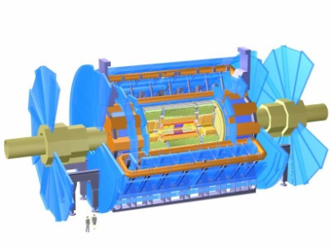
DKB (v.1)
DKB R&D project
  was initiated in 2016
Initial goal
  reconstruct connections between research results and data samples
Suggested information sources
  PDF
  wiki pages
  Indico
  …
MC generation
modeled
data
real
data
data
data
data
data
data
…
…
…
…
data
…
Paper
Paper
Paper
Chain
of production and analysis tasks
Notes
Discussions
Twiki

Slide 5
Development routes
Knowledge extraction
Development
Metadata integration
Virtuoso
RDF and ontology storage with reasoning
Ontology
scientific experiment metadata scheme
Dataflow
ETL process as data stream
PDF Analyzer
metadata extraction form PDF documents
Stages
ETL modules
Communication protocol
between Kafka supervisor and Stage worker
Apache Kafka
streaming platform

Slide 6
DKB (v.1): achieved results
ATLAS information model developed
(within a matter of consideration)
Information integration system: conceptual architecture developed
Federated information system concept developed
Automated metadata extraction tool for internal supporting notes (PDF) for scientific papers developed
Integrated information: from ~400 supporting notes
Result validation:
  human analysis of supporting notes;
  cross-check with AMI/GLANCE.

Slide 7
Data Knowledge Base v.2
2017-2018

Slide 8
Concept evolution
Started with unstructured sources:
  proof-of-concept: DKB is able to integrate information from different sources and restore connections between information objects;
  information from unstructured sources is not always reliable.
Can be applied to multi-source requests:
Request example:
  find production tasks by some attribute via BigPanDA monitoring web-interface;
  get information from Rucio for related (input and output) data samples via CLI;
  get information from AMI for same data samples via CLI.
New DKB concept:
  universal tool for multi-source queries.

Slide 9
Multi-source requests (1)
Web GUI
cmdline API
Issue
to solve
BigPanDA
monitor
Rucio
get detailed info
for datasets of found tasks
cmdline API / web GUI
search for tasks:
param1,param2
AMI
get additional information
about found tasks
ensure Y
X API
Y API
clarify X
srcX
srcY

Slide 10
Multi-source requests (2)
Oracle API
cmdline API
ProdSys
Rucio
cmdline API / web GUI
get detailed info
for related datasets
Issue
to solve
get task info
AMI
DKB
get additional information
about found tasks
What do we know?
get related
information Y
X API
get related
information X
srcX
srcY
Y API

Slide 11
DKB for Production System (1)
Web GUI
  Full-text (google-like) task search
  (metadata from Production System, AMI, Rucio, Chicago ES)
    https://prodtask-dev.cern.ch/dkb/#/task_keywords/
  Derivation tasks:
    dataset events number
      https://prodtask-dev.cern.ch/dkb/#/task_keywords/
    output/input events ratio
      https://prodtask-dev.cern.ch/dkb/#/deriv_ratio/
  WIP:
    Hashtag task statistics
    Extended search
    Task chain: resource usage statistics

Slide 12
DKB for Production System (2)
Backend storage: Elasticsearch
  http://aiatlas171.cern.ch:9200
Information integration:
  updated/new records detection by task timestamp (ProdSys)
  regular update: every hour
    takes ~2 min
  in case of scheme/algorithm change: full reprocessing, starting from “now” and back to 2014
    one month reprocessing takes ~20 hrs

Slide 13
REST API
Recently added REST API allows to isolate internal structure of DKB storages from external users
DKB
DKB
DKB
REST
API
DKB
Integration service
ProdTask-dev
Integration service
request-1
ES storage
ES storage
request-2
Graph storage
Graph storage
request-2

Slide 14
Summary

Slide 15
Summary
DKB provides flexible mechanism for metadata integration, that allows to integrate data from sources of arbitrary number and type
With this mechanism we have already took place
of some multi-source requests, providing information from Production System (DEFT, JEDI), Rucio, AMI and analytics cluster in University of Chicago by single request to DKB
Extension and modification of the existing integration dataflow can be performed in the near “continuous integration” way

Slide 16
Project perspectives
Works on DKB project will go on in 2019-2021
(supported by … grant)
DKB manpower from Tomsk Polytechnic University and Kurchatov Institute (2.5 FTE in total):
  Marina Golosova
  (team leader, resource administrator, developer)
  Vasily Aulov (developer)
  Anastasiia Kaida (developer)
  (possibly) +2 persons

Slide 17
Routes forward
Keep on working with prodtask-dev, addressing more requests
Turn interaction of prodtask-dev interfaces with DKB
to the new API
Improve update policy
  Currently update is triggered by timestamp field from Production System database, but not all other systems do update this timestamp when related data are updated
Improve information integration mechanism
  Fix what should be fixed
  Extend functionality
  Minimize manual operations with administration
  and management tools

Slide 18
Questions
New applications for DKB as information integrator
Data preservation in DKB
  NoSQL storages mostly support no “update” operations
  Changes in integration process require re-processing
  of all data – thus we have the most actual version from original sources
  Original sources can remove data

Slide 20
Summary
DKB provides flexible mechanism for metadata integration, that allows to integrate data from sources of arbitrary number and type
With this mechanism we have already addressed some user needs, providing information from Production System (DEFT, JEDI), Rucio, AMI and analytics cluster in University of Chicago by single request
Extension and modification of the existing integration dataflow can be performed in “continuous integration” way
Routes forward
WEB-interface views:
  pre-constructed
  adjustable
Improvement of the operating workflow mechanism
New dataflow functionality
  Data flow routing
    Allow single processor to produce output messages of different types
    Avoid reduplication of data flow on splitting
Before:
T
T
T
T
After:
T
T
T
T

Slide 22
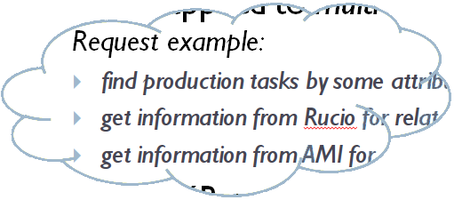
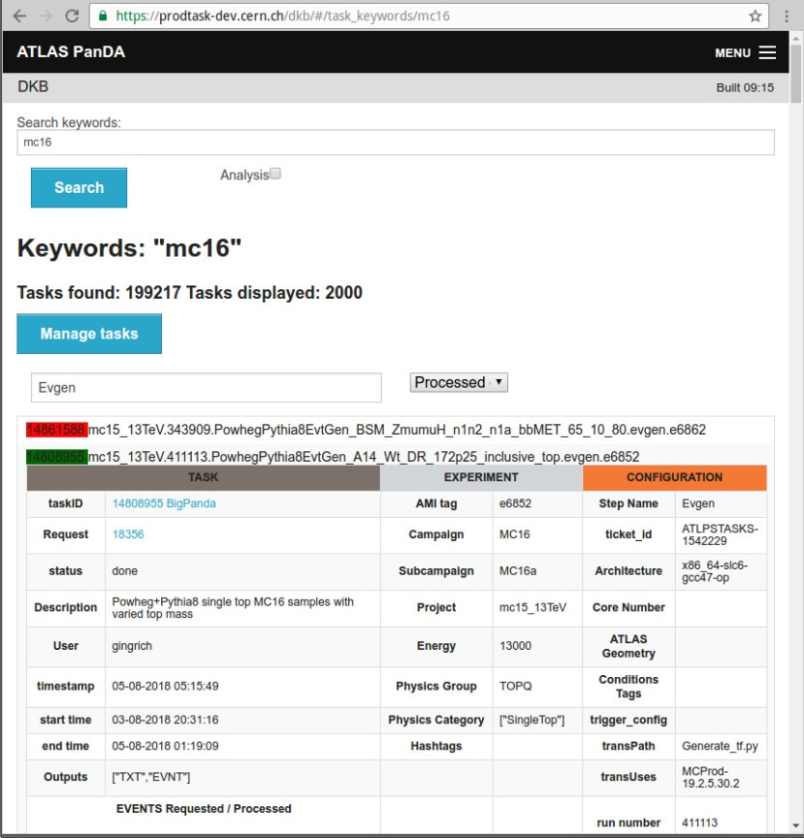
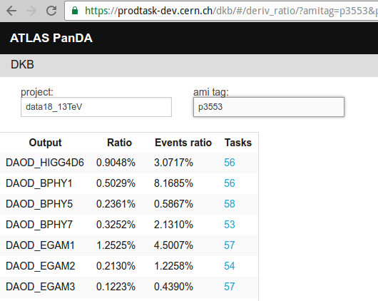
What`s done
WEB-based interface:
Production and analysis tasks
search by keywords:
(full-text search by all text information
available for tasks: task name, user name,
research group, campaign, project, description,
ATLAS geometry, tags…)
Derivation tasks statistics
(project + AMI tag)
http://prodtask-dev.cern.ch/dkb/#/task_keywords/
https://prodtask-dev.cern.ch/dkb/#/deriv_ratio/

Slide 23
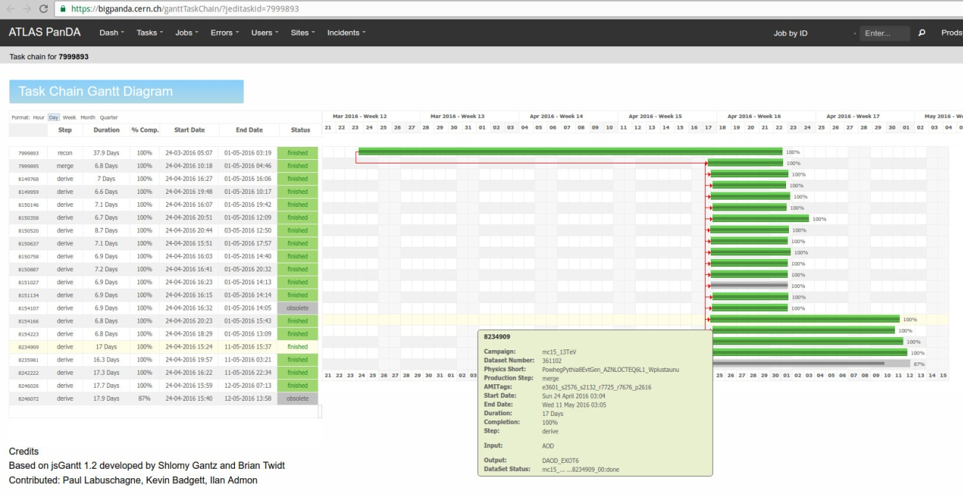
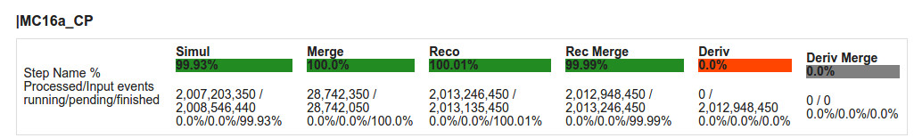
What`s coming next (WIP)
New web interfaces:
  Extended search interface
  Task statistics by production steps
  Task chain resource usage statistics
REST API:
  Isolate web interfaces from DKB internals (storage(s) and data schemas)
https://bigpanda.cern.ch/ganttTaskChain/
https://prodtask-dev.cern.ch/prodtask/request_hashtags_main/#/hashtags/

Slide 24
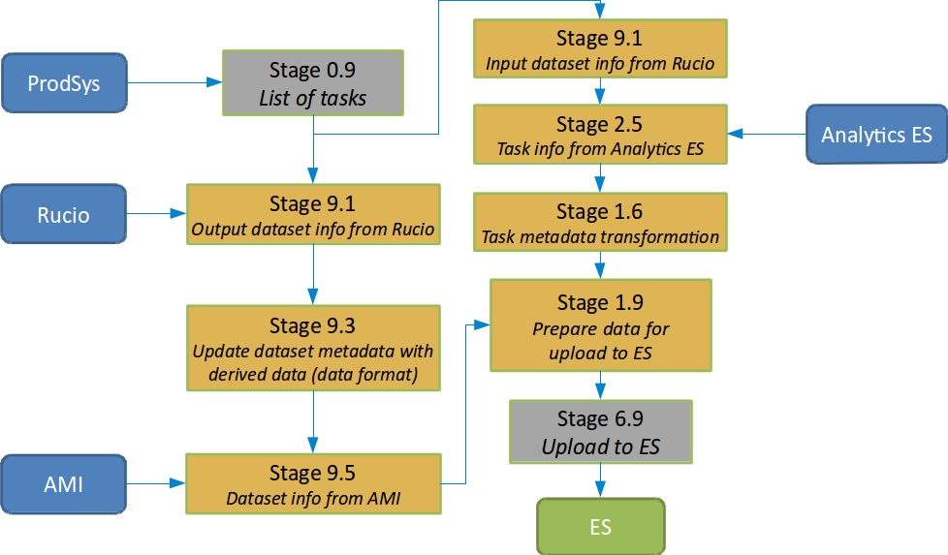
Under the hood (how it works)
Dataflow task run by schedule (every hour), integrating new/updated data from sources
When dataflow changes (added extraction of new data or changed/extended logic of a processing step), whole set of data can be reprocessed without pause in regular workflow
Dataflow scheme
Single thread processing:
hourly update: ~2 min
reprocessing of 1 month: ~20 hrs
Storage populating / data reprocessing
Start
Earliest
historical data
Reverse data load
Scheduled
updates
time
Load step
Regular data load

Slide 25
Dataflow capabilities
Arbitrary integration topology
  Splitting in two identical data flows
  Joining of similar data flows
Scalability
(provided by Apache Kafka)
  Distributed processing
  Configurable parallelization
Multi-language modules support
Node 2
Node 1
T
L
E
T
T
T
T
Node 4
Node 5
Node 3
T
E
L
T
T
T

