Slide 1
R2E Annual Meeting Wrap-Up
Rubén García Alía, on behalf of the R2E Project

Slide 2
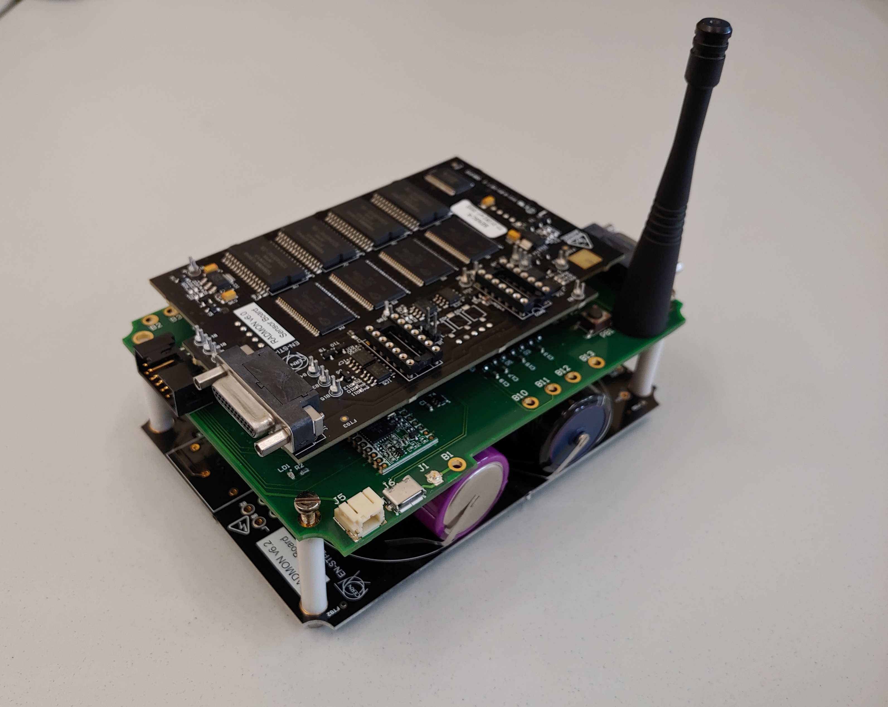
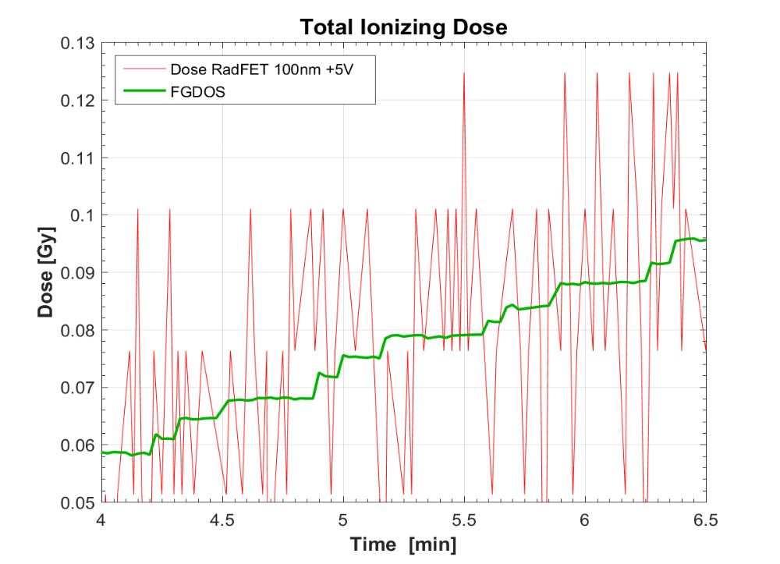
Radiation monitoring
Key improvements in an already very mature and complete “system”
Pushing the limits of space, time and dose/fluence resolution (while maintaining high cost efficiency)
Wireless solutions, Floating Gate System on Chip, distributed optical fiber dosimetry (active + passive…)
Relatively “small” changes in accelerator settings/operation can lead to “large” changes in environment and have a very strong impact on system performance

Slide 3
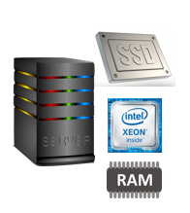

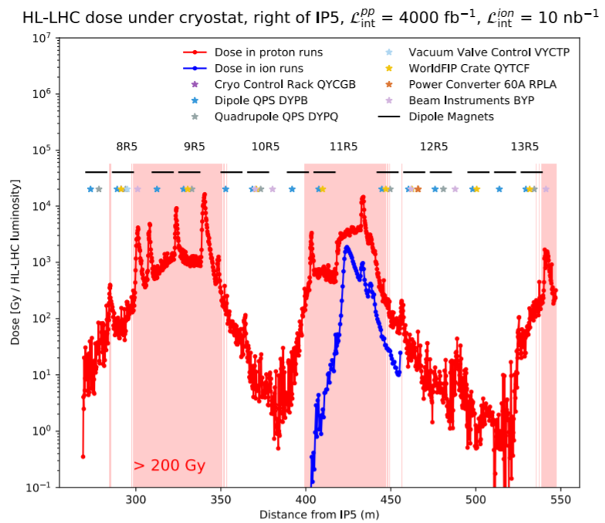
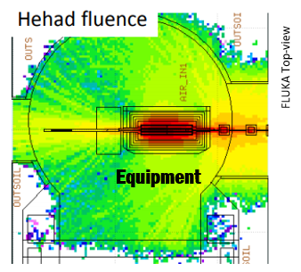
Radiation level data processing and FLUKA
MCWG analysis: essential in order to efficiently digest and interpret very large quantities of data
  Importance of automated routines; link to radiation levels on equipment and associated lifetime risk
FLUKA for R2E: Crucial ingredient for definition of future radiation levels
FLUKA studies & radiation level analysis already cover “most” needs for e.g. HL-LHC, however further user requirements are important in order to optimize future efforts and outcome (related 2019 review)

Slide 4
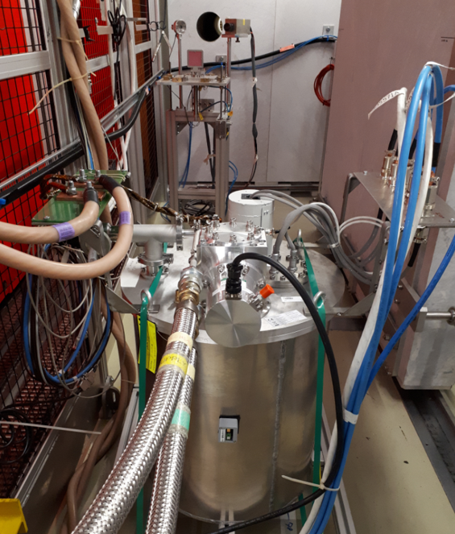
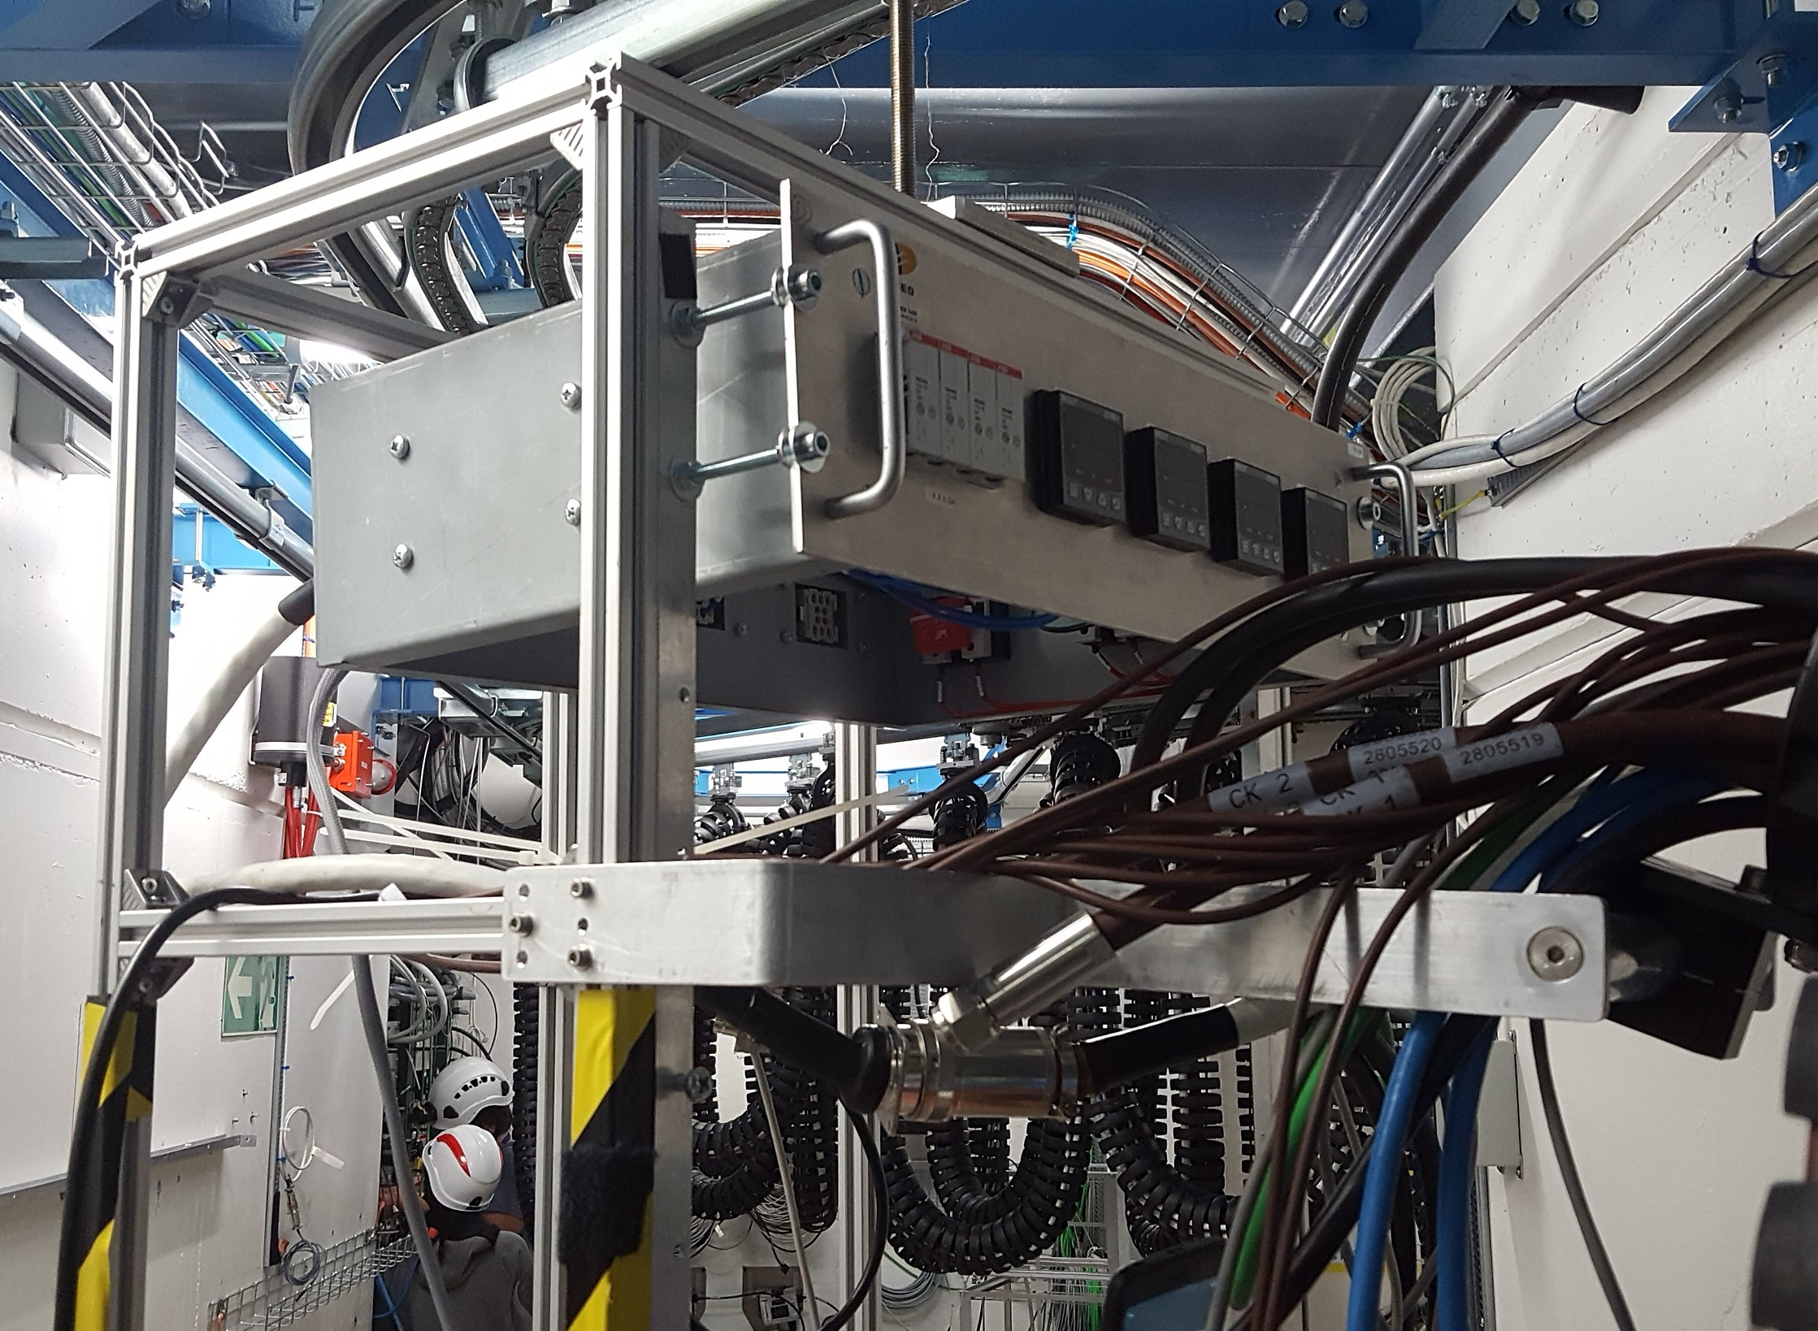
Facilities & testing
Radiation testing for high-energy accelerators implies very broad range of experimental environments, radiation levels and type of effects (electronics, materials…)
R2E provides an essential service for part qualification (mainly PSI) and facility operation
Importance of component radiation test database
Strong link between Radiation Hardness Assurance and facilities – optimized approach: large reference database, batch acceptance (and possibly stock) and system level validation

Slide 5

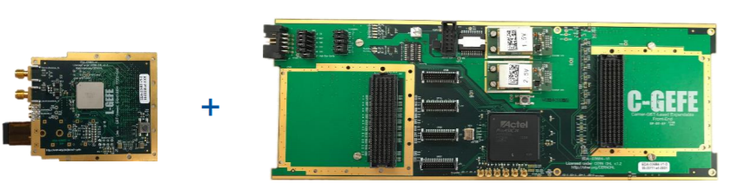
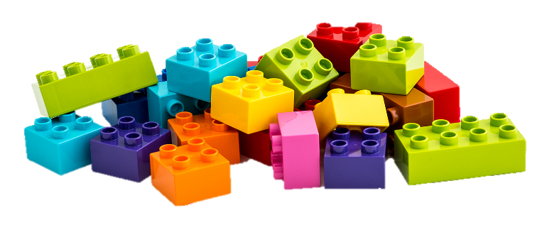
Rad-tol developments
Ranging from modification on commercially available modules (components, schematics) to fully customized ASIC designs
Importance of common building blocks & modular designs (e.g. BE/BI GEFE and application to BE/CO DIOT)
Relevance of COTS batch procurement & acceptance
NanoXplore: excellent opportunity for rad-hard FPGA as building block for future systems

Slide 6
Many challenges ahead…
LS2:
  LS3 developments, part qualification & procurement
  Continuation of R&D activities: very important part of project mainly due to rapidly evolving microelectronic technologies
  Facility, monitoring and analysis tool maintenance & upgrade
Run 3:
  Validation of radiation tolerance of “new” qualified systems
  Radiation monitoring, with focus on LIU impact
  Further preparing for unique HL-LHC environment & availability requirements

Slide 7
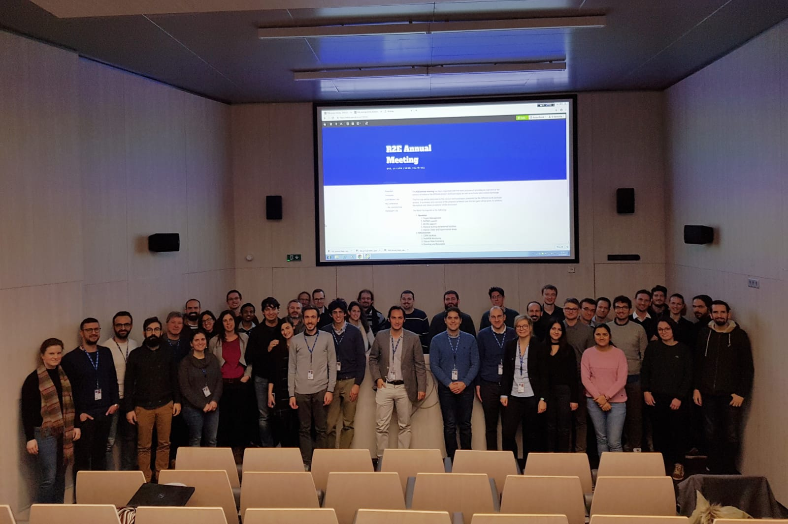
…but a great team to tackle them!

Slide 8


A special thanks to…
Salvatore, Slawosz and Yacine for the session preparation and chairing
Melanie, for the critical organization support
All the speakers for the excellent presentations!
Please join us for an R2E drink!!

