Slide 1
Introduction and R2E overview
Rubén García Alía, on behalf of the R2E Project
https://indico.cern.ch/event/760345/

Slide 2
R2E Annual Meeting
Main objective: to provide a global view of the project to those of you participating in it (i.e. promote internal exchange/collaboration, know whom to ask what, etc.)
Structure:
  First day focused on Work Package presentations (mandate, status, outlook…)
  Second day focused on more specific technical/scientific topics, typically related to student/fellow work
Feedback welcomed in order to improve for next year’s organization

Slide 3
Main R2E building blocks
Radiation Monitoring and Calculation
Rad-tol system development (mainly) based on COTS
Radiation Hardness Assurance
Qualification Approach
Radiation Test Facilities
mitigation → prevention

Slide 4
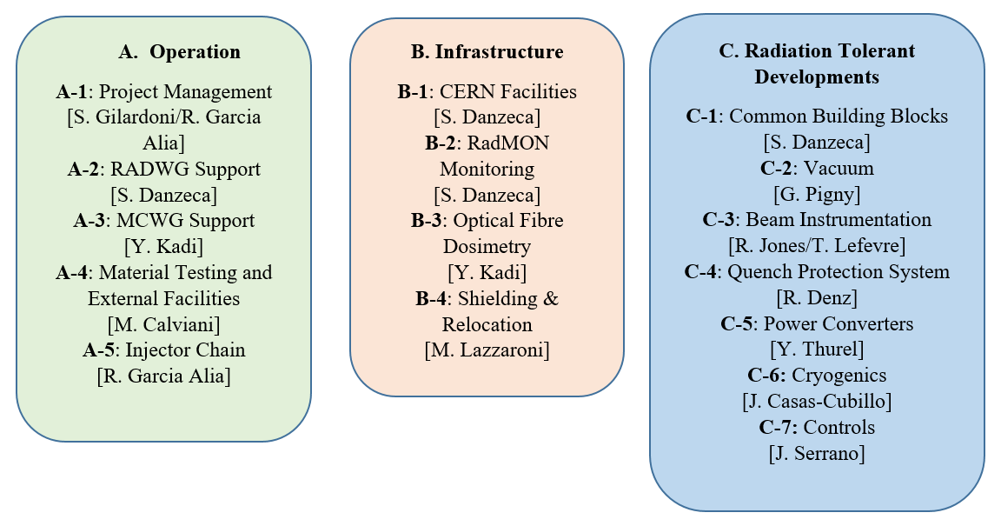
R2E Work Package structure

Slide 5
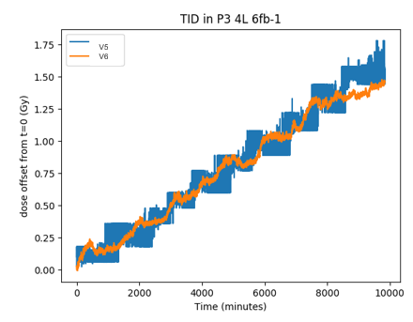
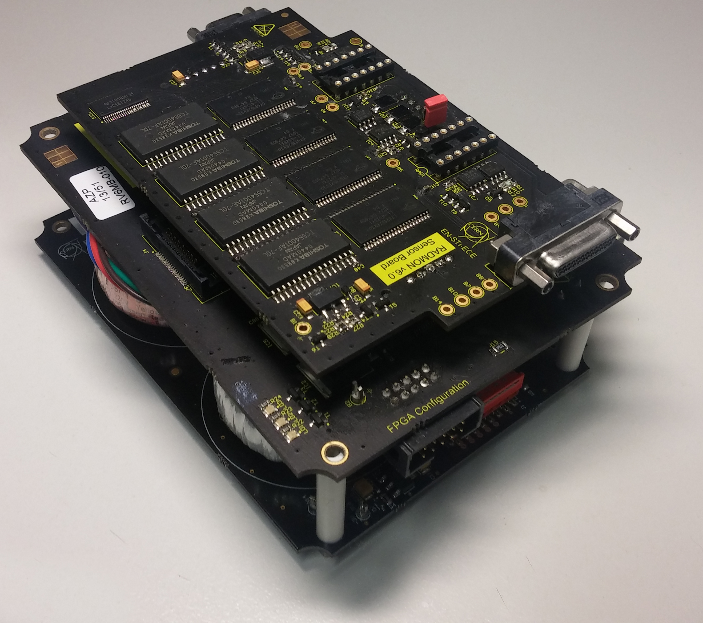
RadMON system
v6 upgrade for LHC (all points except IP4 and IP6)
  Enhanced radiation lifetime (~250 Gy)
  Improved TID and HEH fluence sensitivity
  Direct thermal neutron (R-factor) measurement
Important not only for LHC, but also for injectors and experimental areas
Complemented with passive dosimetry (RadFET, nMOS, BatMON); BatMON v7
  65nm Cypress memory, floating gate dosimeter
Continuous operation/maintenance and development activities
Strong interest from other accelerator/nuclear facilities, as well as for space

Slide 6
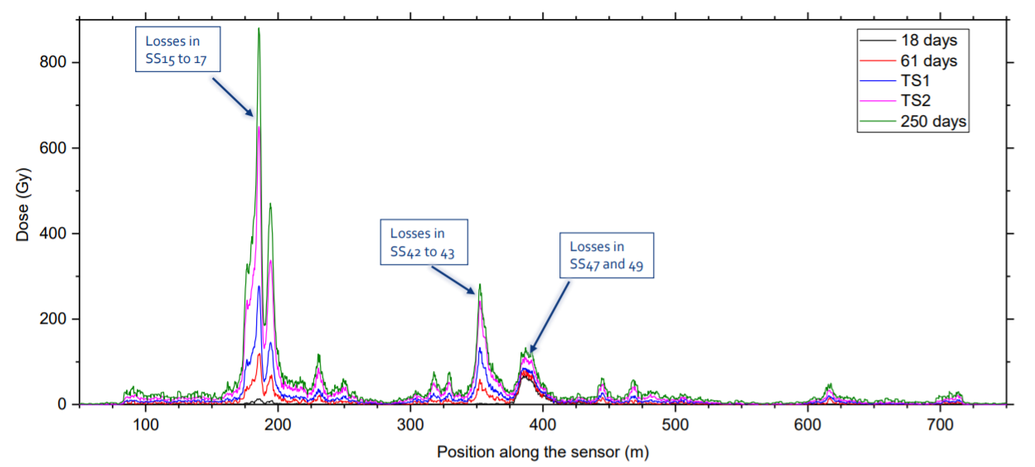
Optical fiber dosimetry
Optical fiber dosimetry during 2018 in PS (D. Di Francesca)
Presently deployed in PSB and PS
Large dynamic dose range and continuous (~1m resolution) spatial coverage
LS2 plans: deployment in SPS and LHC dispersion suppressor (IP1, IP5 and IP7)

Slide 7
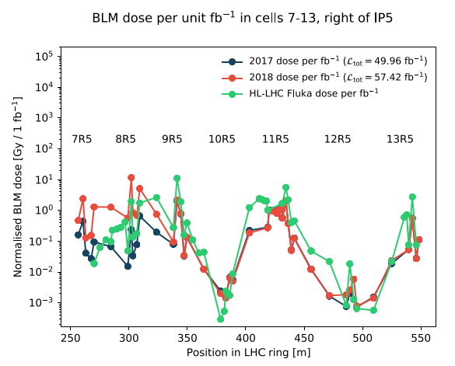
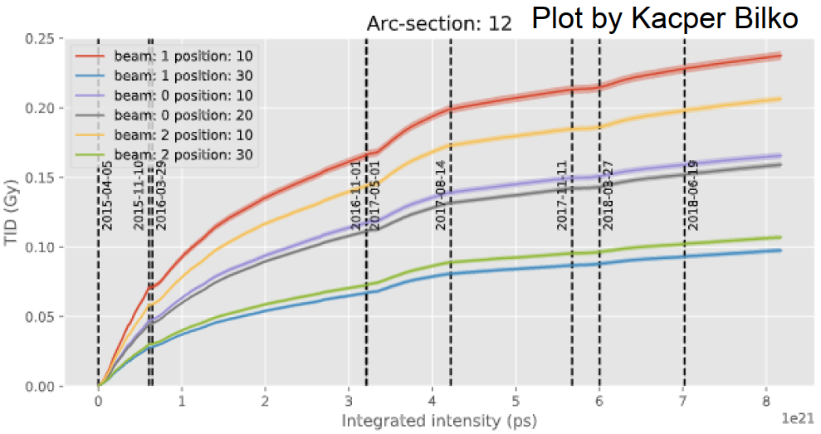
Radiation level monitoring & reporting
Monitoring & reporting activity, both upon specific requests, and in terms of general reports
MCWG radiation level analysis/database: mainly based on processed BLM data (very broad data set), now also including RadMON and extending into injectors
2018 LHC radiation level monitoring highlights:
  Impact of TCL6 collimator settings on RR and DS levels (IP1 and IP5)
  Increased losses in IP7
  Evolution of LHC ARC radiation levels
  Ion BFPP losses

Slide 8

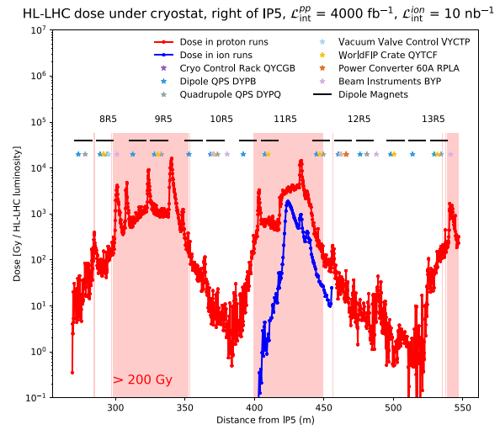
FLUKA R2E calculations
Key in determining radiation levels for LIU and HL-LHC configuration and operational conditions
Efficiently covering large majority of HL-LHC (WP10) areas of concern for equipment groups:
  Shielded areas (UJ, UL, RR) around IP1, 5 and 7
  DS in IP1, 5 and 7 (including possible cell 9 location for 11T/TCLD)
Activity includes also simulations for test facilities (CHARM, CC60) and FCC

Slide 9
2018 impact of R2E on LHC operation
Main 2018 LHC radiation environment features:
  Confirmation of very low radiation levels in the LHC arc (<100 mGy/year at equipment location)
  Increased losses per unit integrated intensity in IP7 due to crossing angle and beta-star settings
  IP1 & IP5: Tradeoff between RR (lower) and DS (higher) radiation levels
  BFPP localized ion losses
Operational implications:
  2018 EPC RR failures in LHC leading to dump (mainly FGC2 controls and 600A power): 11 (factor ~2 reduction of failures per unit integrated luminosity with respect to 2017)
  Significant increase in QPS failures due to (i) increased DS levels in proton operation (cell 8-9), (ii) ion operation
    First signature of radiation lifetime issues (i.e. not SEE related) on LHC equipment → rising edge of bathtub curve
  “Few” SEE-events in commercial systems in shielded areas (e.g. UL PLCs for PIC) → presently in the shadow of operation, but could become more critical with increased radiation levels

Slide 10
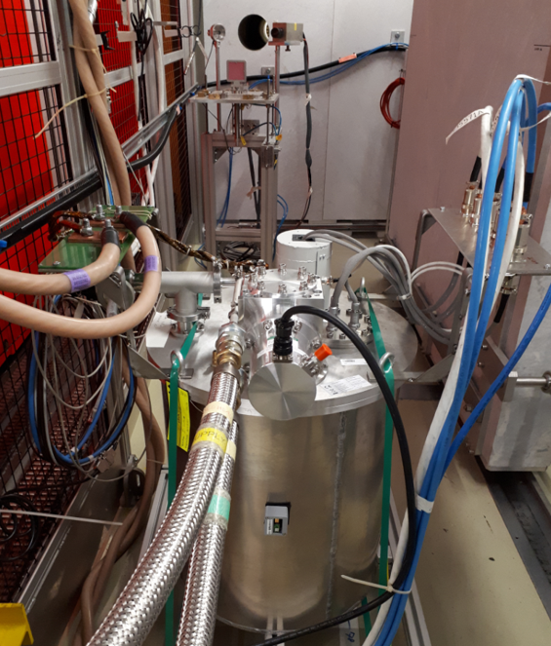
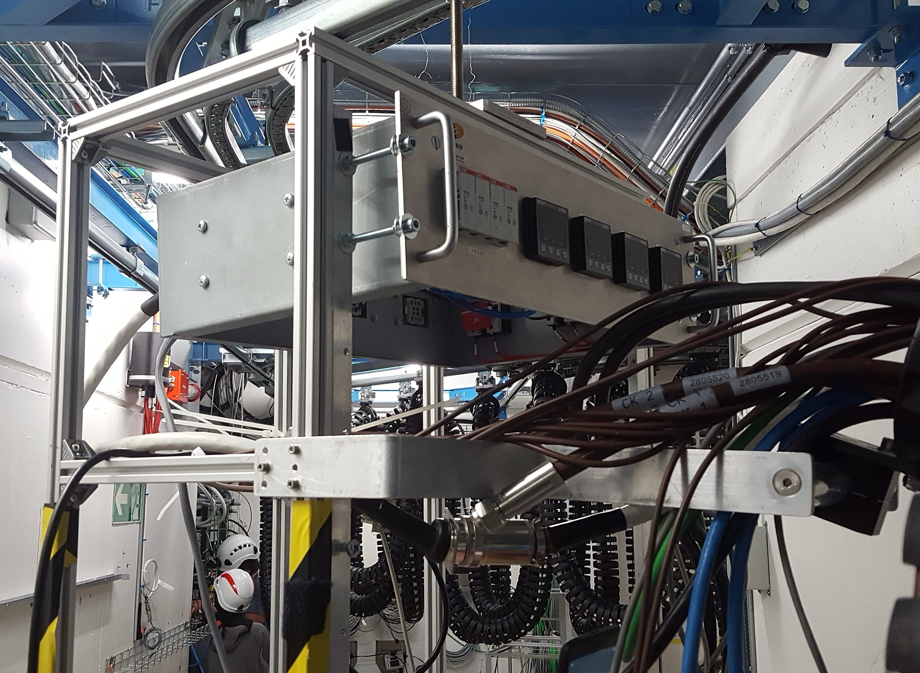
R2E test facilities at CERN
CHARM:
  “Flagship” of CERN radiation facility, tailored for high-energy accelerator environment and system level testing
  Examples of 2018 CHARM accelerator equipment (LS2) tests: 11T uQDS, quench heater power supplies, cold-by pass diode, current lead temperature controller, electronics for pressure sensors…
  Key R2E support for facility operation, interface with users, test preparation & interpretation…
CC60:
  In-house solution for TID testing and component and board level
  Factor ~10 source activity increase for 2019

Slide 11
External facilities for regular R2E qualification
PSI (200 MeV protons):
  For TID/DD/SEE testing of components for equipment groups (i.e. test service)
  ~70 references tested in 2018, reports available on radiation test database
TID tests through Fraunhofer (~5 MGy target levels)
  Relatively new R2E activity; crucial in terms of (i) building and preserving associated know-how, (ii) reducing test campaign cost and person-power
  Passive tests, typically for materials (i.e. requiring post-irradiation analysis at CERN)

Slide 12
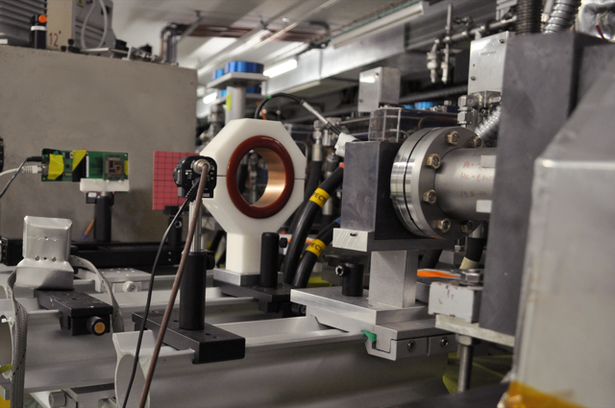
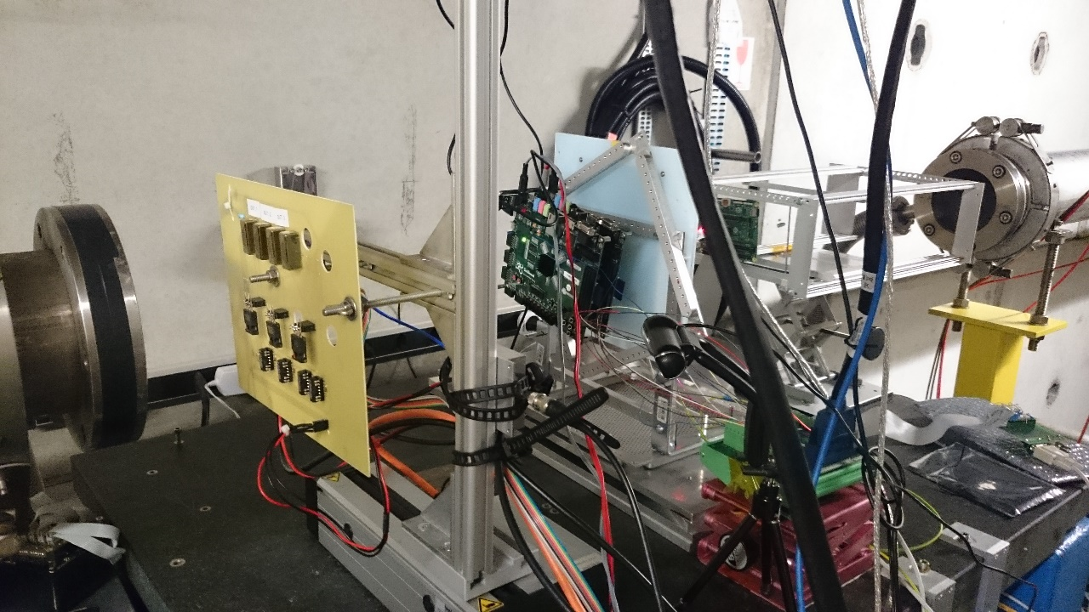
Other test facilities for R2E activities
Non-conventional irradiation sources & beams at CERN
  VESPER at CLEAR (high-energy electrons)
  Am-Be neutron source (e.g. for SEU setup validation)
  Ultra-high energy heavy ions at CHARM and North Area
Other external test facilities for recent R2E activities
  ILL (thermal neutrons) and LPSC (14 MeV neutrons) in Grenoble
  Low energy protons and ion cocktail at RADEF (Jyvaskyla)
  Atmospheric-like neutron spectrum for SEE testing at ChipIr (large beam available for board/system level testing)
  IJS reactor in Ljubljana (mainly displacement damage)
  Pion testing at PSI (through RADSAGA)
  GSI high-energy and micro-beam ions

Slide 13
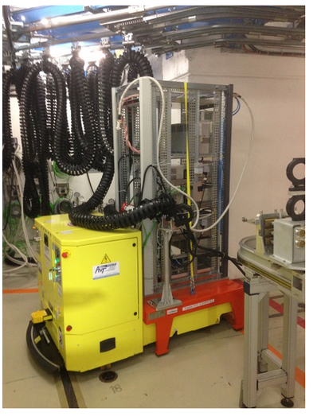
R2E equipment group developments (LS2)
Power converters:
  FGClite (already in operation in LHC ARC since EYETS 16-17)
  600A & 4-6-8 kA power converters
GEFE BPM electronics (for SPS)
QPS:
  Quench detection system for 11T
  Upgrade of main quadrupole systems
Vacuum gauge electronics

Slide 14
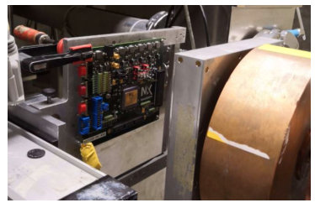
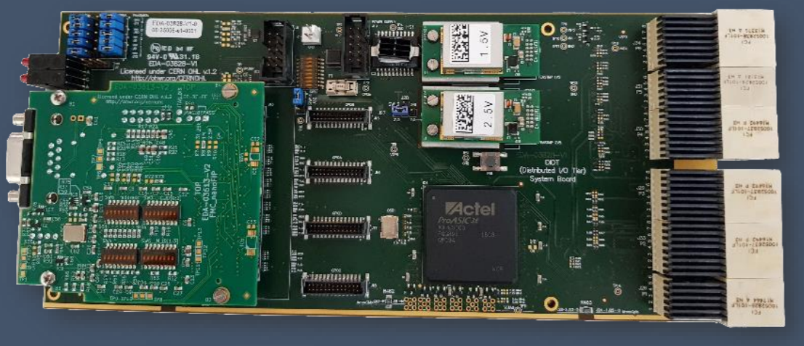
Common development examples
Evaluation of NanoExplore rad-hard FPGA for CERN applications
  EU effort to build ITAR free rad-hard FPGA based on 65nm ST technology (mainly for space applications, strong ESA support)
  Very promising radiation test results; lot procurement foreseen for 2019; working on implementing and testing accelerator applications
  Complementary efforts based on SmartFusion2 (as natural ProAsic3 replacement)
Support for radiation tolerant elements of BE/CO DIOT
  Ongoing developments (both in-house and through external company collaboration) to provide high-power DCDC converter module (synergies with TE/EPC needs)
  Initial design and qualification of Powerlink FMC board (baseline solution: soft-core System-on-Chip)

Slide 15
R&D activities related to RHA
Radiation effects on electronics evolve rapidly, mainly linked to the fast technological evolution
It is important to keep up-to-date with radiation effects on emerging technologies (e.g. deep sub-micron FPGA, wide-bandgap semiconductors for power and RF electronics) due to (i) obsolescence of older technologies and (ii) enhanced performance
A lot can be learnt from the well-established radiation effects space community, but “our” environment and needs are unique
Examples of ongoing R2E R&D activities with direct RHA implications (i.e. how we qualify electronics for the accelerator):
  TID and displacement damage synergy effects on e.g. bipolar components and opto-couplers (how representative is the test environment of the actual operation conditions?)
  Impact of intermediate and thermal neutrons on soft-error rate for LHC shielded areas (what is their relative contribution for state-of-the-art technologies, and how can we qualify in a representative manner?)
  Radiation effects on wide-bandgap semiconductor technologies (SiC, GaN)

Slide 16
R2E collaboration status
Universities (mainly Montpellier and Jyvaskyla):
  Collaboration agreements in place (or being implemented); regular student exchange (e.g. trainees, PhDs)
  Saint Etienne: strong focus on optical fiber dosimetry
CNES:
  Very active collaboration, mainly focused on common qualification needs and radiation monitoring
  CNES-CERN Steering Committee Meeting held in May 2018: https://indico.cern.ch/event/731449/
ESA
  Long-standing collaboration focusing on access to CERN and external radiation facilities and respective R&D studies
  Finalization of protocol on “radiation environments, technologies and facilities”, to be signed early 2019
ITER:
  Workshop held in May 2018 to provide overview of radiation effects on electronics activities and possible common points of interest: https://indico.cern.ch/event/708324/ (possible similar event to be held in 2019 with GSI → 2020: more general workshop on “radiation environments and effects on electronics in high-energy accelerators and nuclear facilities”)

Slide 17

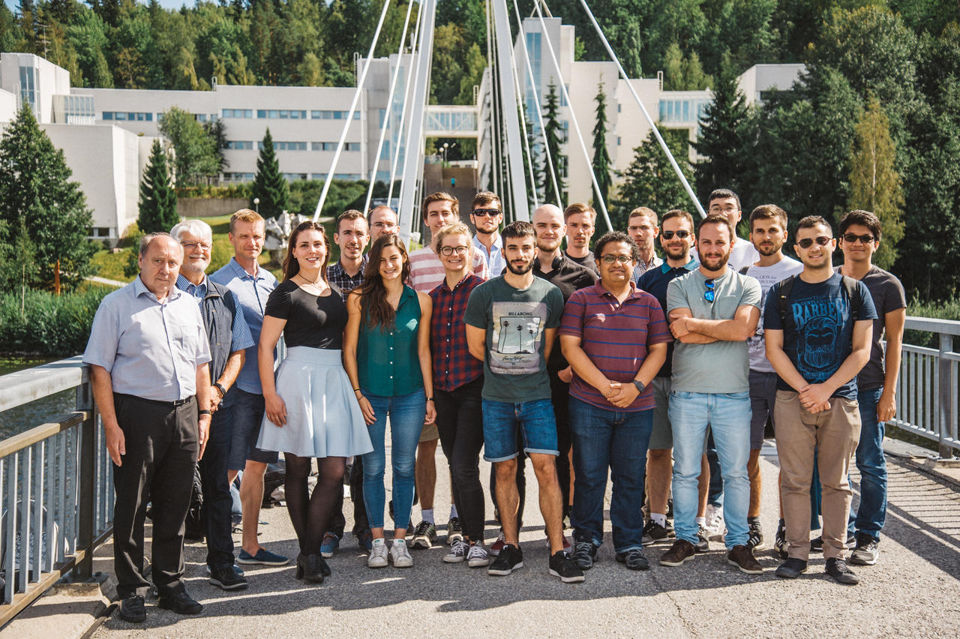
RADSAGA Marie Curie network
Network of 15 students distributed around different universities, laboratories and companies in Europe; coordinated by CERN
Working on emerging challenges for radiation effects on electronics in space, avionic, ground-level and accelerator applications
4 year project, started March 2017
Main 2018 achievements relevant to R2E:
  System-level testing in CHARM (e.g. software defined radio for satellite communication) and implications on RHA guidelines
  Custom design and calibration of variable voltage supply SRAM radiation monitor
  On-going rad-hard designs (e.g. CMOS imager)
http://radsaga.web.cern.ch

Slide 18
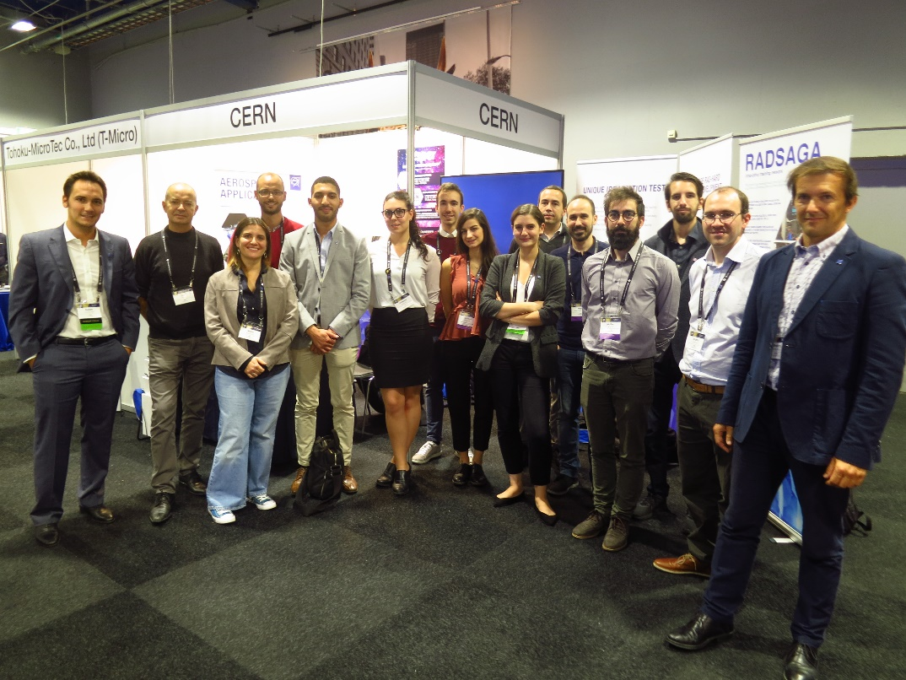
Many thanks to all!!
(part of the R2E team at RADECS 2018)

