Slide 1

Radiation Test Service (RADWG support)
Salvatore Danzeca (EN/SMM-RME)

Slide 2
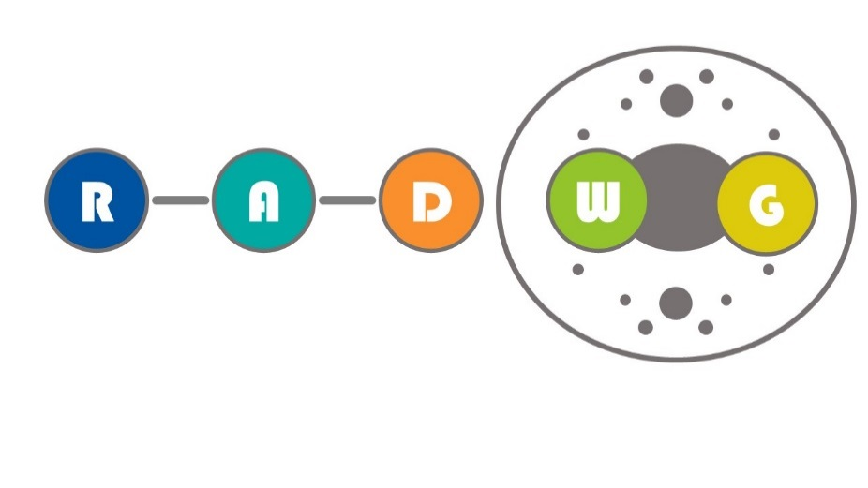
RADWG Mandate
It provides support to the accelerator sector equipment groups for the assessment of radiation tolerance of electronic equipment to be installed in radiation exposed areas.
It is as a forum for electronic engineers to discuss
  design practices
  radiation tests
  radiation induced failures in the accelerators.
It coordinates radiation test campaigns inside and outside CERN
The RADWG assists the R2E Project leader for the evaluation of the technical aspects of the proposed mitigation actions with the representatives of the equipment groups

Slide 3
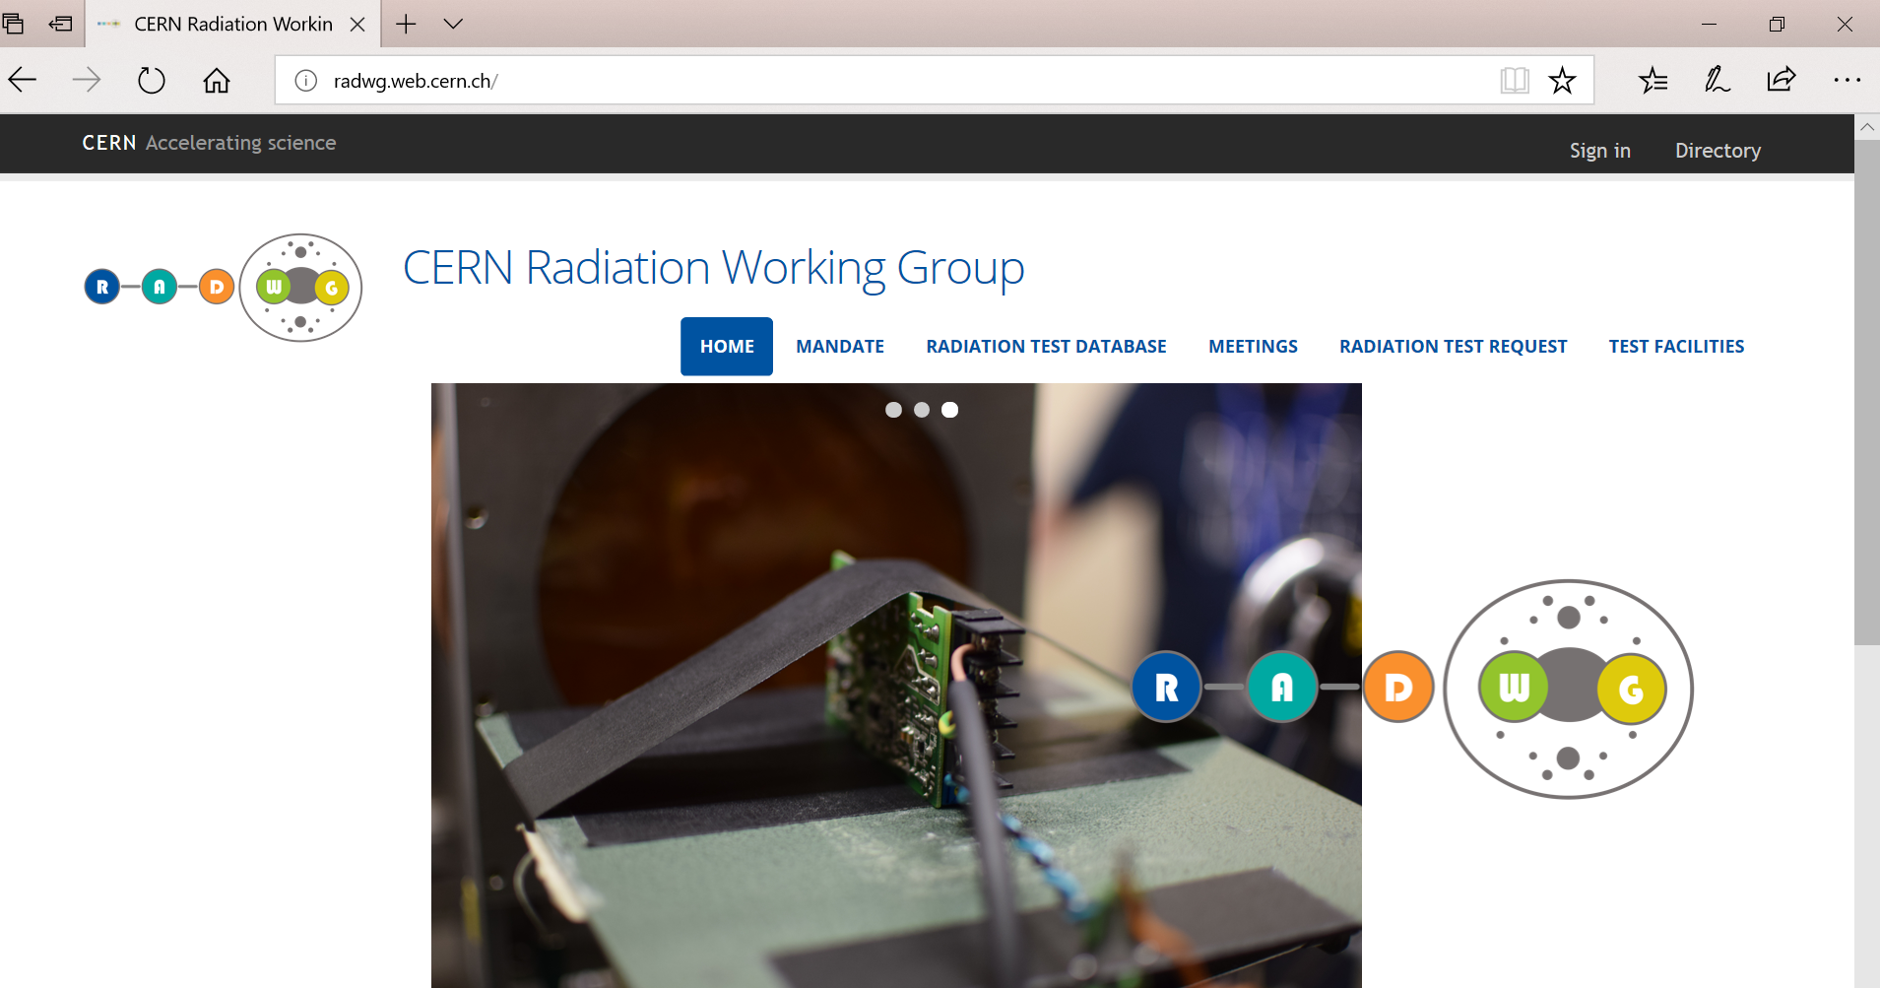
RADWG some numbers
60 RADWG meetings from the 2009
161 users subscribed to the mailing list lhc-proj-radwg-members and contact Gilles Foucard
Subscribe yourself to the mailing list to have access to the databases!
2018 New Website: https://radwg.web.cern.ch/

Slide 4
Radiation test as a service
Radiation testing requires:
  Knowledge of radiation effects on electronic
  Tests setup
  Instrumentation
  Facilities
  Result comprehension and reporting
Mandate:
  reduce and help the equipment group to lower the burden of the radiation test by giving the support as a service
  still keep high the knowledge sharing and the collaborations

Slide 5


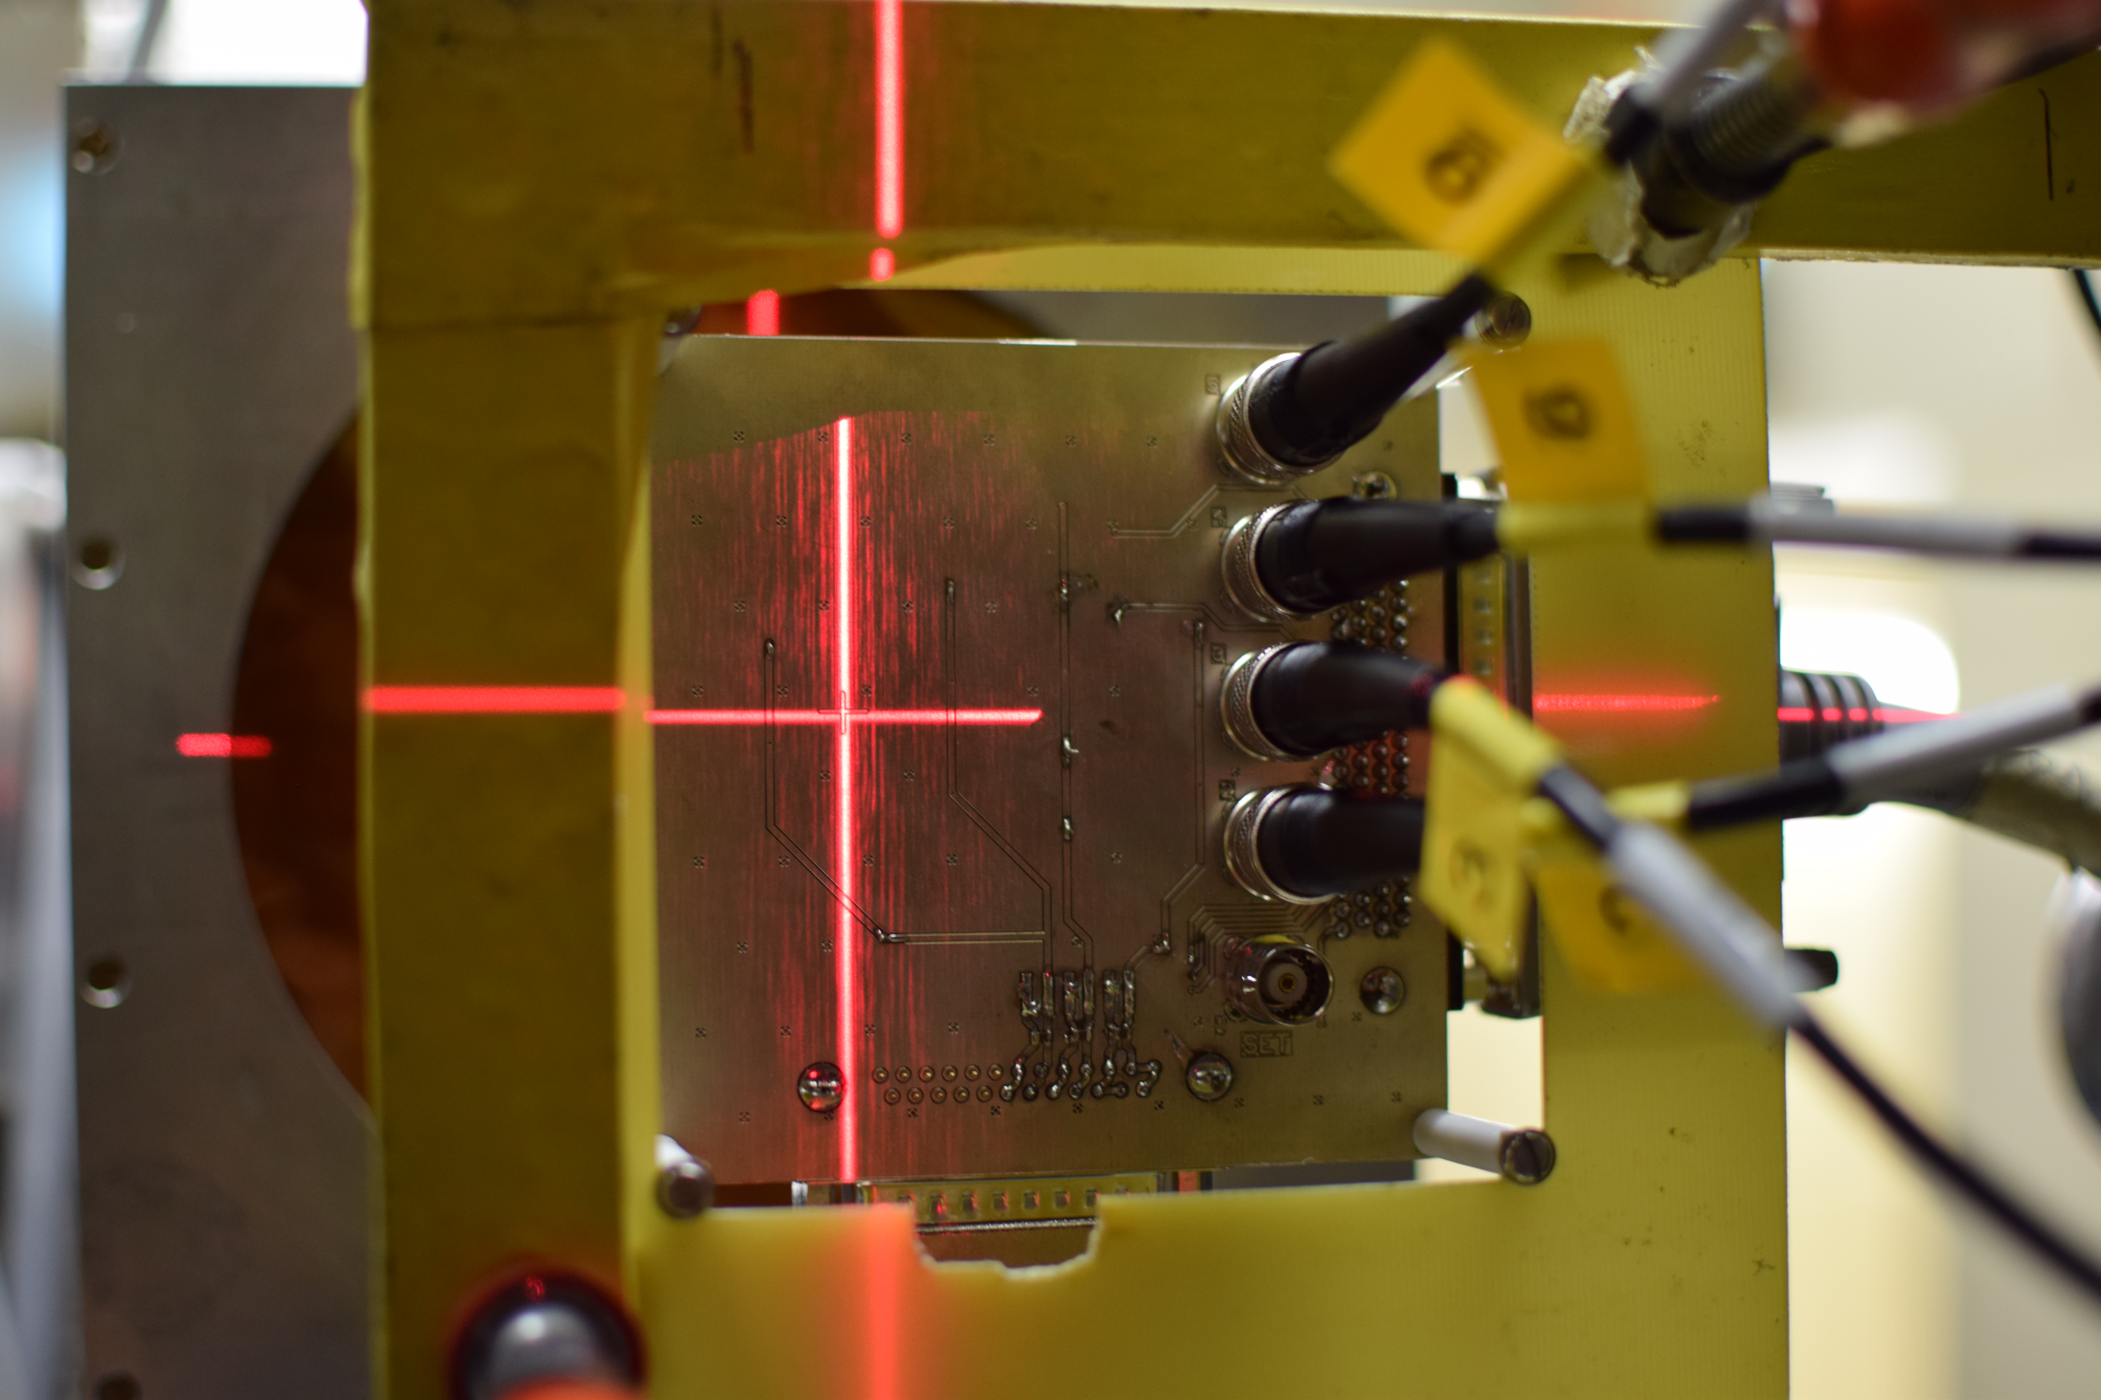
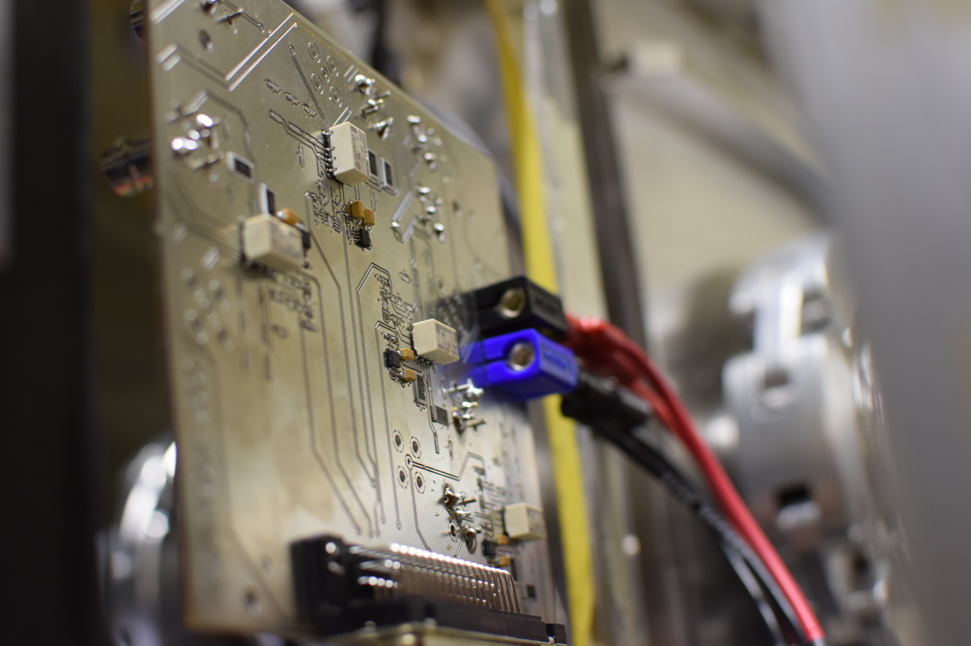
Radiation test service – EN/SMM-RME
Request collection
The request for radiation testing are collected and processed selecting the most suitable methodology and facilities
Database and Publication
Test planning and structure
01
The results are collected, stored and in EDMS and published in the RADWG database to allow an easy research of the best candidates for the new radiation tolerant designs
Each component/system is analyzed and all the possible radiation effects are taken into account for planning the test and structure it
06
02
Result analysis
The results are analyzed during and after the tests for each components considering the end application and the possible operational issues
Board and instrumentation preparation
05
03
For each component a dedicated set of test board is prepared and the associated instrumentation is chosen to face the complexity of the radiation test
04
Testing
The test are carried out at CERN facilities such as CHARM or Co60 and in external facilities. The transport, personnel and instrumentation are selected considering the peculiar aspect of each faiclity

Slide 6
Request collection
During the years the requests for new component increased from 40-50 components per year to more than 100 components in 2018
The trend is expected to not be reduced but increased due to the new developments for LS2 and LS3
All the equipment groups in charge of new developments requested the radiation test service to qualify the selected components

Slide 7
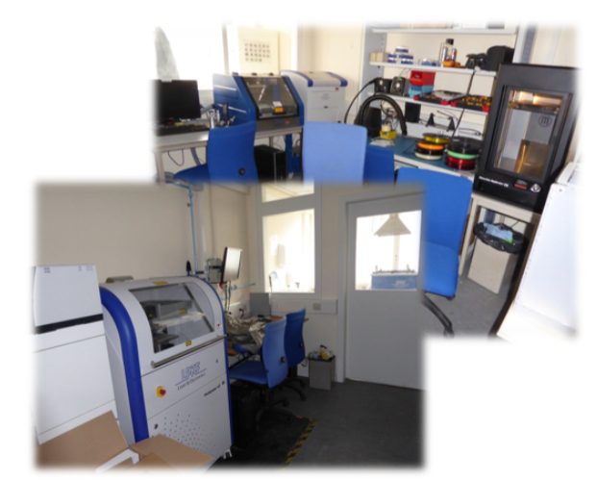
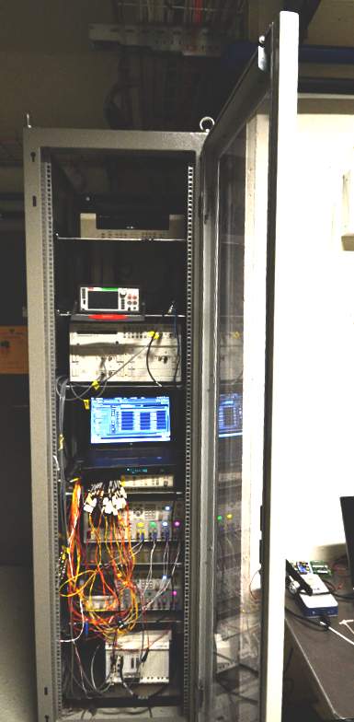
How?
Acquired know-how and development of standard test structures and instrumentation to be used allows a test every month on new devices
Tests are not limited to the requested parameters monitoring but general parameters are measured to be as general as possible and allow other users to verify the suitability of the devices for their purposes.
Key points:
  Ability to produce test cards within a week
  Ability to quickly develop firmware and software suited for the tests
  Availability of high-end instrumentation to face the most difficult task (i.e fA measurements under irradiation, Single Event Transient)

Slide 8
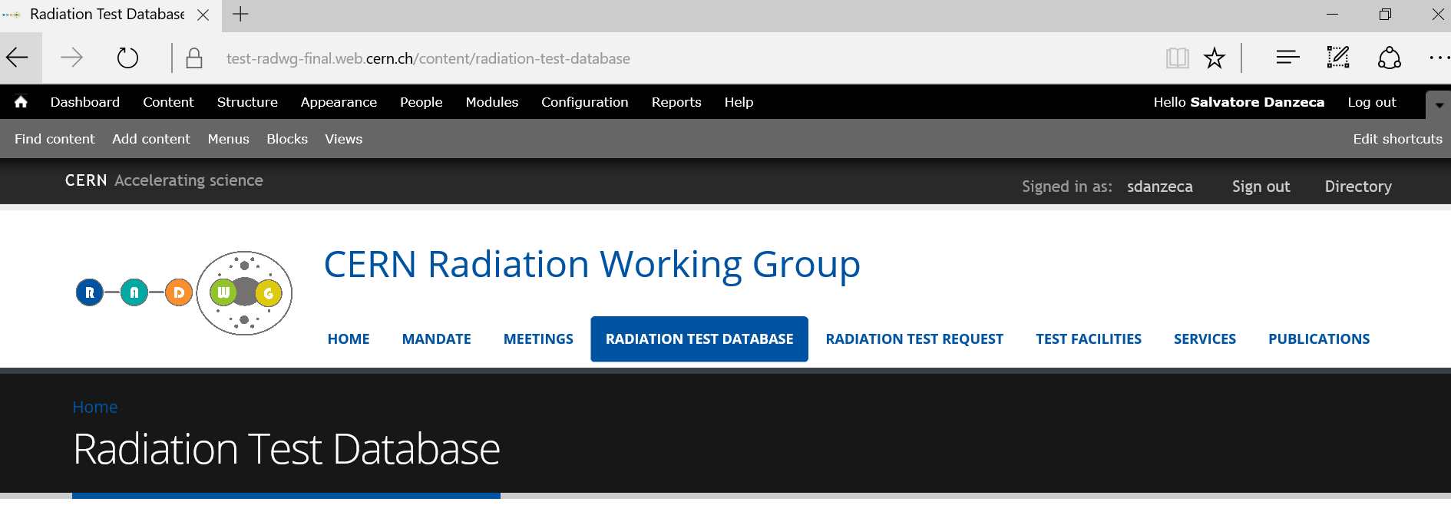
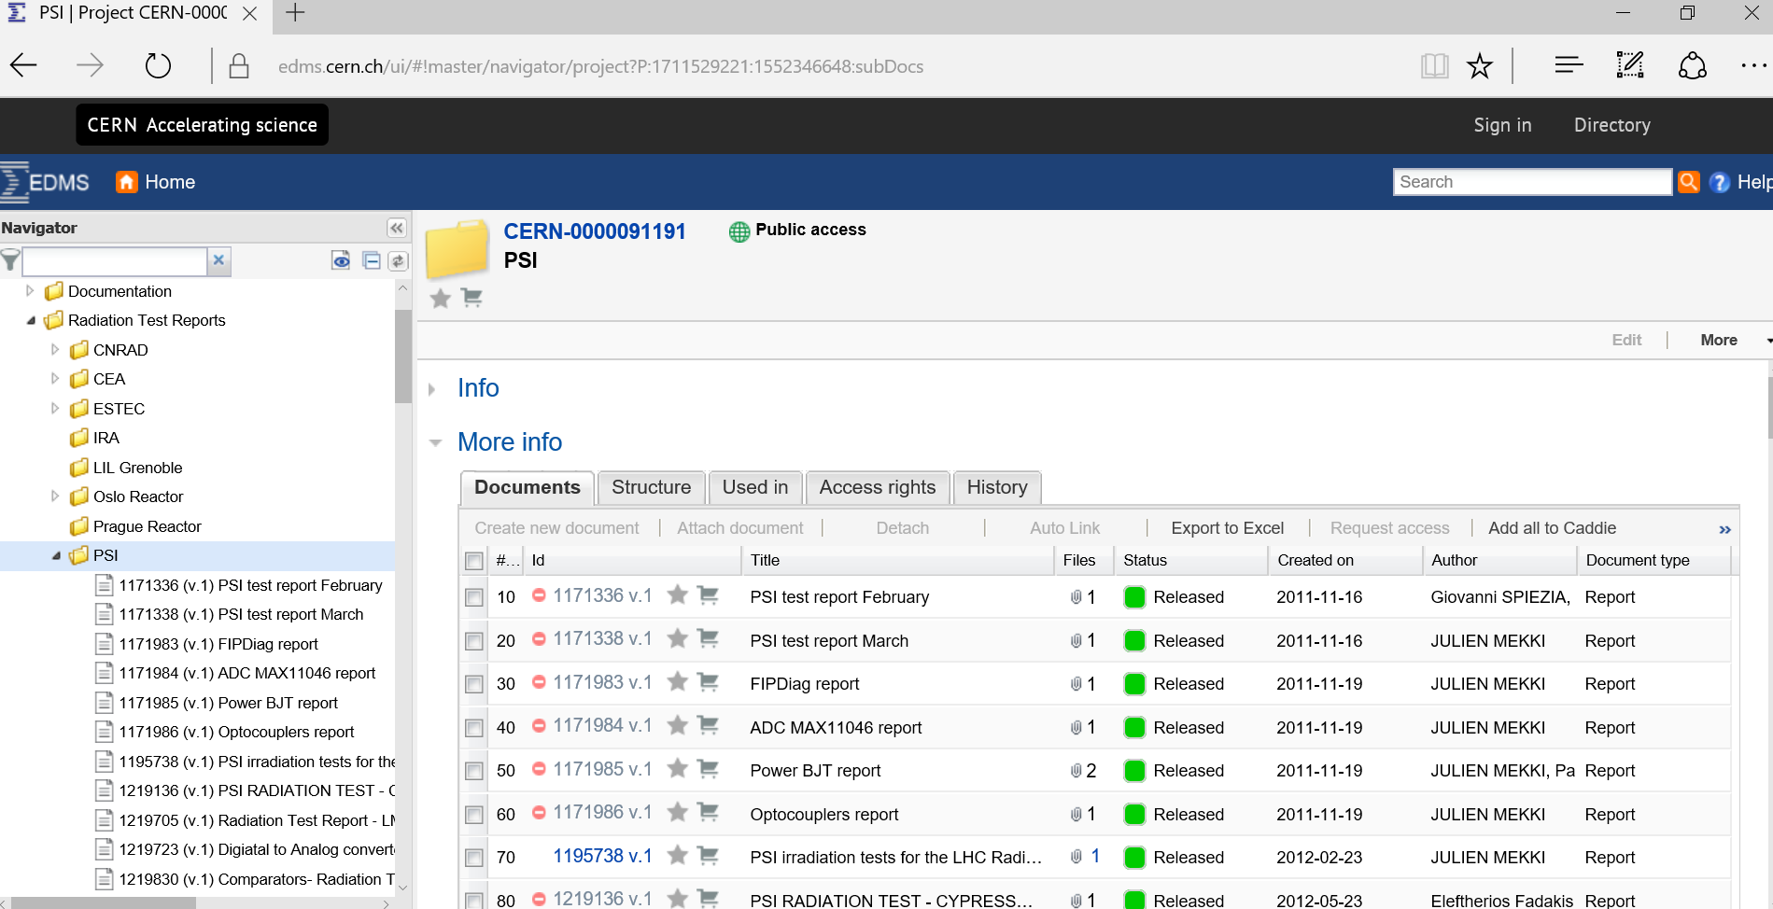
Test results and reporting
The service produces reports in a common template for all the components tested
  Test reports template ensure a coherent reporting
The service maintains two databases accessible by all the equipment groups
Radiation test results are reported also via the Radiation Working Group
The website https://radwg.web.cern.ch/ embeds an easy accessible database
  more than 285 reports from the 2011 up to 2018
It embeds also the TE-EPC component list and tests
https://edms.cern.ch/ui/#!master/navigator/project?P:1711529221:1382953417:subDocs
https://radwg.web.cern.ch/

Slide 9
Conclusions
The RADWG is a support forum where the equipment group can share their knowledge and results
The radiation test service has the mandate to provide radiation test data to the equipment groups developing rad-tolerant design
The radiation test service covers all the steps for a radiation campaign, from the test specification up to the reporting.
Tests are carried out to be more general as possible in order to create the common building blocks that can be re-usable by many other equipment
The two databases with the radiation test data are maintained to be the reference for all the CERN

Slide 10
Thank you

