Slide 2

R2E Annual Meeting
The Monitoring Calculation Working Group (MCWG)
Oliver Stein EN-EA-PE
K. Bilko, D. Di Francesca, R. Garcia Alia, K. Kandemir,
Y. Kadi, G. Lerner, G. Li Vecchi, C. Martinella,
MCWG

Slide 3
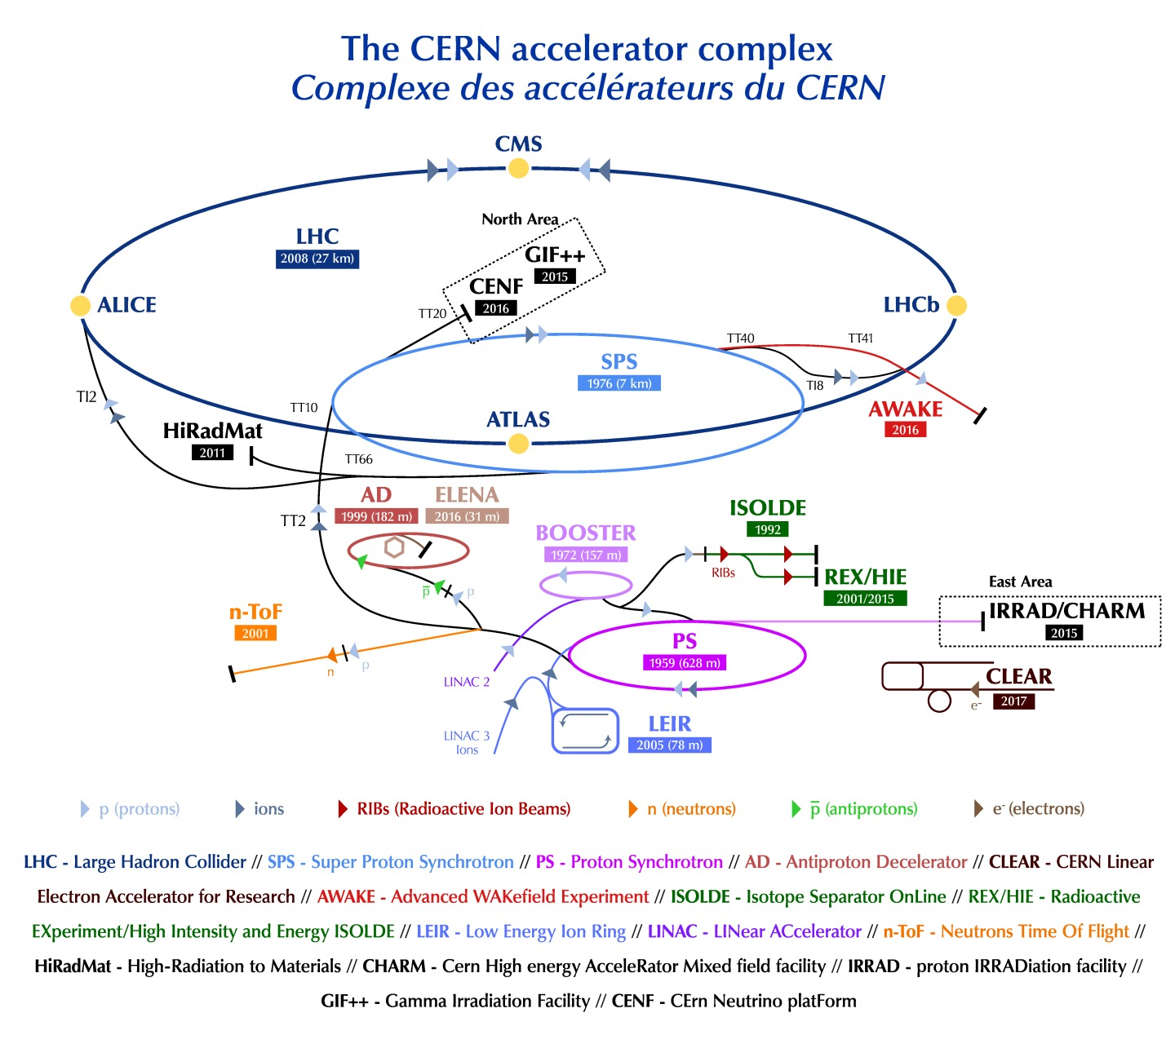
Accelerator operation and radiation fields
Continuous losses during accelerator operation creates a mixed radiation fields in the tunnels and adjacent caverns.
Radiation can negatively impact the life time and the functionality of the accelerator components and in worse case can lead to downtime of the machines.

Slide 4

Accelerator operation and radiation fields
Continuous losses during accelerator operation creates a mixed radiation fields in the tunnels and adjacent caverns.
Radiation can negatively impact the life time and the functionality of the accelerator components and in worse case can lead to downtime of the machines.
For optimal operation:
→ Qualified radiation tolerant systems
→ Radiation fields need monitoring
MCWG

Slide 5
Mandate of the Monitoring Calculation Working Group
Evaluation and analysis of distribution and evolution of the radiation fields along CERN’s accelerator complex.
Assessment of potential radiation risks resulting in requirements for handling existing equipment and future installations.

Slide 6
MCWG, from mitigation to prevention strategies
During Run1 of the LHC the main task of the MCWG was to react to electronic failures and to mitigate these failures in the future.
For Run2 the activities the focus changed to prevention of radiation induced failures, by providing information about the radiation distributions in order to minimize the risk of radiation induced failures.

Slide 7
Monitoring Calculation Working Group
Radiation detection
Users
BLMs
RadFets
Equipment groups
Dedicated requests
Dedicated analysis
Radiation data handling
General analysis
Online monitoring
RadMons
RPLs
Fluka team
OFD*
RP-Survey
Operations
Accelerator operation
HL-LHC WP
Beam intensities,
beam present times, luminosities,
collimator settings
Active exchange and
close collaboration with user groups.
many more …
* Optical Fibre Dosimetry project within the MCWG

Slide 8

Activities MCWG
Service
User Requests
Dedicated analysis of radiation levels at specific positions requested by the users.
Reports and
requirements how to proceed.
Past:
Requests were handled 100% manually
Time consuming
No reusability
Not reproducible
Very long response times to user requests.

Slide 9
Activities MCWG
New activities
Service
Optimisation
Operations
User Requests
Internal Projects
Online Monitoring
Dedicated analysis of radiation levels at specific positions requested by the users.
Reports and
requirements how to proceed.
Implementation of automated analysis for standardised routines.
Reduction of response time for user requests.
Monitoring the
day to day operation with standardised analysis routines.
Notifications in case of unusual radiation
level evolution or distribution.

Slide 10
Activities MCWG
New activities
Service
Optimisation
Operations
User Requests
Internal Projects
Online Monitoring
Dedicated analysis of radiation levels at specific positions requested by the users.
Reports and
requirements how to proceed.
Implementation of automated analysis for standardised routines.
Reduction of response time for user requests.
Monitoring the
day to day operation with standardised analysis routines.
Notifications in case of unusual radiation
level evolution or distribution.

Slide 11
Activities MCWG
New activities
Service
Optimisation
Operations
User Requests
Internal Projects
Online Monitoring
Dedicated analysis of radiation levels at specific positions requested by the users.
Reports and
requirements how to proceed.
Implementation of automated analysis for standardised routines.
Reduction of response time for user requests.
Monitoring the
day to day operation with standardised analysis routines.
Notifications in case of unusual radiation
level evolution or distribution.

Slide 12
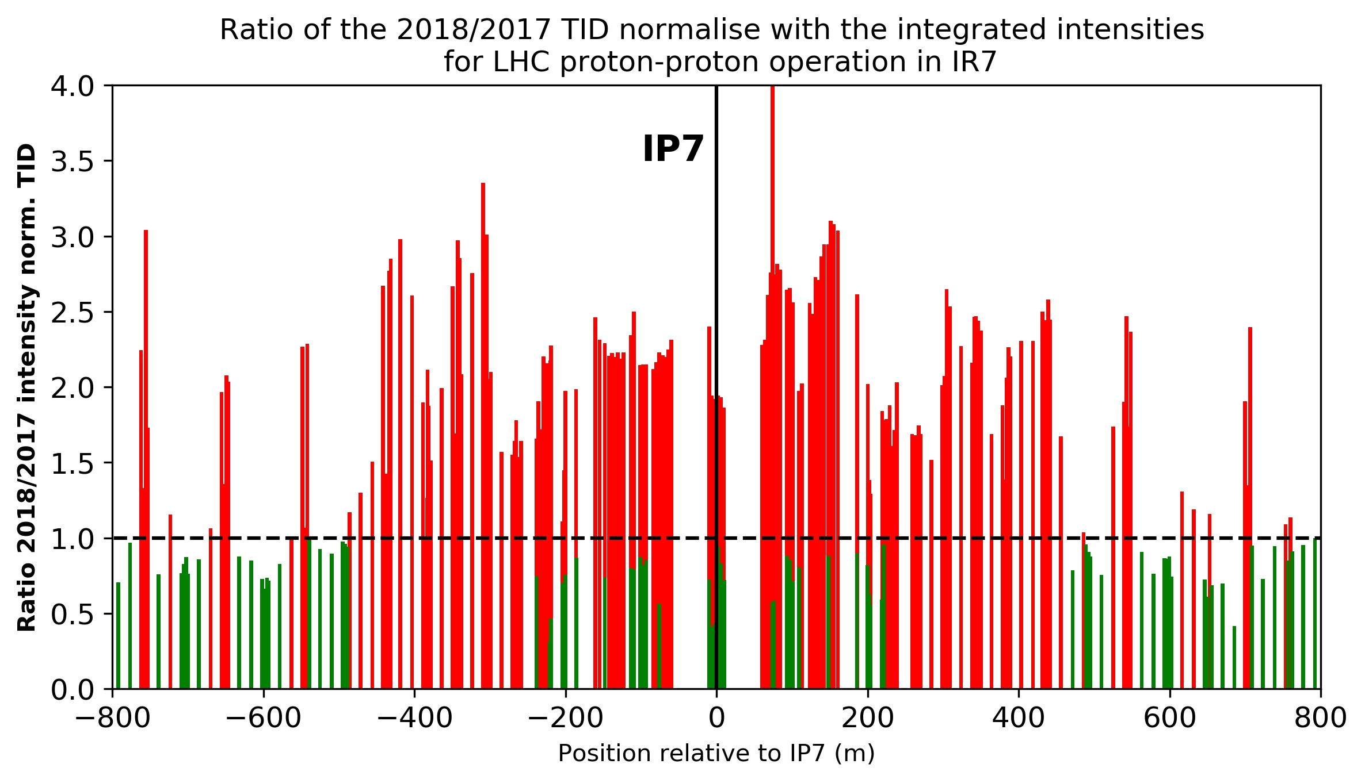
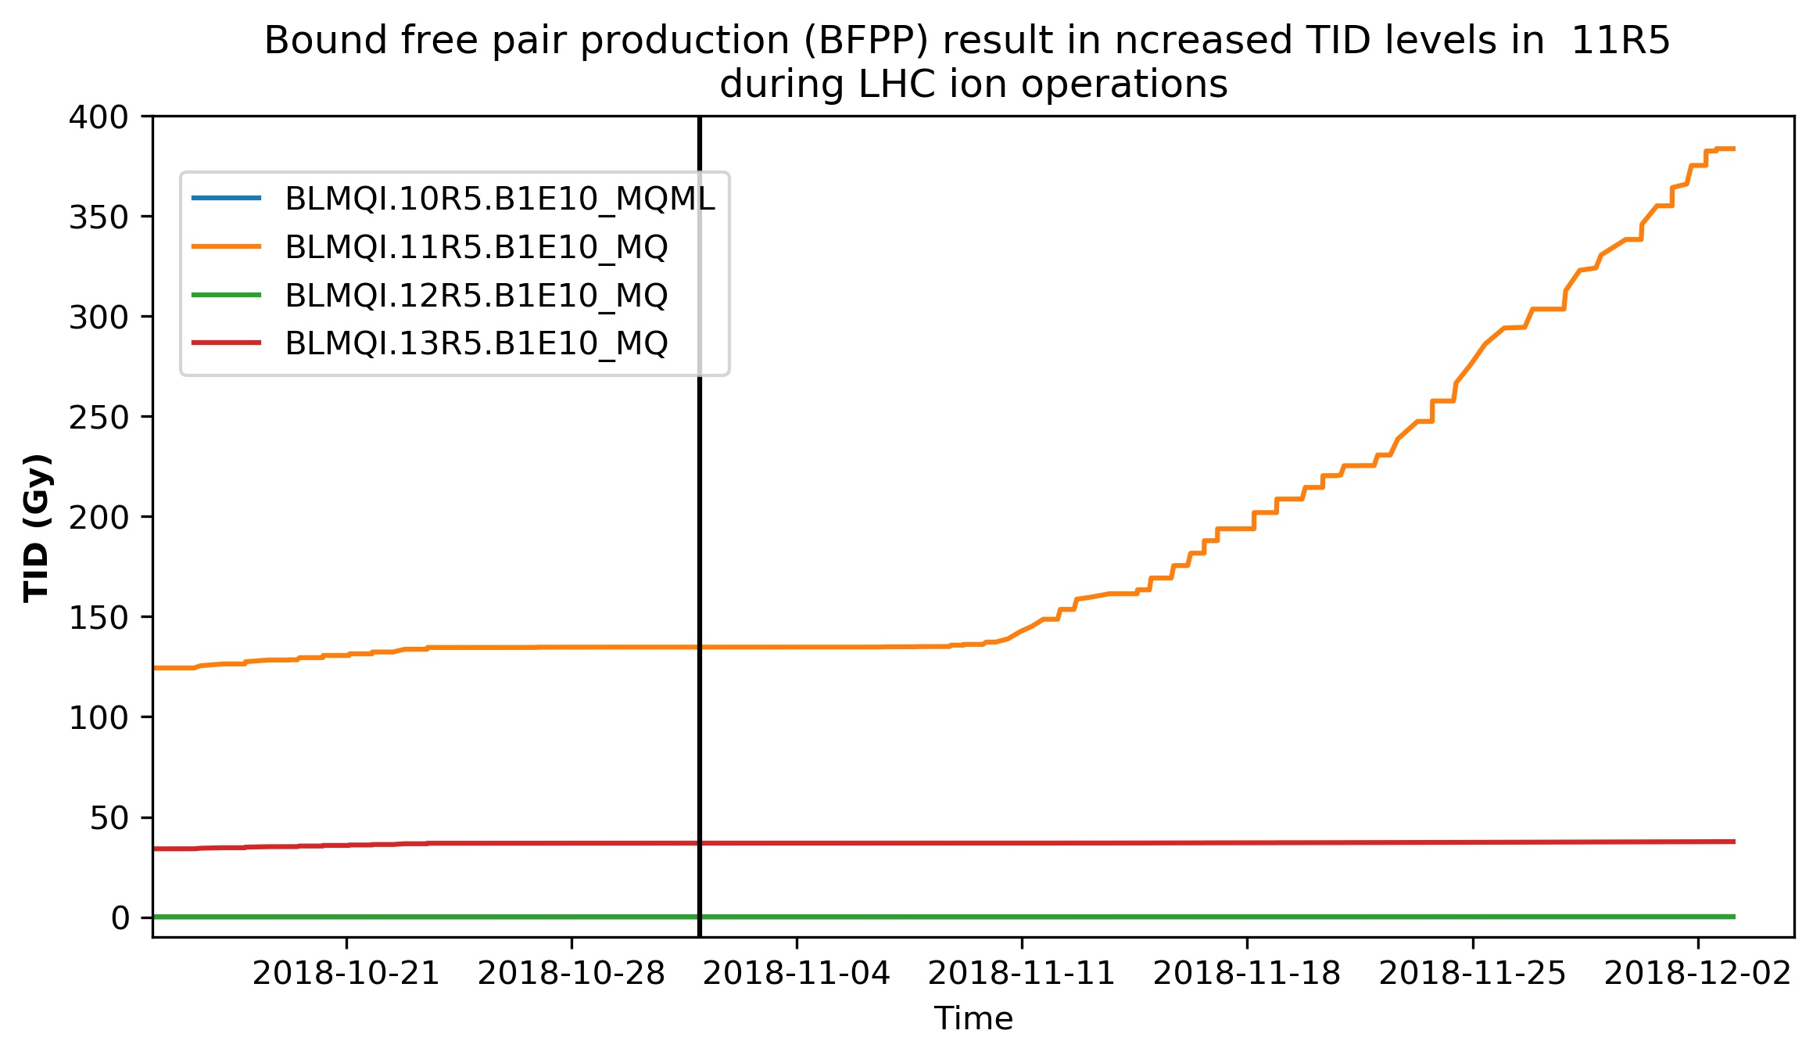
MCWG User requests highlights (2018)
Increased normalised losses in IR7 for 2018
pp operation compared 2017*
LHC ion operations: Significant contribution to local
TID levels due to bound free pair productions
Ratio < 1, good
Ratio > 1, not so good
LHC protons
LHC Ions
BFPP losses
The ratio TID 2018/2017 normalised with the
integrated intensity is > 1, direct implications for the HL-LHC
Increased levels due to changes in the accelerator operations*
* Update on the expected radiation levels for HL-LHC, G. Lerner

Slide 13
Improvement and Optimisation of MCWG workflow and activities
Strengthening the collaboration with LHC-operations, RadWG, FLUKA, etc.
for improving our analysis approaches
Development of MCWG analysis tools
    Automated analysis
    Standardised routines and algorithms
    Automated notifications
    SQL database
    Data sources included: BLMs, RadMons,
Data quality assurance

Slide 14
Day to day monitoring following the accelerator operations
Since 2018:
Continuous standardised analysis of the radiation data in the LHC
3500 BLMs
300 RadMons
Monitoring the evolution of the dose distribution during the annual operation*
Identifying the impact of changes in the accelerator operation on the dose levels
Analysis of baseline levels and local radiation maxima
Creation of reports including dose analysis and intensity calculations
Monitoring the radiation levels in the PSB and the PS by using OFD **
* Handling and analysis of radiation data sets,
the advantages of automised calculations and
fast accessibility of radiation measurements, K. Bilko
** Optical Fibre Dosimetry, D. Di Francesca

Slide 15
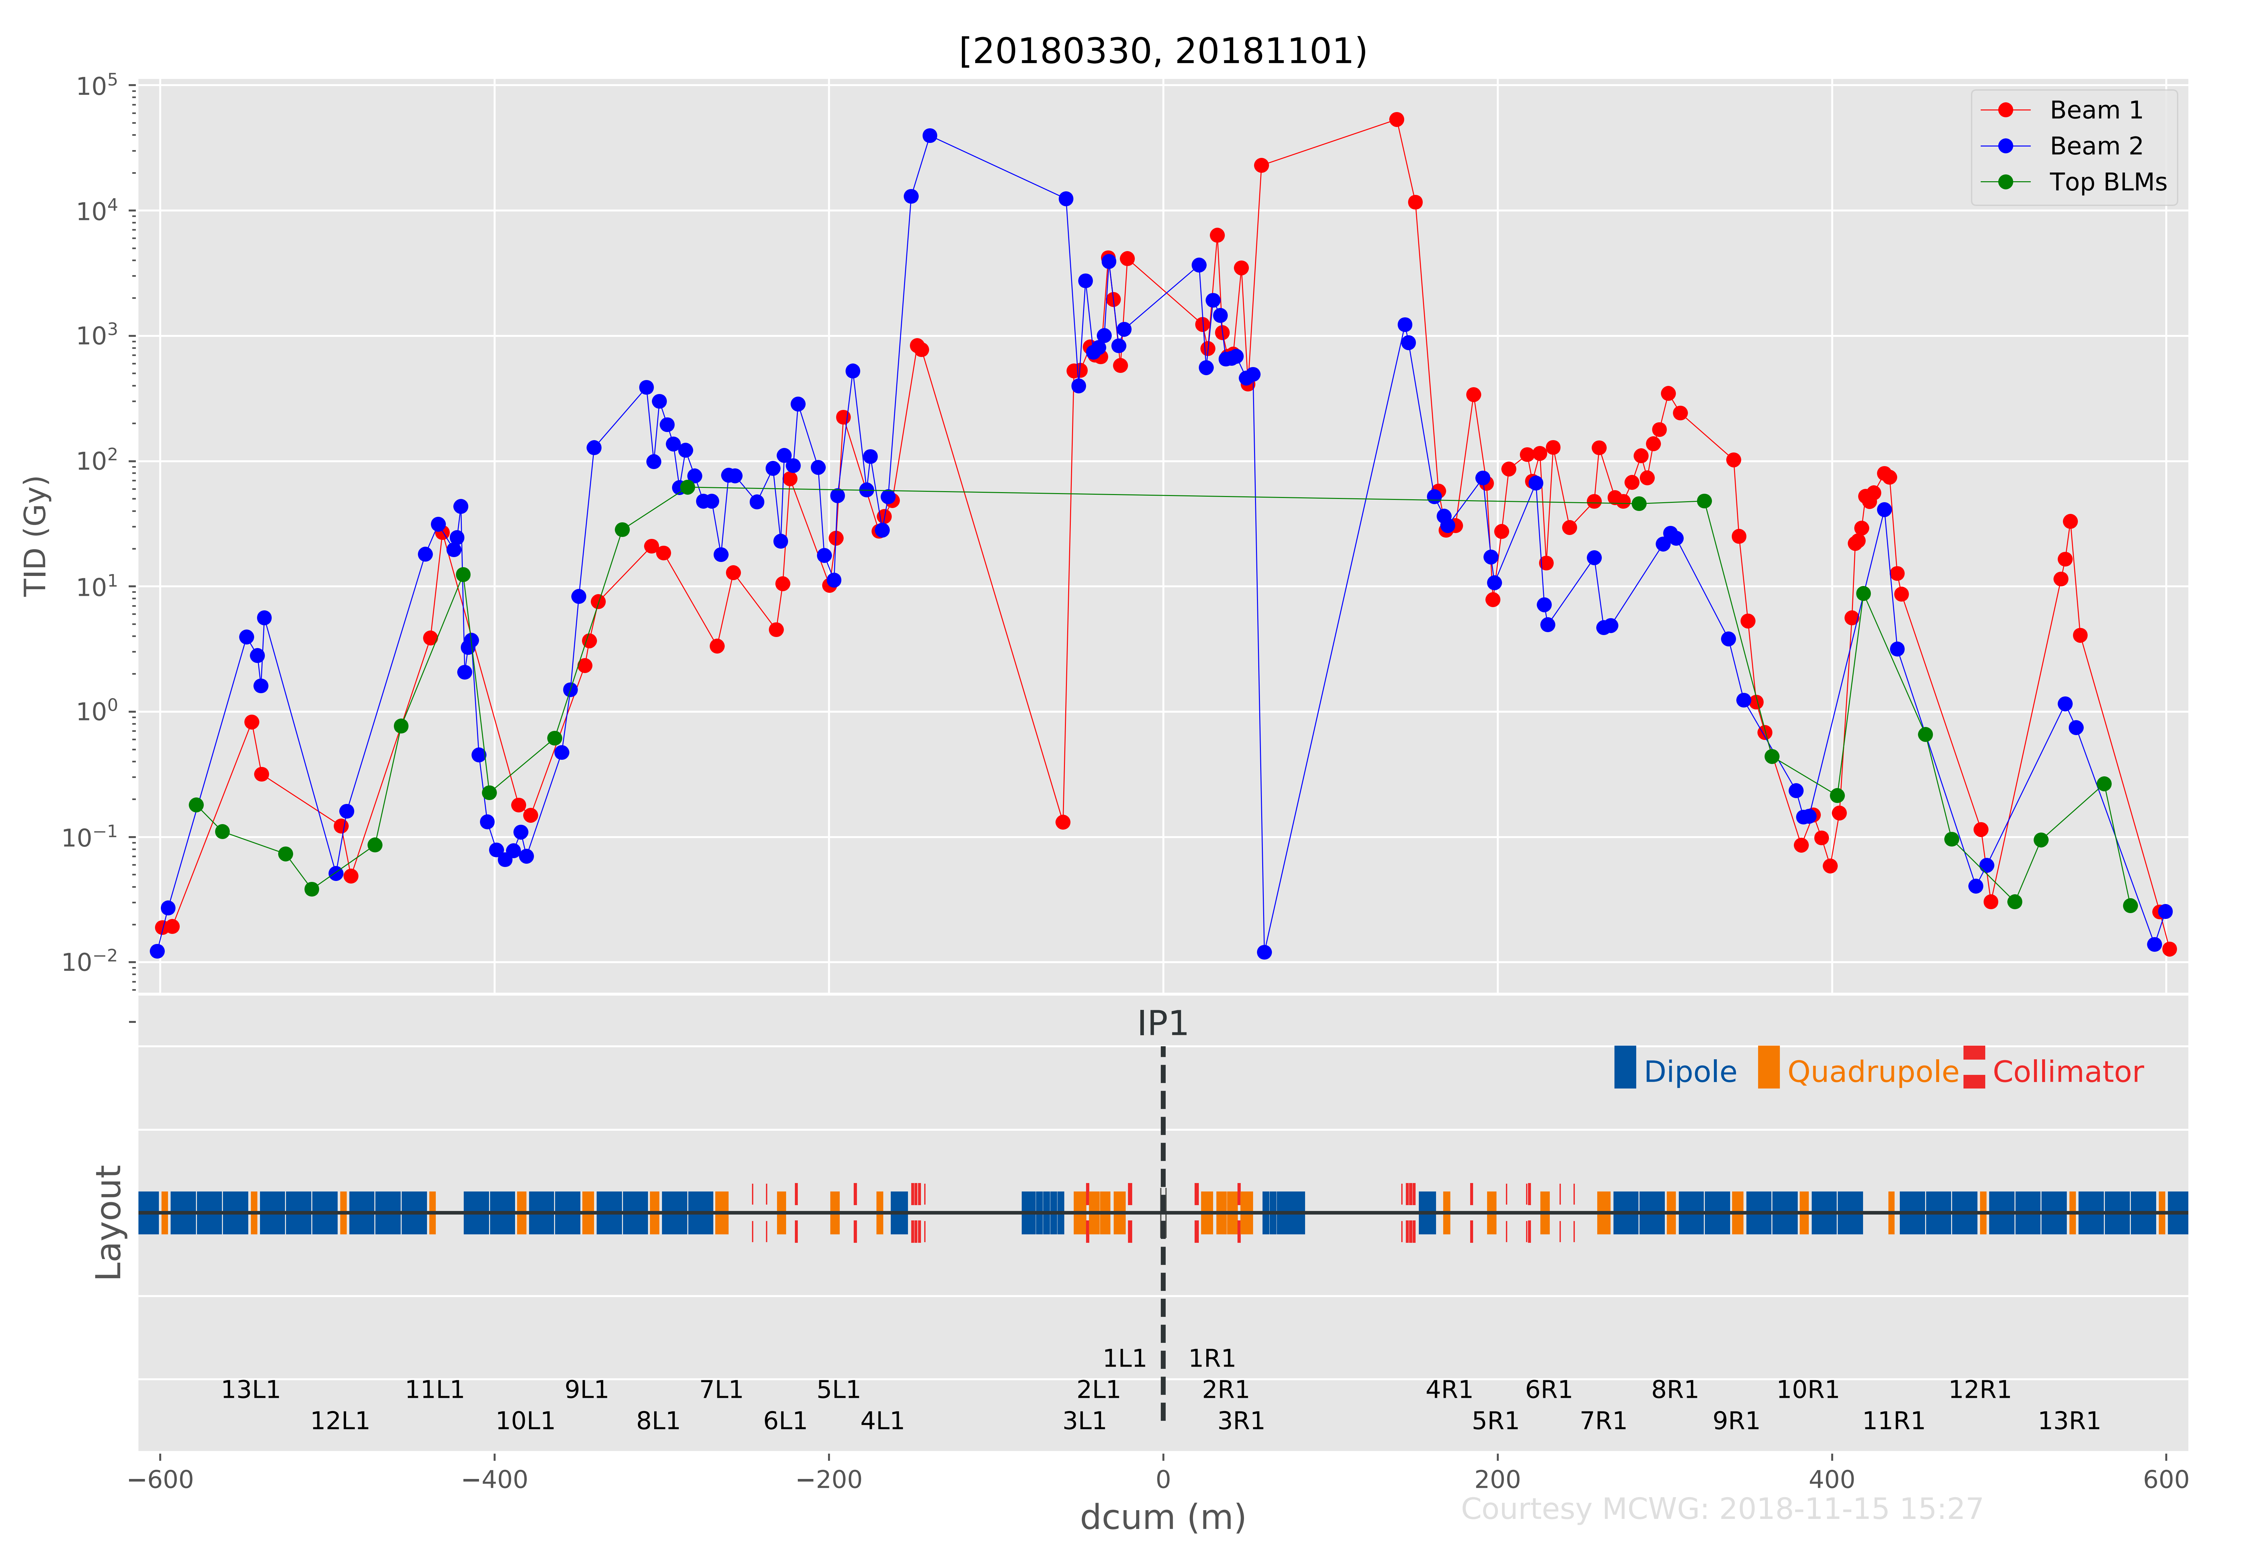
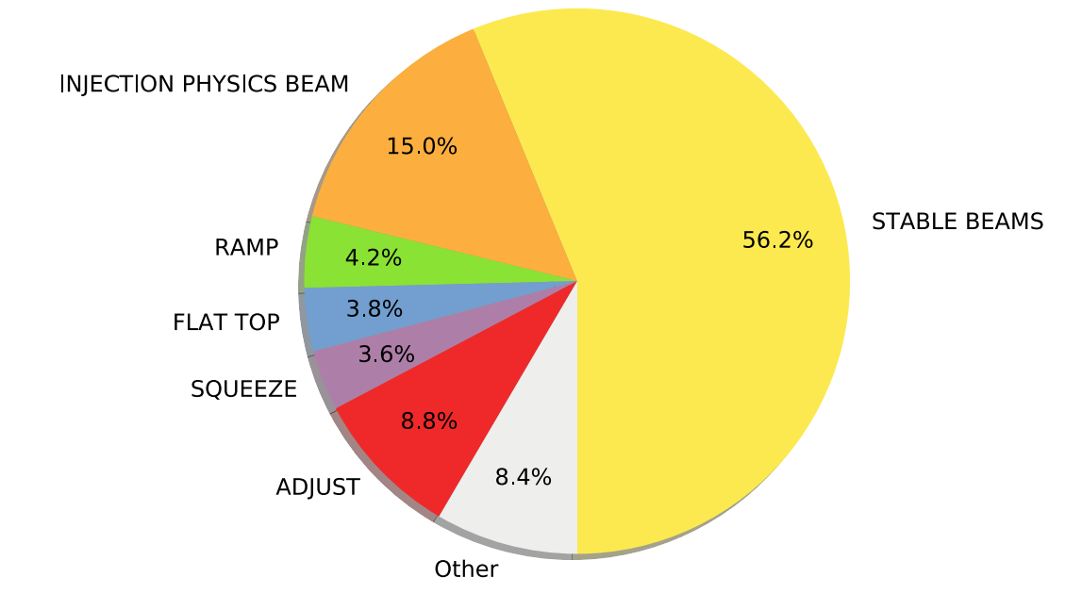
Day to day monitoring following the accelerator operations
Creation of BLM based radiation reports allows to
follow the LHC operations directly.
TID evolution analysis give indications
if loss pattern change during the year
IR1 Dose distribution for the 2018 proton-proton run
Percentage of
beam present time

Slide 16
Future projects and plans for the MCWG
LS 2
2019
2020
2021
2022
LS2
LHC
Injectors
Recommissioning
Operation
Long Shutdown 2 activities:
Implementing all radiation data sets into the MCWG database infrastructure
allowing fast and more detailed analysis of the radiation fields
Improving the automated analysis routines
    Optimisation and automated notifications
  Data quality assurance
Adaptation of the MCWG tools to the Run 3 infrastructure

Slide 17
Future projects and plans for the MCWG
Run 3
2019
2020
2021
2022
LS2
LHC
Injectors
Recommissioning
Operation
Run 3 activities:
Monitoring the radiation distributions during the accelerator operation after the shutdown
  Providing regular reports on the radiation levels
    LHC, SPS, PS, PSB, transfer lines and experiments
  Reacting to dedicated requests
    BLMs, RadMons, BatMons, RadFets, RPLs, OFD, RP-Surveys
Testing and optimisation of the MCWG tools to the Run 3 infrastructure

Slide 18
Core personnel of the MCWG
Name | Tasks
Ruben Garcia Alia | R2E project leader
Yacine Kadi | MCWG chairman, coordination
Oliver Stein (Fellow) | MCWG coordination, request coordination, radiation data analysis, development of analysis routines, requests
Kacper Bilko (Fellow) | Radiation data analysis, development of analysis routines, database maintenance
Giuseppe Lerner (Fellow) | Radiation data analysis, direct link to HL-LHC
Corinna Martinella (PhD) | Irradiation tests, RadMon analysis, requests
Diego Di Francesca (Fellow) | Optical Fibre based Dosimetry (OFD)*
Gaetano Li Vecchi (PhD) | Optical Fibre based Dosimetry (OFD)*
Keziban Kandemir (TECH) | Optical Fibre based Dosimetry (OFD)*
* Separate presentation: Optical Fibre Dosimetry, D. Di Francesca

Slide 19
Costs and budget of MCWG
MCWG Costs
MCWG 100% financed by the R2E project
Personnel:
Fellows, PhDs and Technical students
Hardware:
R&D for optical fibre dosimetry
Installation for optical fibres in the accelerators
30% Personnel
70% Hardware

Slide 20
Summary
The Monitoring Calculation Working Group (MCWG) is part of the Radiation to Electronics project (R2E)
Multiple collaborations with R2E work packages and with other CERN groups
MCWG three columns:
Service: Response to requests
Operational: Monitoring the day to day operation
Optimisation: Improvisation of the existing routines and new projects
Future:
Centralisation of all radiation data sets
Active monitoring of all accelerators
Improving the radiation data analysis

Slide 21

Conclusion
MCWG direct link between equipment and simulation groups and the accelerator operation
MCWG became much more efficient during the past two years
Faster Response to requests
Standarised analysis routines
Daily radiation reports following the accelerator operations
Vital working group to ensure the radiation monitoring
Beside the daily routines, many new ideas and projects planned for LS2 and Run3
A lot of changes in the infrastructure expected during LS2
Recommissioning of the accelerator after LS2 will bring new radiation environments,
which need to be understood
For an effective and productive monitoring the MCWG needs continuous optimisation
MCWG

Slide 22
Conclusion
MCWG direct link between equipment and simulation groups and the accelerator operation
MCWG became much more efficient during the past two years
Faster Response to requests
Standarised analysis routines
Daily radiation reports following the accelerator operations
Vital working group to ensure the radiation monitoring
Beside the daily routines, many new ideas and projects planned for LS2 and Run3
A lot of changes in the infrastructure expected during LS2
Recommissioning of the accelerator after LS2 will bring new radiation environments,
which need to be understood
For an effective and productive monitoring the developed tools need maintenance and optimised
To secure all the MCWG related activities in the future
also the manpower needs to be secured as well!
MCWG

Slide 23
Thank you for your attention!
MCWG
Thanks to the MCWG members, the R2E project groups, the users and collaborators!

Slide 24
Conclusion
MCWG direct link between equipment and simulation groups and the accelerator operation
MCWG became much more efficient during the past two years
Faster Response to requests
Standarised analysis routines
Daily radiation reports following the accelerator operations
Vital working group to ensure the radiation monitoring
Beside the daily routines, many new ideas and projects planned for LS2 and Run3
A lot of changes in the infrastructure expected during LS2
Recommissioning of the accelerator after LS2 will bring new radiation environments,
which need to be understood
For an effective and productive monitoring the developed tools need maintenance and optimisation
MCWG
For securing all MCWG activities in the future the manpower needs to be secured as well.

