Slide 1
R2M – Radiation To Material
Material testing and external facilities
EN/STI/TCD
Elisa Guillermain
Marco Calviani
indico.cern.ch/event/760345/

Slide 2
Why testing equipment and material ?
  Consequences of equipment radiation damage :
              Machine unavailability
              Unforeseen replacement costs
  Equipment qualification allows :
              Selecting the most resistant equipment / materials
              Meeting equipment lifetime constraints
              Anticipate failures (prevention)
              Avoiding ALARA issues (radiation protection)

Slide 3
Contents
WP R2M scopes
    Support in assessing radiation damage to CERN accelerators equipment
    Coordination of CERN wide high doses irradiation tests in external facilities
    Long-term know-how on material radiation damage effects
Progress overview
Outlook and prospects

Slide 4
Support in assessing radiation damage to CERN accelerators equipment
Which material(s)
Which radiation is representative (Gamma ? Particles ?)
CERN environment = mixed particle field
  Most of irradiation tests performed with gammas
    TID damage depends on the dose (Gy), not the radiation type
    Can reach high dose rate with large volume
    Do not activate samples
  Particles irradiation required in some cases, depending on material
    Examples: crystals, ceramic, piezo (?)
Materials = polymers, glass, etc
  All equipment but electronics and beam intercepting devices (BID)
  Materials damage due to
    TID (Total Ionizing Dose)
    DD (Displacement Damage)
    Cumulative effects :
    Long-term damage!
    Accelerated ageing tests

Slide 5
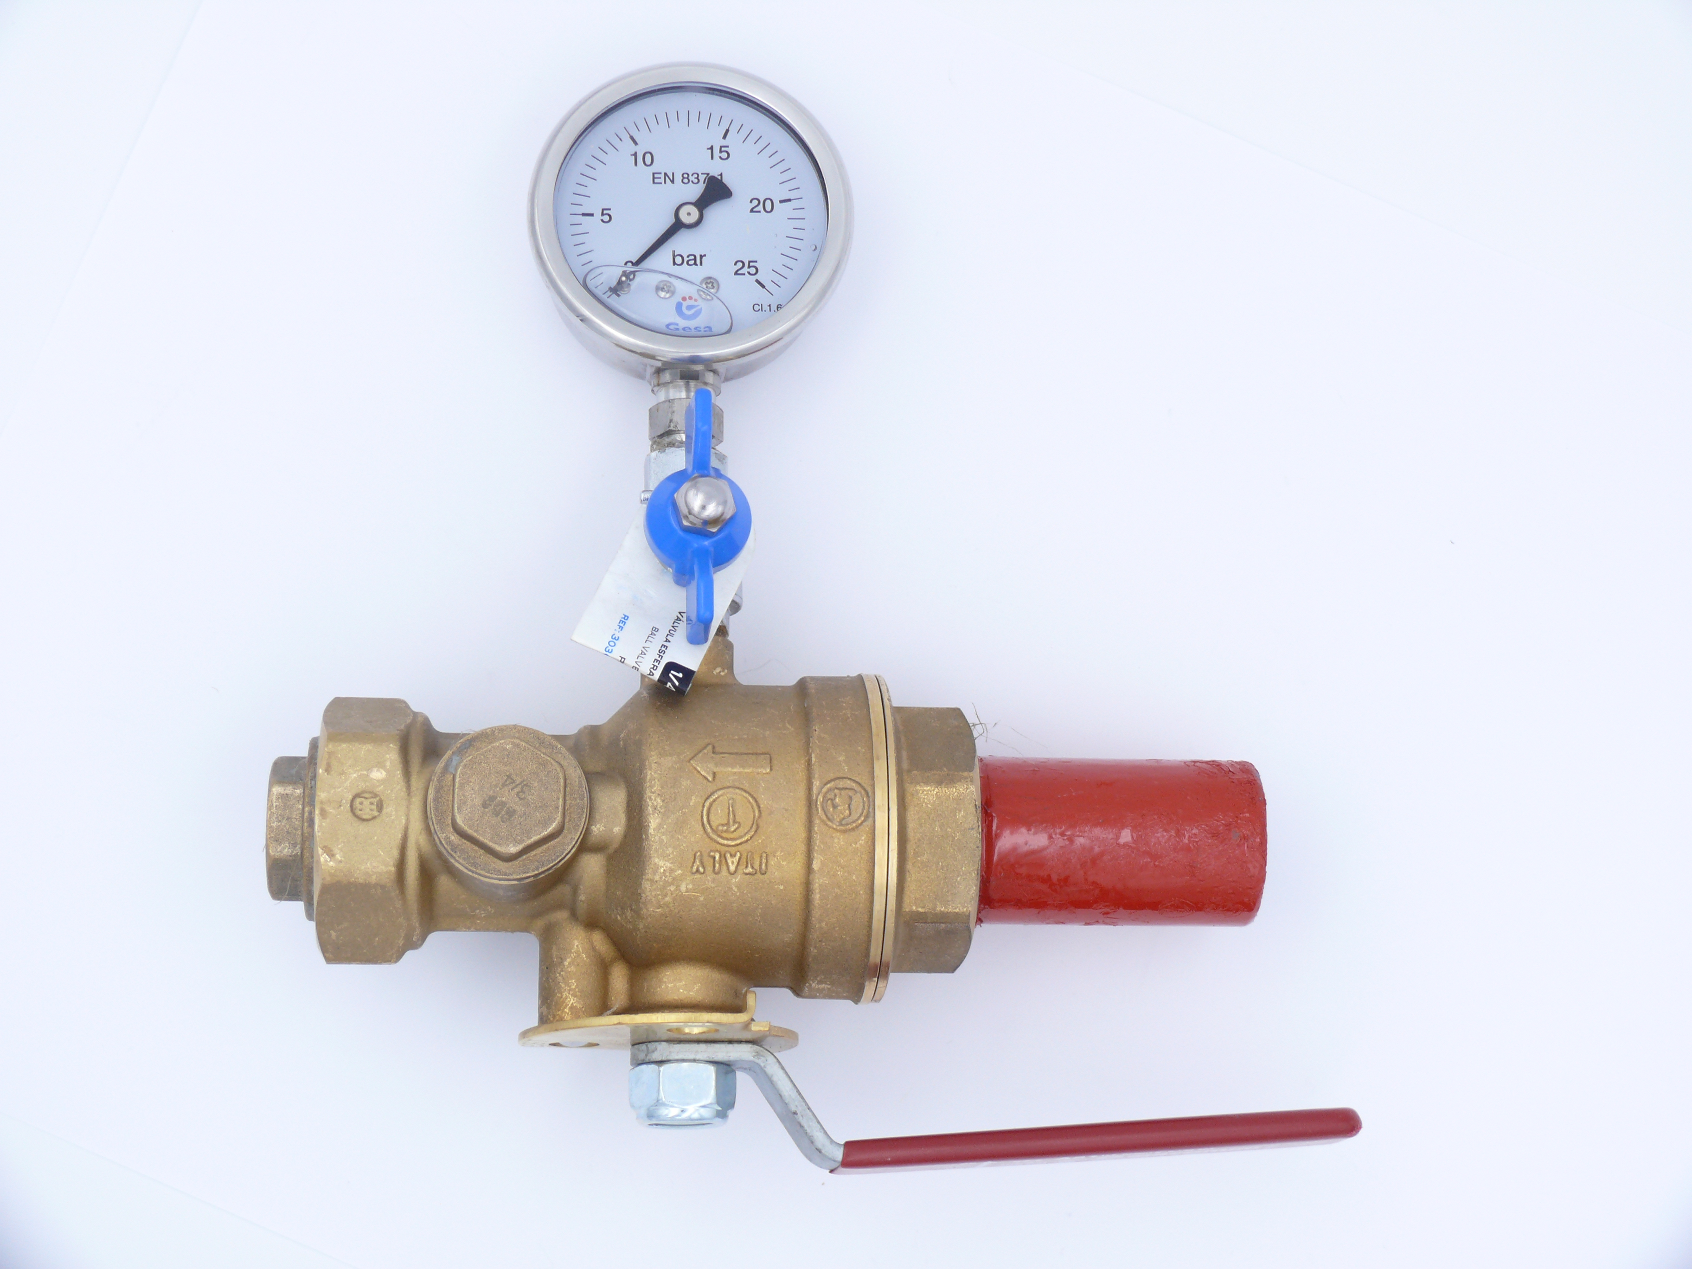
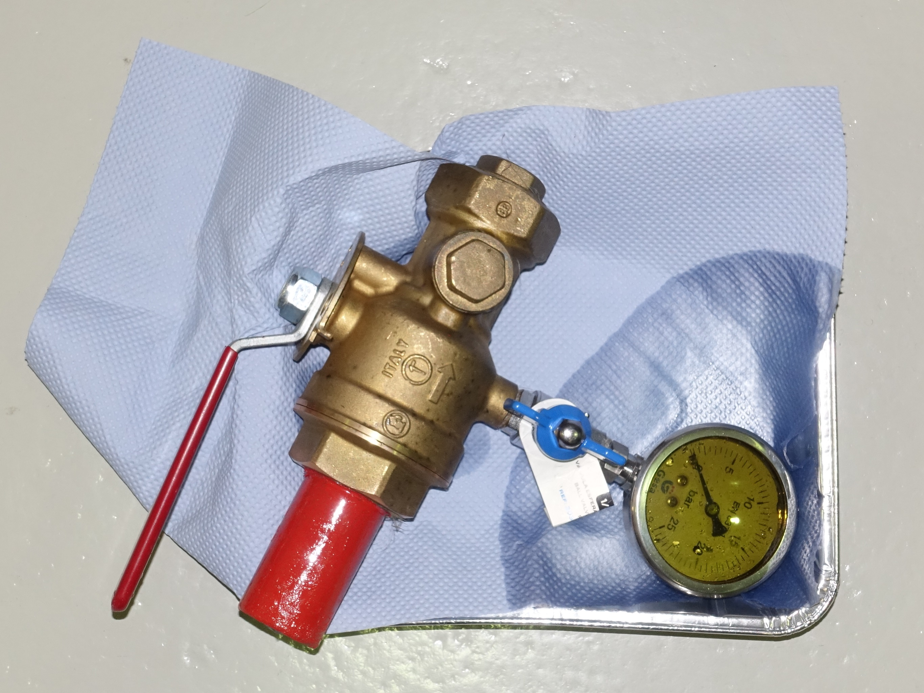
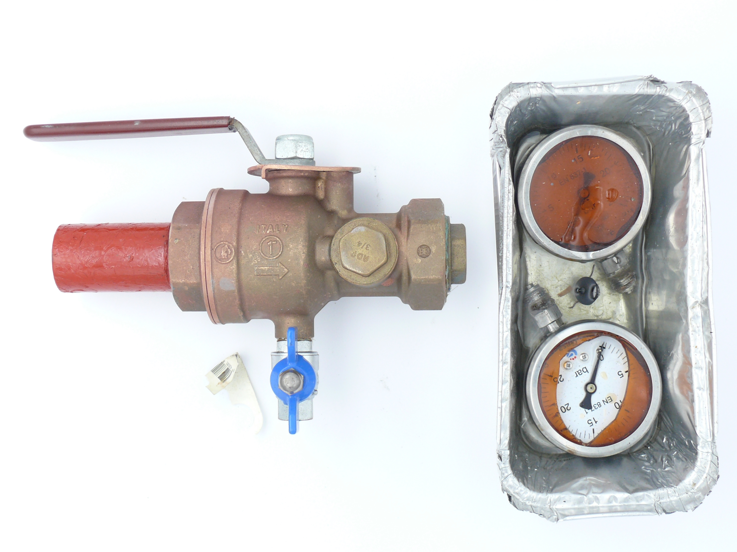
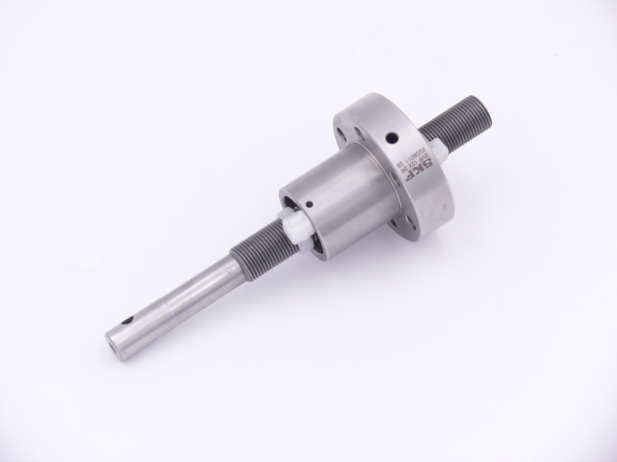
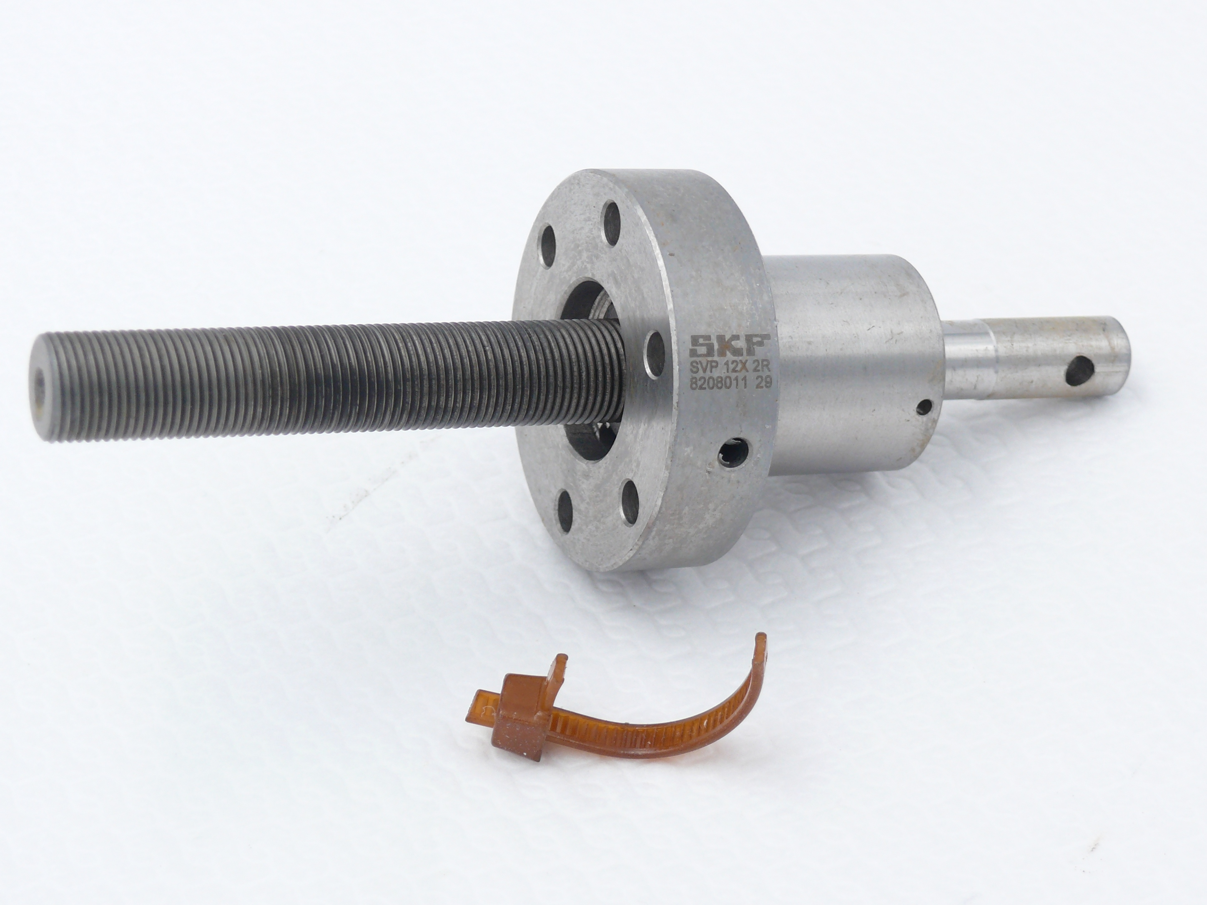
Irradiation tests: Few examples
Test and drain valve (SPS fire safety upgrade): (1) not irradiated, (2) 500 kGy, and (3) 3 MGy
Gamma irradiation in BGS facility conveyor, September / October 2018
(1)
(2)
(3)
Lead screws for LHC collimators: (1) not irradiated, (2) 5 MGy
Gamma irradiation in BGS facility conveyor, September / October 2018
(1)
(2)

Slide 6


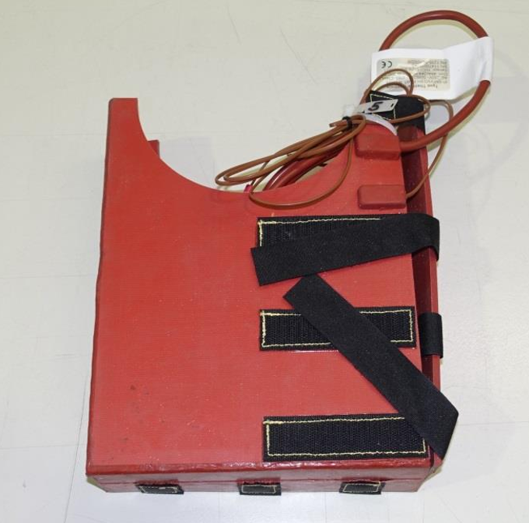
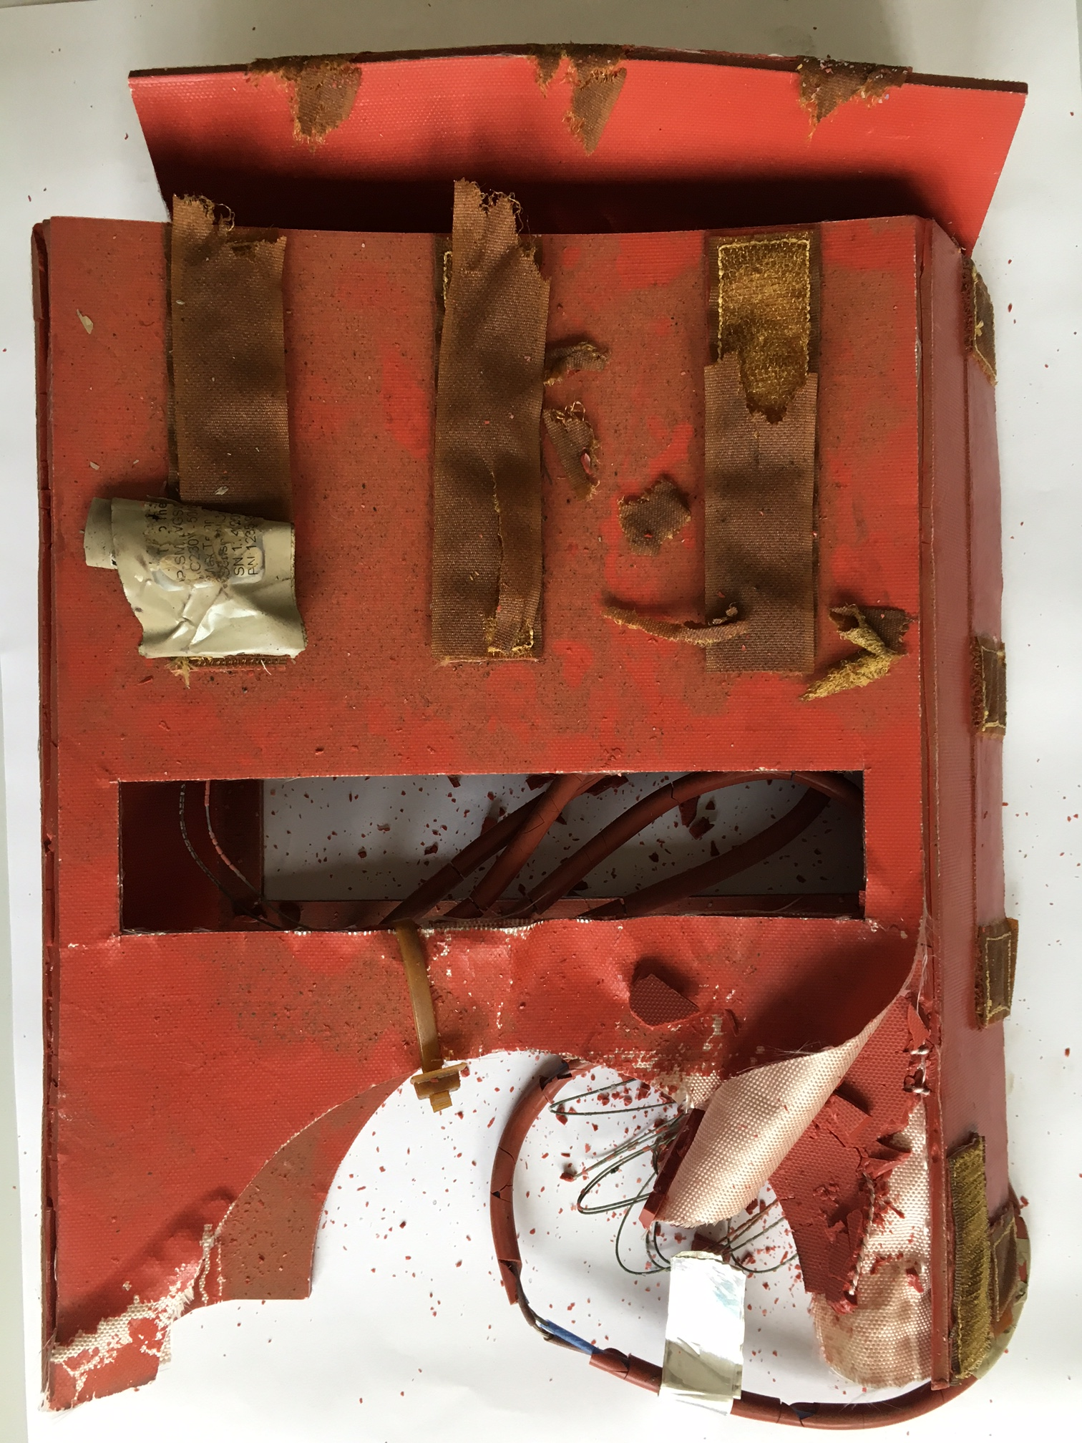
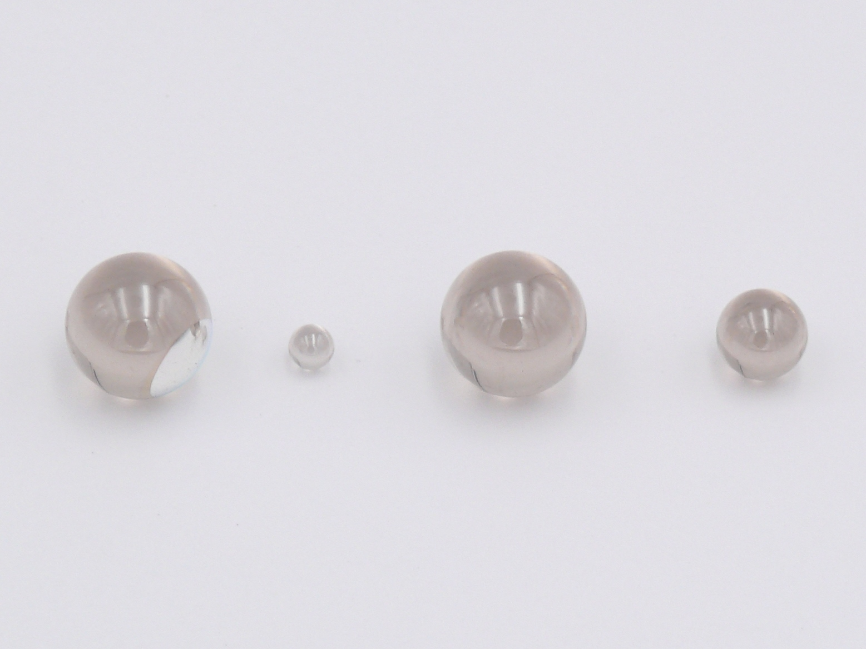
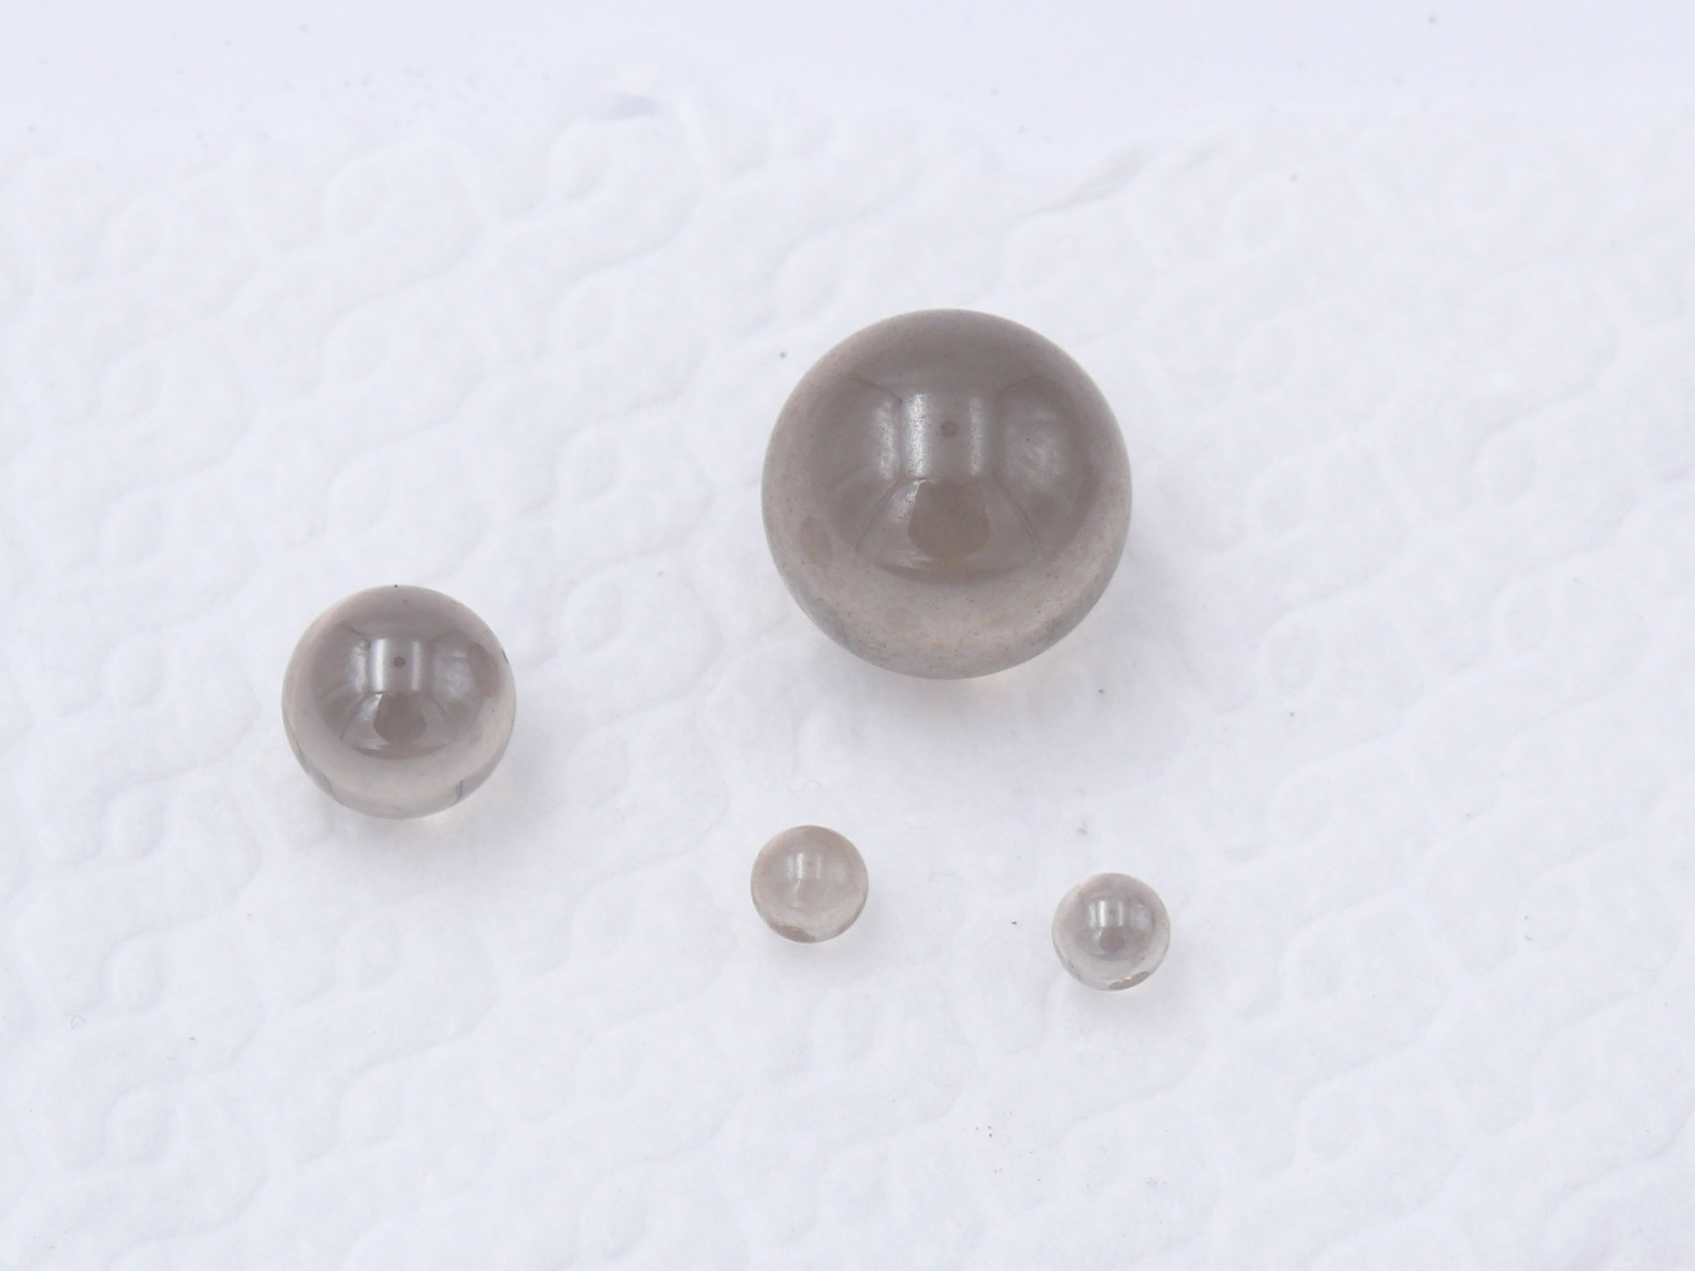
Irradiation tests: Few examples
(2)
(1)
(2)
(1)
(3)
(4)
Vacuum bake out jacket:
(1) not irradiated, (2)10 MGy
Gamma irradiation in BGS facility conveyor,
May / June 2017
High index glass balls for high precision
alignment optical systems:
(1) not irradiated, (2) 300 kGy, (3) 1 MGy and (4) 5 MGy
Gamma irradiation in BGS facility conveyor,
September / October 2018

Slide 7
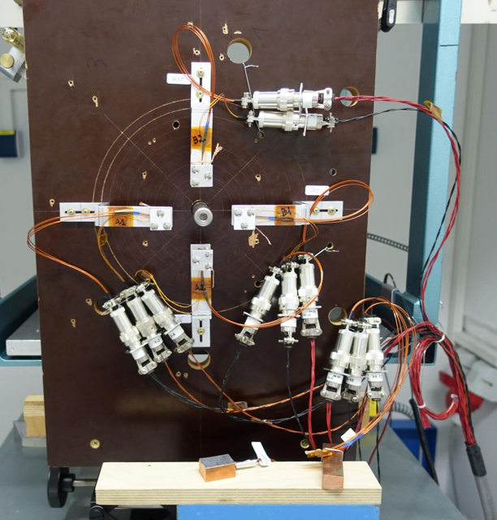
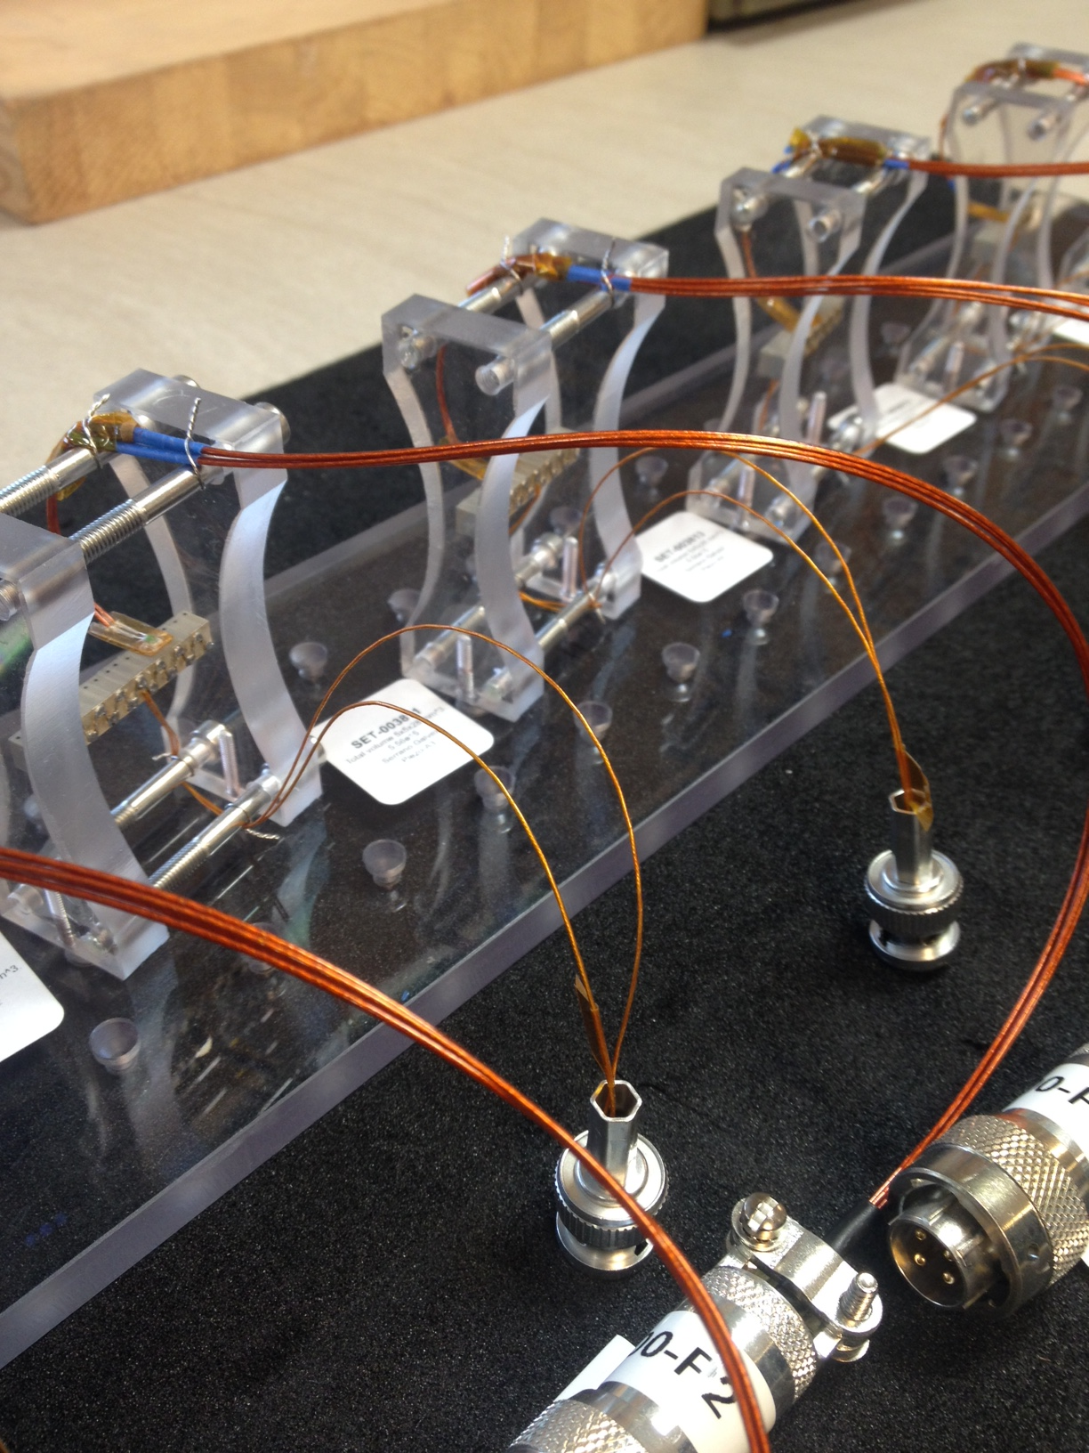
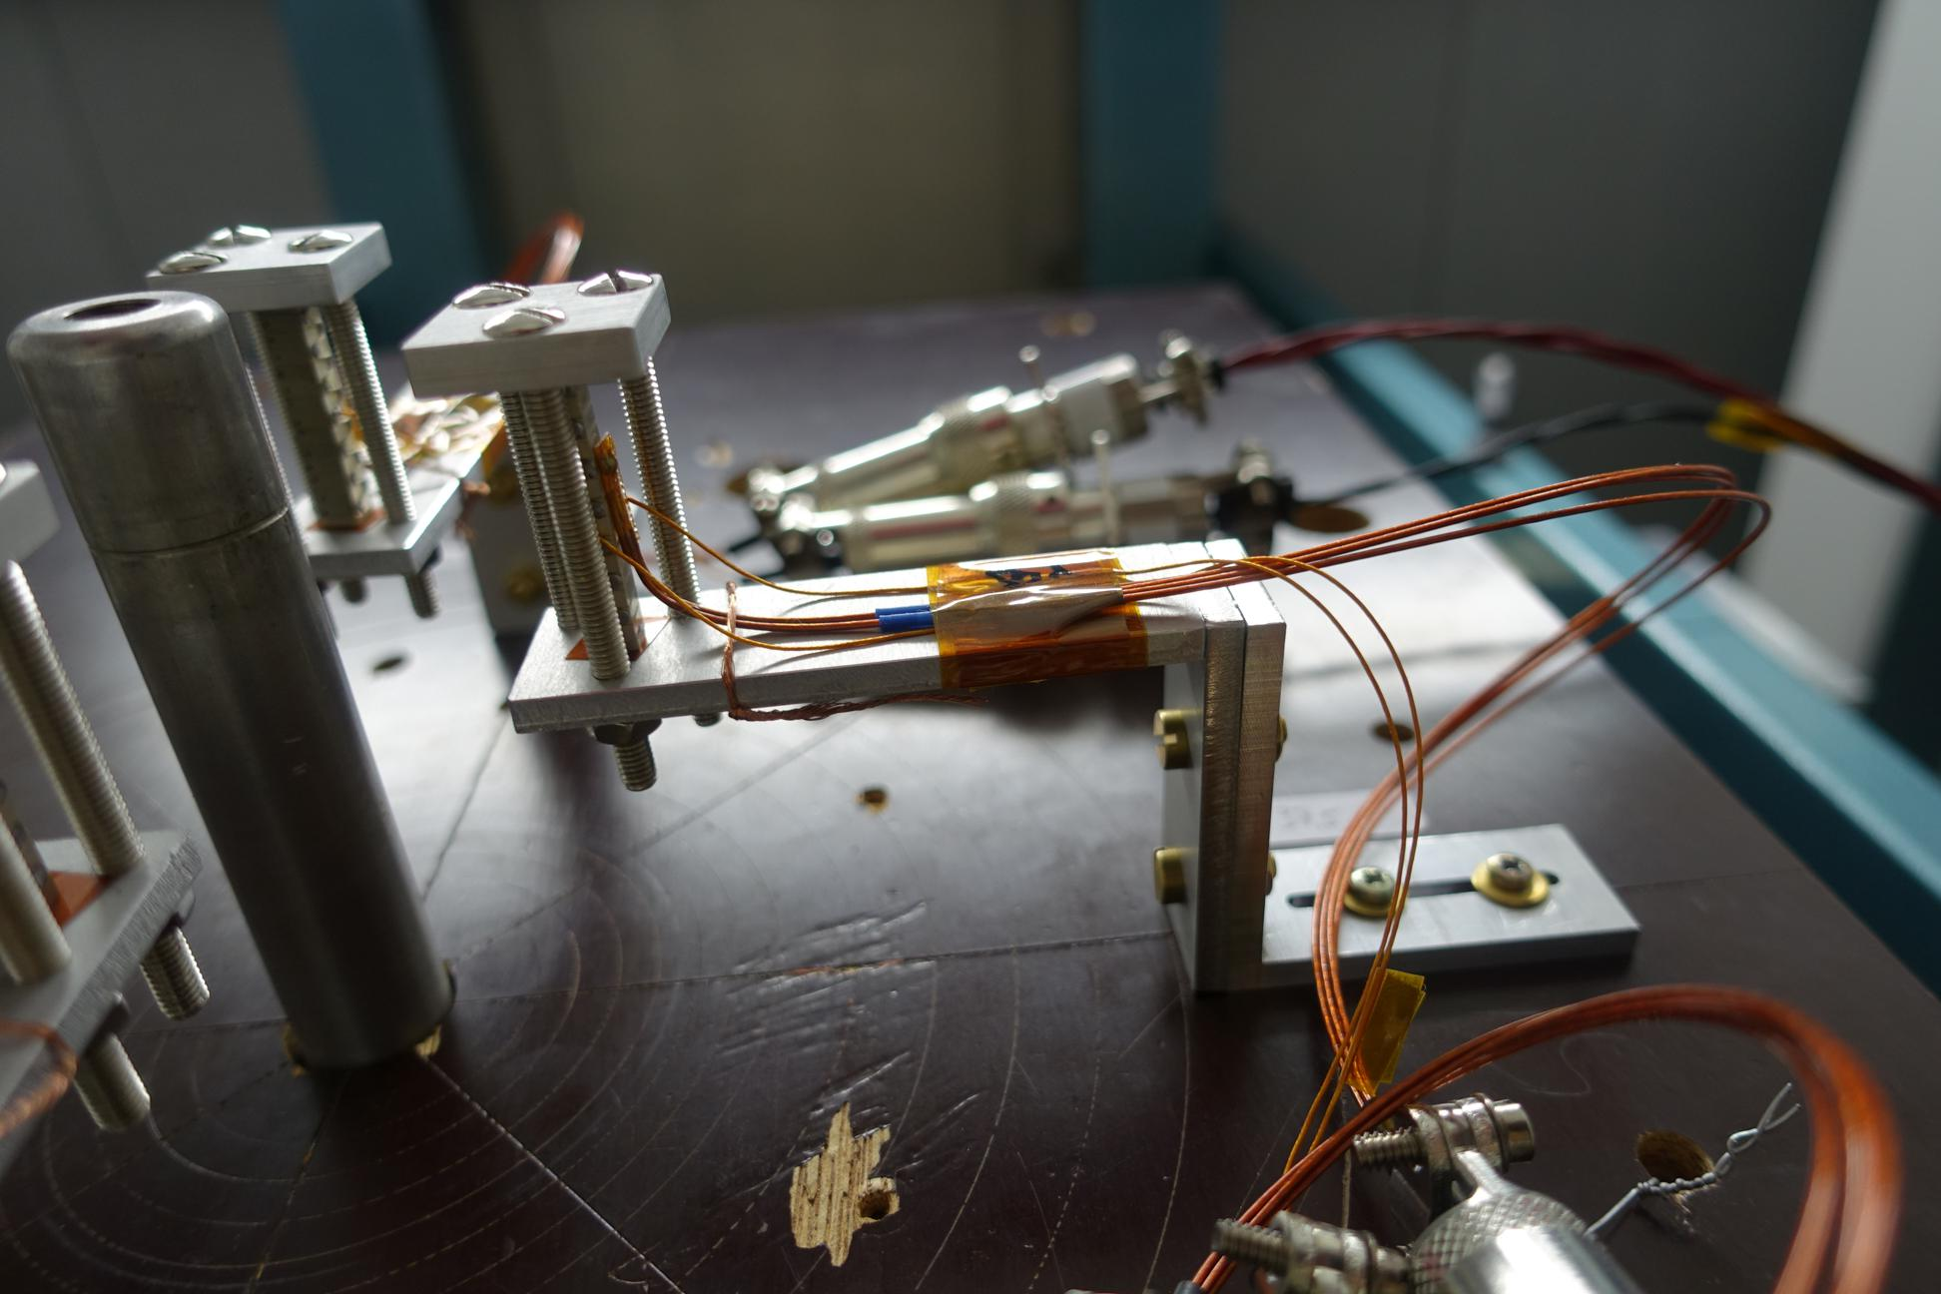
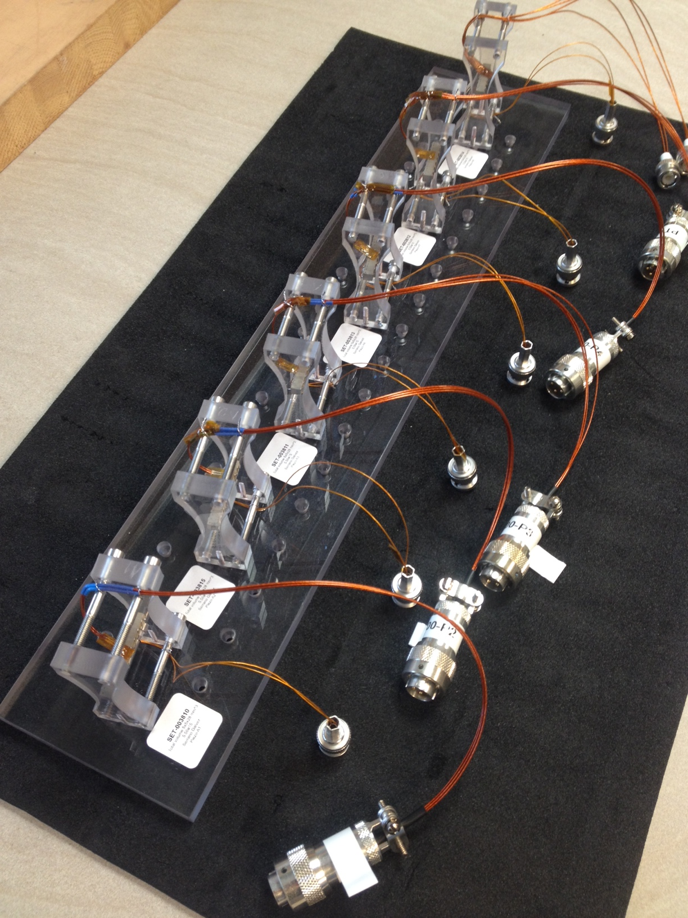
Irradiation tests: Few examples
Test of piezoelectric actuators
For the UA9 Si crystal collimation goniometer
Test in Fraunhofer
Gammas from ⁶⁰Co
Dose of 1MGy
Active Test
(Also 10MGy as passive)
Test in IRRAD
24 GeV protons from PS
Fluence of approx. 10¹⁶ p/cm²,
Dose of approx. 2MGy
Active Test

Slide 8
Support in assessing radiation damage to CERN accelerators equipment
Which material(s)
Which radiation is representative (Gamma ? Particles ?)
Installation area(s) and expected lifetime
Which total dose / fluence ? Dose steps ?

Slide 9
Support in assessing radiation damage to CERN accelerators equipment
Radiation levels
  Radiation levels will increase to the point where material radiation physical “damage” will become (again) an issue
  More and more location and equipment concerned
  Increasing demand for high dose irradiation tests
  In the LHC -> HL-LHC
  In the injectors
  At which total dose to perform the irradiation tests ?
  Depends on equipment location + wished equipment lifetime
  Support from MCWG
  Support from the FLUKA team
  See previous talk, and Wednesday 09:00 – 12:00

Slide 10
Support in assessing radiation damage to CERN accelerators equipment
Which material(s)
Which radiation is representative (Gamma ? Particles ?)
Requirements
Test Technical Specification
Installation area(s) and expected lifetime
Which total dose / fluence ? Dose steps ?
Choice of an irradiation facility
Pre- and Post-Irradiation characterization test(s)
Which samples size / shape / number ?

Slide 11

Some irradiation facility examples
Cumulative effect :
Need for high dose (or, high fluence)
Accelerated tests :
Need for high dose rate
Total Ionizing Dose (TID)
→ Gamma irradiation - ⁶⁰Co
CERN gamma source (CC60)
  Activity is too low for assessing material resistance
  20 kGy in 45 days (x10 increase in the near future)
External gamma facilities
  BGS (Wiehl in Germany)
    through Fraunhofer INT
    Since 2012 with R2E/R2M activities
    10 MGy in 45 days for large volumes
    30 MGy in 45 days for small volumes
  Ionisos (Dagneux near Lyon)
    For a long time with EP dpt
    Since 2015 with R2E/R2M activities
    500 kGy in 45 days
CERN facilities do not reach all CERN requirements… (even for electronics..)
Need for external facilities
Displacement Damage (DD)
→ Particle irradiation
CERN in-house
  Protons : IRRAD
  Mixed field : CHARM
  Tunnels (TDC2), target areas (AD)
  New irradiation platforms under study :
    nTof target, ISOLDE dump
External facilities

Slide 12
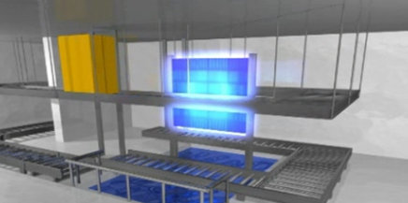
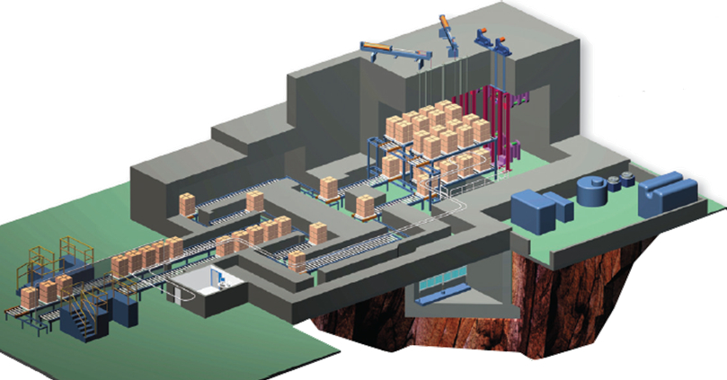
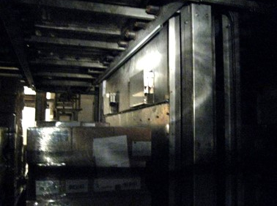
High dose gamma irradiation facilities
External commercial facilities for large scale irradiation
  Aimed at sterilization, decontamination, cross linking
  Allows for large volumes (pallet)
  Normal facility operation = large volumes and moderate doses
    ≠ from CERN high dose irradiation
    Planning to be done well in advance

Slide 13
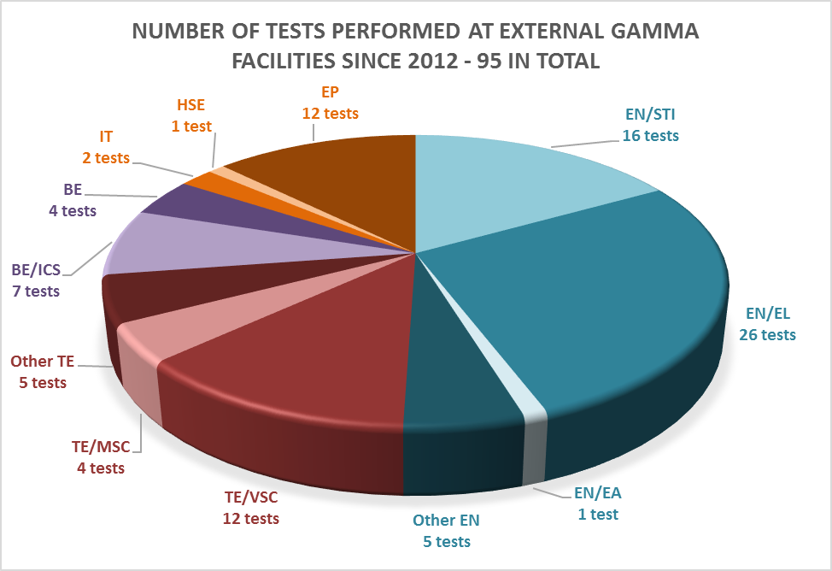
Coordination of CERN wide irradiation tests in external facilities
Irradiation tests volume
  Depends on upgrades, scheduled maintenance, long shutdowns
  R2M to anticipate requests and preparing facilities access in case of needs
Number of irradiation tests performed with commercial gamma facilities since 2012 = 95 tests
  From 100 kGy up to 100 MGy

Slide 14
Coordination of CERN wide irradiation tests in external facilities
R2M "team" aims at
    Managing relationship with external facilities
        Technical aspects
        Administrative aspects
    Follow-up of irradiation tests and corresponding documentation
    Coordination of CERN material irradiation tests
    Combination of irradiation campaigns
      CERN wide coordination of irradiation campaigns
      Shared irradiation time : Optimization of time and cost

Slide 15
Coordination of CERN wide irradiation tests in external facilities
Commercial gamma facility
Pallet irradiation
Mean dose rate
  10 kGy/h

Slide 16
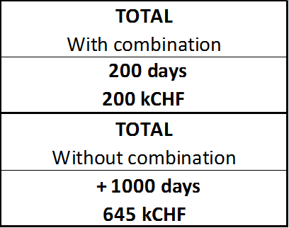
Coordination of CERN wide irradiation tests in external facilities

Slide 17
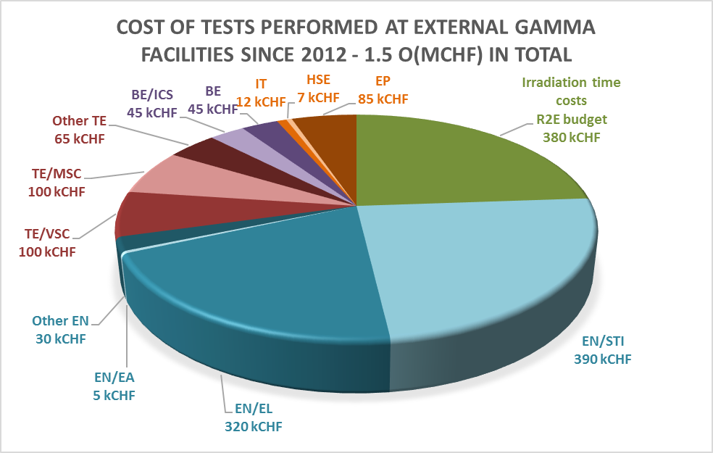
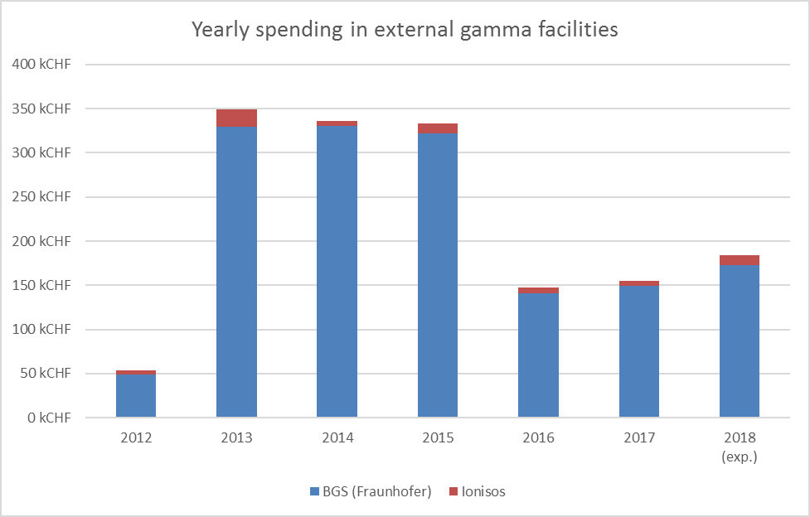
Coordination of CERN wide irradiation tests in external facilities
  Shared irradiation time costs: R2E Budget Code
  "Samples handling" costs: Equipment group Budget Code
    Samples procurement, characterization tests and related analysis also from Equipment groups

Slide 18
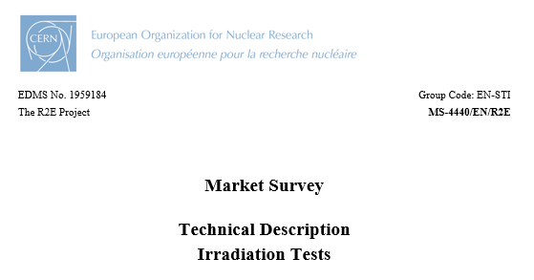
Coordination of CERN wide irradiation tests in external facilities
  25 firms contacted
    16 gave no feedback
    5 declined
  10 firms / group of firms replied
    Qualification on-going
  IT foreseen for 1st quarter of 2019
    1 MCHF over 5 years
    200 kCHF/year
  TS describes norms to comply with, required documentation, etc
Market survey launched mid-2018
MS-4440/EN/R2E

Slide 19
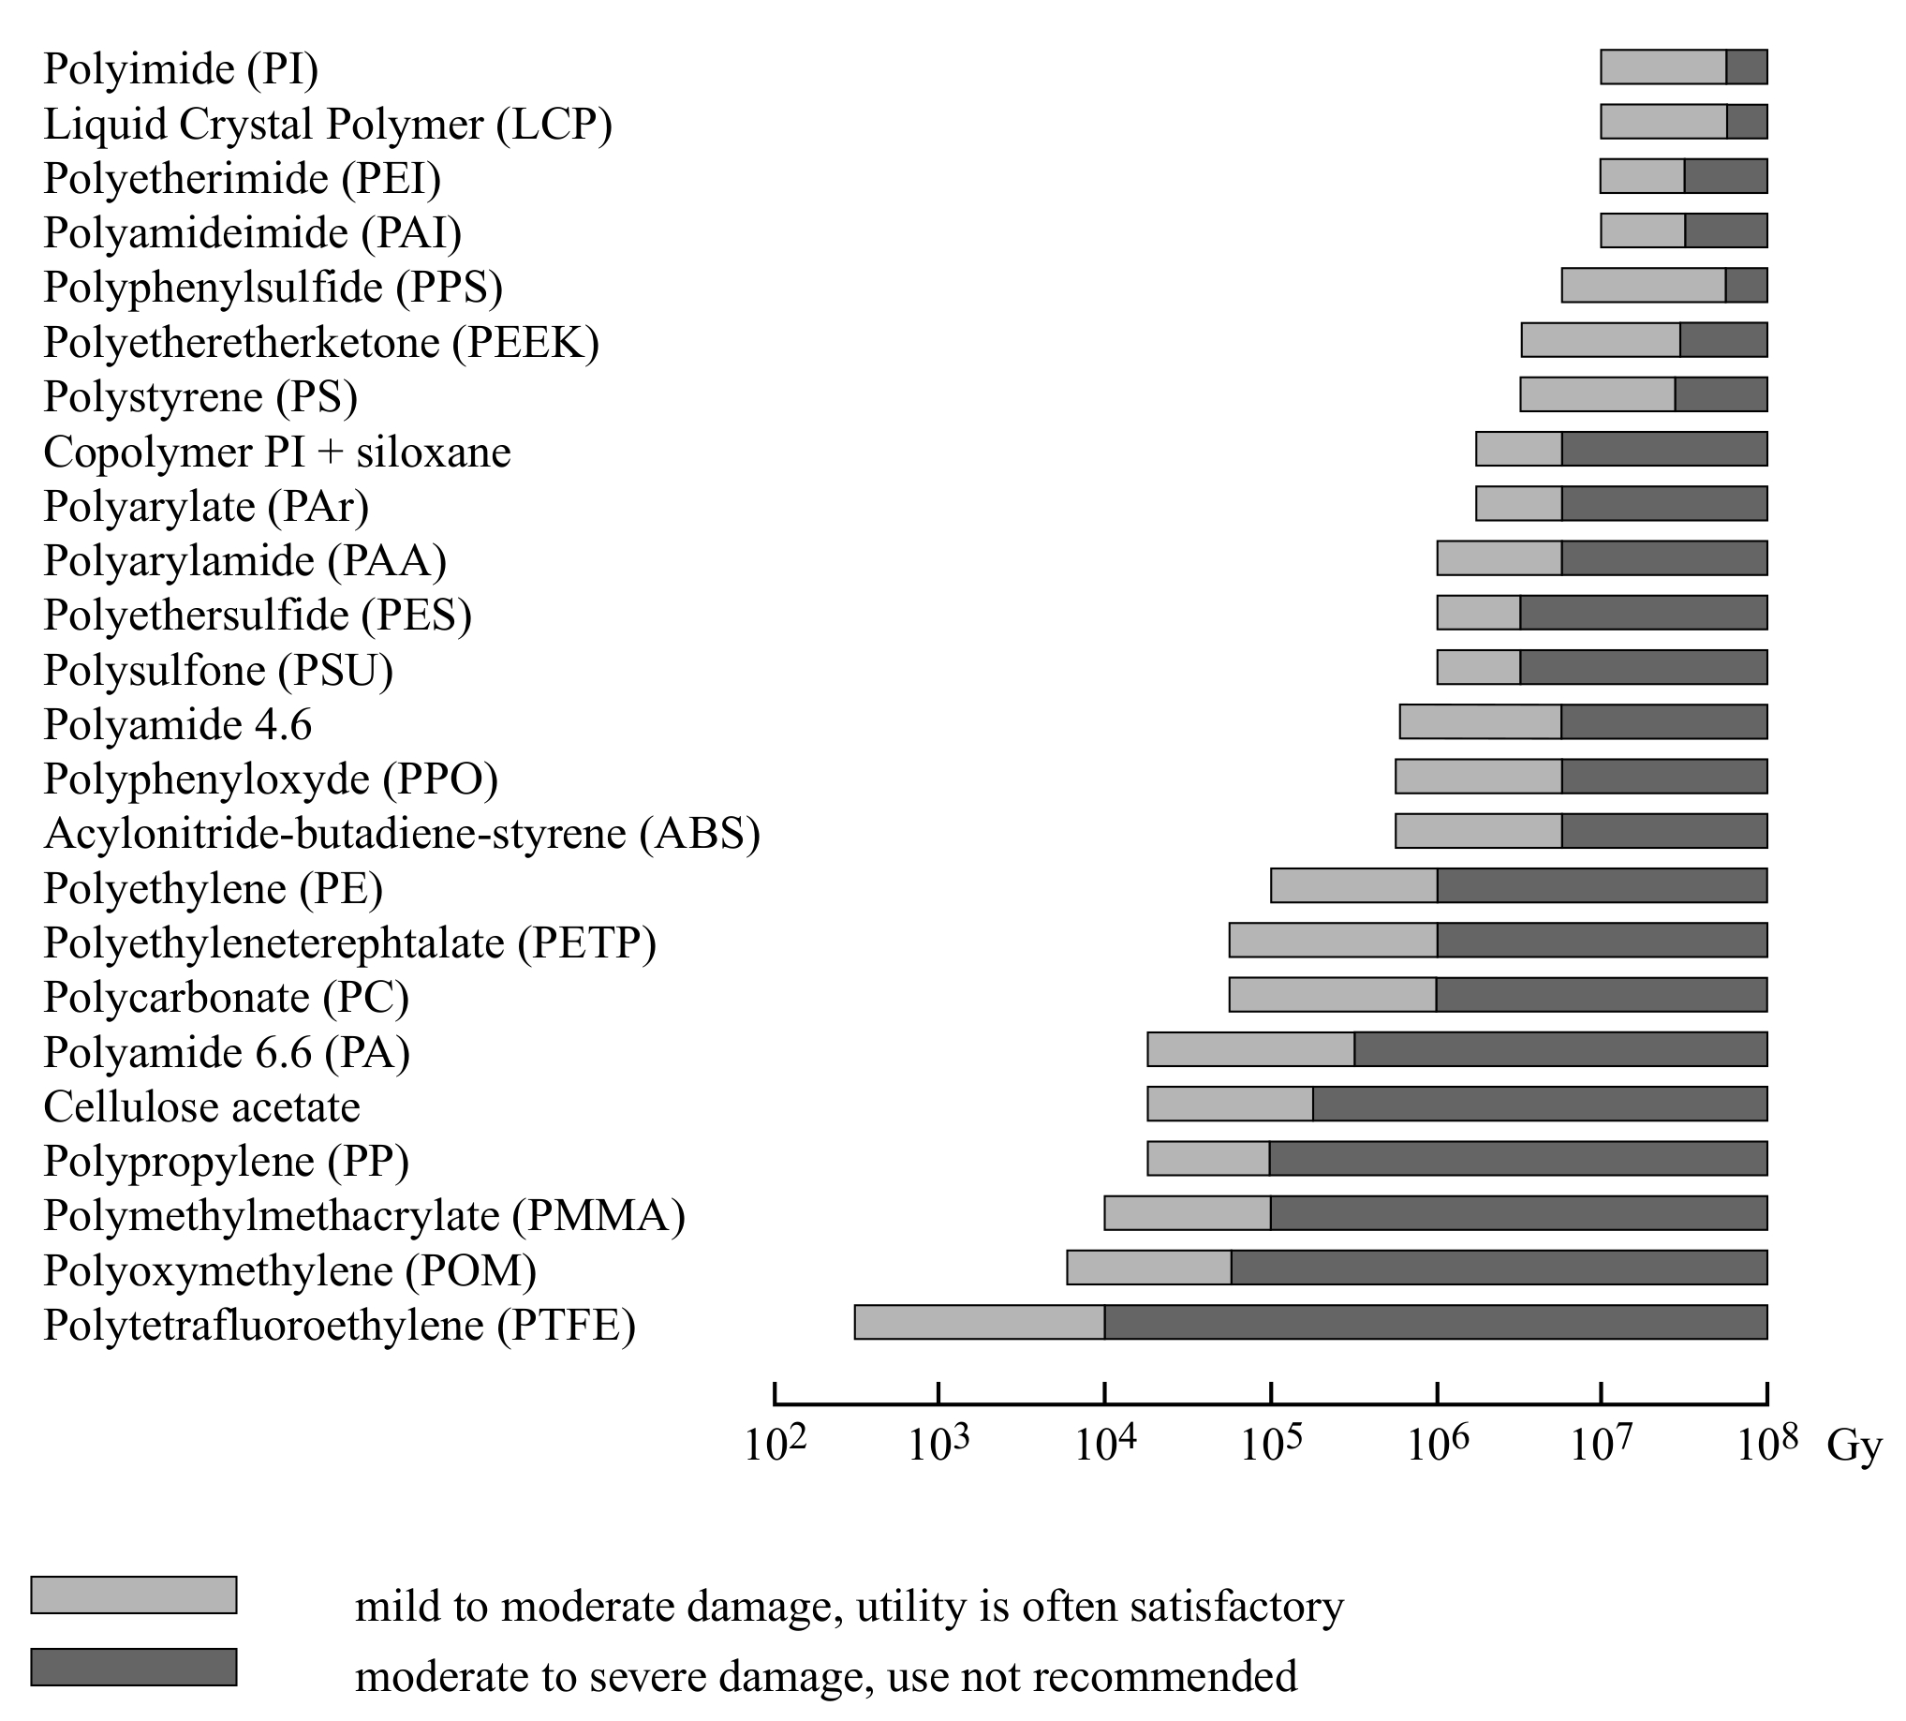
Long-term know-how on material radiation damage effects
CERN History with materials under radiation :
  Late 70’s → Early 2000’s :
    Yellow books: Compilation of radiation damage test data
    → The bible(s) !
    Post irradiation characterization : mechanical tests
  In 1995
    IS41 ‘’The use of plastic and other non-metallic materials at CERN with respect to fire safety and radiation resistance’’
  In 2014 :
    "Demand for radiation test campaigns (TID, DD) is steadily increasing"
    "Time and man-power constraints are a frequent issue for equipment groups"
    "R2M" as an R2E spin-off
Yellow book report CERN-98-01
Compilation of radiation damage test data
http://cds.cern.ch/record/357576

Slide 20


Long-term know-how on material radiation damage effects
Documentation and Quality assurance
Current situation
  Technical Specification
    Produced by the equipment group
    Describing CERN requirements and shared with the irradiation facility staff
    Template available in EDMS 1807333
  Reporting
    Irradiation report
    Characterization report, including analysis and conclusions
    If applicable, global report for multiple tests
  Archiving of relevant documentation
    Share know how and results
    Avoid redundant tests
    Twiki – collaborative website
    EDMS structure - centralized documentation to guarantee long-term documentation
  Radiation to material CERN guideline
    Same purpose than EDMS 1740220 "Radiation Hardness Assurance Procedure"

Slide 21

Resources
Resources
  2012-2015
    Activity held by R2E project leader
  2016-2018
    Activity held by TEMP (3 year)
  2019
    TEMP extended for 6 months – until June 2019
    Fellow expected as from July 2019
In R2E C&S review (Indico 666689, 10.2017) "R2M Outlook and Strategy" talk by Marco Calviani :
  Long-term management of R2M+R2BID know-how would require a dedicated staff
  Similar level of resources should be made available in equipment groups requiring R2M-related test

Slide 22
Conclusion
Current situation for material irradiation tests
  Increasing demand for high dose irradiation tests
  Equipment group responsible for their equipment
    Example of TE/VSC
  R2M for expertise and support
    Support to equipment groups = efficient preparation of the tests
    Optimization of time and cost when combining tests
    Centralization of archives
    Contract set-up with external gamma facilities
Importance of centralizing the know-how in order to avoid wasted resources and budget
  Know-how can be lost due to non-continuous support and no long-term strategy
Material irradiation testing is a key activity for CERN operation
Expertise on material radiation damage is essential for CERN
  Resources are presently limited – long-term management to be clarified

