Slide 1
R2E in injectors and experimental areas
Rubén García Alía, Melanie Krawina, Salvatore Danzeca, Matteo Brucoli, Luigi Esposito, Elisa Guillermain, Diego Di Francesca, Oliver Stein, Yacine Kadi

Slide 2
Introduction
Injector availability is becoming increasingly more critical for LHC
Initial R2E scope is limited to LHC, however (as underlined in 2017 Cost & Schedule review), there is a high risk of R2E injector unavailability mainly related to:
  Environment evolution linked to LIU
  New equipment installation
R2E injector WP status:
  “New” activity, beyond project’s initial scope
  Limited person-power, scattered through various project activities (MCWG, R2M, RADWG…)
    Dedicated COAS during past few months: Melanie Krawina (EN/STI-BMI)
  High variation in “R2E awareness” amongst equipment groups for existing and future electronic equipment in injectors:
    Example of R2E development & qualification for injectors: GEFE BPM
    However, most cases could not follow the “R2E RHA”, therefore LS2 focus is already on mitigation (mainly relocation)

Slide 3
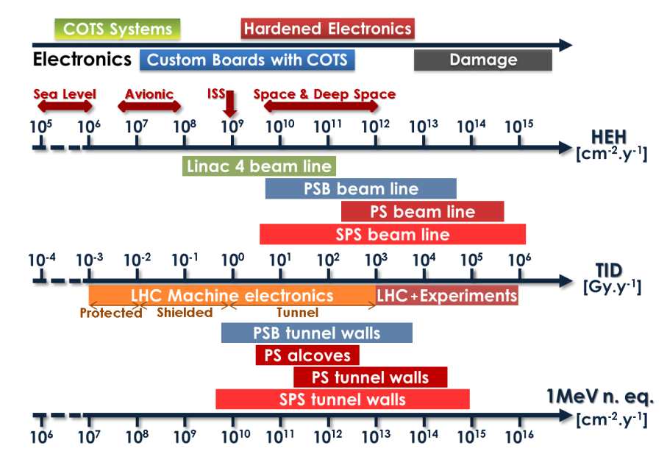
Injector environment study (Saraiva 2015)
Based on RP surveys for loss maps and FLUKA for radiation level distribution
In general: not being super-conducting machines, radiation levels in injectors can be significantly larger than those in LHC ARC
Broad variety of “COTS systems/modules” to be operated in radiation environment after LS2
CERN-ACC-NOTE-2015-0042

Slide 4
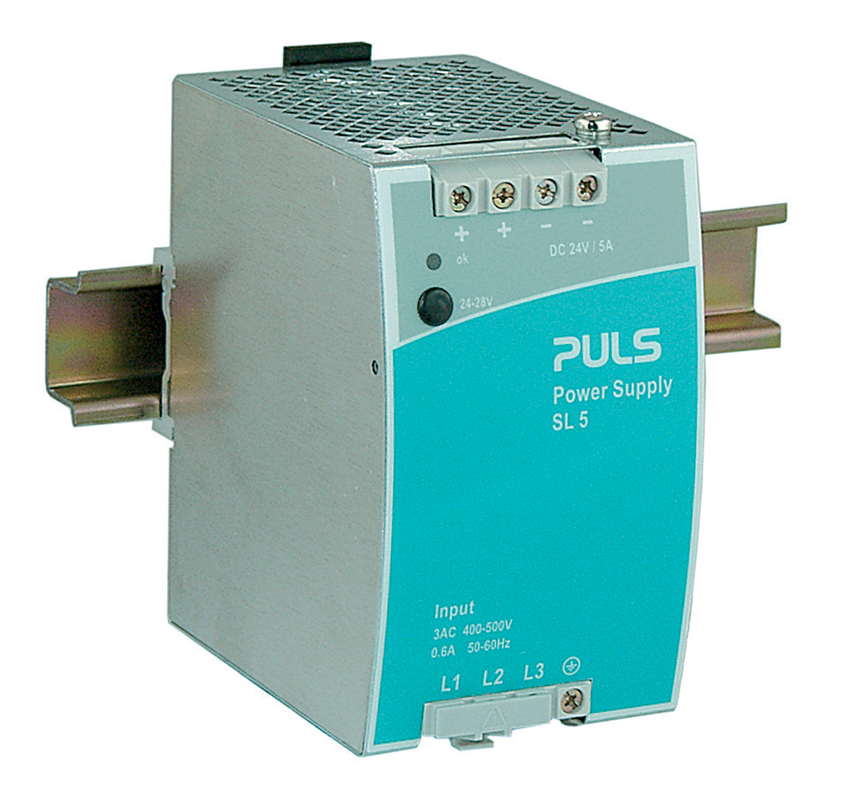
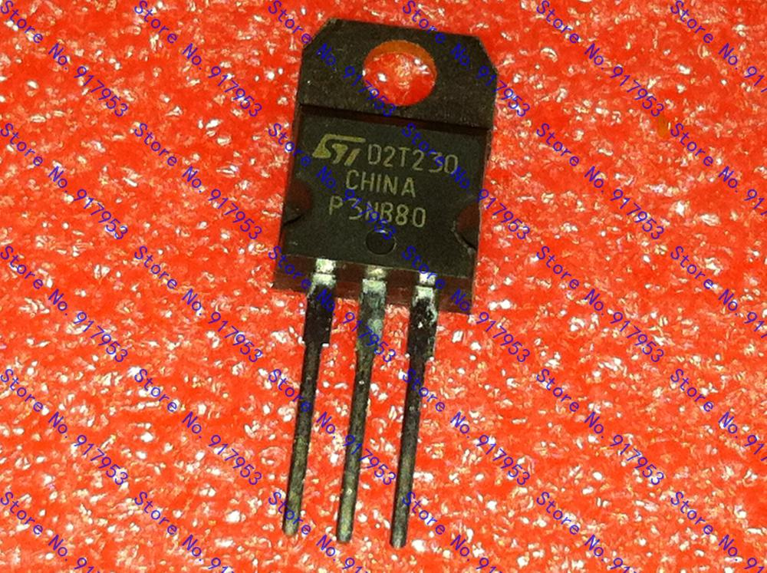
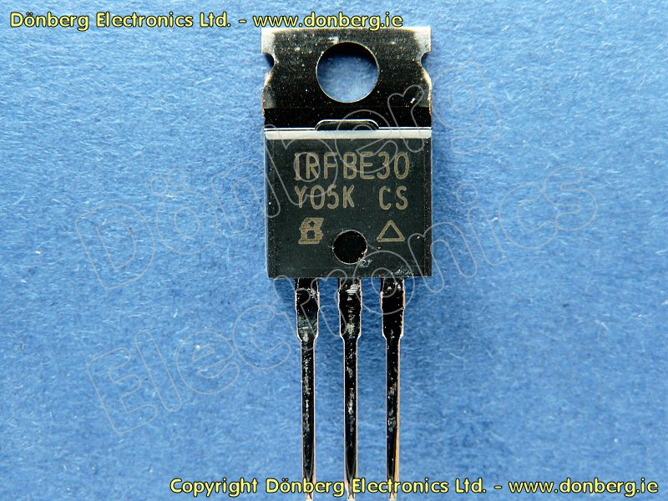
Risk linked to use of COTS modules in radiation
Power MOSFET used in pre-regulator of power converter AC-DC
Two MOSFETs of similar electrical specs but very different sensitivity
SE PULS SL5.300 unit
STP3NV80
(N-channel, 800V)
22 destructive events before 2015
IRFBE30
(N-channel, 800V)
Conclusion: for rad-tol design, being in control of individual part selection is essential, also linked to re-design options
One destructive event before 2015

Slide 5
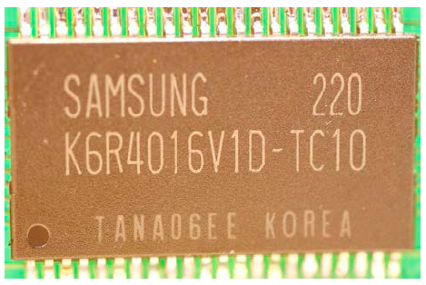
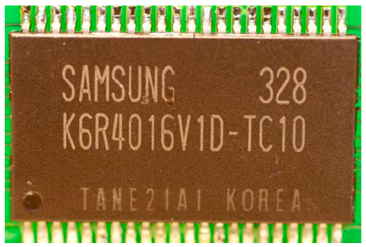
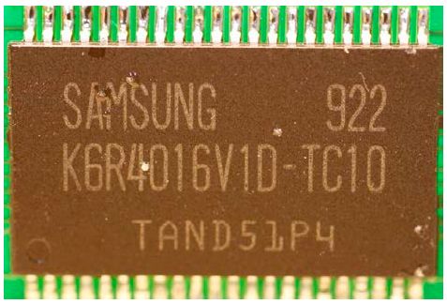
Lot-to-lot variability
Example: same reference but different date codes
“Single Event Latch-up (SEL) analysis of the 256k x 16 SRAM Samsung K6R4016V1D-TC10 Heavy ion and Proton Test Report Comparison with the Proba-2 GPS Phoenix SEL rate”, V. Ferlet-Cavrois, M. Muschitiello, M. D’Alessio, ©ESA

Slide 6
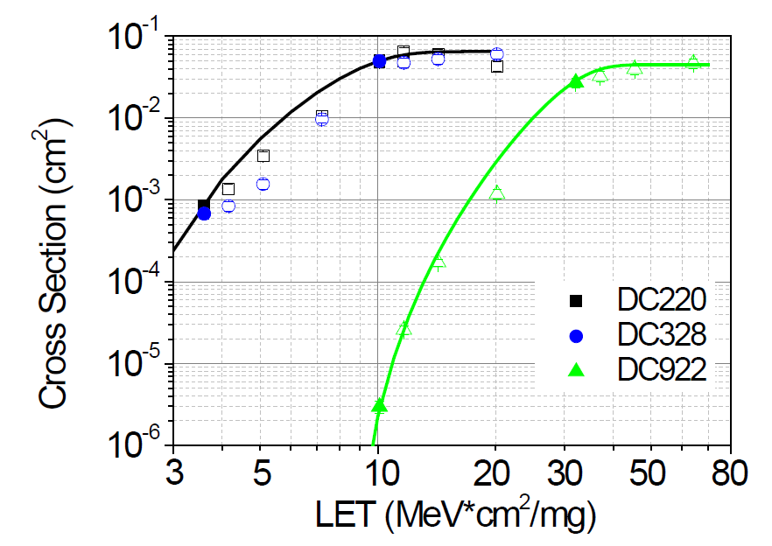
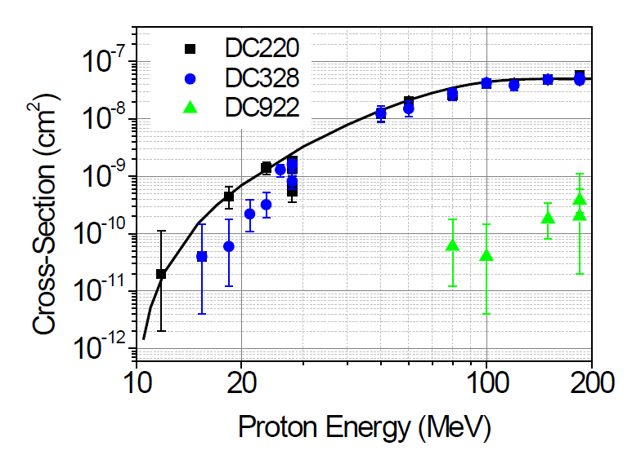
Lot-to-lot variability (II)
Same reference and different date code with SEL sensitivity difference of factor ~500
Importance of lot/batch traceability and common component purchase
Assuming RR radiation level: ~10⁸ HEH/cm²/yr
~5 SEL/year
~10⁻² SEL/year

Slide 7
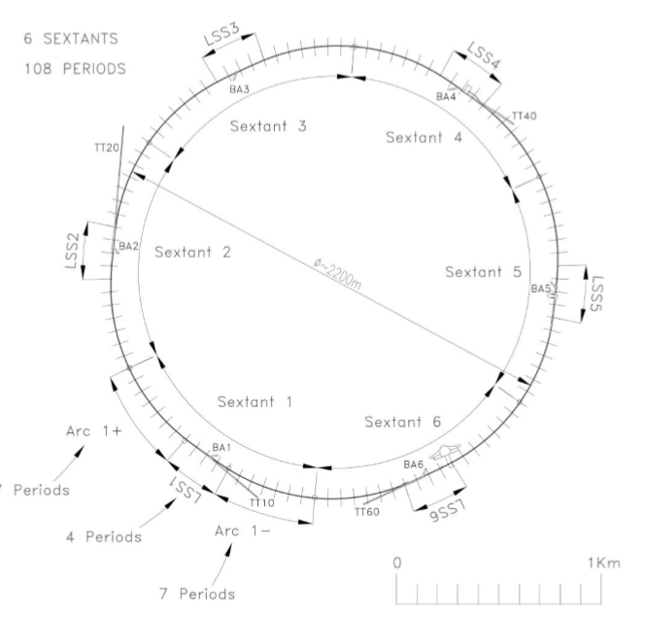
SPS layout
Divided into 6 sextants, each with 36 half-period (32m long, containing 100 element numbers)
LSS: half-periods 14-22
ARC-: half-periods 0-13
ARC+: half period 23-35
TA/BA tunnel access areas

Slide 8
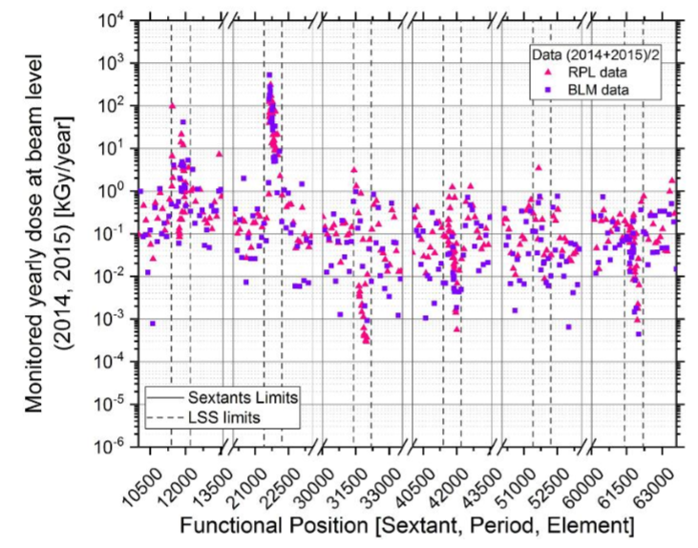
SPS radiation levels (BLM, RPL)
So far, mainly based on RP surveys, RPLs and BLMs (see plot, LSS1 [dump] and LSS2 [North Area extraction] hot-spots)
Now also incorporating RadMONs and passive R2E dosimetry
Values used to determined expected radiation levels on e.g. emergency lighting system, sprinklers, etc. (tested to >MGy levels through R2M)
“Study on the SPS Radiation environment”
by Elisa GUILLERMAIN (EDMS 1739976)

Slide 9
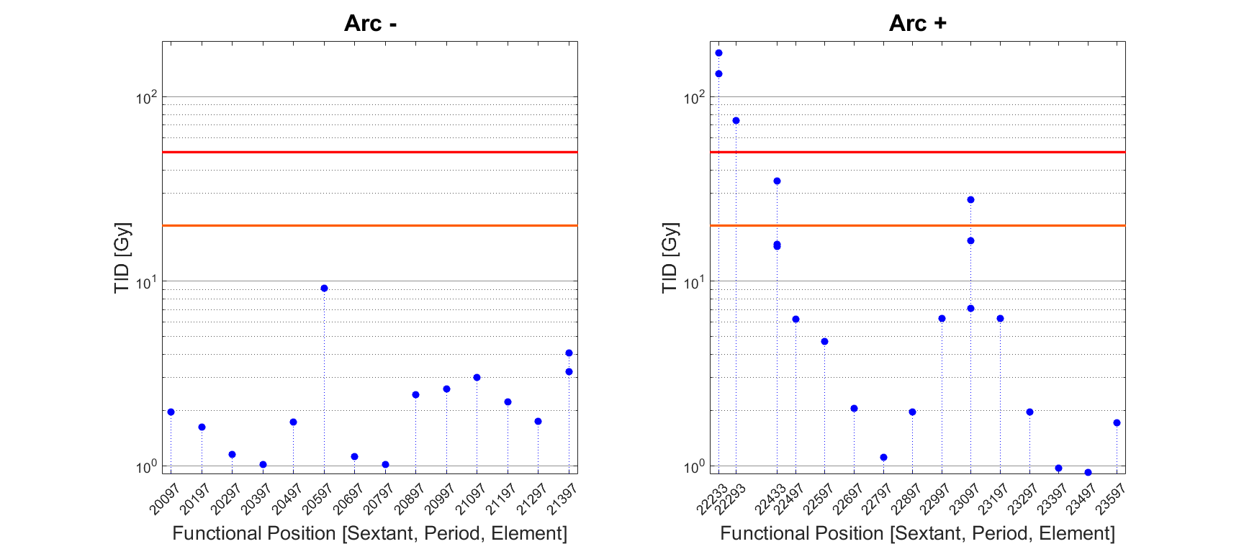
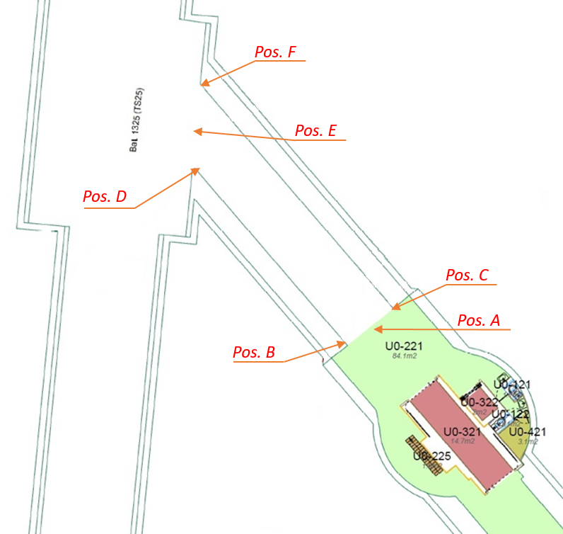
SPS radiation levels: 2017 passive dosimetry
Focusing on BE/BI equipment
TID in ARC: nMOS dosimeters below magnets, ~1-10 Gy/year → DS-like LHC levels
TA2:
  At tunnel side, ~0.75-1.5 kGy/yr
  BA2, tunnel access: ~1-1.5 kGy/yr
  Inner area: ~10¹⁰ HEH/cm², R-factor ~5.5, ~10 Gy/yr
TA1:
  At tunnel side: ~1-2 Gy/yr
  Inner area: ~4-10×10⁷ HEH/cm², R-factor ~5-8
TA6: factor 5-10 lower than TA1
LSS2
“TID, Φ_{HEH} and Φ_{ThN} measurements along the SPS accelerator and the adjacent Tunnel Access Areas” by Matteo BRUCOLI (submitted as ATS Note)
TA2

Slide 10
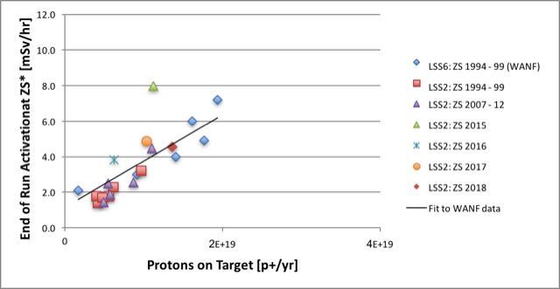
SPS LSS2
Input from M. Fraser
1.4×10¹⁹ protons extracted to North Area in 2018, important increase expected for e.g. SHIP
Main associated operational constraint is activation near extraction septa; in addition, hotspot in terms prompt dose and associated equipment lifetime

Slide 11
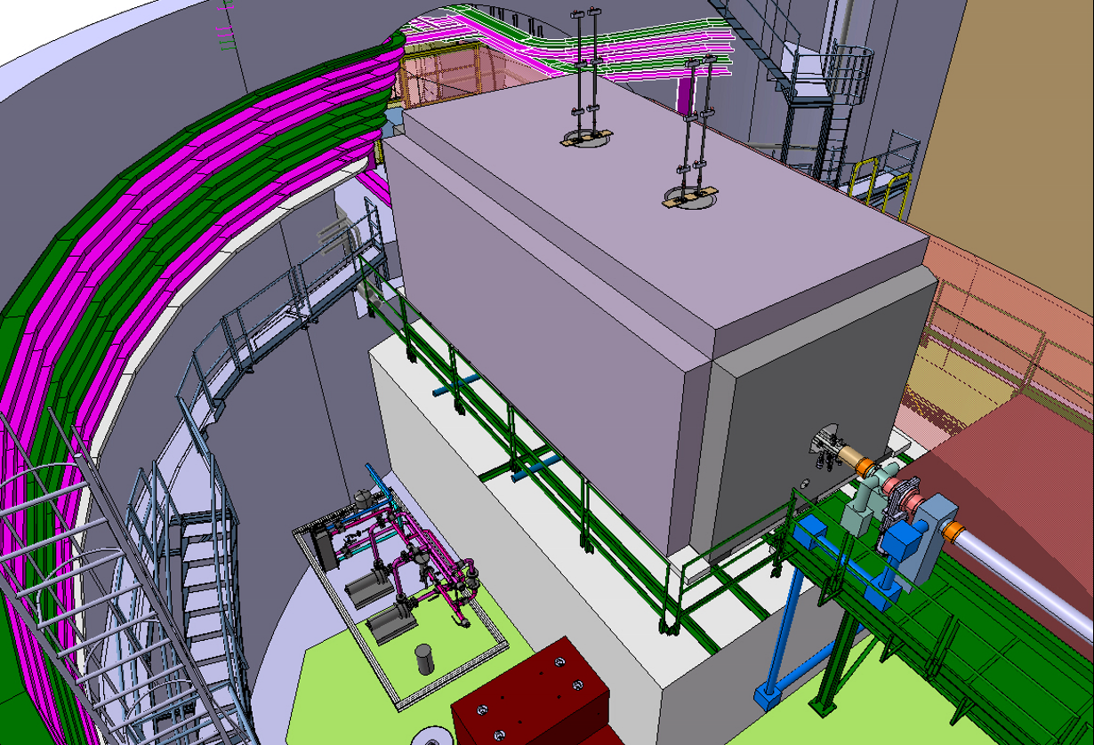
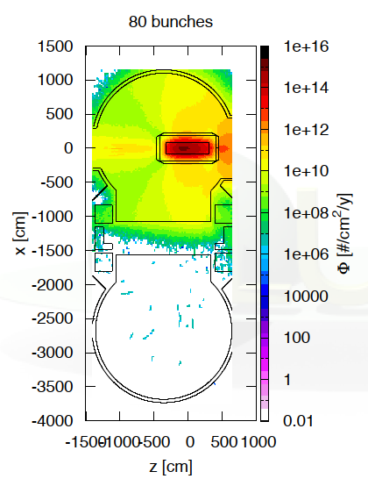
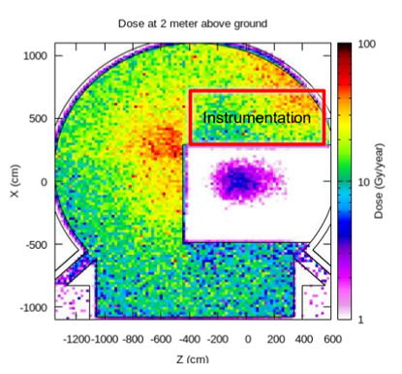
SPS LSS5 dump
Critical FLUKA support in radiation level definition
Impacting multiple equipment in ECX5 area (more about expected radiation levels and related equipment in Melanie’s talk)
ECA5 shielded area: significantly lower values than ECX5, but still reaching levels (~10⁶-10⁷ HEH/cm²/yr) which could pose threats to sensitive electronics (i.e. dilution generators)

Slide 12
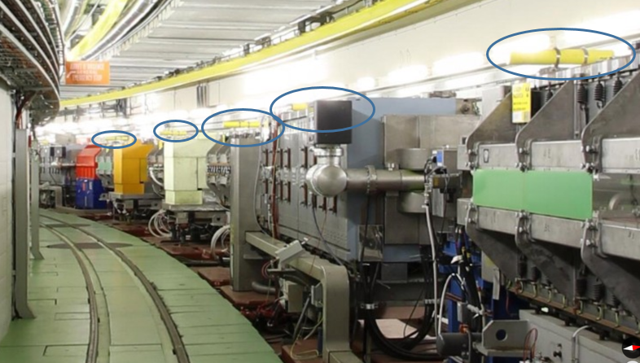
PS 2018 monitoring: fiber + BLMs
PS BLM system (100x, one per section), including also 1 kHz frequency sampling (i.e. losses during cycle)

Slide 13
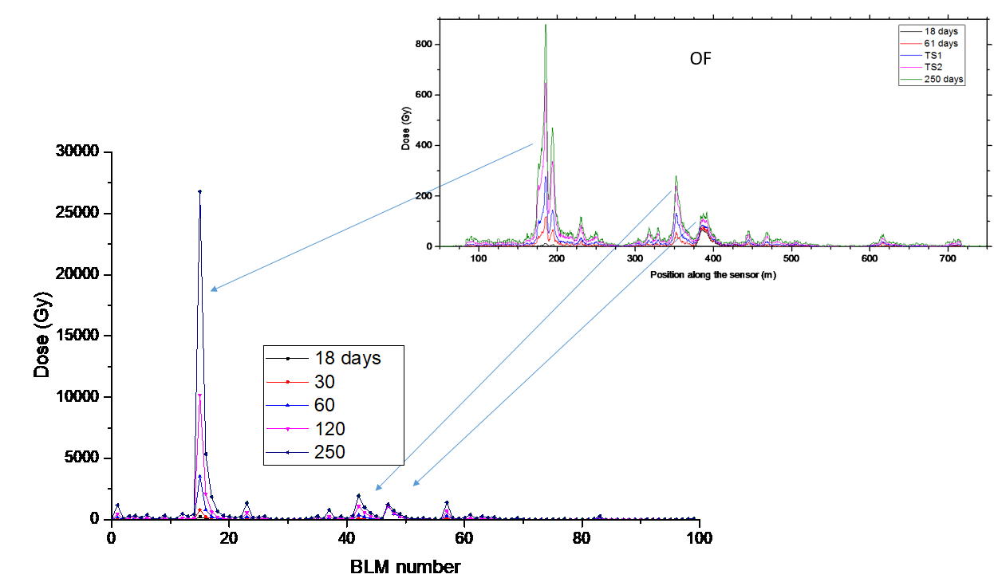
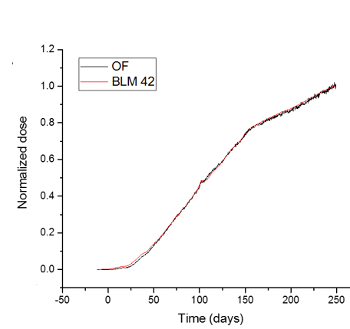
PS 2018 monitoring: fiber + BLMs (II)

Slide 14
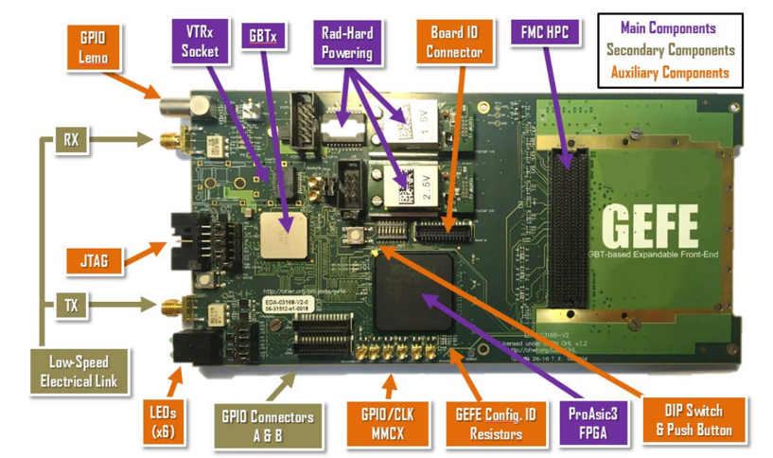
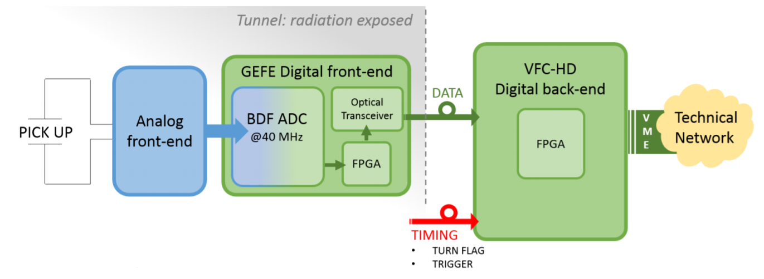
GEFE development & qualification
Multi-purpose FPGA-based radiation tolerant card for data acquisition & controls (equipment responsible: Manoel Barrios, BE-BE-QP)
Combination of rad-hard (e.g. GBTx transceiver) and COTS (e.g. ProAsic3 FPGA) components
Component level tests at PSI, system level tests at CHARM (750 Gy target)
Excellent example of “injector” development with LHC applications (“common building block”)

Slide 15
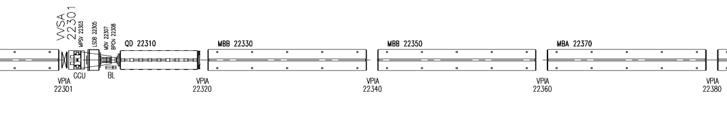
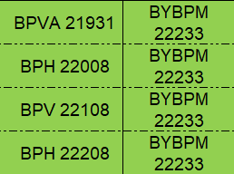
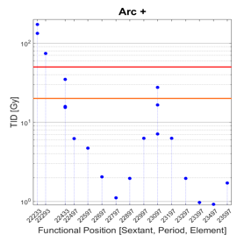
GEFE radiation levels
Majority of SPS ARC rack locations have levels below ~20 Gy/yr (Run 2)
However, radiation levels of ~200 Gy/yr near LSS2
Importance of radiation level knowledge for possible R2E mitigation (e.g. equipment rotation/replacement, etc.)

Slide 16
Examples of further recent SPS/injector requests
SPS LSS4 and LSS6 areas for gamma factory electronics
WIC and optical fibers for TI2/TI8 injection lines
SPS LSS5 equipment (BE/BI, EN/CV…) → more in Melanie’s talk
PSB and AD: upgrade of BTV cameras

Slide 17
Experimental areas
R2E provides support on request basis
Many different examples of support in e.g. monitoring, relocation & shielding evaluation, etc. (COMPAS, BDF test area, nTOF…)
Commercial electronics modules (e.g. PLCs…) used in radiation areas on a regular basis
  High associated R2E risk, but criticality typically lower than for injectors/LHC
Main general comment: when radiation to electronics problems arise in experimental areas, R2E support in terms of “short-term mitigation” (i.e. monitoring & simulations → relocation & shielding) can be very efficient

Slide 18
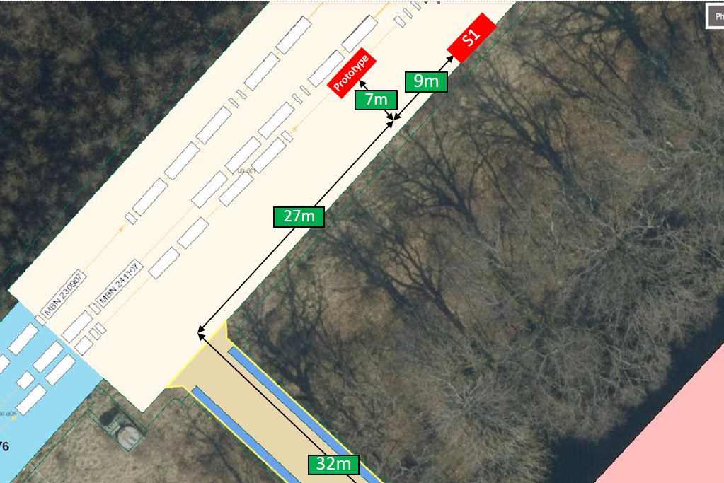
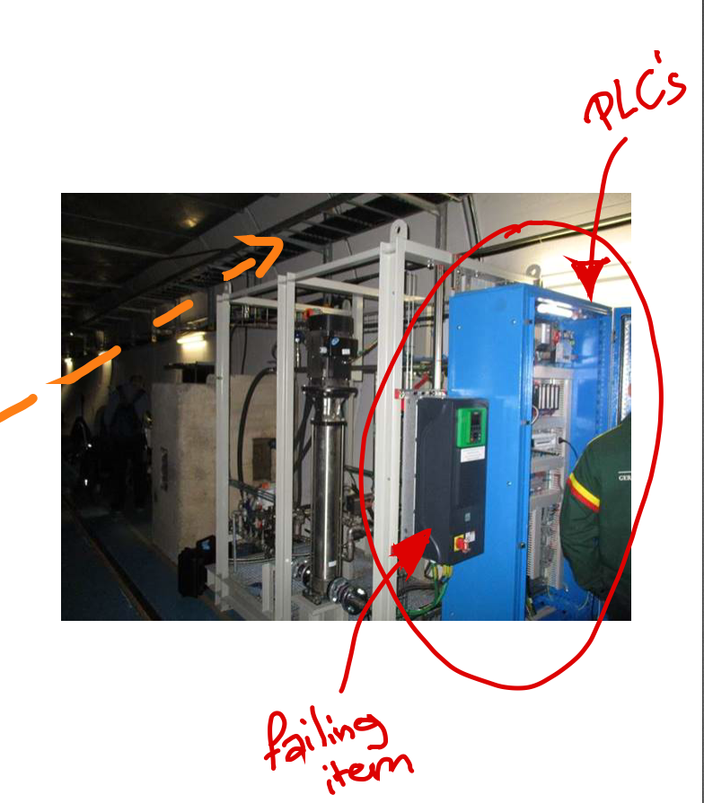
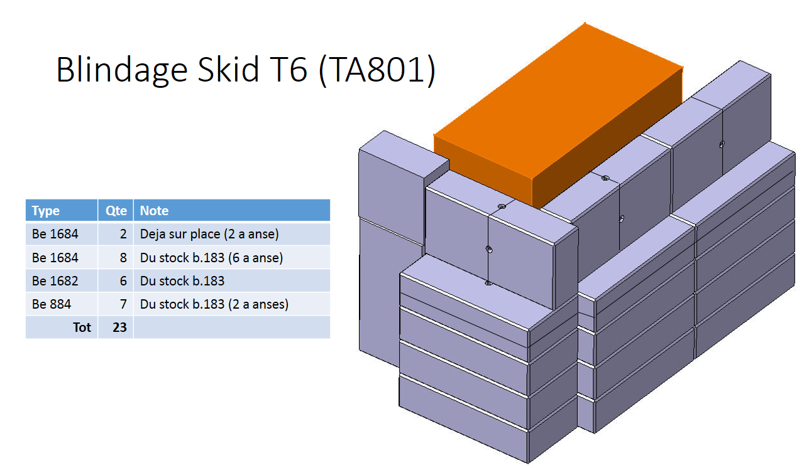
R2E shielding activities
(input from M. Lazzaroni)
View of TCC2 Tunnel
Concrete blocks to provide
Picture of the equipment (PLC) to protect
(BDF: Beam Dump Facility)

Slide 19
Injector summary
LS2 objective:
  to reach a monitoring, calculation and equipment inventory level similar to that of the LHC
  to prepare (or even implement) possible R2E mitigation actions (i.e. relocation) during Run 3
  (more globally) to ensure that R2E issues will not pose as significant constraint to the injector/LHC Run 3 operation
  R2E injector WG to become more active in 2019, involving all different stakeholders (monitoring, calculations, equipment groups…)
Post-LS2:
  To propose radiation tolerant COTS-based in-house design for critical applications in radiation areas
Let’s apply the lessons learnt from the LHC to the injectors

