Slide 1


CERN facilities
Salvatore Danzeca (EN/SMM)

Slide 2
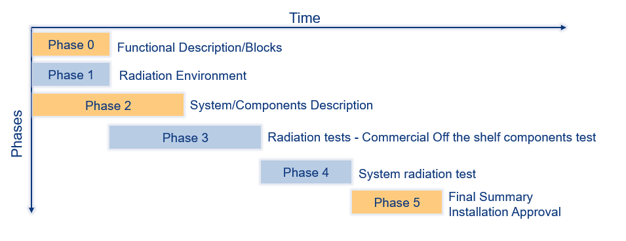
Up to now..
We have the RHA guidelines
Phase 3 and Phase 4 depends on the availability of suitable and relevant radiation test facilities
Suitable for :
  Component testing (Phase 3)
  System level testing (Phase 4)
Relevant
  Adapted to test up to the expected radiation design margins (RHA)
  Meaningful results for the expected radiation environment

Slide 3


Radiation test facilities for the electronics
RHA procedure:
  TID
  Displacement Damage
  SEE
Not only at component level but also at system level
We need facilities for assessing these quantities

Slide 4


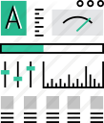

Radiation test Facilities
Operation
Coordination
The facility operation includes the preparation the installation and the removal of the setup. Big part of the operation is also the beam steering, verification and follow-up.
Maintenance,
Upgrade
Dosimetry
The user requests are collected and processed reserving the most suitable slots in the facilities. Multiple requests are accommodated in the same slot to be more effective
Continuous monitoring is essential to provide the users with reliable measurements. The users receive the dosimetry document for their tests
During all the course of the facilities lifetime they are maintained and improved to fulfill the increasing amount of requests

Slide 5
Radiation test facilities used for the electronics
Internal at CERN
  CC60
  CHARM
PSI Proton Irradiation Facility
Other external facilities

Slide 6
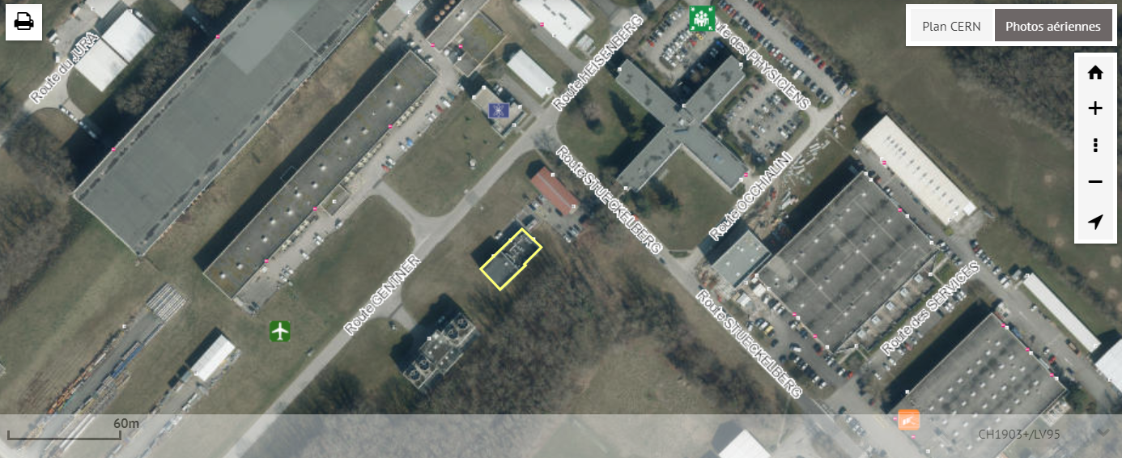
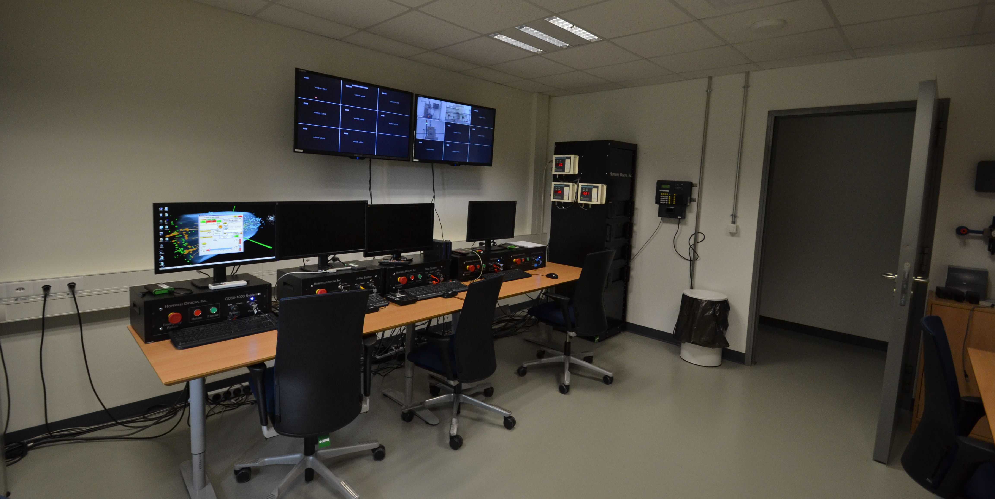
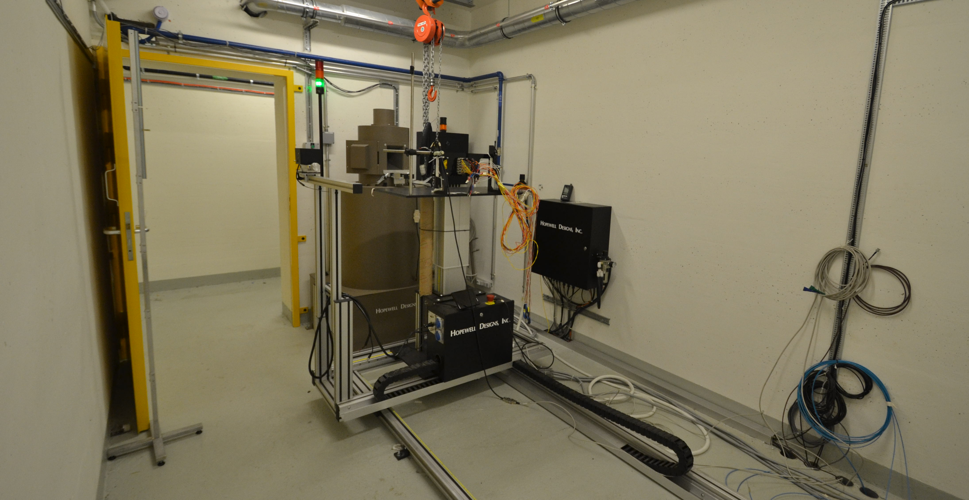
CC60 at CERN
10 TBq Co60 Facility for TID effects located in Prevessin
Operational from the 2015
dose rates from 20Gy/h up to 0.36Gy/h
300-200 Gy/h spot inside the irradiator used for EP testing (8cm from the source).
Adapted to test for Enhancement Low Dose Rate Effects (ELDRS)
Multiple users running in parallel are allowed in the facility
Facility calibration at each irradiation
Facility used also for the sensor calibration

Slide 7
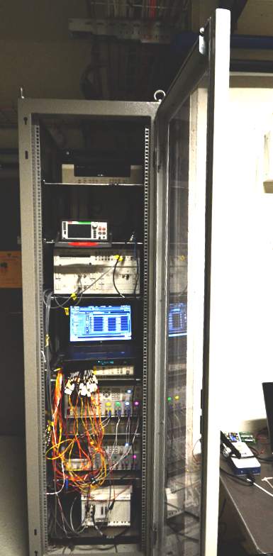
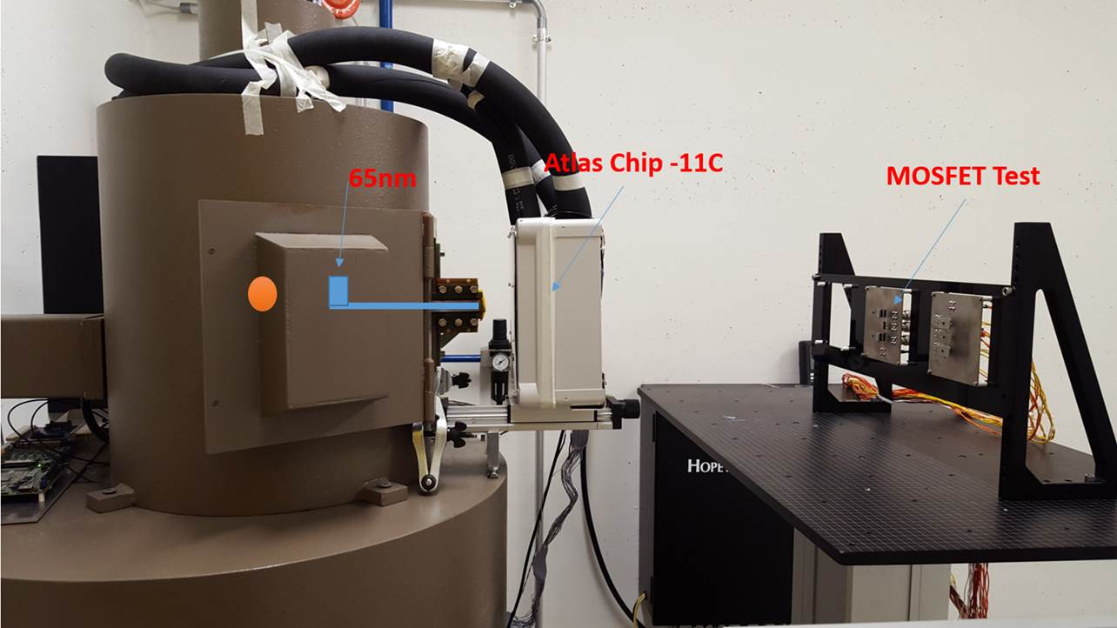
CC60 Facility utilities
Facility provides:
  Running continuously 24/7
  Internally developed website to monitor the status of the irradiation: https://cc60monit.web.cern.ch/
  Radiation test service support a fix test setup with which the users can monitor analogue signals and supply power to their DUT
  Possibility to carry out test up to -20 °C thanks to a chiller and a cold box installed in the facility (in collaboration with EP)
  Calibration at each run with ionization chamber

Slide 8
Facility usage
The facility allows to have several users in parallel
Around 30 % of the total irradiation time was used also by EP
Several test campaigns usually last for months keeping the facility occupied for long time.
The requests are more and more on high dose levels (>1KGy)
There is the need for a new source which will be able to perform the tests quicker and at higher doses on larger volumes
Planning to install for the 2018 a new Co60 source of x10 the activity of the one installed
The proposal has been accepted by RP and in the three parties meeting.
Improvements of the shielding will be required on the room walls and on the roof
CC60 will run during LS2 and up to when HL-LHC

Slide 9
CC60 facility upgrade
100TBq source
dose rates from 200Gy/h up to 3Gy/h (end room)
3-2 KGy/h inside the irradiator
Call for tender ended in October
Q2-Q3 of 2019 source installed and ready
New website for the user requests and information on the facility

Slide 10
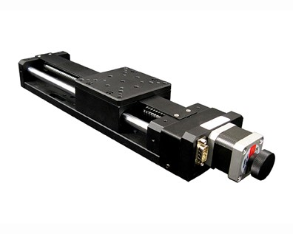
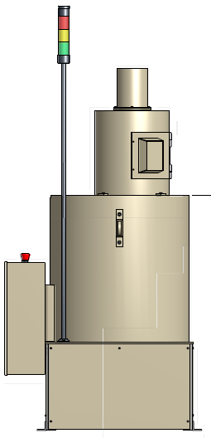
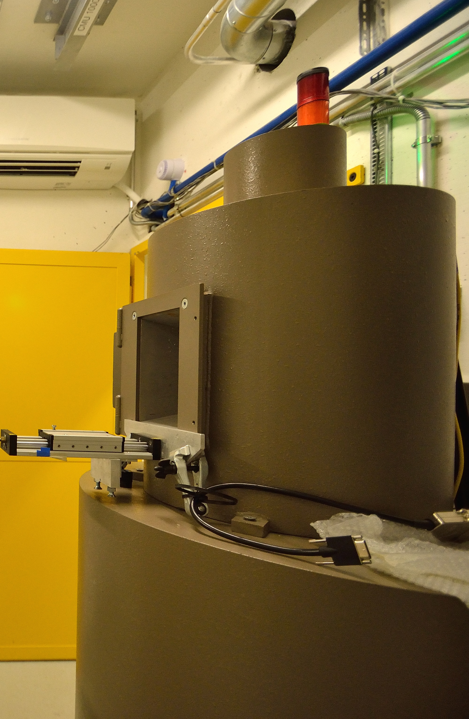
CC60 facility - infrastructure upgrade
Modification for RP constraints being discussed
  wall shielding
  collimator shape
  irradiator shielding
  second lead door
Water cooling upgrade to allow large power supplies testing
Linear axis stage to allow precise positioning inside the irradiator collimator
irradiation room
10 Tbq (current) source
100 Tbq (new) source
Additional Shielding

Slide 11
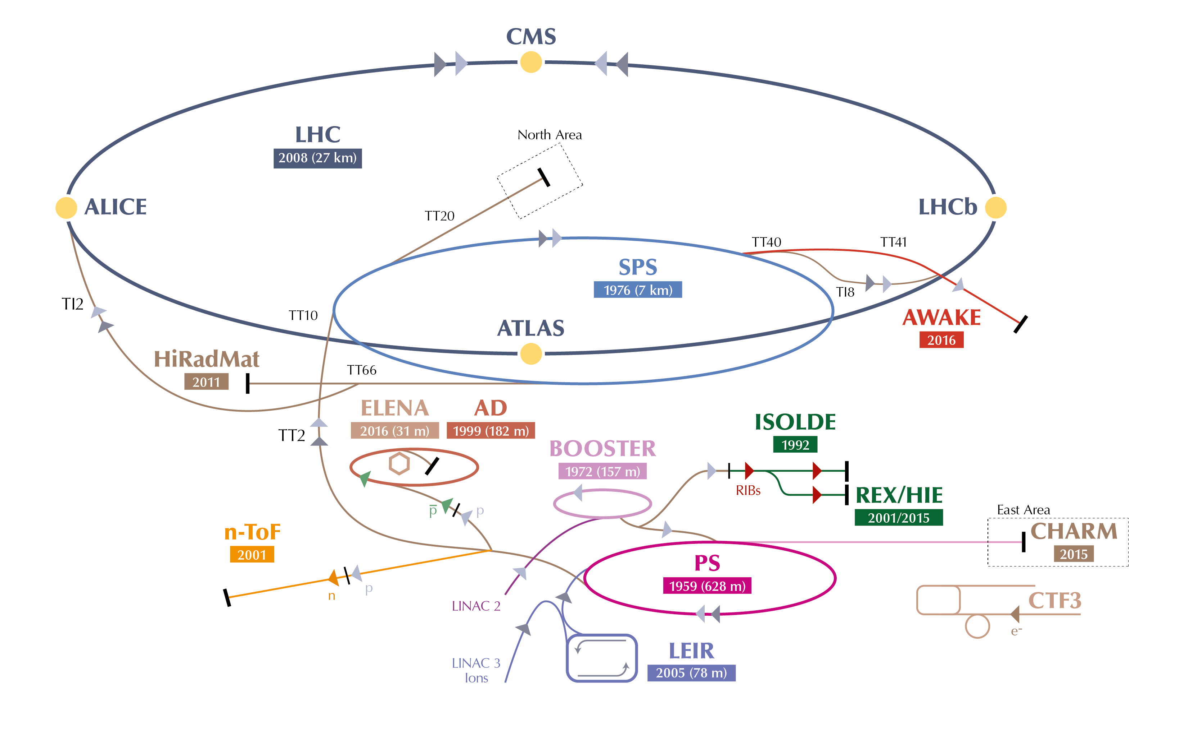

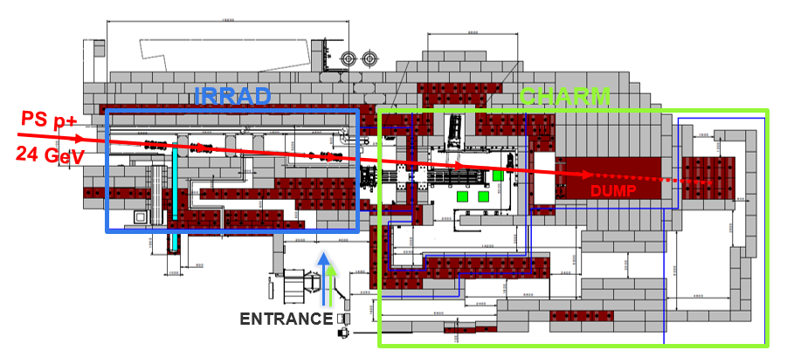
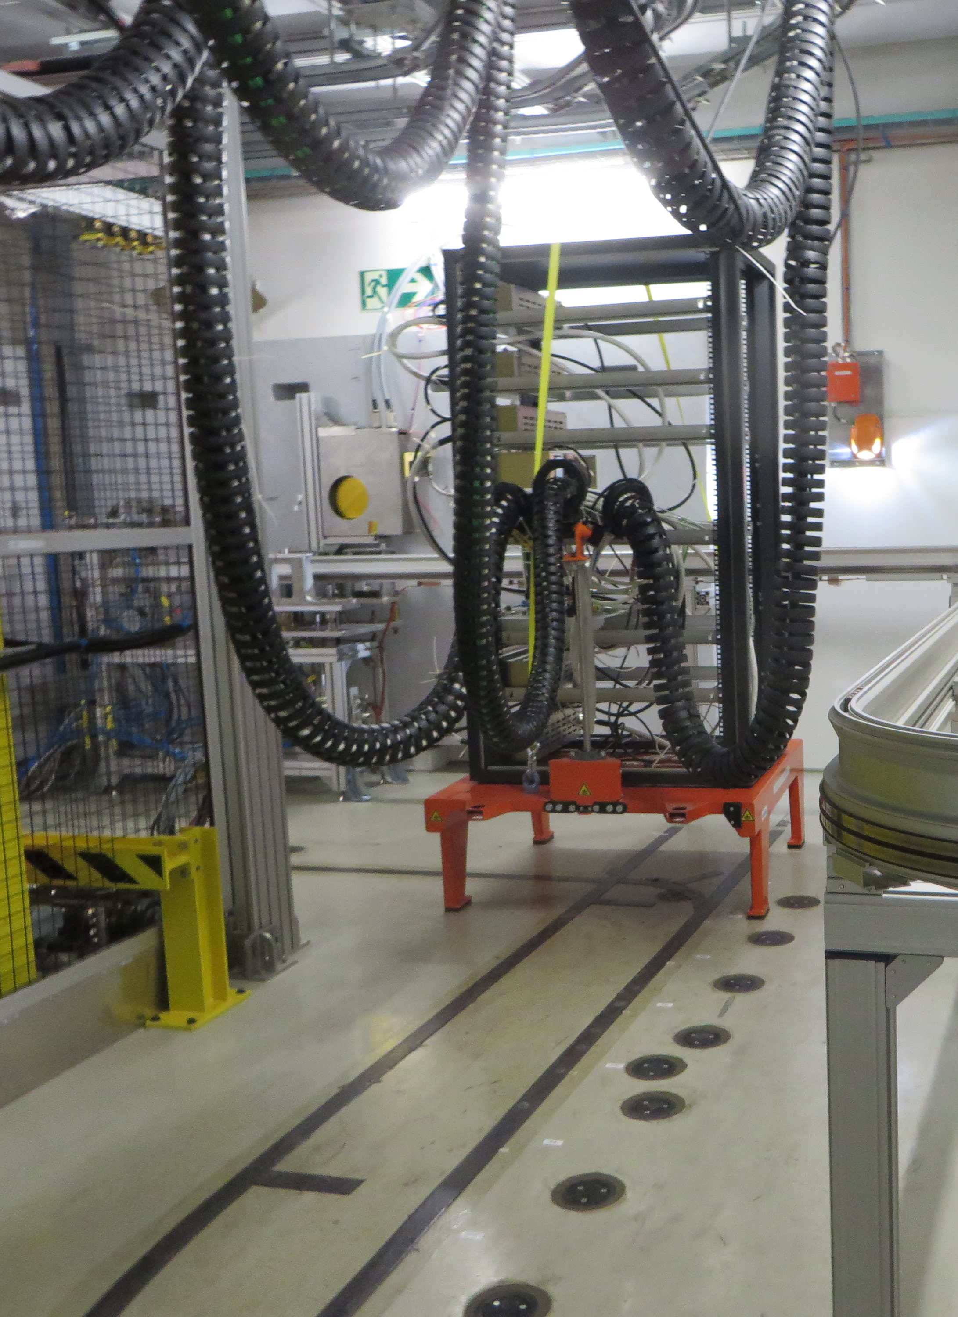
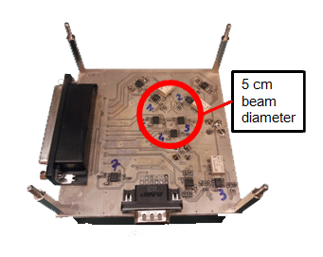
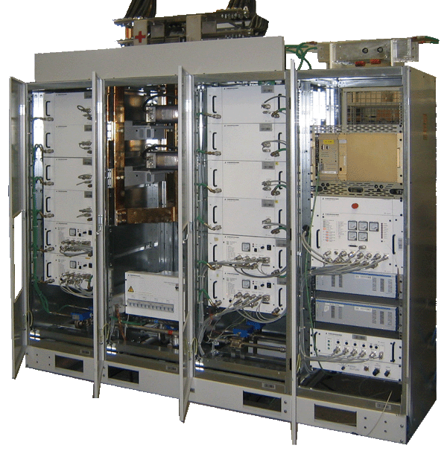
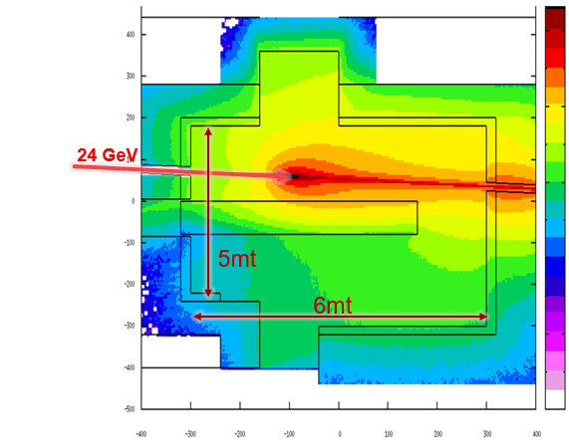
  CHARM
  Cern High Energy AcceleRator Mixed-Field
Main purpose
Radiation tests of electronic equipment and components in a radiation environment similar to some representative radiation fields.
• Large volumes electronic equipment
• High number of single components
• Mixed-Particle-Energy
  - Tunnel and Shielded areas
?
CHARM!

Slide 12
CHARM Status
No free slots in the 2018 planning. All the operational weeks booked
  32 users in the 2016
  25 users in the 2017
  61 users in the 2018
  3 User running during the overall CHARM Irradiation sessions: TE/VSC, TE/MPE, HSE/RP.
Coordination of the access carried out between RP, EN/SMM and EN/HE.
Installation/Removal of test equipment: every Wednesday
Full support during the dry run and test preparation in terms of cabling and organization
Online dosimetry with the RadMon system
  Complex radiation spectra
  Several dose rates
  Self shielding
Proton On Target
 | 2017 |  | 2018
Cu | 2.85E+17 | 80.05% | 3.49E+17 | 74.92%
Al | 4.71E+15 | 1.32% | 1.68E+15 | 0.50%
AlH | 1.36E+16 | 3.82% | 1.63E+15 | 0.04%

Slide 13
CHARM Status – Heavy Ion session
Three weeks of irradiation:
No free slots in the 2018 planning. All the operational weeks booked:
  15 users in the 2018
  the access carried out between RP, EN/SMM and EN/HE
Installation/Removal of test equipment every Day: 25 access in total (two or three accesses/days)
Full support for the organization (in terms of cabling and planning), during tests installation, during the irradiation session (continuous communication with the CCC), also during the late afternoon, night.

Slide 14
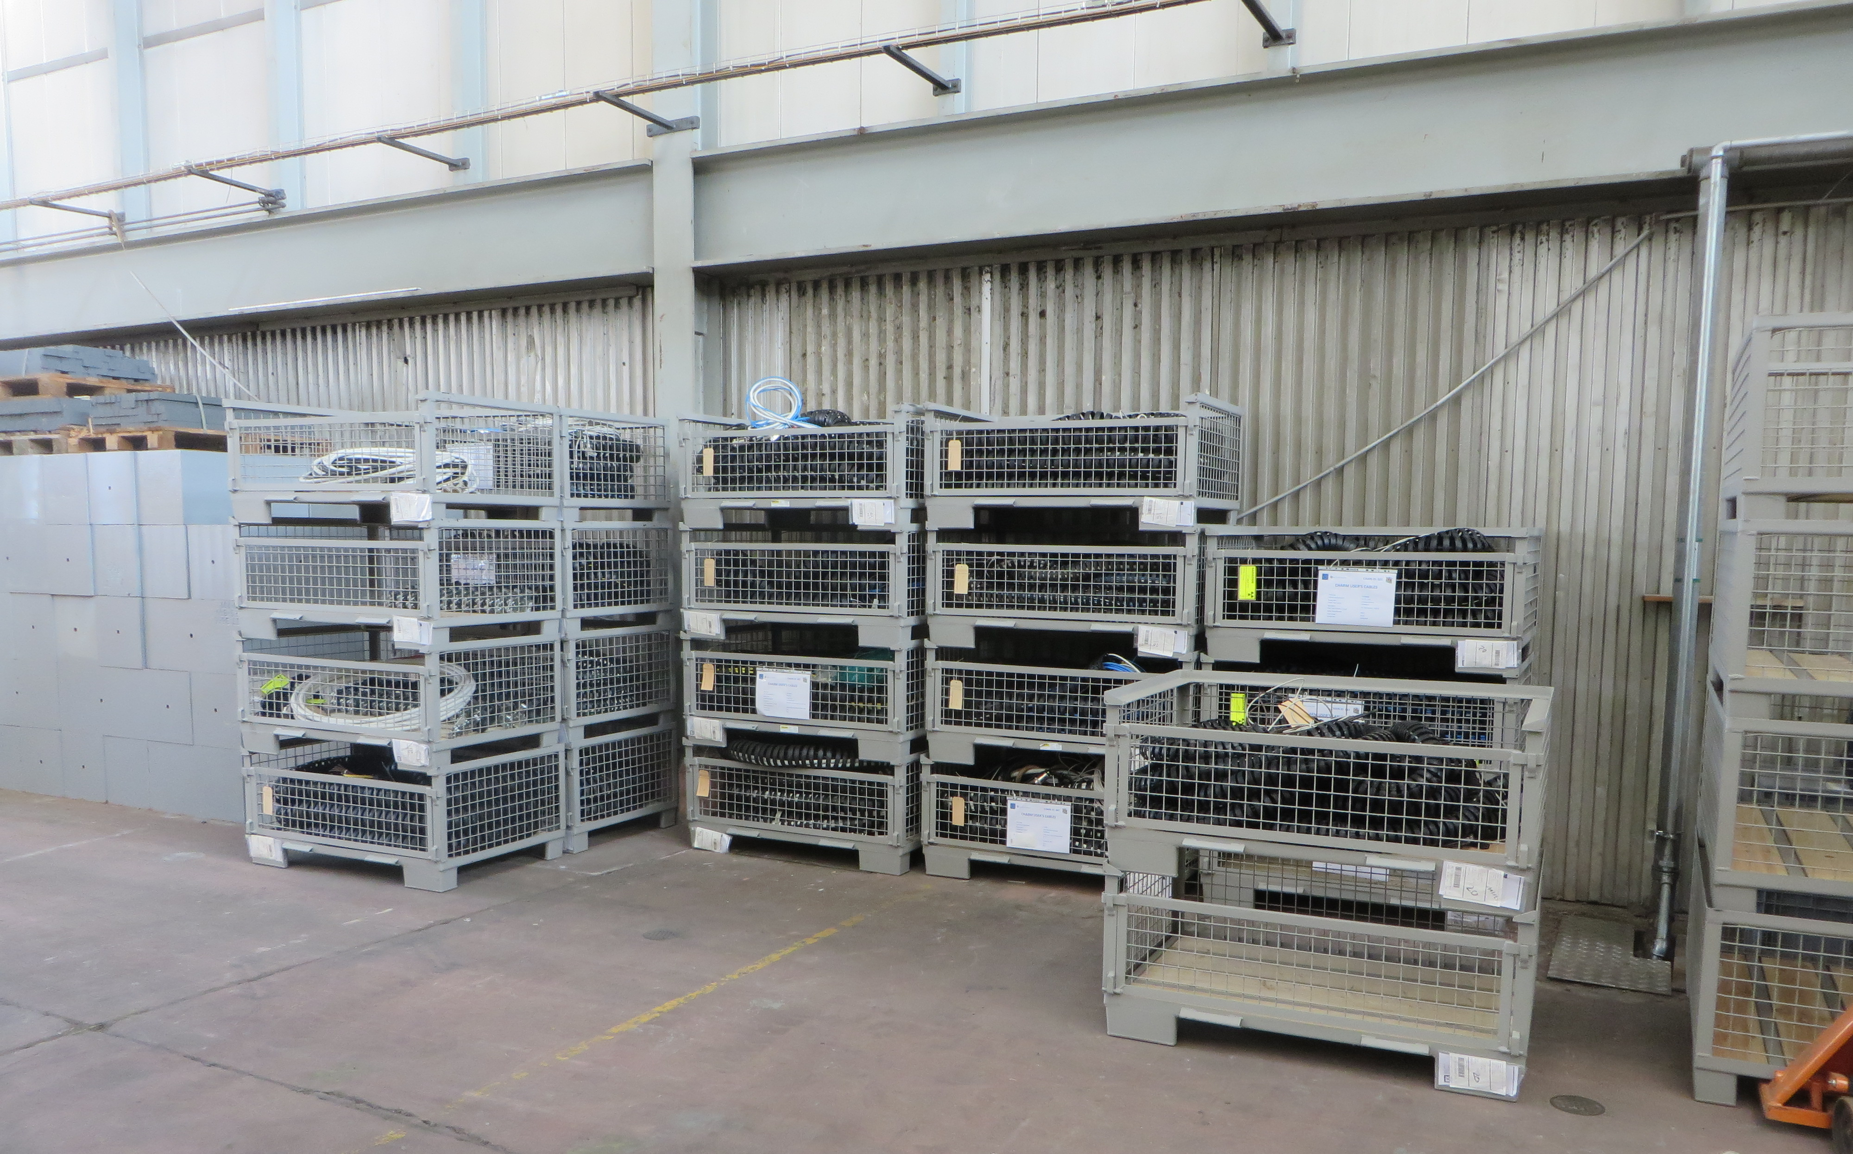
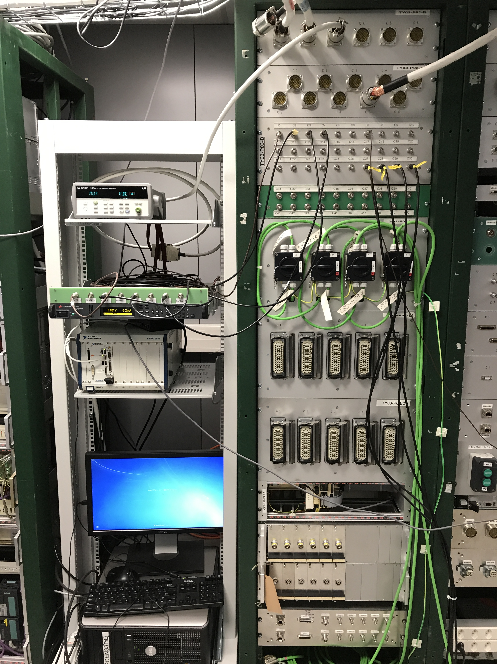
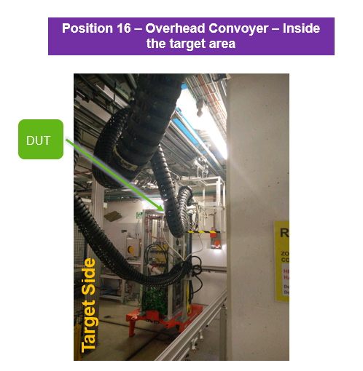
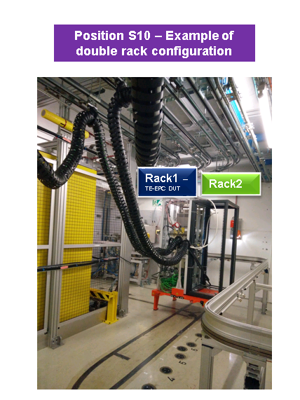
Upgrade
Done
CHARMBot Robot for inspection
Overhead conveyer test setup in the preparation room
Software for Axis x-y Montrac
New DC power cables
Foreseen (LS2)
66 Items : Link
Automatic cable chain insertion system
Enlarge the Control Room
Improve Control room conditioning system

Slide 15
PSI Proton Irradiation Facility
Component qualification is mainly made in PSI with proton beam of 200MeV
Motivation:
  Possibility of testing the three radiation effects at same time : TID, DD and SEE
  Relatively short cables allow high speed digital components to be tested
  Collimated beam allow to irradiate only one small portion of the board where the DUTs are mounted without caring of the components around (no effects on the electronics around)
7-8 campaigns per year for a total of 240 hours/year
Is available during the LS2
Beam time during the weekend
Possibility to test up to 10 components per campaigns
Contract with PSI since 2011, renewed every year.
We concluded in 2017 a 5 years contract which allow us to cover all the needs up to LS3

Slide 16
Other external facilities
Other gamma facilities are used when the expected radiation levels are higher than 1KGy
Coordination with R2M in order to profit of the same slots
External gamma facilities
  BGS (Wiehl in Germany) 30 MGy in 45 days for small volumes
  Ionisos (Dagneux near Lyon) 500 kGy in 45 days
Displacement Damage facilities
  JSI TRIGA reactor available through the AIDA2020
  1 Test carried out in the 2018
Calibrations and research
  CHIPir (Oxford) 1 test carried out in the 2018
  ILL Grenoble Thermal neutron
  PTB
Other : irradiation-facilities.web.cern.ch

Slide 17
Conclusions
Overview of the internal facilities
  Requires continuous follow-up:
    Users coordination
    Operation
    Dosimetry
    Upgrades
CC60 facility is the CERN internal facility for gamma irradiation used 24/7 for most of the year
Upgrade with the new CC60 source planned for Q2-Q3 2019
CHARM facility is the CERN mixed field irradiation facility used for component and system testing in a radiation environment similar to the LHC
  CHARM is in continuous upgrade to face the increasing number of user and requests that book the facility for long periods of time
  Restart April 2021
PSI PIF proton facility is used and it will be used for component qualification
  7-8 Campaigns per year: 240hours/year
Other external facilities can be used for calibration and testing purposes

Slide 18
Thanks to all the CHARM Team

