Slide 1

RadMON Monitoring
Salvatore Danzeca (EN/SMM-RME)

Slide 2
Overview
RadMon ecosystem overview
  V5 and the new V6
RadMon installation in the LHC
RadMon installation in the Injectors
Other Passive solutions
R&D in sensors and architecture

Slide 3

Historic Evolution of the RadMon
2007
RadMon V5
2014
Installation in the Injectors
2018/2019
Wireless BatMon
2005
RadMon first proposal
RadMon V4
2013
RadMon V6
2016/2017
RadMon V6
LHC deployment

Slide 4
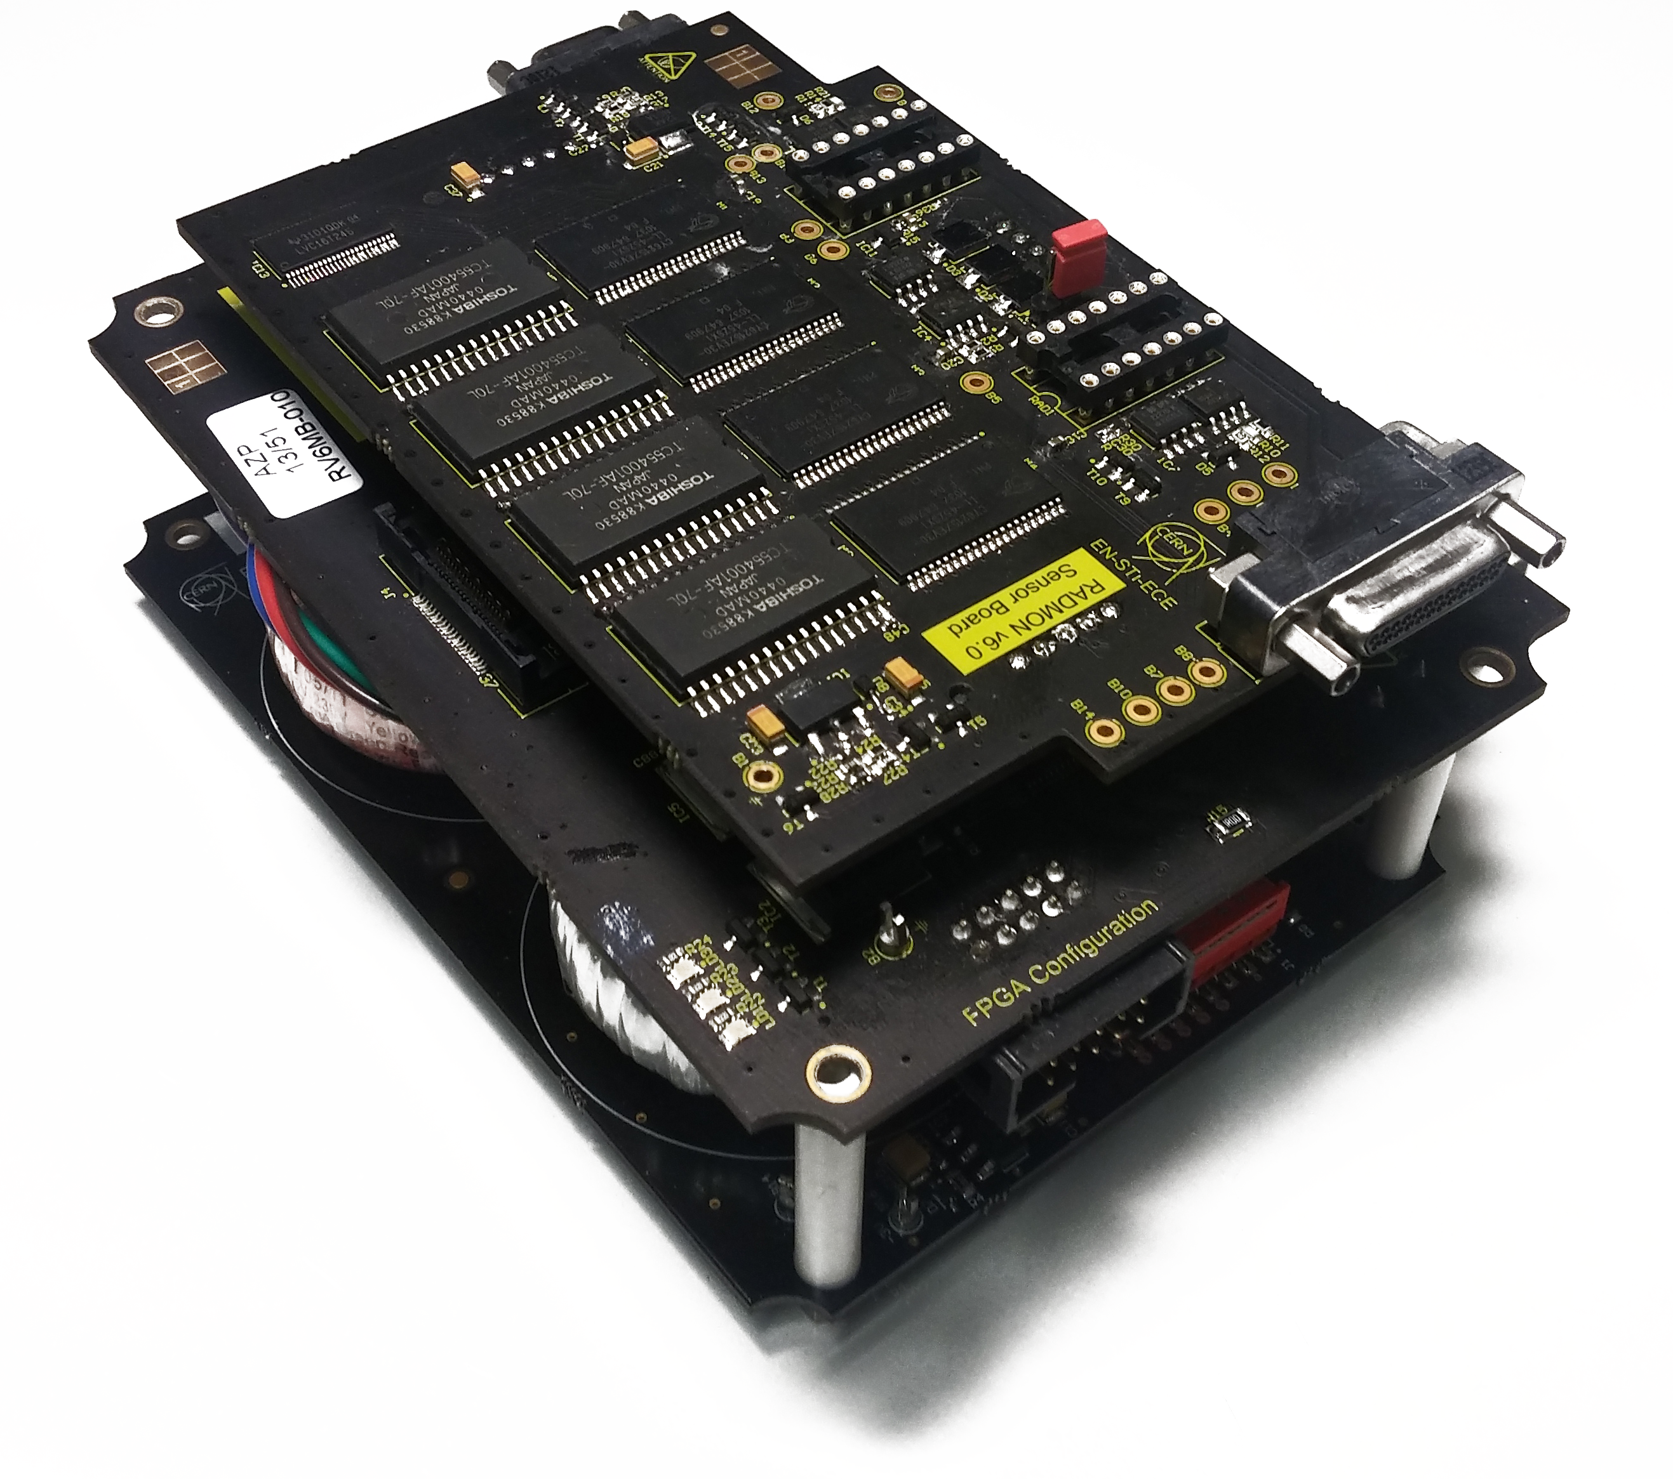
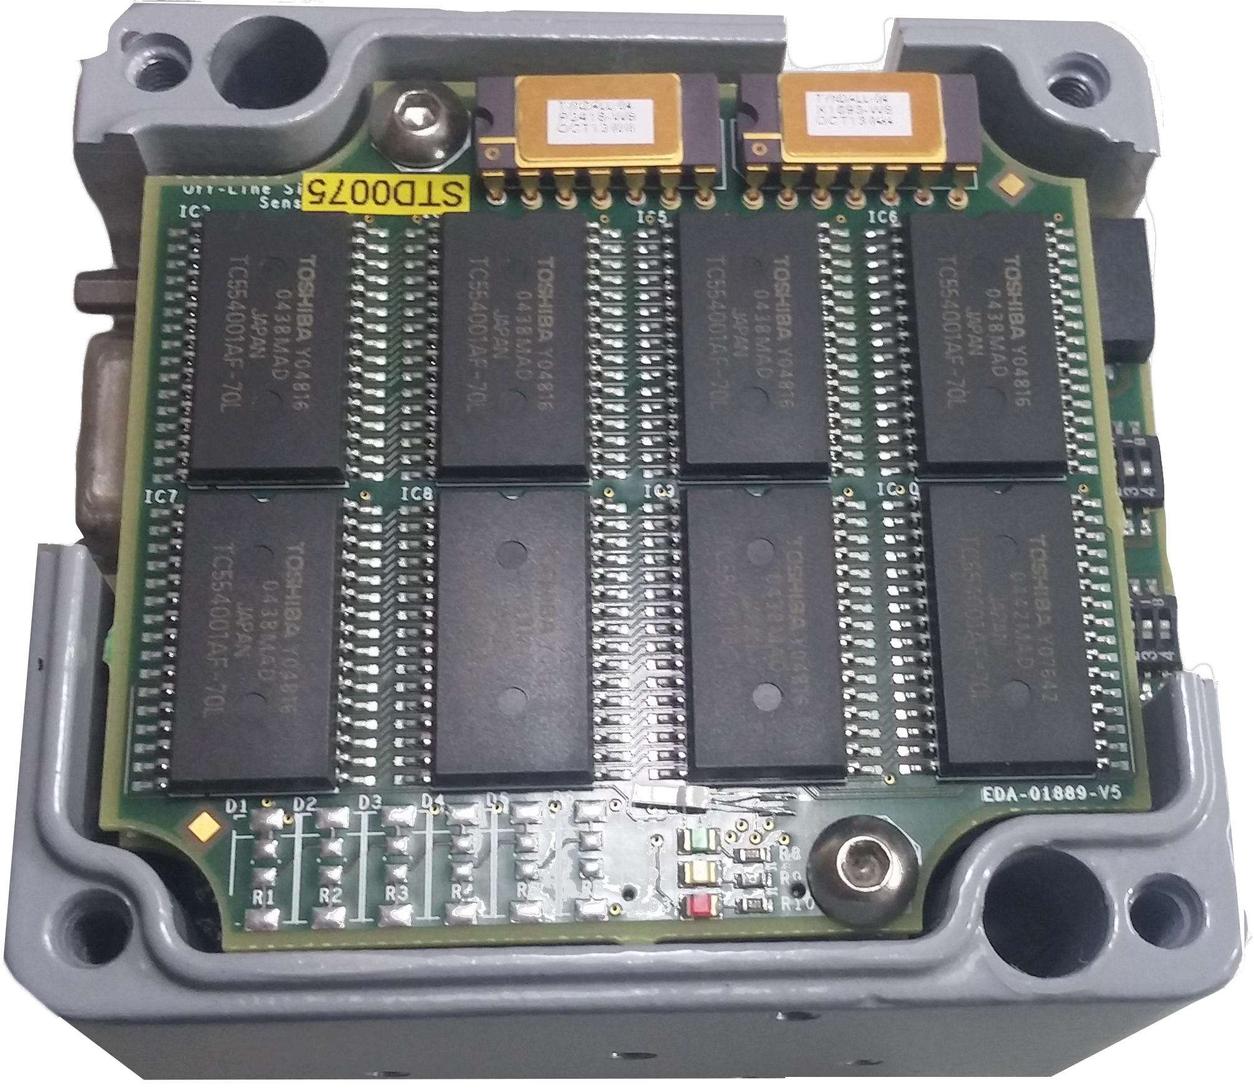
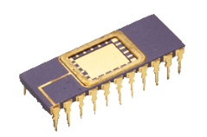
RadMon Ecosystem
RadMon
Passive RadFets
BatMon

Slide 5
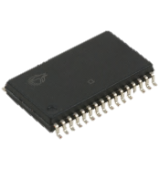
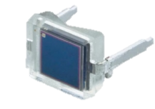
Scope of the RadMon
Measure the Total Ionizing Dose , the Displacement Damage and the High Energy Hadron Fluence in order to:
  Monitor the Radiation Level in the LHC tunnel
  Design and install new equipment
  Anticipate the electronics degradation
  Investigate the cause of failures
  Simulation benchmarking
Memories
SEE
RadFet
Radiation
Effects
Pin Diode
TID
DD

Slide 6
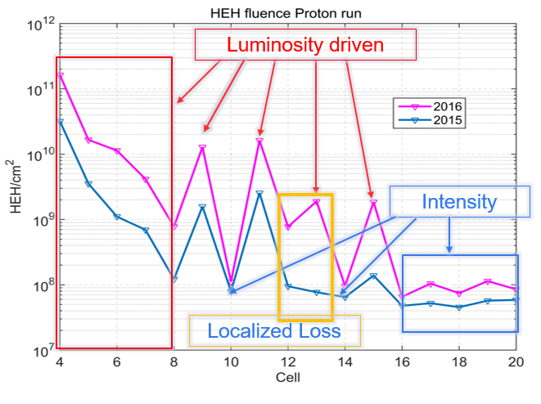
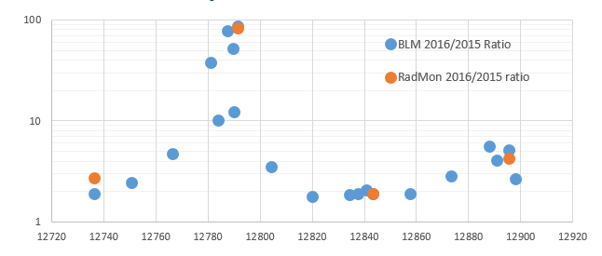
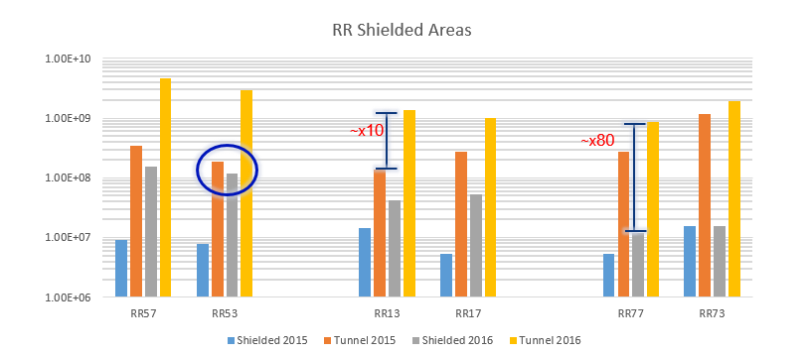
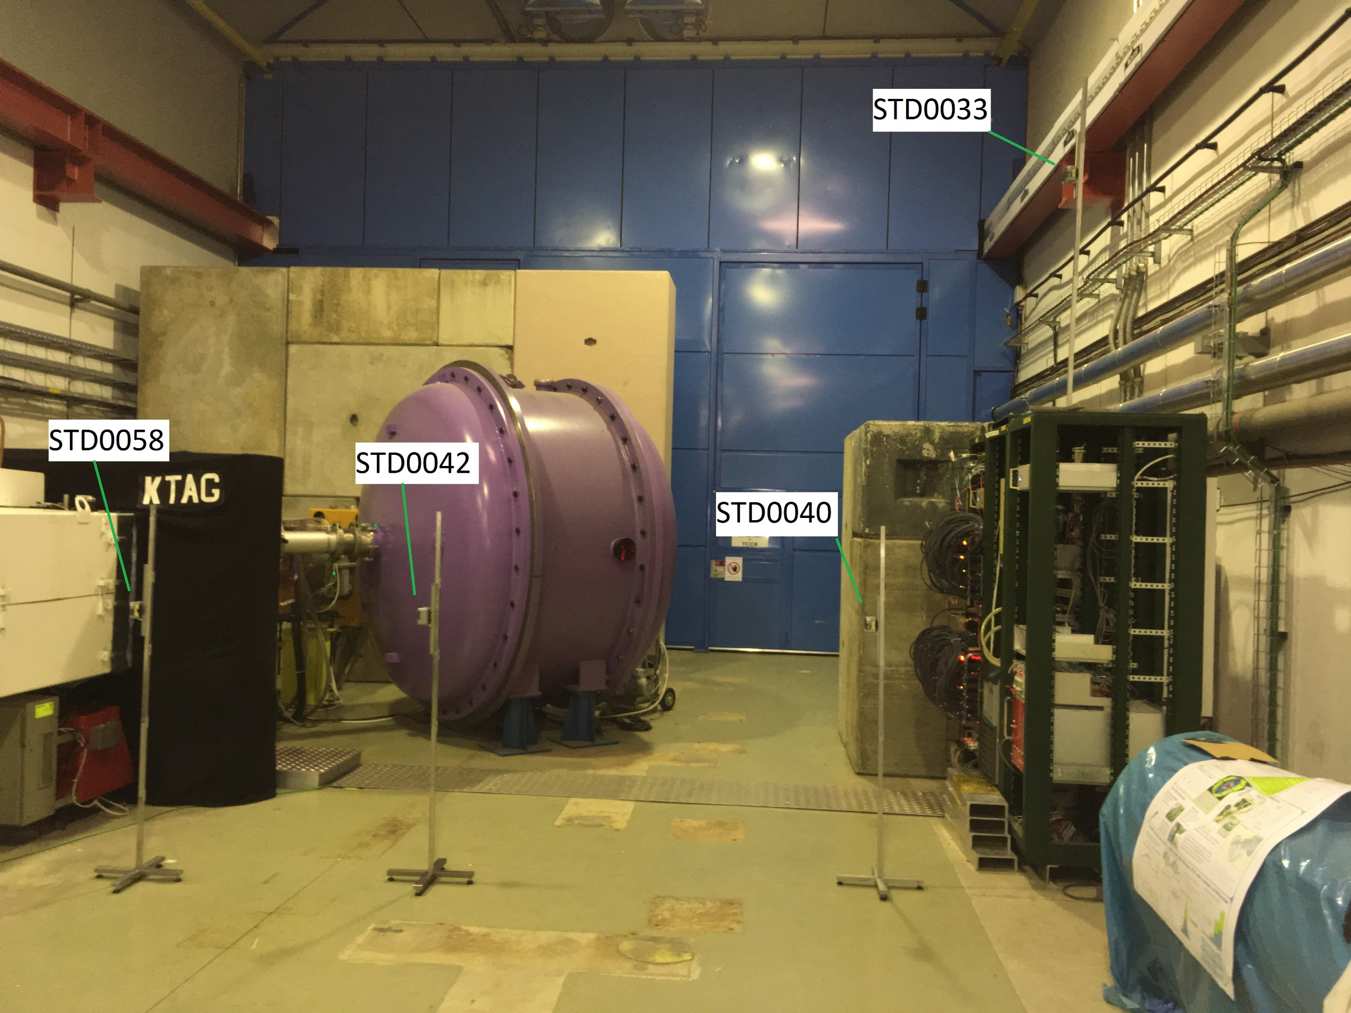
Usage example
Comparison of the radiation levels every year and extrapolation for the future
Measure the dose and the fluence in not expected localized high loss point
Measurements in shielded areas for failure tracking and extrapolation
Non conventional requests coverage with passive dosimeters and battery RadMon i.e FASER, LINAC4, RR53, UJ14…
13L5

Slide 7
RadMon Comparison
Two versions of RadMon currently deployed
V5: low monitoring resolution for the actual requirements, obsolescence of the components
V6 is a full custom design
V6 is more robust against radiation
V6 communication fully compliant with the previous version
Deported module foreseen in all the installations
The V6 can be upgraded
Parameters | V5 | V6
Communication | FIP | FIP
TID tolerance | 80 Gy | 200-250 Gy
Deported module | YES (50 mt) | YES (50 mt)
Reprogrammability | NO | YES
Modularity | YES | YES
Upgradability | NO | YES

Slide 8
LHC installation plan for version V6
Points | Total Radmons | V5 | V6 | Installation
Point 1 | 43 |  | 43 | Already Installed
Point 2 | 43 |  | 43 | Already Installed
Point 3 | 32 |  | 32 | Already Installed
Point 4 | 36 | 36 |  | LS2
Point 5 | 42 |  | 42 | Already Installed
Point 6 | 57 | 57 |  | LS2
Point 7 | 41 |  | 41 | Already Installed
Point 8 | 41 |  | 41 | Already Installed
ALICE | 12 |  | 12 | Already Installed
ATLAS,CMS,LHCb | 45 | 16+20+9 |  | LS2
Total | 392 | 138 | 254

Slide 9
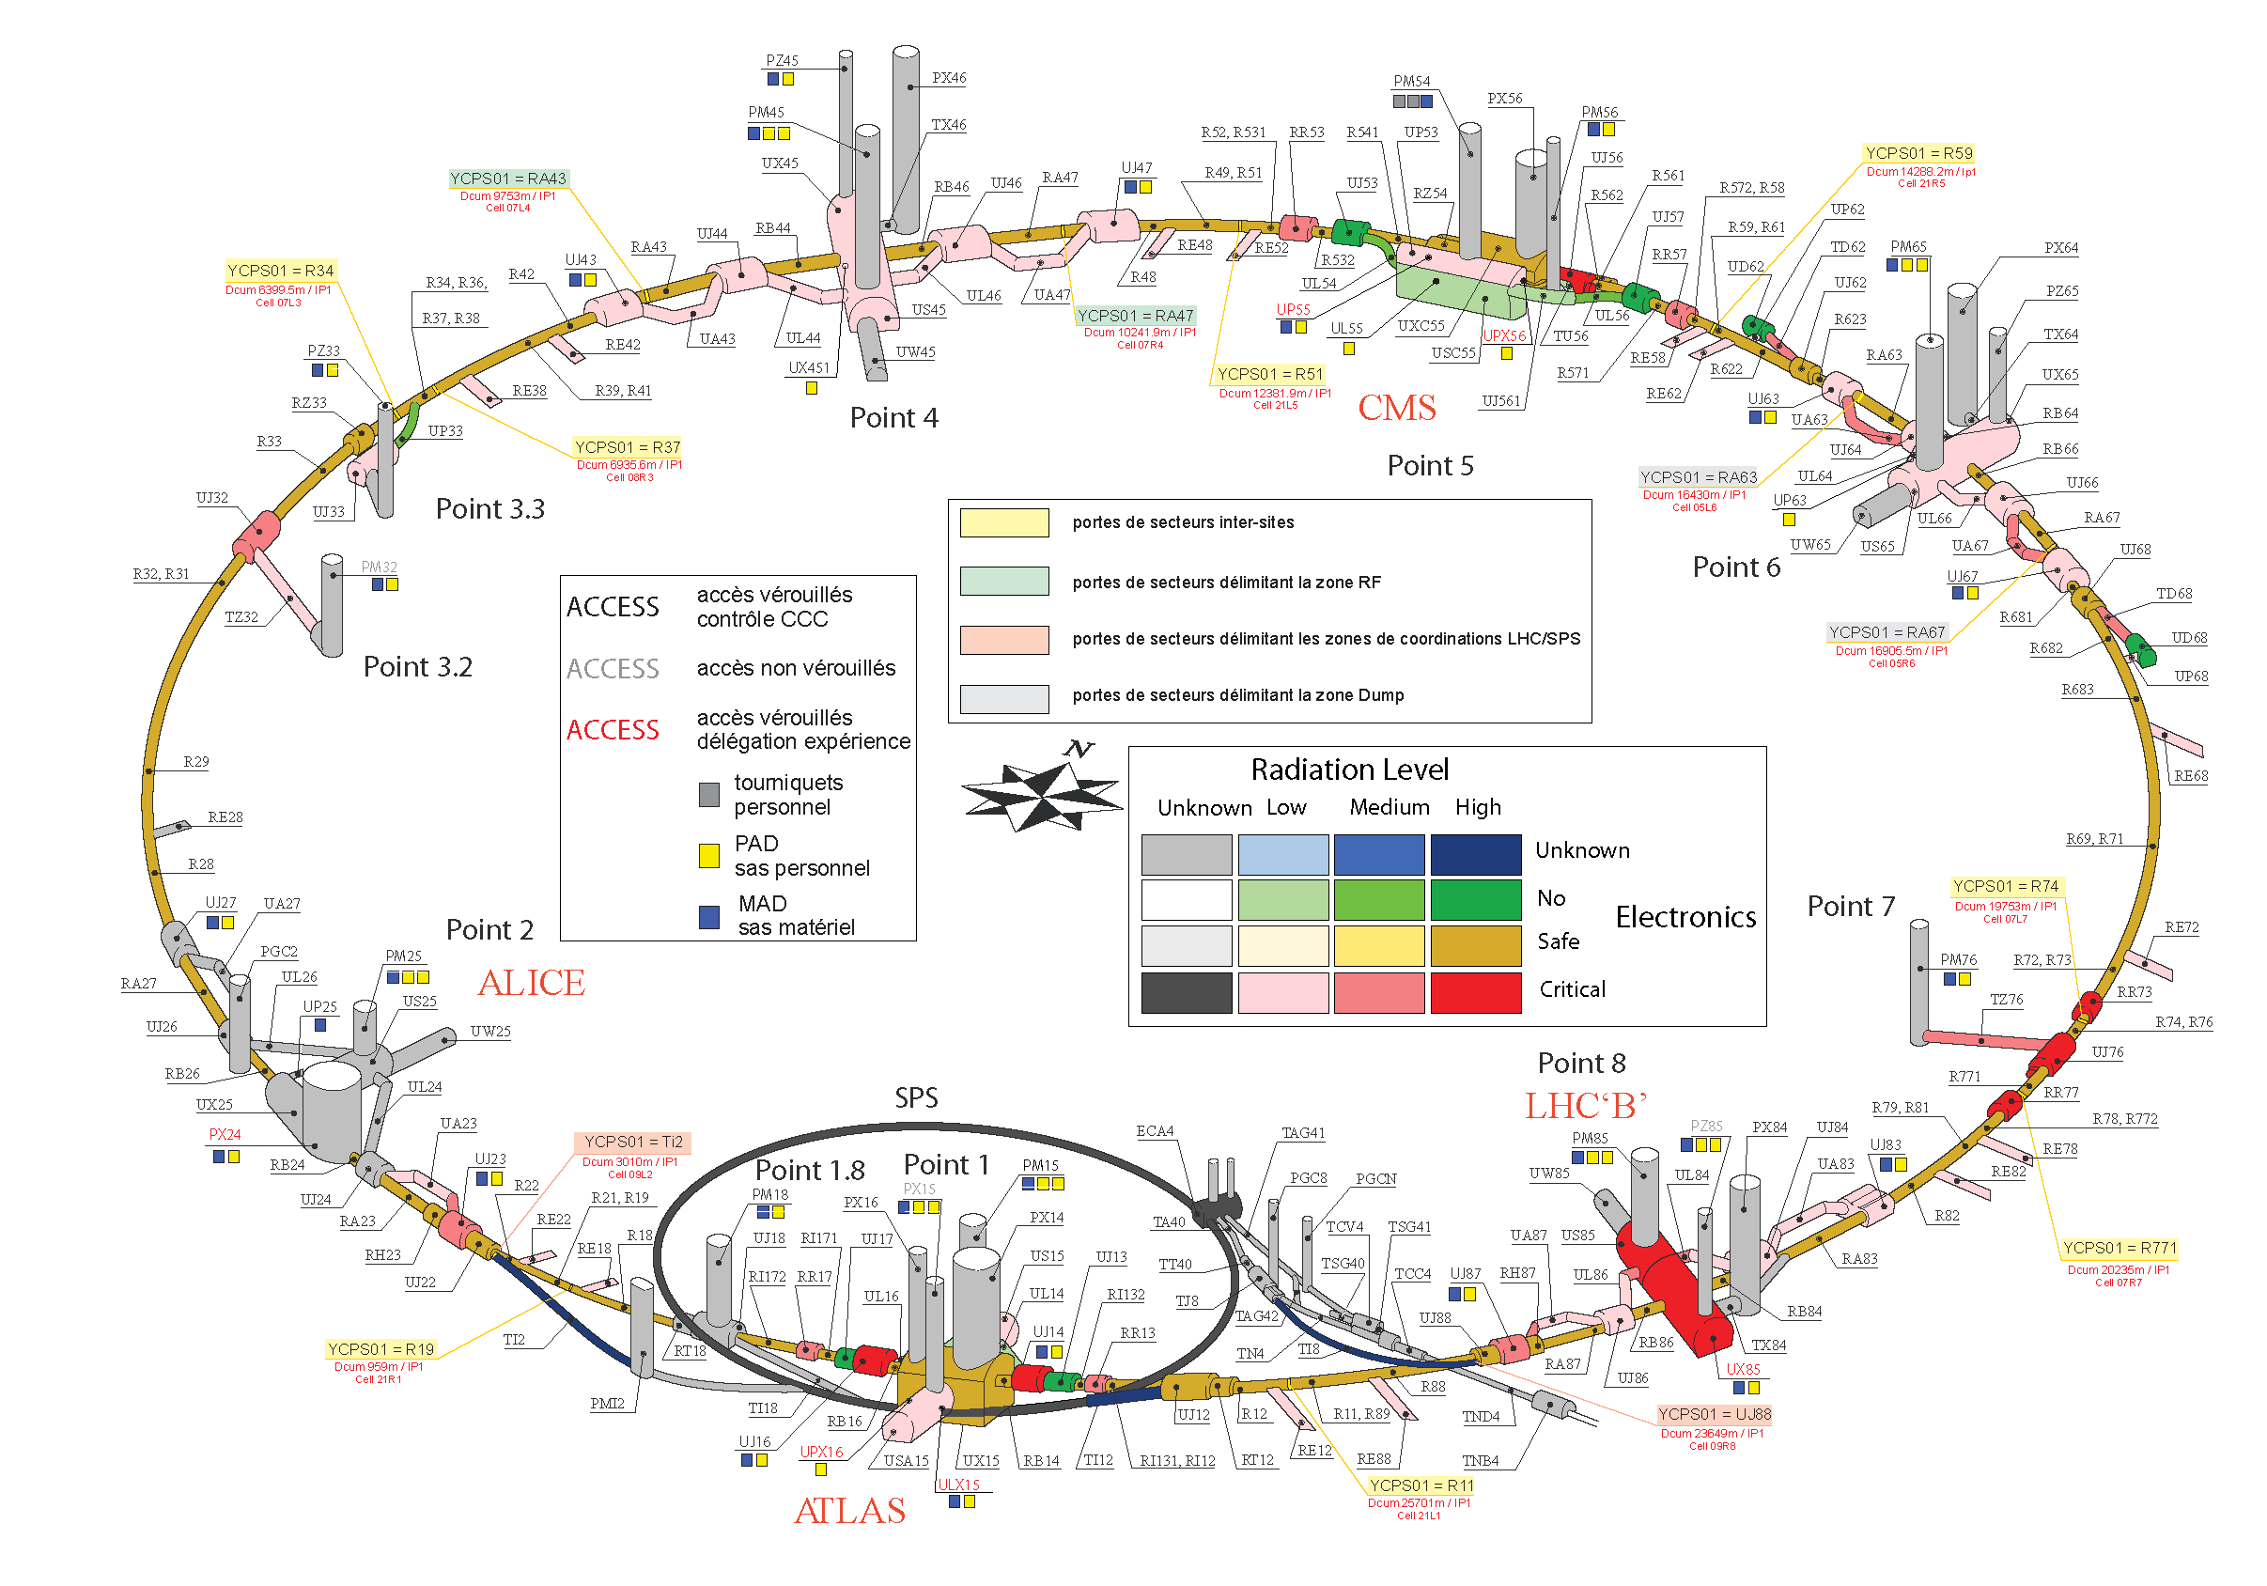
RadMon LHC installations
LHC in all Points
DS/ARC (from cell 7 to 20)
  RadMon are placed below the interconnect between the last MB/MQ of a given cell
  In all points (apart from point 4 and 6) a deported module is attached to the equipment before the interconnection
  Equipment below MB/MQ!
  In the UJs, RR, UL, UAs in the tunnel side and internally
  In LS2 the SMAC project will require the displacement of all the RadMons in the interconnections
  At the end of the LS2 all the RadMon will be placed back in place
cell i
cell i+1
MB
MB
MQ
MB
Tunnel equipment (QPS, CRYO, BLM or EPC)
Motherboard
cell i
cell i+1
MB
MB
MB
MQ
MB
Deported
Motherboard

Slide 10
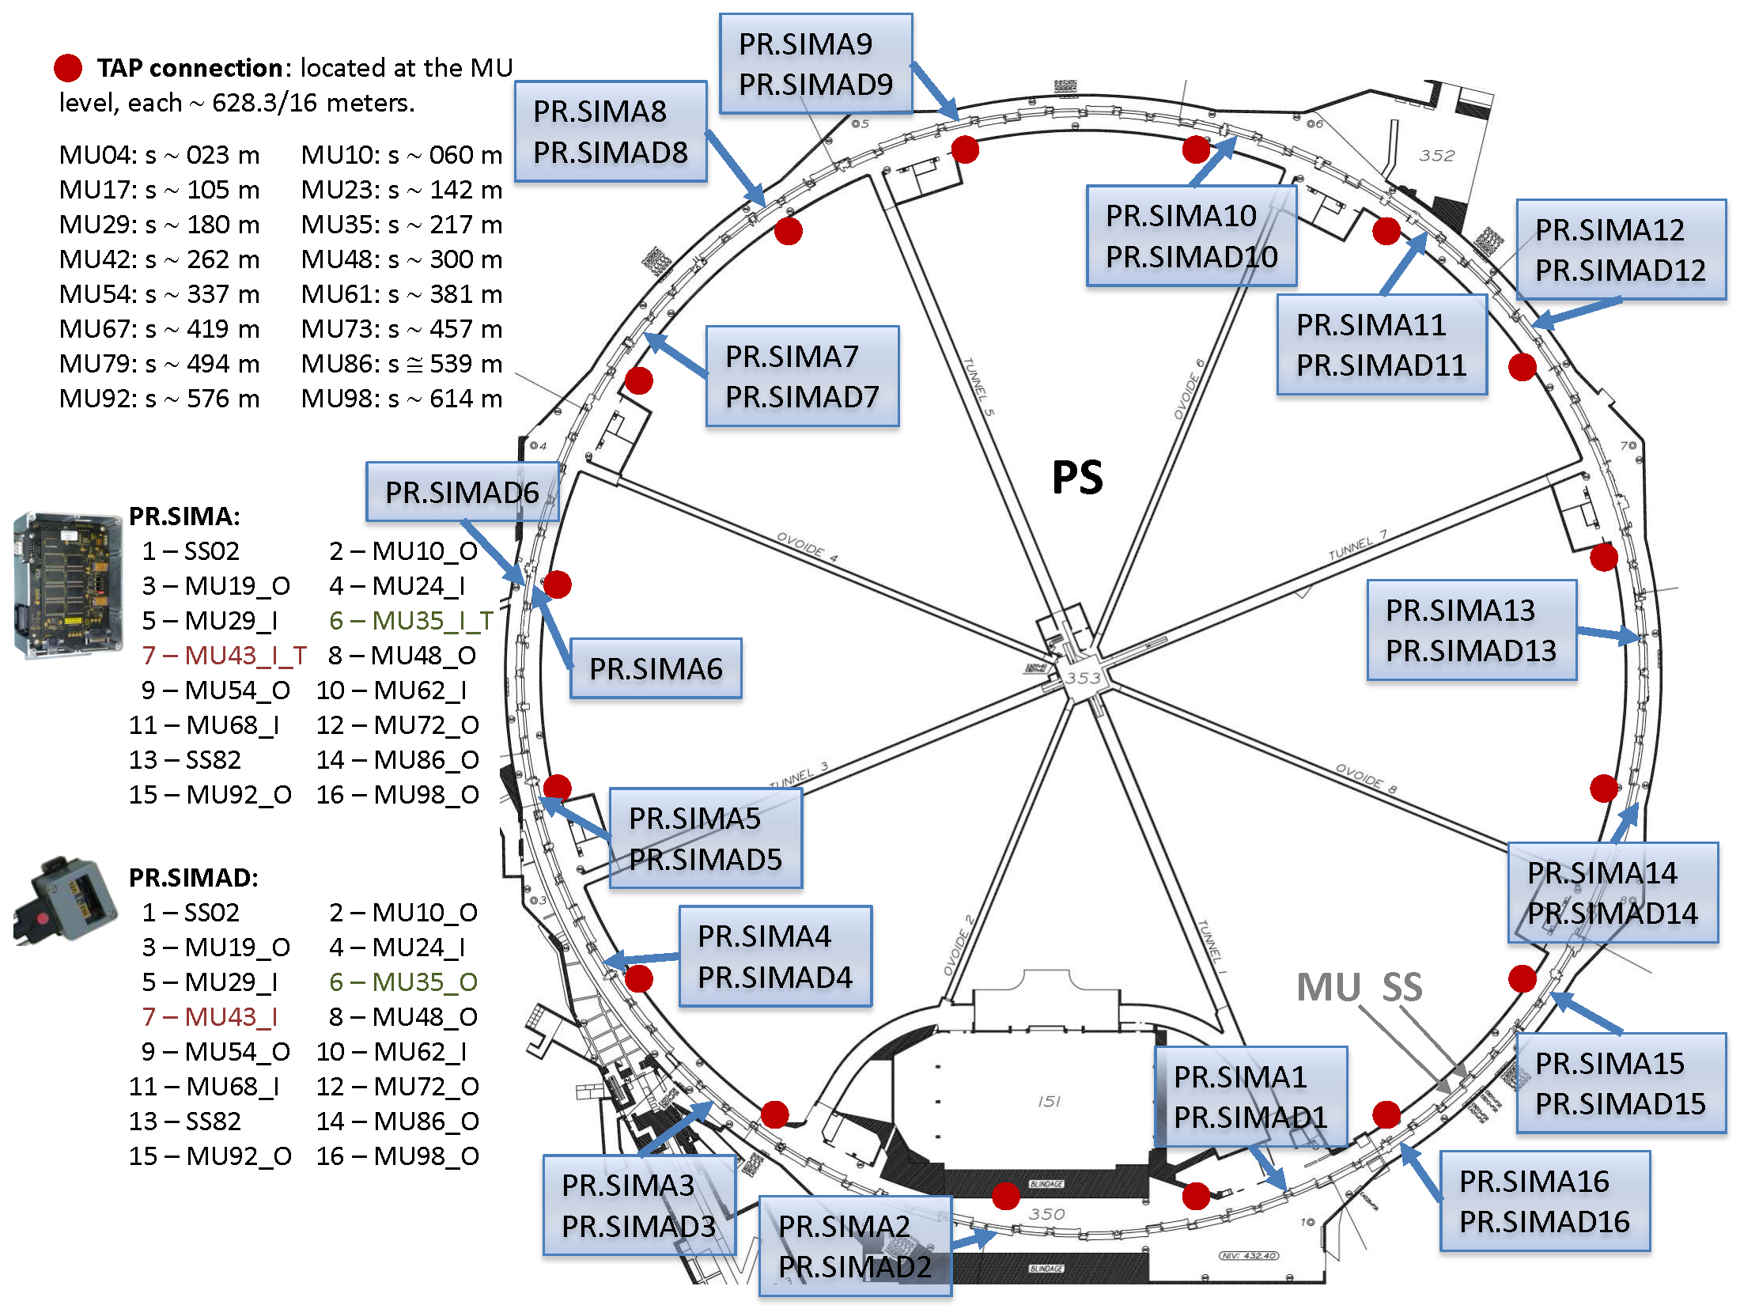
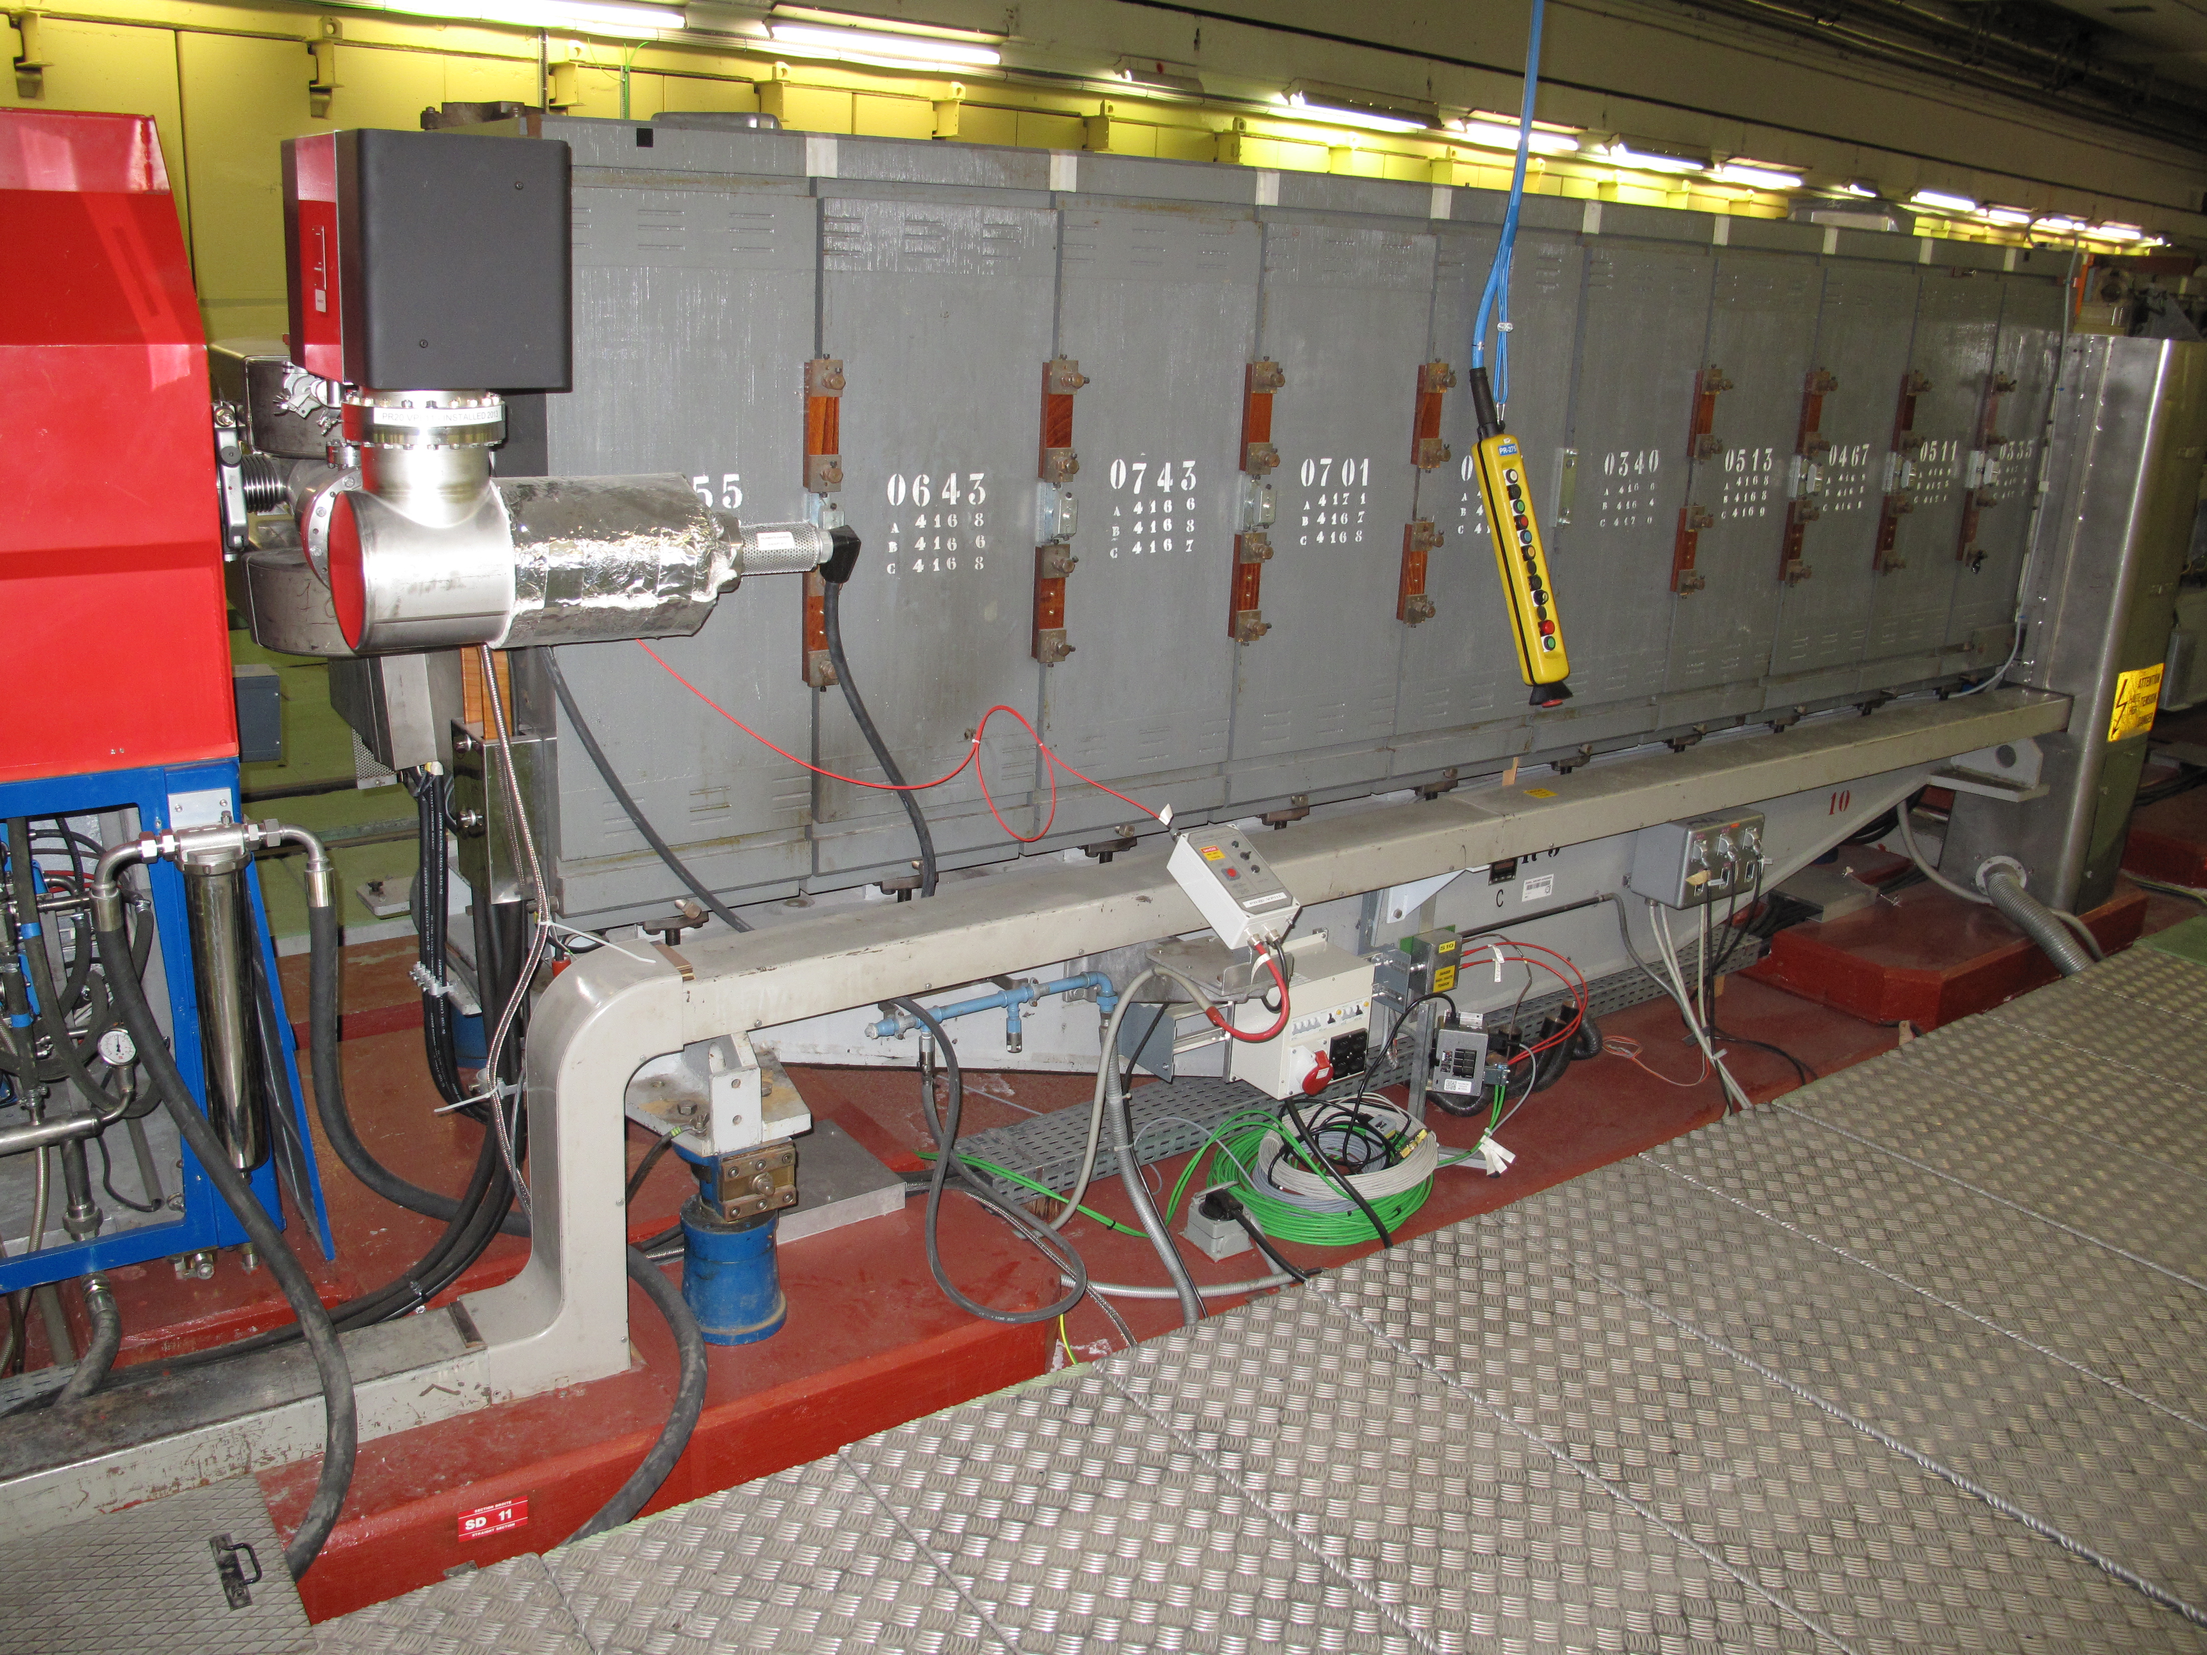
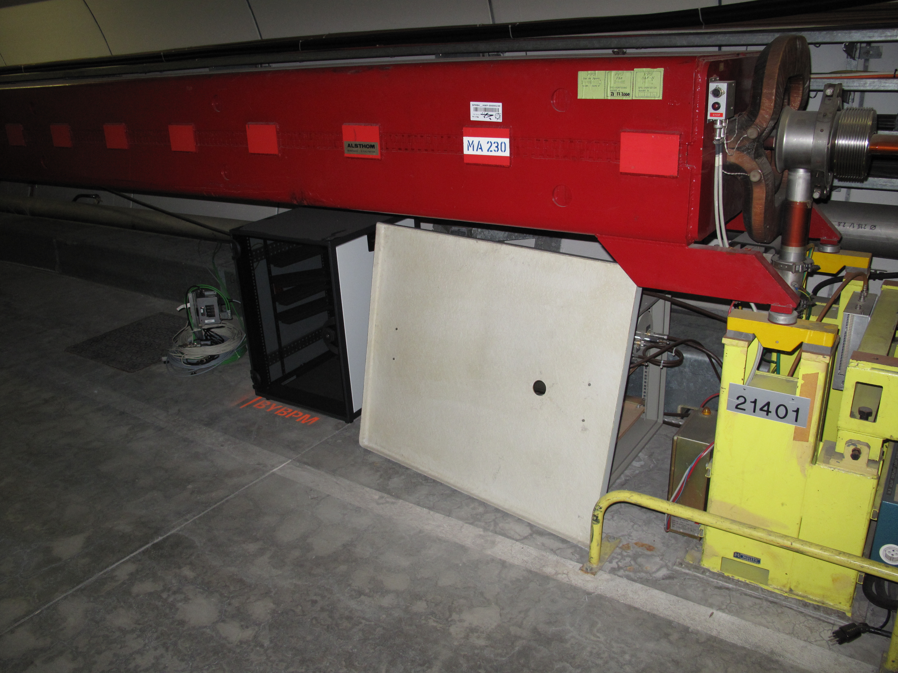
RadMon V6 in the injectors and Experiments
Installation points | Total V6 Radmons
Booster | 8
PS | 16
SPS | 59
ALICE | 13
NA62 | 11
HiRadMat | 5
CHARM | 7
AWAKE | 3
Total | 122

Slide 11
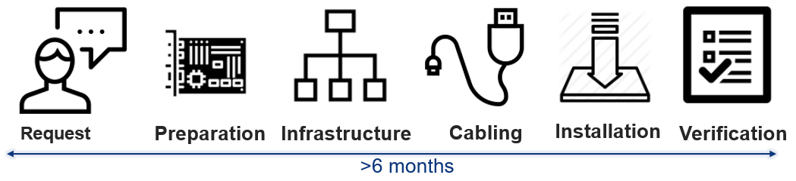
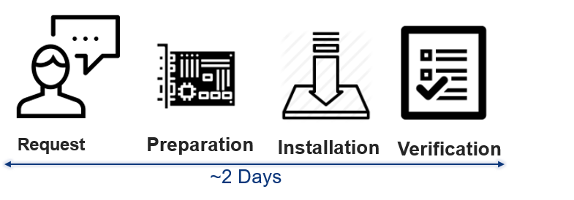
The origin of the idea
Key idea is born around the RadMon
  RadMon is a system of cabled devices with a well defined infrastructure inside the CERN (device management, gateways, logging etc..)
  More than 500 devices are installed currently in the LHC
What happen if one user want to monitor the radiation level in a place where RadMon are not available?
  We have mainly only the technical stop (few days) for the installation
  Usually the requests arrive few days before the access…

Slide 12
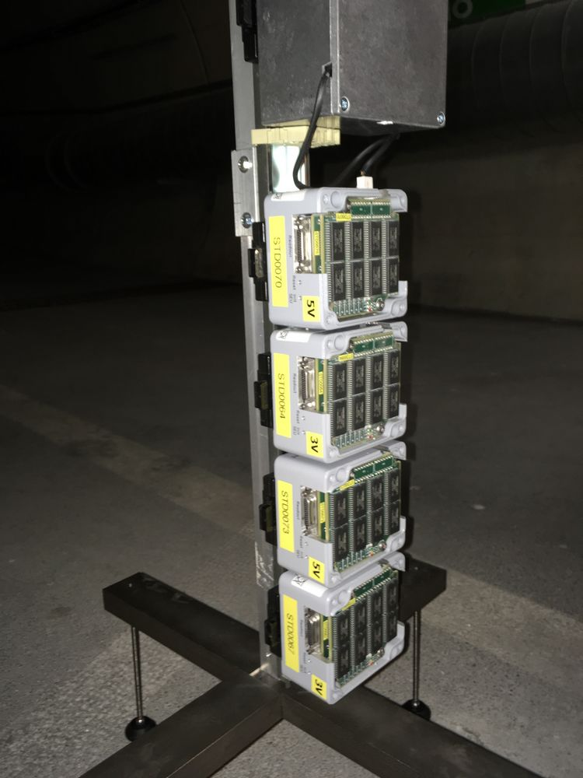
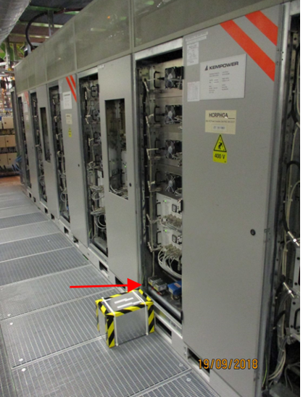
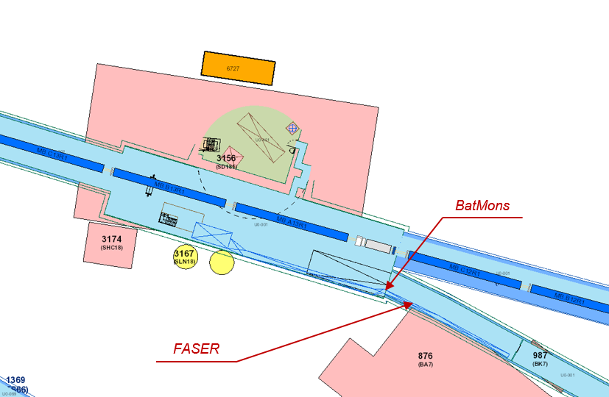
BatMons and Passive RadFets
Where there is no need or no possibility of having a fixed installation (mainly due to the FIP cabling) we use the BatMons
Currently installed in:
  Linac 4
  TI12/TI18
  RR53
  UJ14/UJ17
  US15
  RA43
  CMS Cavern
20 Passive dosimeters installed in ALPHA
200 Passive dosimeters installed in the SPS for monitoring the dose in the miniracks of BE-BI
40 Passive RadFet installed in the PSB for the RF cavities
100 Passive dosimeters installed in Point 1 and Point 5 for the 2018 BFPP
>40 interventions during the 2018 Technical Stops for the installation of more than 50 BatMons and 100 passive dosimeters.

Slide 13
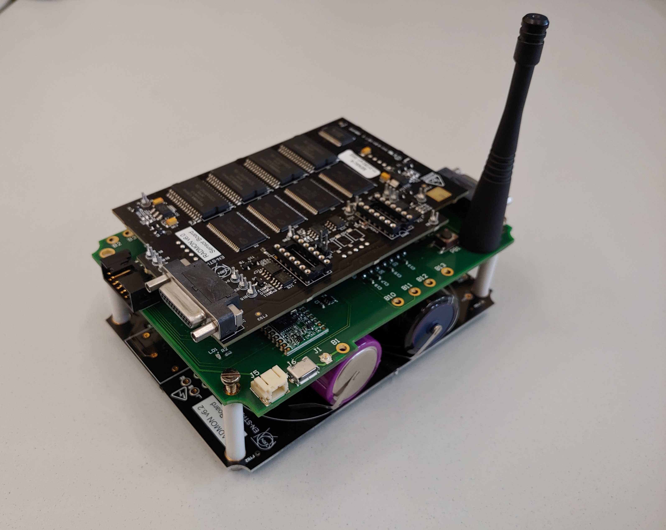
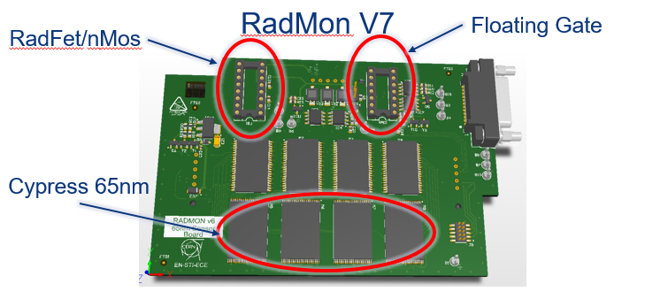
R&D New BatMon
Development of the new prototype of BatMon
Motivation:
  few spares left
  Obsolescence of several components
  Local logging and wireless solutions
The WBatMon: a Wireless BATttery radiation MONitor
  Monitor and control radiation sensors
  Modular
  Battery powered
  Reliable under radiation
  Wireless communication over km range
  Well known standard for IoT
    Strong collaboration with IT/CS for the choice of the supported link
  Same form factor as the actual RadMon
  The first wireless radiation tolerant CERN development
2009
2018

Slide 14
Conclusions
RadMon ecosystem is an essential instrument (R2E eyes) for knowing the radiation levels in the LHC tunnel and shielded areas, injectors and experiments.
The plan is to have for the end of LS2 all RadMon V6 installed in the LHC tunnel and experimental galleries
Large work of SMAC project will require to move all the RadMon from the interconnection for re-installing them before the LHC start
BatMon and Passive dosimeters deployed in the LHC, injector and in the experiments will be always supported
WBatMon development in progress: the first radiation tolerant wireless development at CERN

Slide 15
Thanks to all the RadMon Team!!

Slide 16
RadMon V5 and V6 a quick overview
Feature | V4-V5 | V6 | Comments
ADC | 12 bit | 16 bit
Controller | MicroFip | FPGA | V6 fully customizable
Health monitoring | 2 Test points | 12 Test Points
Configuration | Manual Switches | FPGA re-programming | V5 access required to change conf
Dynamic Range | Limited by the +10V ADC | Programmable attenuator

Slide 17
Reviewed location LHC part 1
Points | Start cell | End cell | Extension YETS | Shielded areas | Non standard installation
1 Left and Right | 4 | 17 | 12-17 | UJ16 UL16 UPS16 RR17 UJ14 UPS14 RR13 | 2R1.1RM03S (out of UJ17) 4R1.1RM19S ( LHCf ) 7R1.1RM11S (out of RR17)
2 Left and Right | 8 | 20 | 9-20 | UA23 UJ23 UJ22 RE22 UA27 RE28 | 4L2.2LM07S (ZDC – close to the beam pipe) 4R2.2RM21S (on the wall of the first floor) 8L2.2LM05S (out of the UJ22)
3 Right | 4 | 20 | NO | RE38 UJ32 RE32
4 Left and Right | 5 | 11 | NO | UX45 | SIMA.5R4.4RM14S (BSRT Beam 1) SIMA.5R4.4RM16S (BSRT Beam 1) SIMA.5L4.4LM14S (BSRT Beam 2) SIMA.5L4.4LM16S (BSRT Beam 2)
5 Left and Right | 4 | 17 | 12-17 | UPS54 UJ56 USC55 RR53 RR57 | SIMA.4L5.5LM07S ( TAN ) SIMA.4R5.5RM05S ( TAN )

Slide 18
Reviewed location LHC part 2
Points | Start cell | End cell | Extension YETS | Cavern | Non standard installation
6 Left and Right | 4 | 20 | NO | UJ64 UA63 UX65 RE62 UA67 UJ66 RE68 | SIMA.17L6.6LM17S ( DUMP beam 1 ) SIMA.17R6.6RM17S ( DUMP beam 2 )
7 Left and Right | 4-7 | 20 | NO | RR73 RE72
8 Left and Right | 4-7 | 20 | 9-20 | UA83 RE82 UA87 UJ88 RE88

Slide 19
LHC experiments: ATLAS, CMS, LHCb
RadMon V4 installed in the 2009
Atlas UX15 16 RadMons installed also on the balcony
CMS UXC55 20 RadMons installed
LHCb UX85 10 RadMons installed

