Slide 1
Optical Fiber Dosimetry
Diego DI FRANCESCA, Yacine KADI, Gaetano LI VECCHI, Keziban KANDEMIR
EN-EA-PE
Indico link: https://indico.cern.ch/event/760345/

Slide 2
Outline
Motivation for Optical Fiber Dosimetry (OFD)
Overview of the OFD in the last years
Main features of the OFD system in 2018
Status of the OFD installations in 2018
Future installations and LS2 activities
Collaborations and dissemination of results
Conclusions

Slide 3
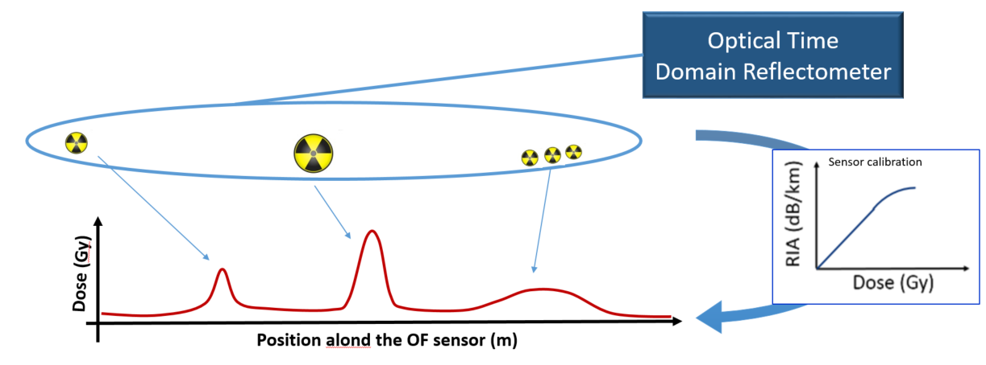
Motivations
Providing 1D radiation maps of the accelerators and online monitoring in order to prevent R2E-related failures
Radiation Induced Attenuation (RIA)
H. Henschel et al., Nucl. Instrum. Methods Phys. Res. B, 69, 307, 1992

Slide 4
Key features
Well adapted for large facilities
Distributed 1D maps of the radiation dose
Online monitoring
All electronics installed in remote and radiation-free locations
Cost effective
Need to replace the OF sensors: cable blowing
One cable -> multiple OFs -> multiple radiation sensitivities
Information of the cumulated dose stored in the OF itself
It also allows to perform distributed temperature measurement

Slide 5
Overview of Distributed Optical Fiber Radiation Sensor (DOFRS)
I. Toccafondo’s
PhD thesis
MCWG 2017-2018:
DOFRS in PSB
A new version of DOFRS implemented in the PS
MCWG 2016-2017
1st operational prototype installed in the PSB
MCWG
2013-2016:
Proof of concept
DOFRS project
KT-Funded

Slide 6
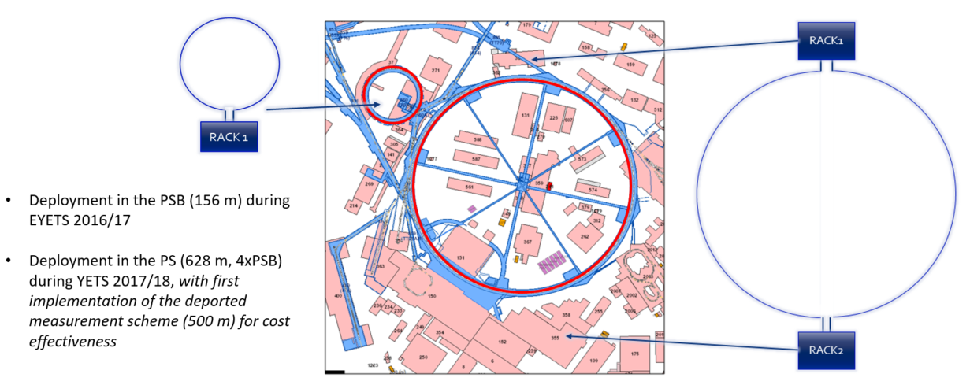
Today’s installations

Slide 7
Main characteristics of DOFRS
2017 (PSB)
2018 (PS and future installations)
Multimode OTDR (not ideal for dosimetry)
  Multimode Optical Switch
  Multimode OF infrastructure
Singlemode OTDR (not used in PSB)
  Singlemode Optical Switch
  Singlemode OF infrastructure
No distributed temperature measurement capability
Significant risks associated to re-buying OF sensor
Fully singlemode system
  Lower costs with improved performance
Distributed temperature measurement capability acquired
Minimization of the risks associated to the OF sensor procurement
Spatial resolution improved by a factor 2.5
Larger dynamic range (8 dB to 12 dB at respective highest resolution!)
No temperature dependence around RT (up to 50 °C)
Higher sensitivity and lower radiation detection limit (from a few Gy to hundreds of mGy)
Measurement easily deported (e.g. tested over hundreds of meters in PS) with further decrease of costs

Slide 8
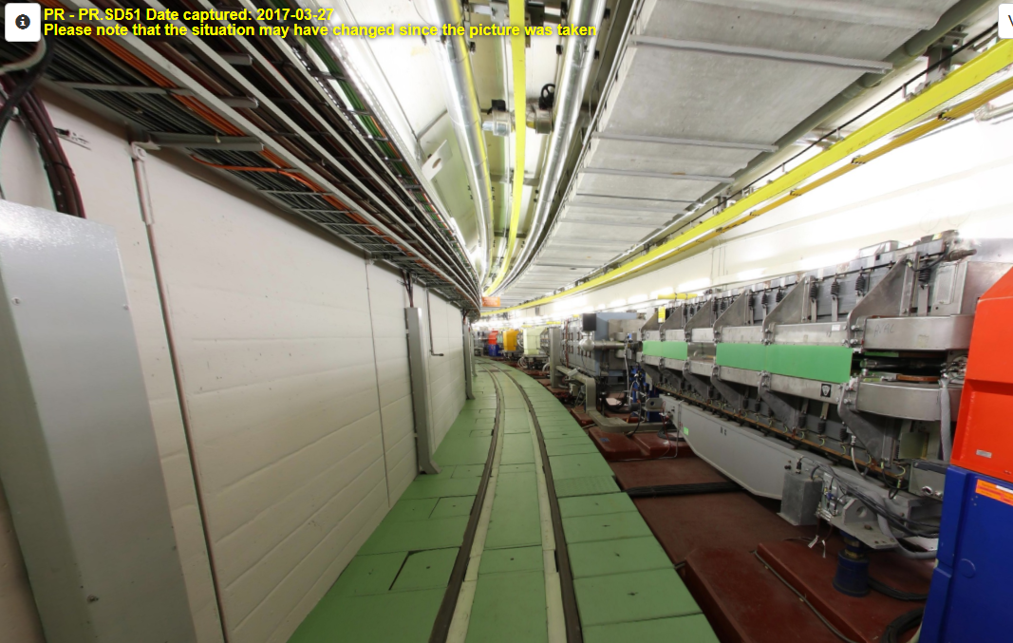
Example of operational year 2018: PS

Slide 9
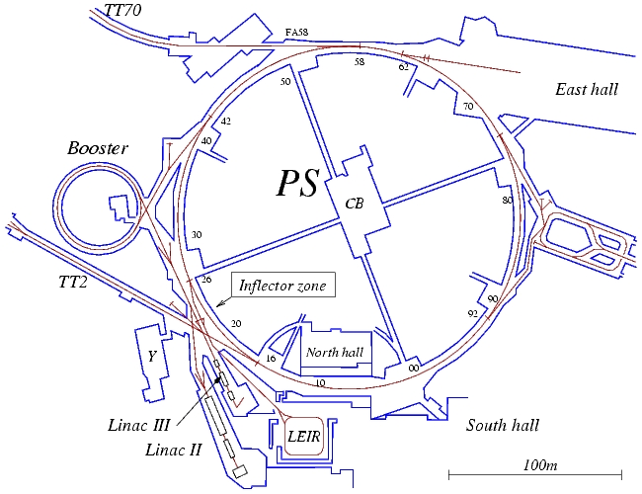
Example of operational year 2018: PS
In 2018
270 days of continuous distributed monitoring of radiation dose levels in both PSB and PS.
Dose measurements cross-validated locally with point technologies.
(Scaling up factor ̴ 4 wrt 2017)

Slide 10
DOFRS future installations
2019-2020:
DOFRS to be installed in SPS, TT20 and LHC
I. Toccafondo’s
PhD thesis
MCWG 2017-2018:
DOFRS in PSB
A new version of DOFRS implemented in the PS
MCWG 2016-2017
1st operational prototype installed in the PSB
MCWG
2013-2016:
Proof of concept
DOFRS project
KT-Funded

Slide 11
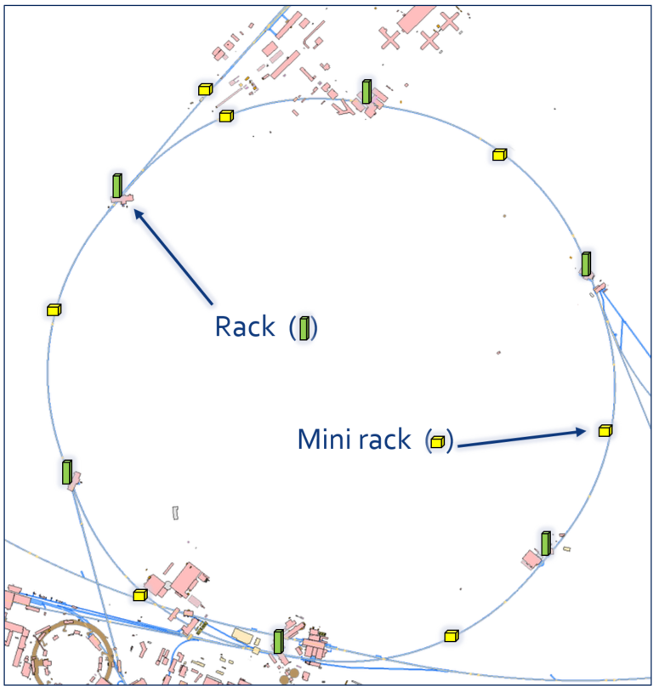
Future installations: SPS and TT20
ECR (EDMS 1969746)
It will be completed during LS2 and operational in Run 3
7.3 km of monitored radiation areas
Possibility to be extended and consolidated

Slide 12
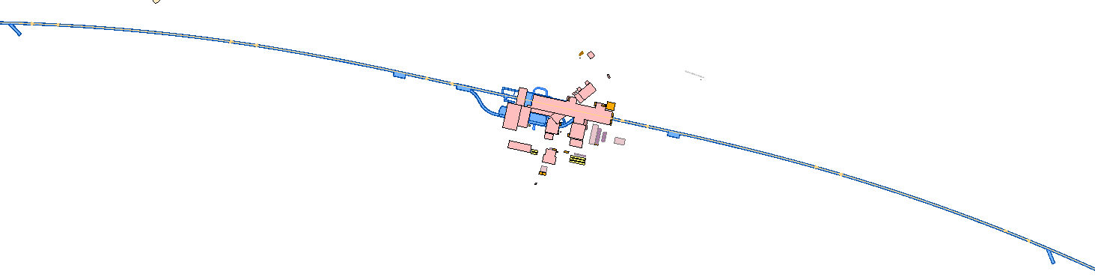
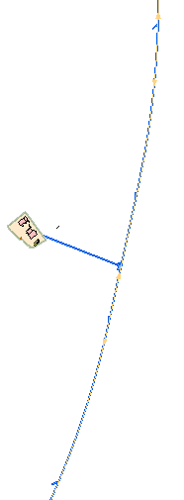
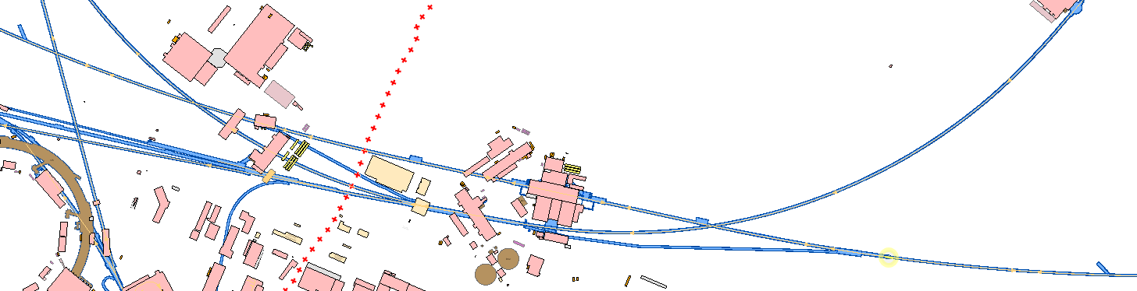
Future installations: LHC
ECR (EDMS 1978574)
It will be completed during LS2 and operational in Run 3
DS regions of IP1, IP5 and IP7
IP5
IP7
IP1
IP1
Ex.

Slide 13
Other LS2 activities
Qualification and calibration of the new OF sensors
  Anticipating future needs
Upgrading our online monitoring tools
  After LS2 the size of our installations will increase by a factor 14 wrt 2018
Anticipating our future needs in terms of automation of data analysis
Ex.

Slide 14







Today’s Optical Fiber Dosimetry team today
OFD team in MCWG
Y. Kadi (Staff)
D. Di Francesca (Fellow)
G. Li Vecchi (PhD)
K. Kandemir (Tech. Student)
At CERN
RADWG and SLAWG
EN-SMM-RME
EN-EL-FC
EN-STI-BMI
and several other groups
Academic collaborations
Relations with industries
Ex.

Slide 15
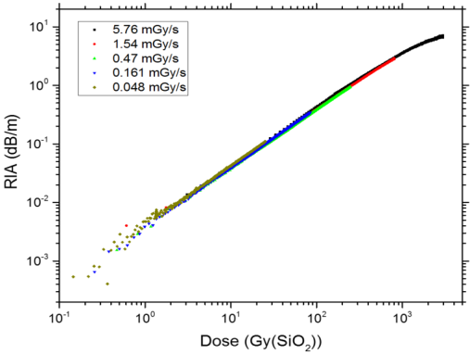
Qualification and calibration of the OF sensors for dosimetry
Study of RIA in different types of Optical Fibers (OFs)
Selection of the best candidates OFs for dosimetry:
  Monotone dose dependence
  No dependence on dose rate
  No dependence on irradiation temperature
  Absence of recovery processes
  Absence of effects related to successive irradiations
Calibration of the sensor under ⁶⁰Co radiation source
Qualification of the sensor for employment in the Mixed field radiation environment CHARM facility
  benchmark with other dosimeters
  benchmark with Monte Carlo simulations (FLUKA)

Slide 16
Dissemination of results
7 publications (including in press) with OFD team as first author
  IEEE Transaction on Nuclear Science
  Physica Status Solidi A
  Optical Materials
  Journal of Material Science
  Journal of Non-Crystalline Solids
  Beilstein Journal of Nanotechnology
  Submitted
  IEEE Transaction on Nuclear Science
  Journal of Lightwave Technology
  Optics Letters
Some conference proceedings (IPAC, OFS, etc.)
Including collaborations

Slide 17
R&D and future prospects
Proactive approach to radiation dosimetry
Tomorrow two presentations will be dedicated to R&D of OF dosimetry/radiation sensing and future challenges:
Optical fiber dosimetry: recent achievements and future prospects
Specialty optical fibers for radiation sensing

Slide 18
Conclusions
New version of DOFRS installed in 2018: interrogators and sensor
Proof of deported measurement capability. Essential to decrease the costs of future installations
Successful installation of DOFRS in the PS (4 times larger installation wrt 2017)
270 days of continuous and distributed dose levels monitoring in the PSB and PS (10 higher radiation dose levels wrt 2017)
2 approved ECR to install DOFRS in SPS+TT20 and DS regions of IP1, IP5 anf IP7 of LHC (14 times larger installation wrt 2018). Ongoing installations.
Constant proactive approach to radiation monitoring, R&D and sharing of our results at CERN and outside of it

Slide 19


Thank you for your attention
Diego Di Francesca
CERN EN-EA-PE
R2E Project
diego.di.francesca@cern.ch
www.cern.ch
Thanks to the members of MCWG,
EN-SMM-MRE, EN-EL-FC, EN-STI-MBI
and our Collaborators UJM and CNES

