Slide 1


Radiation tolerant developments in Beam instrumentation
T. Lefevre on behalf of the Beam instrumentation group

Slide 2
Outline
Introduction
BI rad-tolerant developments
Common developments with EP/ESE
Testing of rad-tolerant and COTS components

Slide 3
General BI considerations
Most of BI activities are subject to R2E issues
  Typical implementation of BI acquisition system
    Front-End (FE) electronic in the Tunnel – Back-End (BE) electronic on Surface
    FE based on rad-hard / rad-tolerant electronics
    True for all large BI systems: BPM and BLM in SPS and LHC
    Typical budget split between FE/BE electronics: 50% - 50%
BI standardization
  Encouraging common developments and ‘standard’ solution within the group
  Part of an even larger effort of standardization with the BE-CO group for acquisition system and data transmission links
Collaboration with EP – BI benefiting from their ASIC design and production

Slide 4
BI developments strongly relies on R2E
FLUKA simulations for an estimation of expected radiation dose (MCWG)
  Understand the specific constrains
  Design the required system architecture
Identifying and testing of rad-tolerant systems (RADWG)
  Choice of components (COTS, rad-tolerant, rad-hard)
  Testing at irradiation facilities for validation
    IRRAD, CHARM, PSI, SACLAY, …
    Hiradmat (functional tests)
Radiation monitoring in the CERN accelerator complex (MCWG)
  Follow-up and evolution of the radiation doses in the machine

Slide 5
BI activities funded by R2E
R2E supports the development of BI rad-tolerant /Rad-hard systems
  Through the funding of Students and Fellows
    based in BI group
    based in EP/ESE working on ASIC design or Rad-hard components (optical transmission link)
  Development of BI custom made rad-tolerant FE electronic board for approved projects (LIU, Hilumi,..)
  General R&D activities looking into longer term problematic for BI (e.g. radiation-hard camera, …)
R2E supports the validation and purchase of COTS components

Slide 6
A selection of BI-R2E developments

Slide 7

BI boards using ASICs developed by EP
New digital Front-end board for the SPS beam position acquisition system
System installed in tunnel underneath magnet
216 units
Part of LIU – Installation performed during LS2

Slide 8
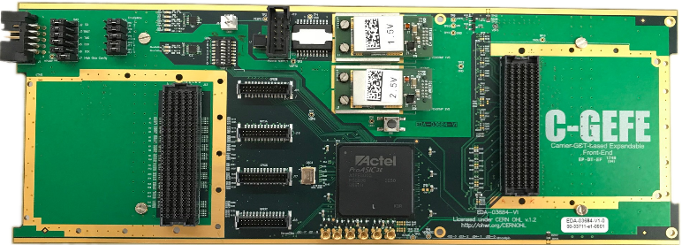
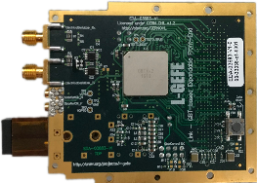
Split GEFE (S-GEFE)
  FE based on a combination of 2 boards: L-GEFE and F-GEFE
  The Link-GEFE (L-GEFE) is rad-hard by design up to TID levels of >10kGy
    Communication ASIC (GBTx) and optical transceivers (VTRx) from EP
  The Carrier-GEFE (C-GEFE) is rad-tolerant up to TID levels of 750 Gy
    FMC carrier card featuring COTS components (e.g. Proasic3 FPGA)
    FMC mezzanine for applications specific acquisition (e.g. ADCs)
+
Courtesy of M. Barros Marin
L-GEFE and C-GEFE may be used independently

Slide 9
Split GEFE (S-GEFE)
  Status:
  Production stage (~300 pieces)
  Roadmap:
November
2017
2018
2019
February
October
March
Finish S-GEFE design
Test S-GEFE prototypes
Launch S-GEFE production
(~300 pieces for ALPS project)
Test S-GEFE production
Courtesy of M. Barros Marin

Slide 10
Developments between BI-EP supported by R2E
Common solution for accelerator instrumentation optical links

Slide 11

Developments between BI-EP supported by R2E
Common solution for accelerator instrumentation optical links
based on the versatile link framework (VTR)
targeting 10.24 Gb/s upstream operation
4 channel wavelength division multiplexing scheme (CWDM)
compatible with next generation rad-hard chipset for optical data links (LpGBT)
Project status
demonstration of 10.24 Gb/s upstream operation
Laser driver (GBLD) insensitive to TID in the specification range
moderate displacement damage of CWDM Lasers
Next steps
radiation tolerance validation of CWDM optical MUX
solutions for standard SFP cage compatibility
defining of final link architecture
moving towards parts procurement and production
Courtesy of C. Scarcella
Ch1
1270 nm
Ch2
1290 nm
Ch3
1310 nm
Ch4
4 x 10 Gb/s on a single fiber
1330 nm

Slide 12
Developments between BI-EP supported by R2E
Common solution for accelerator instrumentation optical links
based on the versatile link framework (VTR)
targeting 10.24 Gb/s upstream operation
4 channel wavelength division multiplexing scheme (CWDM)
compatible with next generation rad-hard chipset for optical data links (LpGBT)
Project status
demonstration of 10.24 Gb/s upstream operation
Laser driver (GBLD) insensitive to TID in the specification range
moderate displacement damage of CWDM Lasers
Next steps
radiation tolerance validation of CWDM optical MUX
solutions for standard SFP cage compatibility
defining of final link architecture
moving towards parts procurement and production
See talk on Wednesday afternoon at 17h35 on
‘Radiation hardness in single-mode optical links for Accelerator Instrumentation’ by Carmelo Scarcella
Courtesy of C. Scarcella
Ch1
1270 nm
Ch2
1290 nm
Ch3
1310 nm
Ch4
4 x 10 Gb/s on a single fiber
1330 nm

Slide 13
Developments between BI-EP supported by R2E
ASICs development for Beam loss monitoring

Slide 14
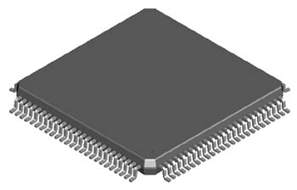
Developments between BI-EP supported by R2E
ASICs development for Beam loss monitoring
Developing two fully functional custom ASICs to evaluate the performance of two different architectures within a realistic environment
Technology
  standard CMOS 130 nm qualified at CERN for 200 Mrad
  Supply voltage 1.2 V (possibly higher for analog)
  Two analog readout channels per chip
  Triplicated digital circuitry with majority voting
  Directly compatible with LpGBT (e-Link)
  Double communication channels for redundancy
  Chip dimensions 4x4 mm
  To be housed in a standard 64 pin Quad Flat Package (10x10 mm)
Project schedule:
2018 : Design and simulation
2019 : Prototypes and testing
2020 : Final prototype architecture selection
Analog
Digital
Ch. 1
Ch. 2
Courtesy of L. Giangrande

Slide 15
Developments between BI-EP supported by R2E
ASICs development for Beam loss monitoring
Developing two fully functional custom ASICs to evaluate the performance of two different architectures within a realistic environment
Technology
  standard CMOS 130 nm qualified at CERN for 200 Mrad
  Supply voltage 1.2 V (possibly higher for analog)
  Two analog readout channels per chip
  Triplicated digital circuitry with majority voting
  Directly compatible with LpGBT (e-Link)
  Double communication channels for redundancy
  Chip dimensions 4x4 mm
  To be housed in a standard 64 pin Quad Flat Package (10x10 mm)
Project schedule:
2018 : Design and simulation
2019 : Prototypes and testing
2020 : Final prototype architecture selection
Analog
Digital
Ch. 1
See talk on Wednesday afternoon at 17h20 on
‘ASIC design for the Beam Loss Monitor upgrade’
by Luca Giangrande
Ch. 2
Courtesy of L. Giangrande

Slide 16
Selecting rad-tolerant components

Slide 17

Selecting rad-tolerant components
NG-Medium Evaluation for BLM
NanoXplore started in 2015 in Paris
HW design in Paris and SW design in Montpellier
STM radhard process
Radiation tolerant market (space and nuclear industries)
4 products available or in the roadmap:
  eFPGA
  NG-Medium (65nm) → VEGAS European project to validate it
  NG-LARGE (65nm)
  NG-Ultra (28nm) → DAHLIA European project to create a SoC
Good feedback from the first users (Airbus, Thales, GVM,…):
“really good support and reactivity”
“No major issue on the hardware”
“Huge improvement of the software in 2017-2018”
Courtesy of M. Saccani

Slide 18

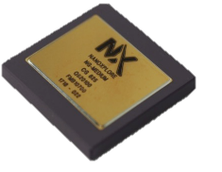
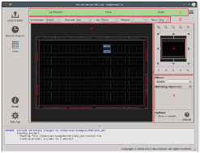
Selecting rad-tolerant components
NG-Medium Evaluation for BLM
SRAM FPGA
RadHardened by design (no need for TMR)
TID up to 300krad (tested also at CERN)
ConfigRAM integrity check
BRAM EDAC
Packaging: plastic FG625 available
35k LUT4/DFF, 112 DSP, 54BRAM, 24 Clocks
Requires a non-volatile memory for configuration
EDA: NanoXmap entirely in Python
This design flow is now mature
IP core generator and scope debugger available
NG-Medium
NanoXmap
Courtesy of M. Saccani
NanoXplore NG-Medium

Slide 19
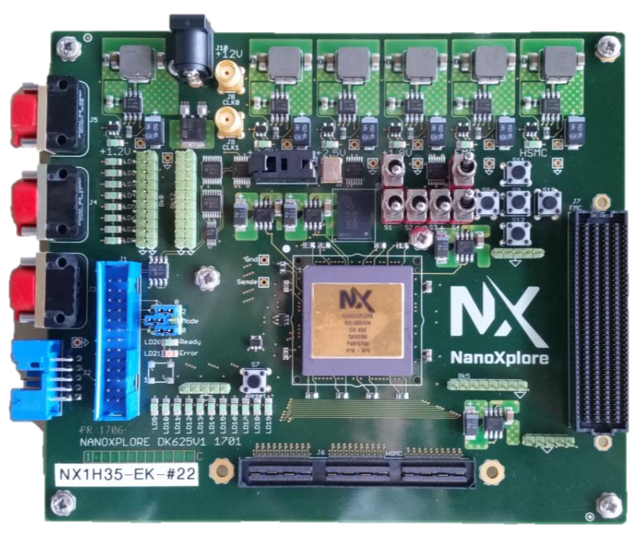
Selecting rad-tolerant components
NG-Medium Evaluation for BLM
Objective:
Replace the antifuse SX72 on the BLM acquisition tunnel board
Improve performances: more bits and faster sampling.
  FPGA footprint: PQFP208 (784mm²) ➔ FG625 mm²
  Technology: 220nm ➔ 65nm
  Registers: 2012 ➔ 32,256
  BRAM: 0 ➔ 56
  DSP: 0 ➔ 112
  LVDS channels: 0 ➔ 240
  Means:
One DevKit in use since November in BL section
  - Evaluation of the design flow
  - Contact with NanoXplore Support to get new features
  (serial number and internal temperature)
  - Design of a mockup by replacing the antifuse pin to pin
Courtesy of M. Saccani

Slide 20
Testing COTS to radiation
Irradiation test of Ethernet to Fibre Optics converter (ADVANTEC EKI-2741LX)

Slide 21
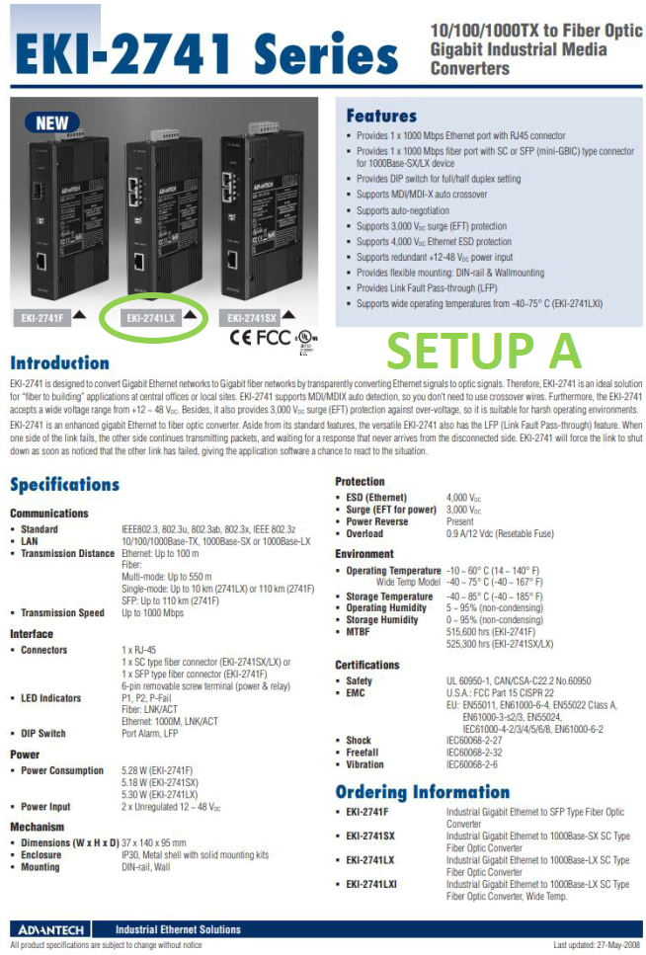
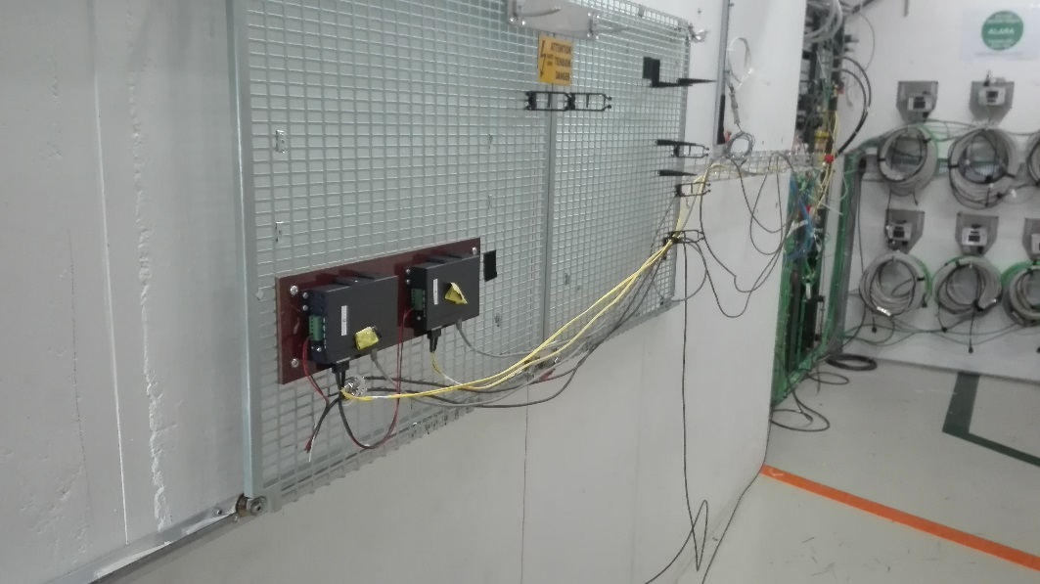
Testing COTS to radiation
Irradiation test of Ethernet to Fibre Optics converter (ADVANTEC EKI-2741LX)
Needed to use high performance Digital camera in CERN accelerator complex
Ethernet
(max 100m)
Dual Fibre SC single mode
Eth/fibre
1G/Single ch.
Eth/fibre
1G/Single ch.
Ethernet
PowerPC, Ethernet network, etc.
Digital Camera
System tested @charm in August 2018
Courtesy of S. Burger

Slide 22
Testing COTS to radiation
Irradiation test of Ethernet to Fibre Optics converter (ADVANTEC EKI-2741LX)
System still alive after the campaigns !
Single events can stop camera acquisitions
  Power cycles reset correctly the system
System keeps working up to 45 Gy TID
  Shielding for ETH to fiber converters foreseen
Failure cross section lower than cameras -> Not limiting factor
Courtesy of S. Burger

Slide 23
Testing COTS to radiation
Irradiation test of Ethernet to Fibre Optics converter (ADVANTEC EKI-2741LX)
System still alive after the campaigns !
Single events can stop camera acquisitions
  Power cycles reset correctly the system
System keeps working up to 45 Gy TID
  Shielding for ETH to fiber converters foreseen
Failure cross section lower than cameras -> Not limiting factor
See talk on Wednesday afternoon at 17h50 on
‘Radiation hardness tests of Optical fibre components’
by Damiano Celeste
Courtesy of S. Burger

Slide 24
Developing rad-tolerant solutions
Beam imaging using Optical fibre bundles

Slide 25
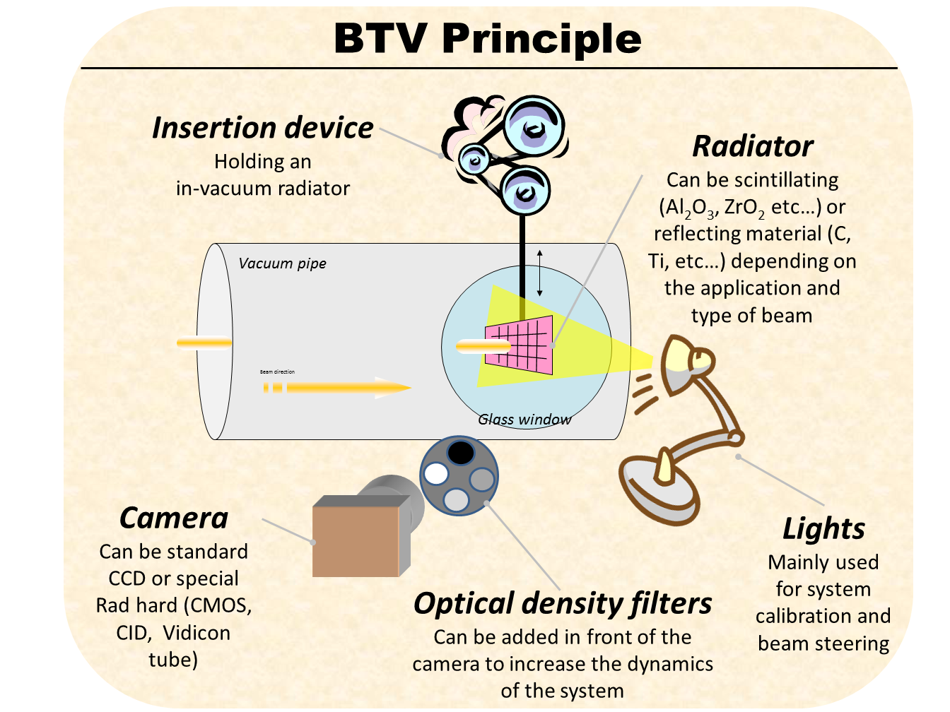
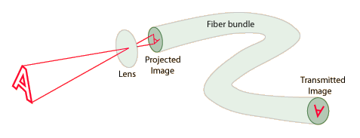
Developing rad-tolerant solutions
Beam imaging using Optical fibre bundles
Problem : The most radiation hard cameras used at CERN, i.e. Vidicon tubes, are no longer produced.
Motivation : Moving the camera as far as possible from the source of radiation
Camera
Courtesy of D. Celeste

Slide 26
Developing rad-tolerant solutions
Beam imaging using Optical fibre bundles
Developing optical system using a 10m long Fiber bundle from Fujikura (FIGR10)
Performing irradiation tests at Saclay using ⁶⁰Co source
Performing functional test on a BTV system in TT2 beam line
Courtesy of D. Celeste

Slide 27
Developing rad-tolerant components
Beam imaging using Optical fibre bundles
Developing optical system using a 10m long Fiber bundle from Fujikura (FIGR10)
Performing irradiation tests at Saclay using ⁶⁰Co source
Performing functional test on a BTV system in TT2 beam line
See talk on Wednesday afternoon at 17h50 on
‘Radiation hardness tests of Optical fibre components’
by Damiano Celeste
Courtesy of D. Celeste

Slide 28
Conclusions
R2E is funding projects in BI at a level of 2.5MCHF (CTC in 2025)
  Manpower and hardware developments
  Main CERN projects : LIU, Hilumi and Consolidation
  R&D activities
BI group strongly relies on R2E project structure
  Calculations on expected radiation levels and doses to electronic
  Testing capabilities, especially at CHARM, IRRAD
  Monitoring capabilities (RadMon)
Please come and listen to the BI talks tomorrow for more details

Slide 29
Thanks for your attention

Slide 30
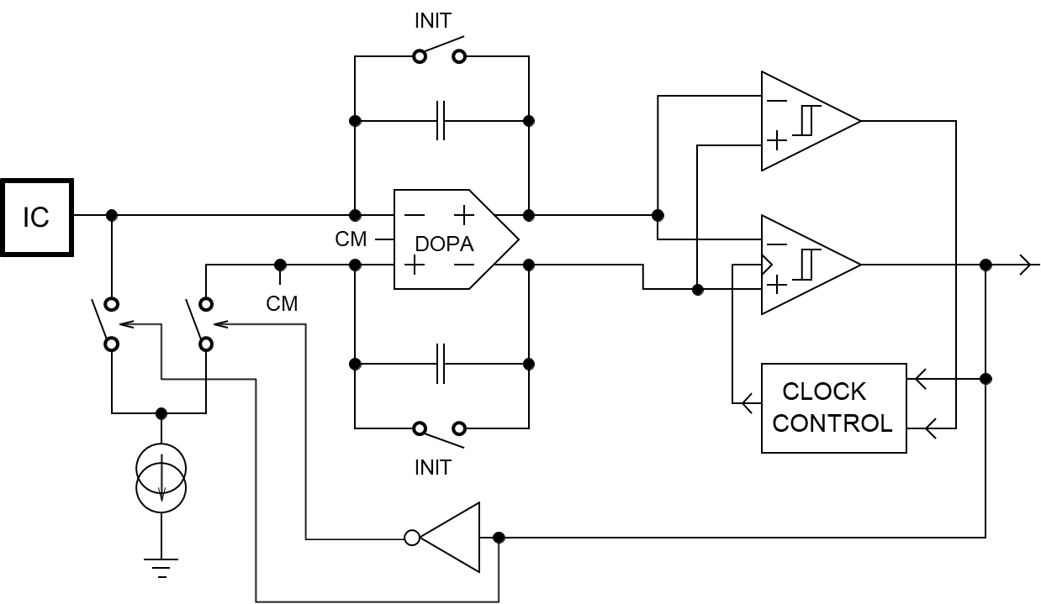
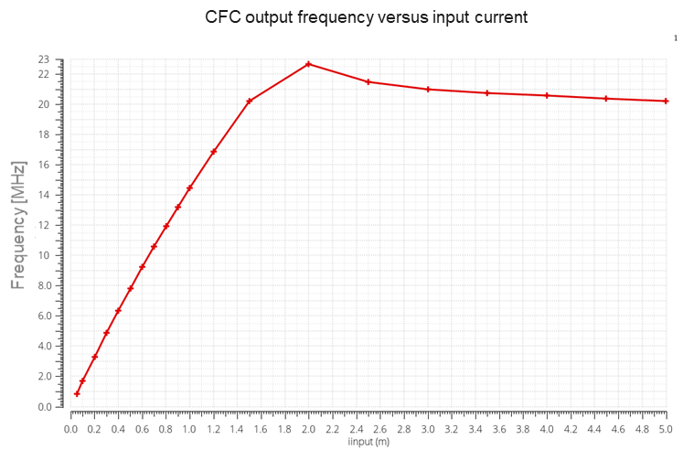
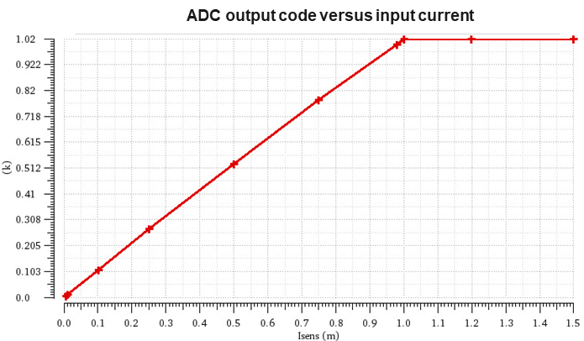
Architectures comparison
Fast response to large current steps.
INL(before calibration) in the higher range (1pA~1mA): 15 %
INL(before calibration) in the lower range (1pA~10µA): 0.5 %
RMS noise in the 10µs integration window (Wilkinson ADC): < 2 nA
Current consumption: 15 mA
High resolution due to oversampling and numerical filtering.
INL (before calibration) in the range 1µA~1mA: < 2 %
RMS noise in the high current range (before filtering): 250 nA
Current consumption: 4 mA ~ 8 mA
Notes:
Asynchronous reference-less CFC based ADC
Differential to single ended sampling and 9bit Wilkinson ADC added to measure the integrator output in case of small input currents. Better performance in terms of power consumption, resolution and immunity to distubances are expected with an oversampling SAR ADC.

Slide 31
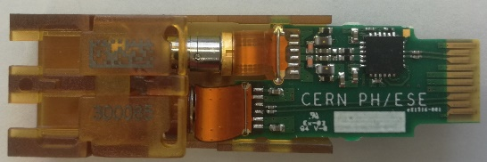
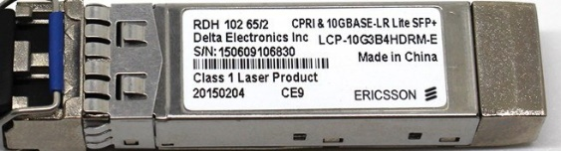
CDWM Single-Mode Versatile link
Radiation zone
Radiation free zone
4 x 10 Gb/s on a single fiber
Front-end
Radiation hard
Transceiver - VTRx
Passive optics
Single-mode optical fibers
Optical MUX/DEMUX
Back-end
Custom off-the-shelf
transceiver
Parameter | Value | Units
Max Uplink Bit Rate | 4.8 or 10.24 | Gb/s
Max Downlink Bit Rate | 4.8 | Gb/s
Wavelengths | 1270/1290/1310/1330 | nm
Total ionizing dose (TID) | 10 | kGy
Fluence | 5 · 10¹⁴ | n/cm² MeV neutrons

Slide 32
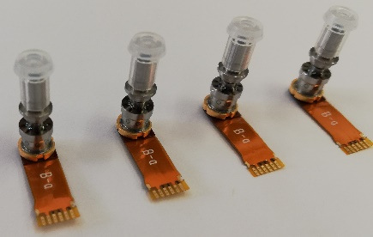
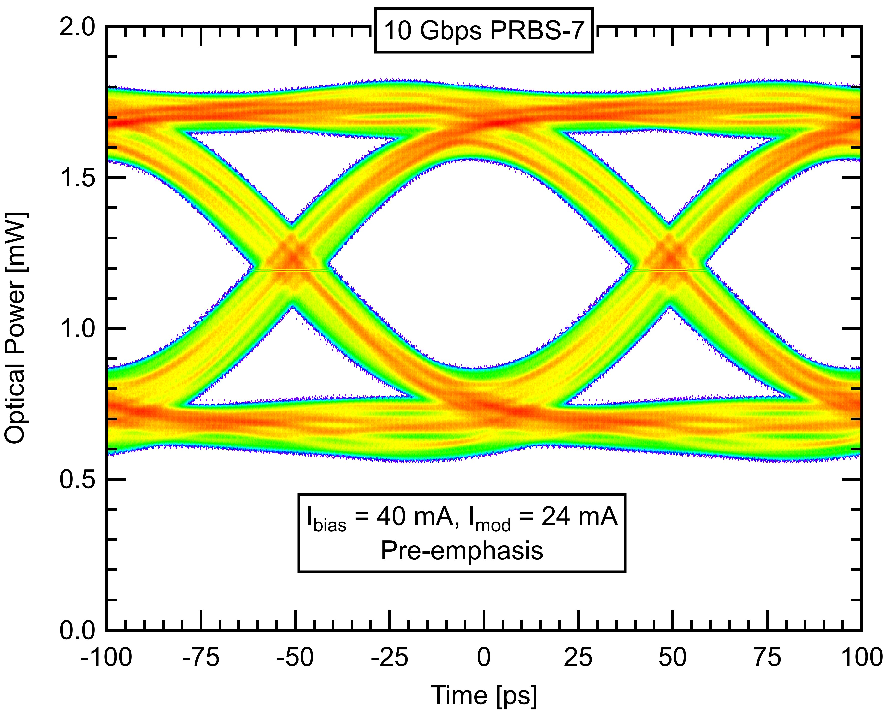
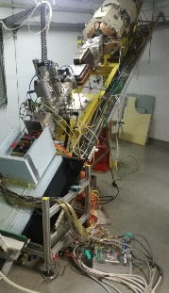
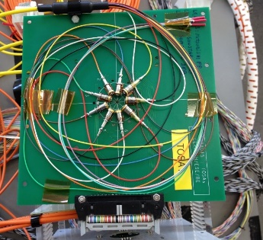
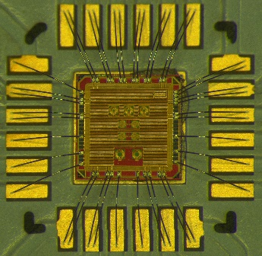
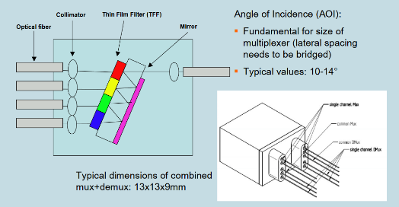
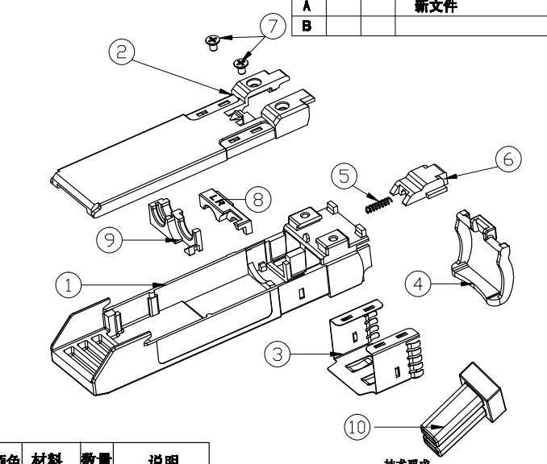
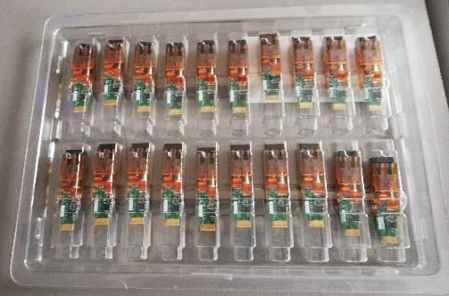
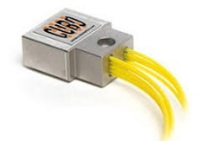
Project Milestones
CWDM COTS EEL procurement
10.24 Gb/s uplink operation
Displacement damage EEL 5 · 10¹⁴ n/cm² MeV neutrons fluence
GBLD Laser driver TID test
Progress
to date
CWDM MUX radiation tolerance
Standard SFP cage compatibility
Link specs definition and production
Next
steps

