Slide 1
Status and Outlook of WP QPS
R. Denz, S. Mundra, J. Spasic, J. Steckert

Slide 2
Outline
Radiation tolerant developments for QPS
QPS & R2E – the 2018 experience
Upgrades LS2
Upgrades beyond LS2
QPS & R2E – tests
Resources
  Person power
  Material

Slide 3
Radiation tolerant developments for QPS - motivation
Main concern are the quench detection (QDS) & DAQ systems
HL-LHC operation
  DS half cell 9 (pp) and 11 (ions) ~100 Gy/year → still of concern
  DS other ~ 10 Gy/year → almost ok
  RR up to ~ 6 Gy/year → ok
  Regular arc ~ 1 Gy/year → ok
Obsolescence of electronic components & useful lifetime
  Major upgrades only feasible during long shutdowns
New requirements, features, enhanced performance
  New requirements for quench detection e.g. for Nb₃Sn magnets
LHC QDS & DAQ systems are safety critical and must be highly dependable!
  ~14000 possibilities to stop LHC at any time
Application is very specific to LHC and its constraints → system is fully custom made (no “black boxes”, neither in hardware nor in firmware)

Slide 4
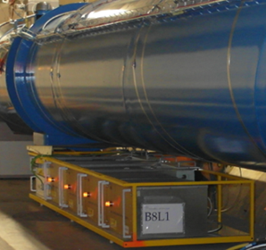
QPS & R2E – the 2018 experience
The somewhat arbitrary decision to change the TCL settings in 2018 increased the radiation load for QPS equipment especially in half-cells 8 around IP1&5, while the R2E induced failure rate in the RRs dropped
  Note: ~50% of QDS downtime in 2018 due to changed TCL settings
R2E problems affected the QPS DAQ systems using the notorious MicroFIP™ and the splice protection systems type DQQBS
  Both systems nevertheless performed better than expected
  Mitigation measures implemented during TS#2 have been successful but cover only the problem of false positive
  Exercise can be regarded as a good test for the HL-LHC

Slide 5
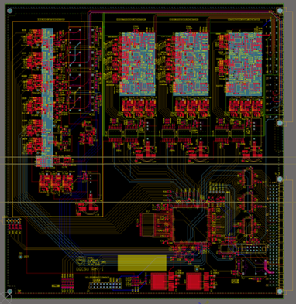
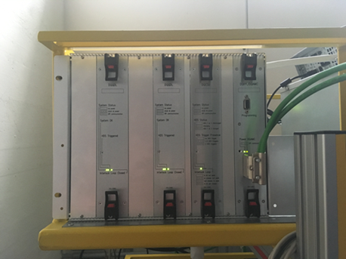
QPS & R2E – upgrades LS2
Upgrade of main quadrupole protection systems: DQLPU type B
  QPS product lifecycle management
  Radiation tolerant quench detector and crate controller
  Field-bus coupler will be recuperated from existing crate
  392 units to be installed
  Prototype including the external power supplies successfully tested in CHARM

Slide 6
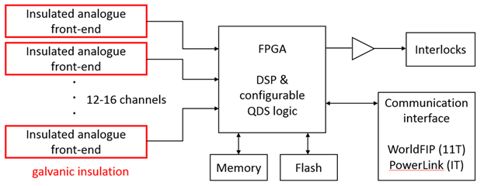
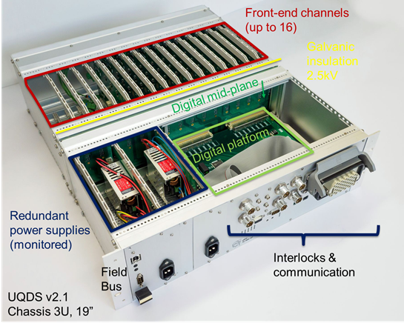
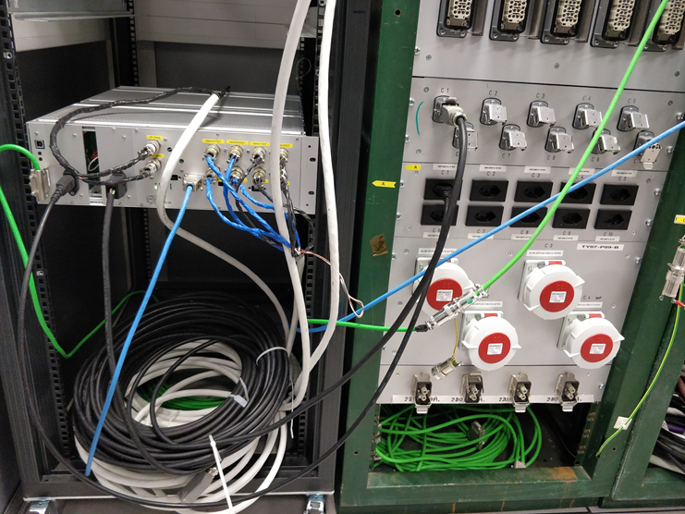

QPS & R2E – upgrades LS2
HL-LHC: Quench detection systems for 11 T Nb₃Sn dipoles
  Versatile system easily adaptable to various tasks reaching from sophisticated quench detection systems to high performance DAQ
  Core of the radiation tolerant version is the IGLOO2™ FPGA
  First deployment of UQDS systems in LHC
    To be installed in RR73/RR77
    Successfully tested in CHARM (large margin for RR operation)

Slide 7
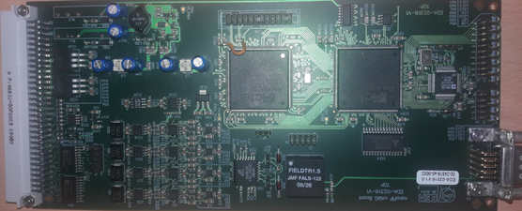
QPS & R2E – upgrades LS2
Upgrade of MicroFip™ based field-bus couplers type DQAMC and DQAMGS in DS areas
  New development using NanoFIP IP core
  Implementation requires as well a modification of the QPS supervision software stack
  Expected to be ready for LHC run 3
Splice protection systems type DQQBS (nQPS)
  Patched version already used in LHC
    Revised version to be produced and tested in PSI
  Should cover the needs for run 3 but HL-LHC may require a fully new development

Slide 8

QPS & R2E – upgrades beyond LS2
Universal three channel quench detection board
  For IPQ and 600 A corrector circuit protection combination with current derivative sensors
  Radiation tolerant version for the RR
PowerLink™ based field-bus couplers
  Providing significantly higher data transmission rates for systems currently installed in the UA, UJ, UL and RR underground
  Hardware interface must be compatible with existing systems
  Radiation tolerant version for the RR
In addition there will be the usual known & unknown unknowns

Slide 9
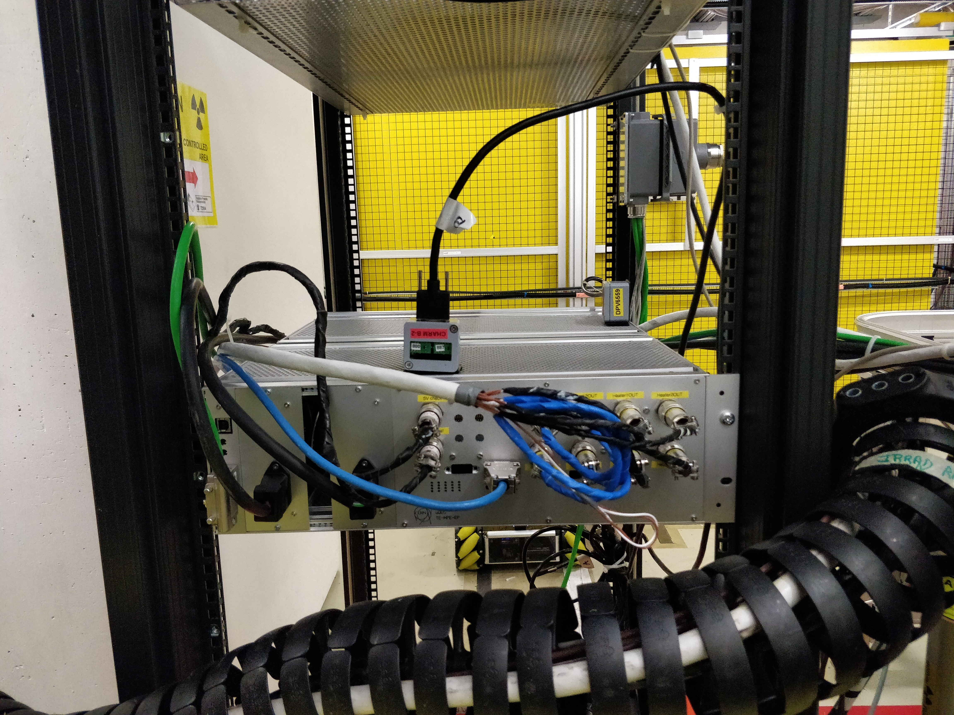
QPS & R2E – tests
Continuous demand for testing of components and assemblies
  2-3 slots / year for component testing @ PSI
    Focusing on SEU immunity
  TID tests using ⁶⁰Co sources
    @CERN or outsourced (e.g. to Fraunhofer institute); coordinated by R2E project
  CHARM tests to be resumed after LS2
Results from recent tests → see presentation by Surbhi Mundra tomorrow

Slide 10
QPS & R2E resources – person power
Status | Contract start/end | Job description
TECH | 02/2019 – 01/2020 | Development of radiation tolerant field-bus couplers specific to QPS applications
FELL | 03/2018 – 02/2020 | Component and system qualification, i.e. management of radiation test campaigns in close collaboration with R2E
PJAS | 33% for another 3 years → new addendum with AGH Krakow in preparation | Verification, test and development of safety critical firmware for quench detection and data acquisition systems (emphasis on radiation exposed systems)

Slide 11
QPS & R2E resources – material
Table includes only those items, for which R2E is the principal reason for the upgrade!
Scope | Project | Description | Qty | Unit price | Total
RUN 3 | nQPS DQQBS | Splice protection system in DS¹ areas 1 & 5 & 7 (pp) and 2 & 8 (ions) | 190 | 300 CHF | 57 kCHF (2019 - 2020)
HL-LHC | nQPS DQQBS | Splice protection system in DS areas 1 & 5 & 7 | 130 | 400 CHF | 52 kCHF (2022 -2023)
HL-LHC | nQPS DQQDS | Symmetric quench detection systems in DS areas 1 & 5 & 7 | 120 | 400 CHF | 48 kCHF (2022 -2023)
HL-LHC | nQPS crate | DS areas 1 & 5 (motherboard only) | 30 | 300 CHF | 9 kCHF (2022 -2023)
RUN3 & HL-LHC | DQAMC | Field-bus coupler DS 1 & 5 & 7 (pp) and 2 & 8 (ions) | 140 | 500 CHF | 70 kCHF (2019 - 2023)
 | DQAMG |  | 60 | 500 CHF | 30 kCHF (2019 - 2023)
 | TEST | Test systems for radiation tests (PSI/CHARM) | N/A | 20 kCHF/y | 100 kCHF (2019 - 2023)
 | Σ |  |  |  | 366 kCHF
¹: DS ≡ half-cells 8 - 12

Slide 12
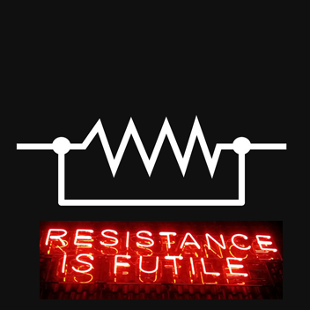

Summary
All major QPS R2E developments have been completed and production
  Some additional developments reflecting the 2018 operational experience
  The deployment of the LS2 upgrades should allow smooth operation up to LS3
R2E will remain an important design constraint for most of the QPS equipment
  Major upgrades are paid by LHC-CONS and HL-LHC but R2E support still needed for R&D (human resources!), tests and some mitigation measures e.g. for field-bus couplers
Many thanks to the R2E project and its predecessors for providing support and expertise since more than two decades!

