Slide 1

Radiation tolerant developments: Power Converters
Review of R2E-related projects
S. Uznanski, B. Todd, Y. Thurel, V. Herrero, J. Chanois

Slide 2
Outline
Finished & qualified products
On-going developments towards HL-LHC
Future developments
Impact of RR converters on LHC operation
Conclusions

Slide 3
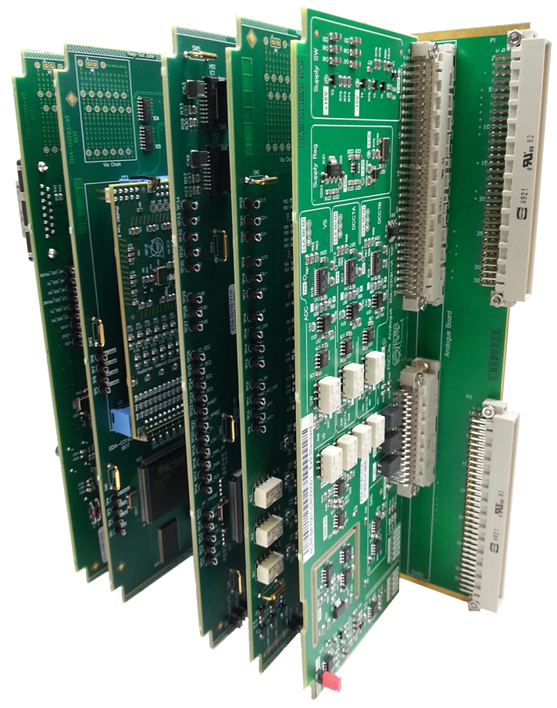

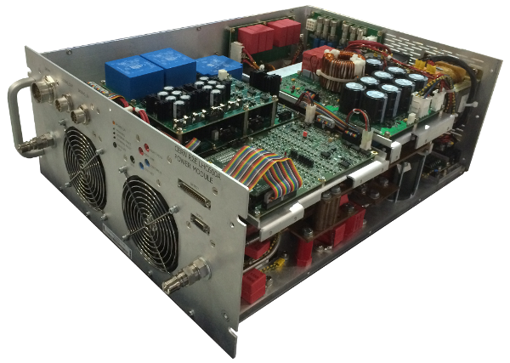
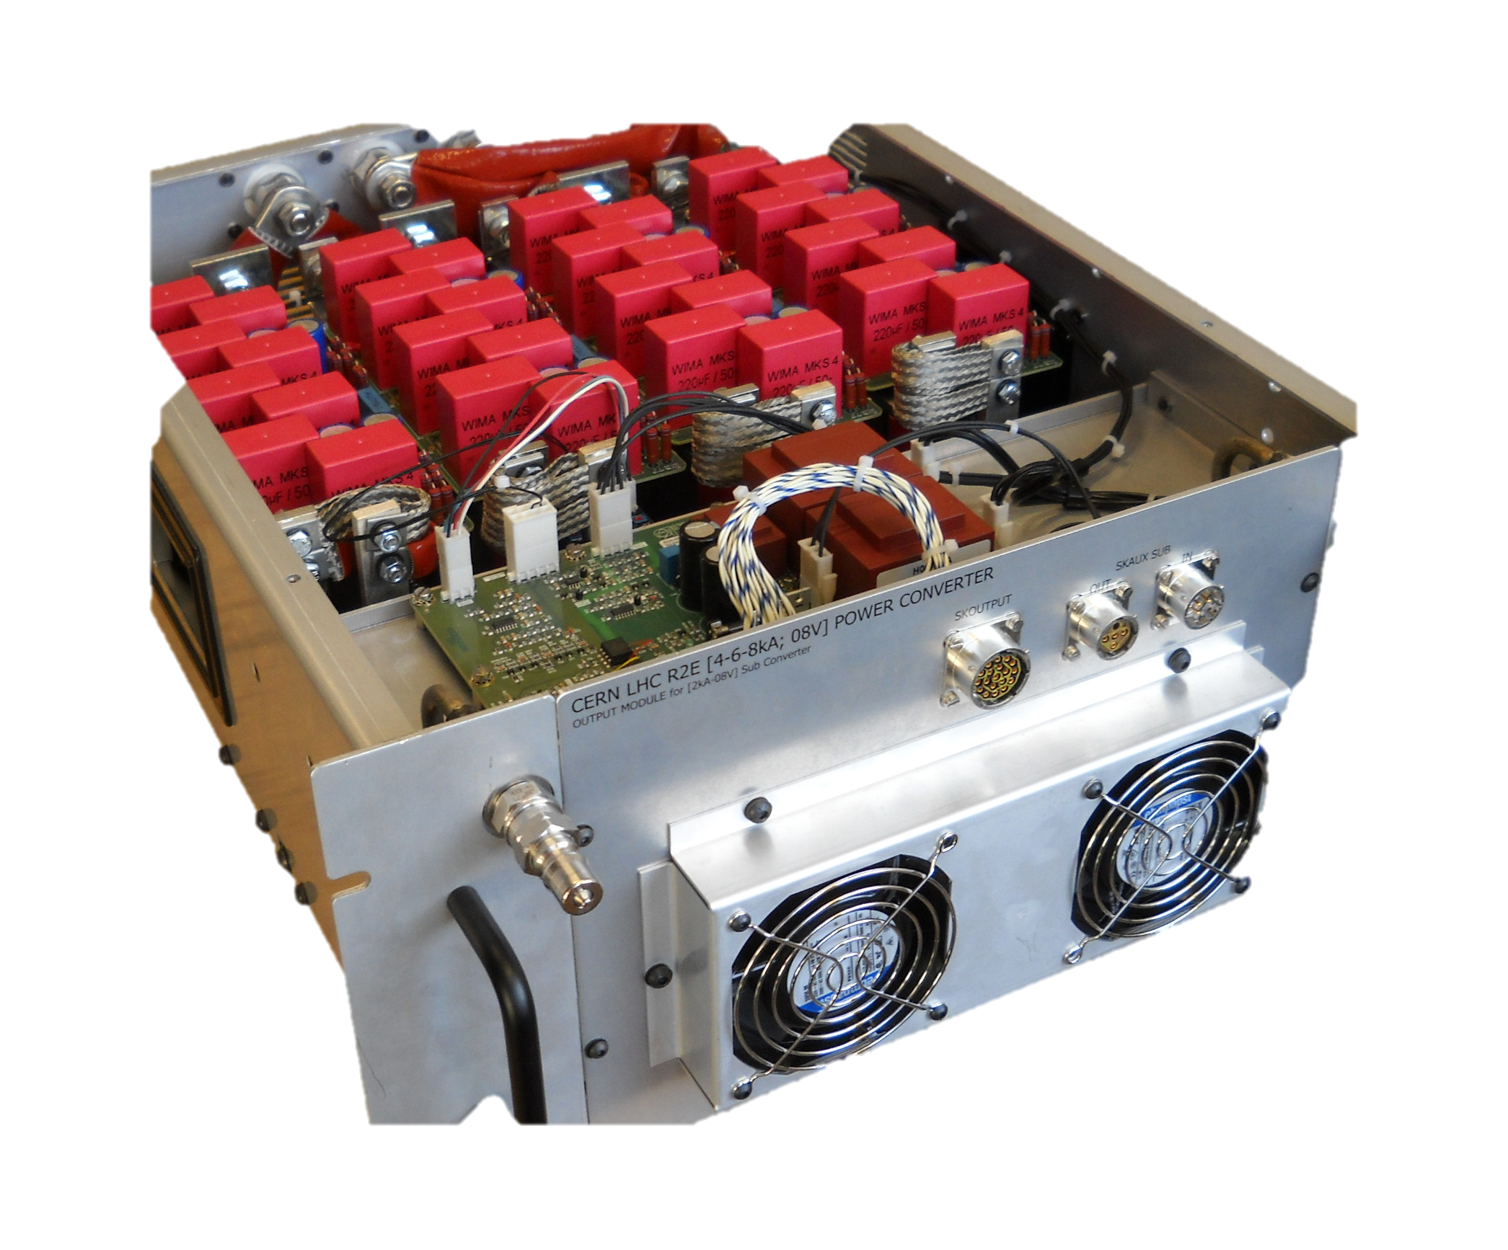
Finished & qualified products
EPC Item / type | Status | TID [Gy] | SEE XS [cm²] | DD [/cm2] | Available | Deployed
FGClite | In operation | 200 qualified | <10⁻¹³ qualified | >10¹² qualified | 2016 | ARC: EYETS RR1/5/7: LS2
RadDIM | In operation | 200 qualified | <10⁻¹³ qualified | >10¹² qualified | 2016 | ARC: EYETS RR1/5/7: LS2
R2E-LHC 600A-10V | Production | 300 qualified | <10⁻¹² qualified | >10¹² qualified | 2019 | RR1/5/7: LS2
R2E-LHC 4-6-8kA-08V | Production | 60 qualified | <10⁻¹² qualified | >10¹² qualified | 2020 | RR1/5/7: LS2

Slide 4
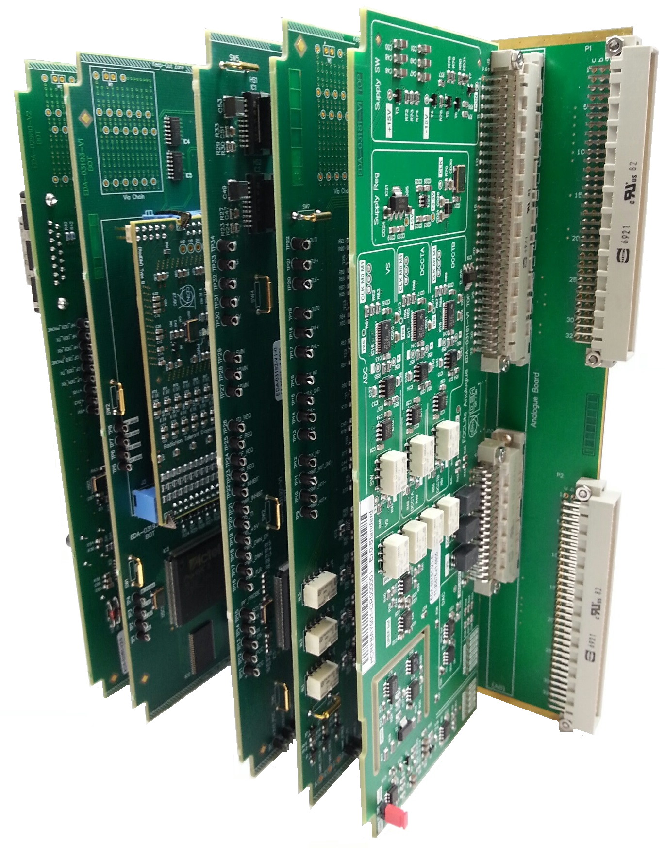
FGClite
Rad-tol & High-Rel replacement of the FGC2
  Distributed regulation to avoid using MCU/DSP in rad-area
  Plug-in compatible with the FGC2
Fully compliant with R2E RHA design flow: EDMS 2046131
  Component selection: type rad-tests
  Production lot rad-tests
  System validation at CHARM
  ~50 components, ~10 facilities, >1000h of beam time
Reliability modeled & confirmed post-deployment
  Proven >1Mh of MTTF, >12M dev*h in OP with
  1 HW failure, 3 HW replacements
1600x |  | 3.4 MCHF |  | 2012-2017
Production |  | Budget |  | Time Frame
1600x

Slide 5
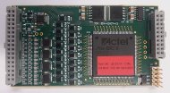
RadDIM
Rad-tol & High-Rel replacement of the DIM-550
  Projects shares the BoM and part qualification with the FGClite
Fully compliant with R2E RHA design flow: EDMS 2046131
  Component selection: type rad-tests
  Production lot rad-tests
  System validation at CHARM
Second production batch needed funded by HL-LHC
  Assembly & test in 2019
  Needed for the HL-LHC(60-120)A-10V
3900x + 2000x
3900+2000x |  | 0.45 + 0.2 MCHF |  | 2012-2016
Production |  | Budget |  | Time Frame

Slide 6
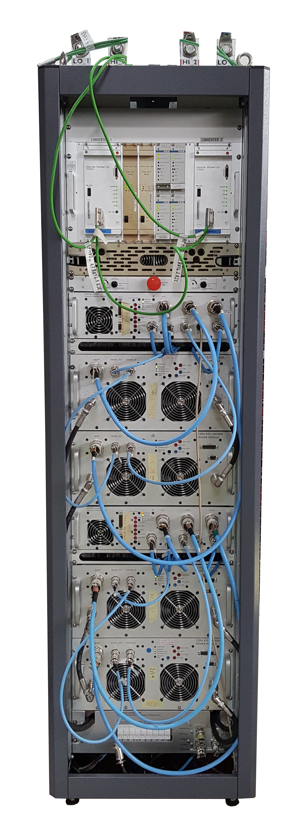
R2E-LHC600A-10V
Rad-tol replacement of the LHC600A-10V
  Rad-tol, fully redundant design overcoming electrical limitations
System rad-validation done at CHARM
  Production lot rad-tests with dedicated testers in 2017
  System rad-tests at CHARM done
Pre-series fully validated at CERN
  Project currently in full production phase
Project on time to be deployed during LS2
133x |  | 4.8 MCHF |  | 2014-2020
Production |  | Budget |  | Time Frame

Slide 7
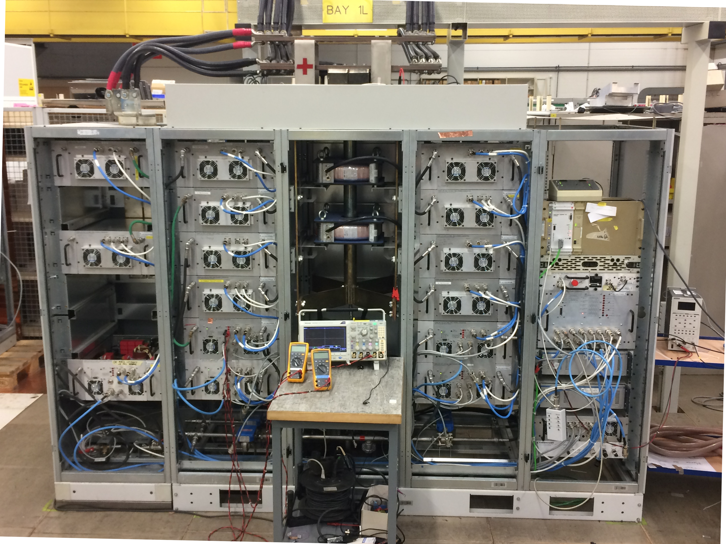
R2E-LHC4-6-8kA-08V
Rad-tol replacement of the LHC4-6-8kA-08V
  Rad-tol, fully redundant design
System rad-validation done at CHARM
  Production lot rad-tests with dedicated testers
  System rad-tests at CHARM
Pre-series fully validated at CERN
  Project in full production phase
Project on time to be deployed during LS2:
  Production on schedule
  Budget has been reduced to 6.00MCHF
  6.35MCHF was requested and is needed
60x |  | 6.3 MCHF |  | 2015-2020
Production |  | Budget |  | Time Frame

Slide 8

On-going / scheduled developments
EPC Item / type | Status | TID [Gy] | SEE XS [cm²] | DD [/cm2] | Budget | Design/ Production
Tri-Volt Bi-Volt | R2E-funded (design) Production not funded 740x*/490x* | 200 Spec | <10⁻¹² Spec | >10¹² Spec | 1.1 MCHF* | 2019-2020 Deployment Post LS2
R2E-HL-LHC60A-10V | HL-Funded (design + prod) R&D >LS2 | 70-200 Spec | <10⁻¹² Spec | >10⁻¹² Spec | 7.8 MCHF | 2022+ Deployment LS3
R2E-HL-LHC120A-10V | HL-Funded (design + prod) R&D >LS2 | 70-200 Spec | <10⁻¹² Spec | >10⁻¹² Spec | 4.4 MCHF | 2022+ Deployment LS3
* Numbers not accounting for units for HL-LHC120A and HL-LHC60A
Price estimation based on production of 25 units

Slide 9
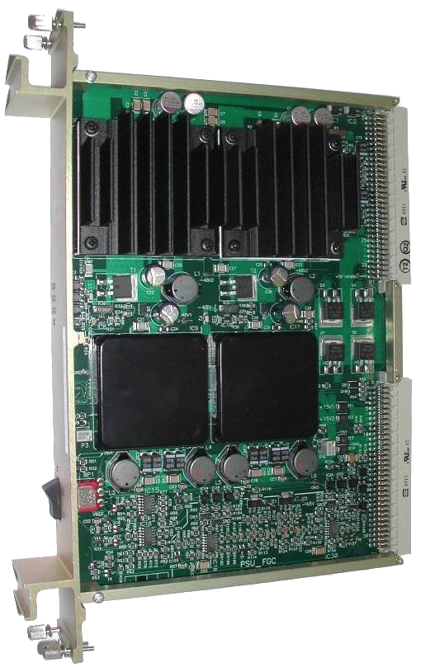
Tri- & Bi-Volt
100W Rad-tol replacement of the current Tri- & Bi-Volt design
  DC-DC module tested at CNGS in 2009: EDMS 1053817
  Bi-Volt/Tri-Volt PSUs tested at CHARM in 2017: EDMS 1933100
Work on-going on DC-DC brick with external companies:
  TRACO: NDA signed and components Rad-tested at CHARM
  ASP: dedicated rad-tol design for CERN
  BE-CO convergences
DC-DC brick & system rad-validation at CHARM
  COTS DC-DC component screening via EN-STI
  Prototype design tests as well as lot qualification needed
Potentially needed During Run3 (replacement) & during LS3 (full deployment)

Slide 10
R2E-HL-LHC(60-120)A-10V
Redundant Rad-tol replacement of the current designs
(R2E CSR Indico 666689)
  Based on the same 60A-10V brick design
  R2E-HL-LHC60A-10V 2x 60A-10V 420 units
  R2E-HL-LHC120A-10V 3x 60A-10V 150 units
Initially both projects were R2E but changed to R2E-HL.
  Numbers & locations still to be confirmed (UJ/UR)
Projects will start after LS2.
420x + 150x |  | 12.2 MCHF |  | 2022-2025
Production |  | Budget |  | Time Frame
Control Chassis not studied in detail, estimated:
3x FGClite with 1x Tri- & 1x Bi-Volt
Tri-Volt: 3x FGClites
BiVolt: 6x DCCTs

Slide 11

New developments
EPC Item / type | Status | TID [Gy] | SEE XS [cm²] | DD [/cm2] | Cost [/unit] | Design/ Production
Fan-Tray | Not funded 200x | 200 | <1E-12 | >1E12 | ? | On-hold Needed for LS3?
Provide a cool air to controls crate in power converter
  Initially dismissed, but is now needed due to mechanical integration
Based on fans selected for power bricks: 60/200A-10V and temperature control mostly re-using the FGClite BoM
  Production would be needed for the LS3?
As for the Bi-/Tri-Volt Proposal to fun the R&D studies from the R2E budget and production from the HL-LHC

Slide 12
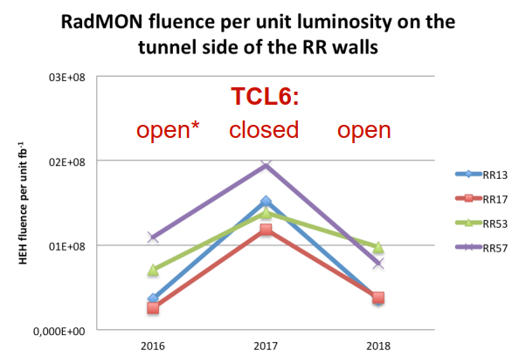
Radiation Levels in RR dependency on TCL settings
TCL6 settings have a strong impact on radiation levels in the RR1/5
2018 open settings for TCL6 allowed a RR rad-levels reduction
  ~4x for IP1 &
  ~2x for IP5
  increase in IP7 due to betatron collimator losses
The ARC rad-levels increased due to open TCL6 impacting MPE equipment in DS locations

Slide 13
Impact of RR converters on LHC operation
Sensitive systems and assumed SEE cross sections in RRs :
  FGC2: 120A (x56), 600A (x76) and 4-6-8 kA (x30): 1.5·10⁻¹⁰ cm2/unit
  Power: 600A (x76): 3.0·10⁻¹⁰ cm2/unit
Expected RR1X-RR5X EPC failures:
  2017: 16 events
  2018 [up to TS2]: 11 events
All rad-related failures in operation in 2018 :
Both controls and converter failures will be mitigated thanks to the FGClite (R2E) and R2E-LHC600A-10V deployment during LS2.
Converter | Power | Controls
LHC600A-10V | 6x | 2x
LHC120A-10V | 0x | 3x

Slide 14
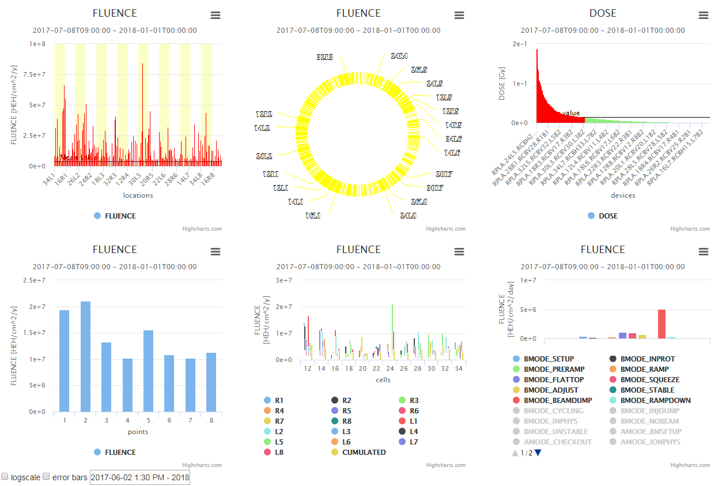
FGClite-Rad-Mon http://fgclite-rad-mon.cern.ch/

Slide 15
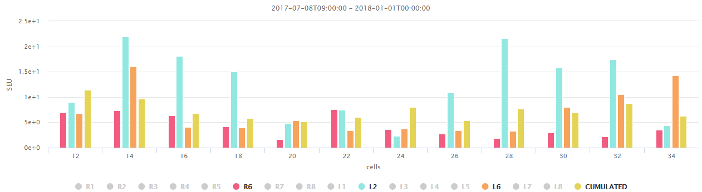
FGClite-Rad-Mon http://fgclite-rad-mon.cern.ch/
758x FGClites in the ARCs: great spatial coverage: Cell12-34
  Low statistics as of now due to low radiation levels in the equipment position
After LS2: 256x FGClites in the RRs (1/5/7)
  Great mapping of rad-level gradients

Slide 16
Conclusions
FGClite & RadDIM are deployed & fully operational:
  FGClite Phase 2 will finish that project
  Qualified rad-tolerance at component- & system-level at CHARM
  Proven a very high-reliability exceeding the specification of 1Mh of MTTF
R2E-LHC600A-10V & R2E-LHC4-6-8kA-08V are in production:
  Qualified at CHARM and satisfying their rad-tol specification
  To be deployed during the LS2
Bi-/Tri-Volt PSUs are in R&D phase
  R&D costs covered by R2E but production is not funded yet
R2E-HL-LHC(60-120)A-10V
  Project is funded from the HL-LHC budget to be launched after LS2
Fan-Tray project is not funded and likely needed for Run 3.

