Slide 2
R2E Annual Meeting 2018
Radiation tolerant developments: Cryogenics
Juan Casas & Nikolaos Trikoupis
CERN TE-CRG
Cryogenic Instrumentation
TE-CRG-CI
https://indico.cern.ch/event/760345/
11 DEC 2018

Slide 3
Contents
Industrial/Commercial equipment.
Rad-hard instrumentation.
  Radiation hardness of the LHC valve actuators.
Custom rad-tol electronics.
  Results from recent tests.
R2E strategy.
Cryogenic Instrumentation
TE-CRG-CI

Slide 4
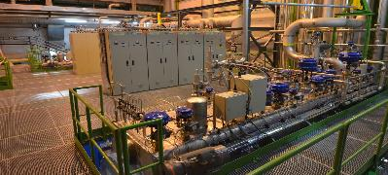
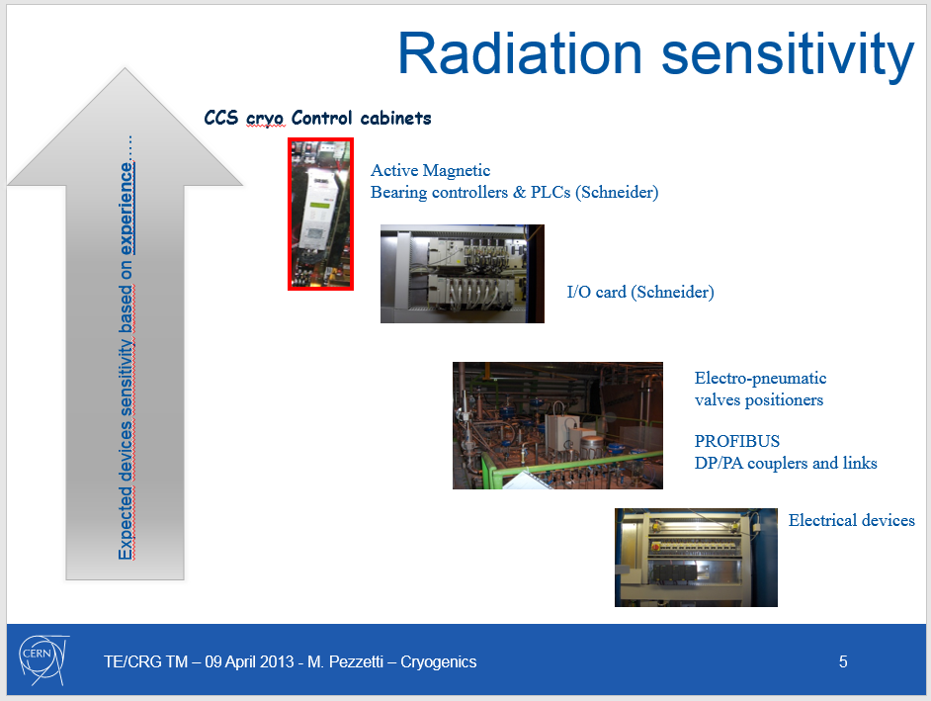
Industrial/Commercial equipment
Commercial equipment in safe/protected areas, mainly:
Industrial Programmable Logic Controllers (PLCs).
PLC associated components (IO, field electronics, ...).
Intelligent valve positioner: active electronics.
Cold Compressor electronics.
…
P4/P8: Already relocated.
P2: No relocation required.
P6 @ UX65. Low rad levels. No R2E failures ever observed (2015 used as benchmark), no relocation planned.
No relocation foreseen for HiLumi.
Cryogenic Instrumentation
TE-CRG-CI

Slide 5
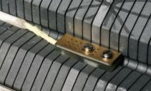
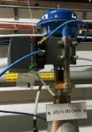
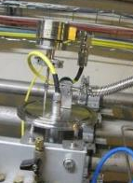
Radiation hard Instruments
Qualified or intrinsically rad-hard instruments:
Temperature sensors (tested @ cold till 3 x 10¹⁴ n.cm⁻²).
Pressure sensors measuring > 1 bar.
Superconducting level gauges.
Solenoid valves.
………
Valve Positioner:
Radiation test: Co-60 gamma source.
Over 10 piezo tested: 1st failure @ 137 kGy TID. Overall test up to 280 kGy.
In-situ radiation monitoring: lower doses than expected from
simulations.
Pressure sensor:
Low range pressure sensors required by LHC and experiments.
Qualified supplier: none @ present!
Candidate devices being evaluated.
Results in the next slides .
Presentation “Radiation Hardness of Pressure Sensors Suitable to Measure in the 0-100mbar Range”, by Michal Jozef Les on 12 Dec 2018 18:20.
Cryogenic Instrumentation
TE-CRG-CI

Slide 6
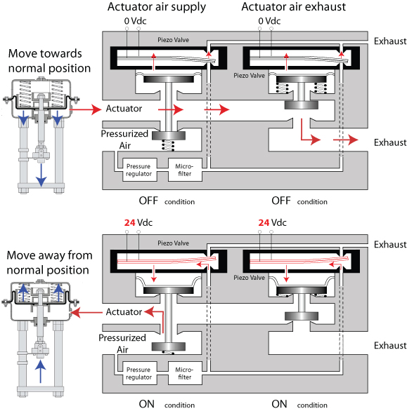

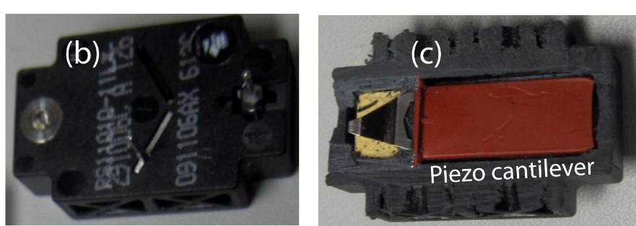
Radiation hardness of the LHC valve actuators
Cryogenic Instrumentation
TE-CRG-CI

Slide 7
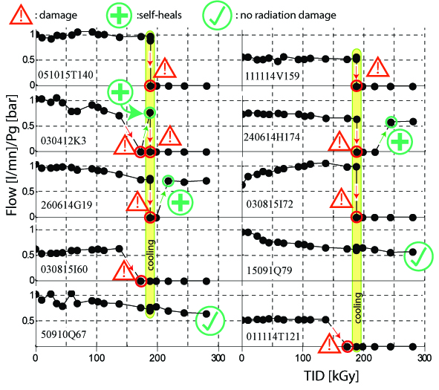
Radiation hardness of the LHC valve actuators
HiLumi radiation estimation shall not exceed 60 kGy for worst location
Gamma rays dose: SIPART qualified for HiLumi
However is the gamma radiation equivalent to a mixed field that include heavy particles?
60 kGy TID target difficult to reach in CHARM
* Eventually single piezo test in HIRRAD?
Cryogenic Instrumentation
TE-CRG-CI

Slide 8
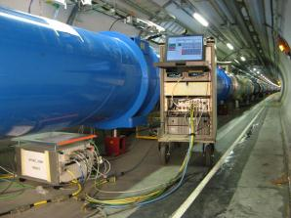
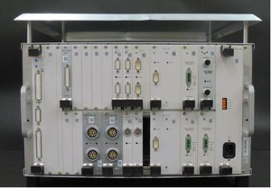
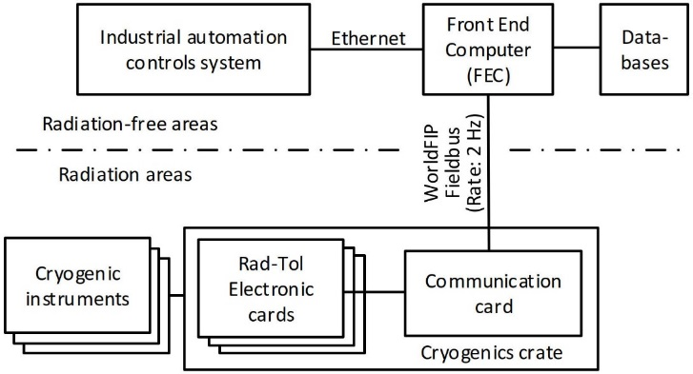
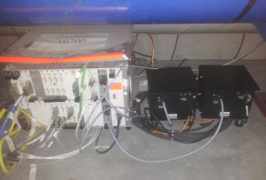
Custom rad-tol equipment - The cryogenics crate
The cryogenics crate
For the LHC:
800 WorldFIP crates
Active channels:
6500 Temperature
800 Pressure
500 Liquid He level gauges
1400 Cold mass heaters
600 Beam screen heaters
1100 Mechanical Switches (I/O)
1050 WorldFIP cards (2100 channels)
System architecture
Installed in ARCs (from cell 8), shielded and protected areas.
All existing designs based on Microsemi antifuse A54SX FPGA (3 kGy).
Rad-tol target for electronic components > 1kGy.
Cryogenic Instrumentation
TE-CRG-CI

Slide 9
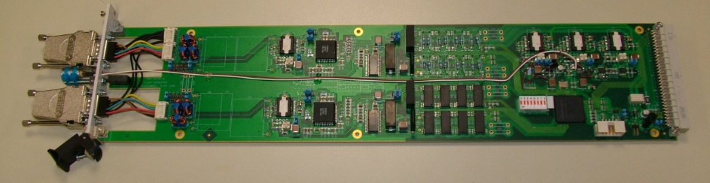
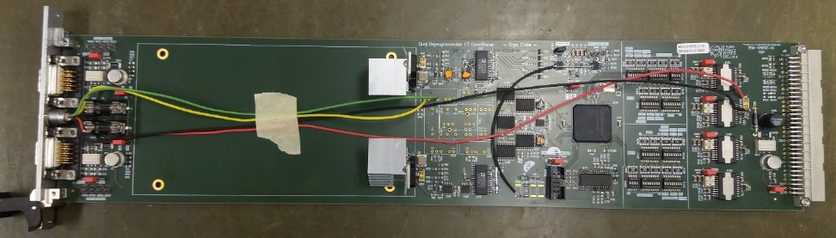
Cards with Smartfusion2 FPGA 2016/2017/2018
Prototype double-channel temperature card
Prototype double-channel LT card
During 2016 the 4 FPGA versions were explored:
Onehot*/Safe, No TMR**
Onehot/Safe, TMR
Hamming 8/4***, TMR
Hamming 8/4, TMR with with distant FFs
*Onehot: FSM encoding with only one “1” bit per state.
**TMR: Triple Modular Redundancy on FFs only.
***Hamming 8/4: Double error detect single error correct.
All versions offered 13-bit diagnostics per channel.
3 cards with FPGA code version Hamming 8/4***, TMR
Cryogenic Instrumentation
TE-CRG-CI

Slide 10
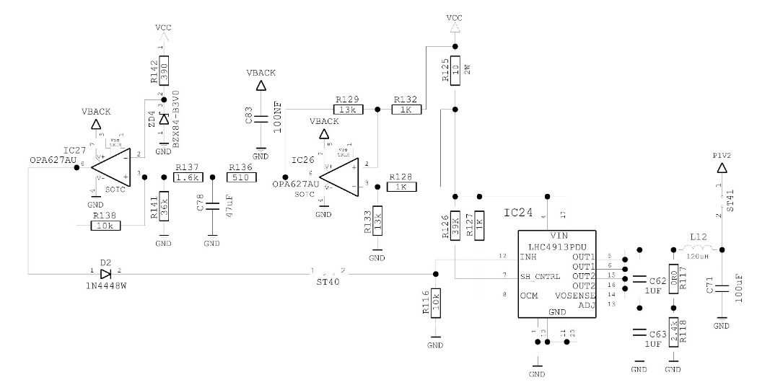
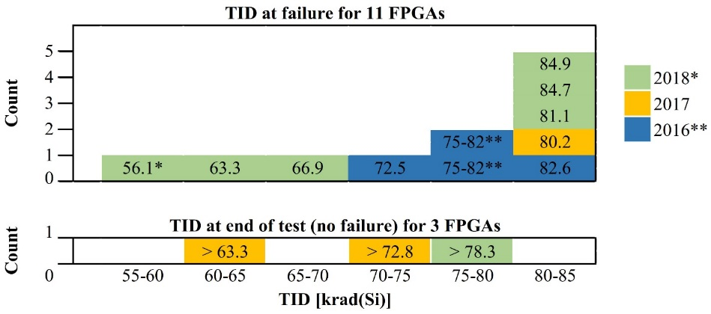
Cards with Smartfusion2 FPGA – Some results
TID results for all cards/campaigns
Anti-latchup circuit to cope with non-destructive SELs.
Testing cards with new reprogrammable FPGA
Approximately 1 automatic action (local or remote) every ~1000 Gy (tunnel).
Observation on the ADC
A new delivery of a long used component (ADC) was found sensitive.
→ Existing productions are OK.
→ To pay attention at future productions.
Paper on Smartfusion2 FPGA under publication: https://edms.cern.ch/document/2050890
Cryogenic Instrumentation
TE-CRG-CI

Slide 11
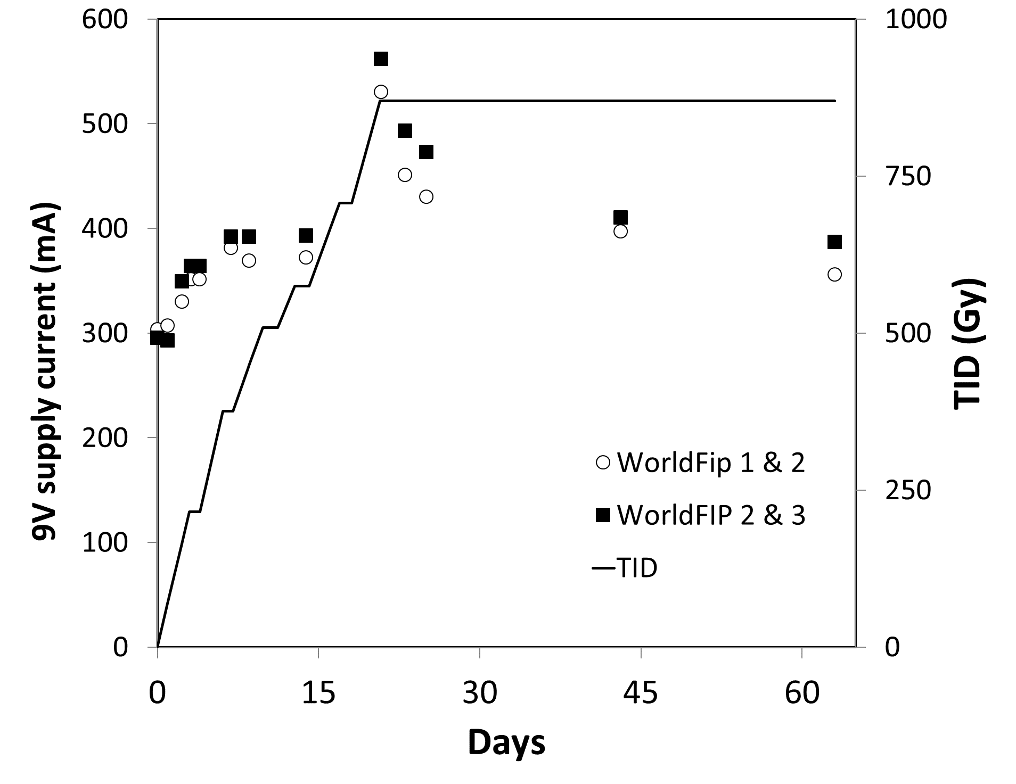
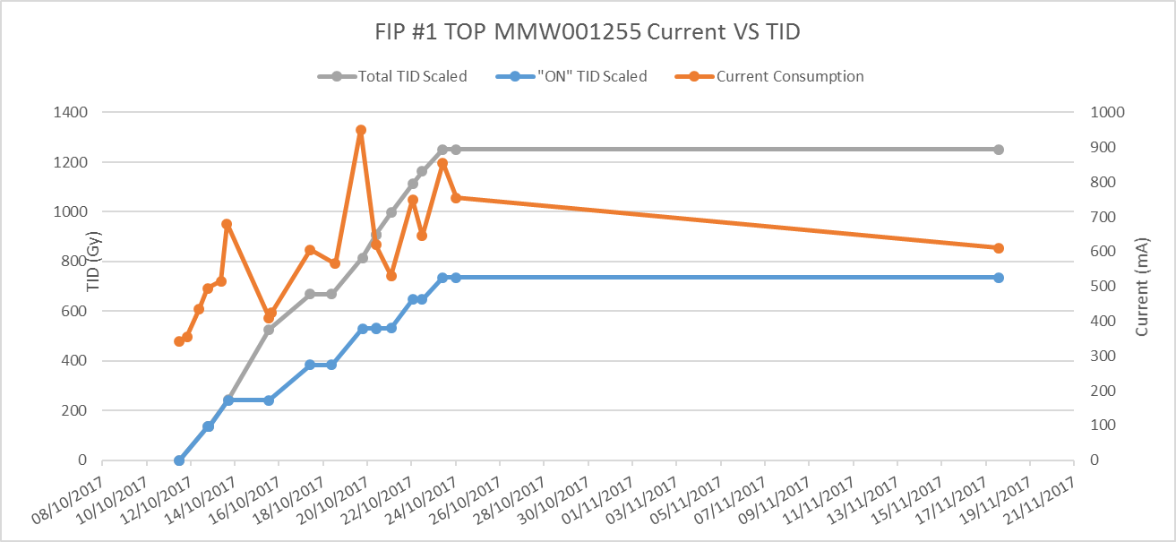
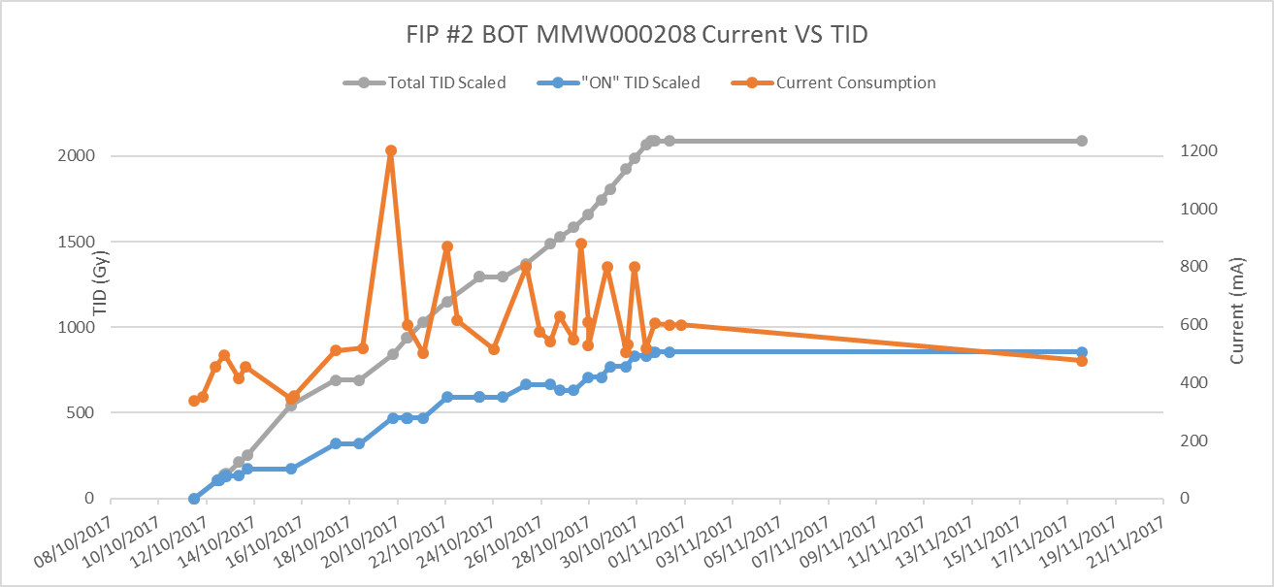
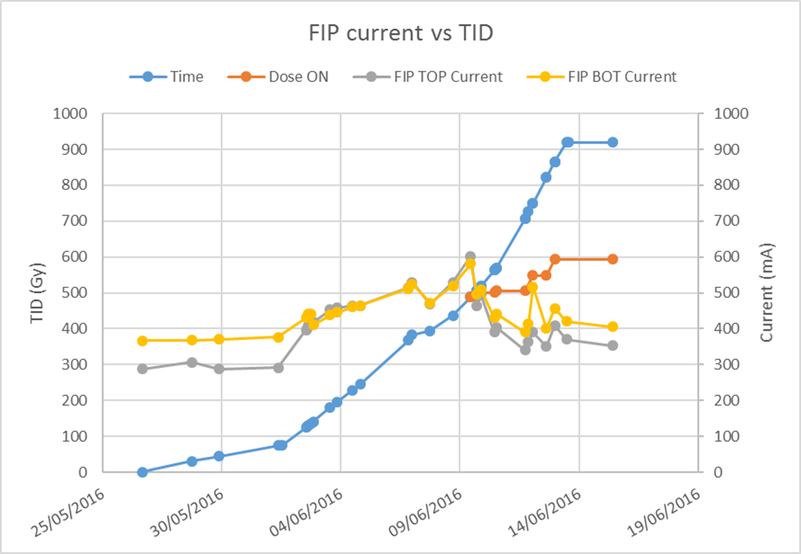
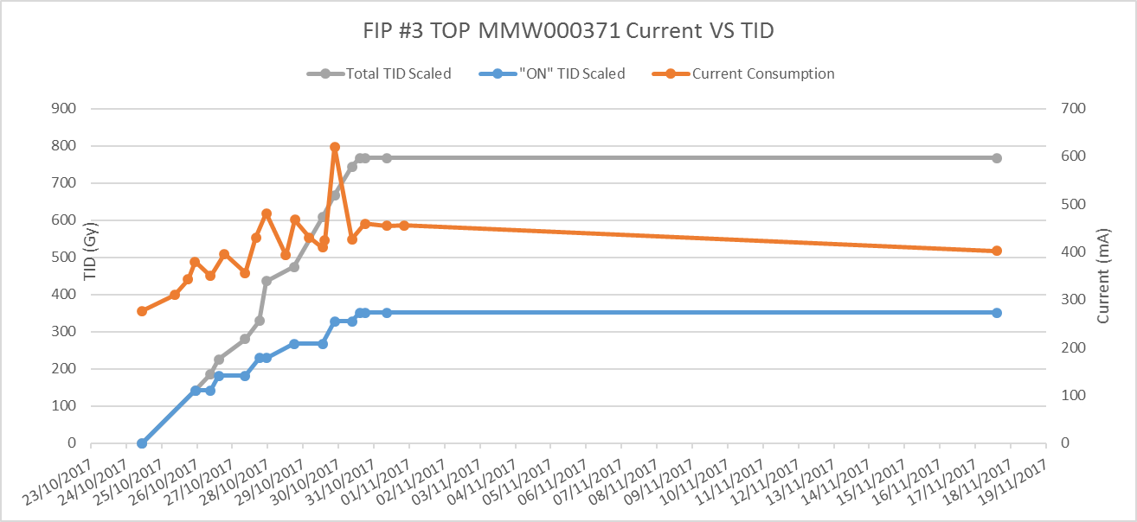
FIP card internal errors – Power consumption
2014/2015
All 3 irradiation combined TID (Gy)
2016
2017: Used cards of previous CHARM tests.
Very high annealing when powered off. All cards are still functional.
2017
Cryogenic Instrumentation
TE-CRG-CI

Slide 12
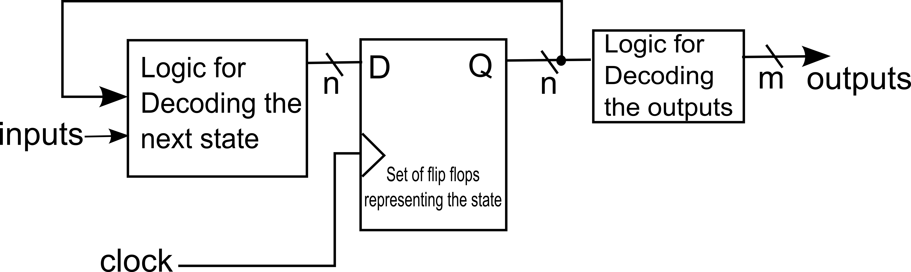
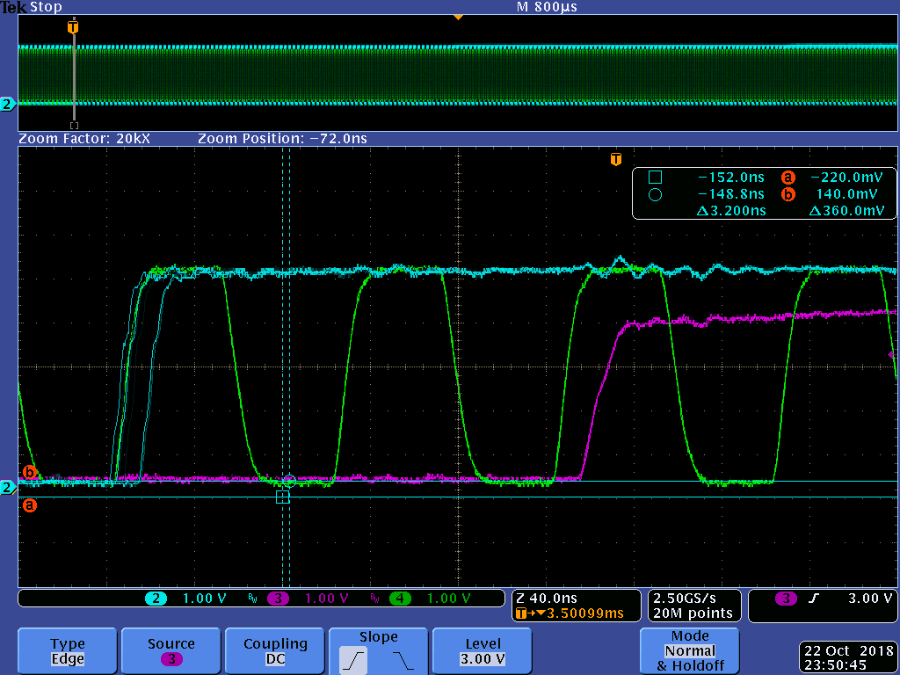
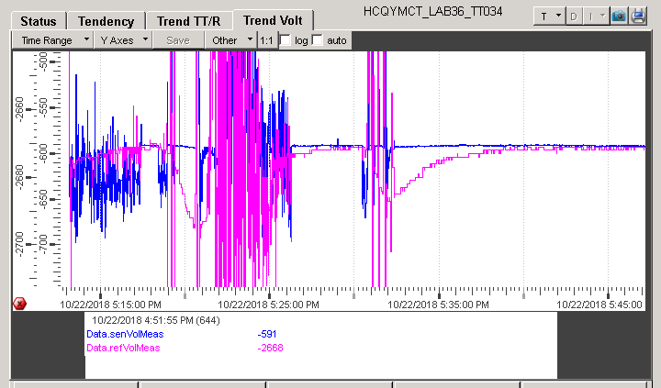
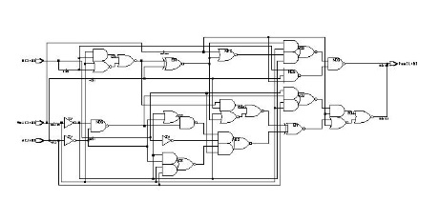
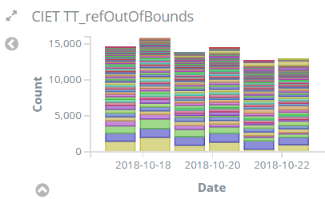
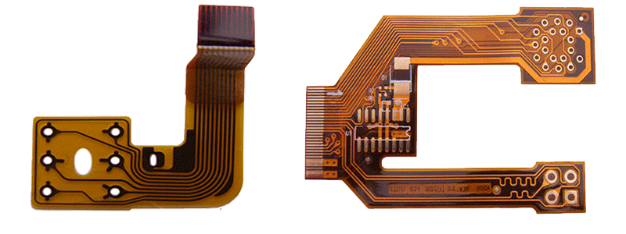
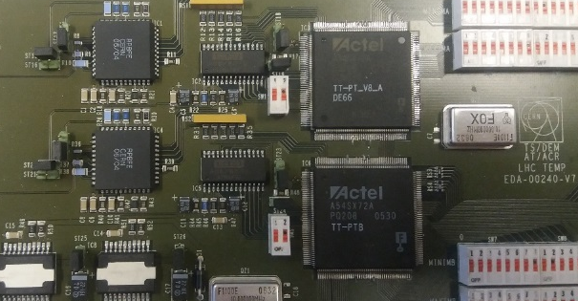
Example of ongoing unforeseen consolidation.
Metastability problem on the antifuse TT FPGAs. For 2019.
“Random” erratic behavior seen on some type of cards → Problem understood: FPGA metastability on asynchronous inputs.
So far problem was treated by replacing the FPGA to another “newer” code version that does not suffer from this problem.
FPGA cannot be reprogrammed → Addition of a flip-flop component patch (FF).
CLK
“ADC Busy” after FF
“ADC Busy” before FF
Tested at 2 spiky cards removed from the tunnel.
Noisy when original card; no noise with extra FF.
Timing violations lead to wrong state in the FPGA statemachine → Reset
Problem solved after synchronizing the busy signal
Example of flex PCB solution
Estimated cost: < 10 CHF
Radiation test specs ready.
To test around Jan/Feb 19.
Test deployment during LS2.
Currently 115 channels + 80 masked out of ~1100 channels
Location on the TT card for flex PCB patch
Cryogenic Instrumentation
TE-CRG-CI

Slide 13
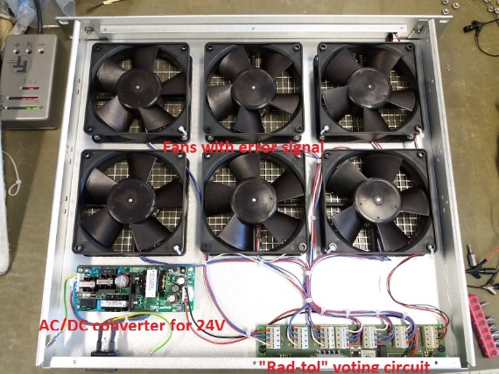
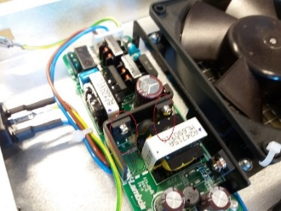
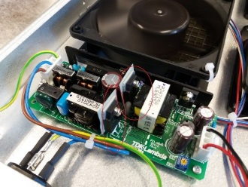
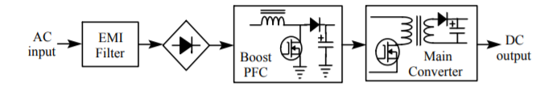
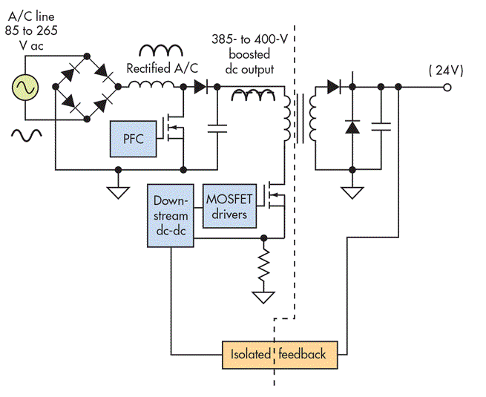
AC/DC 24V 50W device TDK-Lambda ZWS50BAF24
Non critical low count ventilator devices installation in shielded areas.
After some failures in LHC, mosfets replaced to rad-tol FCA36N60NF.
After more failures on the modified supplies, the circuit was analysed.
Original power mosfets
Modified power mosfets
Original circuit produces 400 VDC and power mosfets see 475-500 VDC!
After disabling the power factor correction circuit, DC voltage at 325 VDC
And power mosfets see 400 VDC.
Tested units:
#1 Rad-tol Mosfet +47V zener without /PFC
#2 Rad-tol Mosfet without zener/PFC
#3 Rad-tol Mosfet without zener/PFC
#4 Original mosfets without zener/PFC
Failed at:
#1 300 Gy, 1.19 10¹² HEH
#2 289 Gy, 1.14 10¹² HEH
#3 568 Gy, 2.25 10¹² HEH
#4 4 Gy, 1.58 10¹⁰ HEH
But finally we will install custom rad-tol linear regulator from crate supply (27 - 33) V to 24 V.
Cryogenic Instrumentation
TE-CRG-CI

Slide 14
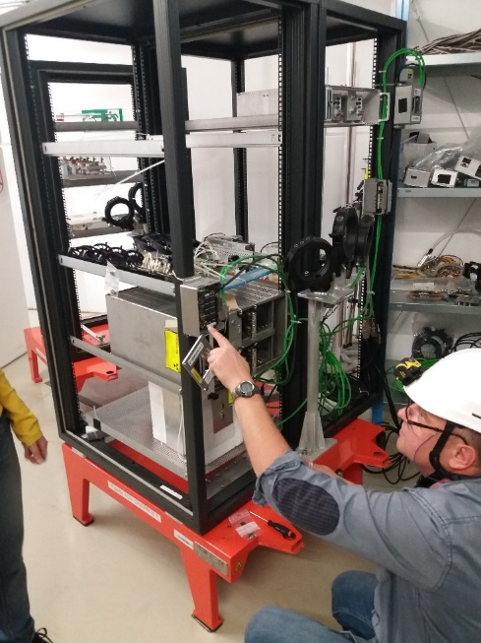
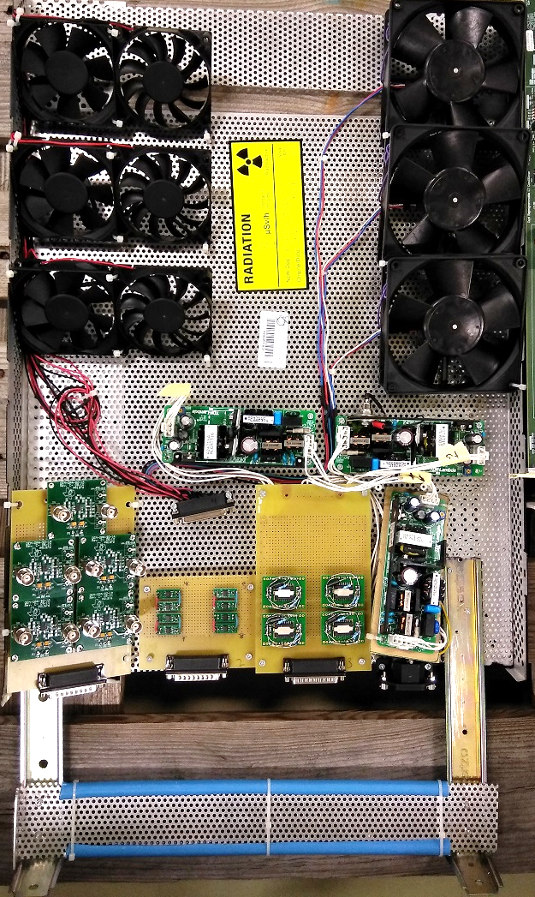
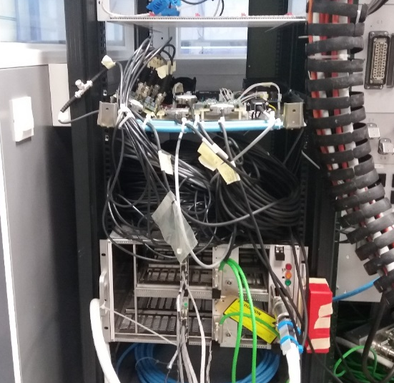
Misc devices/components e.g. 2017
FANs:
Ebmpapst VarioPro 4314/17T (4.8W @ 24V)
Microblow FMA8012BS-M (1.44W @ 12V)
SUNON PF80201V1-000U-A99 (3.42W @ 12V)
OPAs:
OPA132
OPA137
OPA192
OPA129
OPA602 (selected lower cost precision OPA replacement for the OPA627)
AC/DC 24 V 50W Unit (TDK-Lambda ZWS50BAF24)
Cryogenic Instrumentation
TE-CRG-CI

Slide 15
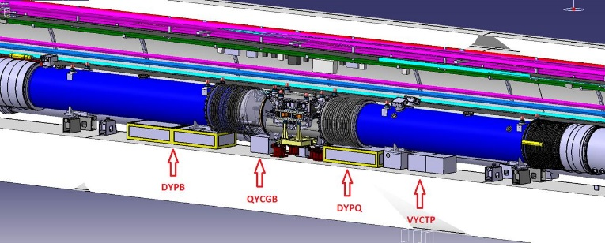
Rad-Tol: Electronics Strategy
Strategy to cope with failures and radiation effects:
Track power consumption for individual cards/crates to assess TID effects.
Presently done in R1 on 10 crates (72 cards) exposed to low and high TIDs.
On “high” radiation areas leave RadTol crates (<10 over 800) to assess:
  Radiation effects (if any); maximum TID (if ever reached).
  Foresee local cable to relocate equipment
  to middle of cold mass for R7/L7 11T case.
Keep adequate quantity of spare cards and components.
Cards rotation could be option as most cards installed in the ARCs (low TIDs).
Regular maintenance/monitoring is a routine task:
Requests for intervention and corrective actions stored in logbooks.
Long-term signals and diagnostic data in logging database.
Daily automated database queries on a set of pre-defined rules to detect potential problems (Elasticsearch/Kibana).
Rad-tol electronics perform as expected.
(However other lifetime reliability problems might occur earlier).
Cryogenic Instrumentation
TE-CRG-CI

Slide 16
Summary
Most of the CRG equipment shall perform satisfactorily under HiLumi conditions:
  Radiation tests are performed once/twice per year. Essential to cope with obsolescence and to qualify new devices.
  CRG dedicates already about 0.5 FTE for radiation issues.
Material/devices purchased/scrapped for/after tests: 10 to 30 kCHF/year.
HiLumi: Stay as is; provisionally install cables to relocate cryo-crates for “risk” areas.
Monitoring/diagnostics/maintenance are continuously being applied to all the equipment that is installed in radiation or radiation-free areas.
End of life failures: no indication yet for any equipment (electronics, valve actuator, etc).
Cryogenic Instrumentation
TE-CRG-CI

