Slide 1


Radiation tolerant developments: Controls
Distributed I/O Tier and Fieldbus project
Greg Daniluk | Eva Gousiou
R2E Annual meeting | 11 dec 2018

Slide 2
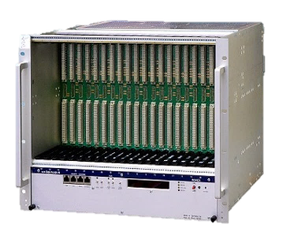
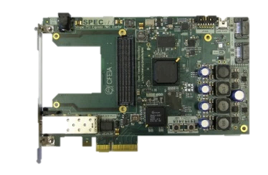
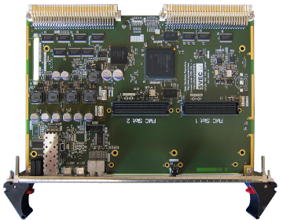

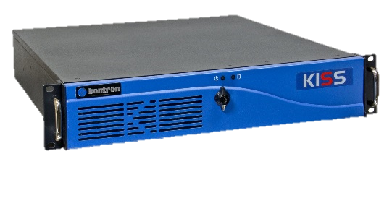

Custom Electronics Architecture
Front-End Tier
Front-End Computer
VME/PICMG/PLC
master
Fieldbus (WorldFIP/PROFINET/etc)
Fieldbus Tier
DIO1
DIO2
DIO3
DIOn
slave
slave
slave
slave
Distributed I/O Tier
actuator
actuator
sensor
sensor

Slide 3
Custom Electronics Architecture
Front-End Tier
Front-End Computer
VME/PICMG/PLC
master
Fieldbus (WorldFIP/PROFINET/etc)
Fieldbus Tier
DIO1
DIO2
DIO3
DIOn
slave
slave
slave
slave
Distributed I/O Tier
actuator
actuator
sensor
sensor

Slide 4



Rad-tol Communication Technologies
GBTx/LpGBTx
performance
500 Gy

Slide 5
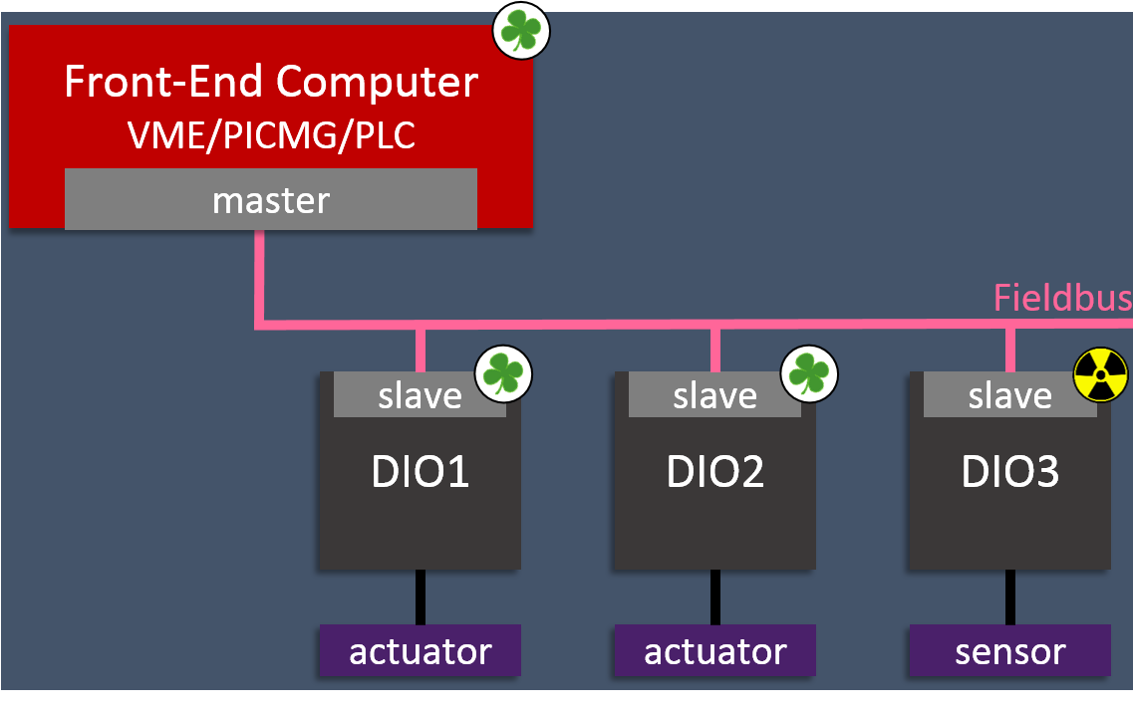
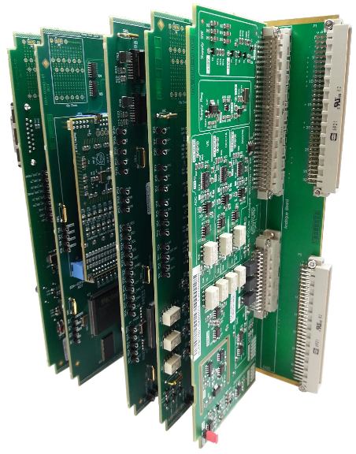
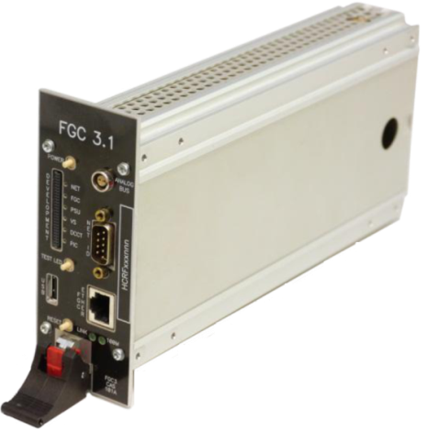
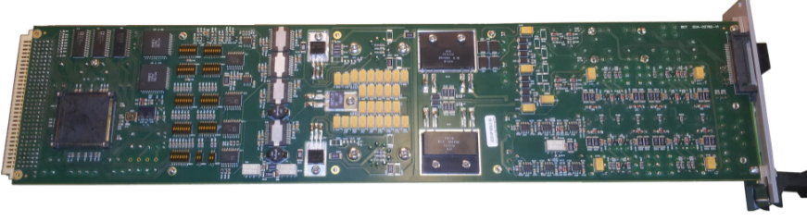
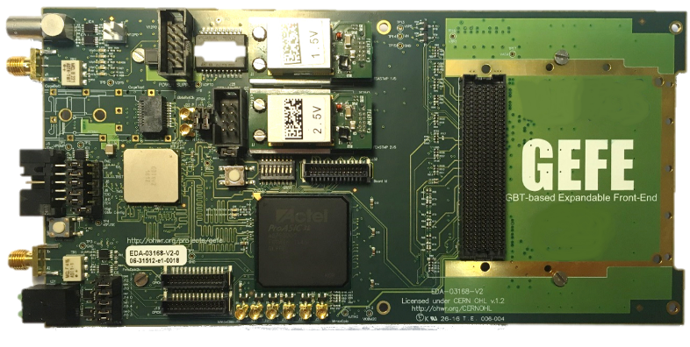
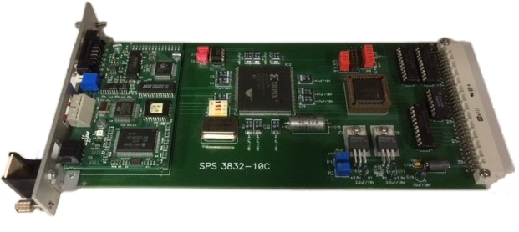
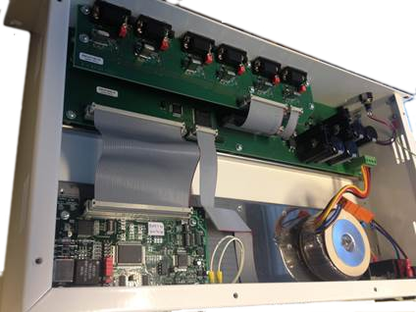
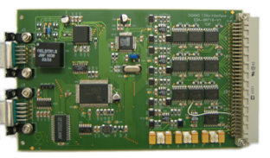
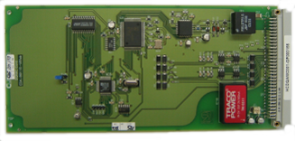
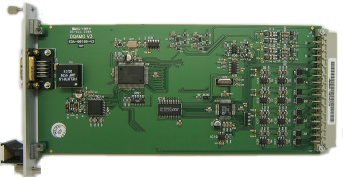
DIOT today
Power Converters
Beam Instrumentation
Cryogenics
Machine Protection
Beam Transfer
Magnets Positioning

Slide 6


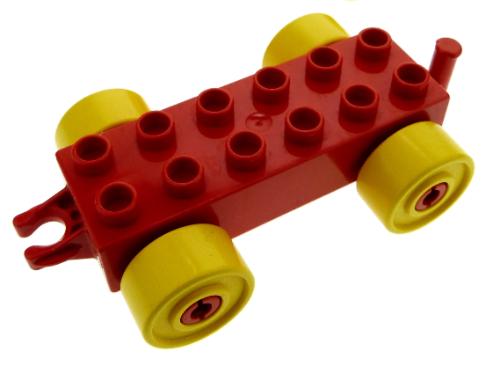




Future DIOT Recipe
Magnets Positioning
Machine Protection
+
=
Beam Transfer
Modular hw kit
Designed with eq.groups
Maintained by BE-CO
App-specific parts
Designed by eq. groups
Beam Instrumentation
Collimators
More robust designs
Benefit from existing developments
Re-use between equipment groups
Notes:
Modular hw kit designed by CO in collab with eq. groups
Mainenance by CO

Slide 7
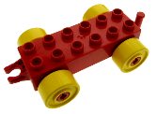
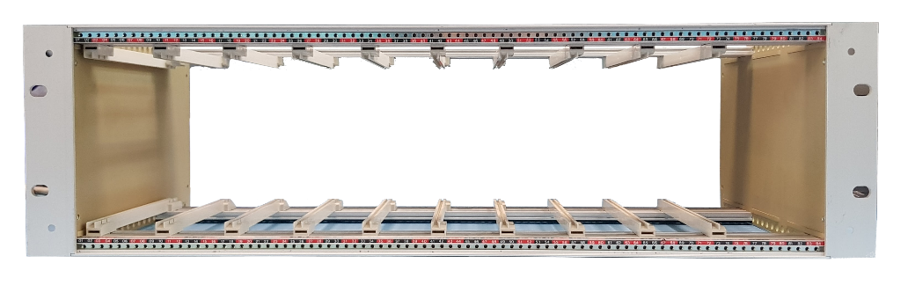
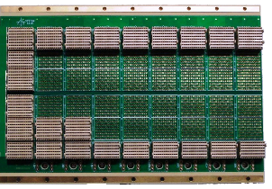

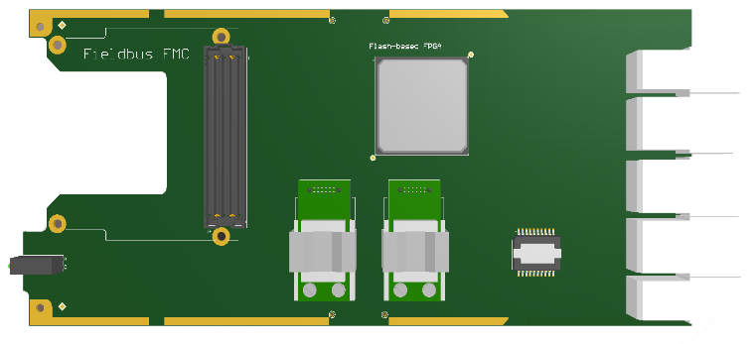
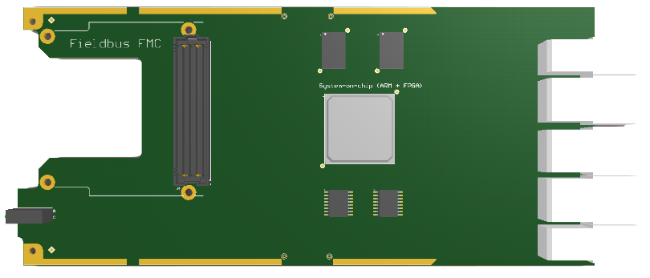
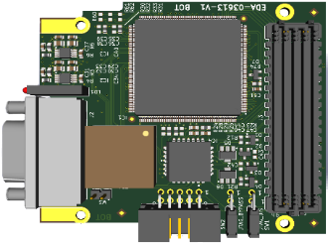
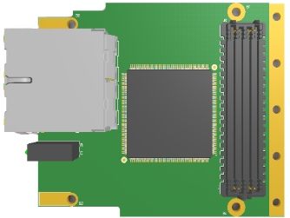
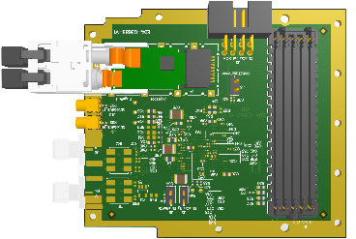
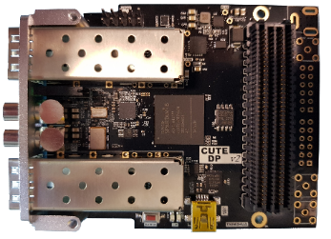
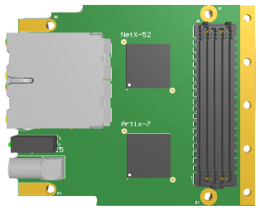
Common hardware kit for DIOT
Power
supply
Radiation-tolerant System Board
System Board
WorldFIP FMC
Powerlink FMC
LpGBTx FMC
White Rabbit FMC
Industrial Ethernet FMC

Slide 8
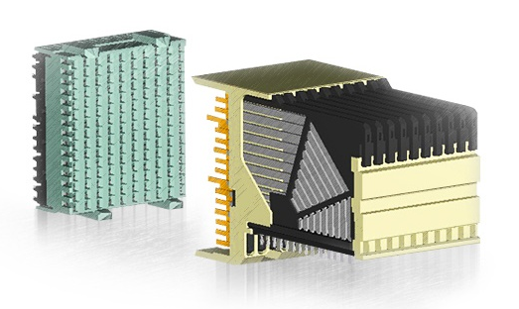
3U Chassis & Backplane
PSU
Custom space
. . . . . . . .
. . . . . . . .
Hosts Power Supply, System Board & Application-specific Peripheral Boards
Low cost crate with 9-slots CompactPCI Serial backplane by default
  Fully passive
  Star-topology differential lanes from System to Peripheral
  AirMax VS connectors
Application-specific backplanes (with the system slot) possible
Optional 1U fan tray
Notes:
No PCIe in radiation
Robust connector used in transportation

Slide 9
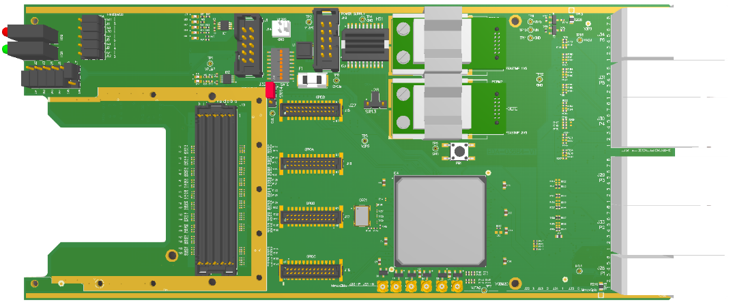
DIOT System Board
220mm
Backplane connector:
communication with
peripheral boards
FMC for fieldbus
FPGA for
  application-specific logic
  common crate monitoring and diagnostics

Slide 10
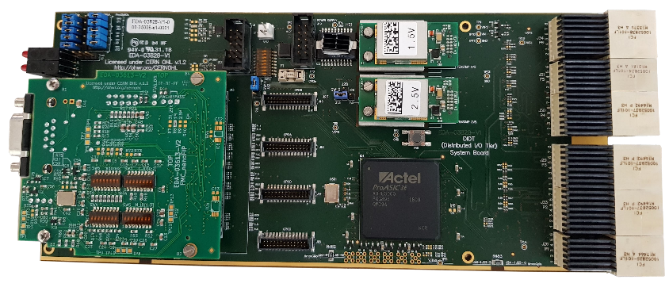
Rad-tol System Board v1.0
EDA-03828
Redesigned C-GEFE (BE-BI)
Added backplane connector to communicate with peripheral boards
Minor fixes (including FMC compatibility)
Together with: BE-BI, TE-MPE, EN-SMM
10 boards produced for lab use
v2.0 in the future, with NanoXplore or Smartfusion2 FPGA

Slide 11
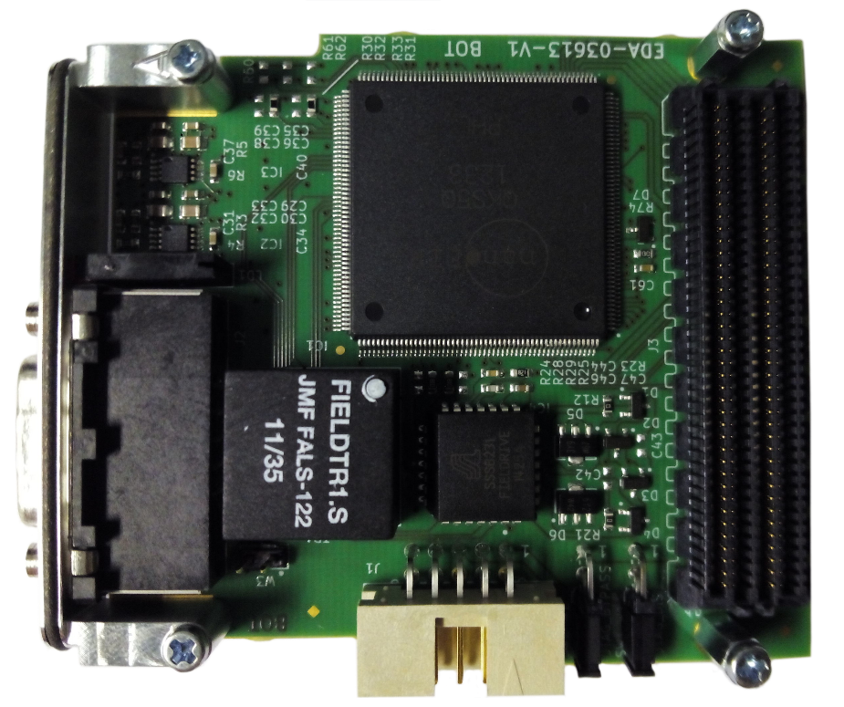
Fieldbus FMCs status
ProASIC3 with nanoFIP
FielDrive + FieldTR from Alstom
Components qualification by R2E
Hardware executions for 31.25k, 1M, 2.5M, 5M
Prototypes produced and tested
Available for lab tests & developments
Radiation tests planned for 2019
https://www.ohwr.org/projects/fmc-nanofip

Slide 12
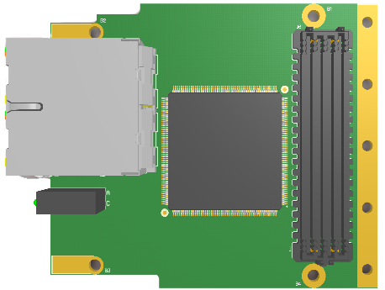
Fieldbus FMCs status
Work in progress
Run openPowerlink stack on SmartFusion2
ARM Cortex-M3 tests in CHARM
RISC-V softprocessor with TMR
R2E funding: Mattia (FELL) dedicated to this task
Radiation tests and components qualification with EN-SMM
See the talk of Mattia Rizzi tomorrow!

Slide 13
Rad-tol Power Supply
Lalit (FELL) dedicated to this task – R2E and HL-LHC funding
Collaboration with R2E and TE-EPC
Survey of currently used rad-tol power supplies
Gathering requirements and drafting specs
  230V AC → DC +12V, +5V, 100W
  TID > 500Gy (1kGy?)
  Redundancy
  PMBus monitoring interface
First lab prototype using FEAST chips as controller of switched supply
Components selection and qualification planned for 2019
See the talk of Lalit Patnaik tomorrow on RaToPUS!
https://wikis.cern.ch/display/DIOT/Rad-tol+power+supply

Slide 14
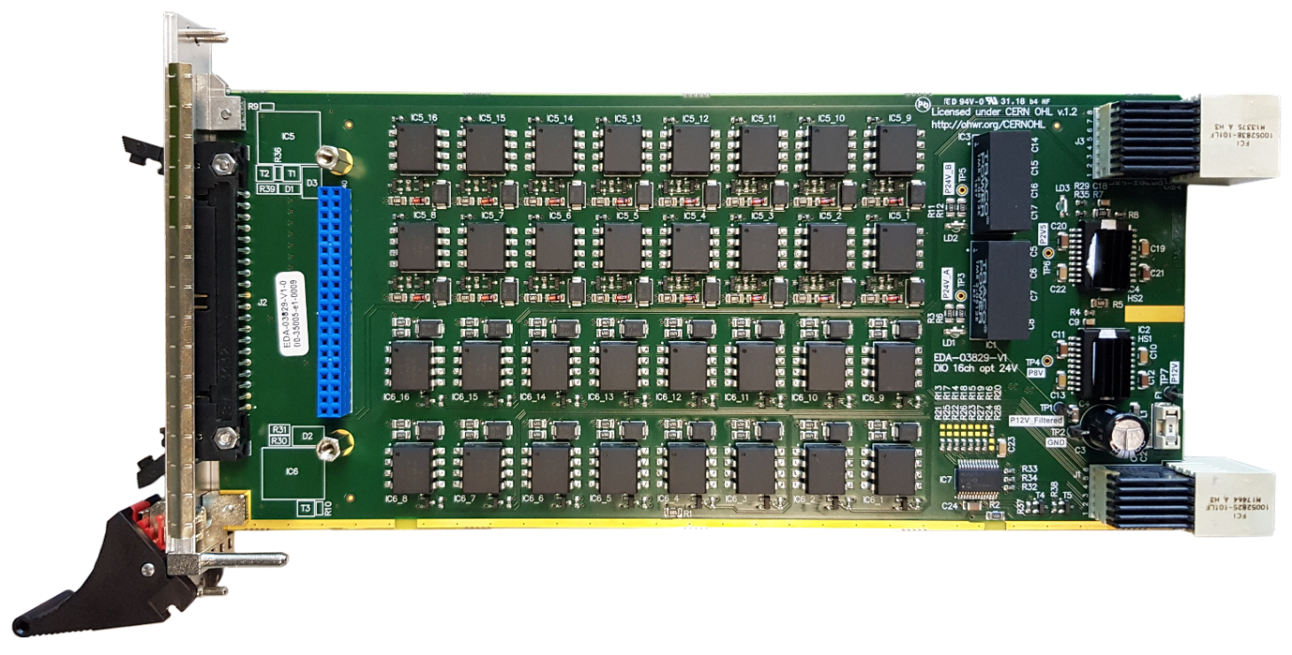
Template Peripheral Board
EDA-03829
I/O board based on requirements for Warm Interlocks application (TE-MPE)
24V generation (TRACO)
16 opto-coupled current loop inputs (HCNR200)
16 opto-coupled relay driving outputs (HCNR200)
Template for future application-specific Peripheral Boards
Radiation tests in 2019

Slide 15
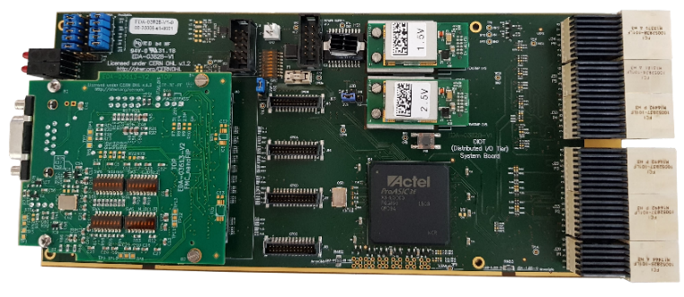
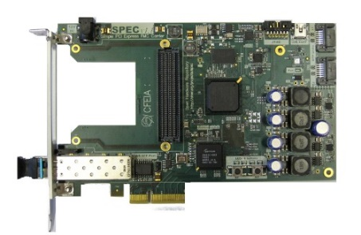
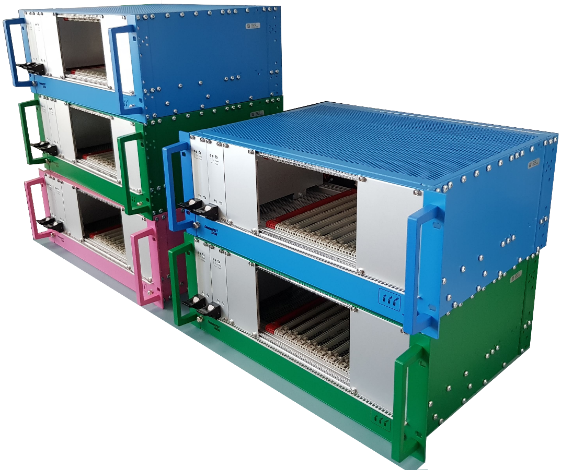
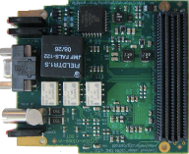
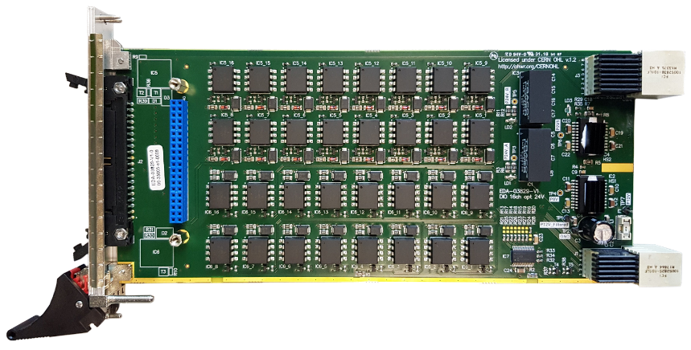
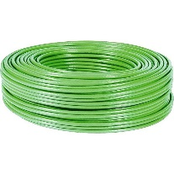
Proof of Concept
System Board + FMC nanoFIP
SPEC + FMC MasterFIP
16I / 16O Peripheral Board
Off-the-shelf CompactPCI Serial chassis
Notes:
Off-the shelf non-rad-tol supplies in the demo crate

Slide 16
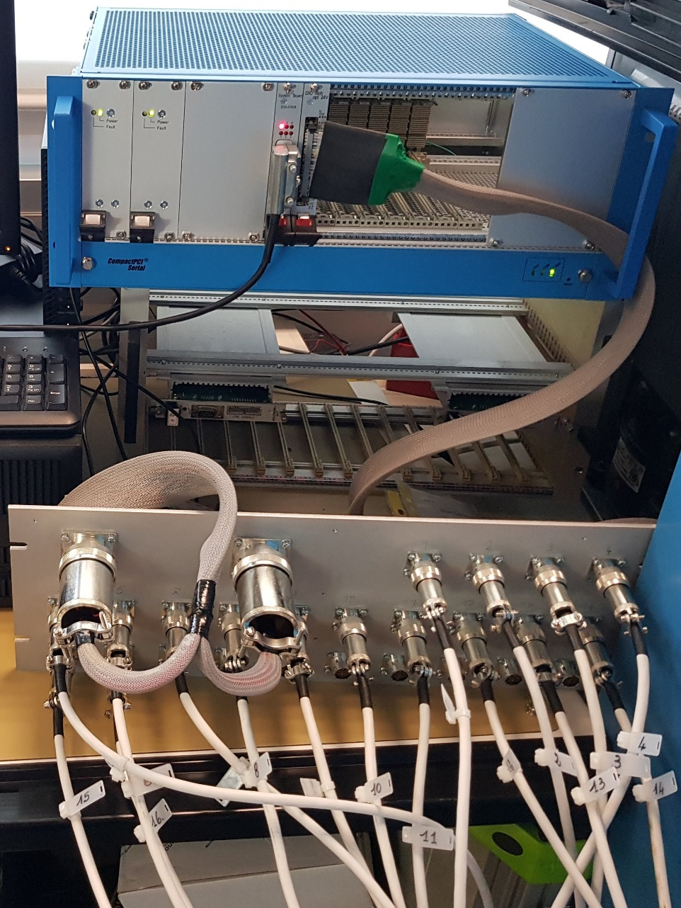
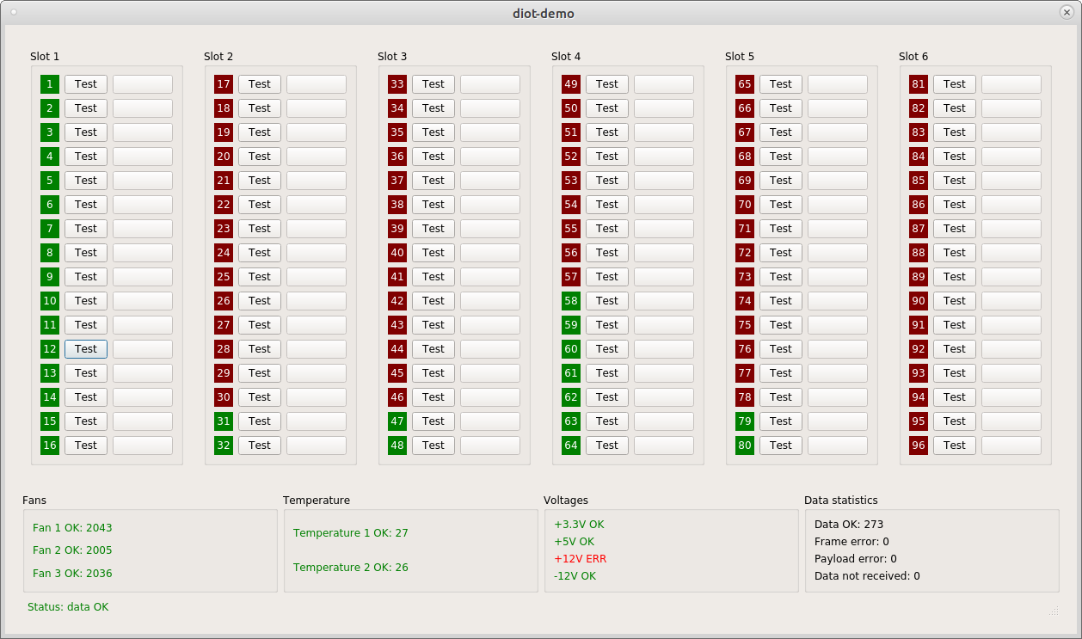
Proof of Concept
DIOT crate with
System Board
WIC Peripheral Board
WIC I/O distribution panel
Notes:
Off-the shelf non-rad-tol supplies in the demo crate

Slide 17
Resources & Collaborations
HL-LHC WP 18 – development & production budget (~1.3MCHF), fellows
  Rad-tol power supply design ( Lalit )
  Crate diagnostics ( Christos )
  Rad-tol System board v2.0
  Reliability Studies
R2E task force - radiation tests, components selection, fellows
  Powerlink implementation ( Mattia )
  Rad-tol power supply design
EN-SMM, TE-MPE, BE-BI, TE-EPC
  Specification
  Design of components of the kit

Slide 18
Timeline
2016
Iterative process with eq. groups to define modular hw kit
Proof of concept
Sep 2018
First Powerlink tests in CHARM
2020
Building blocks available for eq. groups
LS3
Deployments in eq. groups

Slide 19
Thank you!
Need more information? Latest status update?
Check: https://wikis.cern.ch/display/DIOT

