Slide 2
R2E Annual Meeting 2018
Results of Functional Radiation Tests of QPS Equipment (to be installed during LS2) at CHARM
Surbhi Mundra
On behalf of TE-MPE-EP

Slide 3
Contents
QPSs for LS2
DQLPUBv2
  About, test setup, results, summary
UQDS
  About, test setup, results, summary
Conclusions
Notes:
To describe the presentation topic, first I will be explaining what are the 2 quench protection systems to be deployed in LS2
I will first explain about DQLPUBv2, what it is, how it was tested, the results and summary of performance.
I will use a similar format for uQDS and finally present my conclusions

Slide 4
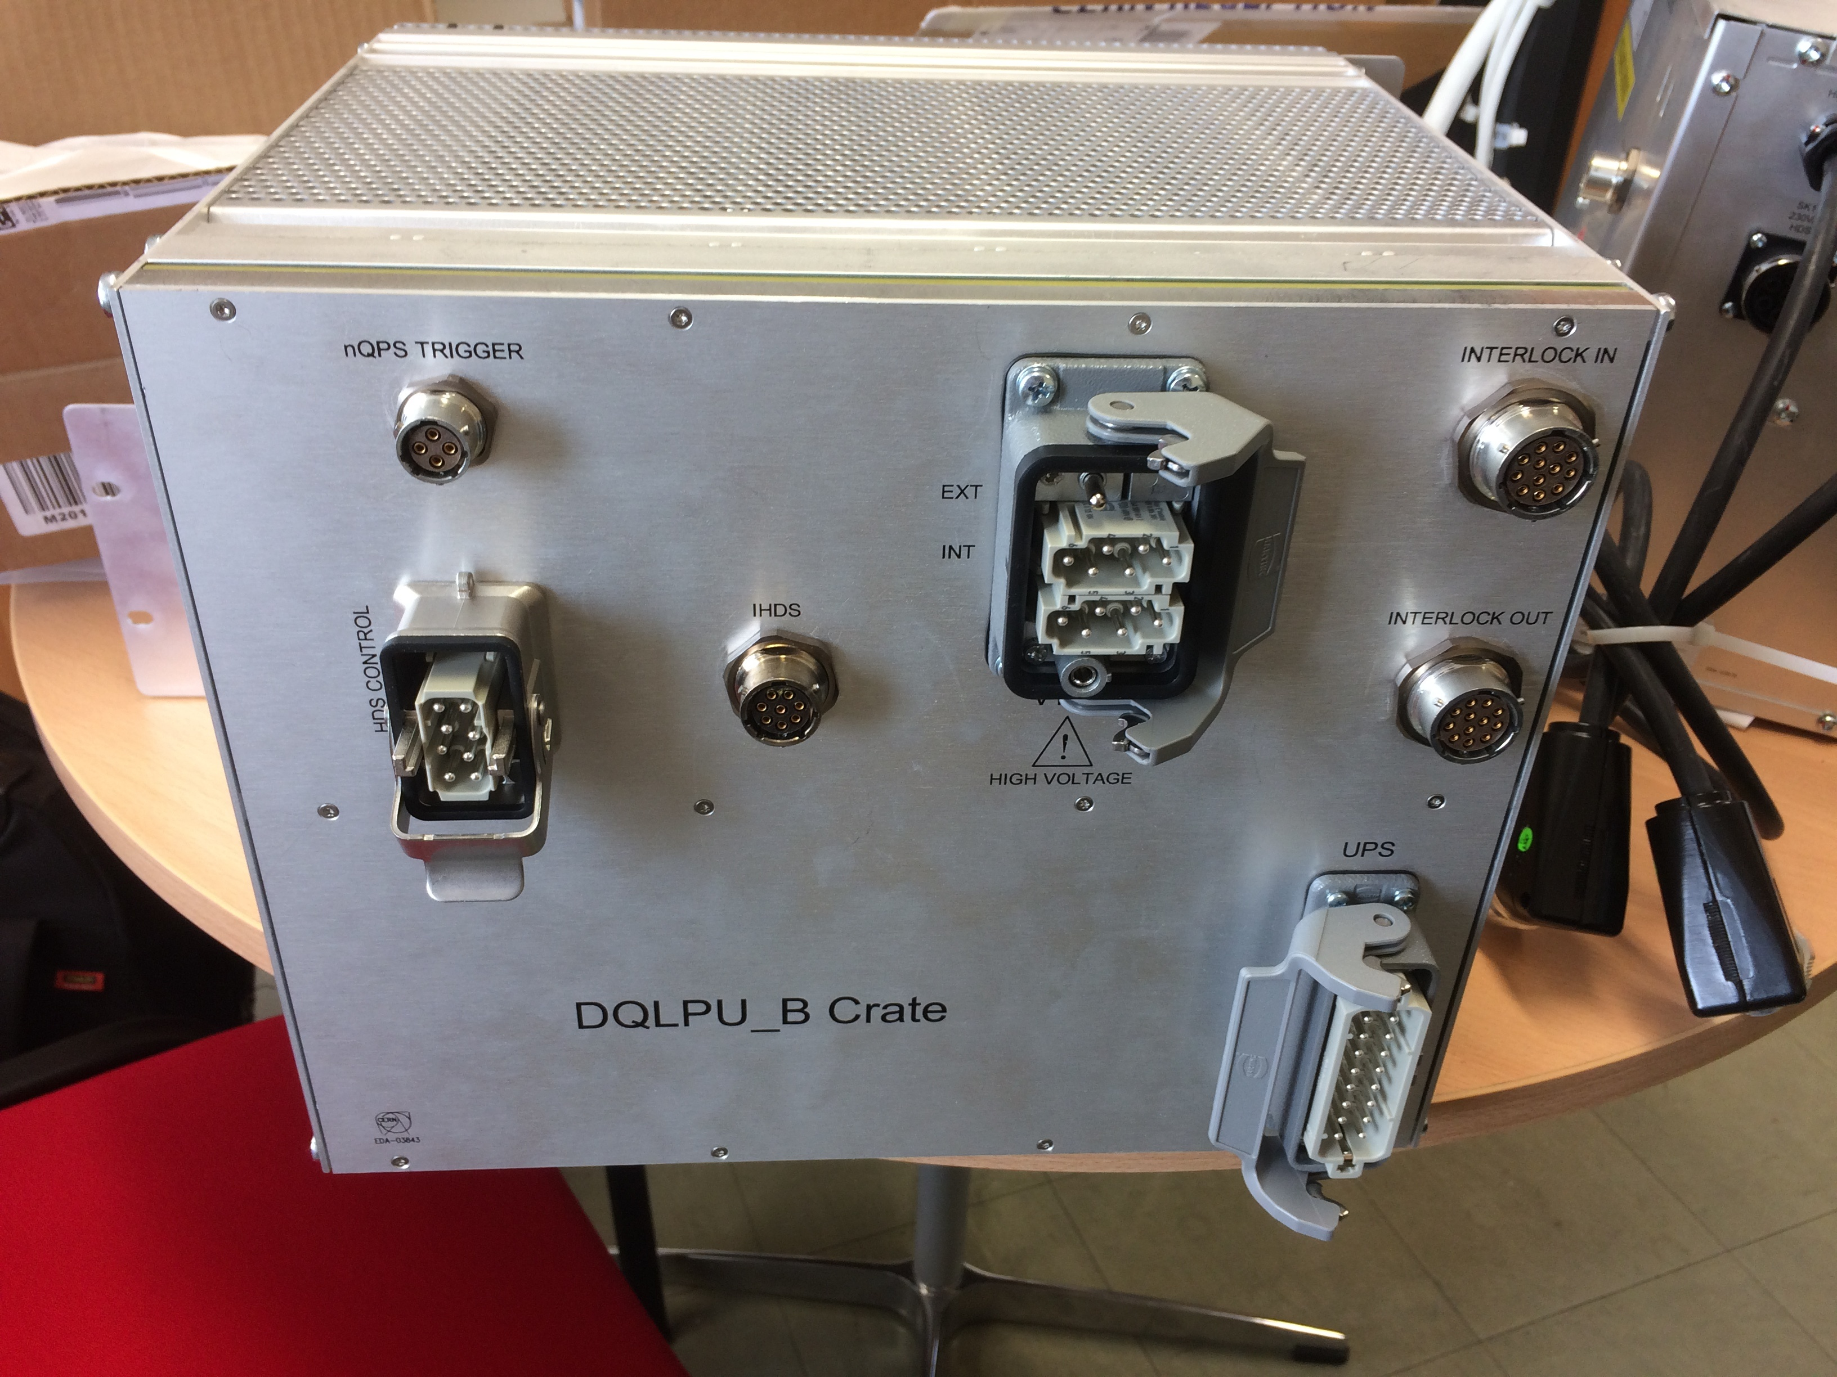
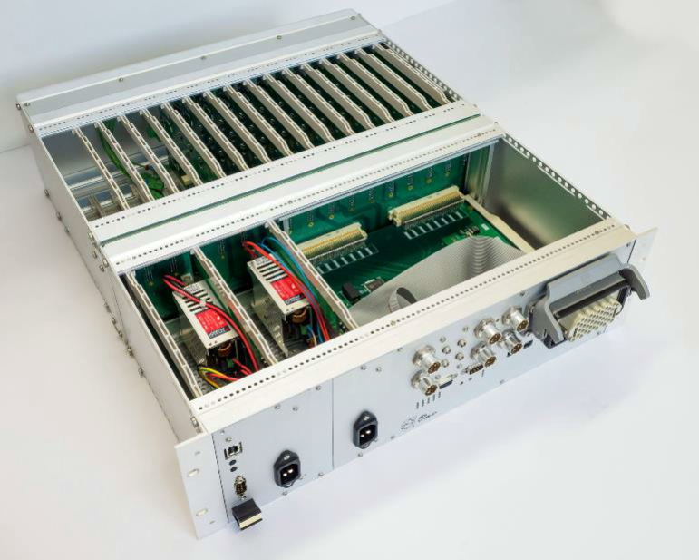
Quench Protection Systems to be installed in LS2
 | DQLPUBv2 | Universal QDS (UQDS)
Protection of | Main quadrupole | 11T magnets
No. of Units | 392 (+48) | 4
Location | DYPQ rack | RR73/RR77
Expected dose rate | <1 Gy/y .. 10+ Gy/y | ~1 Gy/y
Total Expected Dose | 200 Gy | 30 Gy
Components | Commercial out of the shelf (COTS), tested in PSI | Commercial out of the shelf (COTS), tested in PSI
Notes:
The MPE-EP group has been working on 2 quench protection systems, DQLPUBv2 and uQDS.
DQLPUBv2 is a development over DQLPUBv1 and 392 of this units will be installed in the yellow rack below the dipoles. It is equipped with enhance diagnostics and maintainability. The components used are either same as used already or have been tested for radiation tolerance at PSI.
Other is uQDS, this modular, versatile system can be universally used to protect against quench in different kind of magnets and systems. It finds its first use in High Lumi Project and further projects like FAIRE. It is new of its kind and has been made of COTS components tested in PSI.

Slide 5
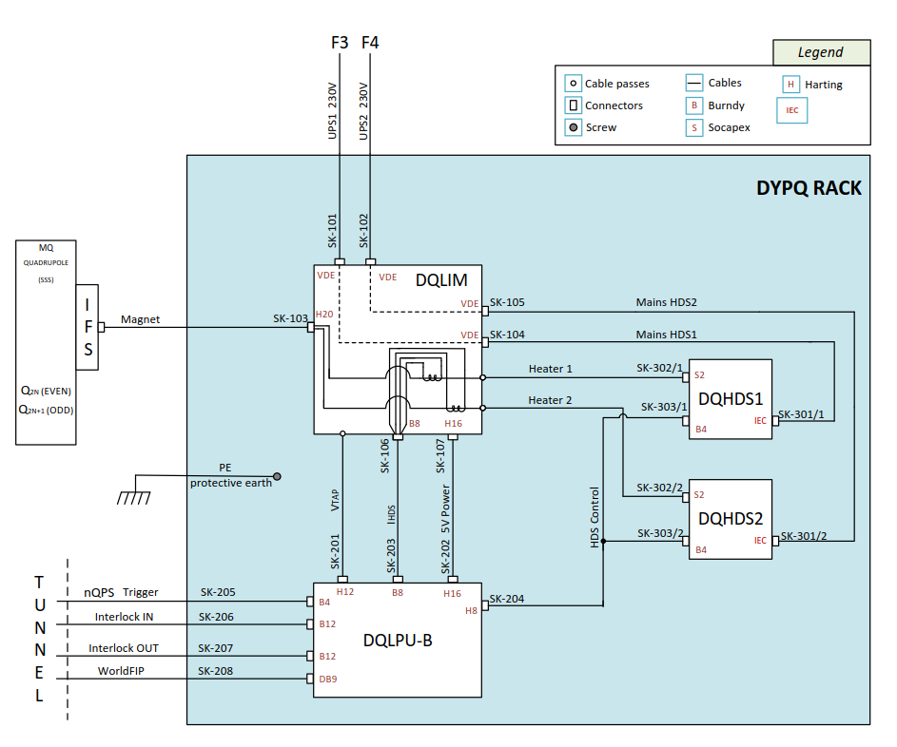
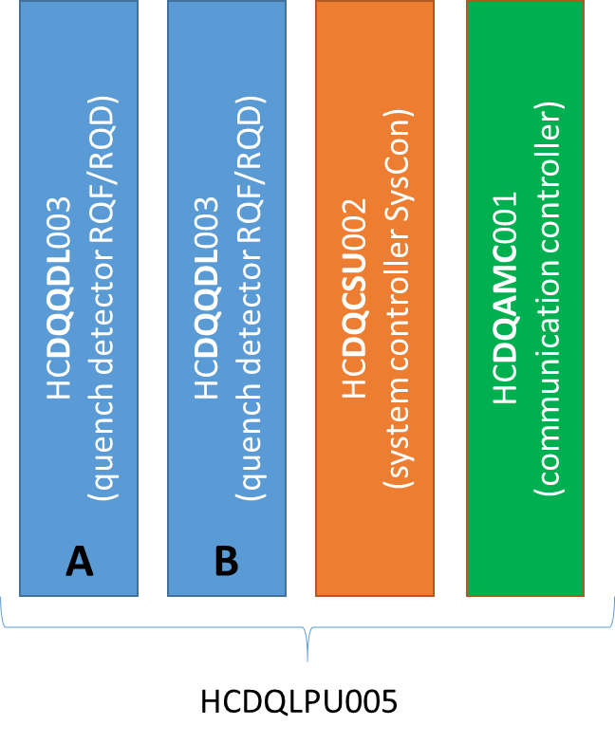
About DQLPUBv2
DYPQ Rack
DQLPU Type B
Located under “A” or “C” dipoles in LHC tunnel
Expected annual dose: <1 Gy/y .. 10+ Gy/y
Target lifetime dose: 200Gy
Notes:
The DYPQ rack consists of DQLIM (Local Interface Protection Module), DQLPUB and 2 DQHDS (heater discharge supplies).
In the event of a magnet quenching, DQLPU unit detects the quench, opens the interlock loops, and triggers the heater firing.
The DQLPU unit consists of 2 redundant local quench detection units (DQQDL), 1 crate supervision unit also called system controller (DQCSU) and communication controller (DQAMC) which provides the interface to communicate with unit through WorldFIP.
Being part of the DYPQ rack, it will be located under “A” or “C” dipoles and is expected to receive dose at 1Gy/y to 10 Gy/y. The design of DQLPUBv2 assumes target lifetime dose of 200Gy.

Slide 6
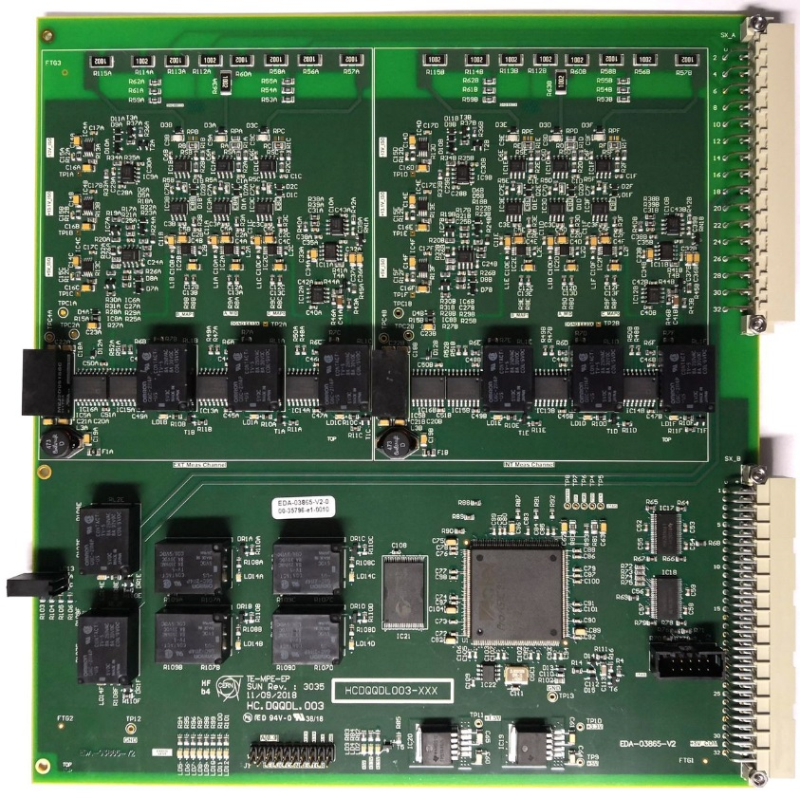
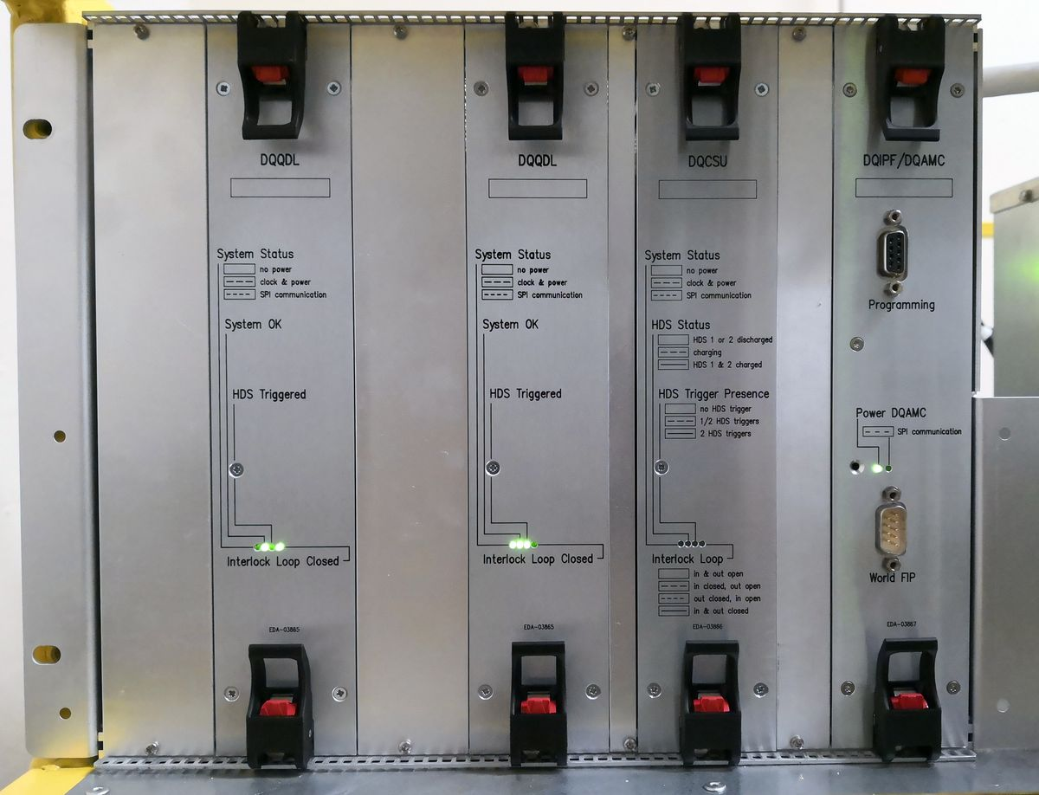
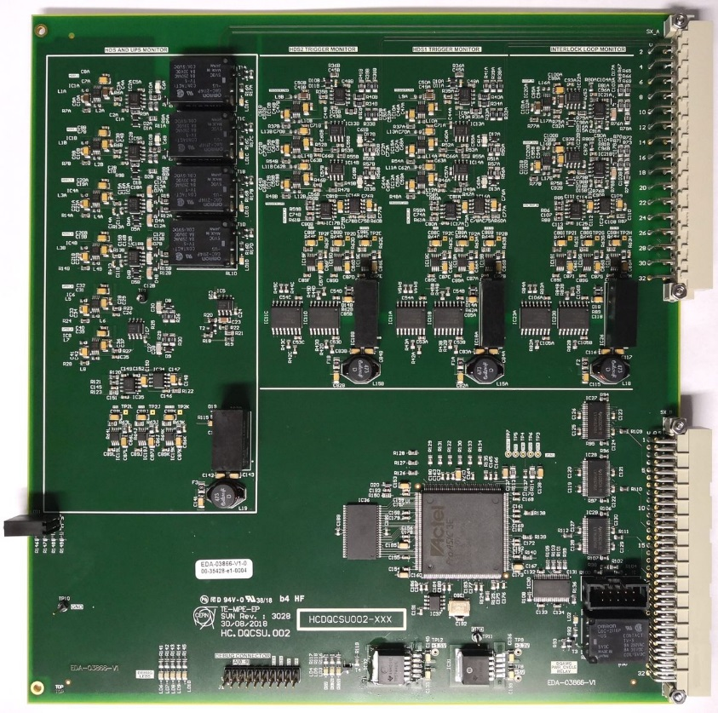
About DQLPUBv2
DQQDL
DQCSU
Notes:
This is a picture of the DQLPUBv2 backplane with its individual crates: 2 DQQDL units, 1 DQCSU and 1 DQAMC unit.
On the right we have the DQQDL and DQCSU PCBs. As can be seen, the layout is dense, packed with large number of electronic components. These components have been radiation tested at PSI for required performance under target dose.

Slide 7
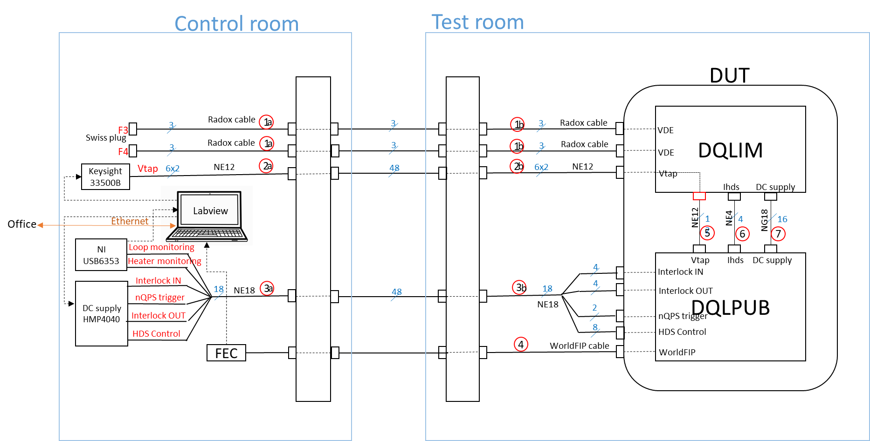
DQLUBv2: Test Setup
 | Configuration | Position | Target Inside | Target Outside | Dose [Gy] | Total POT
Run 1 | “CuOOOO” | 10 | 2018-06-13 | 2018-06-18 | 218.69 | 1.27E+16
Run 2 | “CuOOOO” | 10 | 2018-06-20 | 2018-06-25 | 229.25 | 1.64E+16
Run 3 | “CuOOOO” | 10 | 2018-09-05 | 2018-09-10 | 156.5 | 1.78E+16
Run 4 | “CuOOOO” | 10 | 2018-09-12 | 2018-09-17 | 197.22 | 1.47E+16
Notes:
Here I show the test setup we used in CHARM.
We connected our DUT comprising of DQLIM and DQLPU in radiation and connected them to the signal and measurement units in control room via patch panels. For recording data we used NI i/o box and WorldFIP communication. We had 4 runs of the test, all at position 10 and for 1 week. The TID varied from 156 to 230 Gy.

Slide 8
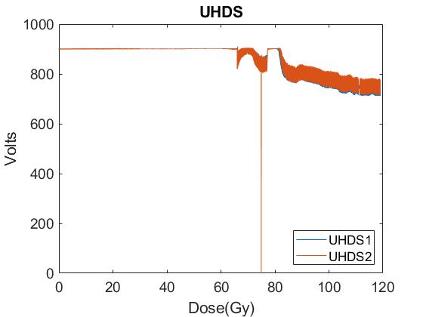
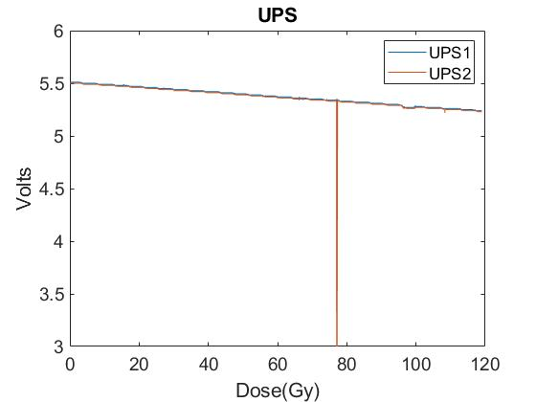
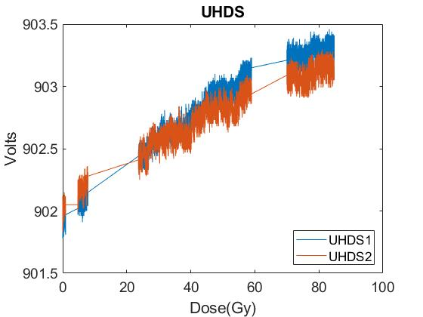
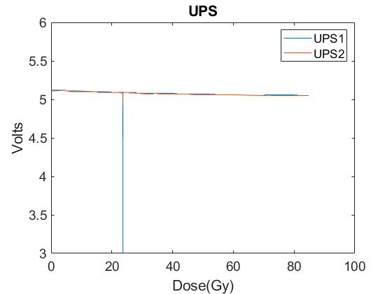
DQLPUBv2: Supply Monitors
Run 1 & Run 2: June’2018
Run1
Run2
UHDS shows drastic change with dose over 70Gy → change of mezannine board → small deviation in Run2
UPS voltage shows constant decay through both runs
Notes:
In this slide I am showing the results from supply monitors. UHDS-> Heater Discharge Supply Voltage, IHDS (Heater Discharge Supply Current), UPS -> Uninterrupted Power Supply
In run1, we saw that UHDS was changing very drastically over 70Gy. After change of a mezannine board, we then saw almost constant UHDS recording
UPS constantly decayed with dose. We know for sure that there was nothing wrong with our supply monitor in DQCSU because if that had been the case, UPS readings would have gone back to 5.5V at start of run 2 when the unit was exchanged.

Slide 9
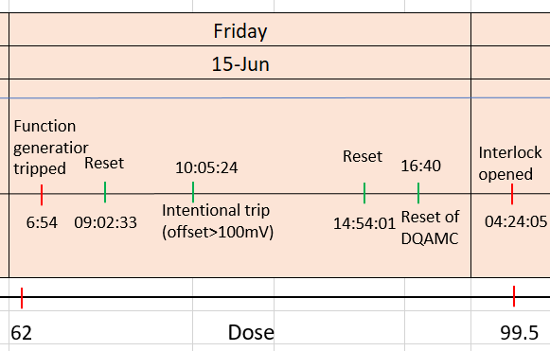

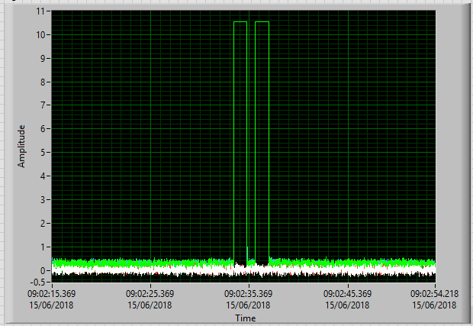
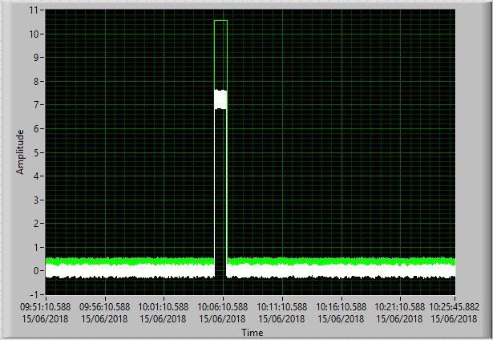
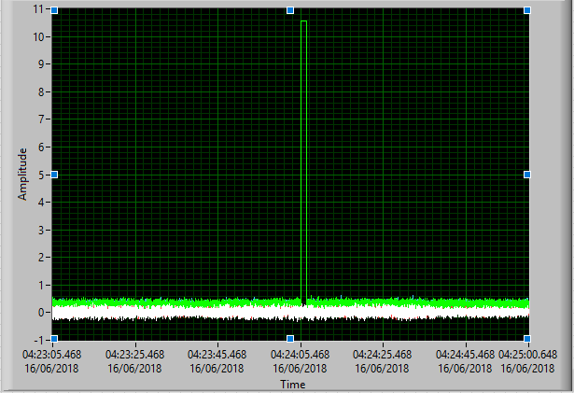
DQLPUBv2: Events Observed
Run 1 : June’2018
1
2
3
System reset → DQAMC resets DQQDL → DQAMC resets itself → DQAMC resets DQQDL → double pulse
Voltage difference between Vtaps > 100mV → interlock loop opening, heater firing
Loss of communication detected by DQAMC → DQAMC resets DQQDL → single pulse
Notes:
This figure is from run1.
On the left, we observe a interlock loop opening 2 times, lets call it double pulse. This happened when a reset command was given to the unit. It caused reset of DQQDL, DQAMC and DQQDL again causing 2 loop openings.
On the right, we see interlock loop opening one times, lets call it single pulse. This kind of event occurred when there was loss of worldfip communication. Detecting communication loss, DQAMC reset DQQDL causing a single loop opening. The issue with these pulse patterns was resolved after a firmware update of AMC.
Other than this, we triggered quench by providing an artificial threshold to the system. This caused the loop to open and heaters to fire. We see one of such event in center.

Slide 10
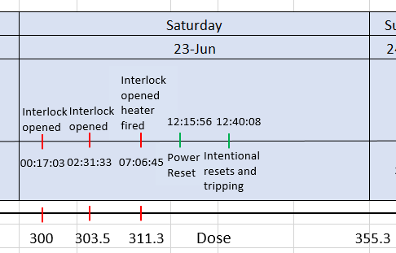
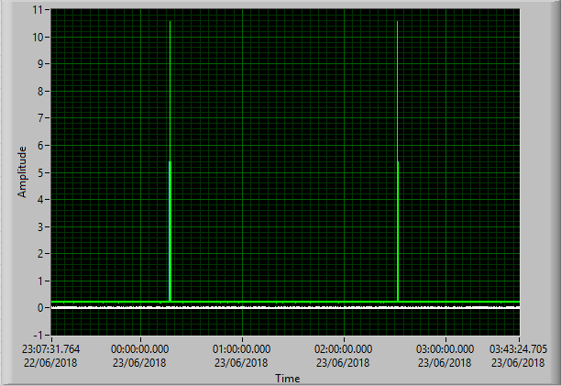
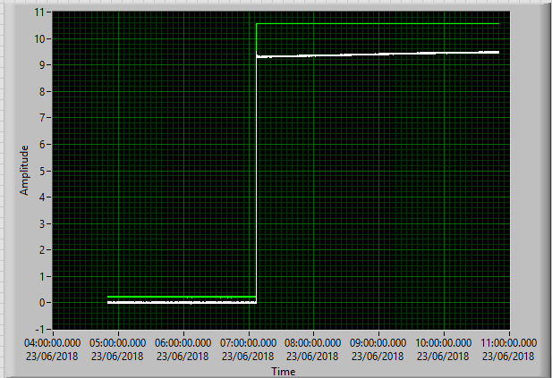
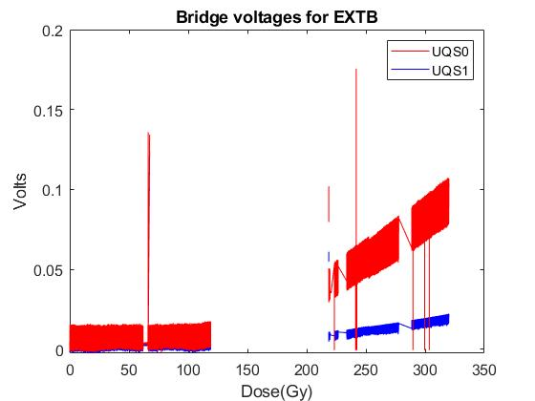
DQLPUBv2: Events Observed
Run 2 : June’2018
4
5
Loss of communication detected by DQAMC → DQAMC resets DQQDL → single pulse
Variation of reference voltage with radiation → change in bridge voltage → Automatic loop opening and heater firing
Notes:
This figure is from run2, where we saw the single pulses same as shown before.
We observed automatic firing of heaters and opening of interlocks at a dose of 310Gy. After analysing the data, it was known that a change of reference voltage with dose causes increase of channel offset which eventually appears as increased bridge voltage. As the bridge voltage crosses 100mV threshold, the system quenches.
A offset compensation scheme has now been implemented and was tested during second set of tests.
I would like to point out that AMC becomes unoperational at around 110Gy so we see the gap between the data presented.

Slide 11
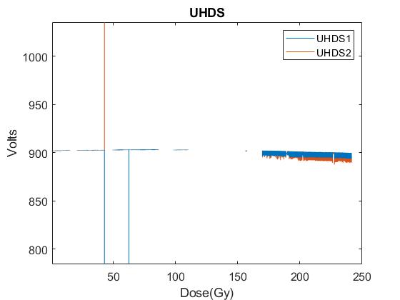
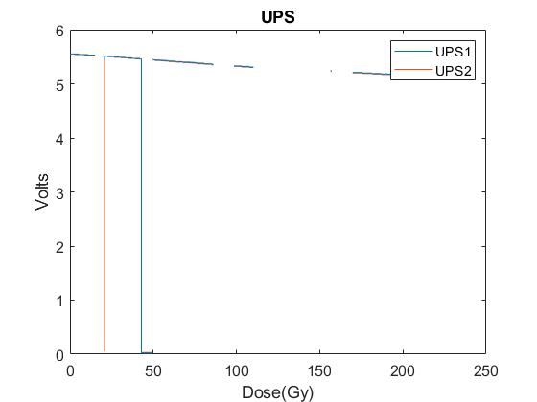
DQLPUBv2: Supply Monitors
Run 3 & Run 4 : Sep’2018
Run 3 & 4
UHDS showed gradual degradation and stayed close to 900V (±20V) till 240 Gy
UPS voltage shows slow decay through both runs
The breaks in the data are due to unavailability of WorldFIP data.
The pulses in the data correspond to power cycles.
Notes:
In this slide I am showing the results from supply monitors of DQCSU from run 3 and 4
UHDS showed gradual degradation in Run 3 and Run 4 with a variation of 2.2% (±20 V).
UPS showed consistent change with Dose and was above 5 V throughout the 2 runs.
The breaks in the data are due to unavailability of WorldFIP data.
The pulses in the data correspond to power cycles.

Slide 12
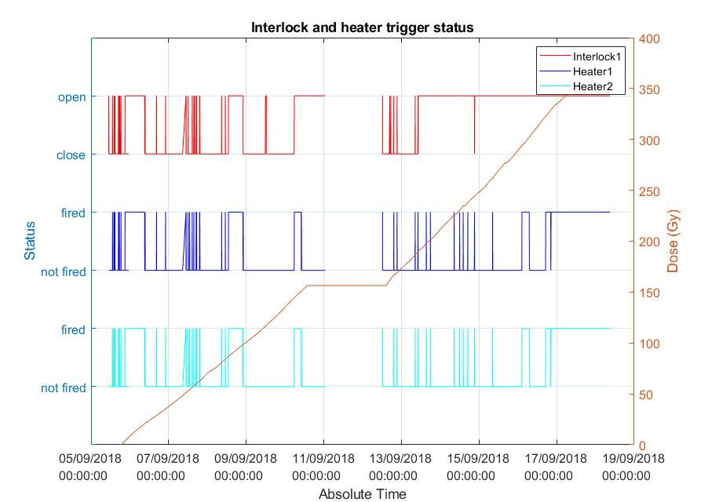
DQLPUBv2: Interlock and Heater Status
Run 3 & Run 4 : Sep’2018
Notes:
In run 3 & 4 we quenched the system many times to check its functionality at different dose of radiation. We did not observe any single or double pulse, and all loop openings were accounted for.

Slide 13
DQLPUBv2: Test Flow
Change of
mezzanine board
Firmware update
Built-in mezzanine
cards
DQQDLB
replacement
Run 1
Variation in UHDS
Run 2
Run 3
Variation in IHDS
Run 4
Variation in IHDS
Variation in IHDS
Single pulses
Double pulse
Variation in IHDS
Single pulses
Double pulses
DQQDLB failure due to isolator
DQQDLB failure due to op-amp
 | Configuration | Position | Target Inside | Target Outside | Dose [Gy] | Total POT
Run 1 | “CuOOOO” | 10 | 2018-06-13 | 2018-06-18 | 218.69 | 1.27E+16
Run 2 | “CuOOOO” | 10 | 2018-06-20 | 2018-06-25 | 229.25 | 1.64E+16
Run 3 | “CuOOOO” | 10 | 2018-09-05 | 2018-09-10 | 156.5 | 1.78E+16
Run 4 | “CuOOOO” | 10 | 2018-09-12 | 2018-09-17 | 197.22 | 1.47E+16
Notes:
So putting it in one slide, we had 4 runs for DQLPU in CHARM. We observed variation of IHDS, UHDS in run1, so changed the mezannin board and UHDS variation was eliminated. The single pulses and double pulses observed in Run 1 & 2 were not visible in last 2 runs after an update in firmware and change of DQCSU hardware. We observed DQQDLB failed in Run 3 due to failure of a digital isolator. The board was already detected with a non-functional isolator before deployment in CHARM. So afterwards we replaced it with another board and this one died due to a faulty op-amp. These 2 components however have been thoroughly tested in PSI and have proved to work just in previous designs.

Slide 14
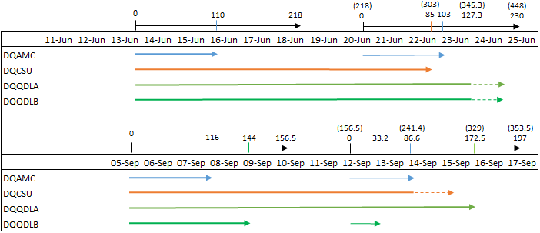
DQLPUBv2: Summary of Performance
Run 1
Run 2
Run 3
Run 4
DQAMC survives for 100 Gy on average, then it fails due to the microFIP IC
DQCSU works at least up to 241 Gy
DQQDL performs well up to 330 Gy
For Run 3 and Run 4, failure of DQQDLB was attributed to failure of one digital isolator and one op-amp respectively. However
  20 digital isolators used in DQLPU B unit, 1 failed out of 47 tested within Run 1-4;
  58 operational amplifier used in DQLPU B unit, 1 failed out of 140 tested within Run 1-4
Notes:
digital isolators: soldering performed just before test to replace a non-functional isolator
Operational amplifier: was one connected to input, more prone to SEUs

Slide 15
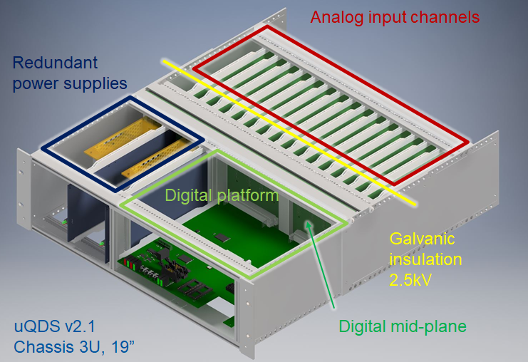
About UQDS
Located at RR73 / RR77
Expected annual dose: ~1 Gy/y
Target lifetime dose: 30 Gy
Notes:
The uQDS or universal Quench Detection System is a modular, versatile quench detection system developed to protect the superconducting elements. the unit is powered with redundant 5 V DC supplies generated by AC-DC converter boards. It consists of 16 galvanically insulated analog input channels and high speed, high resolution electronics to process these signals. It has an FPGA based board which can be custom programmed based on the protection requirements.
Due to the presence of radiation in some of the dedicated installation areas, the system is designed to be radiation tolerant up to about 1 Gy/a. In this test the unit was exposed to a mixed field of radiation with dose rate 1.5 Gy/h.

Slide 16
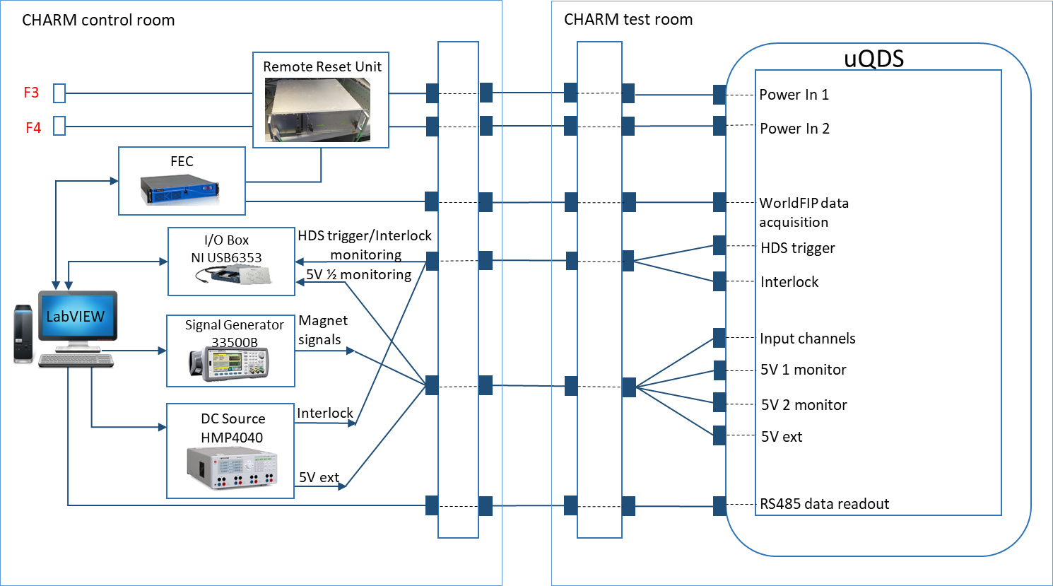
UQDS: Test Setup
 | Configuration | Position | Target Inside | Target Outside | Dose [Gy] | Total POT
Run 1 | “CuOOOO” | 10 | 2018-09-26 | 2018-10-01 | 247.7 | 1.98E+16
Notes:
Similar to DQLPU, we had setup of uQDS. Signals were supplied using remotely operable signal generator and power supply. Data was recorded using NI i/o box, WorldFIP and RS485 communication. We had 1 run of the test, all at position 10 and for 1 week. The total integrated dose amounted to 250 Gy.

Slide 17
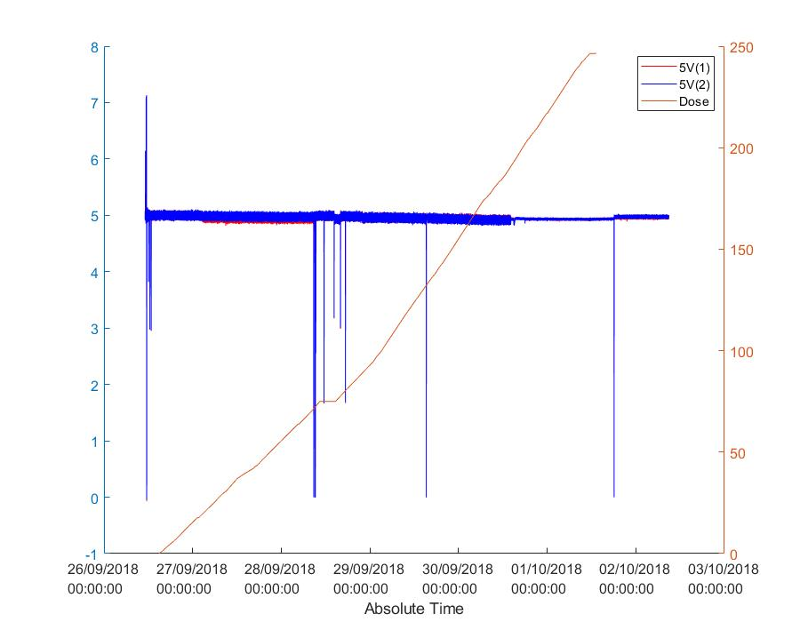
UQDS: Power supplies
Power cycle
Survived 250 Gy!

Slide 18
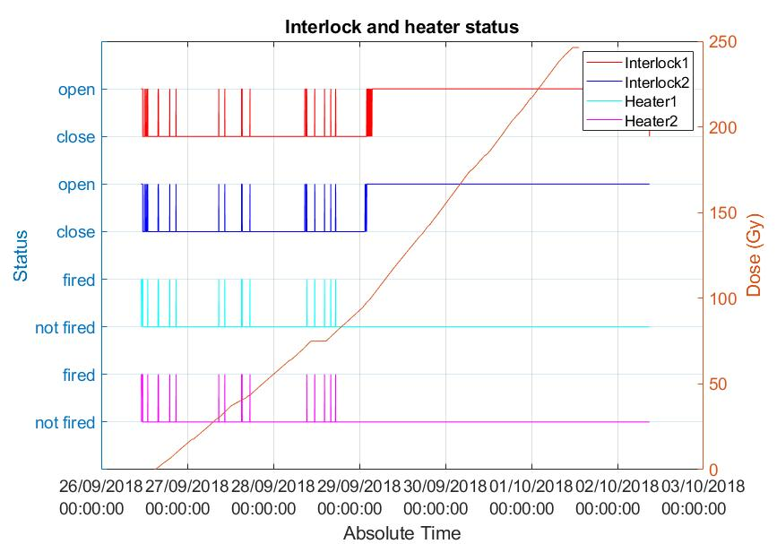
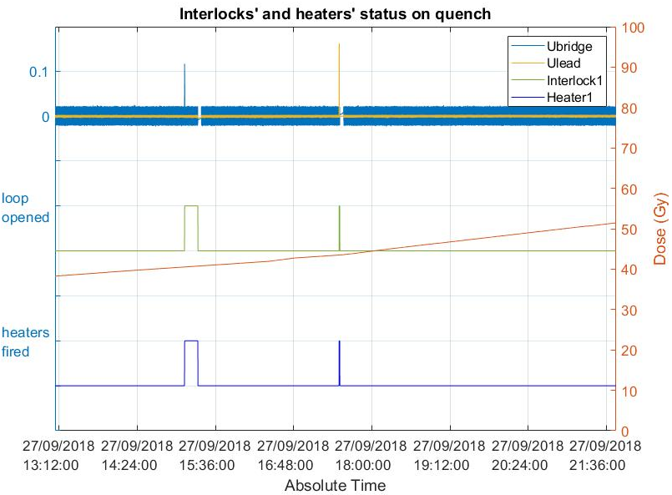
UQDS: Response
Responded to all stimuli up to 100 Gy !
Notes:
As in DQLPU, uQDS was also tested for its functionality at different dose of radiation and it responded well upto 100Gy. On the left I have shown all the events incurred. On the right we have the magnet and lead voltages causing loop opening and heater firing. No signals showed significant gain or offset variation.

Slide 19
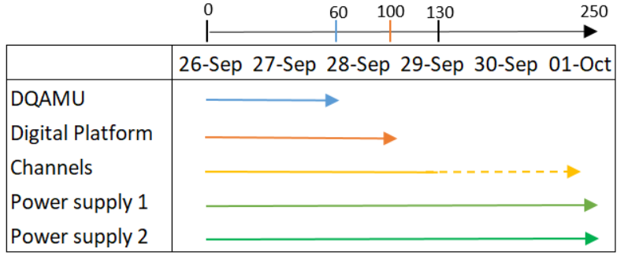
UQDS: Summary of Performance
WorldFIP communication functional till 60 Gy
At ~100 Gy Interlock loop opened and could not be closed, failure due to photoMOS
Analog channels worked well (at least) up to 130 Gy (RS485 reading was stopped at 130Gy, unable to resume at 250 Gy)
Power supplies survived 250 Gy!

Slide 20
Conclusions
392 DQLPUBv2 units and 4 UQDS units to be deployed in LS2
CHARM provides radiation environment similar to LHC but at higher rate
DQLPUBv2
  Expected total dose is 200 Gy
  4 weeks of irradiation campaigns, @1.5 Gy/hr
  Survives > 300 Gy with change of DQAMC
UQDS
  Expected total dose is 30 Gy
  1 weeks of irradiation campaigns, @1.5 Gy/hr
  Survives > 100 Gy with change of DQAMU
  More research on photoMOS required

Slide 21

Thank you !

