Slide 2

Activities of the
Monitoring Calculation Working Group (MCWG), from dedicated user requests to online radiation monitoring
MCWG
Oliver Stein EN-EA-PE
K. Bilko, R. Garcia Alia, Y. Kadi, G. Lerner, C. Martinella

Slide 3
Activities of the MCWG
Service
Operations
Optimisation
User Requests
Online Monitoring
Internal Projects
Dedicated analysis of radiation levels at specific positions requested by the users.
Reports and
requirements how to proceed.
Monitoring the
day to day operation with standardised analysis routines.
Notifications in case of unusual radiation
level evolution or distribution.
Implementation of automated analysis for standardised routines.
Reduction of response time for user requests.

Slide 4
MCWG Request Work Flow
Users
MCWG
MCWG
Equipment groups
Request tracking with JIRA
Assessment of available data sources
  BLMs, RadMons, etc.
Identification of important parameters
    Luminosities, intensities, collimator settings
Dedicated analysis
MCWG internal assessment
Contacting involved groups
Communication with user
MCWG Meeting
Fluka team
Presentation of results
Radiation report
Requirement and recommendations on how to proceed
Discussion with Users
Feedback
Operations
HL-LHC
many more …
Requests to: mcwg-request@cern.ch

Slide 5
MCWG User requests
Examples
Impact of collimator openings around ATLAS and CMS on the dose distribution in the dispersion suppressors and the adjacent RR, LHC
Radiation measurements in IP7, test electronics for new BPM system, LHC
Dose estimations in the transfer lines TI2 and TI8, SPS - LHC
Radiation measurements in 416 and 616, installation of detectors requested, SPS
Dose calculations in PS injection region for future pin diode installation, PS
Radiation levels on the BTV cameras after LS2, PSB
…

Slide 6
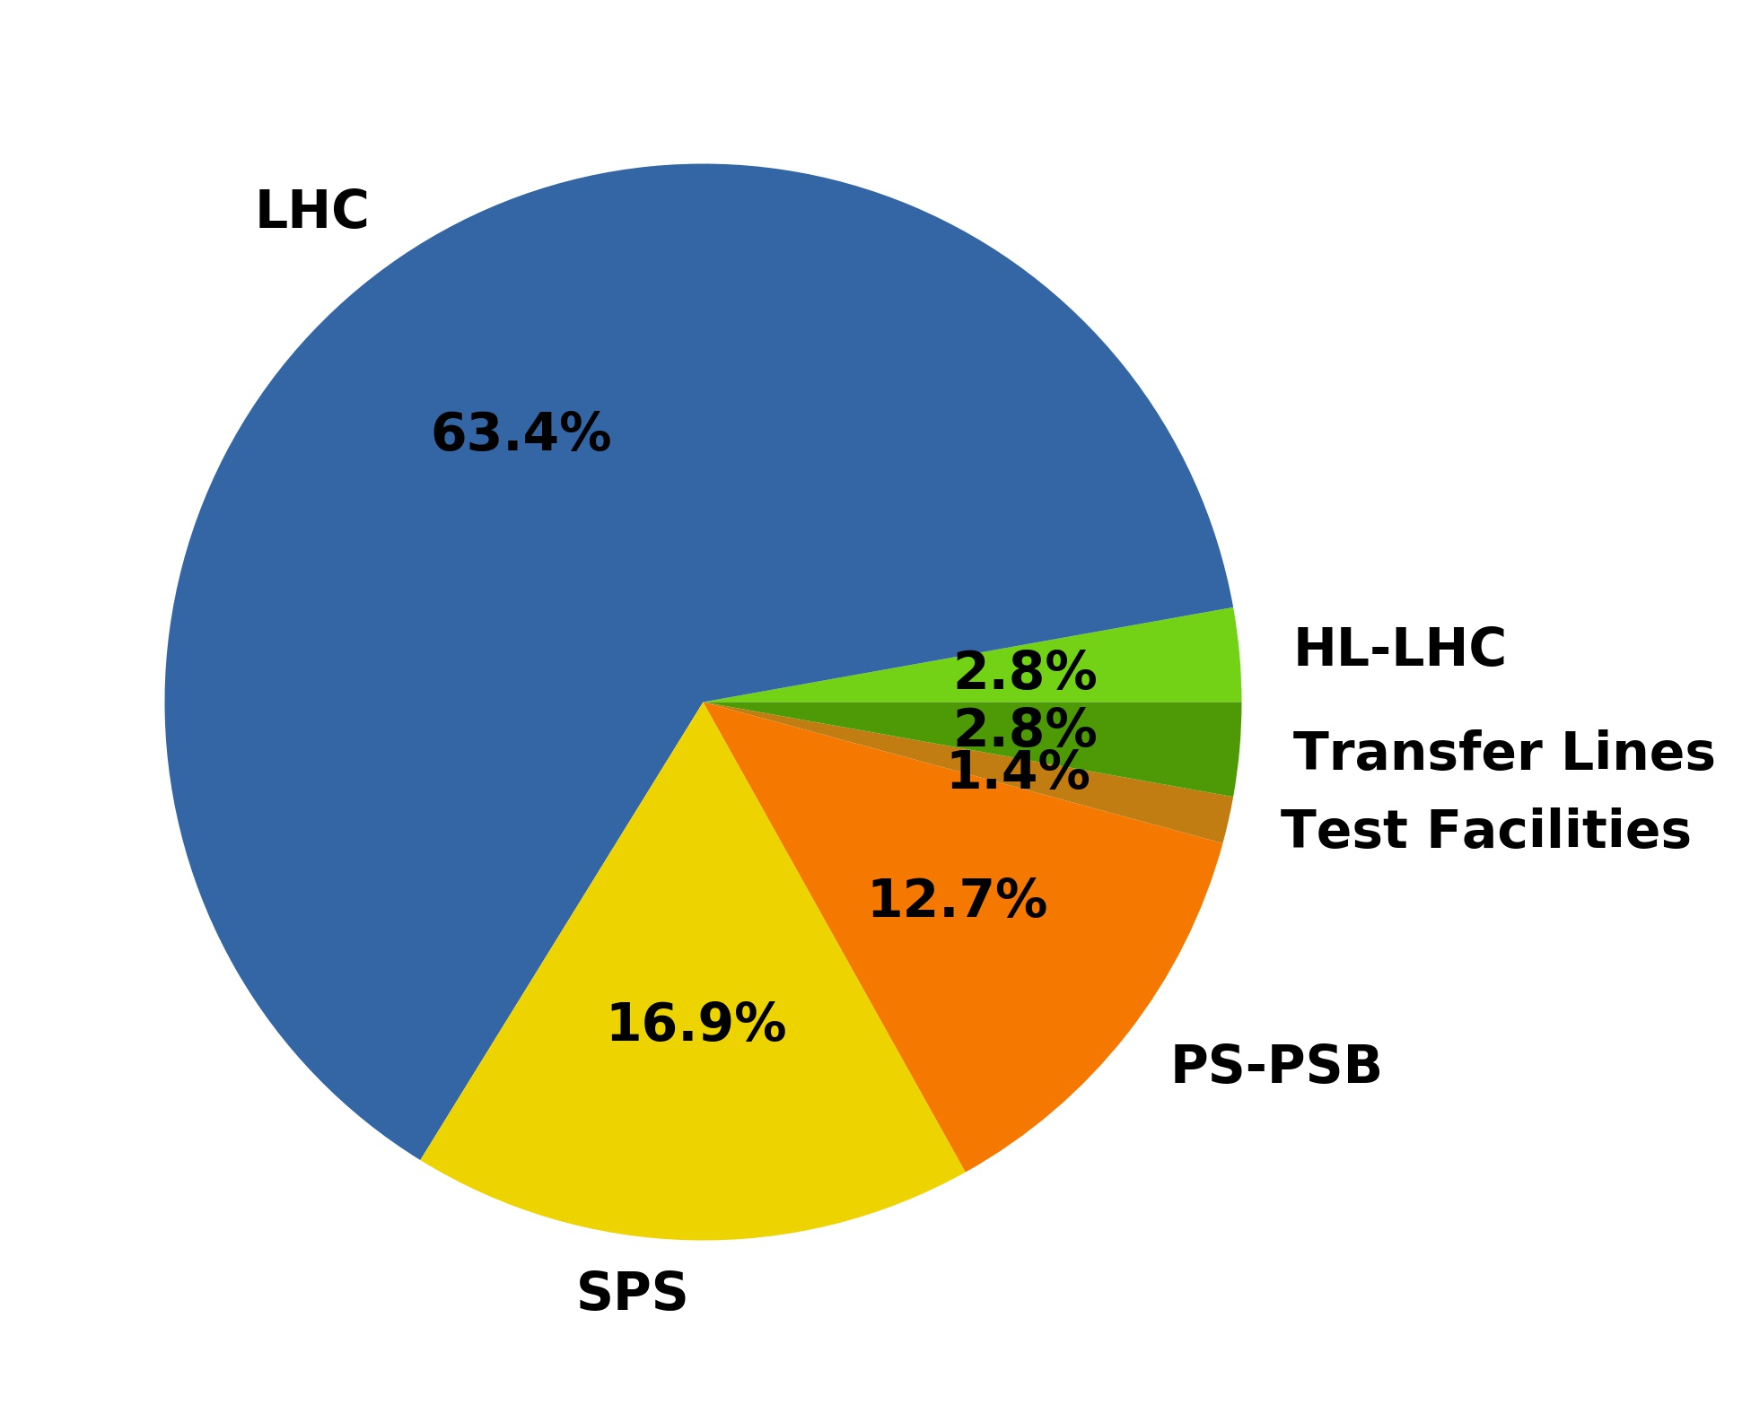
MCWG User requests
LHC
In Run 2: > 70 User requests
Majority concerning the LHC.
Request for injectors are increasing.
MCWG
Location | Requests (#) | Percentage
LHC | 45 | 63.4
SPS | 12 | 16.9
PS-PSB | 9 | 12.7
Transfer Lines | 2 | 2.8
HL-LHC | 2 | 2.8
Test Facilities | 1 | 1.4
SPS
Results presented and discussed
in 36 MCWG meetings.

Slide 7
Day to day monitoring following the accelerator operations
Goal: Monitoring the distribution and evolution of the radiation fields
along the accelerators “online” close to the accelerator operation.
General and request independent radiation monitoring
Analysis of the general radiation field structures
Base line values
Radiation maxima
Impact of changes of accelerator and beam parameters
Identifying irregular radiation levels
Assessing potential risks
Informing the users and equipment groups

Slide 8
Day to day monitoring following the accelerator operations
Challenge: More than 40 km of accelerators and beam lines to cover!
Very different radiation environments!
Use of different radiation sensors:
Active sensors: BLMs, RadMons, Fibres
Passive sensors: BatMons, RadFets, RPLs, Fibres
Data sources:
CERN logging data bases: active monitors
Equipment groups: passive monitors
Huge data sets require standardised data handling and analysis routines
LHC annual TID:
  Arcs: < 100 mGy
  IRs(max): > 100 kGy

Slide 9
Day to day monitoring following the accelerator operations
First steps: Online radiation monitoring of the
LHC dose distribution since 2018.
Analysis of the BLM data sets and additional beam parameters!*
Analysis of more than 3500 BLMs
Online radiation monitoring requires automated data handling and analysis routines
Standardised analysis routines allow the direct comparison of recent data sets with radiation data from previous years.
Online monitoring results regularly presented and discussed in the monthly MCWG meetings.
IR7: 2018 normalised radiation levels factor 2-3 above the levels during previous years.
Beta* and crossing angle leveling impacting on the radiation levels in the collimation regions.
* Handling and analysis of radiation data sets, the advantages of automised calculations and
fast accessibility of radiation measurements, K. Bilko

Slide 10
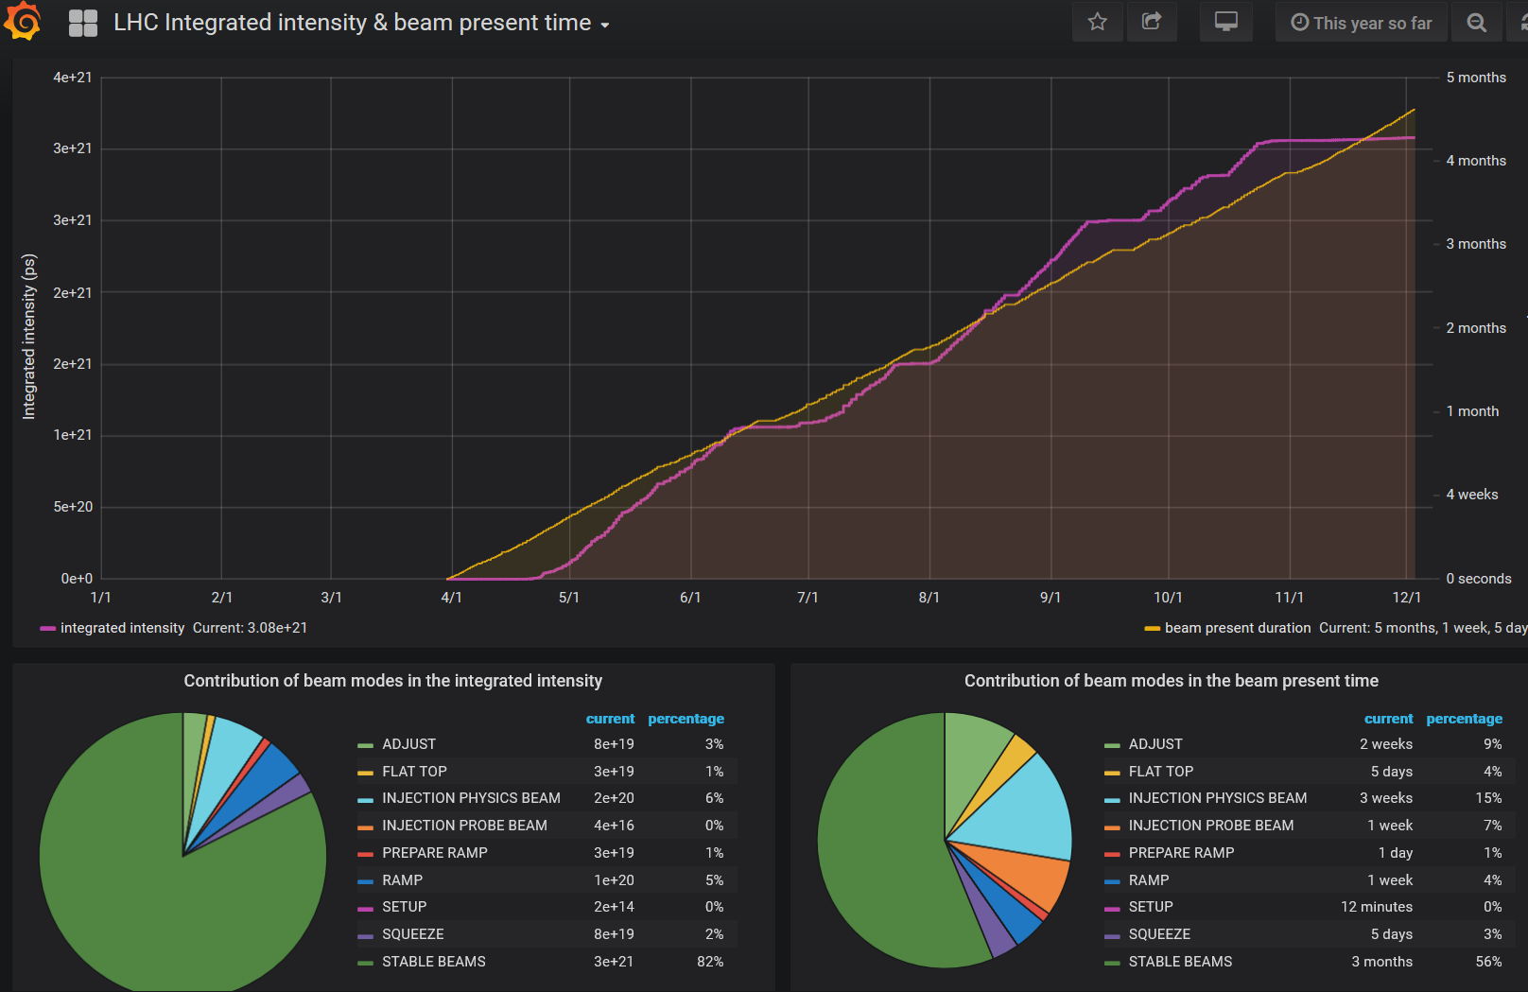
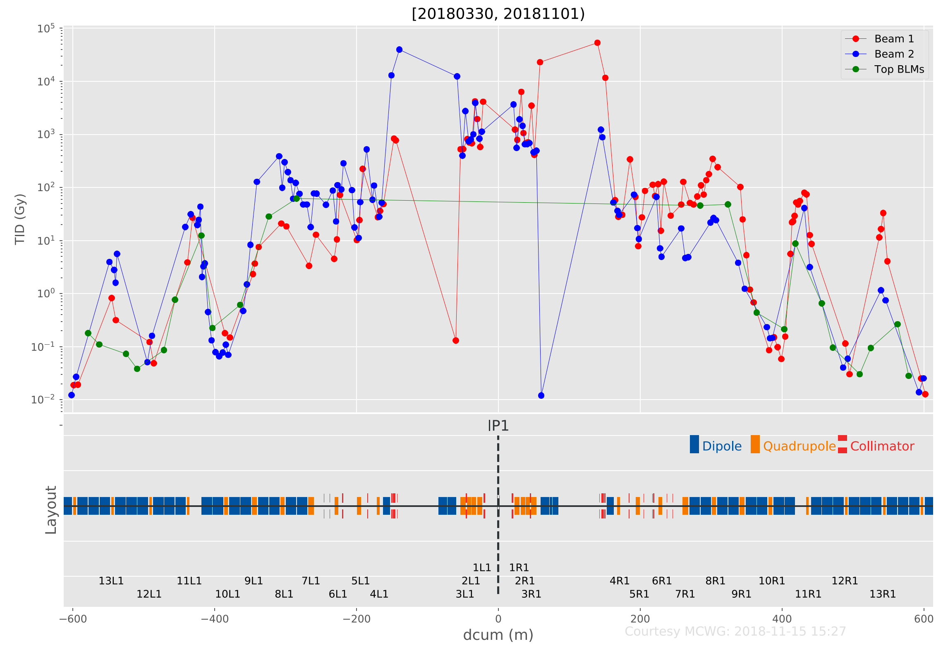
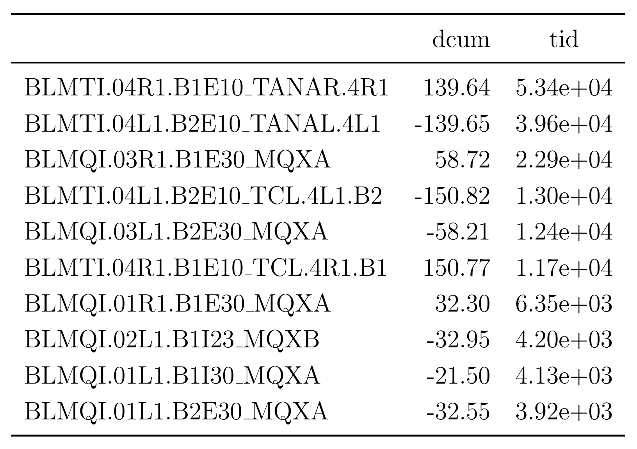
Day to day monitoring following the accelerator operations
Analysed data accessible via dash boards and publication of daily reports.
Creation of automated
radiation reports
Evolution
Distribution
Intensities
Luminosities
Listing Top10 hottest BLMs
Dose distribution in IR1
Using Grafana dash boards for quick data access
Manual checks on TID/ intensity evolution
MCWG

Slide 11
Advantages of the online radiation monitoring
Continuous analysis of the evolution of the radiation distributions.
Structured data handling and development of analysis routines ease user requests.
By including the data sets from previous years of accelerator operations,
changes due to different accelerator operations can be analysed easily.
Current status:
MCWG radiation monitoring database
LHC BLM data 2012 – 2018
LHC RadMon data 2018, partial
Analysis of the radiation levels in the LHC arcs show a decrease of the annual doses between 2015 and 2017.
Based on the dose rates the vacuum conditions in the LHC arcs can be estimated.*
.
* Master Thesis of Kacper Bilko, MCWG (in preparation)

Slide 12
Future projects and plans for the MCWG
Long Shutdown 2 activities:
Implementing ALL radiation data sets into the MCWG database infrastructure
allowing fast and more detailed analysis of the radiation fields
  BLMs, BatMons, RadFets, RPLs, Fibres, RP-Surveys
Adaptation of the MCWG tools to the Run 3 infrastructure
Run 3 activities:
Monitoring the radiation distributions during the accelerator operation after the shutdown
  Providing regular reports on the radiation levels
  LHC, SPS, PS, PSB, transfer lines and experiments
  Reacting to dedicated requests

Slide 13
Conclusion
MCWG extends its activities: User requests + Online monitoring of the radiation levels
Optimisation of the data handling and analysis
→ Online monitoring of the radiation levels and much faster response to user requests
Daily radiation reports following the accelerator operations
Monitoring the radiation levels along CERN’s accelerator complex requires
a general and automated approach
Automated monitoring of the LHC dose levels has proven to be very useful
MCWG provides valuable input for other working and equipment groups
Future: LS2 and Run3
Creating a general MCWG radiation measurement data base including all available data sets
Radiation Monitoring Run 3: New radiation environments after LS2 need to be understood
MCWG

Slide 14
Thank you for your attention!
MCWG

