Slide 2


Handling and analysis of radiation data sets, the advantages of automated calculations and fast accessibility of radiation measurements
Kacper Bilko
(EN-EA-PE, Monitoring and Calculation Working Group)

Slide 3
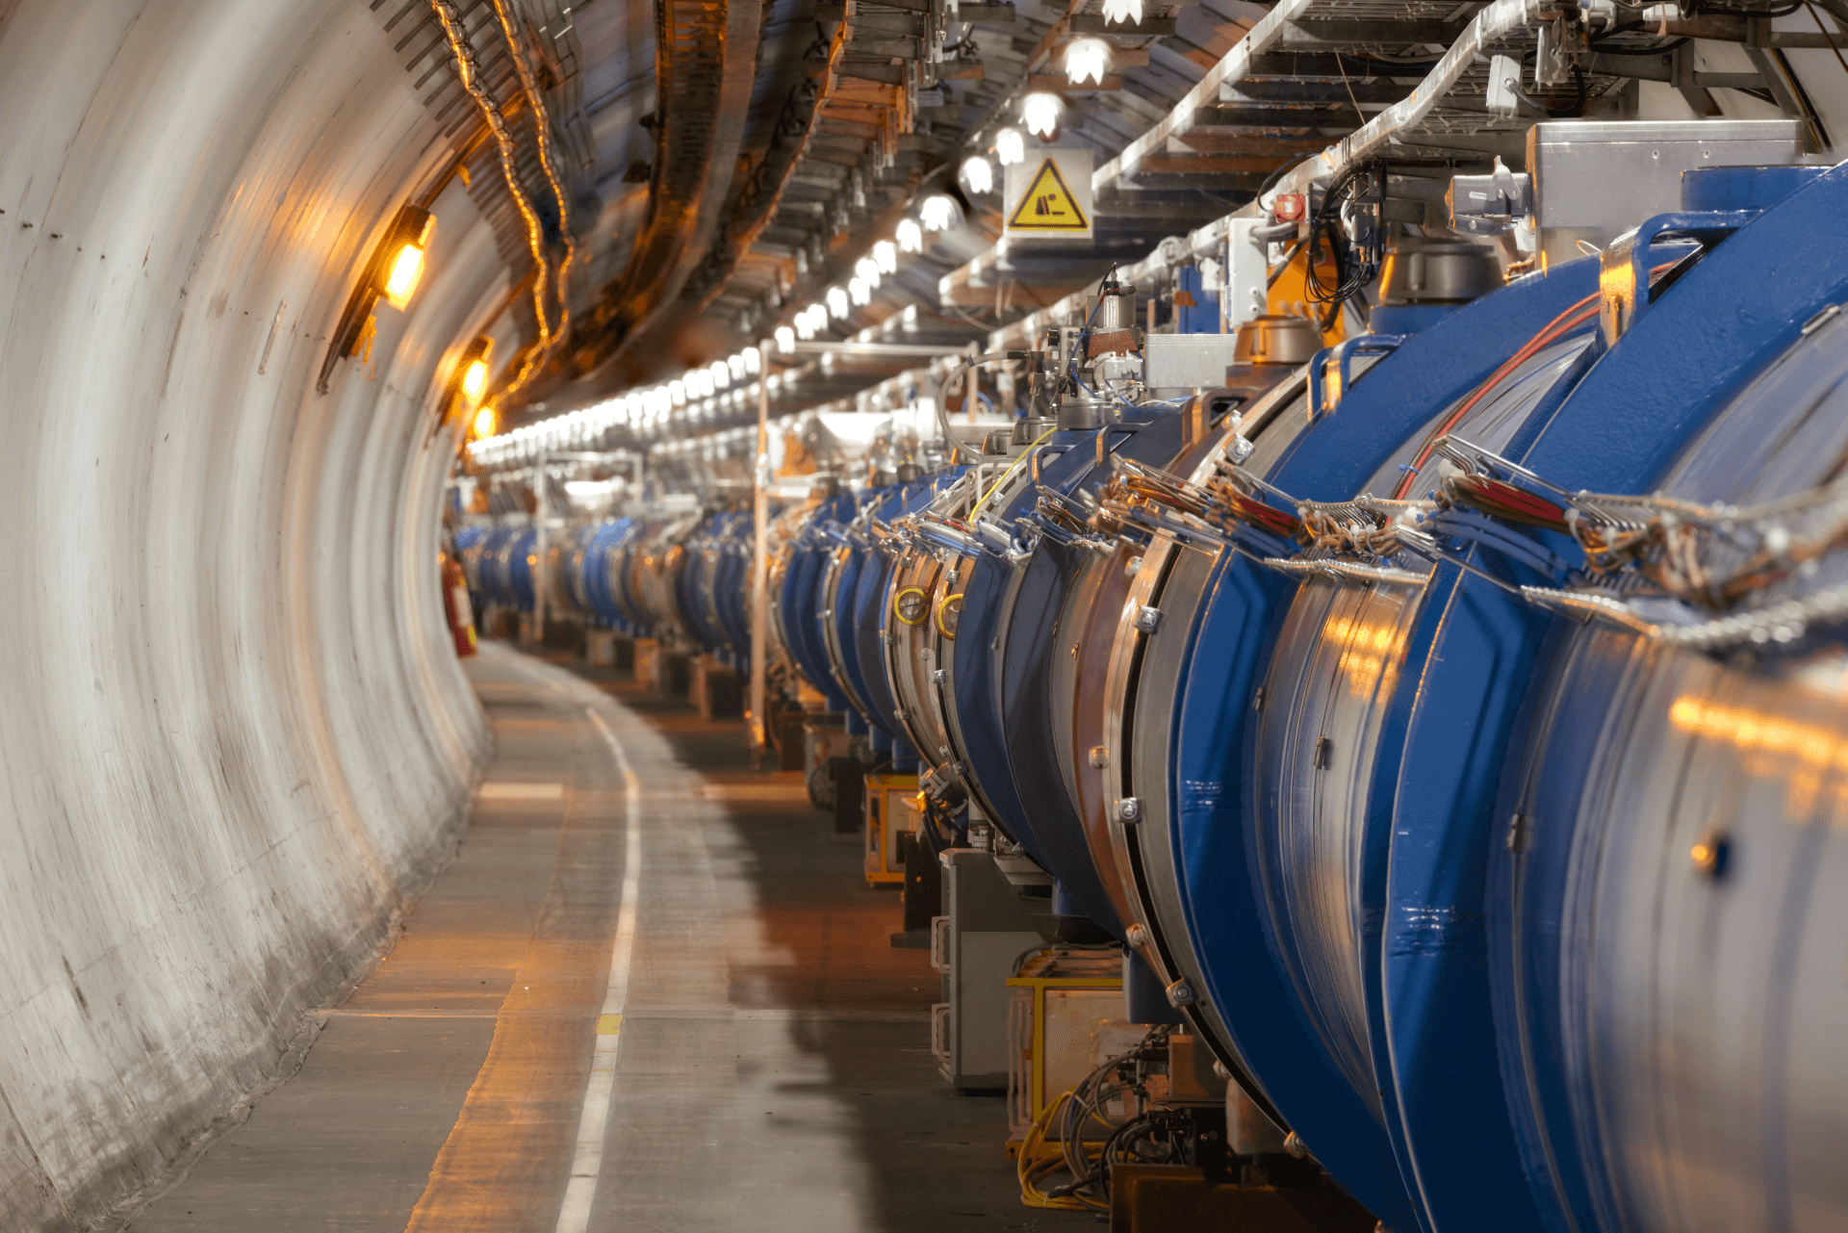
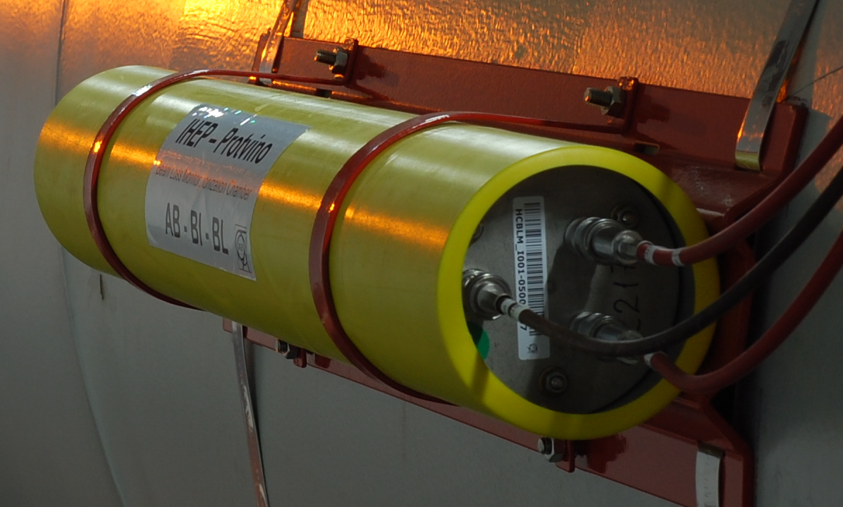
Dose detection and analysis (LHC BLMs)
LHC parameters
Losses
Accelerator operation leads to continuous slight losses, thus the radiation.
Dose rate from CALS
MCWG’s analysis
Ionising radiation is detected by Beam Loss Monitoring system.
Although it is not the primary purpose, can be used as distributed dosimetry system
...
Other input

Slide 4
Dose detection and analysis (LHC BLMs)
Data from >3500 BLMs used →
HUNDREDS OF GB
of data to analyse
LHC parameters
Losses
Accelerator operation leads to continuous slight losses, thus the radiation.
Dose rate from CALS
MCWG’s analysis
Ionising radiation is detected by Beam Loss Monitoring system.
Although it is not the primary purpose, can be used as distributed dosimetry system
...
Other input

Slide 5

Limitations in the past…
Every radiation request handled manually
→ slow, time-consuming
Slow access to CERN Accelerator Logging Service (CALS) via Timber
Timber → processing (i.e. “excel”) → results
Usage of the non-offset corrected data
→ BLM beam-not-present baseline contribution to the dose
So sluggish!
Took ages to obtain results
Download hourly integrated data via Timber (manually)
Summing
Providing the results
Overestimations for low dose environments
(ARC sections)

Slide 6
Limitations in the past…
Manual, slow, time-consuming, inconsistent
Not efficient!
Reliable analysis impossible…
How to
improve it?
The only solution: AUTOMATION
Every radiation request handled manually
→ slow, time-consuming
Slow access to CERN Accelerator Logging Service (CALS) via Timber
Timber → processing (i.e. “excel”) → results
Usage of the non-offset corrected data
→ BLM beam-not-present baseline contribution to the dose
So sluggish!
Took ages to obtain results
Download hourly integrated data via Timber (manually)
Summing
Providing the results
Overestimations for low dose environment
(ARC sections)

Slide 7






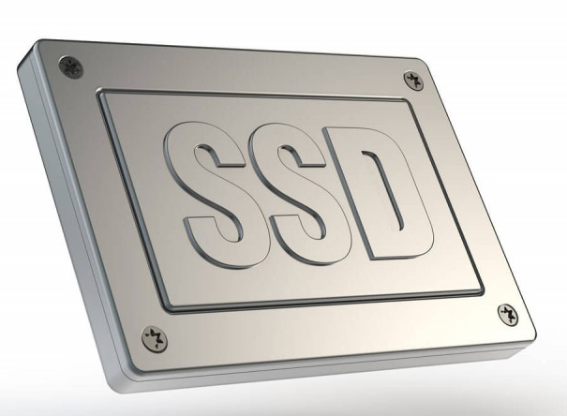



How to automate?
Physics
Ideas
Algorithms
Software
Technologies
Developed tools
Hardware
Automation

Slide 8

Automation of the analysis
Data downloading
Data processing
Data analysis
BLM data from CALS
Offset correction
Integration
Data filtering
Beam modes contribution
Daily downloading
Data saved to the local database (DB) ensure rapid access,
General
Dedicated
  Online dashboard
  Daily PDF reports
  Annual doses for all BLMs with BM contribution
  Anomalies:
    Identification
    Monitoring
  User requests
Fully automated

Slide 9
Data downloading
Daily basis
Download accelerator parameters
Save to local DB
Save to rapid and efficient local database → cross platform,
Download BLM data
LOSS_RS12 (dose rate averaged over ~ 84 s integration time)
From ~3600 BLMs
Intensities
Beam modes
Beam present flags
Different accelerator parameters (fill number, ...)
Easy access by all MCWG users → no need to store or download data on multiple workstations,
Not only automated,
But also parallelised

Slide 10
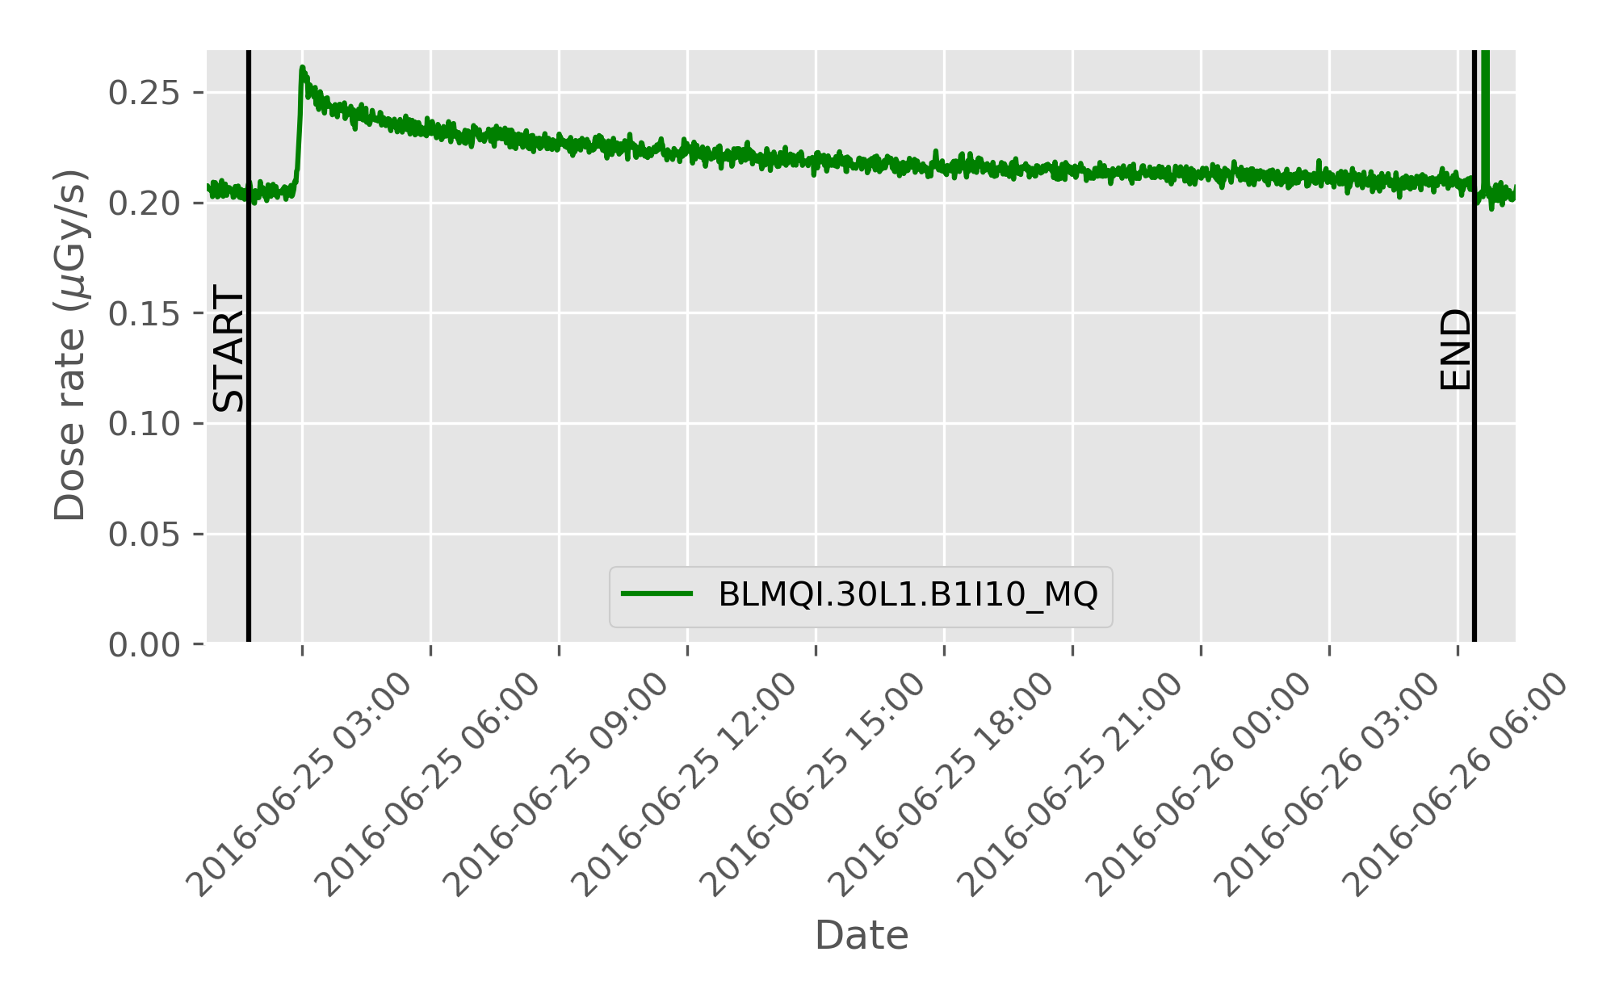
Data processing
34 188 296
BLM intervals in the DB
Data filtering
Offset correction
Save to local DB
Consider periods only when beam was in the LHC (interval)
Offsets, fill-by-fill doses, BM contributions, times are saved to DB
Integration
Each BLM separately,
Fill-by-fill basis,
Besides integration, calculate contribution of different beam modes,
Subtract beam-not-present baseline from the data.

Slide 11
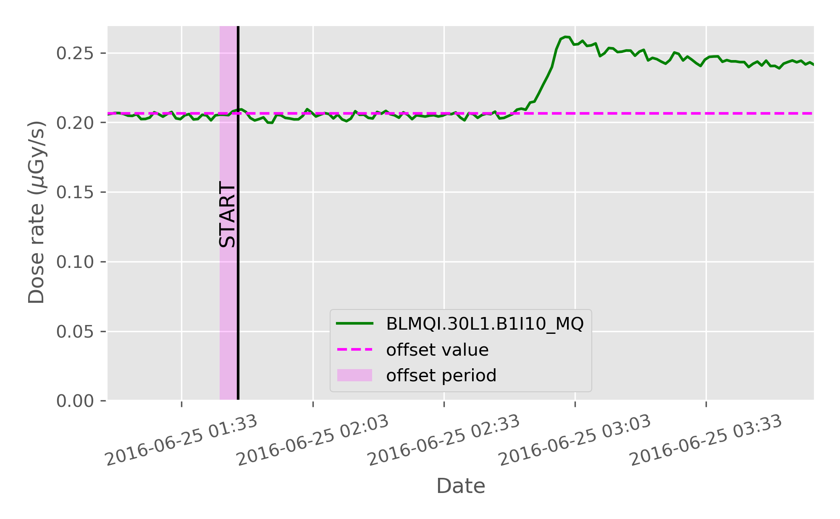
Data processing
Data filtering
Offset correction
Save to local DB
Consider periods only when beam was in the LHC (interval)
Offsets, fill-by-fill doses, BM contributions, times are saved to DB
Integration
Each BLM separately,
Besides integration, calculate contribution of different beam modes,
Fill-by-fill basis,
Subtract beam-not-present baseline from the data.
No beam
Beam present

Slide 12
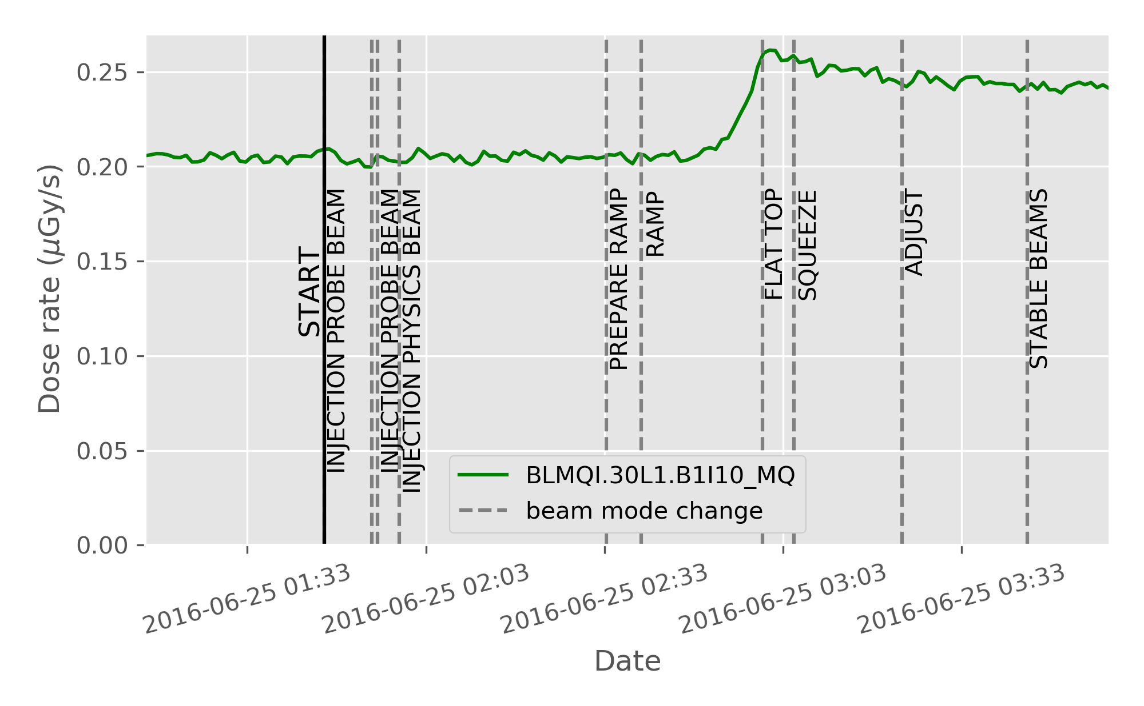
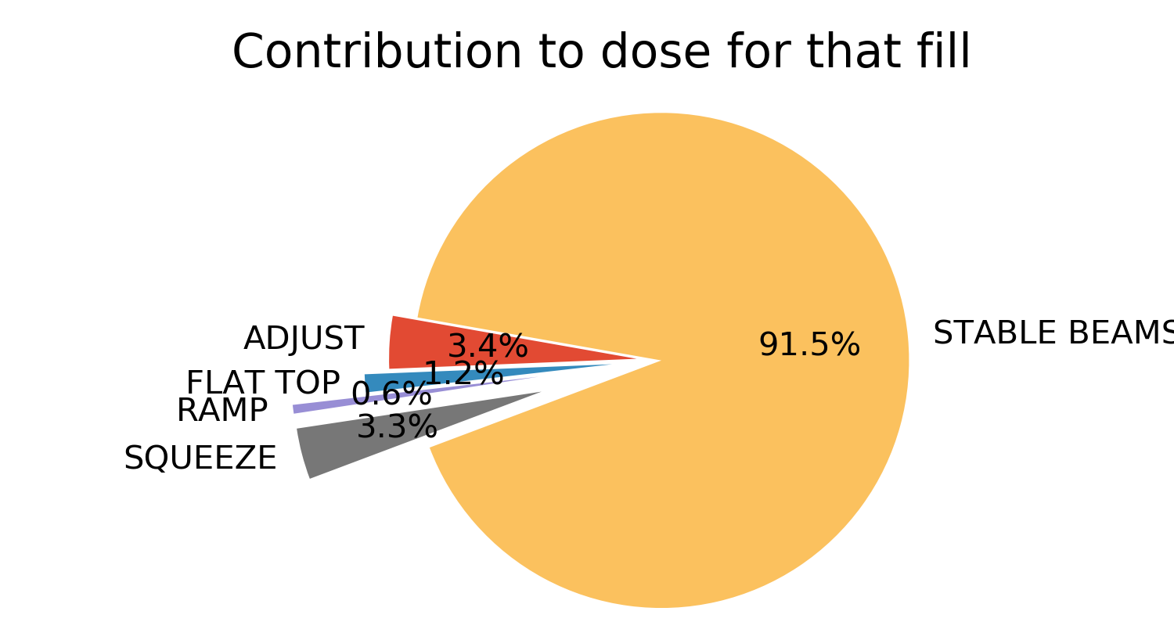
Data processing
Data filtering
Offset correction
Save to local DB
Consider periods only when beam was in the LHC (interval)
Offsets, fill-by-fill doses, BM contributions, times are saved to DB
Integration
Each BLM separately,
Fill-by-fill basis,
Besides integration, calculate contribution of different beam modes,
Subtract beam-not-present baseline from the data.
100 328 374
BLM subintervals in the DB

Slide 13
Data processing
Data filtering
Offset correction
Save to local DB
Consider periods only when beam was in the LHC (interval)
Offsets, fill-by-fill doses, BM contributions, times are saved to DB
Integration
Each BLM separately,
Fill-by-fill basis,
Besides integration, calculate contribution of different beam modes,
Subtract beam-not-present baseline from the data.
Daily basis
Not only automated,
But also parallelised

Slide 14
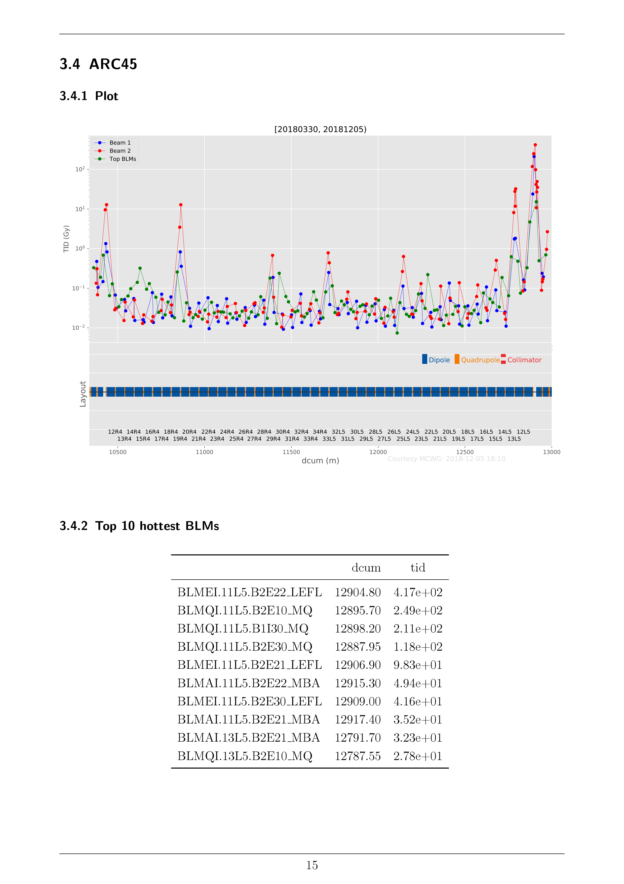
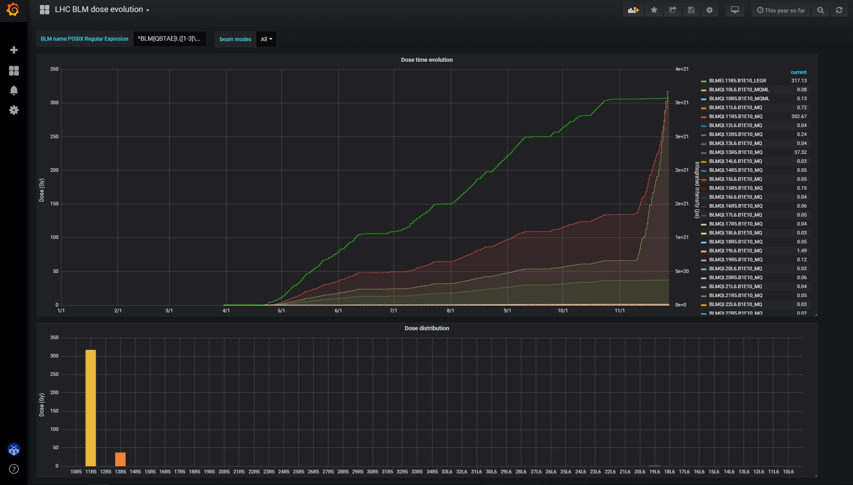
Data analysis → results
Online Monitoring Dashboard
Daily radiation reports
Mission impossible without
full automation!!!

Slide 15
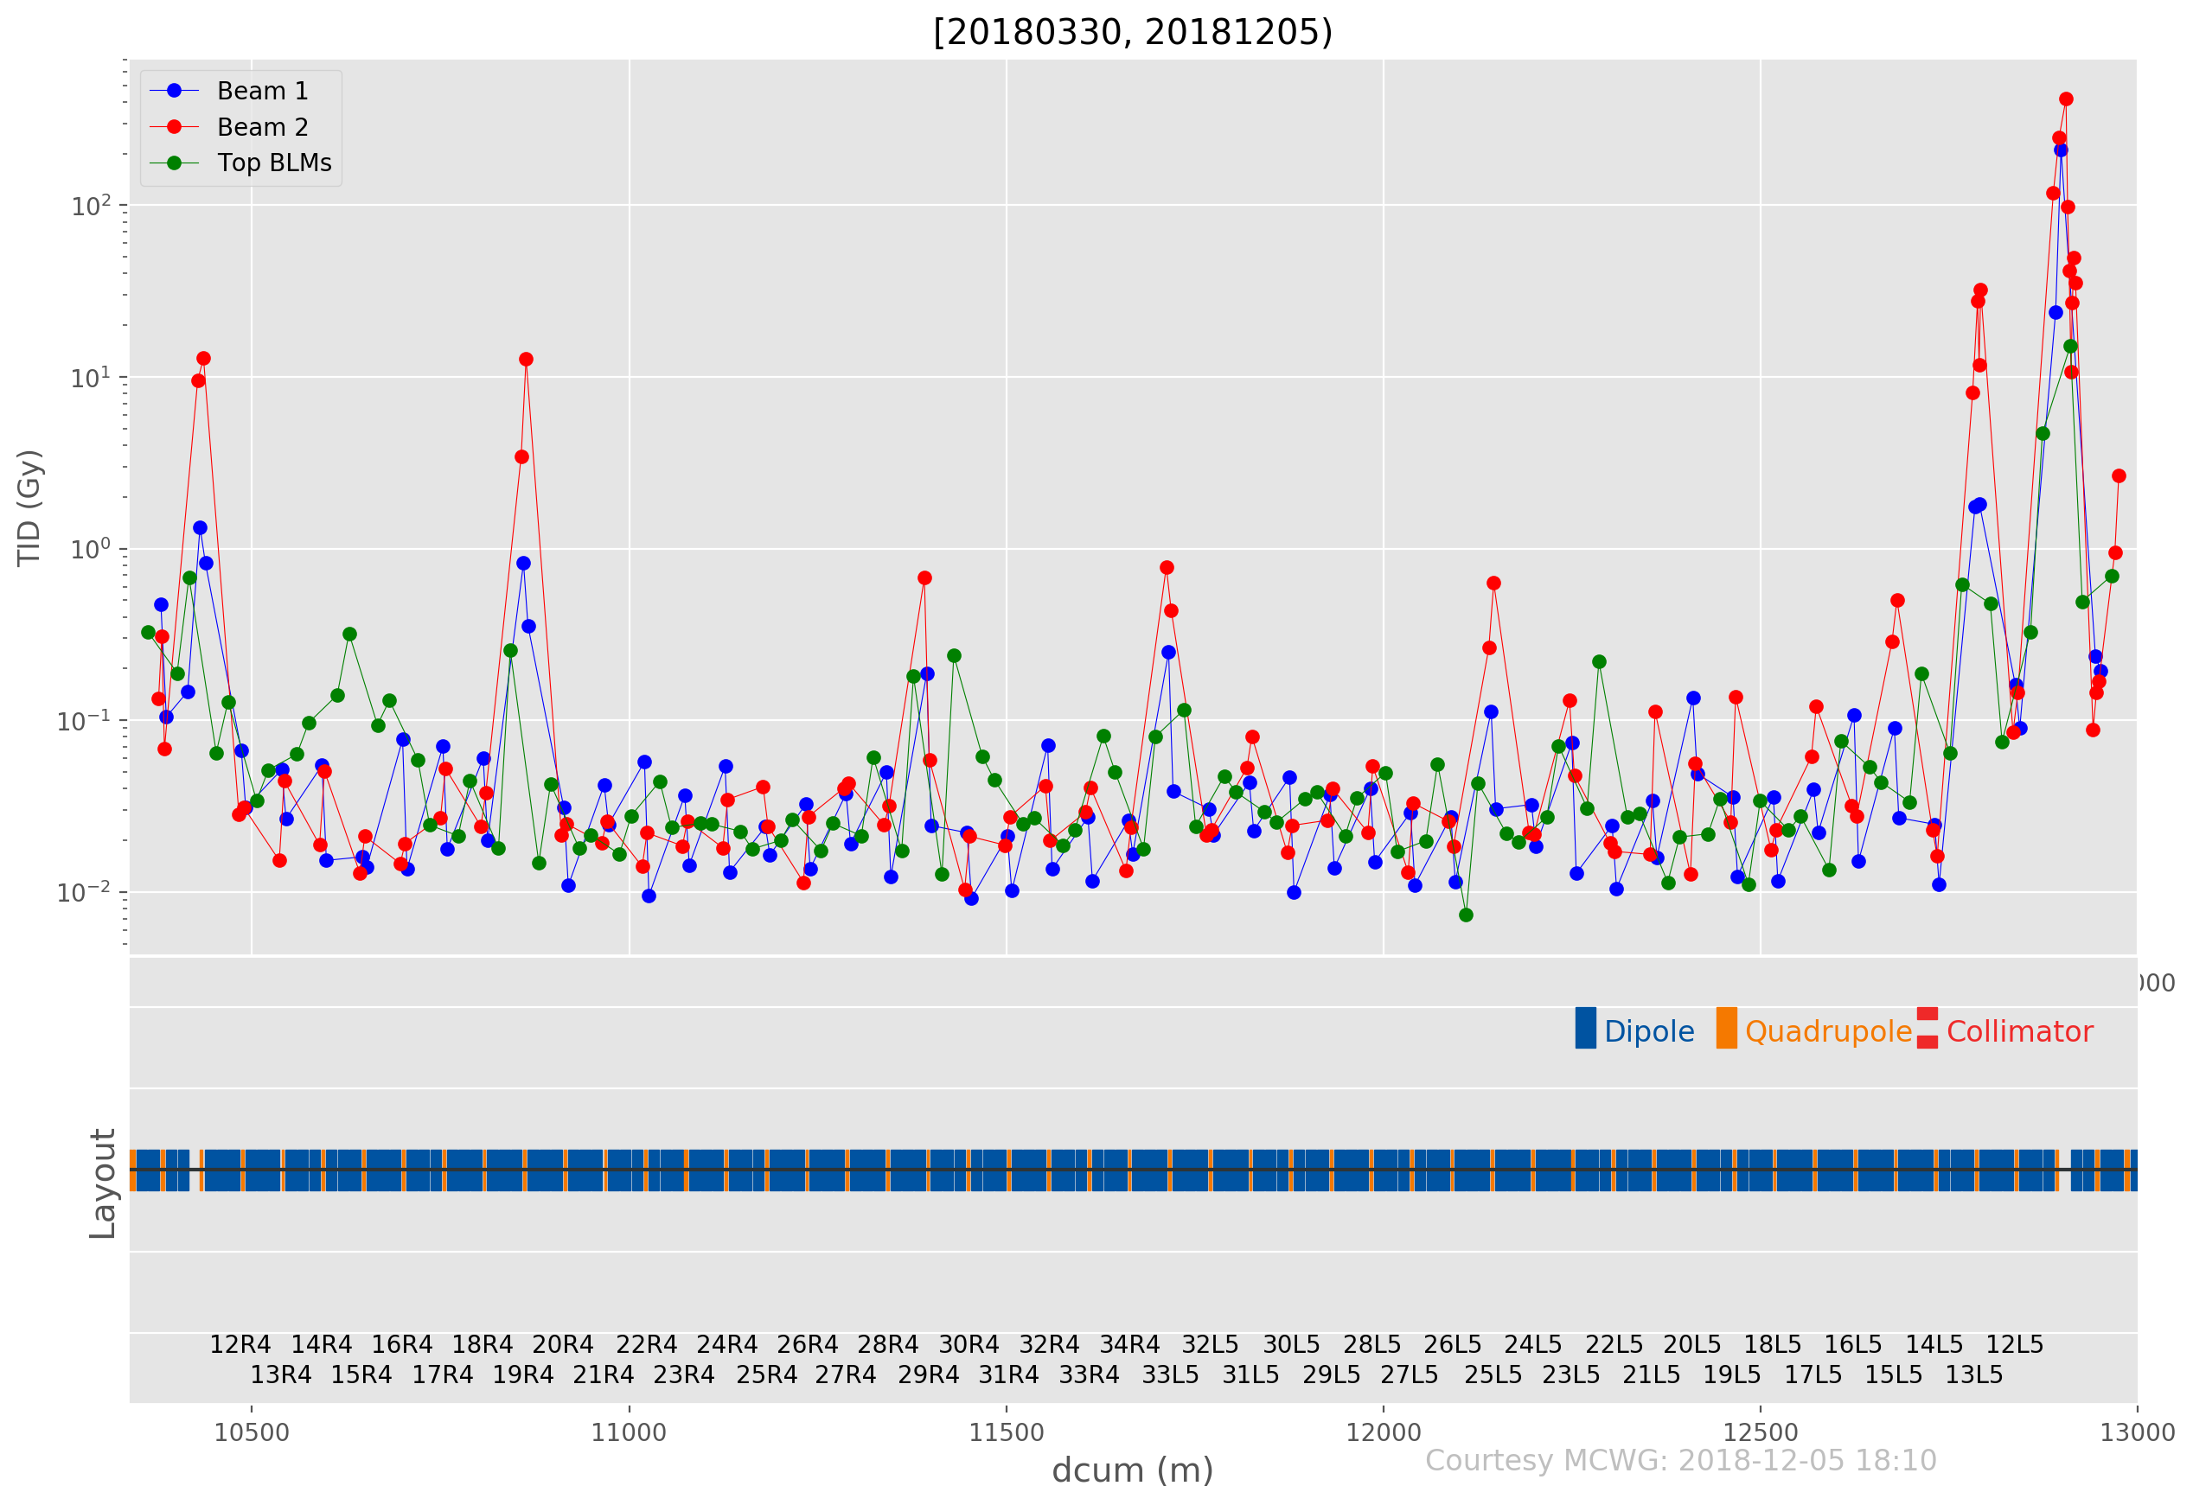
Example: daily report - ARC 45, 2018
Anomalies
(“spikes”)
Baselines¹
¹ 6 baselines for each ARC section

Slide 16
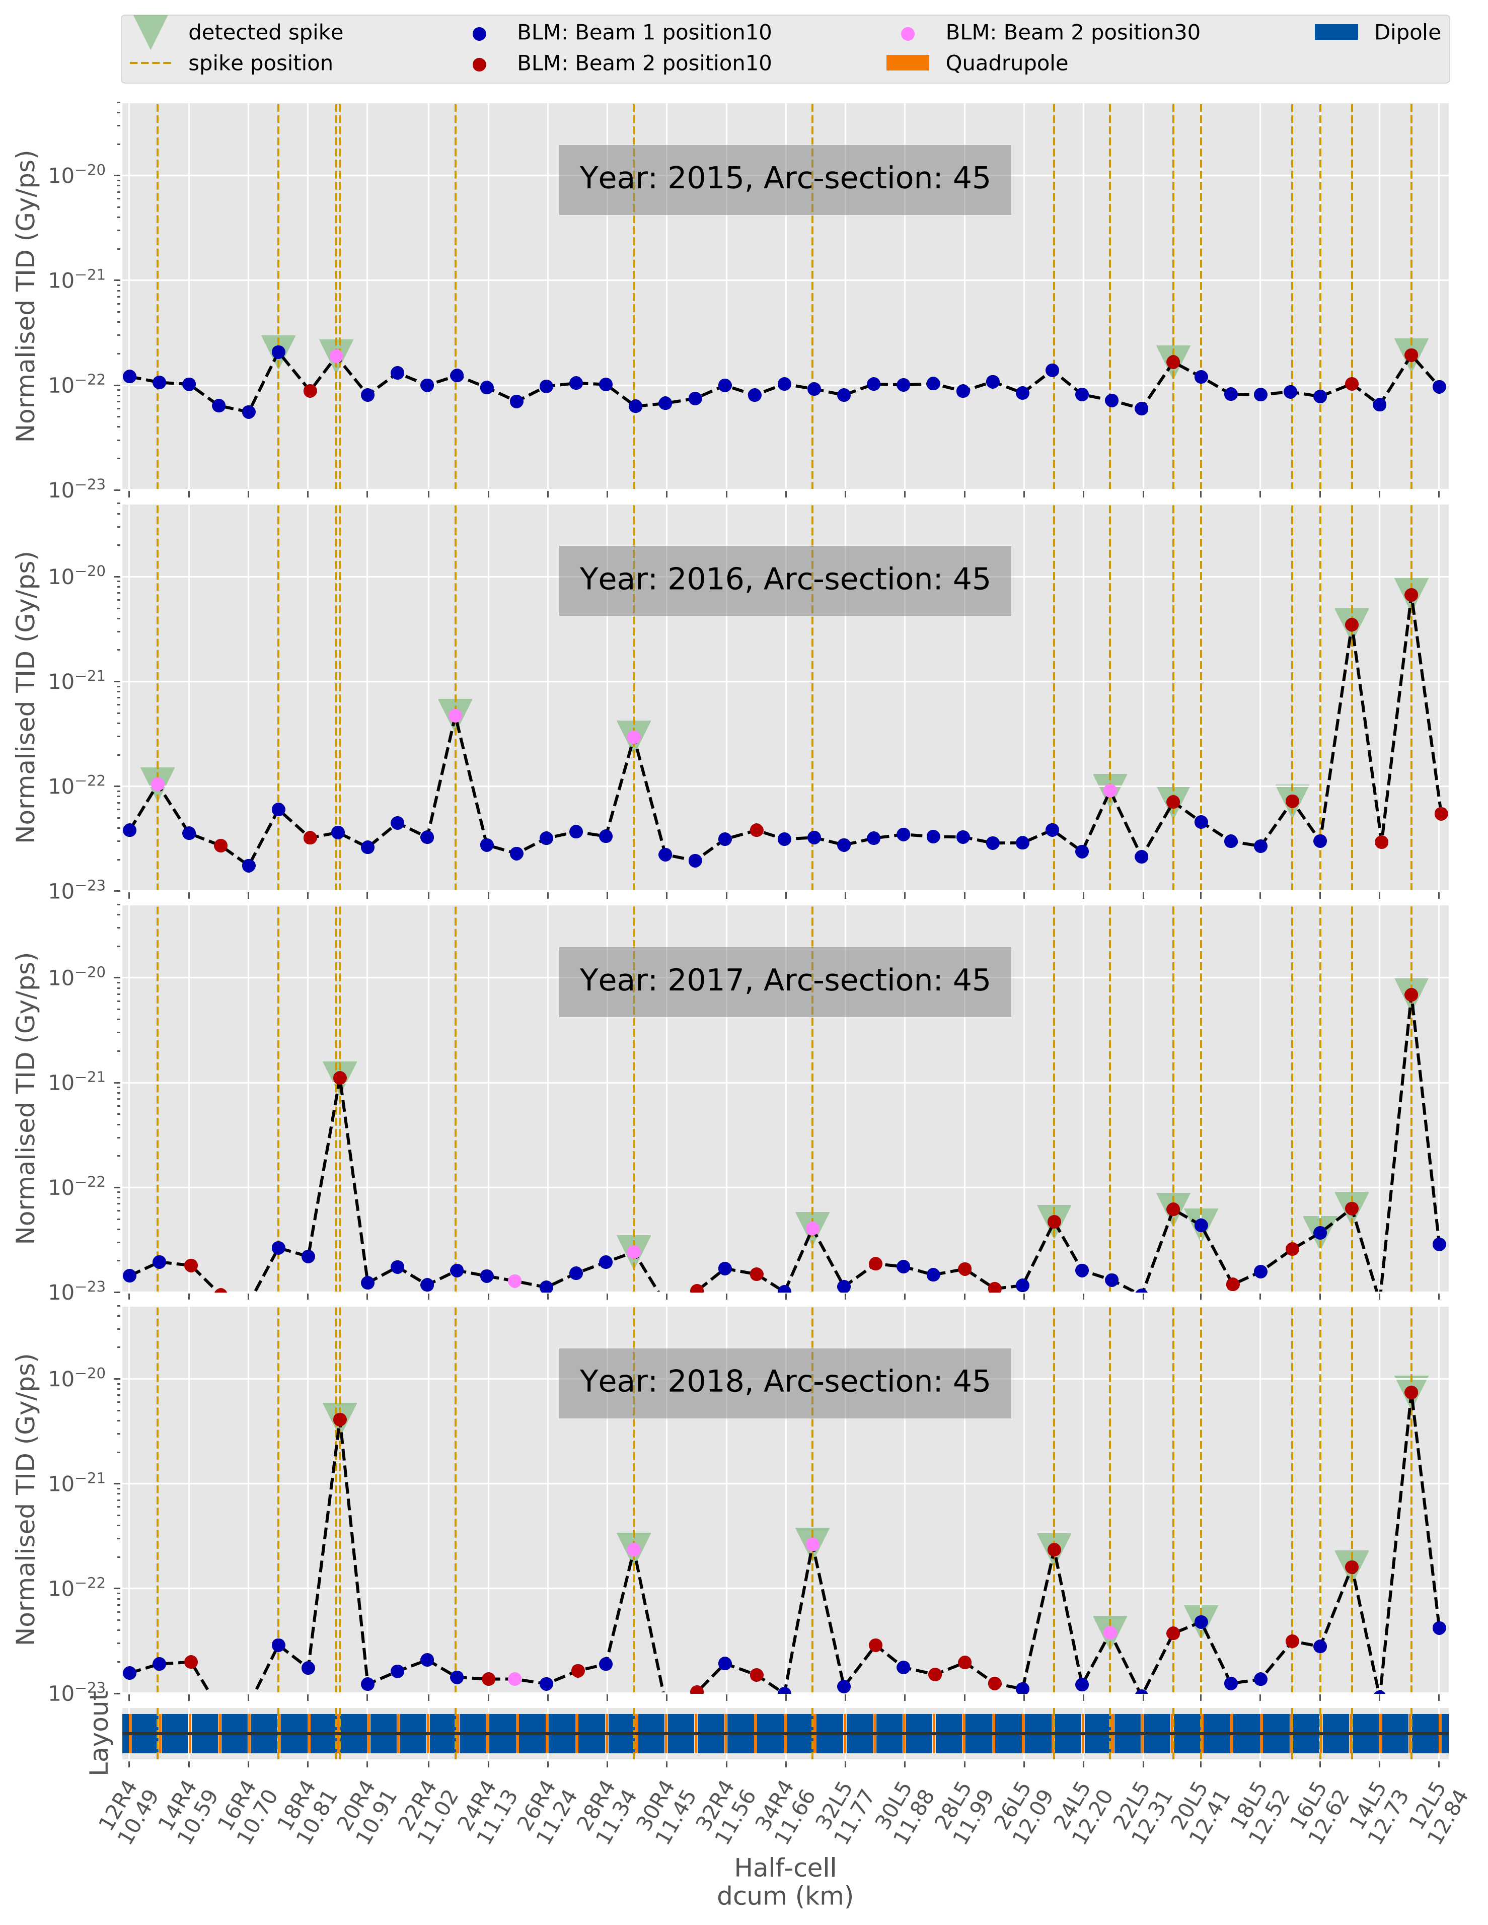
Spikes exceed baseline
up to 3 orders of magnitude
Potentially dangerous
Identification
and monitoring is critical
Spikes identification
algorithm
Dynamic behavior
Need of detailed analysis…

Slide 17
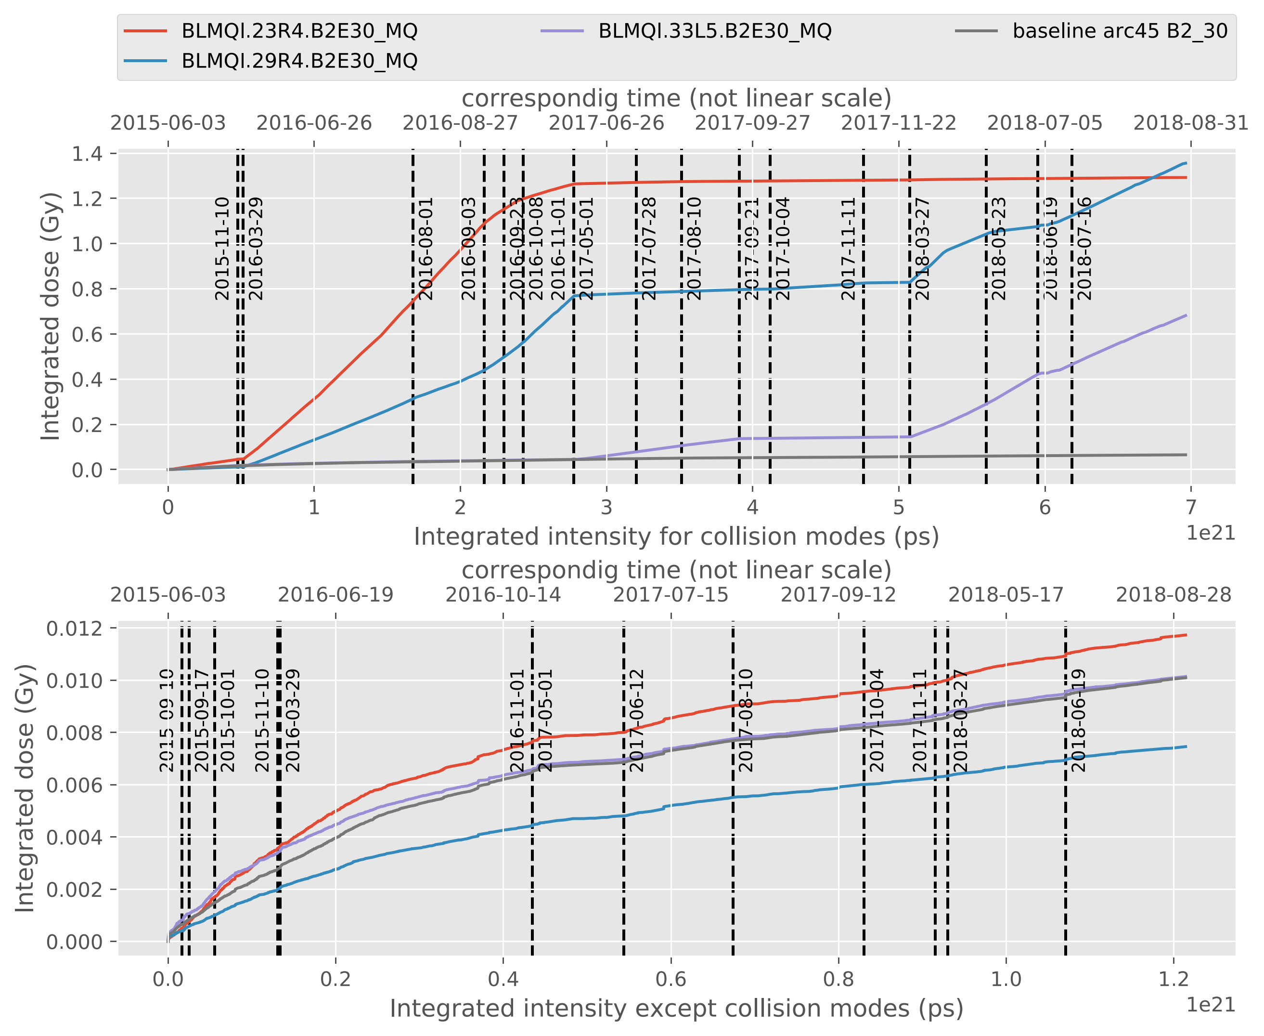
Detailed spikes analysis
Always comparing with
the corresponding baseline
Detection of
evolution changes
Correlation with the accelerator parameters changes

Slide 18
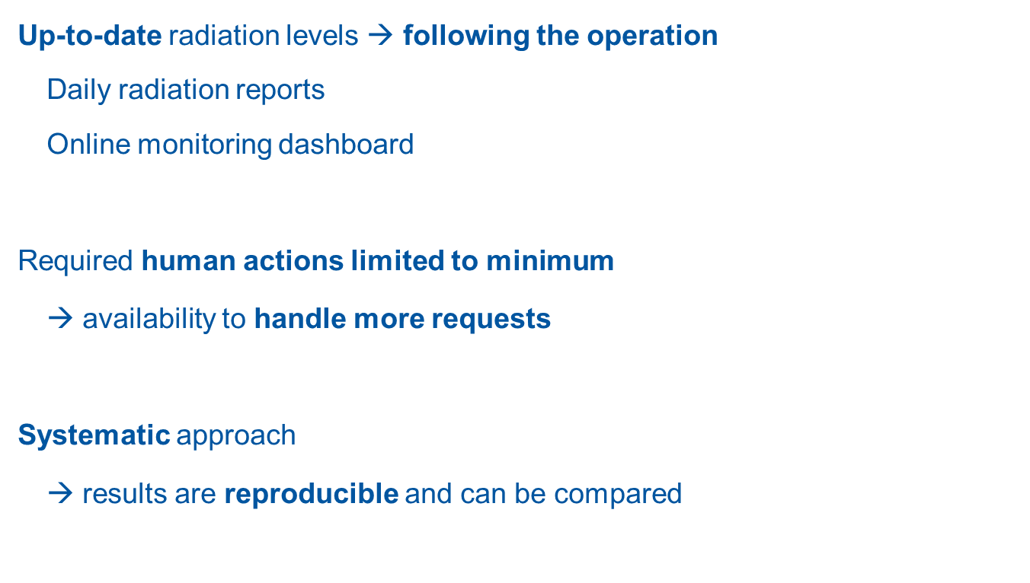
Current capabilities
Up-to-date radiation levels $→$ following the operation
Daily radiation reports
Online monitoring dashboard
Required human actions limited to minimum
→ availability to handle more requests
Systematic approach
→ results are reproducible and can be compared

Slide 19
Future…
LHC BLMs based dose analysis – almost complete
Full automation of spikes and baseline analysis + implementation in the daily reports
Full automation of analysis for different radiation monitors
Full automation of radiation monitoring in Injector Chain and Transfer Lines
More sophisticated analysis
Machine Learning usage for detecting correlation between accelerator settings and dose distributions
Further development and maintenance

Slide 20
Thank you for your attention!

Slide 22
Backup slides

Slide 23
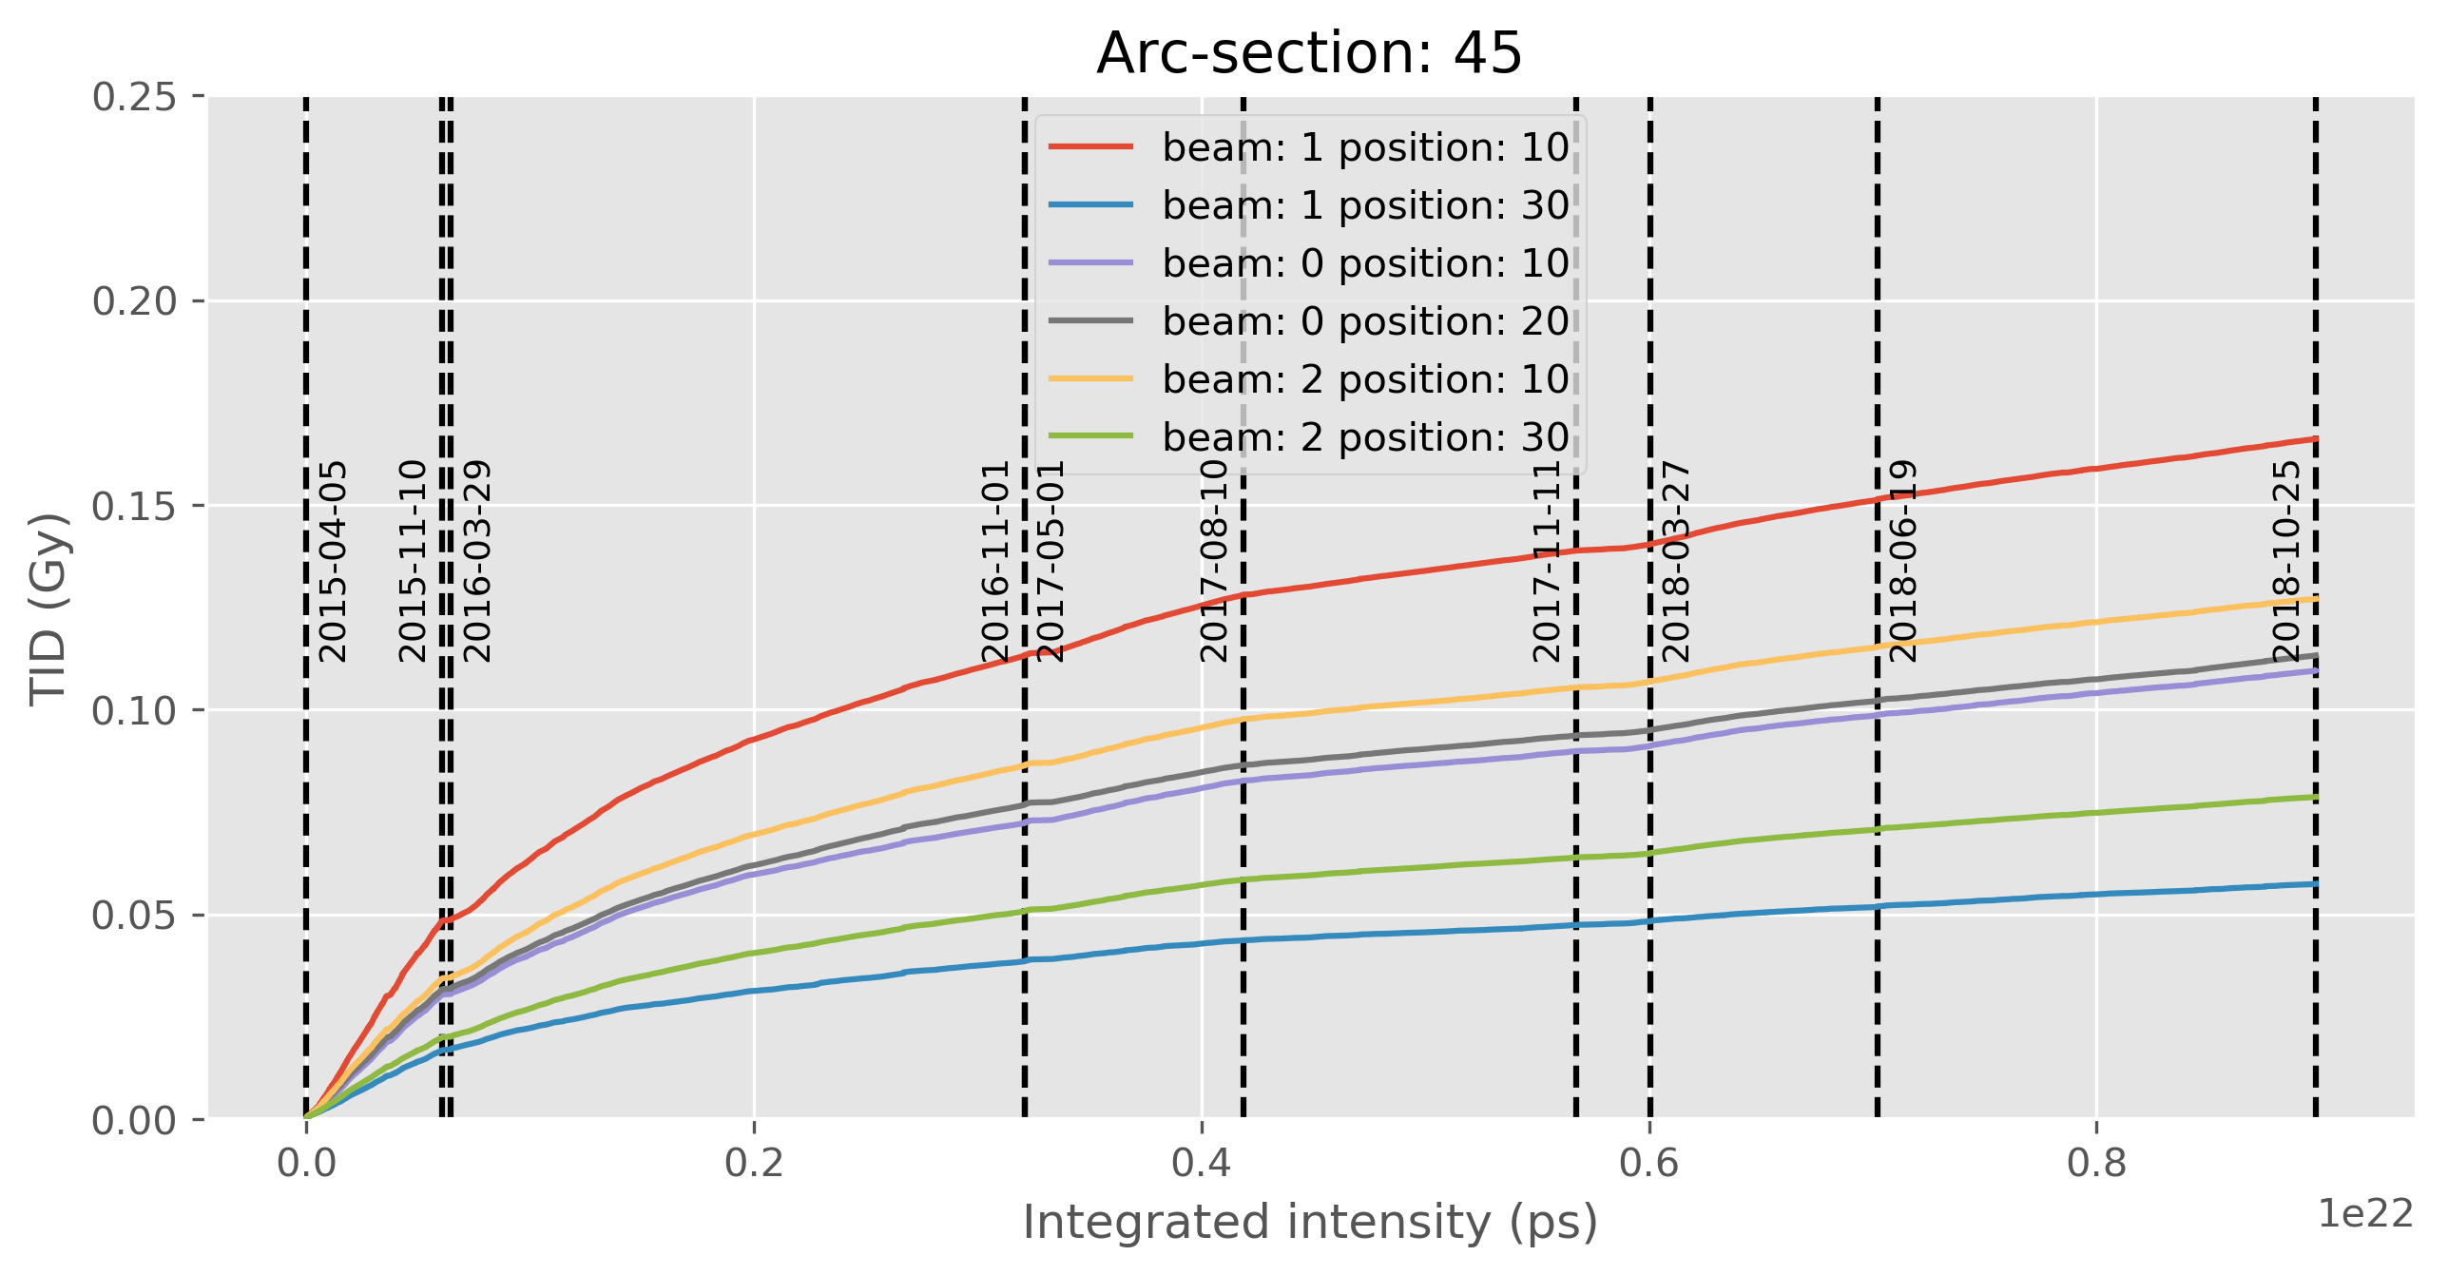
ARC baseline analysis
Very low doses! → the highest baseline dose for pp operation 0.25 Gy/Run 2
Based on the multiple BLMs in each arc section
Can be used to residual gas density estimations, spikes analysis and simulation scaling

Slide 24
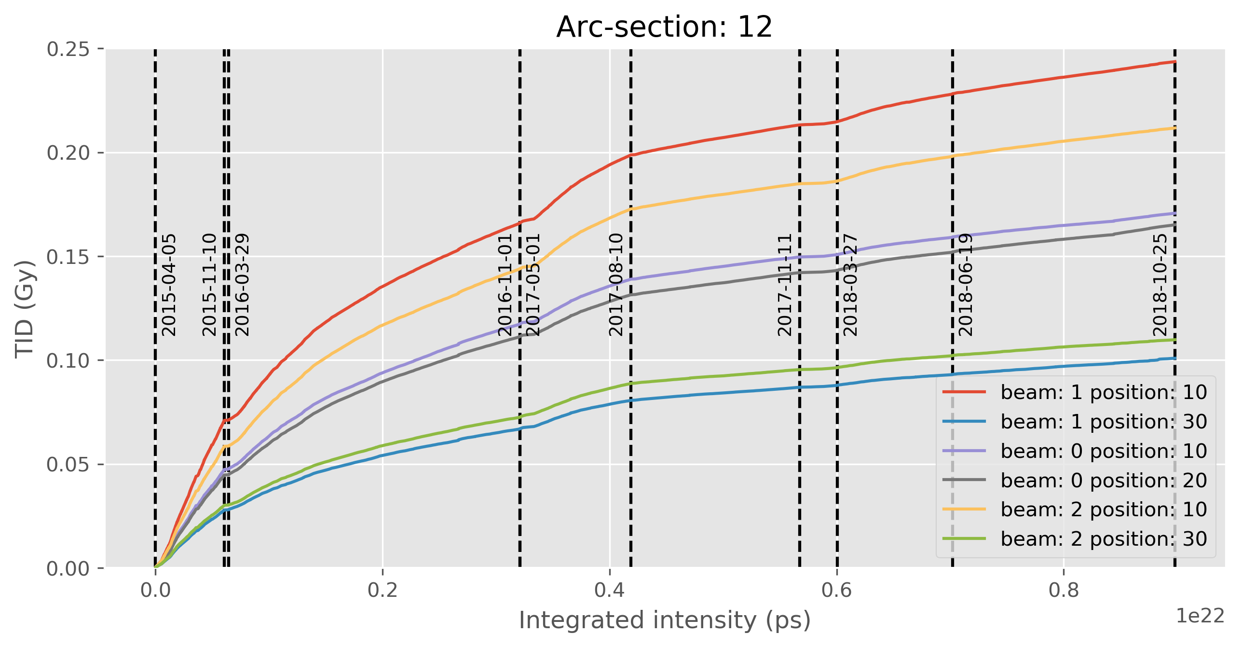
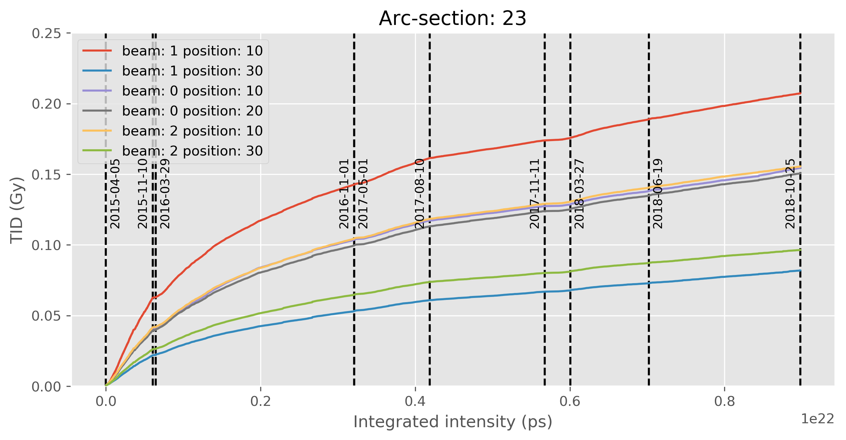
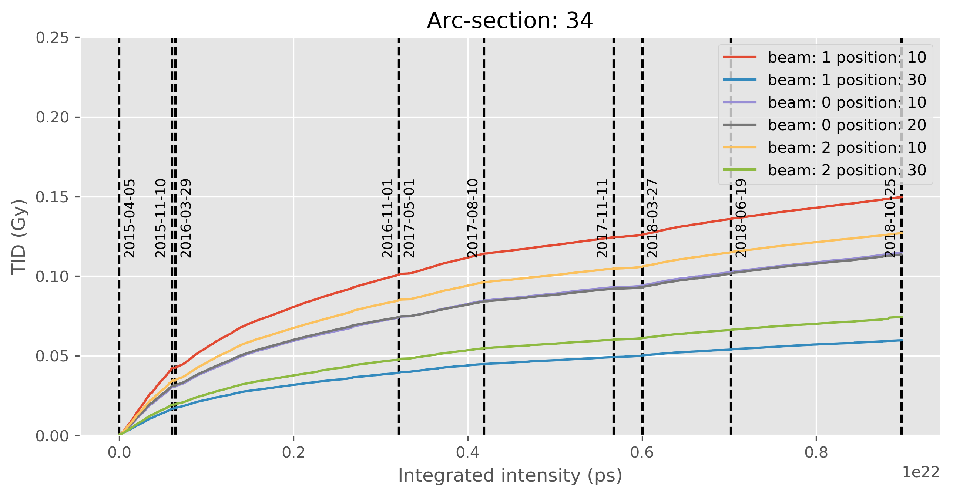
Evolution of baseline doses over the integrated intensity for all beam modes (proton-proton operation only)

Slide 25
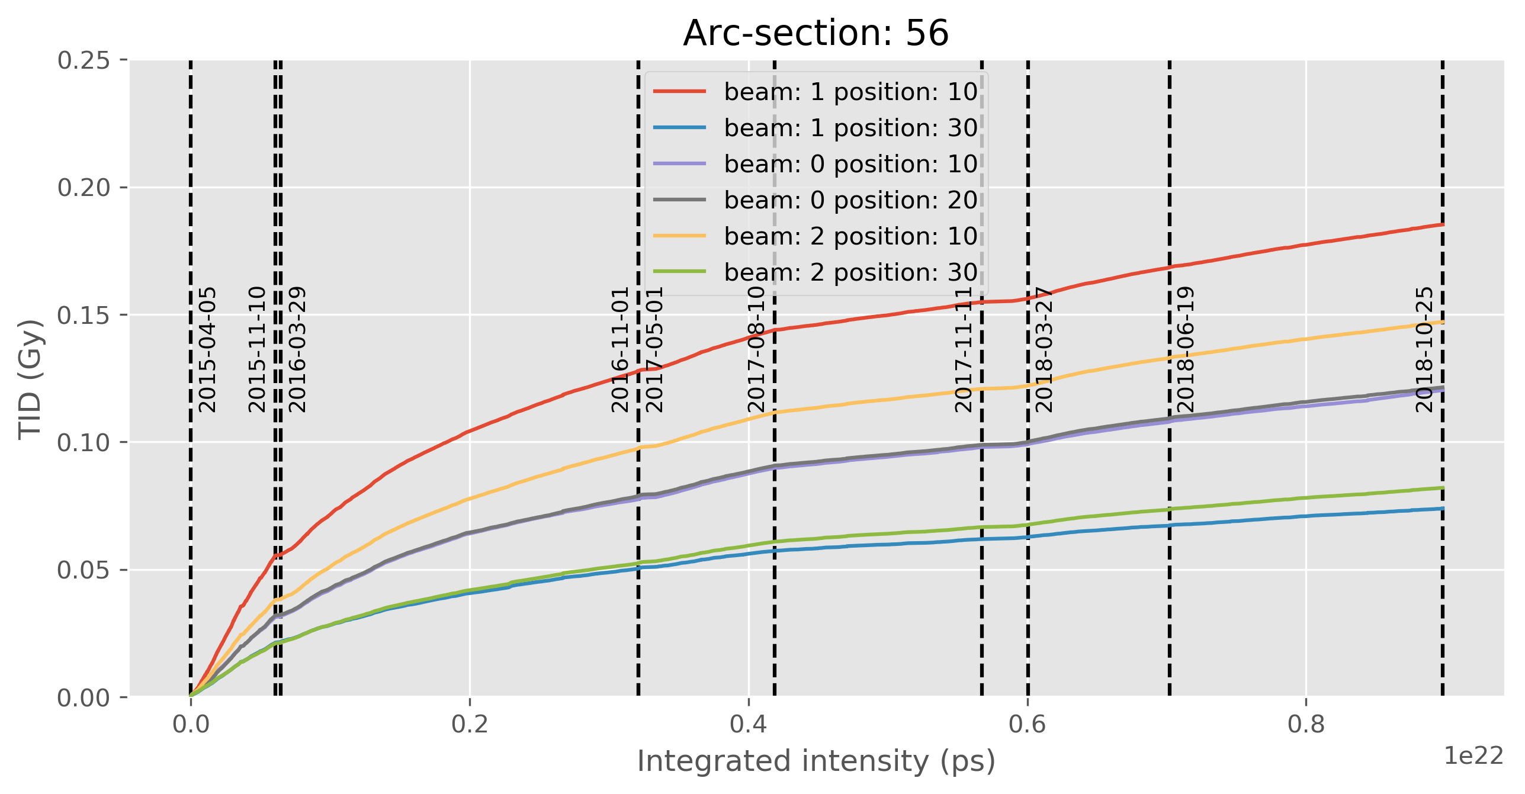
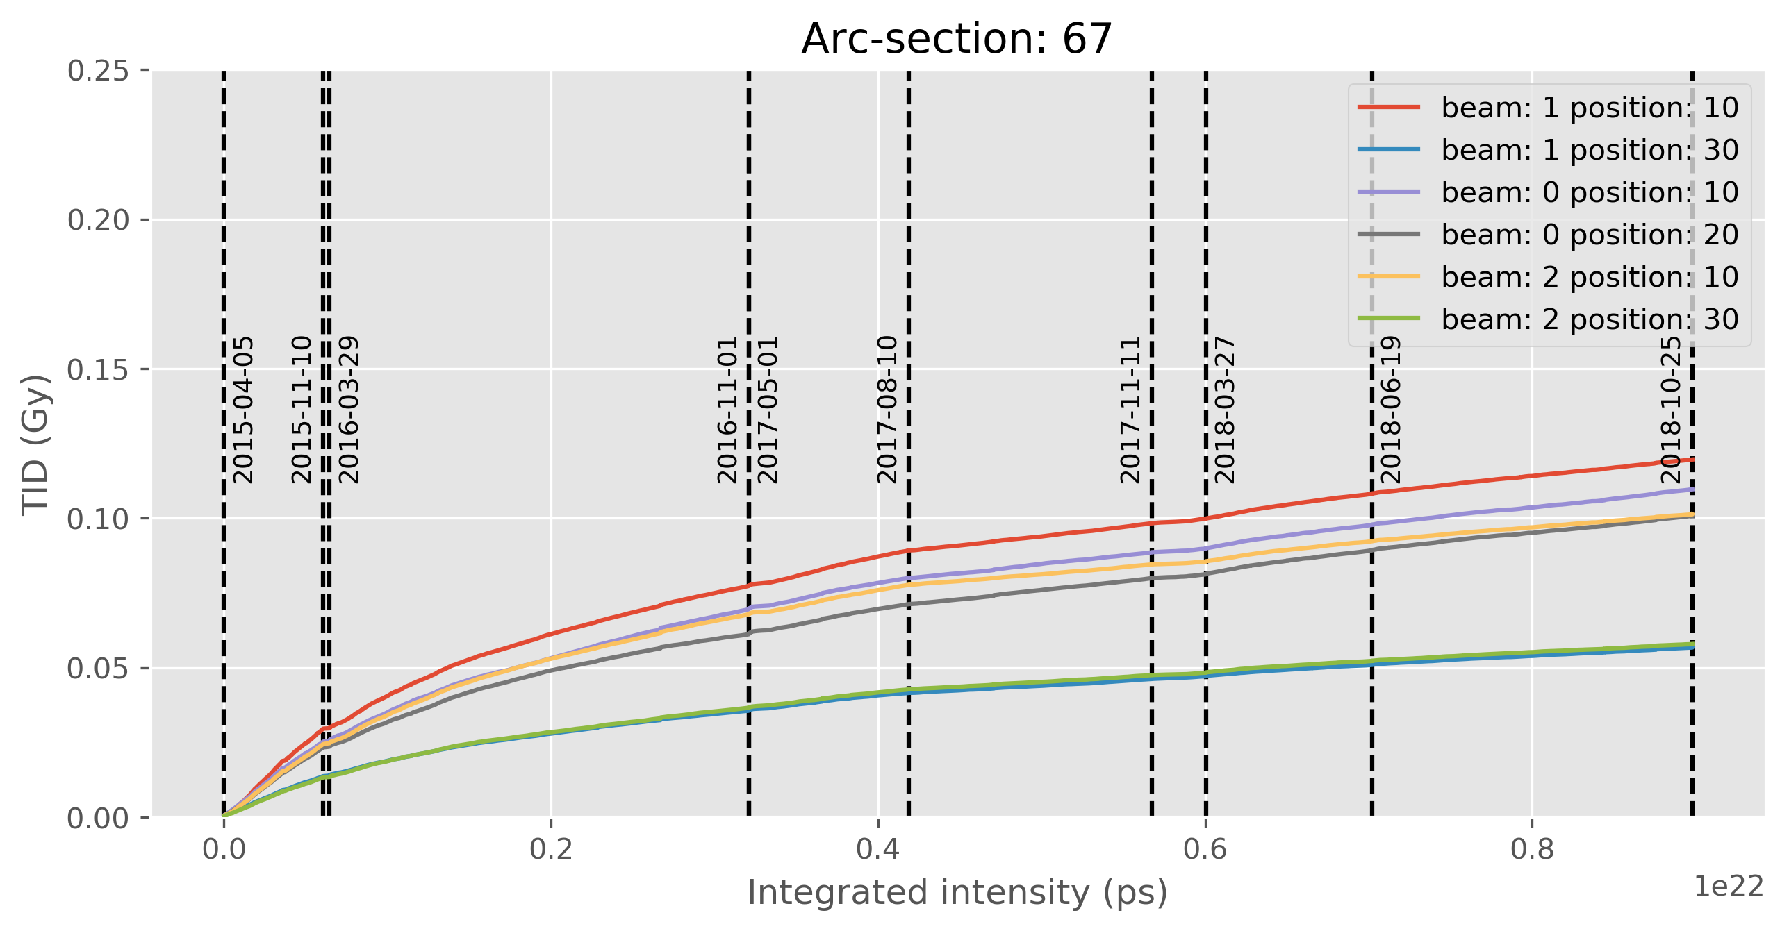
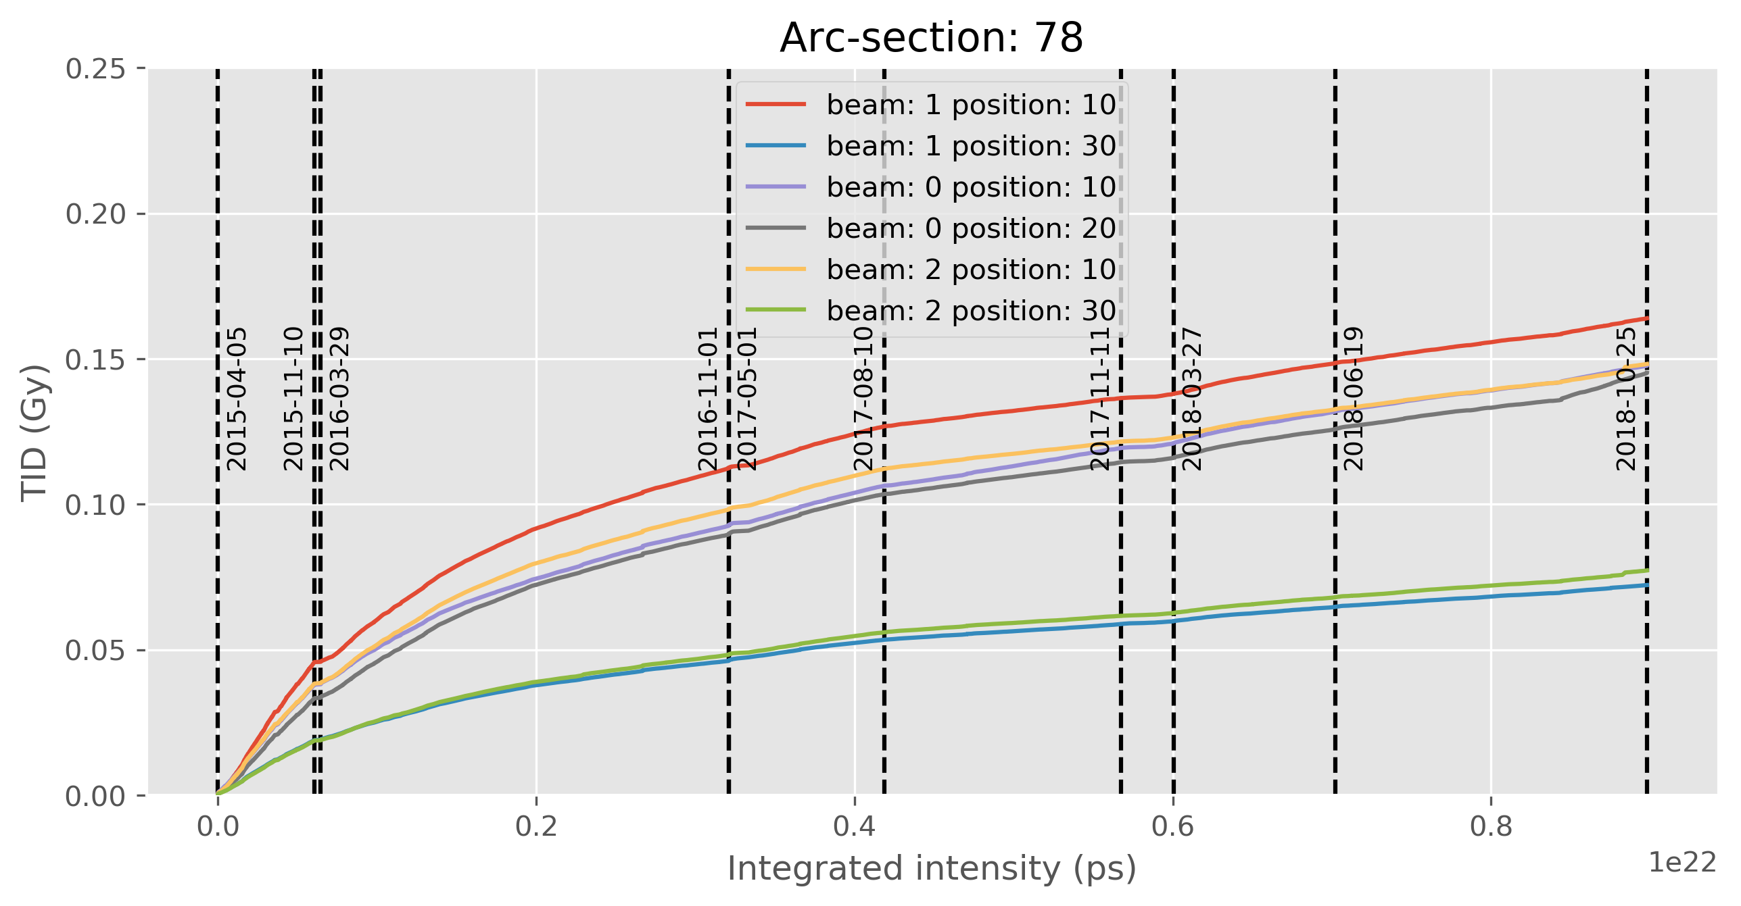
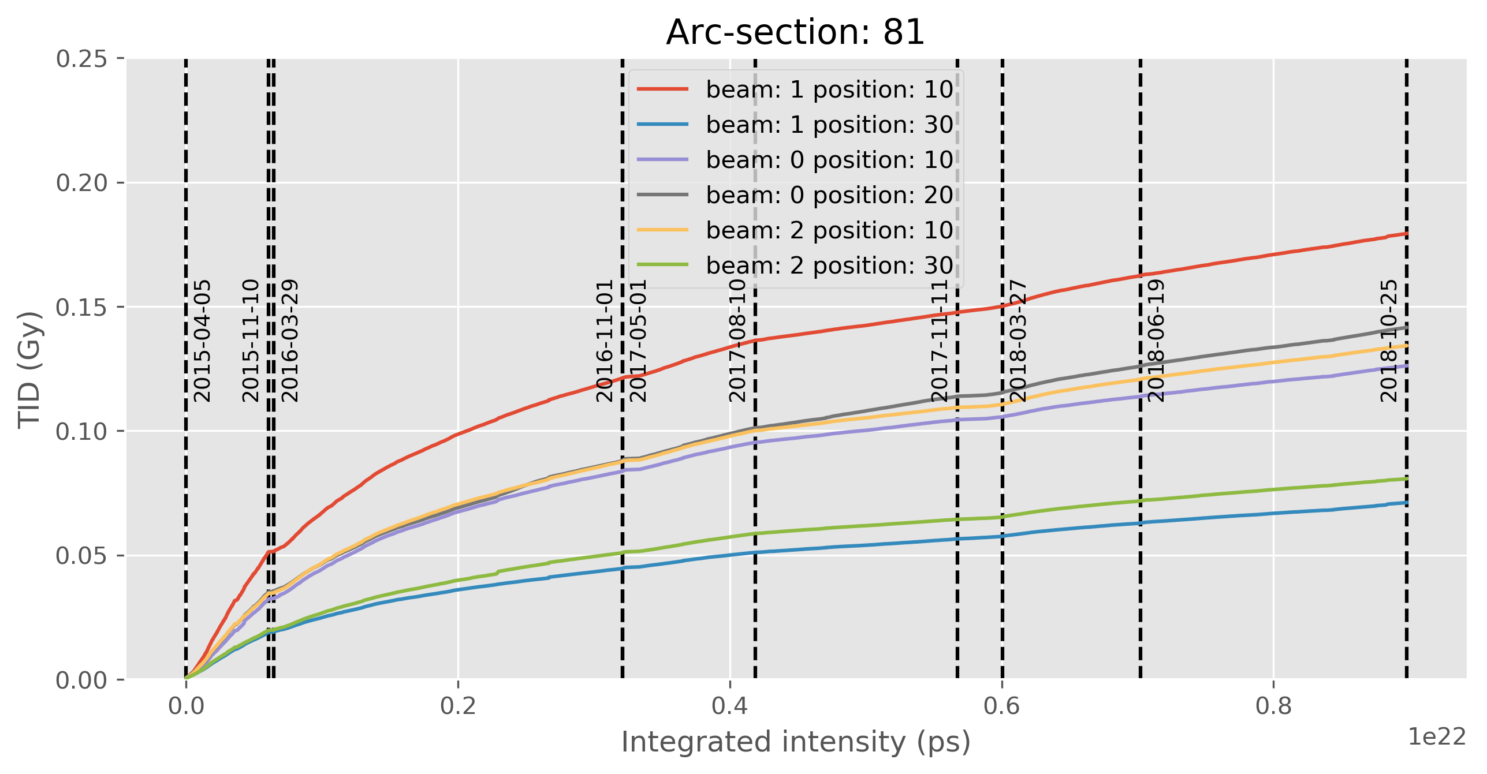
Evolution of baseline doses over the integrated intensity for all beam modes (proton-proton operation only)

