Slide 1


Overview of RADSAGA activities at CERN
Andrea Coronetti (EN-STI-BMI)
Indico link: https://indico.cern.ch/event/760345/
RADSAGA

Slide 2
Outline
Introduction
CHARM Experiments
Heavy Ions Experiments
CNES – Ninano and 3DPlus Camera
Pion testing at PSI
Prospects for 2019

Slide 3
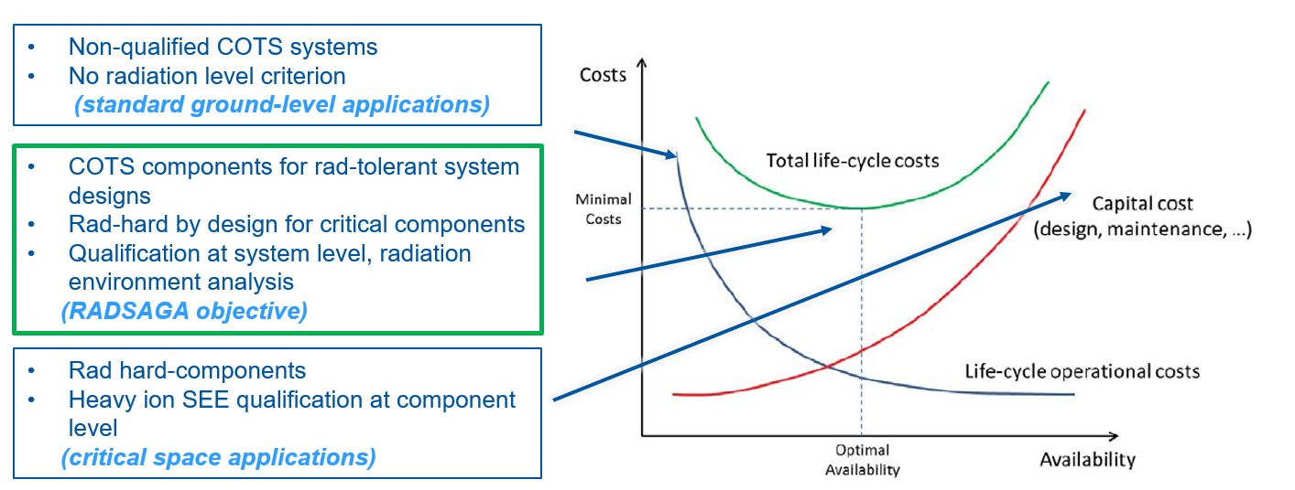
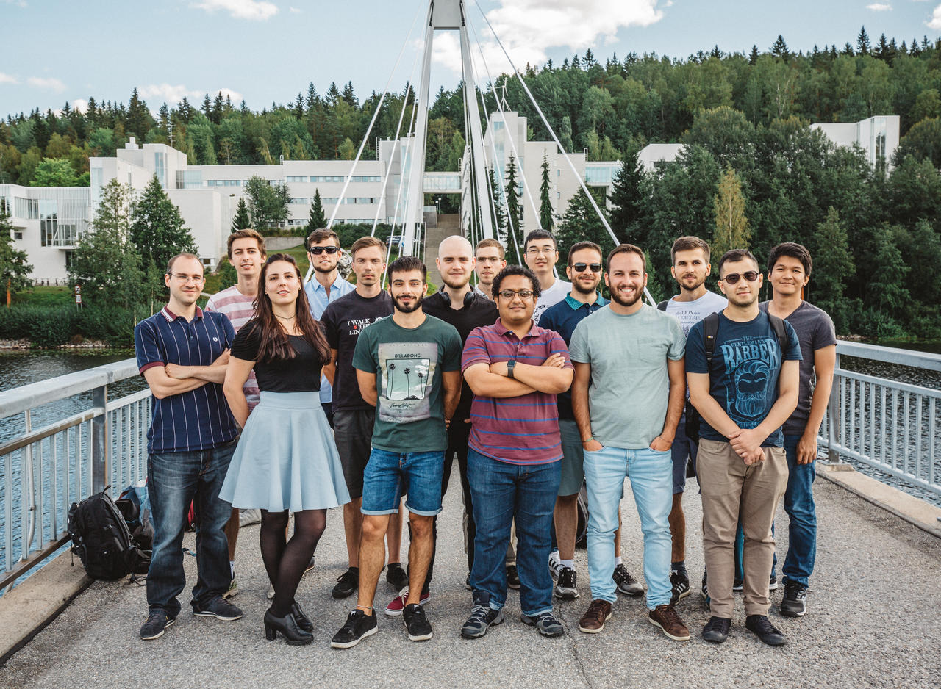
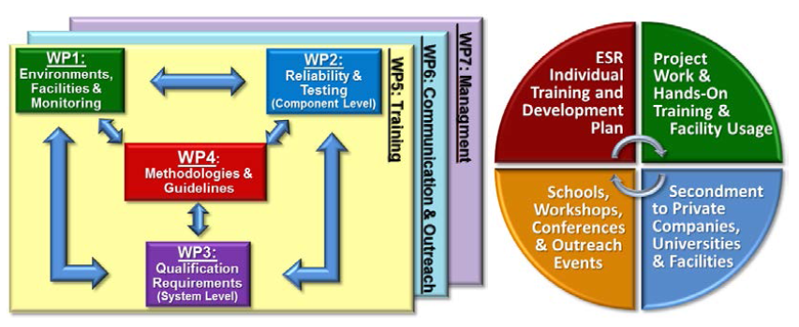







Introduction
4
4
1
1
2
1
2

Slide 4
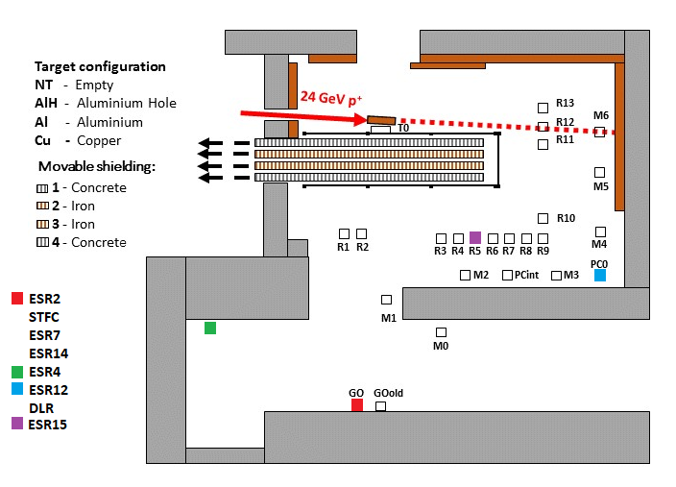
CHARM Experiments
6 ESRs + 1 partner (CNES) + 2 associates (STFC, DLR)
WP1 (Environments, facilities and monitoring):
  ESR2: Cu-doped optical fibers
  ESR4: PIN diode Canberra
  STFC: PIN diode
WP2 (Components):
  ESR7: GaN and SiC Power MOSFETs
WP3 (Systems):
  ESR12: PoL DC-DC Converter
  ESR14: Data System Acquisition (avionics)
  DLR: General Software Defined Radio
WP4 (Guidelines):
  ESR15/CNES: Ninano + 3DPlus Camera

Slide 5
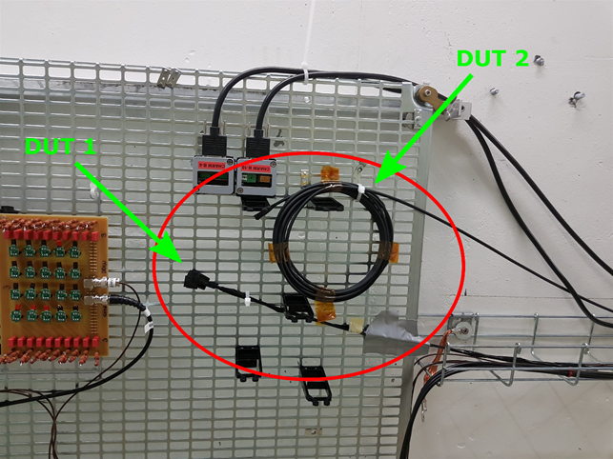
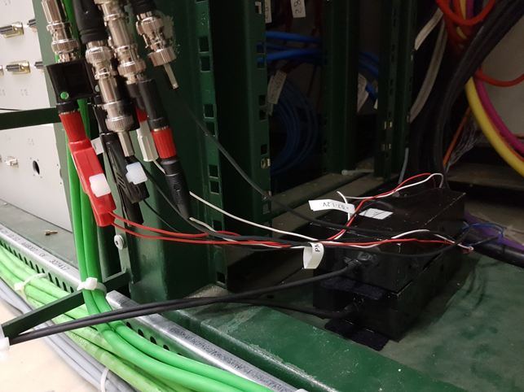
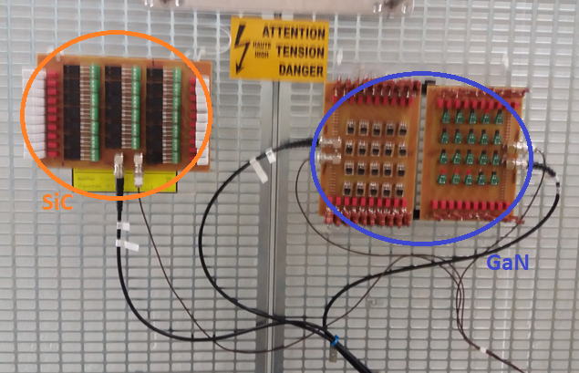
CHARM Experiments
DUT1: Cu-doped optical fiber
DUT2: FDP Cherenkov fiber for comparison
(Credit Daniel Soderstrom)
Optical fibers
  Scope: assessment of Radioluminescence of Cu-doped fiber
  FDP used for filtering Cherenkov
  Issues during test preparation
    Only short fibers possible
    PMT installed underneath the patch panel
    Signal PMT much higher than RL
Power MOSFETs
  COTS GaN and SiC :
    Panasonic PGA26E19BA (GaN, 600 V)
    EPC EPC2012 (GaN, 200 V)
    CREE C3M0120090 (SiC, 900 V)
  No SEB on GaN
  SEB on SiC at 95% of max VDS
Photomultiplier Hamamatsu
(Credit Daniel Soderstrom)
SiC and GaN Power MOSFETs

Slide 6
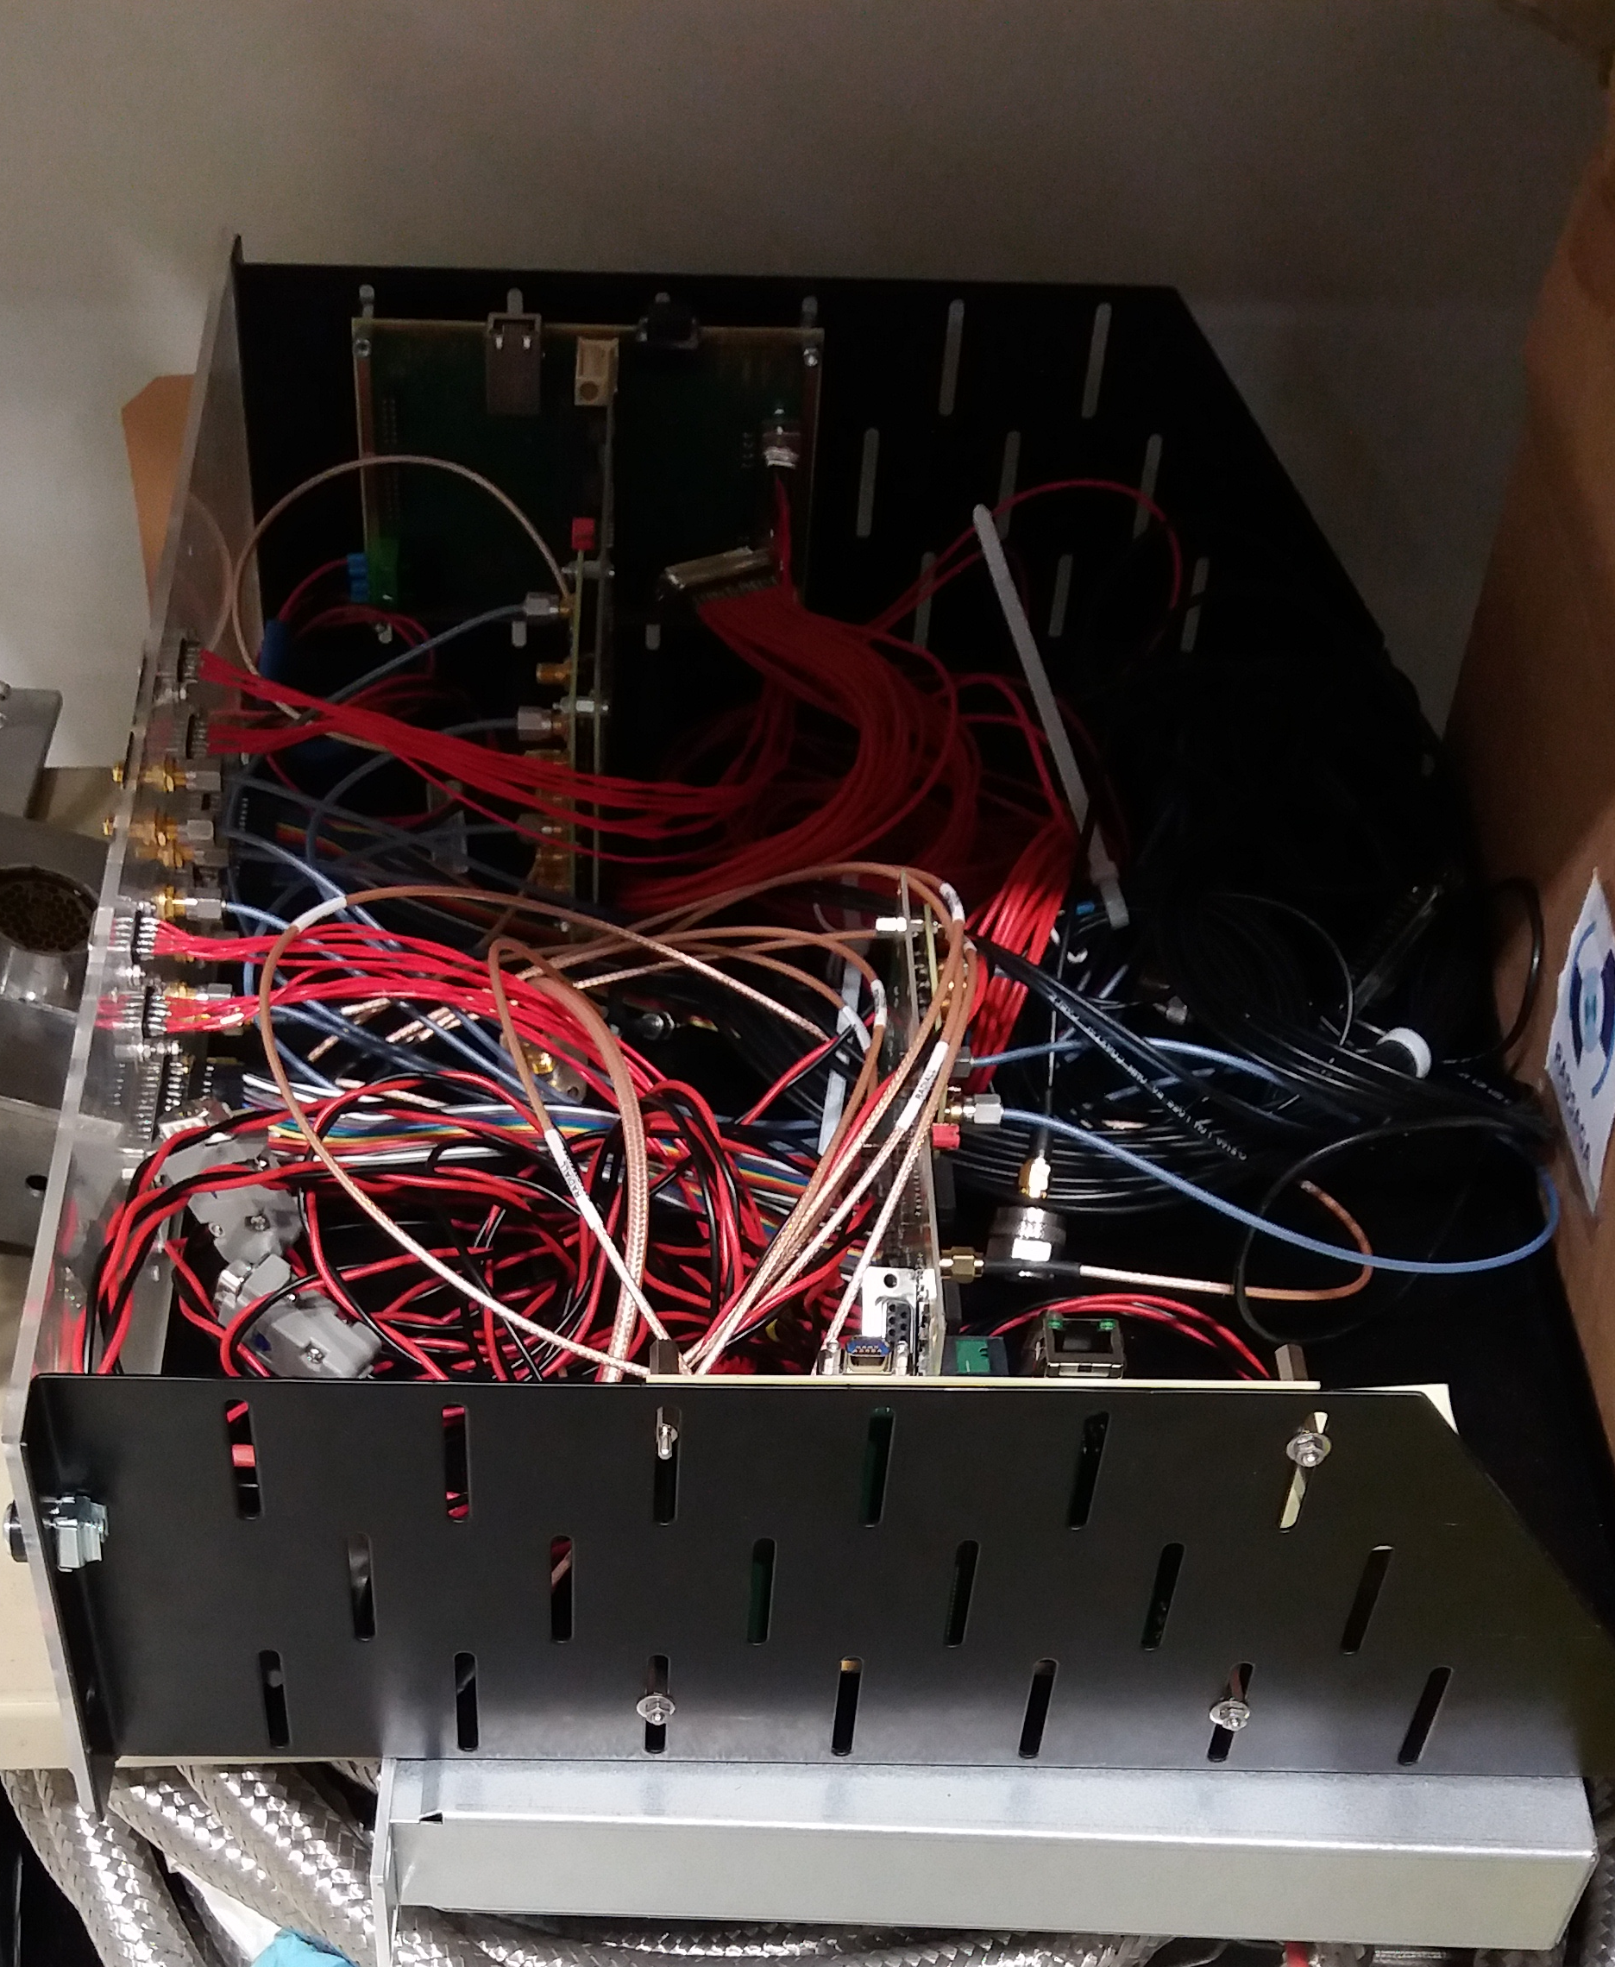
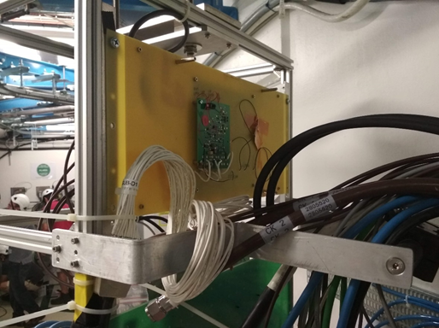
CHARM Experiments
DLR General Software
Defined Radio setup
2 DUTs were tested
PoL DC-DC Converter
  2D board version of 3DPlus product
  Rad-hard space system
  First test: no SET, no SEL
  Re-iterated with less rad-tol components
  Why? Scope is assessment of SET propagation at system level
  SET seen, no SEL
* German Aerospace Agency
DLR* Software Defined Radio
  Main application: COM inside SAT constellation
  Digital data transmission of modulated RF signals and telemetry
  RFIC AD9361
    No errors on RF chip
  Controlled by Zynq with Linux OS
    Multiple errors on Zynq and FPGA resets
    Reset operation not affected by spill (t > 20 s)
  High flux functional errors at system level
    KVI proton test at various fluxes
2D version of 3DPlus
PoL DC-DC Converter
(Credit Tomasz Rajkowski)

Slide 7
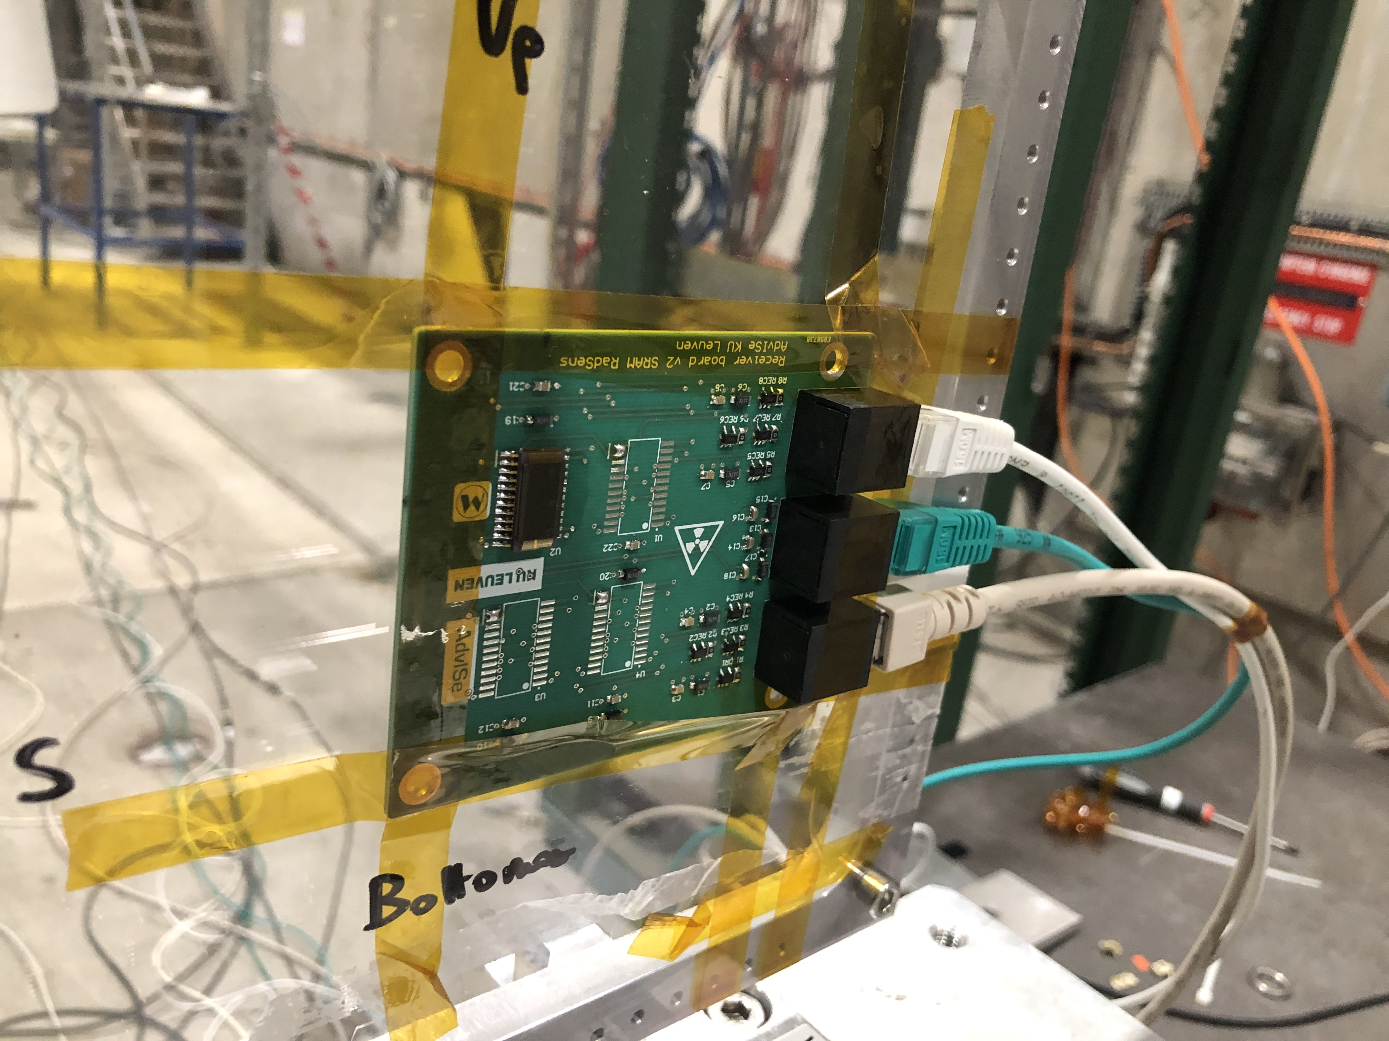
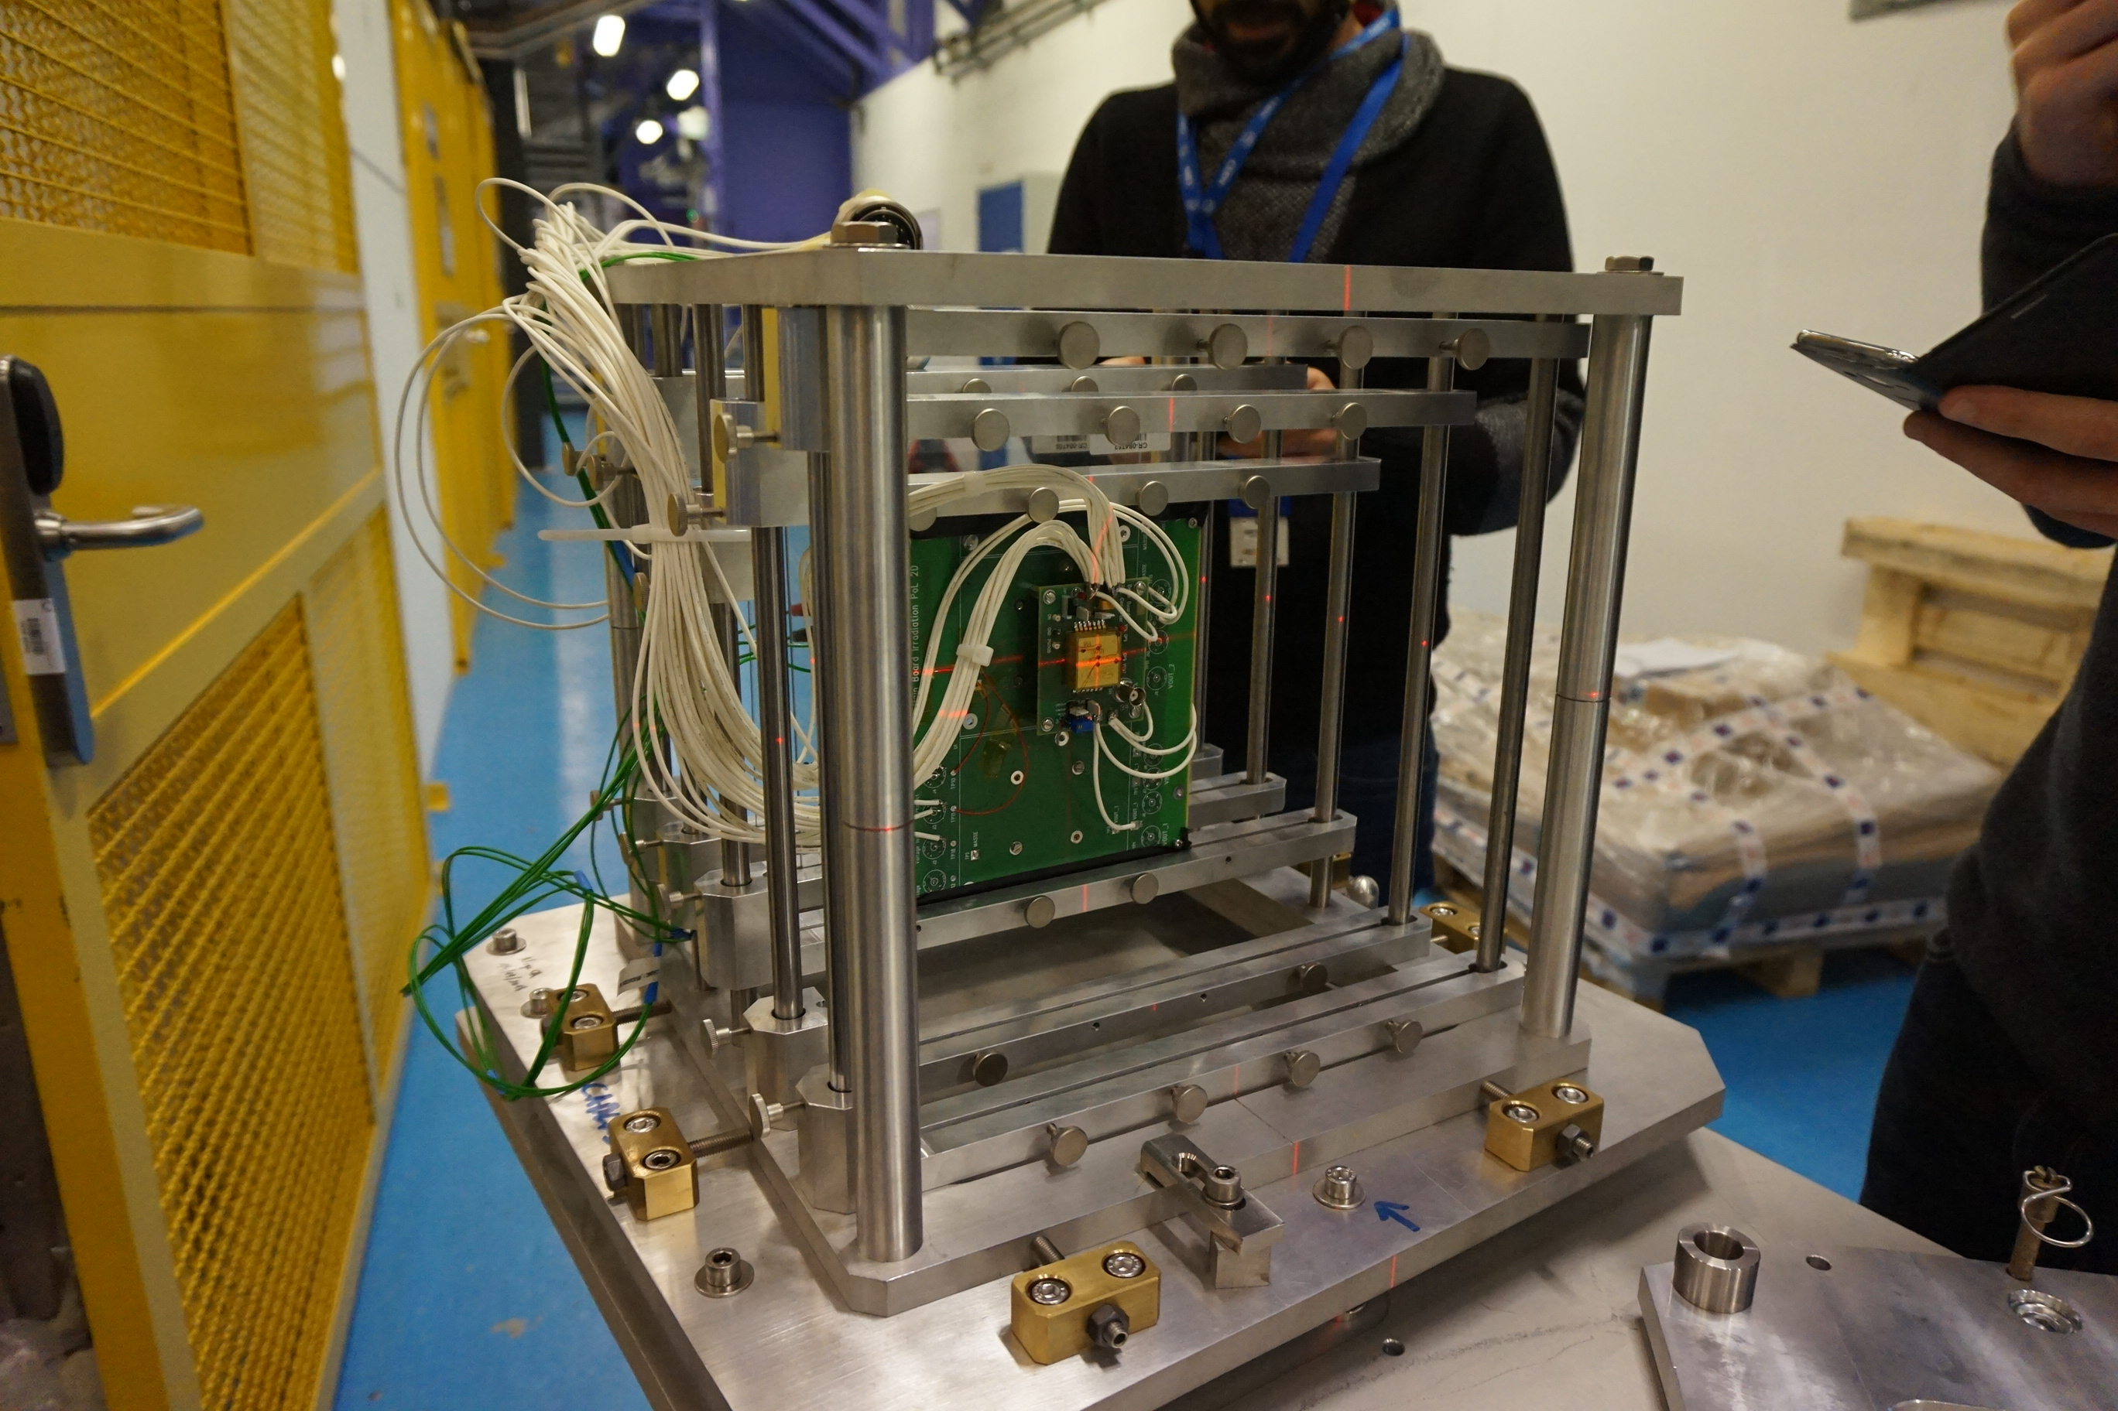
Heavy Ions Experiments
SRAM-based SEU Monitor at H8
(Credit: Jialei Wang)
H8 North Area
  Low flux, higher LET (9 MeV.cm²/mg)
  ESR5: SRAM-based SEU Monitor
CHARM
  High flux, lower LET (8 MeV.cm²/mg)
  ESR7: GaN and SiC Power MOSFETs
  ESR12: PoL DC-DC Converter
3DPlus PoL DC-DC Converter on Montrac
(Credit: Tomasz Rajkowski)

Slide 8
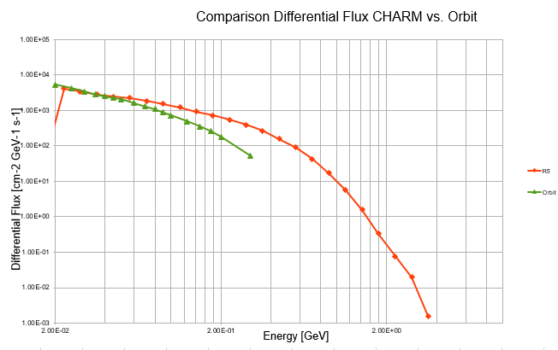
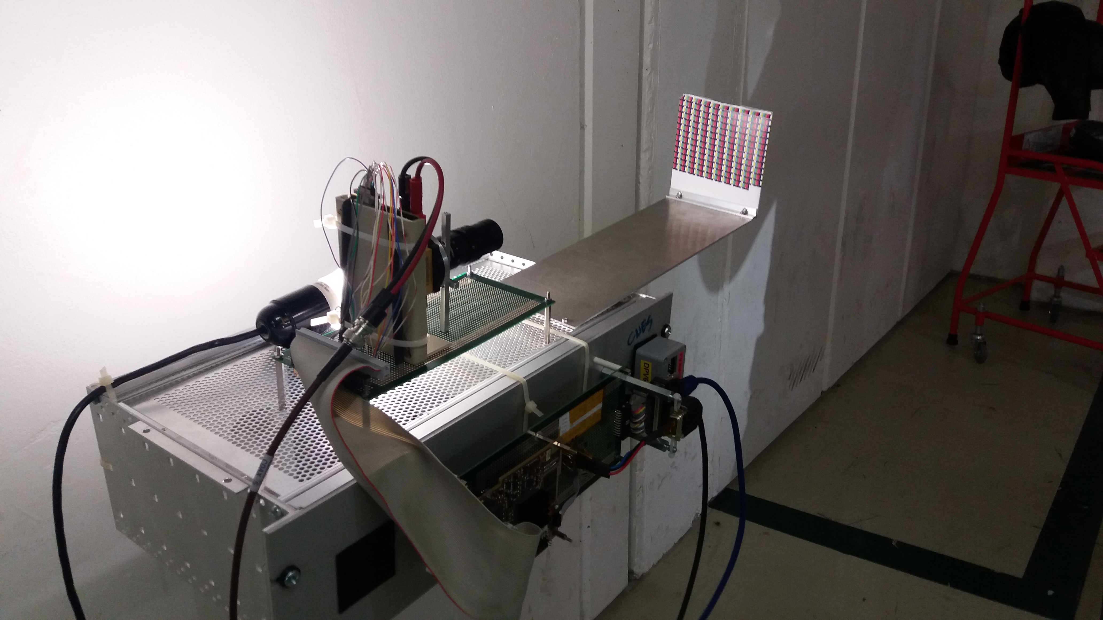
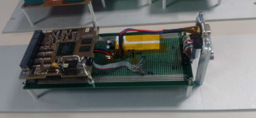
CNES – Ninano and 3DPlus Camera
Test in R5 relevant for LEO spectra
Test of OBC with payload
Scope: performances of OBC and camera
Setup issues:
  First 2 weeks in G0
  Last 2 weeks in R5
Zynq still operational after 400 Gy(Si)
Ninano test board for CHARM
(Credit: CNES)
Ninano+Camera test setup for CHARM

Slide 9
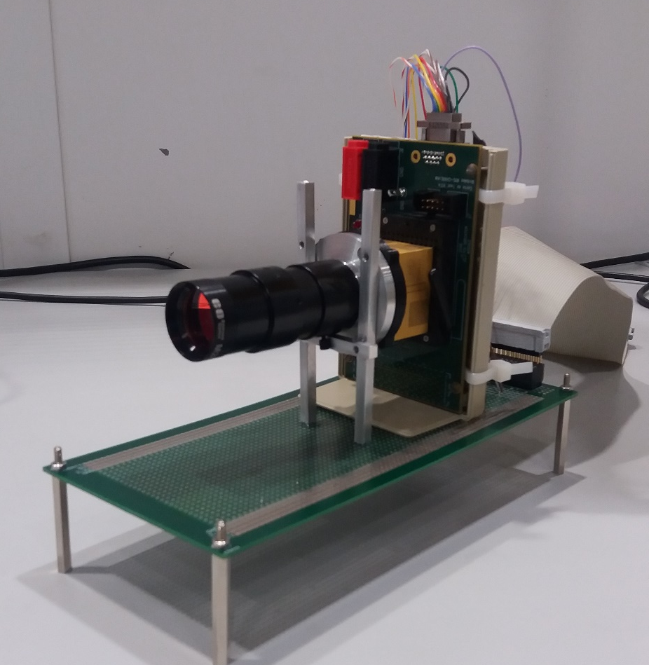
CNES – Ninano and 3DPlus Camera
Commercial 3D module
  SpaceWire COM with OBC
  4 Mpixels (10/12 bits per pixel)
  Eyesat config, high exp time (1500 ms)
Declared radiation performances
  Rad-hard technology (TID > 400 Gy(Si))
  SEL immune up to 60 MeV.cm²/mg
Tested radiation performances:
  Internal electronics is TID tolerant up to 500 Gy(Si) (Co-60)
  SEL seen at CHARM
3DPlus Camera and optics

Slide 10
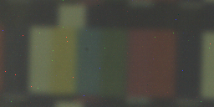
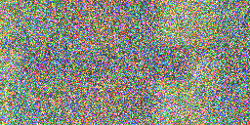



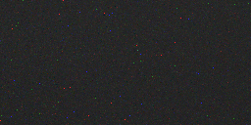
CNES – Ninano and 3DPlus Camera
Dry-run
Only radiation test for real images
  Dose ~ 400* Gy(Si)
  1 MeV neq fluence ~ 5E+12* cm⁻²
  HEH fluence ~ 7.5E+11* cm⁻²
  Data from FLUKA assuming 5E+11 POT per spill
Many pixels saturated after 1 week in G0
Progressive degradation in coming weeks
Full white image
No recovery after 1 month from irradiation
Better performance for black image (last week)
Unknown issue on readout electronics or CIS?
1st week G0
2nd week G0
3rd week R5
1 month after irradiation
4th week R5, exp time 15ms

Slide 11
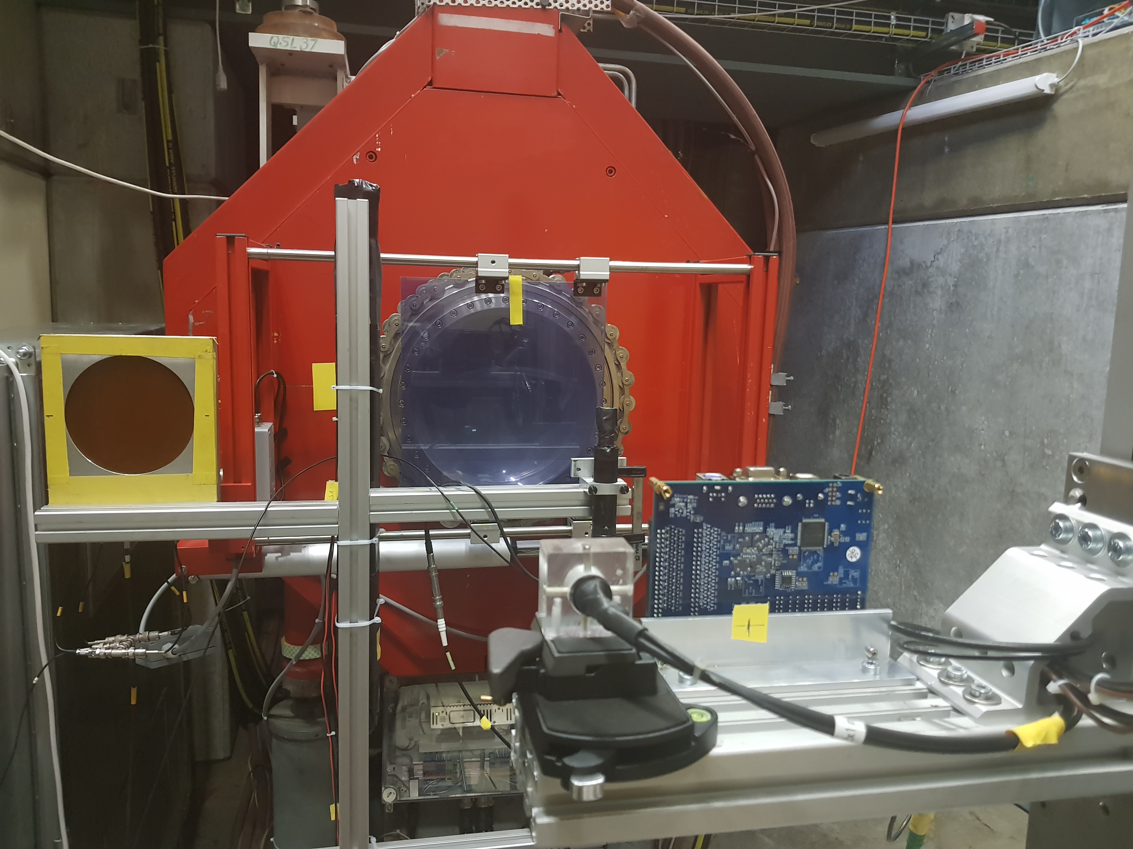
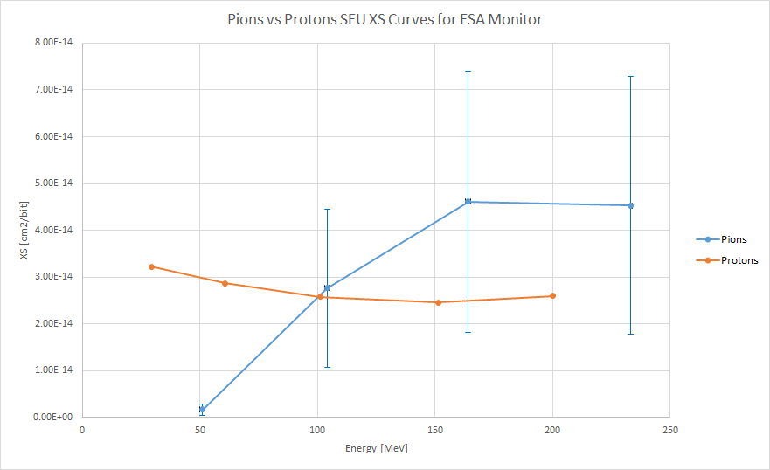
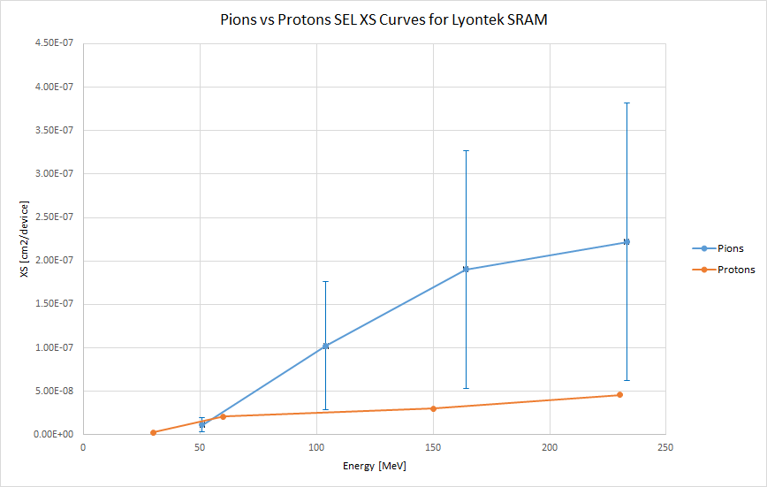
Pion testing at PSI
πM1 beamline at PSI
(Credit: Daniel Soderstrom)
Motivation
pions make for large part of mixed-field
treated as protons for SEE qualification
πM1 beamline
Energy ~ 51-233 MeV
FWHM ~ 1x1 cm²
Max flux ~ 3e6 cm⁻²s⁻¹
π⁻, π⁺ available, only negative tested
DUTs tested
SEU
  ESA Monitor, Cypress 90 nm, Cypress 65 nm, ISSI 65 nm
SEL
  Lyontek 180 nm, Brilliance 180 nm
Outcome
Resonance peak above 100 MeV (mixed-field impact?)
Different date code for SEL!

Slide 12
Prospects for 2019
RADSAGA
KVI-CART, high energy protons (January, ESR2, ESR5, ESR13)
ChipIR, neutron spallation (March, ESR7, ESR13)
GANIL, high LET heavy ions (July)
RADEF, new 16 MeV/n heavy ions (?)
PSI, high energy protons (?)
ESR15
Electron DD on PIN diodes at VESPER (April)
Guideline development
  Facility summary
  Wide bandgap
  14 MeV neutrons

Slide 13
Overview of RADSAGA activities at CERN
Andrea Coronetti (EN-STI-BMI)
Indico link: https://indico.cern.ch/event/760345/
RADSAGA

