Slide 1
SEE mechanisms in power MOSFET devices: theoretical, simulation and experimental approaches
P. Fernández Martínez, G. Tsiligiannis, G. Foucard, S. Danzeca, R. García Alía
Indico link: https://indico.cern.ch/event/760345/

Slide 2
Outline
Project goals
Theoretical approach
Simulation approach
Experimental approach
Future steps and Outlook

Slide 3
Project Goals
Evaluation
Establish a reliable method (non-destructive) for testing
Prediction
Understanding
Predict device performance in different radiation environments
Understand the Failure mechanisms
SEE on Power MOSFETs
Theory
Experiments
Bibliographic Study
Simulation
Observation of the failures in distinct environments under various conditions
TCAD and FLUKA

Slide 4
Theoretical approach
(i.e. Dig into the literature)
Two main action fields:
Understand the physical mechanisms leading to SEE
State of the art of the experimental techniques to study this effects
SEE on power MOSFETs have been studied since the late 80´s
Many of our questions can be solved with a convenient bibliographic study
Don´t reinvent the wheel!!!

Slide 5
Simulation approach
Semiconductor Device Simulation (a.k.a. TCAD):
  Homemade definition:
How to simulate SEE effects with TCAD?
Find the solution of the semiconductor equations for a model of a semiconductor device, under some specific boundary conditions, taking into account the solid state physics and by using numerical (Finite Difference / Finite Element) methods.
  We act on the physical model for the carrier Generation, including a Charge Distribution in a specific region of the semiconductor and then we simulate its evolution.
    The Charge Distribution Profile (amount of charge, length, width… ) is correlated with the incident radiation properties (LET, range, etc…)
    but the relationship is not calculated in the TCAD Simulation (we need the input from FLUKA or similar….)

Slide 6
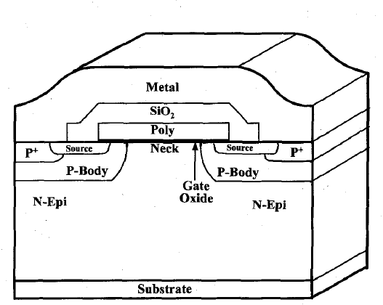
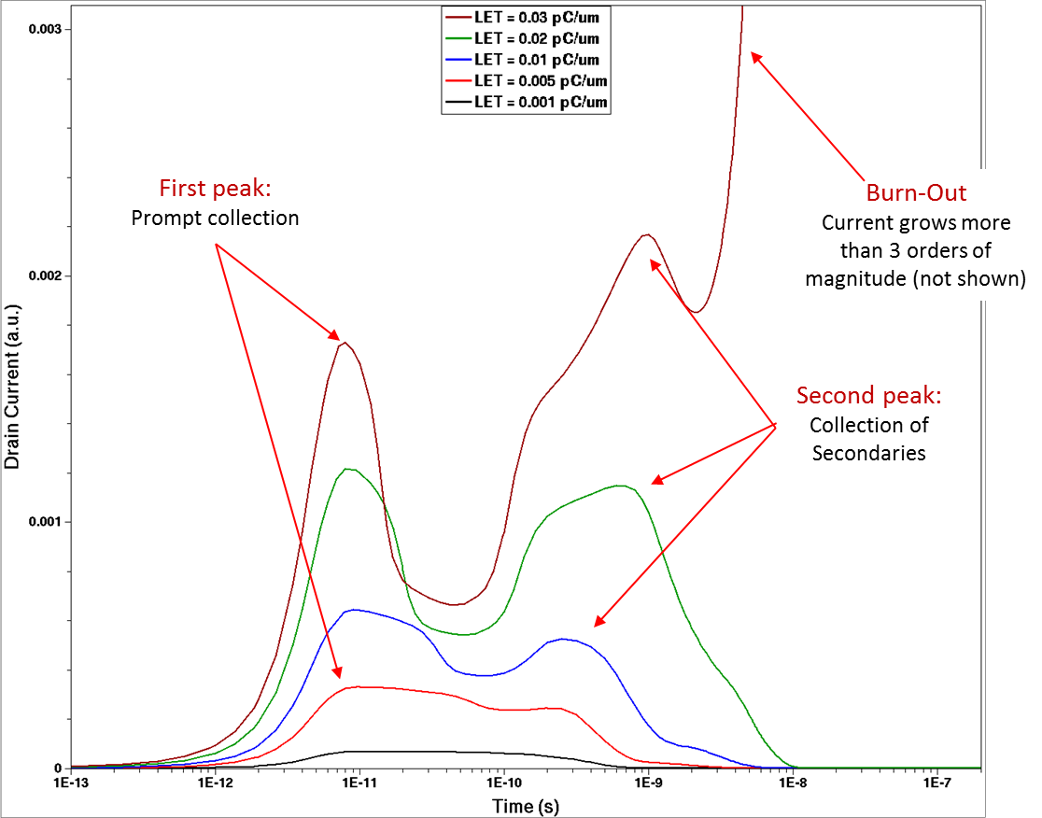
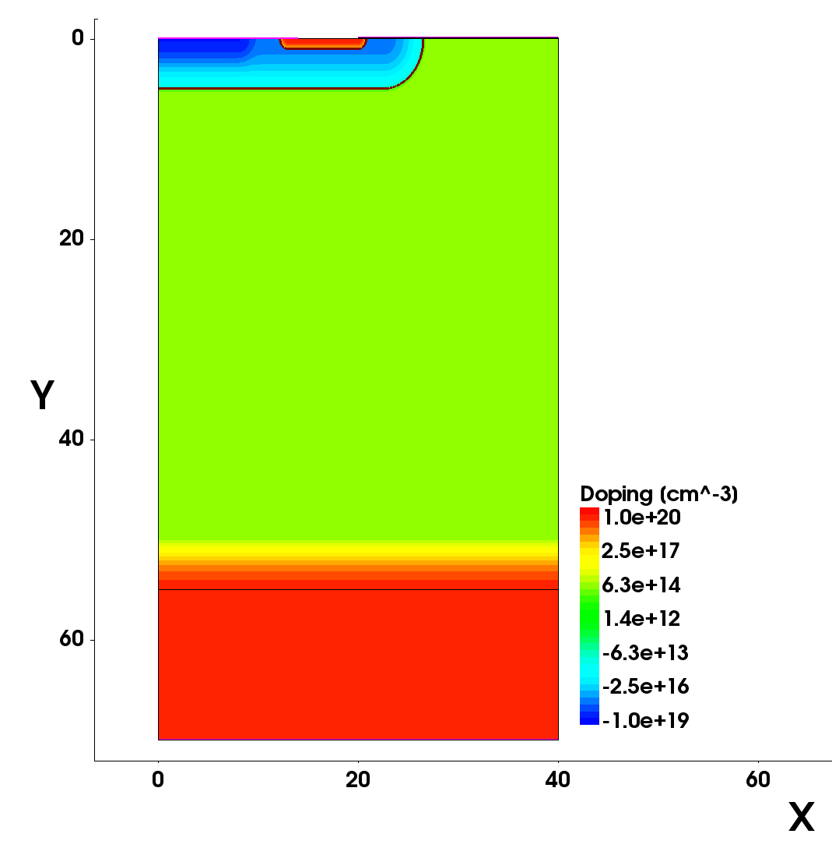
Simulation approach
TCAD 2D Model
P+
N+
Gate Oxide (100 nm)
P Body
N- Epitaxy
Gaussian transition
N+ Substrate

Slide 7
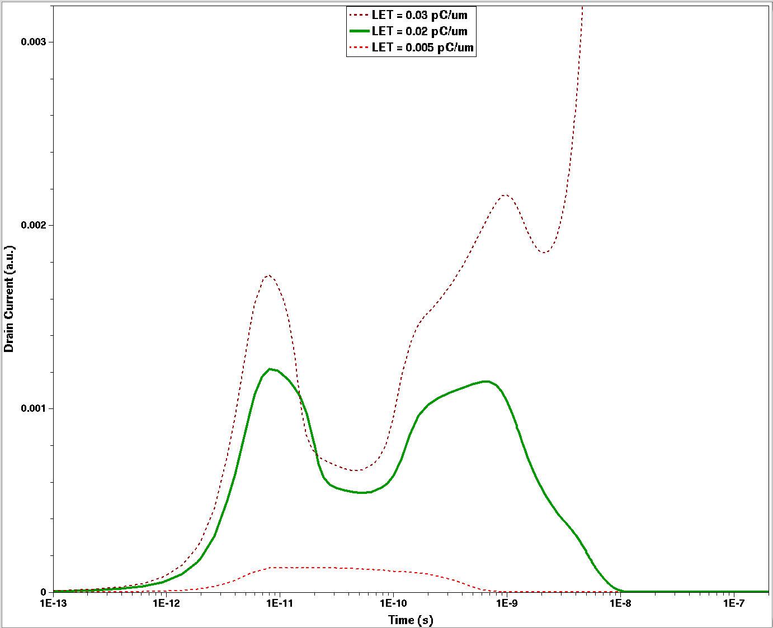
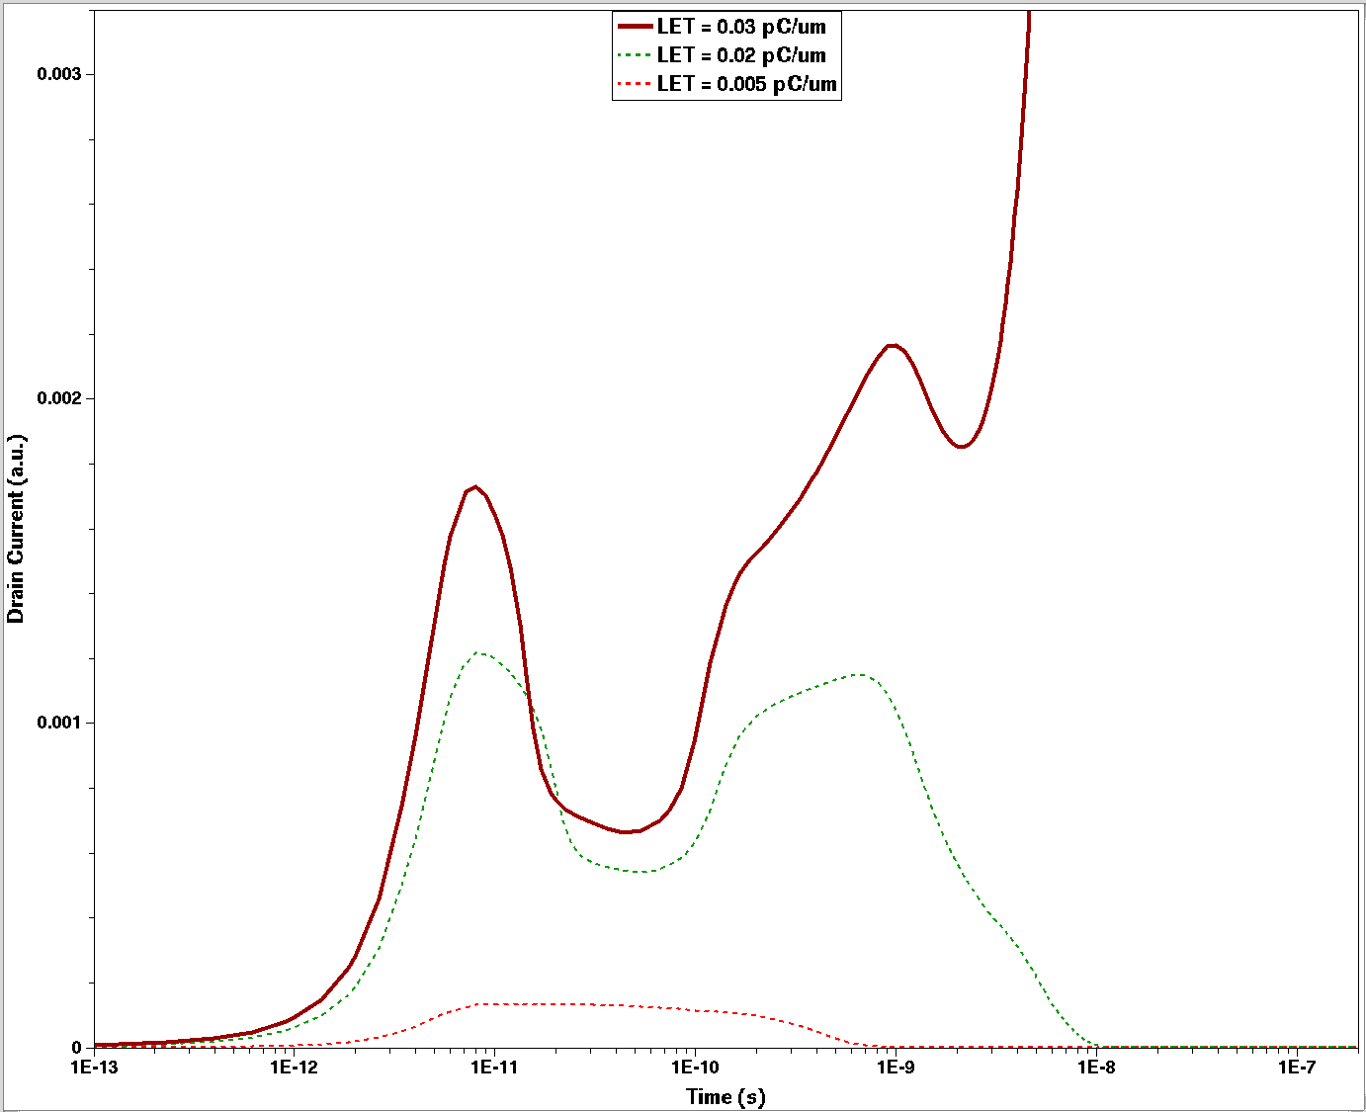
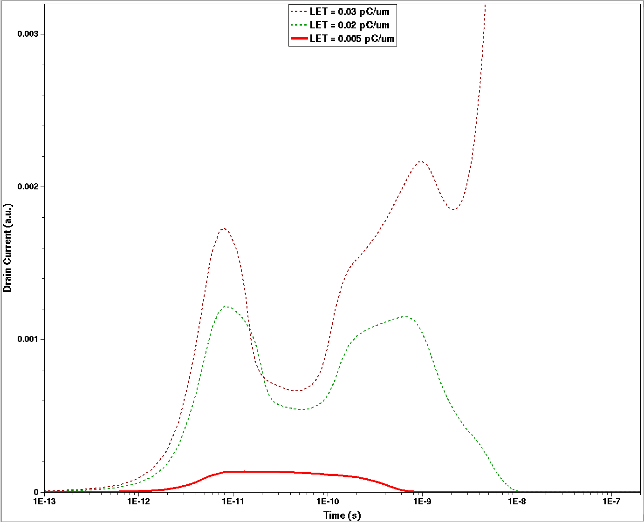
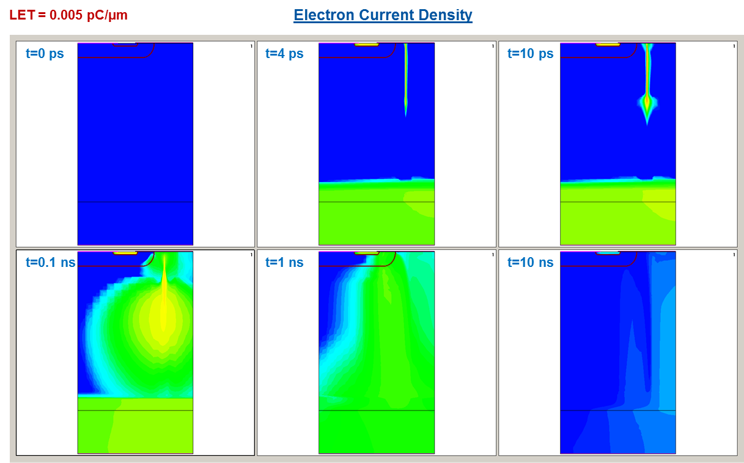
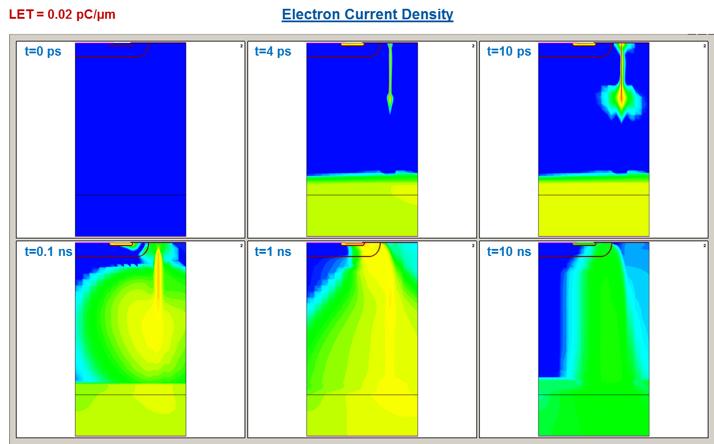
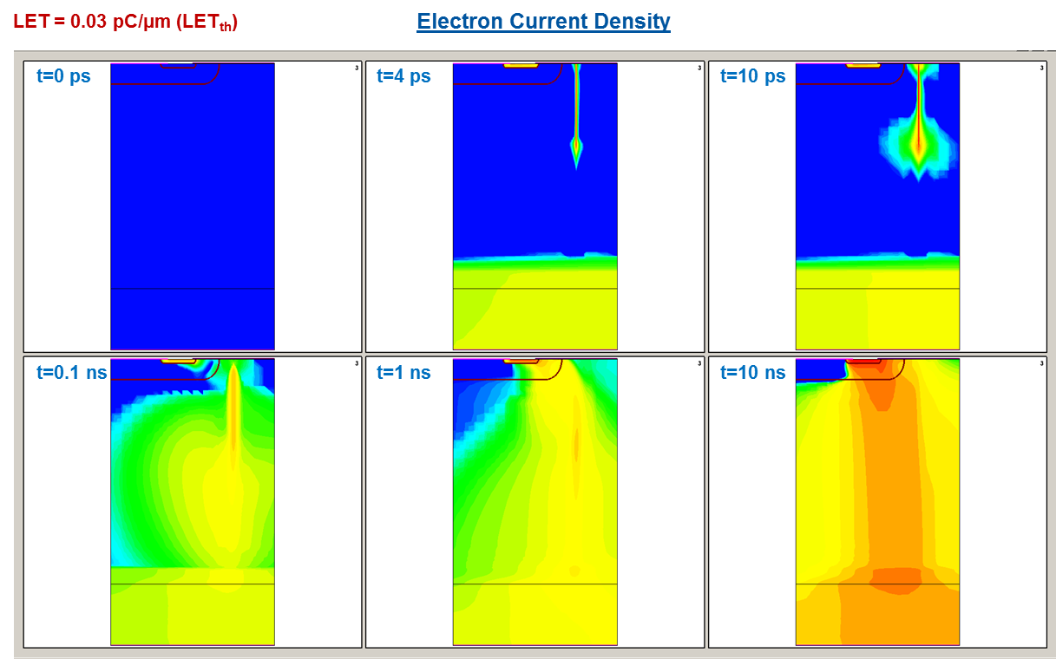
Simulation approach
TCAD 2D Model
P+
N+
Gate Oxide (100 nm)
P Body
N- Epitaxy
Gaussian transition
N+ Substrate

Slide 8
Simulation approach
SEE: Stochastic
TCAD: Deterministic
FLUKA/TCAD Combination
TCAD Simulation is an excellent tool to evaluate the consequences of the SEE at device level
  Evaluate and define Sensitive Volumes
  Define SOA: LET, range, voltage thresholds
From FLUKA to TCAD:
FLUKA: how the event-by-event energy is deposited in the device
TCAD: What are the consequences on the device performance
From TCAD to FLUKA:
TCAD Simulation cannot give statistic predictions
TCAD: Identification of SV and triggering criteria
FLUKA: Interaction only on this SV with triggering criteria

Slide 9
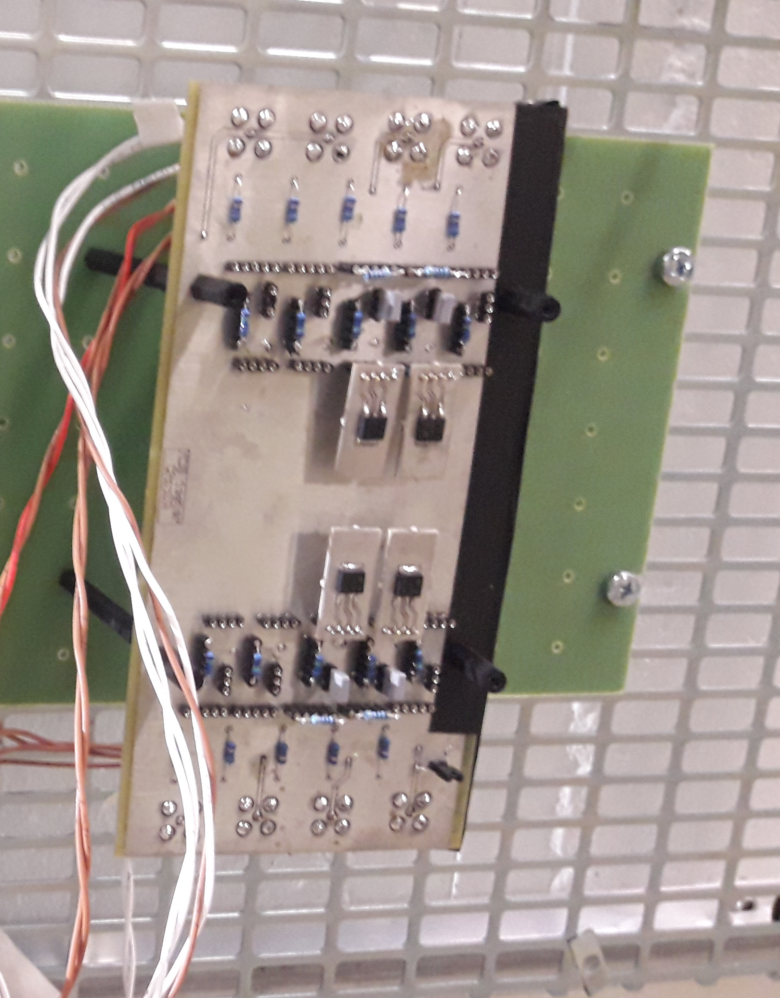
Experimental approach
Credits to G. Tsiligiannis, G. Foucard and S. Danzeca
How to test SEE on Power MOSFETs?
Destructive vs. Non-destructive
“Standard” setup for each kind of SEE?
Case of Study: SEB on COTS Power MOSFET
Based on P. Oser et al. IEEE TNS, 61 (2014)

Slide 10
Experimental approach
COTS MOSFET: Tested in mixed-field (CHARM), atmospheric-like neutron spectrum (ChipIR) and UHE HI beams (CHARM and SPS-NA)
STD10: 100 V, 13 A
Simulated V_{th} for SEB
Simulated V_{th} for SEB
Preliminary Analysis

Slide 11
Outlook and Future work
The study of SEE on Silicon Power MOSFETs is faced from a theoretical, simulation and experimental point of view
R2E related objectives:
  To provide a list of MOSFETs of different characteristics that are compliant with the high-energy accelerator radiation environment and typically radiation tolerance requirements
  To outline possible links between the MOSFETs technology and its sensitivity/tolerance to radiation
Future: New references/components, new technologies, new tests, improved setups….

Slide 12
¡Muchas Gracias!

