Slide 1
Ultra-High Energy heavy ion test campaigns at CHARM and North Area CERN Facilities
Maria Kastriotou, Pablo Fernandez Martinez, on behalf of the STI/BMI – R2E unit
Indico link: https://indico.cern.ch/event/760345/

Slide 2
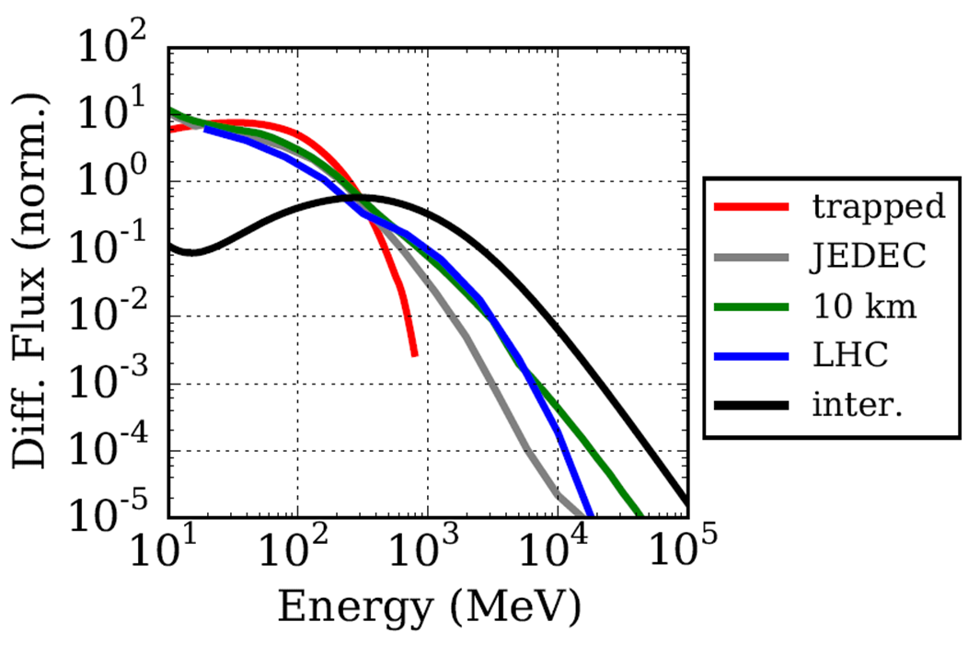
Interest in heavy ions
Roughly 20% of the hadron flux in the LHC tunnel has energies greater than 1 GeV
Heavy ions can be used for soft error evaluation and part screening for destructive events.
Insensitivity to heavy ions of large enough LET grants insensitivity to protons and mixed field environments

Slide 3
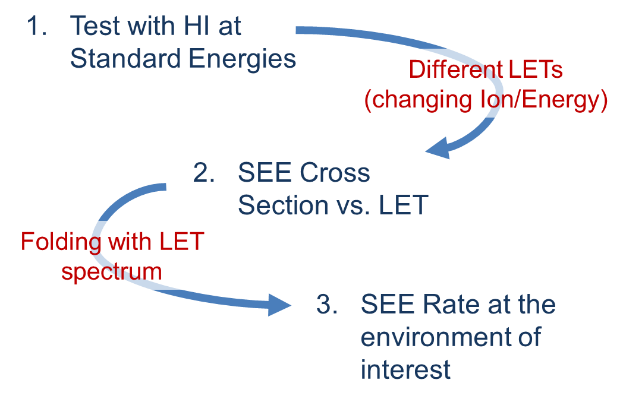
Why heavy ion testing?
Standard heavy ion facilities:
~70-270 μm range of ions
Component delidding (hazardous for the component, impossible in complex geometries)
Non constant LET throughout the SV
Tests in Vacuum
UHE ion testing provides a homogeneous LET without the need for component delidding, while introducing the possibility of parallel board testing.
Notes:
Underline that indeed, for complex geometries and packaging structures, testing with protons and/or very high energy ion beams might be the only solution

Slide 4
CHARM and North Area ion beams
Pb beam characteristics | CHARM | North Area
Energy (AGeV/c) | 5.4 | 150
LET (MeVcm²/mg) | 8.0 | 8.8
Beam size (cm²) | ~5x5 - 8x8 | Up to ~ 5x5
Pulse length (s) | ~0.2 | ~10
Complementary facilities, with similar LET and different beam characteristics
North Area provides lower fluxes, variable beam size/intensity possible to change in the control room, and frequent accesses
CHARM is ideal for irradiation with higher particle fluences, provides good dosimetry and is adapted to electronic systems testing.
Due to the large beam size, big/multiple components can be tested.
The flux is high enough to perform displacement damage studies (F. Ravotti, I. Mateu)

Slide 5
Test practice
Preparation
(2 months)
Calibration
Tests
Internal setups
Contact of users
Investigation of beam dosimetry instruments and calibration methods
Local (facility) beam instruments and additional detectors
CHARM: 3 weeks (incl. calibration)
North Area: 1 week (incl. calibration)

Slide 6
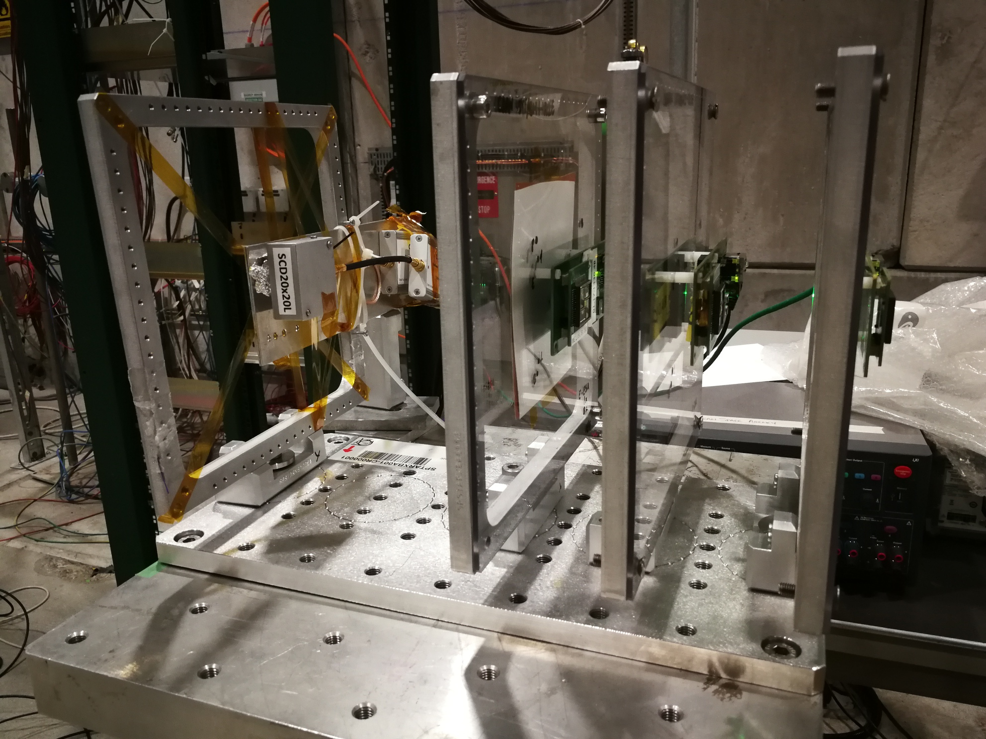
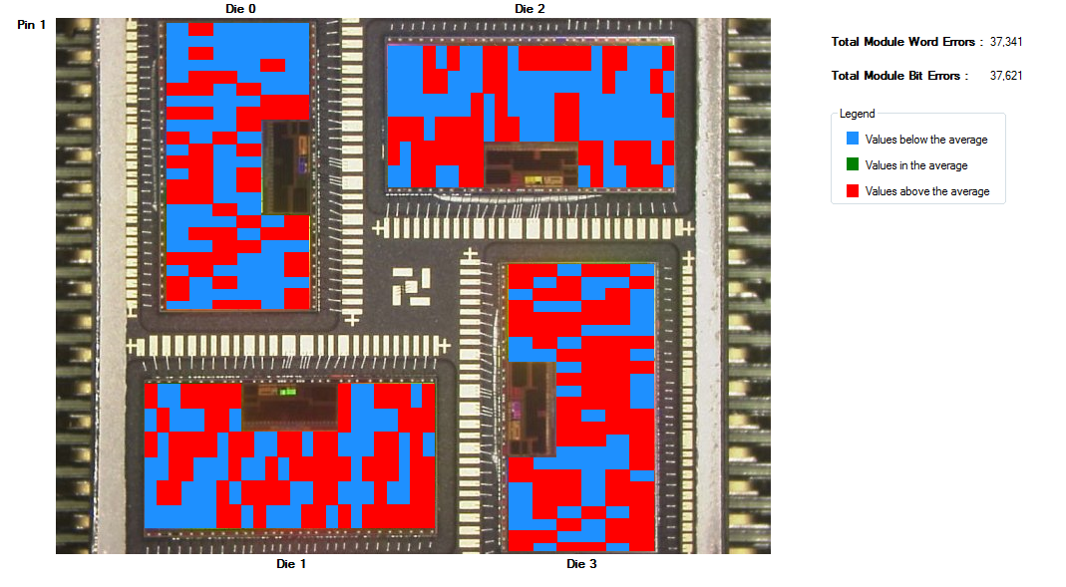
Beam attenuation in UHE
3 ESA monitors in parallel
Well aligned beam
Max attenuation of 20% in all cases
Parallel board testing is possible, fluence calibration is preferable
Notes:
North Area and beam attenuation

Slide 7
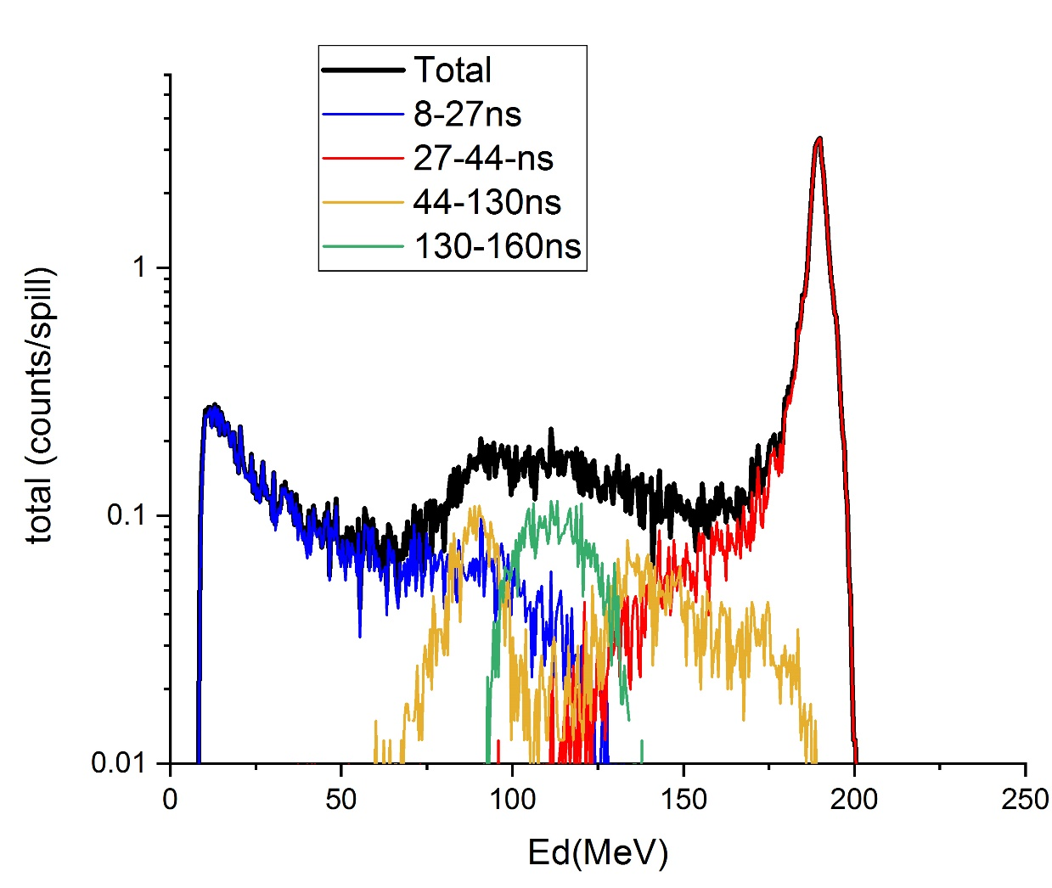
Beam fragmentation in UHE
Beam composition examined by a diode (C.Cazzaniga, ChipIr), following the setup with 3 sets of boards+plexiglass
Beam fragmented, however the initial, high LET Pb ions still compose large part of the beam
Type1: fast signals: neutrons/light ions
Type2: The main peak. Direct ionization of Pb
Type3: Probably fission fragments?
Type 4: Possibly a different kind of fragments?

Slide 8
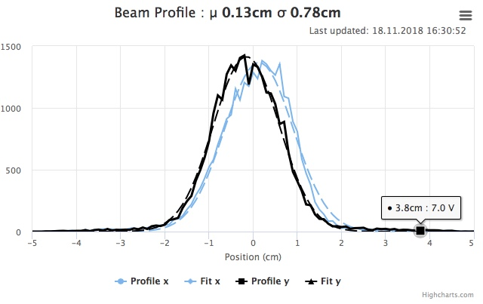
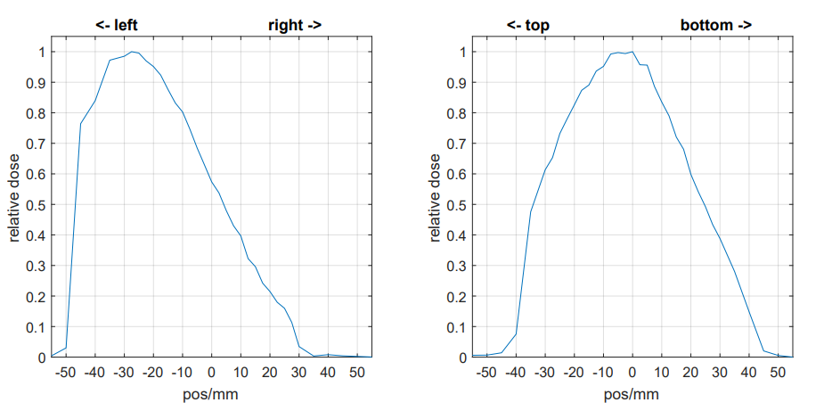
Challenges faced in the North Area
Facility provided instruments: DWC (delay wire chamber - beam size), scintillator (counts and composition)
Measurements with other detectors imply that the beam size is different than the one suggested by the DWC. Still under investigation (large deam divergence due to a defocused beam?)
DWC
PTW

Slide 9
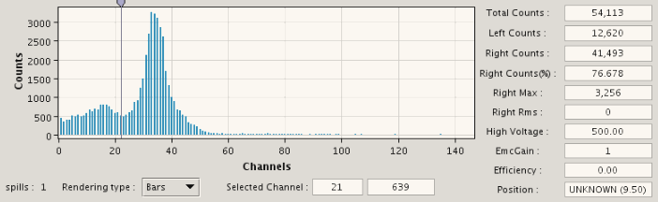
Challenges faced in the North Area
Facility provided instruments: DWC (delay wire chamber - beam size), scintillator (counts and composition)
The scintillator pulse height analysis, showing the beam fragmentation, does not contain the full energy window (different to previous diode measurements).

Slide 10
Performed tests
In both facilities, under UHE heavy ion beam, STI/BMI tests included:
  ESA SEU monitor
  SRAM memories (Samsung, Alliance, Brilliance, Lyontek, Cypress 65 & 90 nm)
  Power MOSFETs (see P. Fernandez Martinez’s talk)
  GaN devices
Data analysis pending
Preliminary results show great agreement with past studies
Preliminary

Slide 11
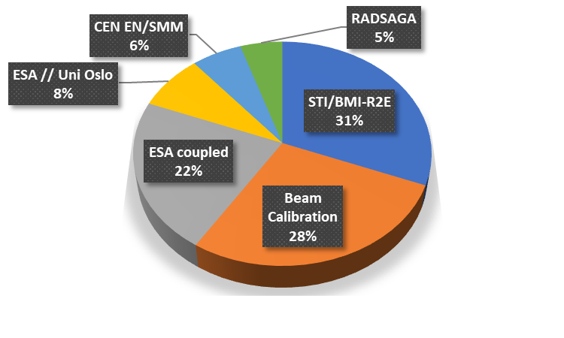
Collaboration with external R2E teams
Knowledge Transfer – Testing opportunities – CERN Visibility
North Area tests
In CHARM tests the CERN:externals ratio is 60:40
(CHARM tests summarized by S. Danzeca in “CERN facilities* ”)
JALIKO (IR)
University of Pireaus (GR)
TU Delft (NL)
Politecnico di Torino (IT)
*https://indico.cern.ch/event/760345/contributions/3159586/attachments/1769002/2873455/Facility_R2E_Annual_Meeting_2018_mb_ch.pdf

Slide 12
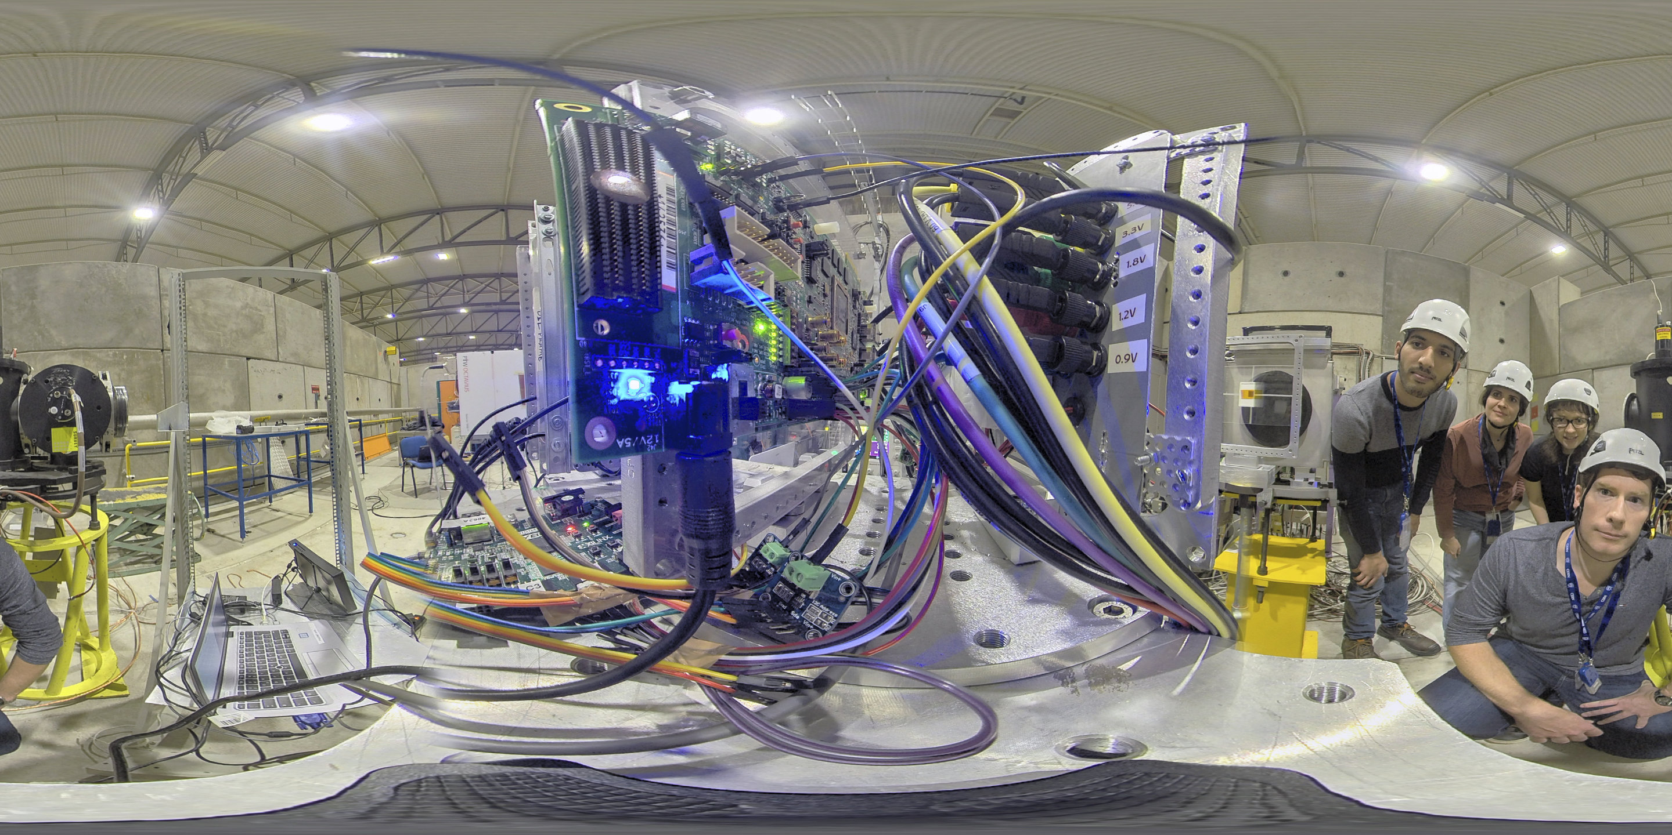
CERN/facilities visibility
CERN/ESA/INTEL
Myriad 2 radiation test
Google news
International (+NL, IRL, IT, SE, GR) websites

Slide 13
Outlook
Measured results to be coupled with FLUKA simulations
During LS2 a large data acquisition in different heavy ion facilities is being planned
CHARM is an independent facility dedicated to electronics testing. We should use CHARM experience to prepare future UHE ion tests in the North Area:
  Communication/agreement with EN/EA
  Selection and upgrade of a location that can support electronics testing:
    Independent line (accesses)
    Shielding (high intensities)
    Beam Instruments appropriate and calibrated for UHE heavy ions

Slide 14
Summary
UHE heavy ions constitute a very useful tool for electronic component evaluation
UHE heavy ion beams are highly interesting for component testing in view of the HL-LHC high radiation levels
CERN heavy beams have been greatly appreciated by the external R2E community
Careful preparation will contribute to take even greater advantage of the North Area beam
Thank you !
Notes:
scientifically and if energy effects are of interest (ionization track structure, nuclear reactions) the CERN ion beams provide a truly unique test opportunity

