Slide 1
SEE flux and spectral hardness calibration of neutron spallation and mixed field facilities
Matteo Cecchetto
R. García Alía, P. Fernández-Martínez, R. Ferraro, S. Danzeca
Indico link: https://indico.cern.ch/event/760345/

Slide 2
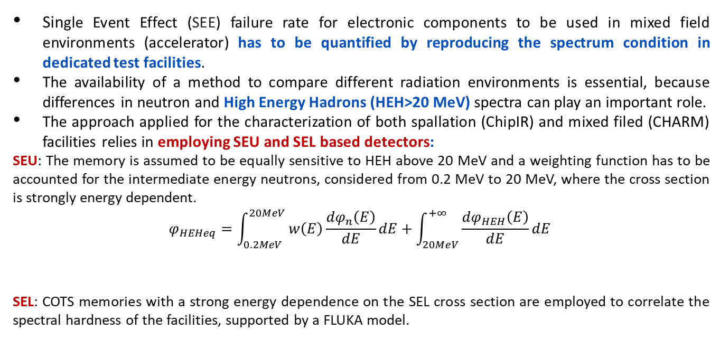
Introduction
Single Event Effect (SEE) failure rate for electronic components to be used in mixed field environments (accelerator) has to be quantified by reproducing the spectrum condition in dedicated test facilities.
The availability of a method to compare different radiation environments is essential, because differences in neutron and High Energy Hadrons (HEH>20 MeV) spectra can play an important role.
The approach applied for the characterization of both spallation (ChipIR) and mixed filed (CHARM) facilities relies in employing SEU and SEL based detectors:
SEU: The memory is assumed to be equally sensitive to HEH above 20 MeV and a weighting function has to be accounted for the intermediate energy neutrons, considered from 0.2 MeV to 20 MeV, where the cross section is strongly energy dependent.
$$φ_{HEHeq}=\int_{0.2MeV}^{20MeV}{w\left(E\right)\frac{{dφ}_{n}\left(E\right)}{dE}dE}+\int_{20MeV}^{+∞}{\frac{{dφ}_{HEH}\left(E\right)}{dE}dE}$$
SEL: COTS memories with a strong energy dependence on the SEL cross section are employed to correlate the spectral hardness of the facilities, supported by a FLUKA model.
Intermediate energy neutrons start to be a major concern with scaling of technology.
R2E Annual Meeting

Slide 3
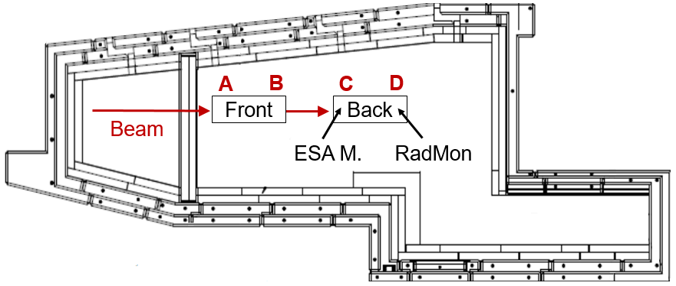
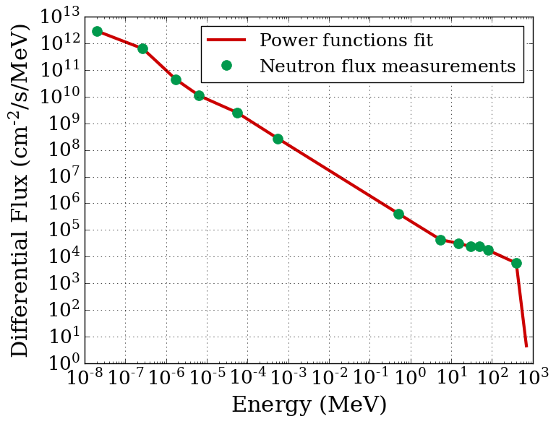
ChipIr facility
The ChipIr (Chip Irradiation) facility (UK), provides a broad neutron atmospheric like spectrum.
  Energies from the thermal neutrons up to 800 MeV
  Neutrons produced by colliding protons against a tungsten target.
  The flux was measured using multi-foils activation.
It was investigated in order to verify its capability of reproducing the SEU and SEL cross sections typically observed in mixed field environments, such as CHARM.
Figure 1: ChipIr spectrum
12 December 2018
R2E Annual Meeting

Slide 4
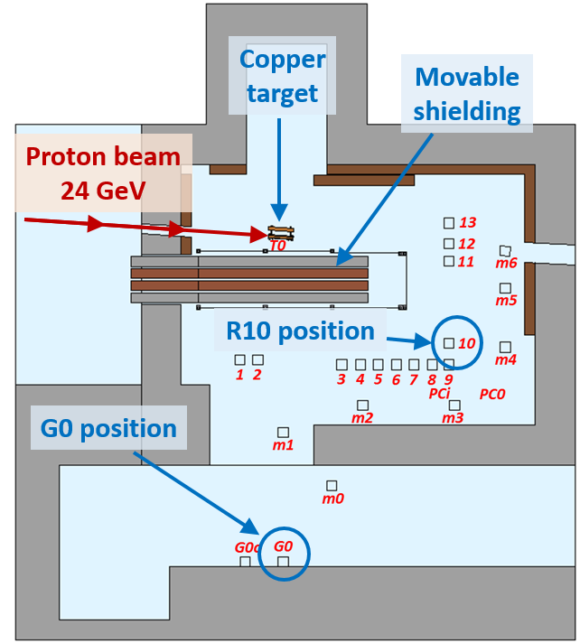
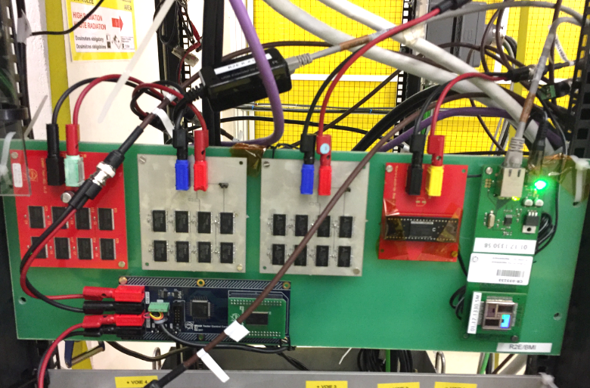
CHARM facility
CHARM generates a mixed-field mainly composed by neutrons, protons and pions from the interaction of 24 GeV proton beam with a copper target.
R10 (hard spectrum) and G0 (soft spectrum) were employed.
SEU and SEL boards tested in R10
R2E Annual Meeting

Slide 5
ChipIR flux cross-calibration
The flux calibration was carried out with:
  1) ESA SEU Monitor (0.25 µm SRAM memory)
  2) RadMon system (Toshiba 400 nm, Cypress 90 nm).
  - Excellent HEHeq agreement within 1% was obtained with the RadMon;
  - Thermal neutron flux within the uncertainty (quite high due to the very low ThN flux compared to the HEH one).
the intermediate energy neutron response (i.e. PTB at 5, 8 and 14 MeV) is essential to derive the flux from the ESA Monitor and Cypress memories.
HEHeq [cm⁻²/s] |  |  |  | ThN [cm⁻²/s]
ESA M. | Spectrum | RadMon | Spectrum | RadMon | Spectrum
2.97×10⁶ ±20% | 3.44×10⁶ | 3.09×10⁶ ±21% | 3.07×10⁶ | 3.49×10⁴ +2.8×10⁵ | 1.60×10⁵
R2E Annual Meeting

Slide 6
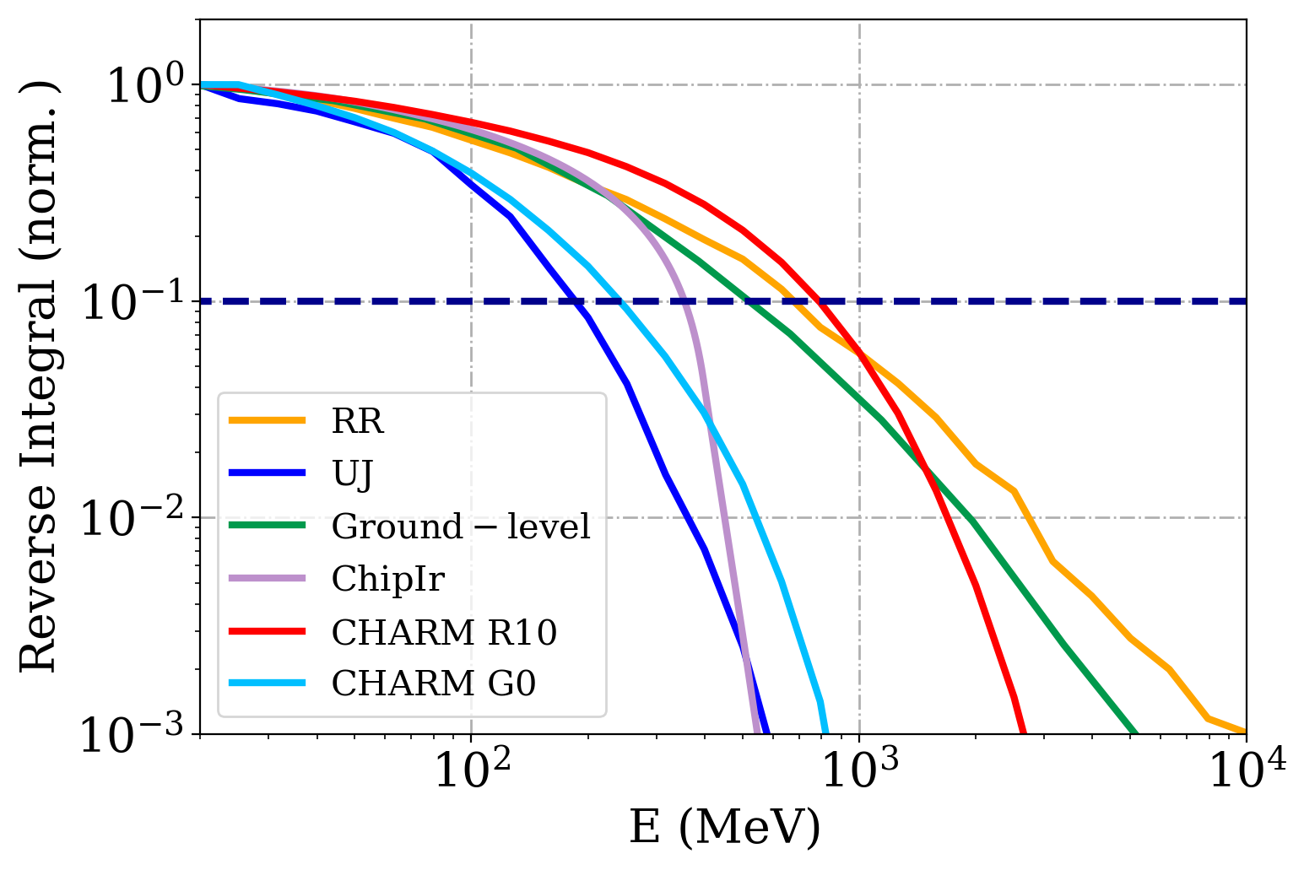
SPECTRAL HARDNESS ASSESSMENT – SEL measurements
Samsung (180 nm) and Alliance (200 nm) are SRAM memories with a strong SEL cross section energy dependence due to the presence of tungsten, deployed as detectors.
Assessment in:
  operational environments: JEDEC, accelerator (UJ, RR alcoves)
  test facilities: ChipIR, CHARM (G0, R10 positions).
  UJ, RR, R10 and G0 are composed by neutrons, protons, pions.
The spectral hardness is quantified through the H_{10%} factor, representative of the energy above which 10% of the total HEH flux is still present in the spectrum, (visible in the reverse integral).
H_{10%}
MeV | UJ | G0 | ChipIr | JEDEC | RR | R10 | Tunnel
H_{10%} | 183 | 194 | 354 | 525 | 690 | 790 | 1800
R2E Annual Meeting

Slide 7
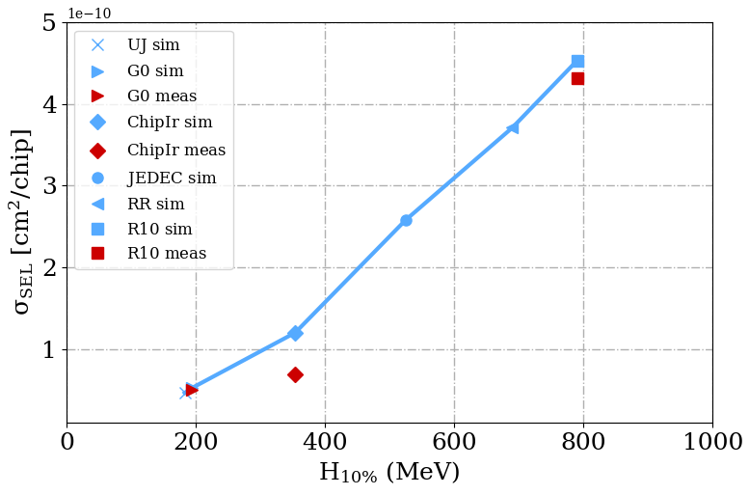
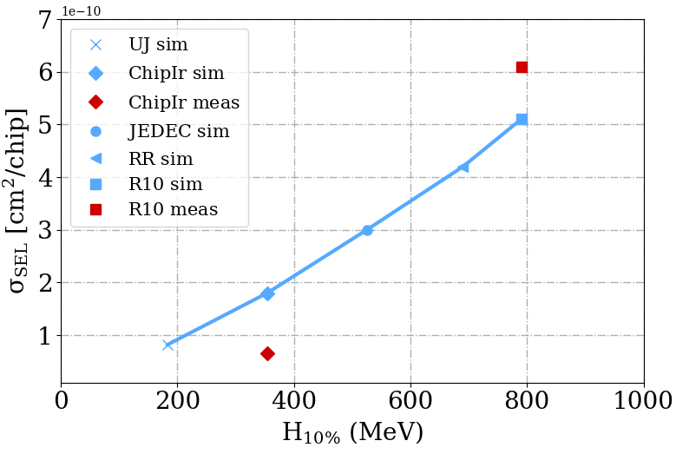
SPECTRAL HARDNESS ASSESSMENT – SEL FLUKA simulations
The FLUKA model retrieves the SEL XS up to several GeV, given the spectrum, Sensitive Volume (SV) thickness and geometrical parameters of the memories.
The SV surface is 4x20 µm² and 0.48 µm³/cell of tungsten are considered.
  Measurements and simulations are in agreement within 60% over a very broad energy and cross section range. Considering the experimental uncertainties of about 30%, the agreement is satisfactory.
Alliance
Strong risk of qualifying components for SEEs in environments with a lower spectral hardness than the operational one.
Samsung

Slide 8
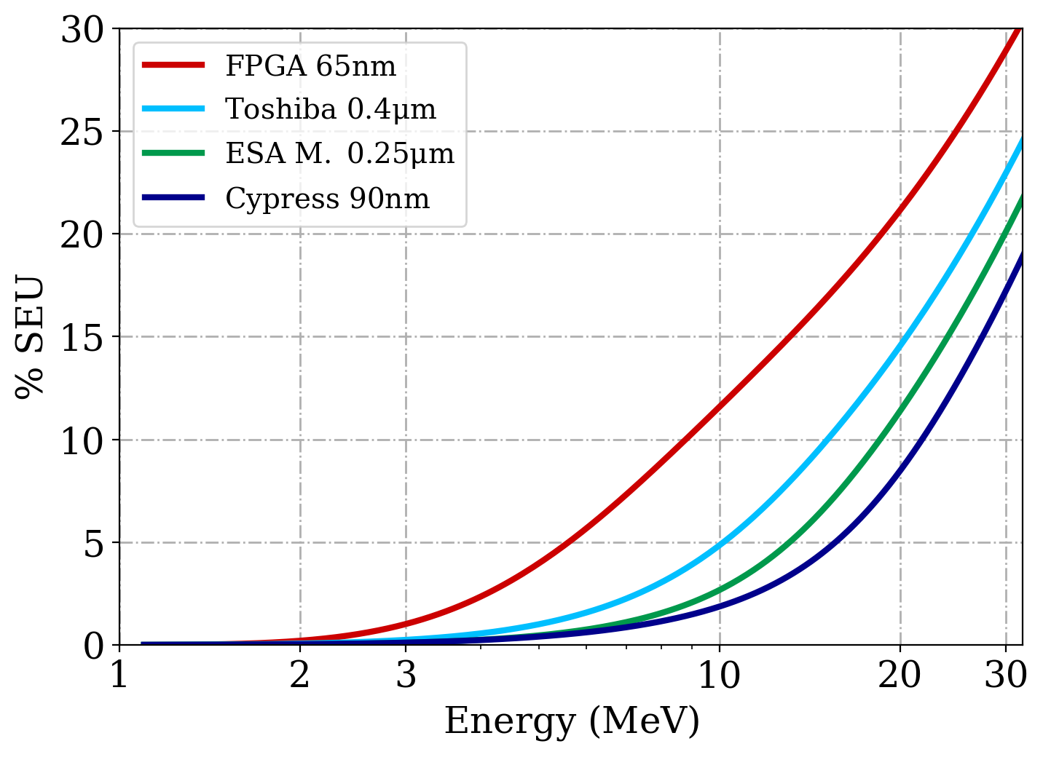
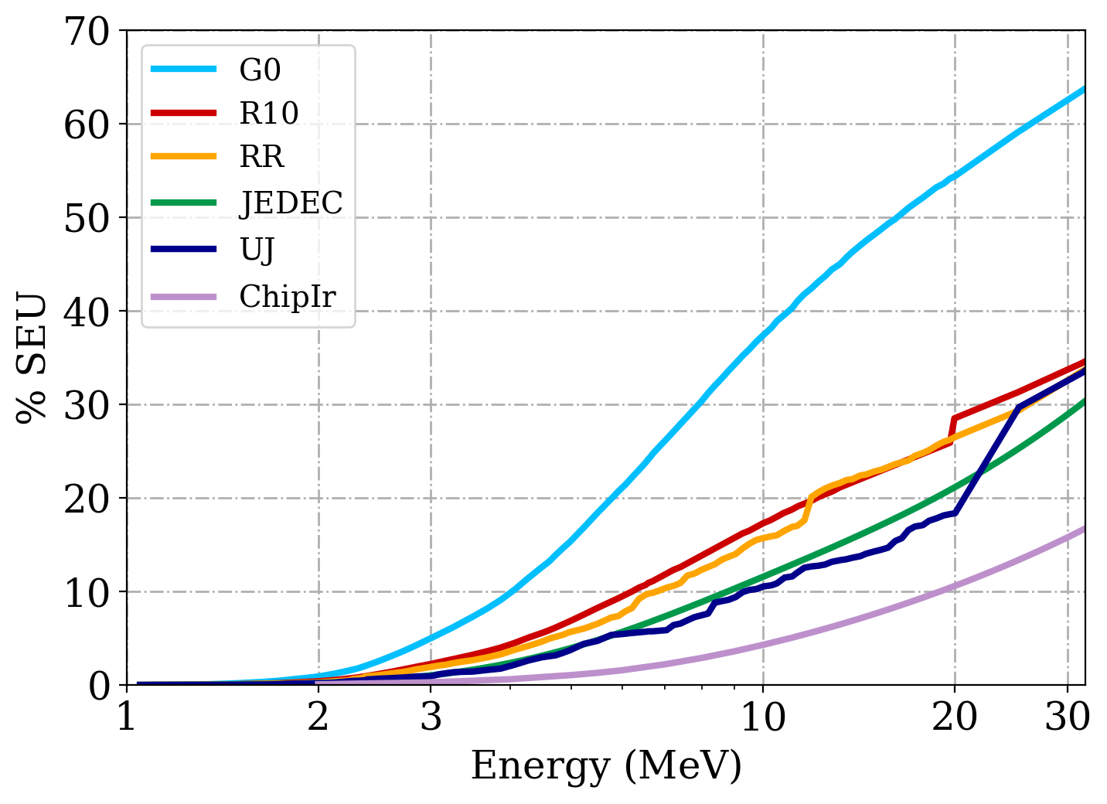
SER induced by intermediate energy neutrons (1)
SER on ESA Monitor, Toshiba, Cypress and a 65 nm FPGA* is evaluated in the 1-3 MeV, 1-10 MeV, 1-20 MeV energy intervals.
65nm FPGA with a G0-like spectrum
more than 50% of the SEUs are induced by neutrons below 20 MeV.
SER from ground level spectrum
SER on 65 nm FPGA
*D. Lambert et al., “Single Event Upsets Induced by a few MeV Neutrons in SRAMs and FPGAs,” in 2017 IEEE Radiation Effects Data Workshop (REDW)
R2E Annual Meeting

Slide 9
SER induced by intermediate energy neutrons (2)
1-3 MeV
negligible impact.
up to 12% of SER for JEDEC, ChipIR, UJ.
up to 36% for CHARM G0 position.
1-10 MeV
1-20 MeV
up to 21% of SER for ground level, 26% in accelerator applications and up to 54% for G0.
1-20 MeV | Spect % | ESA M. | Toshiba | Cypress | FPGA
UJ | 39.4 | 9.6 | 12.3 | 7.1 | 18.4
G0 | 84.1 | 39.2 | 31 | 24.1 | 54.4
ChipIr | 15.3 | 6.7 | 8.2 | 5 | 10.6
JEDEC | 43.4 | 11.4 | 14.5 | 8.5 | 21.1
RR | 56 | 17.8 | 13.5 | 9.9 | 26.5
R10 | 60.5 | 19.2 | 15.1 | 11.7 | 28.5
SER (%) impact of different spectra
R2E Annual Meeting

Slide 10
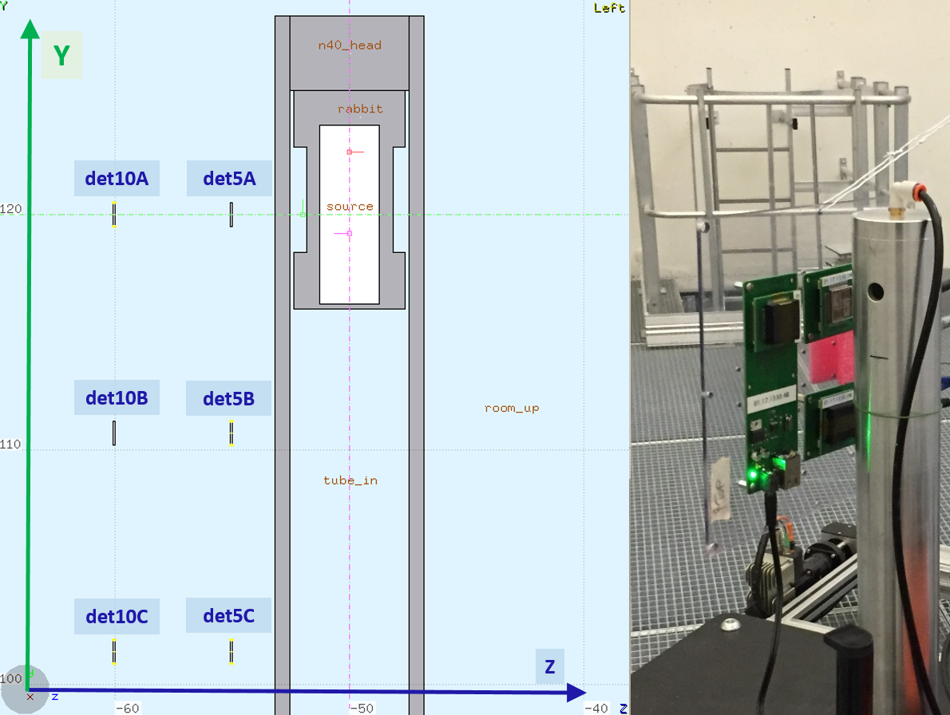
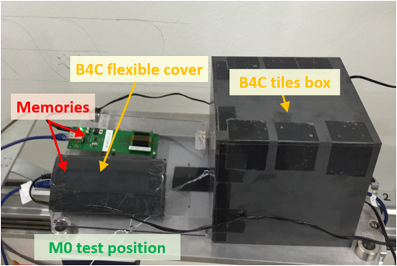
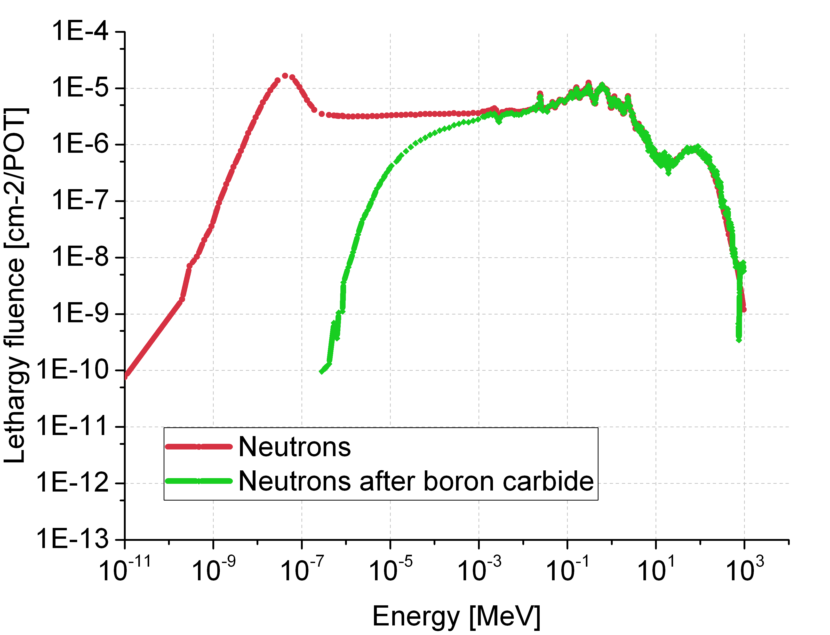
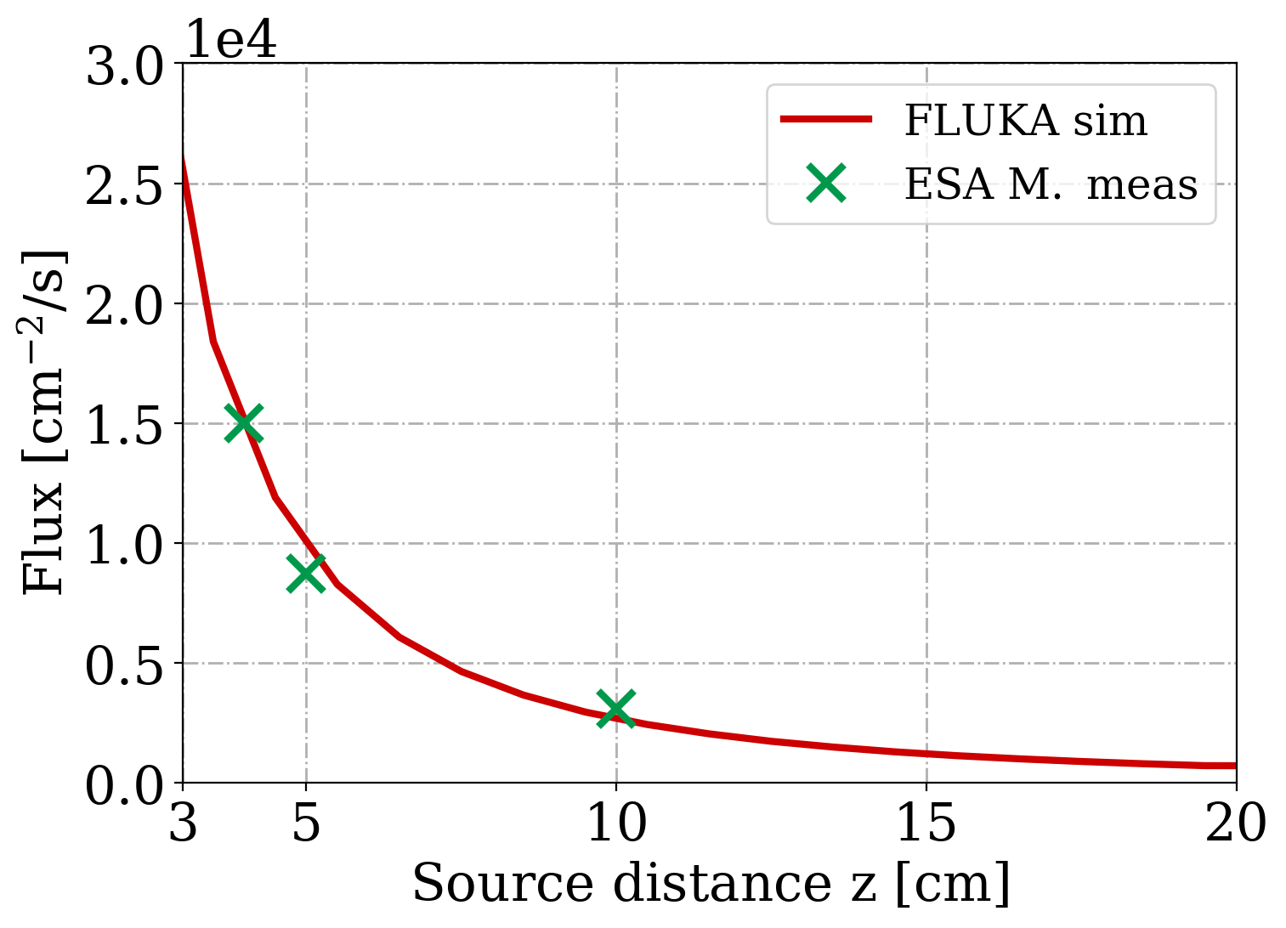
Complementary work/Outlook
The use of the Am-Be neutron source at CERN for SEU/SEE setup validation and evaluation of sensitivity to intermediate energy neutrons.
The impact of thermal neutrons, for which an important sensitivity has been measured for highly integrated technologies.
R2E Annual Meeting

Slide 11
Conclusions
The procedure of cross-calibrating spallation and mixed-field facility through SEU detectors have been shown to be valid, with an excellent agreement on the HEH flux.
The approach of determining the spectrum hardness through SEL measurements have been applied to ChipIr and CHARM. Compatible cross sections have been extracted through a FLUKA model, which therefore enables the calculations for environments in which measurements are not directly feasible, as for atmospheric and LCH areas.
The spectral hardness of ChipIr enables for tests dedicated to some accelerator applications as shielded areas. However, tunnel and more energetic alcoves exhibit harder spectra, reproducible in CHARM.
Considering the SEU rate of memories down to 65 nm, 1-10 MeV and 1-20 MeV ranges induce respectively up to 12% and 21% of the total SER in ground level applications, reaching up to 36% and 54% in accelerator environments.
Intermediate energy neutrons (1-20 MeV) yield a larger SER contribution in accelerator rather than atmospheric applications.
R2E Annual Meeting

