Slide 1
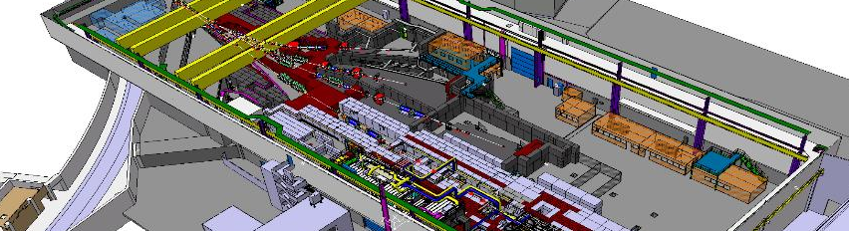


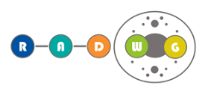

CHARM Dosimetry challenges and new opportunities
C. Cangialosi, Marie-Curie Fellow
R2E Annual Meeting 2018
12/12/18 - CERN

Slide 2

Overview
Studies of constraints encountered in the CHARM Dosimetry. Indeed, a deep knowledge of these peculiarities become essential to characterize properly the mixed field of the facility during the test session.
Studies for the improvement of CHARM facility in term of new test opportunities, starting from 2021.
  Boron Carbide shielding employment to protect electronic against ThNs.
  Exploring the capabilities of CHARM facility to measure the ThNs cross section of SRAMs.
CERN, Dec. 12, 2018

Slide 3

Overview
Studies of constraints encountered in the CHARM Dosimetry. Indeed, a deep knowledge of these peculiarities become essential to characterize properly the mixed field of the facility during the test session.
Studies for the improvement of CHARM facility in term of new test opportunities, starting from 2021.
  Boron Carbide shielding employment to protect electronic against ThNs.
  Exploring the capabilities of CHARM facility to measure the ThNs cross section of SRAMs.
RADECS 2017 Geneva, Switzerland, Oct. 2017.
C. Cangialosi et all. “Thermal Neutron SRAM Detector Characterization at the CERN Mixed-Field Facility, CHARM” IEEE Trans. Nucl. Sci., vol. 65, issue 8, pp. 1887-1893. - 2018
CERN, Dec. 12, 2018

Slide 4

CHARM Facility
PRIMARY PROTONS BEAM IMPINGES A METAL TARGET (POT): A SECONDARY RADIATION FIELD IS CREATED
3 KEY ELEMENTS:
Target
Movable Shielding
Positions
CuCIIC
POT/h = 3.38E+15
Scale
1 m
AlH - Aluminium Hole
Al - Aluminium
Cu - Copper
24 GeV Proton
13
T0
12
14
Movable
shielding
1
11
2
IN BEAM
3
Longitudinal Position
4
C – Concrete (1,4)
I – Iron (2,3)
NO accessible area
Lateral Position
10
3
4
5
6
1
2
7
8
9
16
15
>16 test positions
> 150 official configurations
THE SPECTRA AND INTENSITY OF SECONDARY FIELD DEPEND ON THE POSITION
Patch
Panels
0
Entrance
CERN, Dec. 12, 2018
Notes:
Choosing the target, the shielding and the test position it is possible to define the spectra and the intensity of the field.

Slide 5



CHARM Facility
At CHARM the POT are proportional to the intensity of the radiation field, so the Radiation Level at CHARM are measured as a function of POT:
$$Dose\left(p,c\right)=POT ∙K_{dose}\left(p,c\right)$$
$$Fluence_{HEH}\left(p,c\right)=POT ∙K_{HEH}(p,c)$$
During the calibration session the Dose, the Fluence (RadMon) and the POT (SEC) are measured:
Each position ‘p’ and configuration ‘c’ can be calibrated with two factors Kdose and KHEH .
$$\frac{Dose\left(p,c\right)}{POT}=K_{dose}\left(p,c\right) [Gy/POT]$$
$$\frac{Fluence_{HEH}\left(p,c\right)}{POT}=K_{HEH}\left(p,c\right) [{cm}^{−2}/POT]$$
During a standard irradiation session measuring the POT is possible to retrieve the Rad. Level on the DUT.
CERN, Dec. 12, 2018

Slide 6

Studies of constraints encountered in the CHARM Dosimetry
2018 Nuclear Science Symposium (NSS) and Medical Imaging Conference (MIC) Sydney, Australia, from the 10th to 17th of November
S. Danzeca, C. Cangialosi et all. “Challenges in dosimetry and testing in the CERN CHARM mixed radiation field Facility”
CERN, Dec. 12, 2018

Slide 7
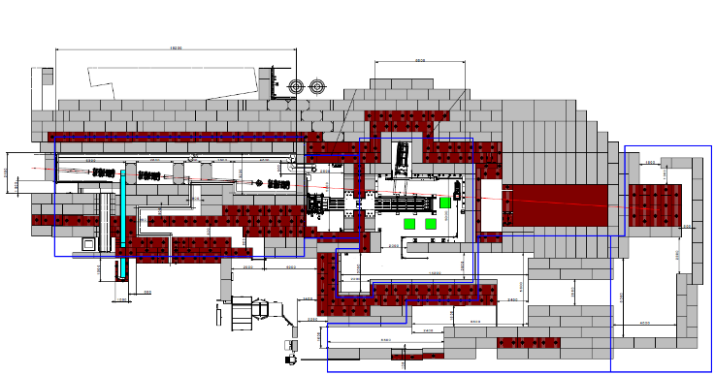
Influence of IRRAD Facility
  CHARM beam line is placed downstream to IRRAD
MWPC
DUMP
IRRAD
CHARM
SEC
PS p+
24 GeV
ENTRANCE
If massive and bulky samples are tested in IRRAD, the effective proton impinging on the target might be less that the one measured by the SEC.
This leads to an overestimation of the POT and consequently, an overestimation of dose and fluence levels calculate for the test run.
CERN, Dec. 12, 2018

Slide 8
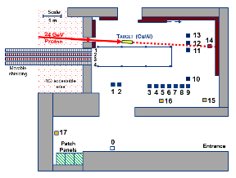
Influence of IRRAD Facility
To assess the IRRAD impact on the CHARM dosimetry, the CHARM HEH k-factor where no samples are placed in IRRAD, are compared with the ones obtained when copper slabs of different thickness are placed in the IRRAD beam-line.
Position 10
heh calibration factor retrieved for position 10 CuOOOO configuration
IRRAD Copper sample | k_{HEH} [10⁻⁵·cm⁻²/POT] | Percentage difference with Normal Run
Normal run* | 7.44 | 0%
1.5 cm | 6.88 | -8%
3 cm | 6.03 | -19%
6 cm | 4.68 | -37%
* NO Samples on the IRRAD beam line
The effects of a sample 6 cm thick lead to radiation levels up to 37% lower than the ones without any samples.
The dose and the fluences on the user’s equipment need to be monitored during the test runs.
CERN, Dec. 12, 2018
Notes:
When IRRAD inserts some samples in the beam line, a decrease
of the counts of SEC2 is expected, as some primary protons are scattered from the beam
line direction. At difference with this expectation, we measured an increase of the counts.
This increase is caused by secondary particles, which are generated by the interaction
between the primary protons and the IRRAD sample. Secondary particles are emitted in
the same direction of the beam line and they are counted by the SEC2. Due to the low
momentum of these secondary particles, when they impinge inside the target, they do not
contribute to the generation of the mixed field of CHARM. In this way, the measurement
of SEC2 are overestimating the real number of POT.

Slide 9
Beam position Influence on the Dose
Position 13
MWPC
Scale
1 m
24 GeV Proton
13
12
14
Movable
shielding
1
11
2
3
4
NO accessible area
10
3
4
5
6
1
2
7
8
9
Position 1
Position 16
Patch
Panels
0
CERN, Dec. 12, 2018
Notes:
Position 1 (up to -60% diff) and Position 16 (up to -50%).
A=110cm, B=84cm, C=160cm
H-FWHM
V-FWHM
51.9 +/- 7.7
47.7+/- 5.5

Slide 10
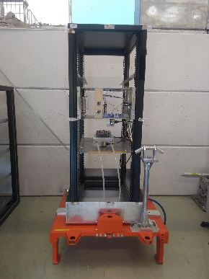
Beam position Influence on the Dose
Position 13
Position 13 – Cu target
Beam position on the Horiz. axis (mm) | K_{Dose} - Percentage difference with Centered Run (%)
 | Position A | Position B | Position C
48.7±0.2 | 59% | 17% | 42%
23.0±0.6 | 27% | 22% | 43%
1.3±0.4 | 0% | 0% | 0%
-33.5±0.8 | -43% | -57% | -59%
C
Beam
A
B
The beam position influences the Rad. level measurement.
The K decrease going away from the beam.
This influence is also observed at test location 1 and 16.
x (mm)
50
23
-33
The dose and the fluences on the user’s equipment need to be monitored during the test runs.
CERN, Dec. 12, 2018
Notes:
Position 1 (up to -60% diff) and Position 16 (up to -50%).
A=110cm, B=84cm, C=160cm
In the direction of

Slide 11
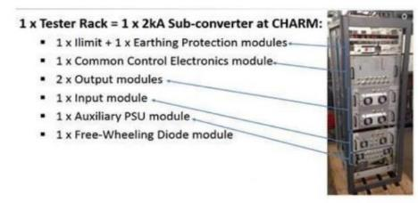
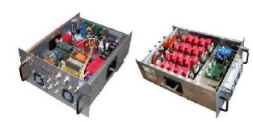
Self shielding effect – R10
Possibility to test large volumes electronic equipment
CERN, Dec. 12, 2018

Slide 12
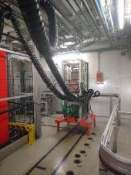
Self shielding effect – R10
Side A
Side B
Position 10 – CuOOOO
Radiation Level | Percentage difference between side A and side B (%)
 | 119 cm
Dose | -34%
HEH | -32%
TE/EPC Test
The dose and the fluences on the user’s equipment need to be monitored during the test runs.
CERN, Dec. 12, 2018

Slide 13

Boron Carbide shielding employment to protect electronic against ThNs
SATIF-14
14th Specialists' workshop on Shielding aspects of Accelerators,Targets, and Irradiation Facilities.
Gyeongju, Korea, Oct. 30 2018
C. Cangialosi et all. “Evaluation of future employment of Boron Carbide shielding at CERN High energy AcceleRator Mixed field (CHARM) Facility”.
CERN, Dec. 12, 2018

Slide 14
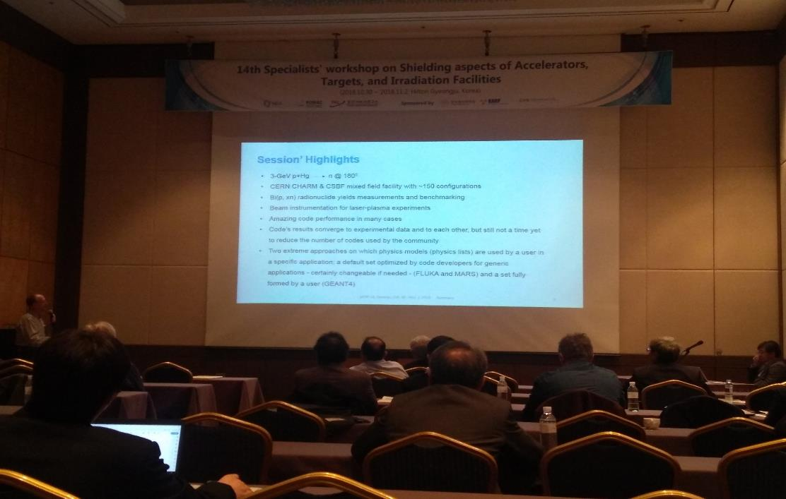
SATIF-14
High appreciation in SATIF-14!
CERN, Dec. 12, 2018

Slide 15
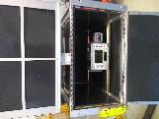
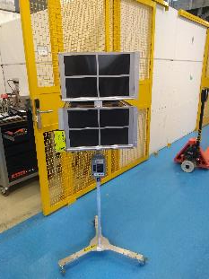
Evaluation of a new type of shielding (B₄C)
To asses the effectiveness of this type of shielding in accelerator-like environment.
Comparison of different B₄C shielding:
  80% B content
  25% B content
RadMon 1
25% B – 7.0 mm
RadMon 2
25% B - 3.5 mm
RadMon 1 Boron Free
  Evaluation of the shielding as a function of Boron sheet thickness (from 2mm to 7mm)
The B₄C shielding employment at CHARM can improve the facility test capability?
CERN, Dec. 12, 2018
Notes:
Not used in the LHC.
Boron weight percent: 80%: 650 E/m2 ---> 2mm and 800E/m2 ---> 5mm.
Thermal neutron affettono l’elettronica, specialmente se c’e’ boro –COTS
Assorber, boron carbide shielding
Boron carbide mass content: 25% B: 400E/m2---> 3.2 mm and 800E/m2 ---> 7mm

Slide 16
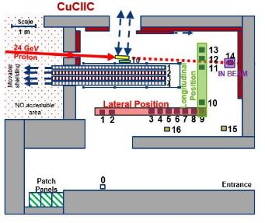
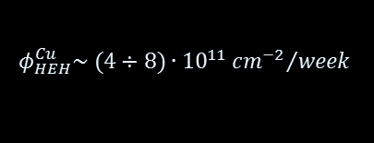
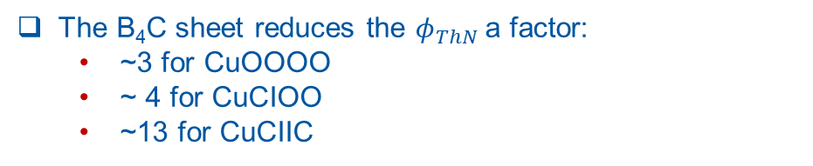
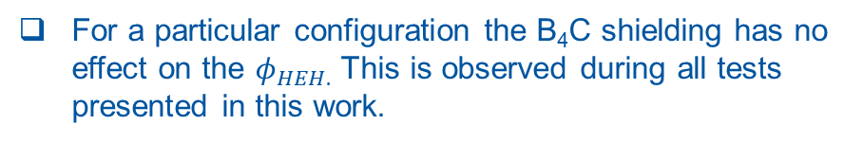
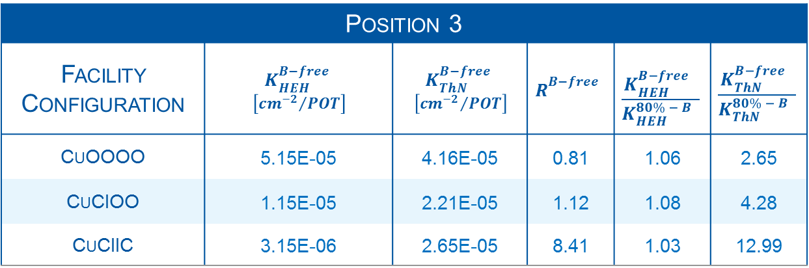
B₄C shielding effect at CHARM
Position 3
Facility Configuration | $$K_{HEH}^{B−free}$$ $$\left[{{cm}^{−2}}/{POT}\right]$$ | $$K_{ThN}^{B−free}$$ $$\left[{{cm}^{−2}}/{POT}\right]$$ | $$R_{}^{B−free}$$ | $$\frac{K_{HEH}^{B−free} }{K_{HEH}^{80\% − B} }$$ | $$\frac{K_{ThN}^{B−free} }{K_{ThN}^{80\% − B} }$$
CuOOOO | 5.15E-05 | 4.16E-05 | 0.81 | 1.06 | 2.65
CuCIOO | 1.15E-05 | 2.21E-05 | 1.12 | 1.08 | 4.28
CuCIIC | 3.15E-06 | 2.65E-05 | 8.41 | 1.03 | 12.99
$$φ_{HEH}^{Cu}\sim (4÷8)∙{10}^{11}{{cm}^{−2}}/{week}$$
POT=Protons impinging on the target
For a particular configuration the B₄C shielding has no effect on the $φ_{HEH.}$ This is observed during all tests presented in this work.
Pos. 3
The B₄C sheet reduces the $φ_{ThN }$a factor:
~3 for CuOOOO
~ 4 for CuCIOO
~13 for CuCIIC
A similar behavior is observed with the Al target at the same position.
CERN, Dec. 12, 2018
Notes:
Intensita piu basse

Slide 17

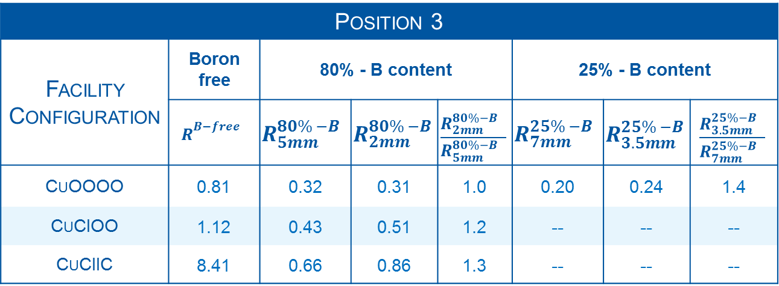
B₄C shielding effect at CHARM
Position 3
Facility Configuration | Boron free | 80% - B content |  |  | 25% - B content
 | $$R_{}^{B−free}$$ | $$R_{5mm}^{80\% −B}$$ | $$R_{2mm}^{80\% −B}$$ | $$\frac{R_{2mm}^{80\%−B} }{R_{5mm}^{80\%−B} }$$ | $$R_{7mm}^{25\% −B}$$ | $$R_{3.5mm}^{25\% −B}$$ | $$\frac{R_{3.5mm}^{25\%−B} }{R_{7mm}^{25\%−B} }$$
CuOOOO | 0.81 | 0.32 | 0.31 | 1.0 | 0.20 | 0.24 | 1.4
CuCIOO | 1.12 | 0.43 | 0.51 | 1.2 | -- | -- | --
CuCIIC | 8.41 | 0.66 | 0.86 | 1.3 | -- | -- | --
The B₄C sheet (both 80% and 25% B content) modifies the particle spectra in favour of HEH with respect to ThN, also for facility configuration with high R factor value.
The thickness of the B₄C sheet plays a key role at higher R-factor value.
In configuration CuOOOO the sheet thickness is negligible for 80% B-sheets, but is significant for the 25% one.
CERN, Dec. 12, 2018
Notes:
It gives information on the softness of the spectrum

Slide 18
Conclusion and Outlook
The Irrad-influence, the beam position influence and the self-shielding effect of massive equipment, make the Dosimetry at CHARM is a real challenge. For this reasons the Radiation Level monitoring during user’s test is necessary.
The tests a CHARM shows the B₄C sheet an efficient solution to protect the electronics operating in the LHC and in the accelerator-like environment.
The B₄C sheets with 80% of Boron seems the best solution for environment defined by spectra dominated by ThN.
2018:
More than 150 configurations.
2021:
The use of a rack covered of B₄C sheet will increase the number of configurations exploitable at CHARM. It will enhance the facility test capability covering new radiation environments suitable for new applications.
Thank you all the CHARM Team!!!
CERN, Dec. 12, 2018
Notes:
We will still keep in charm

Slide 19
Thank you for your attention!

Slide 20
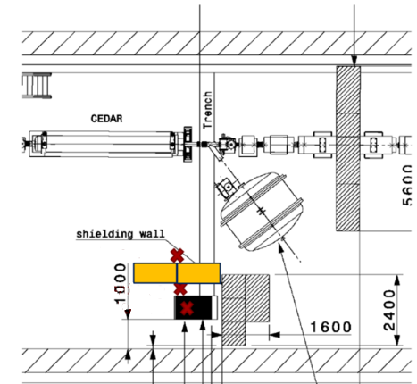
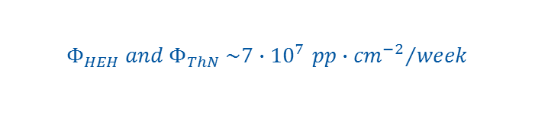
Application
Concrete
NA62 Experiment
Rack covered with B₄C
Aim to study rare kaon decays
2017:
several failures in the readout of electronic equipment.
$$Φ_{HEH} and{ Φ}_{ThN} \sim 7∙{10}^{7 }{{pp∙cm}^{−2}}/{week}$$
can induces failures to electronic components (FPGAs or SRAM).
Pos. A
Pos. B
2018:
Concrete shielding
B₄C shielding
BatMon System
Pos. C
CERN, Dec. 12, 2018
Notes:
In order to assess the radiation levels in the tunnel, and to validate the shielding effect put in place in the 2017, BatMons have been installed in the tunnel areas close to the sensitive equipment in the 2018. At the end of the 2017, two additional concrete blocks have been installed close to the LKr readout rack to reduce even further the High energy hadron (HEH) fluence coming from the target zone. In addition to this, the racks containing the electronics for the KTAG and LKr have been covered with sheets of Boron Carbide (B4C) to shield from the thermal neutrons (THN) which could have been the cause of several failures in the 2017 run.
NA62 will measure the rate at which the charged kaon decays into a charged pion and a neutrino-antineutrino pair.
The measurements carried out in the time frame 20/06/2018 - 18/07/2018 showed that the HEH and Thermal neutron out of the shielding are in the range of 7E7 per week. This value can potentially induces failures to electronic equipment such as FPGAs or SRAM memories. The shielding effectively reduces the HEH fluence by a factor ~10 as can be noted in Table 4 (Position1/Position2 and Position1/Position3). The boron carbide shielding is very effective to capture thermal neutron, indeed the thermal neutron fluence is reduced by a factor 28 with respect to the out shielding position (Position1/Position2) and of a factor 12 only considering the effect of the boron carbide (Position3/Position2).
pixel tracking detectors (GTK) tracking detectors
Liquid Krypton calorimeter detector, (LKr)

Slide 21
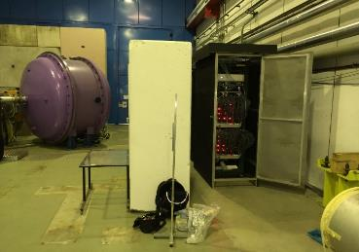
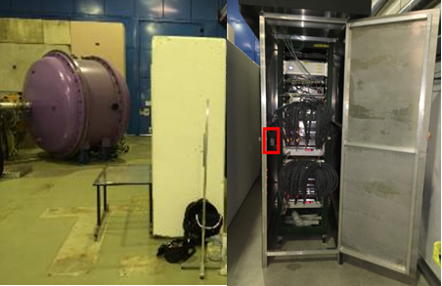
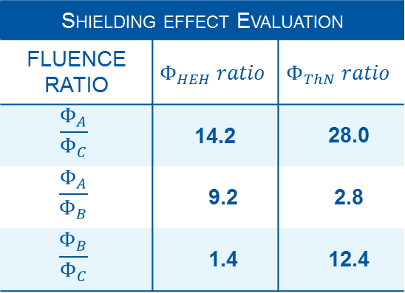
Application
Shielding effect Evaluation
FLUENCE RATIO | $$Φ_{HEH} ratio$$ | $$Φ_{ThN} ratio$$
$$\frac{Φ_{A}}{Φ_{C}}$$ | 14.2 | 28.0
$$\frac{Φ_{A}}{Φ_{B}}$$ | 9.2 | 2.8
$$\frac{Φ_{B}}{Φ_{C}}$$ | 1.4 | 12.4
A
B
C
The Co-shielding reduces the $Φ_{HEH}$ by a factor ~10
B₄C-shielding reduces the $Φ_{ThN}$ by a factor 12
The two shielding are very effective to capture ThN, indeed the $Φ_{ThN}$ is reduced by a factor 28.
CERN, Dec. 12, 2018
Notes:
Liquid Krypton calorimeter detector, (LKr)

Slide 22
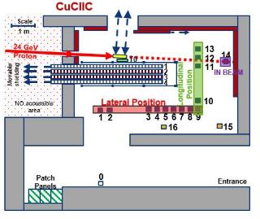
Application Vs CHARM
A
B
C
NA62 → Position A → $7.1∙{10}^{7} \frac{pp∙{cm}^{−2}}{week}$
CHARM conf. → AlHOOOO at Position 0 → $8.5∙{10}^{7} \frac{pp∙{cm}^{−2}}{week}$
CERN, Dec. 12, 2018
Notes:
Liquid Krypton calorimeter detector, (LKr)

