Slide 1
Investigation of new technologies and concepts for reliable computation and fast communication
Georgios Tsiligiannis
EN-SMM-RME

Slide 2
Outline
Introduction
Problematic
FPGAs Solutions
μProcessors Solutions
Future Work

Slide 3
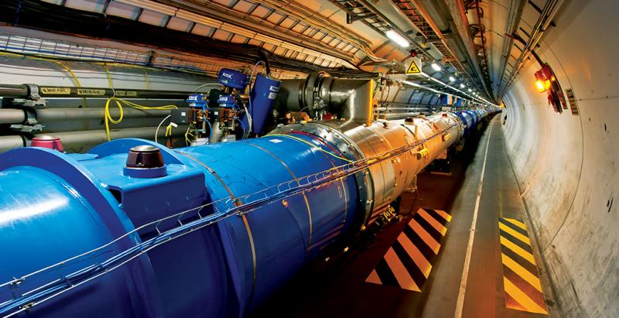


Introduction
Electronic Systems are based in the co-existence between analogue and digital components
  Central core (the “brain”) is usually a μProcessor, or an FPGA.
  Computational, control and communication tasks
The faster our “brain” works, the more (and better) things we can do!
SRAM
FLASH
However!!! Radiation Effects to Electronics have always been a limitation factor when it comes to performance:
Future upgrades mean
  More data, higher speeds
  More radiation -> showstopper?
DC/DC
FPGA/
μProcessor
DAC
Amplifiers
ACTUATORS
LDO
ADC
SENSORS
TRANSCEIVER
(Eth) PHY

Slide 4


Problematic
speed
size
complexity
low power
interfaces
low cost!
So far there are two main type of systems:
  Systems that operate in high speed
  Systems that conduct complex operations
Reliability
Speed
The perfect component
Power
What if we want both speed and complexity?
What about reliability?
Different applications require different features
  A long investigation on FPGAs and μProcessors
  provide users with as many options as possible for them to chose
low power
speed
low cost

Slide 5
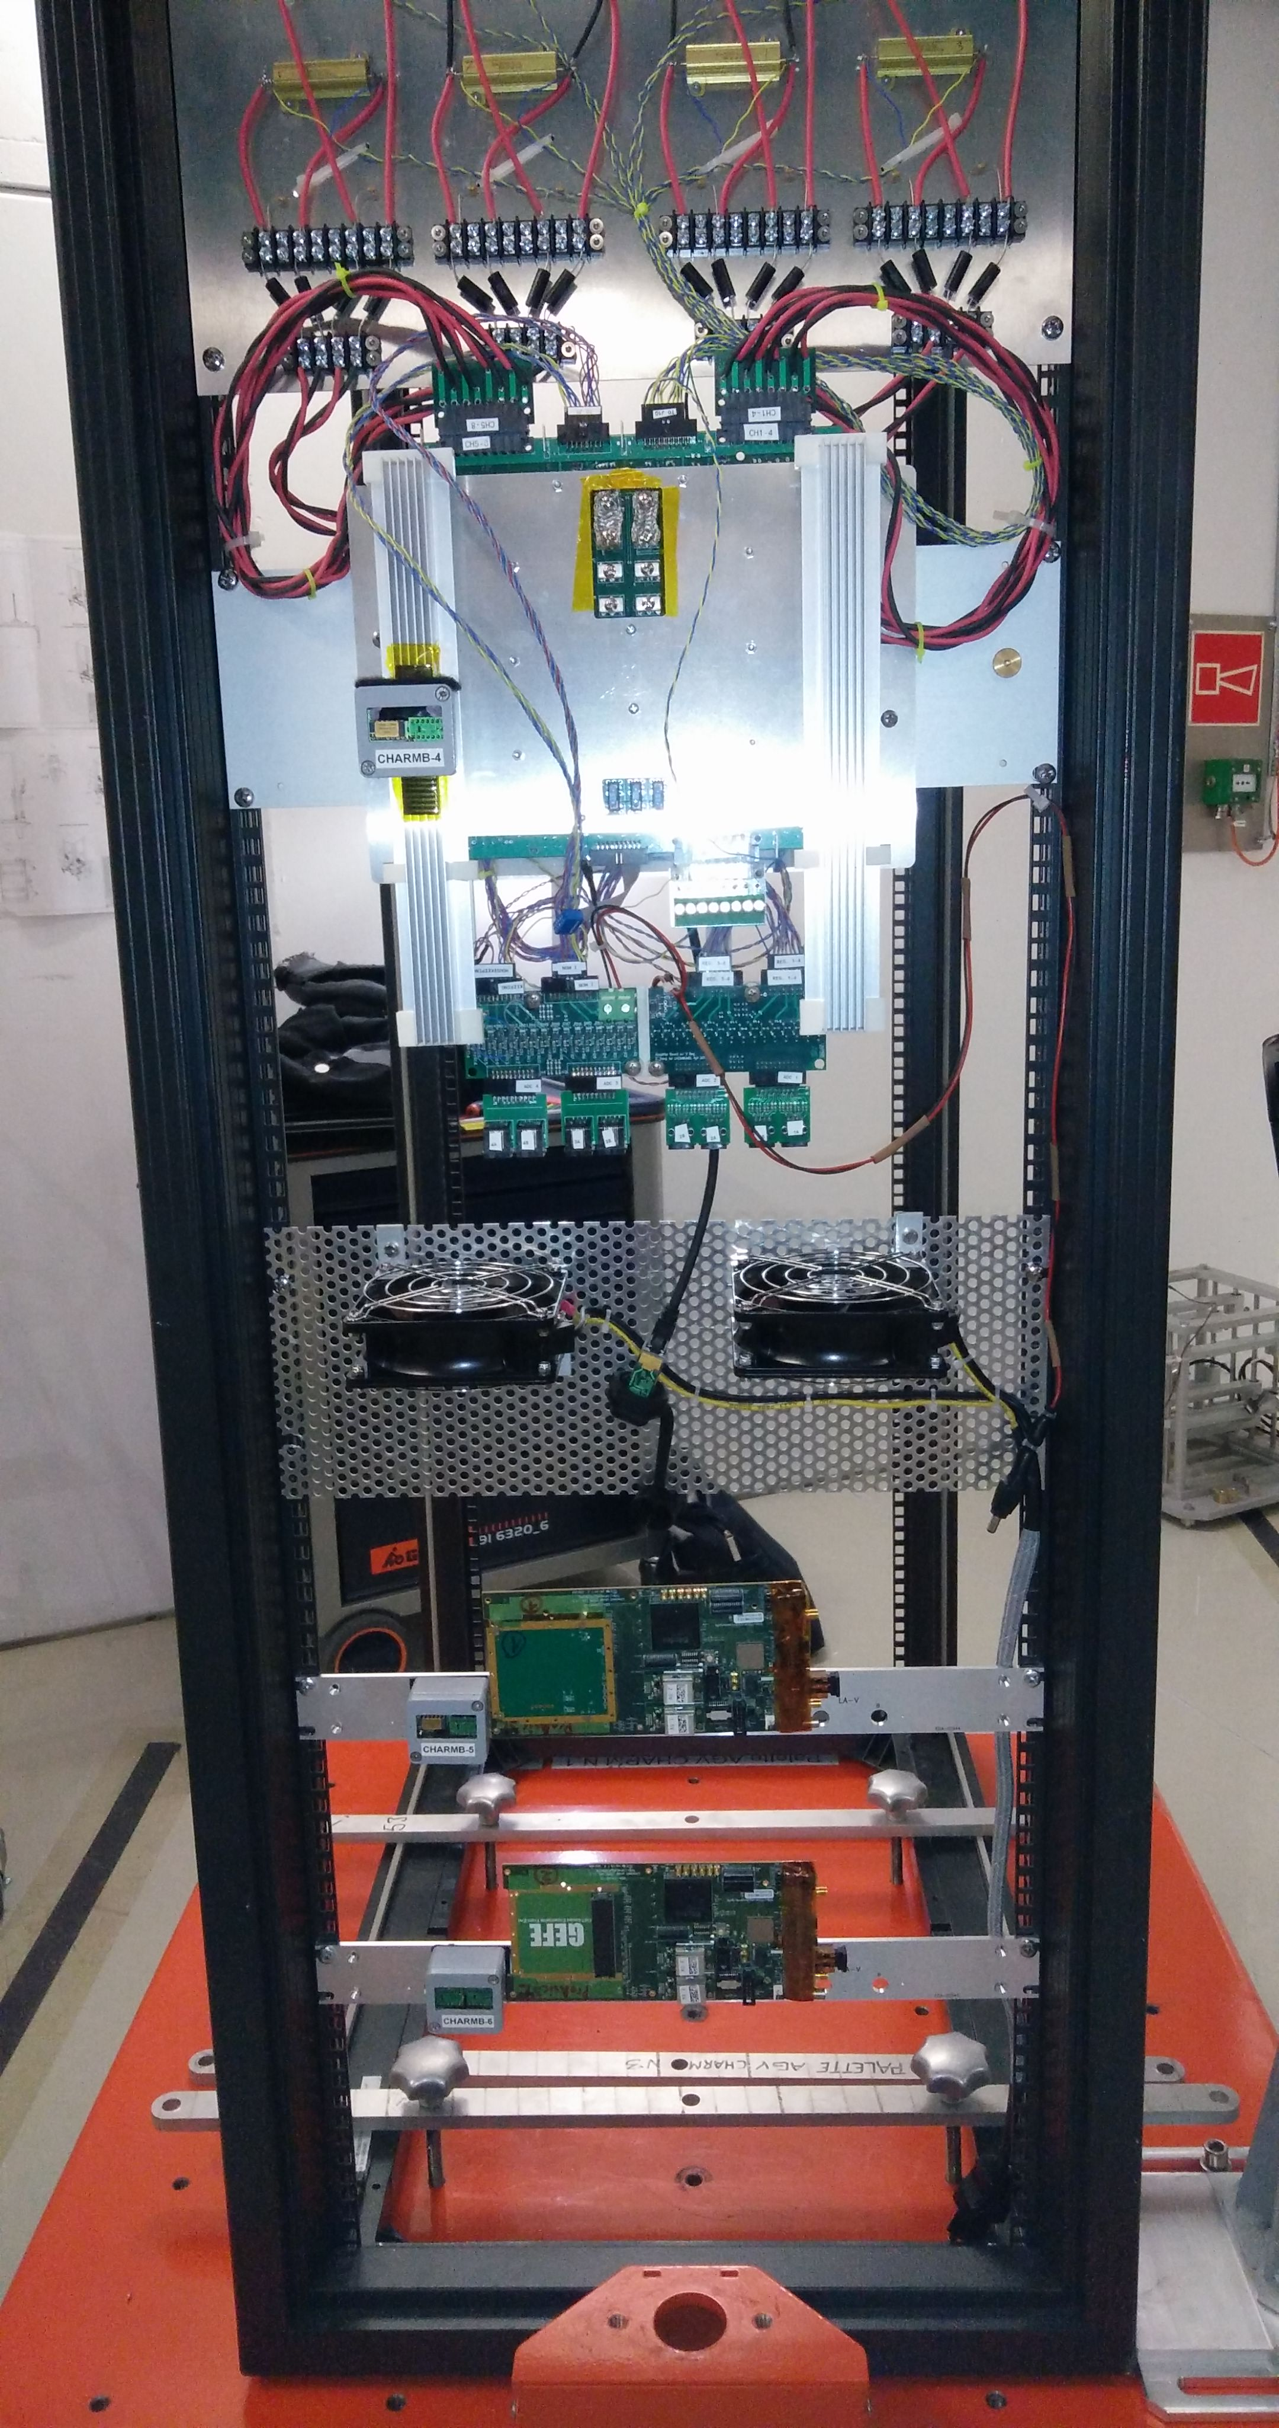
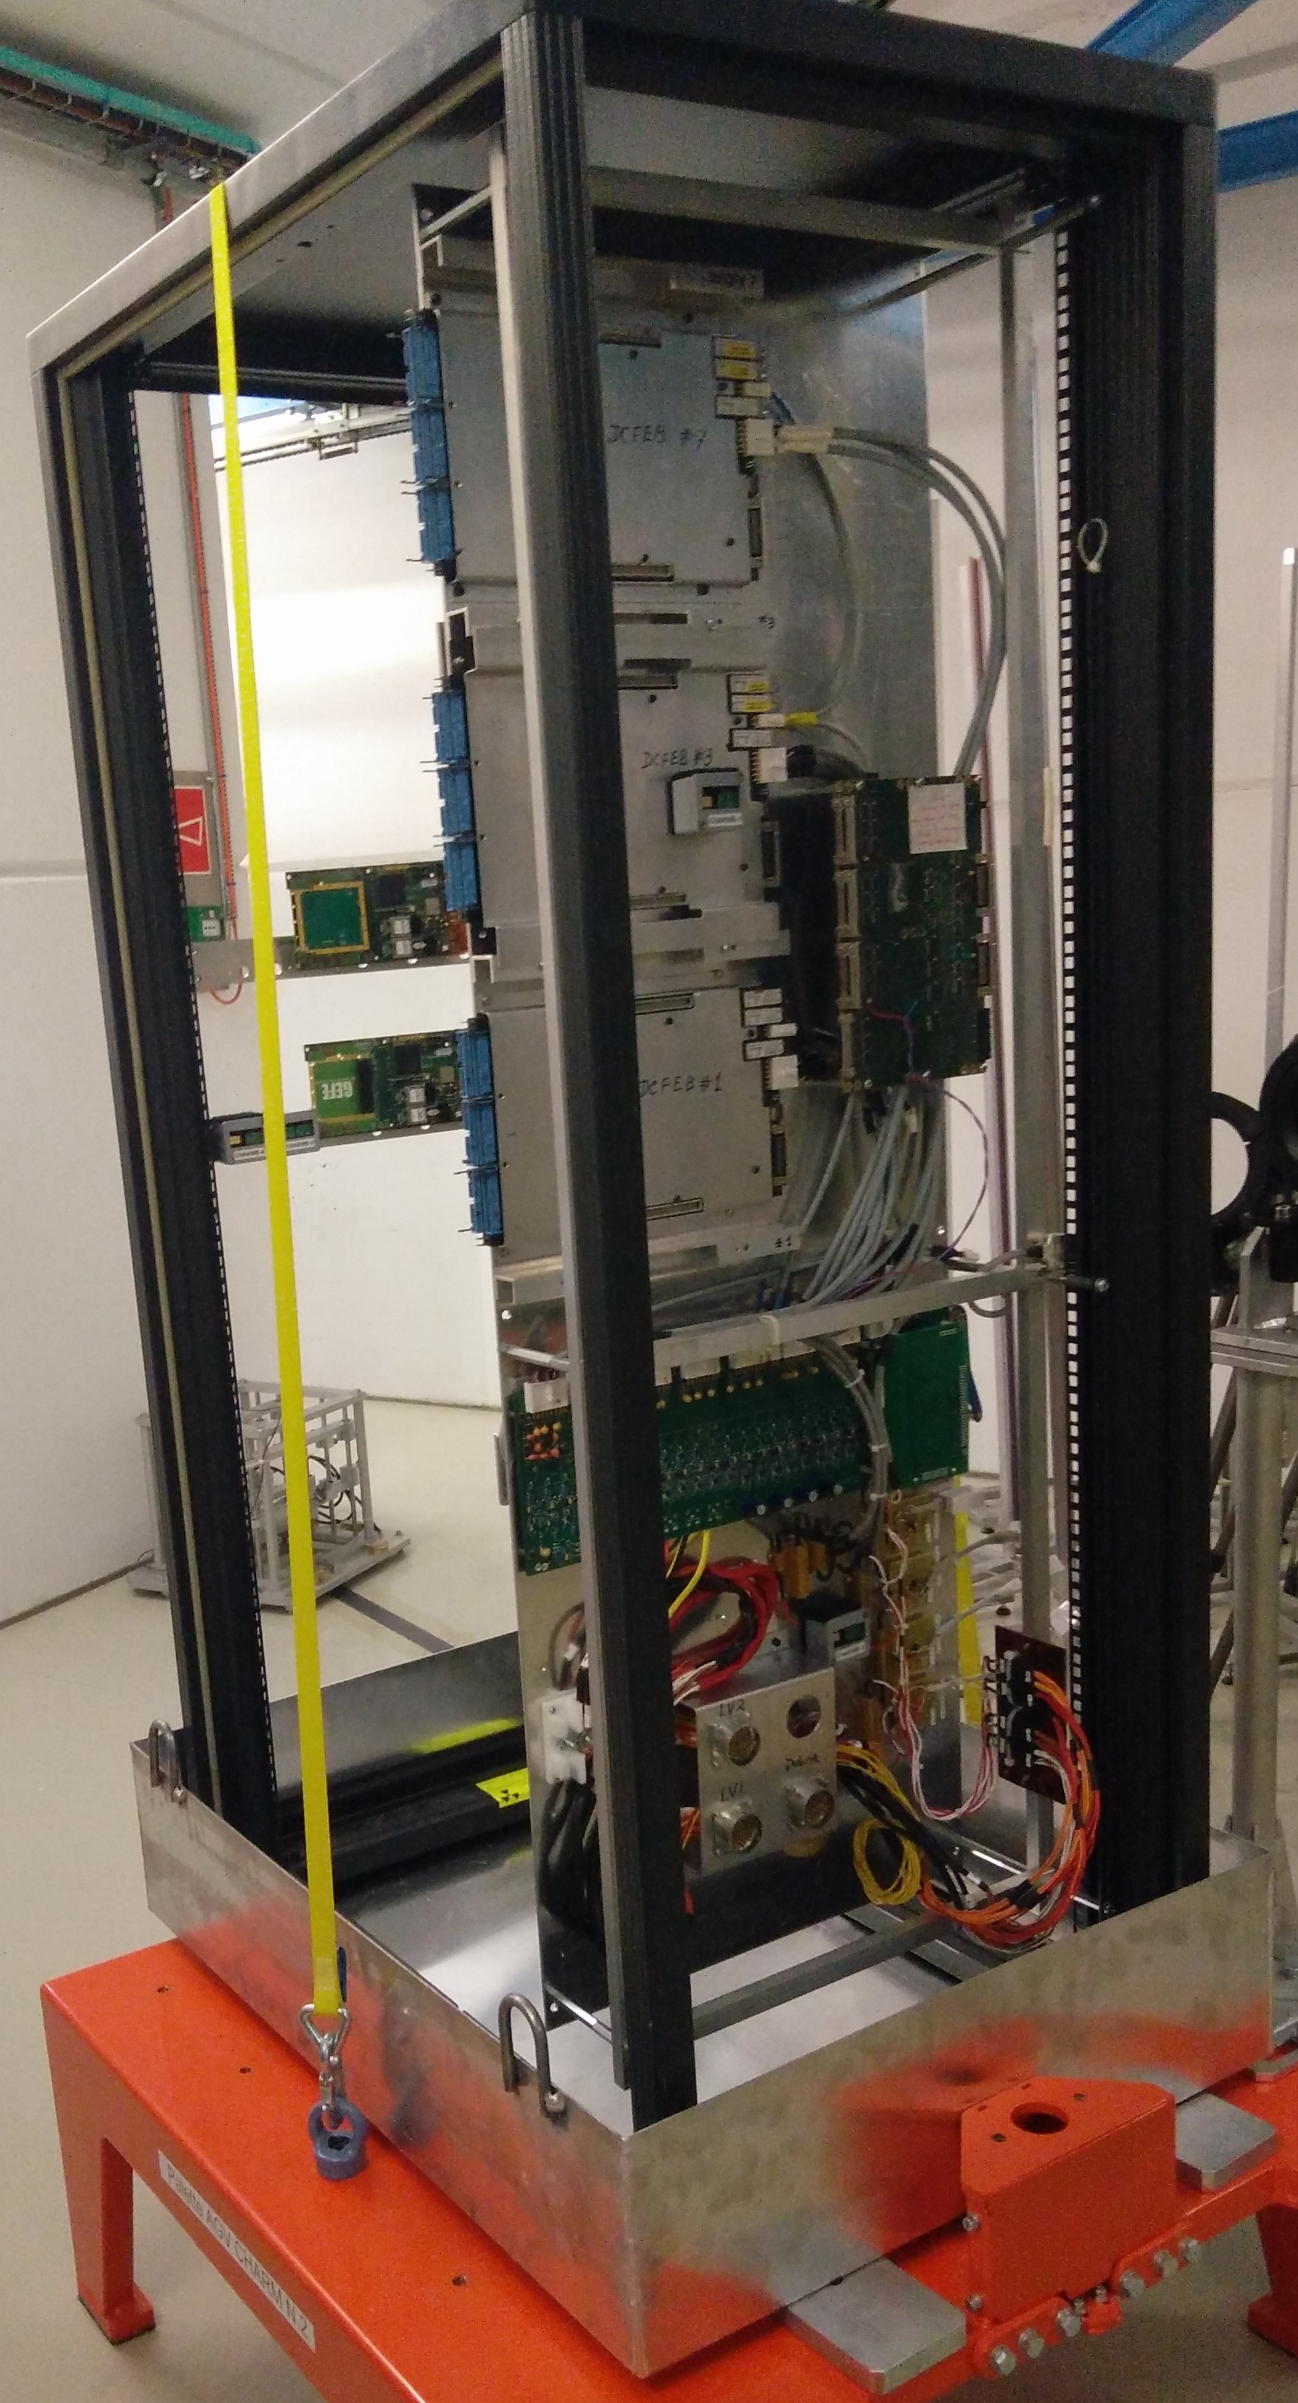
FPGA Solutions ProASIC3E
Traditionally at CERN two FPGAs have been used:
  ProASIC3E FPGAs for less crotical applications
  Anti-FUSE FPGAs for critical applications.
Several new FPGAs and technologies are being considered by equipment groups and not only and are tested
EN-SMM-RME leads the qualification of new FPGA and μProcessors
Component level + System Level
ProASIC3E Flash Based FPGA tests:
EN-SMM-RME + BE-BI for the GEFE System.
  Team of R. Ferraro, I. Deg’Innocenti, M. Barros Marin and G. Tsiligiannis
  System Level testing @ CHARM
E. Gousiou tests for NanoFIP converter @ PSI
Results @ EDMS 1863774, 1183301
© Courtesy of R. Ferraro, M. Barros Marin and I. Deg’Innocenti
© Courtesy of R. Ferraro, M. Barros Marin and I. Deg’Innocenti

Slide 6
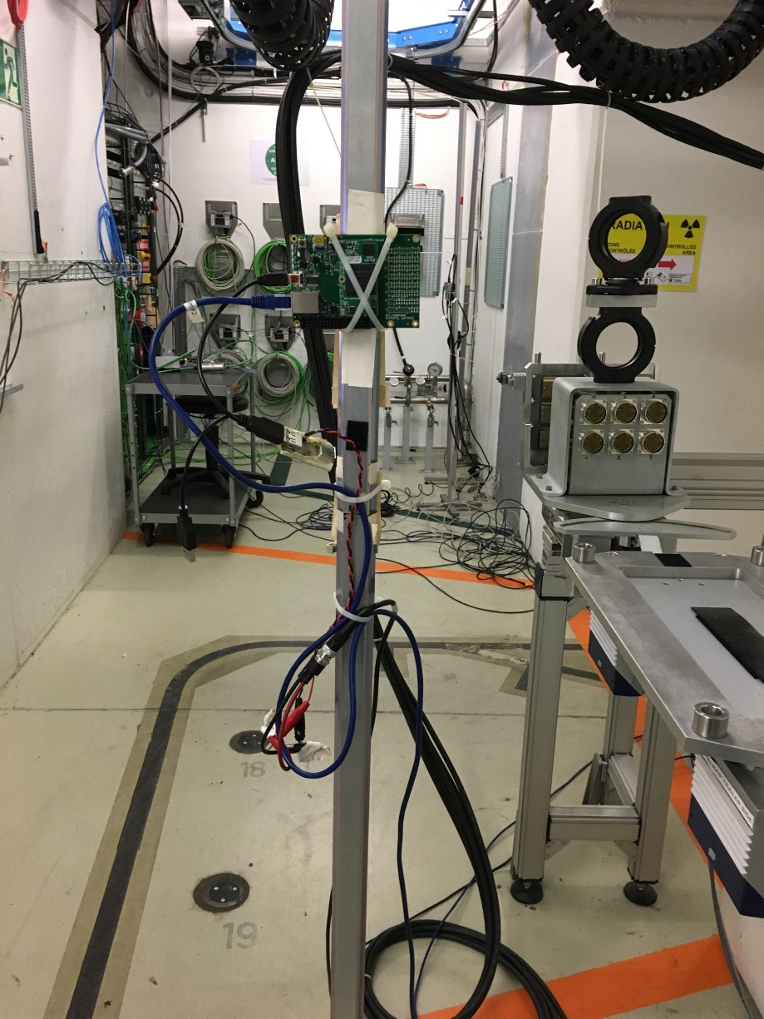
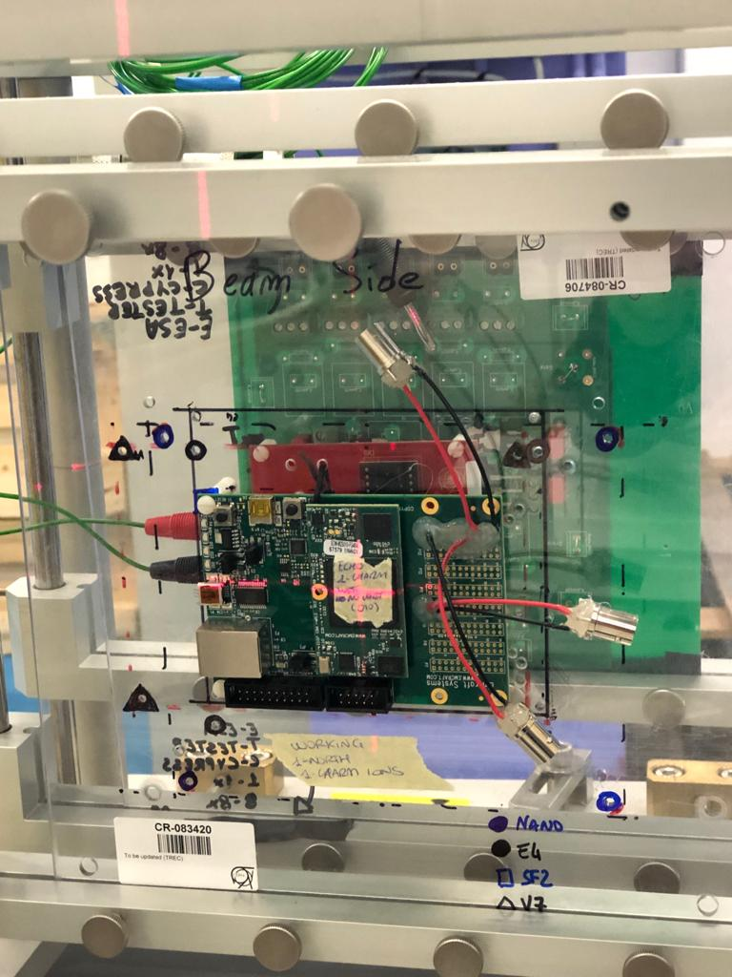
FPGA Solutions SmartFusion2
SmartFusion2 Flash Based SoC FPGA: Fabric + ARM Cortex-M3
Full qualification campaign @ PSI with 200MeV protons
  flip flops, PLL, BRAM, DSP, dose level limitation, re-programmability, applications etc.
  Results @ EDMS 1607767
  G. Tsiligiannis et al., “Investigation on the Sensitivity of a 65nm Flash-Based FPGA for CERN Applications,” REDWS RADECS, Germany, September 2016.
CHARM tests by TE-CRG @ EDMS 1892584
CHARM Radiation tests of SF2
©Courtesy of G. Gnemmi
Further tests with μProcessor + FPGA fabric for fast transmission of data using RAW Ethernet
  Bare Metal + RTOS - G. Gnemmi driving the tests now
  Combined tests at PSI, CHARM (protons) and CHARM (Heavy Ions)
  Results under processing and towards a full reliability analysis
  RADECS + EDMS on the way!
Microcontroller Subsystem (MSS)
SF2 FPGA
Cortex M3
eNVM
FPGA Fabric
AHB Bus
WDG Timer
Eth MAC
Reset Ctrl
FIC
SmartFusion2 SoC FPGA
CHARM HI Tests
©Courtesy of G. Gnemmi

Slide 7
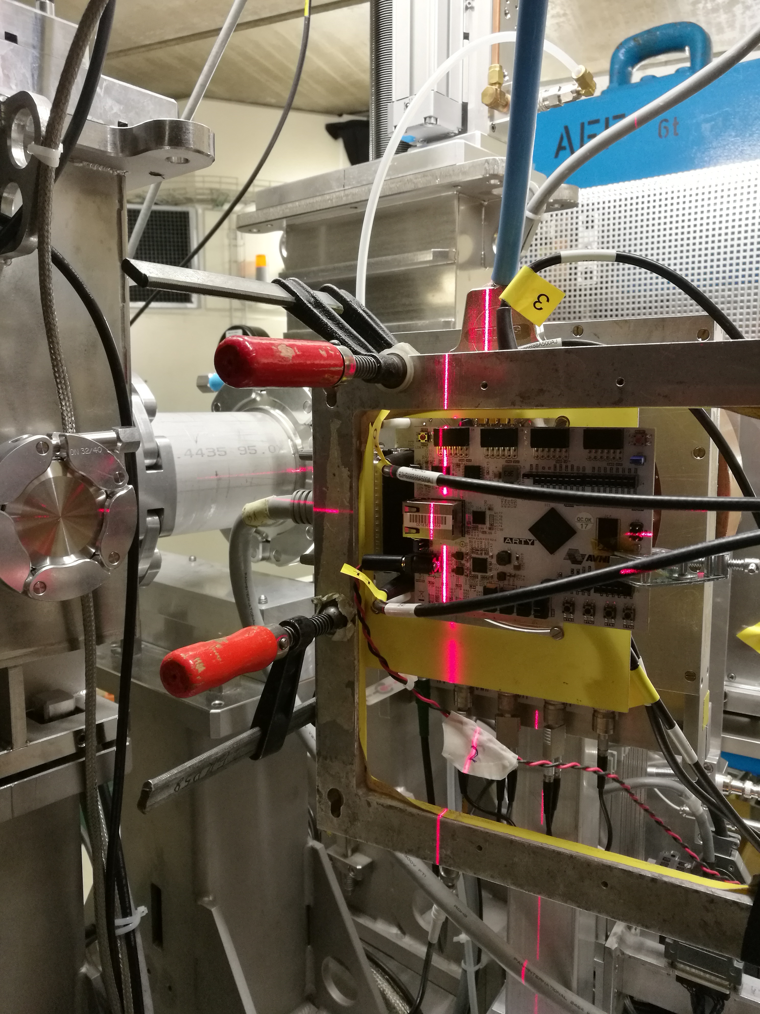
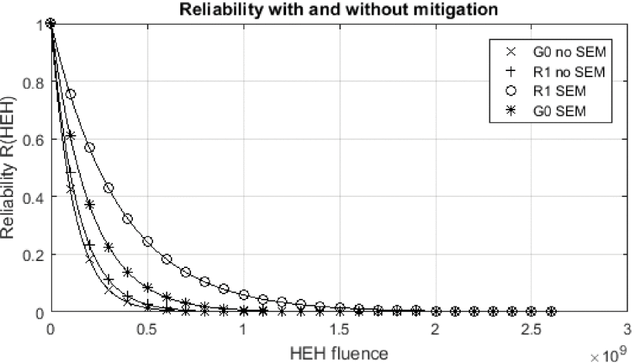
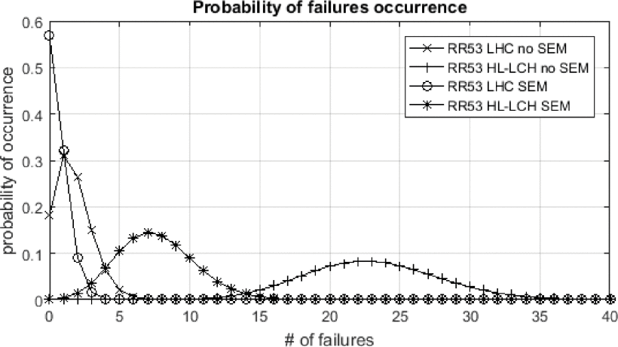
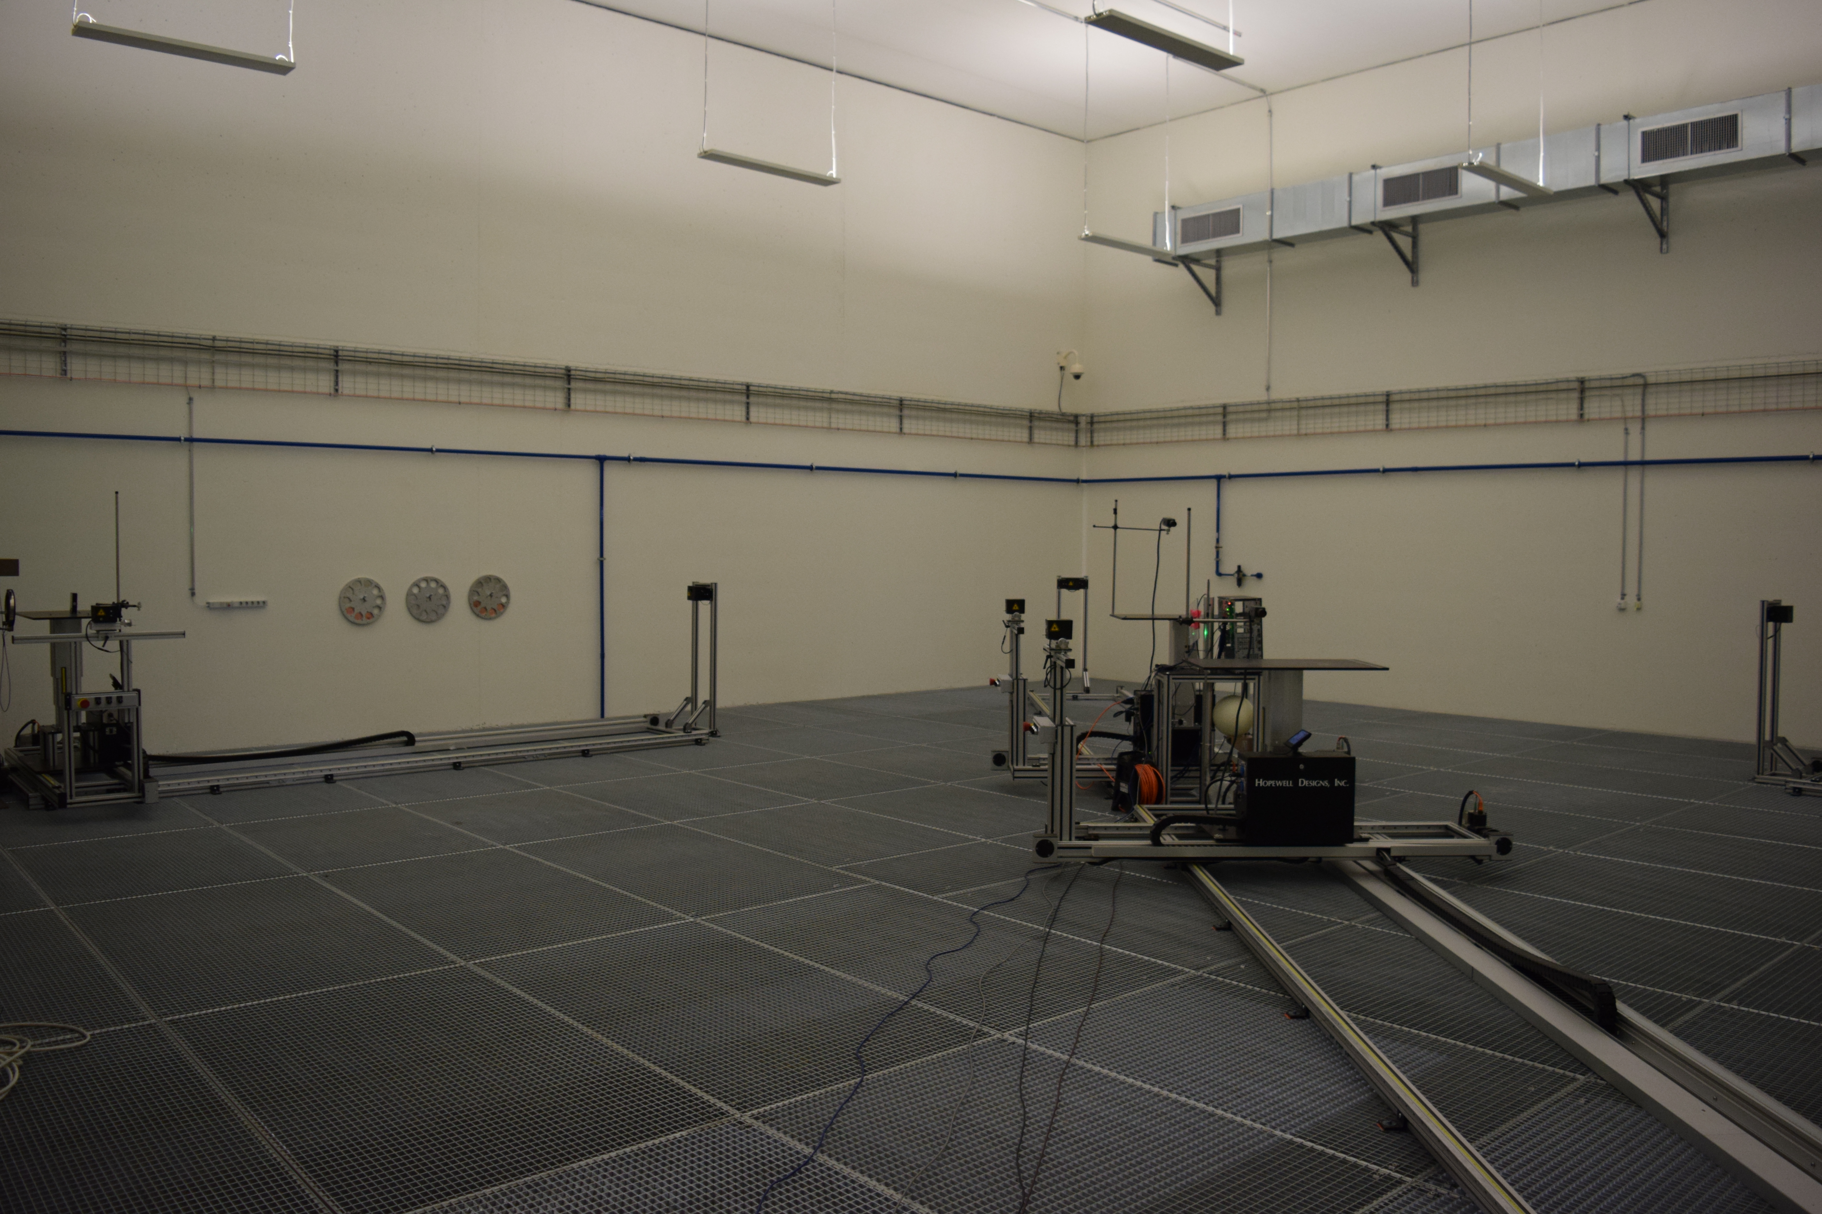
FPGA Solutions Artix7
The Artix7 FPGA has been targeted: System Level testing
  Configuration memory (CRAM) testing at CHARM, Am-Be, ESRF and ILL facility
  System Level testing with μBlaze + LwIP @ CHARM
A novel methodology has been introduced:
  Reliability analysis of a System based on CHARM SEU data
  Failure prediction of the System
  G. Tsiligiannis et al., “Radiation Effects on Deep Sub-micron SRAM-based FPGAs under the CERN Mixed-Field Radiation Environment,” IEEE Trans. Nucl. Sci., vol.6 no.8, pp. 1511-1518, February 2018.
Reliability function of the application for locations G 0 and R 1, with and without the use of the soft error mitigation IP (scrubber).
Probability of the number of system failures for position RR53 calculated with the annual fluence for the LHC under run 2 at 2×10⁸ HEH and for the HL-LHC at 2.7×10⁹ HEH.
Am-Be Facility @ CERN
PSI Radiation campaign

Slide 8
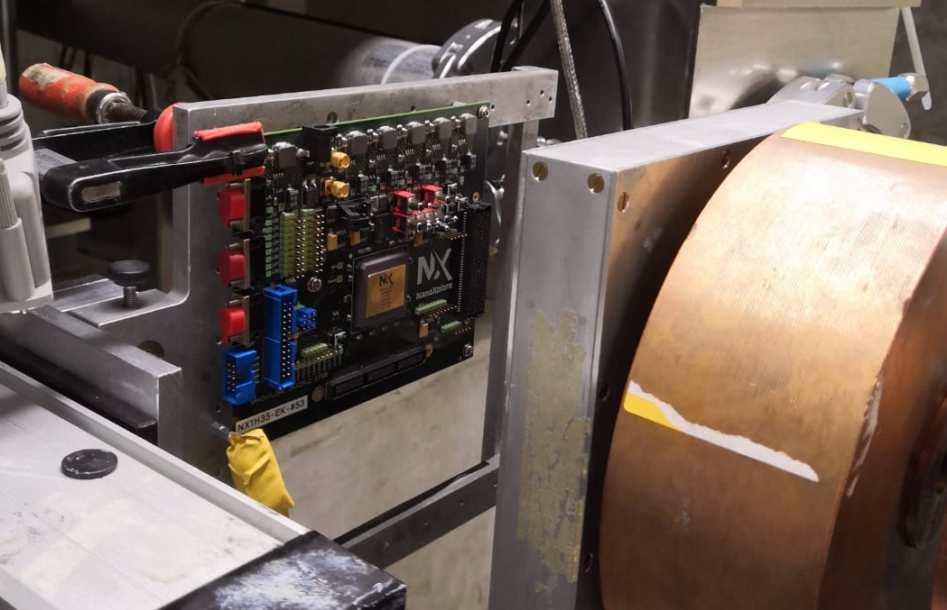
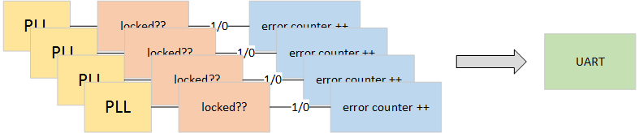


FPGA Solutions NanoXplore
NanoXplore supported by ESA and CNES to create a “made in Europe” RadHard FPGA
NG-MEDIUM: 65nm Rad-Hard SRAM Based FPGA
Full qualification @ PSI with 200MeV protons
  FlipFlop, DSP, PLL, RAM, TID limits, CRAM etc
Promising results
  >3kGy + Good SEE response
Technical Training to be scheduled the 30th of January to the 1st of February
Results @ October RADWG meeting (indico)
Results to be published to the next RADECS + EDMS
NG-MEDIUM FPGA Radiation testing at PSI facility with 200MeV beam
PLL Test structure schematic
Flip Flop test structure schematic

Slide 9
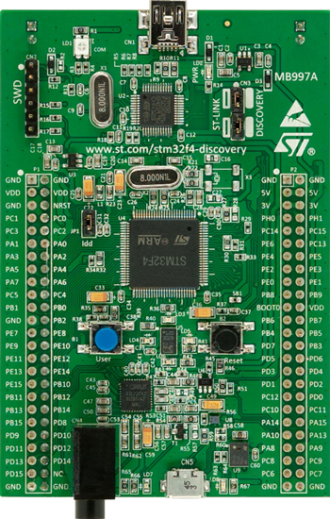
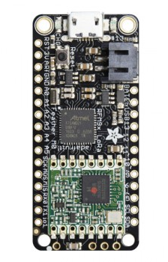
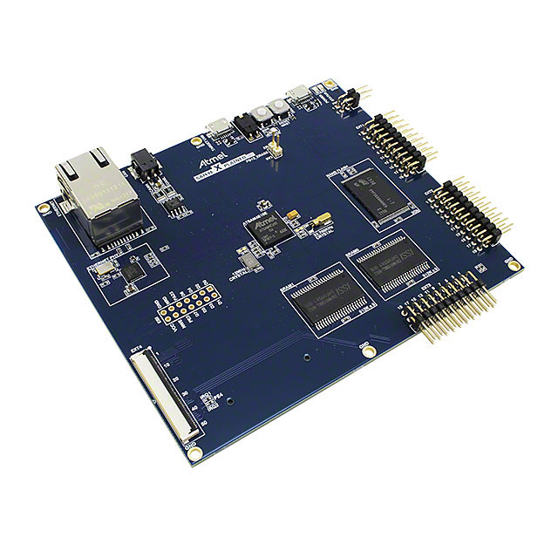
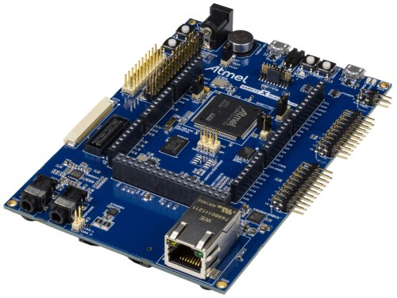
MCU Solutions
New approach for certain tasks that don’t necessarily need an FPGA (we don’t want to shoot a fly with a bazooka!)
STMicroelectronics and Atmel offer large variety of COTS
M0, M4 and M7 ARM Cores
Multi-level testing:
  Internal RAM, ADC, FPU, peripherals, Ethernet, Wireless
STM32F4, STM32F7, SAM4E, SAMV71, SAMD21 tests @ PSI with 200MeV protons
G. Piscopo, A. Damigos Papotis, G. Gnemi
Results show that some MCUs have outstanding resilience to TID (up to 500Gy)
  Reports @ EDMS 2059030 + 2059033
  Further results: NSREC + RADECS +EDMS
STM32F4 MCU
SAMD21
SAM4E MCU
SAMV71 MCU

Slide 10
Future Work
Several options exist that can be well adapted to a wide range of applications
Radiation can be limiting but thanks to the vast expansion of FPGAs and MCUs since the last decade, a wide range of COTS exists that can cover our needs
Further developments and testing at the FPGA and MCU level
  Focus at the System level performance of certain applications
  Understand better and invest in Reliability Methods for the prediction of the performance of Systems operating in radiation environments
More components to be tested -> always seeking for the best balance between performance and reliability
  More fine grained tests

Slide 11

Thank you for your attention!
Questions?!

