Slide 1
Powerlink: status and developments
Mattia Rizzi
BE/CO/HT

Slide 2

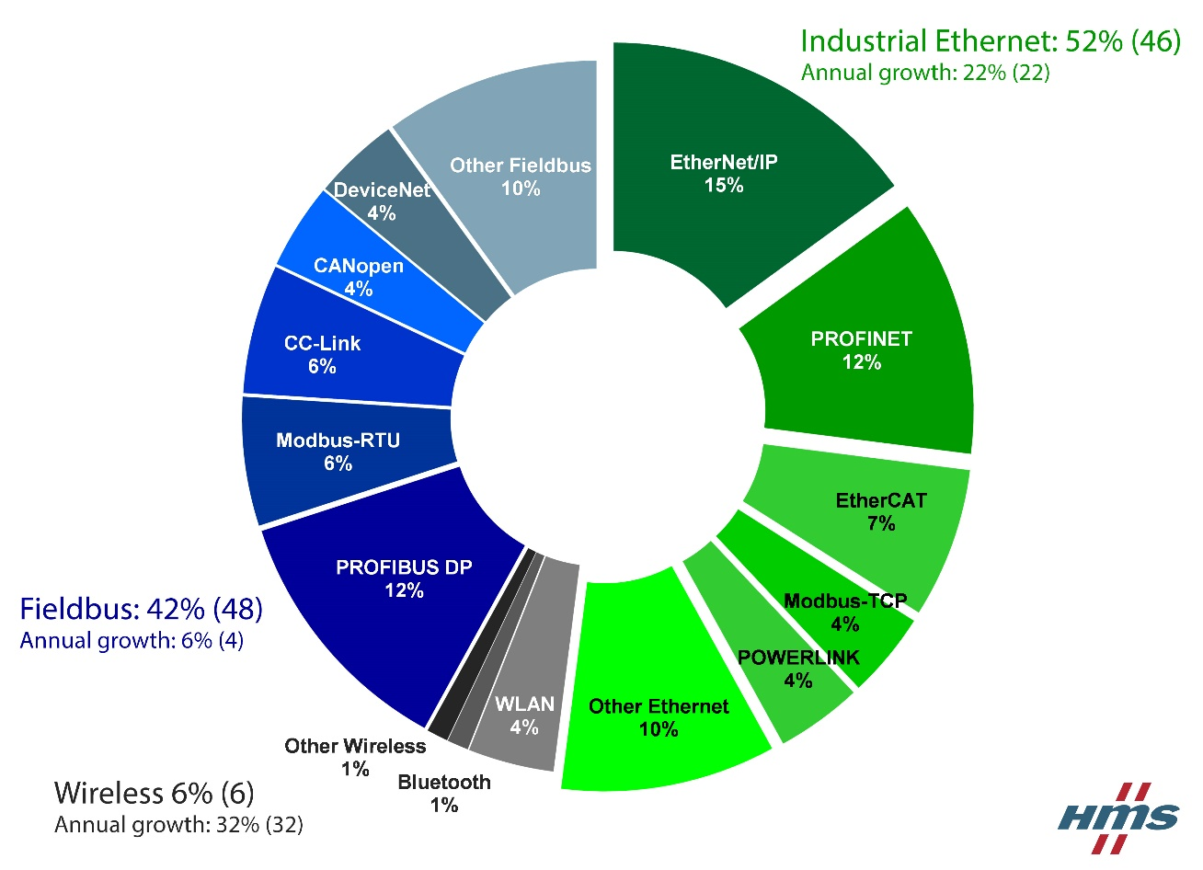
Powerlink – What is?
Industrial Ethernet Fieldbus
  ProfiNET (Siemens)
  EtherCAT
  Ethernet/IP
Open Standard
  No patents (royalties)
  No mandatory subscriptions
  No mandatory sell

Slide 3
Powerlink stack
Open source implementation available (openPOWERLINK)
Run on a number of devices
  PLC
  Computer (userland and kernel)
  Embedded devices
    Userland runs in a ARM
    Kernel runs in a soft-processor for real-time perfomances
openPOWERLINK not designed for low-memory embedded device
  Running userland & kernel stack require >300 kB of memory (code and data)
  Code of Master and Slave implementation is mixed together
Goal: run it on a SmartFusion 2 FPGA

Slide 4

SmartFusion 2
FLASH based FPGA, with fabric SRAM and DFFs
ARM core + ECC SRAM (64 kB) + eNVM (flash memory for code)

Slide 5
Results at CHARM using ARM Cortex-M3
openPOWERLINK memory footprint reduced to 170 kB (143 kB of code, 27 kB of data)
Processor clocked at 100 MHz
Data memory protected by ECC
Tested in G0 position for one week (about 25 Gy TID)
  Multiple self-resets due to internal PLL loss-of-lock
  Freezed several times (one every 10 hours), power cycle required, no useful debug messages
  No increased power consumption detected
Cortex-M3 is not TMRed
AHB interconnect is not TMR
eNVM is OK under radiation, but it is connected to AHB interconnect!

Slide 6
Soft-core based SoC
RISC-V softprocessor with TMR
ECC (SEC-DED) instruction memory up to 92 kB
ECC (SEC-DED) data memory up to 32 kB ought to be enough for anybody
Application loaded from eNVM memory and stored inside both memories (integrity check/cryptographic signature)
Instruction mem
Data memory
SecureROM
RISC-V
RISC-V
WB Slave & Scrubber
ECC
DPRAM
WB Slave & Scrubber
ECC
DPRAM
RISC-V
CPU
WISHBONE
interconnect
AHB
eNVM
Ethernet MAC
UART (debug)
Watchdog

Slide 7
Logic utilization
Partial TMR of RISC-V running at 50 MHz, 32 kB + 32 kB of ECC SRAM, Ethernet MAC
Fmax: 60 MHz
DFFs and LUTs with MS2050 SF2: 30% (15k LUTs, 13k DFFs)
Instruction mem
Data memory
SecureROM
RISC-V
RISC-V
WB Slave & Scrubber
ECC
DPRAM
WB Slave & Scrubber
ECC
DPRAM
RISC-V
CPU
WISHBONE
interconnect
Ethernet MAC
UART (debug)
Watchdog

Slide 8
Results at CHARM using RISC-V SoC
Partial TMR of RISC-V running at 50 MHz
ECC instruction and data memory: 8 kB + 8 kB
RISC-V running a checksum of data memory
ECC single error & double error stats
  SEU Cross-section (single error correction): 2.4E-14
  Double error cross-section: no data
Instruction mem
Data memory
SecureROM
RISC-V
RISC-V
WB Slave & Scrubber
ECC
DPRAM
WB Slave & Scrubber
ECC
DPRAM
RISC-V
CPU
WISHBONE
interconnect
UART (debug)
Watchdog

Slide 9
Prospects for 2019
True TMR of RISC-V, keeping 50 MHz
Optimize SRAM utilization
Fix Ethernet MAC bugs and improve it for rad-tol
Optimize Powerlink stack: 50 kB of code
Test low-latency Industrial Ethernet PHY (Texas Instruments DP83822) under radiation

