Slide 1



RaToPUS: A Generic Radiation Tolerant Power Supply for Distributed I/O Tier Project
Lalit Patnaik
lalit.patnaik@cern.ch
R2E Annual meeting | 12 dec 2018

Slide 2
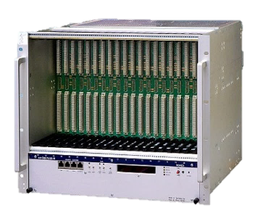
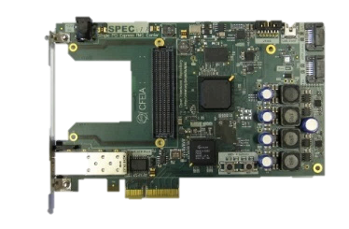
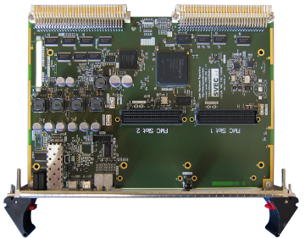

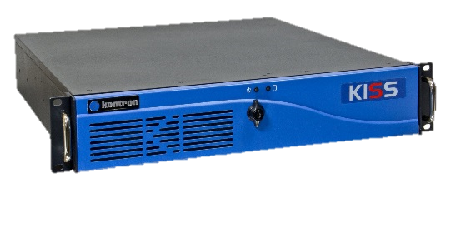

Objective
Design and test a generic PSU for Distributed I/O Tier (DIOT) crates
to be used under radiation environment by various CERN user groups.
Front-End Tier
Front-End Computer
VME/PICMG/PLC
master
Fieldbus (WorldFIP/PROFINET/etc)
Fieldbus Tier
DIO1
DIO2
DIO3
DIOn
slave
slave
slave
slave
Distributed I/O Tier
actuator
actuator
sensor
sensor

Slide 3
DIOT crate mockup
19” (48.3 cm)
15” (38 cm)
PSUs
Custom space
3U or 5.25” (13.3 cm)
. . . . . . . .
. . . . . . . .
Each PSU: 3U x 170 mm x 8HP
Two PSUs in redundant/load-sharing mode
Accessible from front side

Slide 4
Target user groups in CERN
Beam instrumentation (BE-BI)
Magnet positioning (EN-SMM)
Machine protection (TE-MPE)
Electrical power converters (TE-EPC)
More …?
Assumptions
All PCBs in the crate (system and peripheral) have POL regulators for low voltage digital circuits (1-3.3V)
Power for high performance analog circuits (<10mV ripple + noise) is provided by dedicated linear regulators external to RaToPUS.

Slide 5
Project schedule
YEAR #1
YEAR #2
Task | 2018 Q4 | 2019 Q1 | 2019 Q2 | 2019 Q3 | 2019 Q4 | 2020 Q1 | 2020 Q2 | 2020 Q3
Define specifications; Survey existing solutions
Design and simulation
Radiation effects training
Laboratory prototyping
Define test specifications and test plan
Non-radiation testing and improvements
Radiation testing and improvements

Slide 6
Project workflow
User groups
Requirement specifications
Topology selection
Component design/selection
Spice
simulation
PCB design:
schematics, layout
PCB fabrication,
assembly, testing
Prototype vX.Y

Slide 7
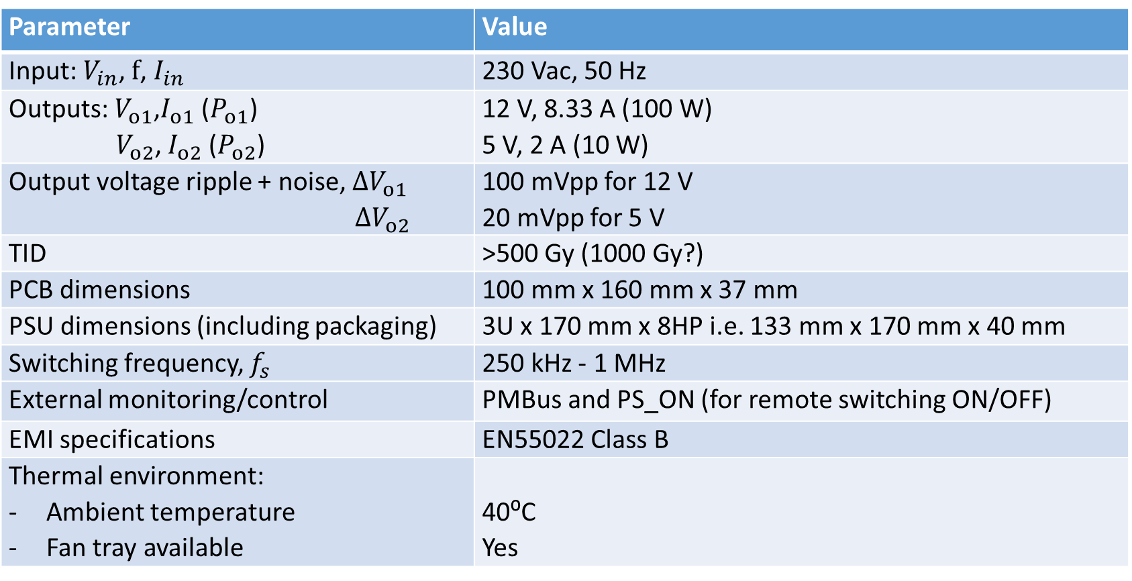
Requirement specifications (tentative)
Parameter | Value
Input: $V_{in}$, $f$, $I_{in}$ | 230 Vac, 50 Hz
Outputs: $V_{o1}$,$I_{o1}$ ($P_{o1}$) $V_{o2}$, $I_{o2}$ ($P_{o2}$) | 12 V, 8.33 A (100 W) 5 V, 2 A (10 W)
Output voltage ripple + noise, ${∆V}_{o1}$ ${∆V}_{o2}$ | 100 mVpp for 12 V 20 mVpp for 5 V
TID | >500 Gy (1000 Gy?)
PCB dimensions | 100 mm x 160 mm x 37 mm
PSU dimensions (including packaging) | 3U x 170 mm x 8HP i.e. 133 mm x 170 mm x 40 mm
Switching frequency, $f_{s}$ | 250 kHz - 1 MHz
External monitoring/control | PMBus and PS_ON (for remote switching ON/OFF)
EMI specifications | EN55022 Class B
Thermal environment: Ambient temperature Fan tray available | 40⁰C Yes
Notes:
EN55022 Class B is the EMI specification for Pentair CPCIs power supply.

Slide 8



Existing Rad-Tol PSU solutions at CERN
7-15Vac
10-20Vdc
  50 Hz Transformer $⟶$ Bridge Rectifier $⟶$ LDO
  50 Hz Transformer $⟶$ Bridge Rectifier $⟶$ DC/DC
BE-BI-BL (25W)
TE-MPE-EP (40W)
TE-CRG-CI (100W)
7-15Vac
10-20Vdc
Advantages
Simple and robust design
No higher voltage switching
Disadvantages
Large and costly transformer
Large heat dissipation in crate
No PFC $⟹$ Large EMI filter
35Vac
48Vdc
  50 Hz Transformer $⟶$ Bridge/PFC Rectifier $⟶$ DC/DC
TE-EPC-CCE (70W)
Notes:
Traco TPP40 Series
Traco THM Series

Slide 9
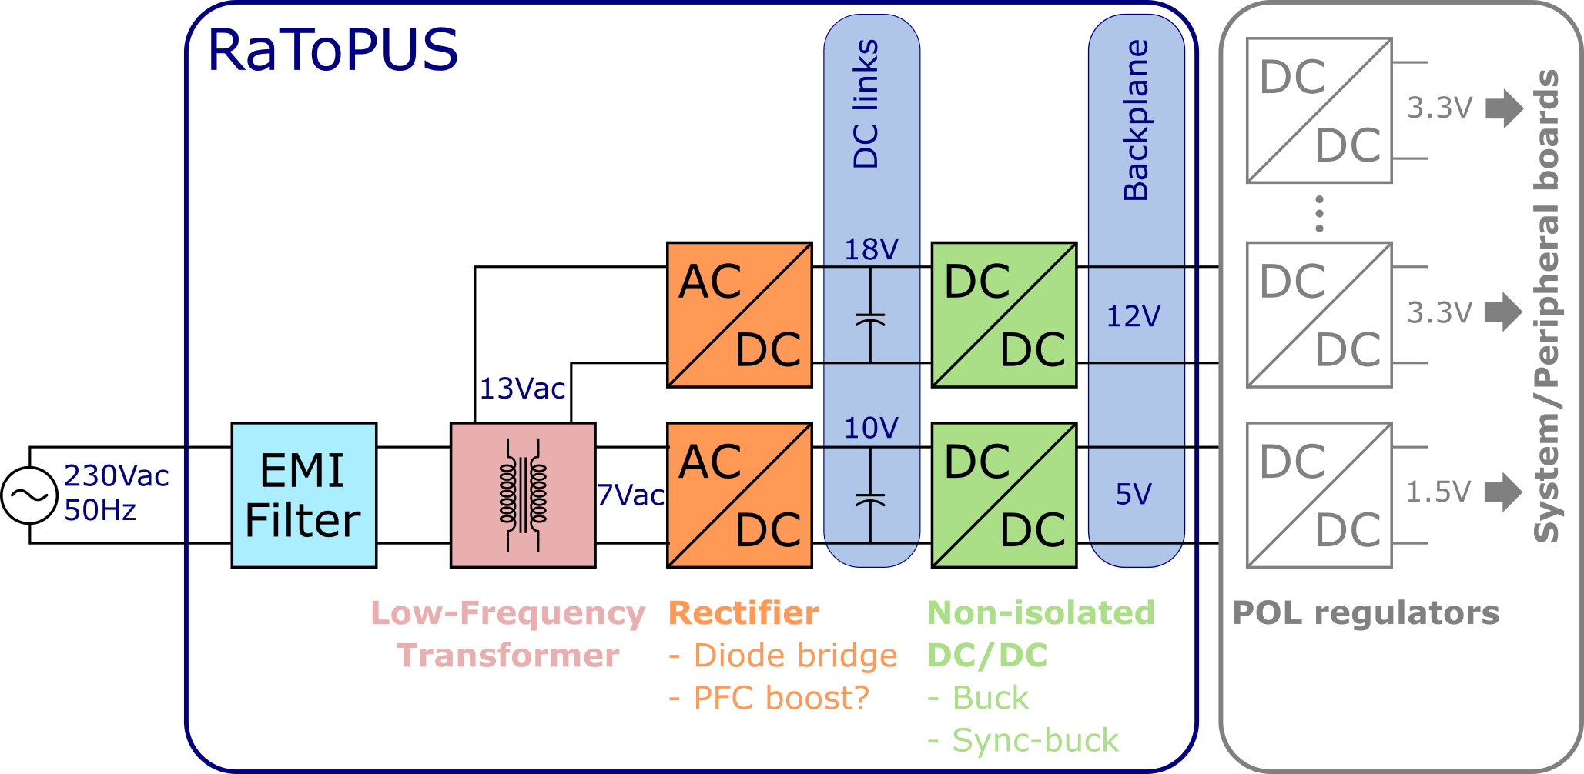
RaToPUS power architecture: Option-1
Large low-frequency transformer
MOSFETs switching at lower voltage
Large EMI filter?

Slide 10
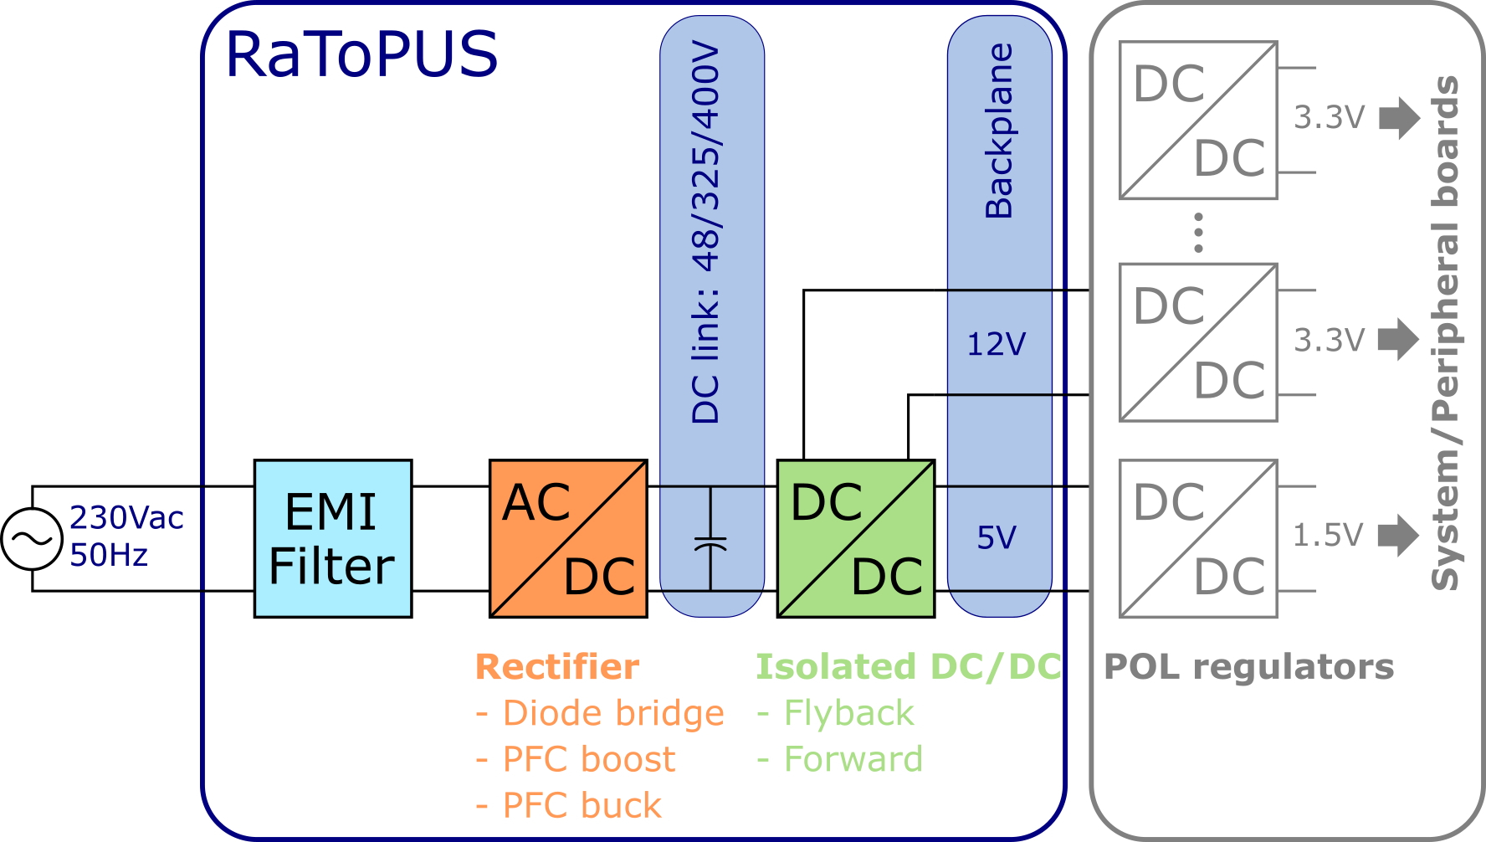
RaToPUS power architecture: Option-2
Small high-frequency transformer (part of isolated DC/DC converter)
MOSFETs switching at higher voltage
Small EMI filter

Slide 11
Radiation hardness: Power stage components
Component | Options | Rad hardness (TID)
EMI Filter | Schurter FMLB-41 | ✓
Bridge rectifier diodes | Multicomp ABS8 | TBD
Power MOSFETs | Infineon IRLI540N Infineon IRHNJ67C30 Infineon IRFB4310 Vishay IRFL110 | TBD 1000 Gy† 300 Gy* 300 Gy*
Filter and DC link capacitors: Ceramic Aluminium electrolytic Tantalum electrolytic | TDK C Series -- -- | ✓
Filter inductor | Bourns SRP1038A Series | ✓
HF transformer | Coilcraft | ✓
LF transformer | Toroidal | ✓
✓ Passive components are assumed to be rad hard by default
*Tested by CERN †Tested by manufacturer
Notes:
600/700 V MOSFETs need to be rad tested by RADWG/R2E

Slide 12
Radiation hardness: Other components
Component | Options | Rad hardness (TID)
Analog controllers for power stages: For DC-DC stage For PFC stage | FEAST ST1845 UCC28056 | 2 MGy* 1000 Gy† TBD
House-keeping bias (power supply for controllers): Extra flyback winding + diode on HF transformer | STPS10H100C Schottky | TBD
MOSFET gate drivers (+12V, -3V) | NCP5901 RHRPM4424 | TBD 1000 Gy†
Isolated voltage sensing | HCNR200 ACPL-C87B | 150 Gy* TBD
Isolated current sensing: Hall-effect sensors | ACS712 | TBD
PWM pulse isolation: High-speed optocouplers | FOD8012A | TBD
Temperature sensing: Solid-state sensors Thermocouple/RTD | LM45 PT100 | 1000 Gy* ✓
MCU/DSP/FPGA for PMBus implementation | TBD | TBD
✓Passive components are assumed to be rad hard by default
*Tested by CERN †Tested by manufacturer
Notes:
There are dedicated PMBus chips, but they are not radiation qualified.
ARM Cortex M0 based MCU for PMBus implementation
There is a possibility to procure STMicro rad-hard components at lower price and even with plastic packages. E.g. Gate drivers.
Note: For rad-hard, hundreds of pieces is considered a bulk order!
Look at CHARM test results for CAEN and Weiner power supplies. Some of those components can be used.

Slide 13
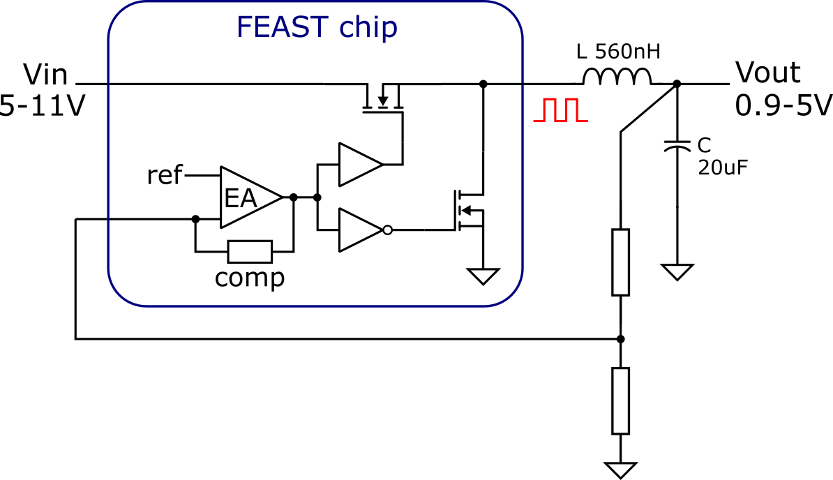
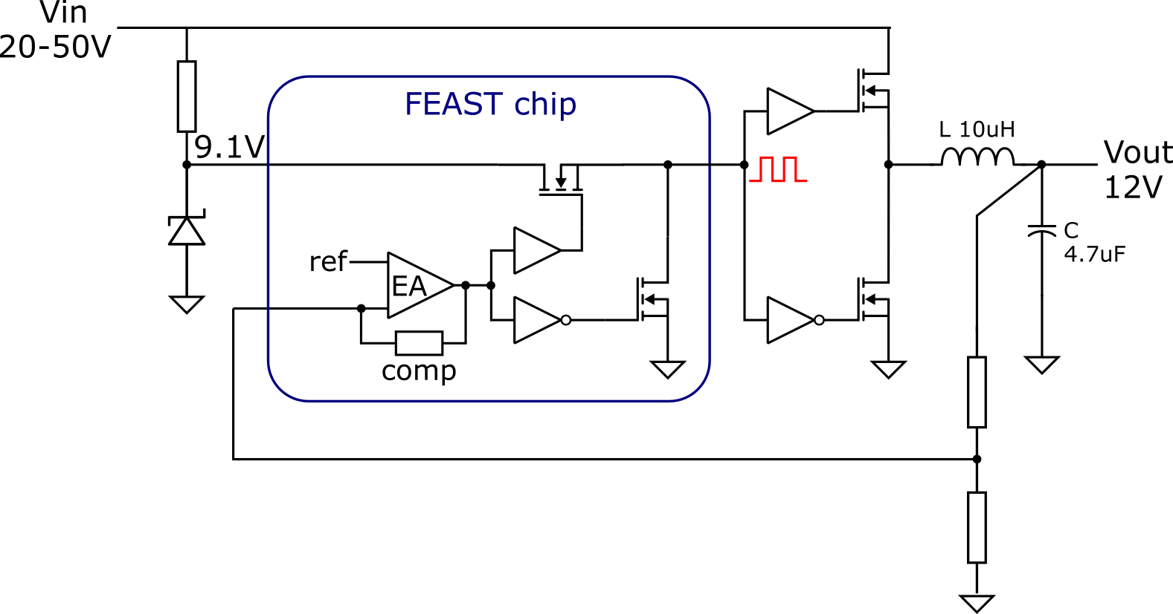
Feasibility study: FEAST as controller for DC/DC stage
Typical configuration: Up to 10W
Modified configuration: Up to 100W
External MOSFETs of higher V and I rating
Larger LC filter on output side
9-12V HKB (house-keeping bias)
Delayed EN for bootstrap capacitor charging

Slide 14
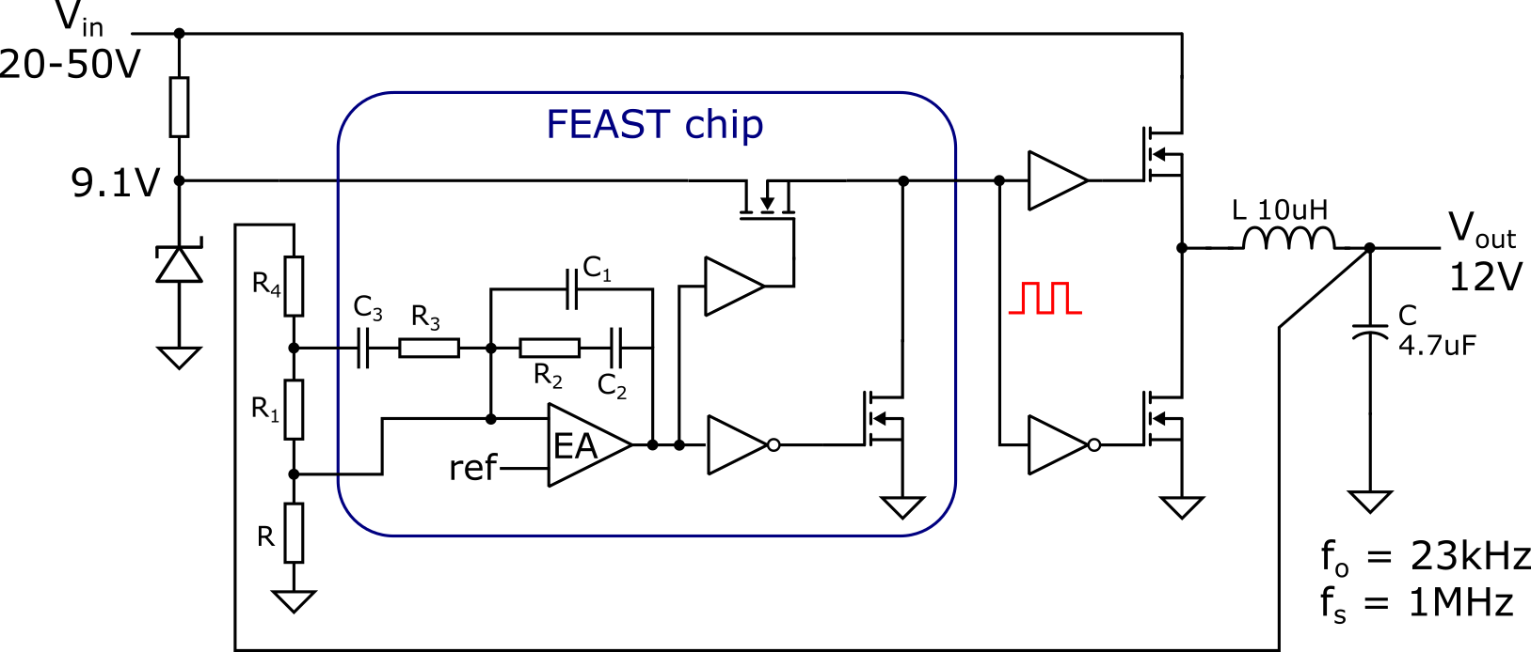
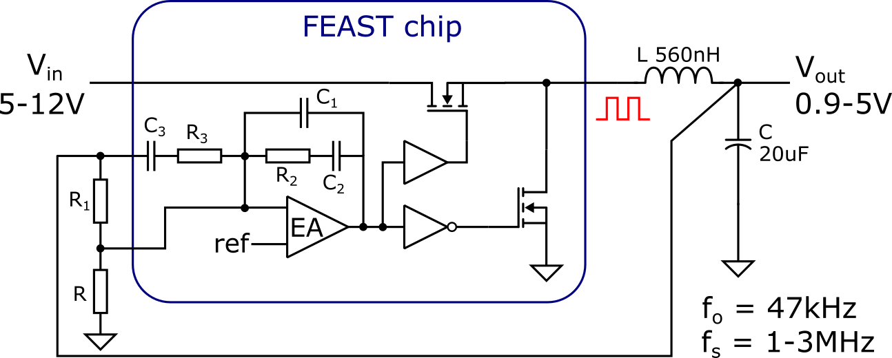
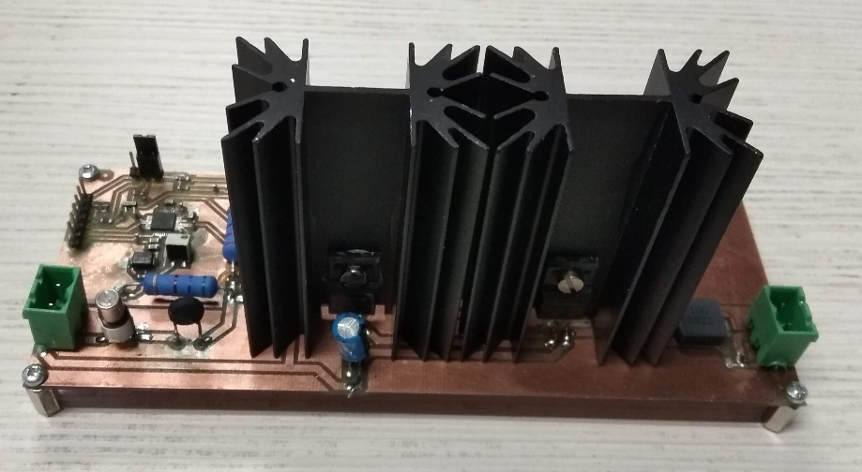
Feasibility study: FEAST as controller for DC/DC stage
Typical configuration: Up to 10W
Modified configuration: Up to 100W
FEAST chip
External MOSFETs with heatsinks
Lab prototype
Loop stability issues

Slide 15
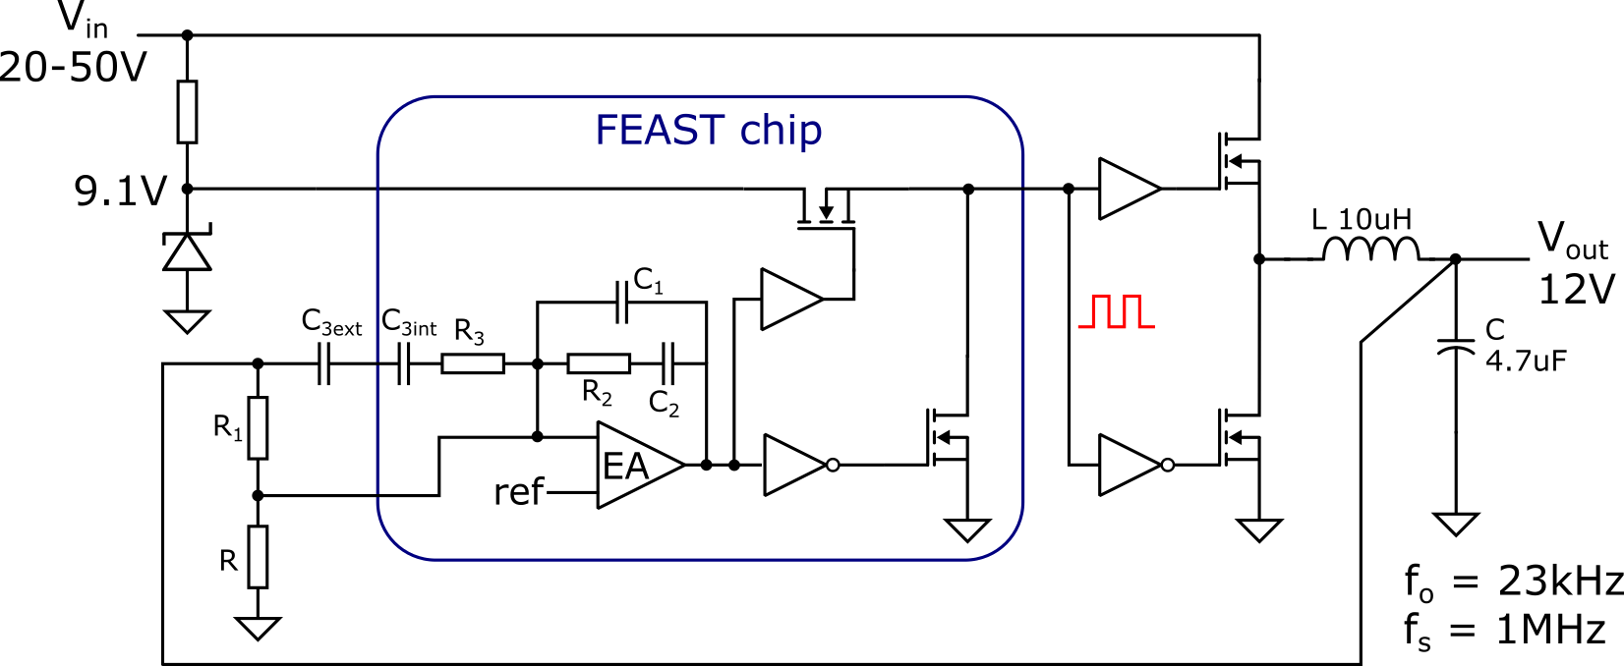
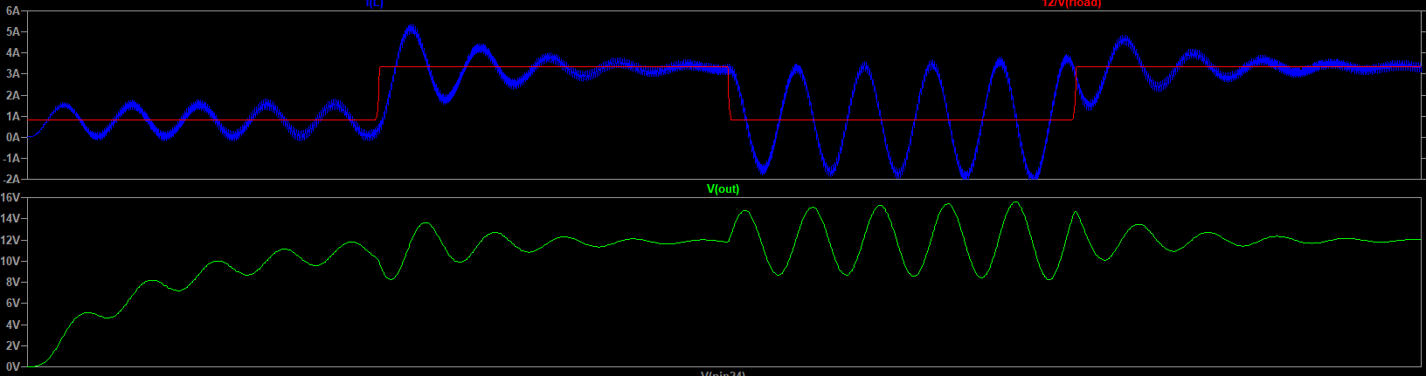
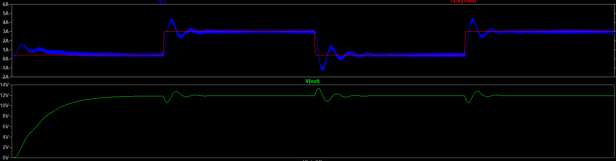
Feasibility study: FEAST as controller for DC/DC stage
Proposed
Solution
200us
400us
600us
200us
400us
600us
I_{L}
I_{L}*
I_{L}
I_{L}*
V_{out}
V_{out}
12V
12V
Spice simulation results: With R₄ With C_{3ext}

Slide 16
Future work and open questions
Can compensation network of FEAST be externally modified for stable operation with up to 100W load? Provisional answer: Yes
Can the switching frequency of FEAST be pushed under 1 MHz? (Typical 1-3 MHz)
Rad-hard isolated DC/DC converter: Design and implementation
Rad-hard PFC converter: Design and implementation
Can GaN/SiC FETs be reliably used in radiation environment?
Effect of switching high voltage MOSFETs (600/700V) under radiation?
  Threshold voltage
  Leakage current
  Single Event Effects/Burnout
https://wikis.cern.ch/display/DIOT/Rad-tol+power+supply
Notes:
Refer Pascal Oser and Sara Siconolfi’s work on SEB mitigation for Power MOSFETs

