Slide 1
Radiation hardness in single-mode optical links for Accelerator Instrumentation
Carmelo Scarcella
Indico link: https://indico.cern.ch/event/760345/

Slide 2
Outline
Optical Links for Accelerator Instrumentation
Versatile Link and Single-mode VTRx
project timeline
Edge-Emitting Laser selection
displacement damage
Wavelength division multiplexing CWDM
Summary and future steps

Slide 3
Optical Links for Accelerator Instrumentation
The Accelerator Instrumentation Group (BE/BI) is moving towards common readout solutions
Radiation zone
Timing/Trigger/Ctrl
&
Data Acquisition
Radiation-free zone
Sensor
or
Actuator
Analogue
Front-End
Card
Digital
Front-End
Card
Optical link
Digital
Back-End
Card
Reach up to 3 km

Slide 4
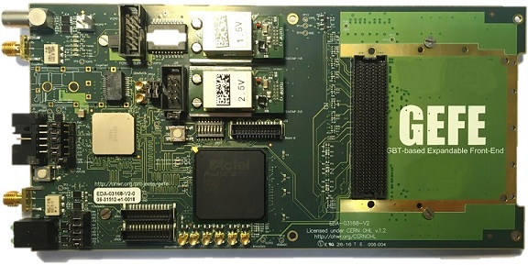
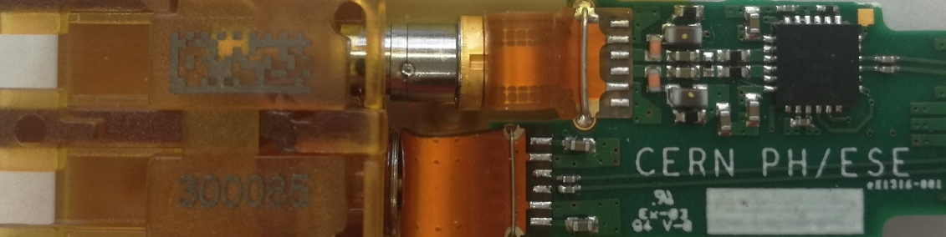
The GBT-based Expandable Front-End (GEFE)
Common hardware development ongoing for LS2 upgrades
Rad-hard
DC-DC
FMC HPC
SM VTRx
GBTx
ProAsic3
FPGA

Slide 5
Project timeline
LS2
LS3/LS4
Rad-Hard Link | GBTx + SM VTRx
Rad-Hard DFE | GEFE & S-GEFE
Users | New SPS BPM system (“ALPS”) Motor control optical interface (“MCOI”) …
Total links | ~ 300
Data-rates | GBTx Tx 4.8 Gbps Rx 4.8 Gbps

Slide 6
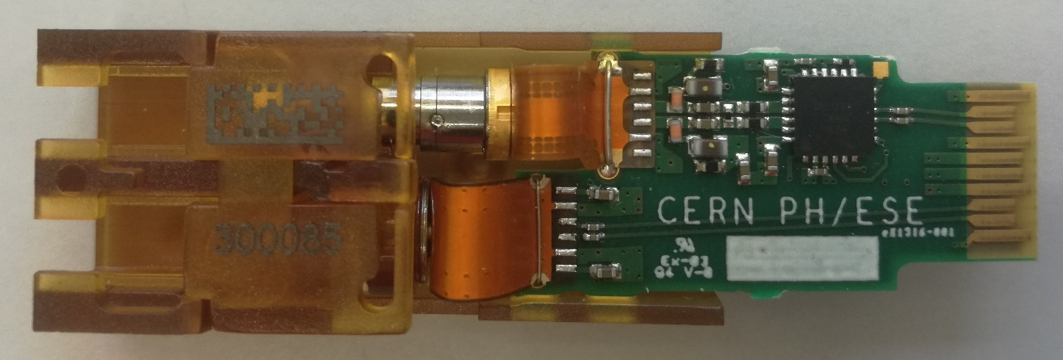
Single-mode Versatile Link Transceiver - VTRx
PCB
Front-End pluggable module
Receiver
  COTS InGaAs Photodiode
  Transimpedance amplifier GBTIA v3
Transmitter
  COTS Edge emitter Fabry-Perot laser
  Laser driver GBLD v4.2
Calorimeter grade radiation tolerance
10 kGy TID
5 · 10¹⁴ n/cm² MeV neutrons
TOSA
TX
Laser Diode
Laser Driver
edge
connector
ROSA
I²C
RX
PIN + TIA
https://espace.cern.ch/project-versatile-link/public/default.aspx

Slide 7
Project timeline
LS2
LS3/LS4
Rad-Hard Link | GBTx + SM VTRx | LpGBT + New SM VTRx
Rad-Hard DFE | GEFE & S-GEFE | Distributed IO Tier (BE-CO) or S-GEFE 2
Users | New SPS BPM system (“ALPS”) Motor control optical interface (“MCOI”) … | LHC BPMs (LS3) SPS BLMs (LS3) / LHC BLMs (LS4) …
Total links | ~ 300 | ~ 5000 - 10000
Data-rates | GBTx Tx 4.8 Gbps Rx 4.8 Gbps | LpGBT Tx up to 10.24 Gbps Rx 2.56 Gbps

Slide 8
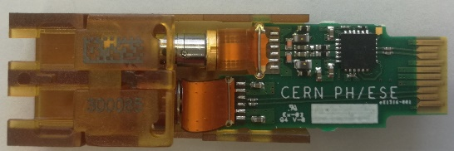
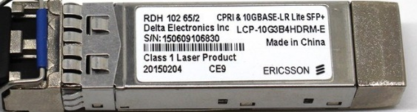

CWDM Single-Mode Versatile link
Radiation zone
Radiation free zone
4 x 10 Gb/s on a single fiber
Front-end
Radiation hard
Transceiver - VTRx
Passive optics
Single-mode optical fibers
Optical MUX/DEMUX
Back-end
Custom off-the-shelf
transceiver
Parameter | Value | Units
Max Uplink Bit Rate | 4.8 or 10.24 | Gb/s
Max Downlink Bit Rate | 4.8 | Gb/s
Wavelengths | 1270/1290/1310/1330 | nm
Total ionizing dose (TID) | 10 | kGy
Fluence | 5 · 10¹⁴ | n/cm² MeV neutrons

Slide 9
CWDM Single-mode Versatile Link Transceiver - VTRx
Front-End pluggable module
Receiver
  COTS InGaAs Photodiode
  Transimpedance amplifier GBTIA v3
Transmitter
  COTS Edge emitter Laser
  Laser driver GBLD v4.2
PCB
TOSA
TX
Laser Diode
Laser Driver
edge
connector
ROSA
I²C
RX
PIN + TIA
0111000101011010000110100
011100010101101001010100

Slide 10
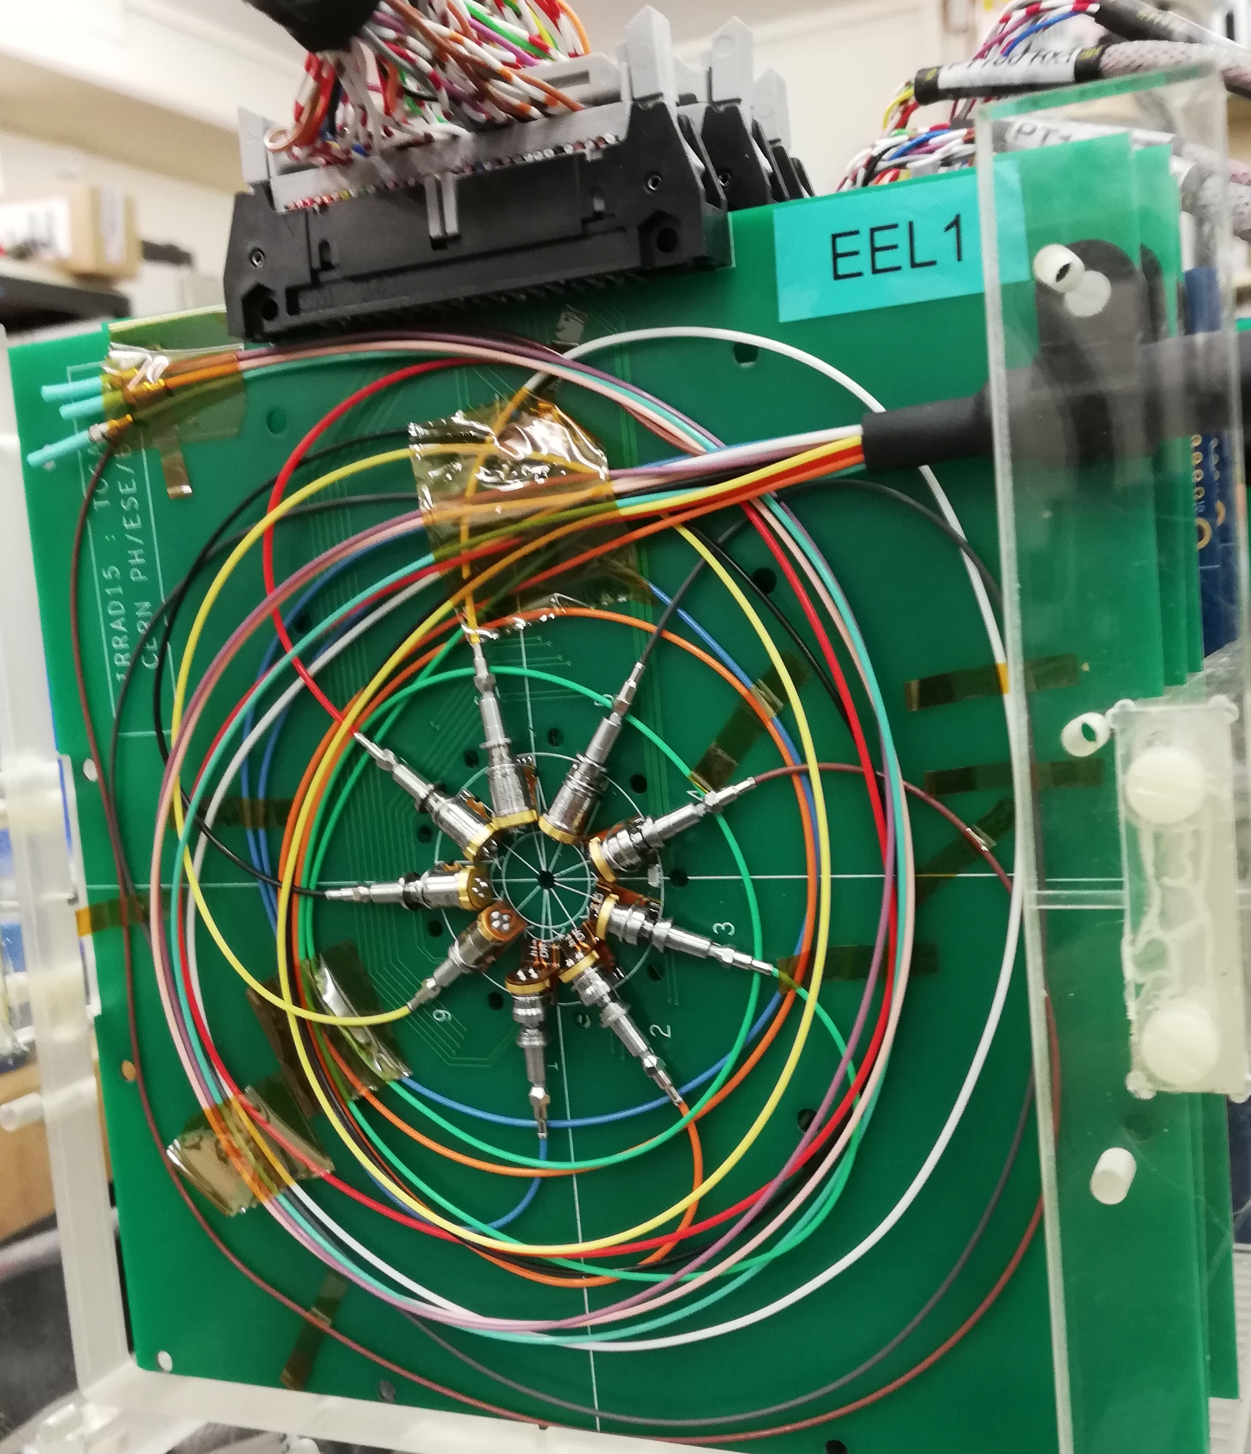
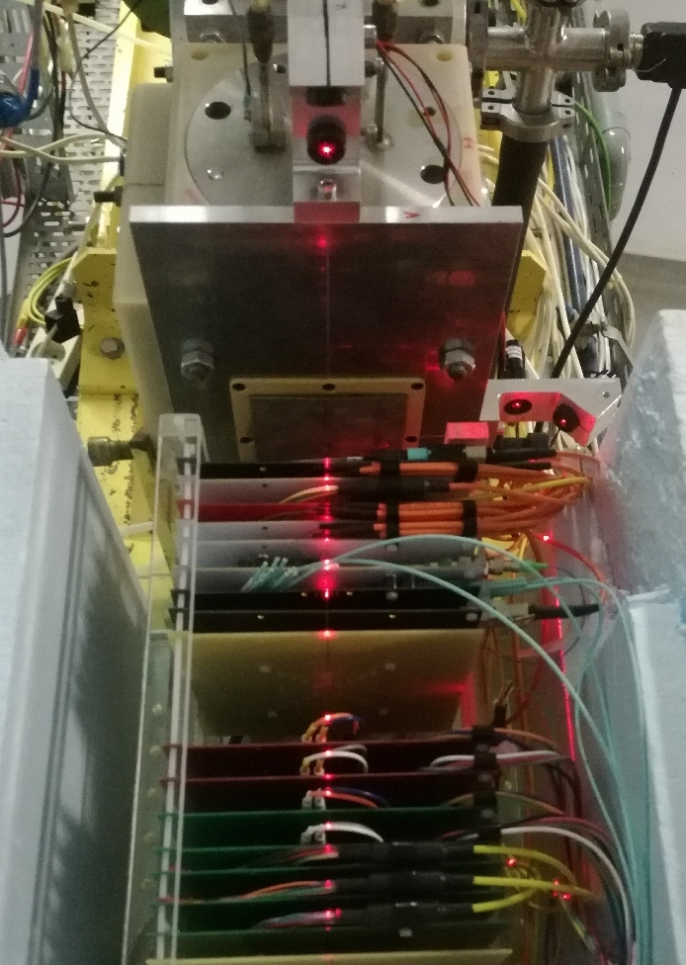
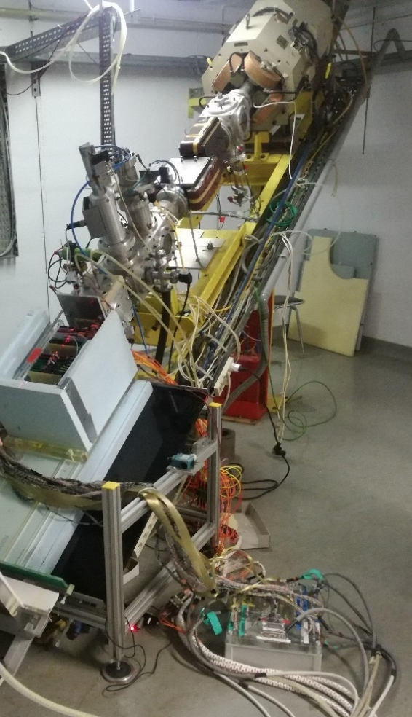
Displacement damage – TOSA in n-beam
Single-mode TOSAs exposed to neutron beam at UC Louvain cyclotron facility (28/11/2018)
Irradiation with fluence up to 5 x 10¹⁴ n/cm² 20 MeV neutrons

Slide 11
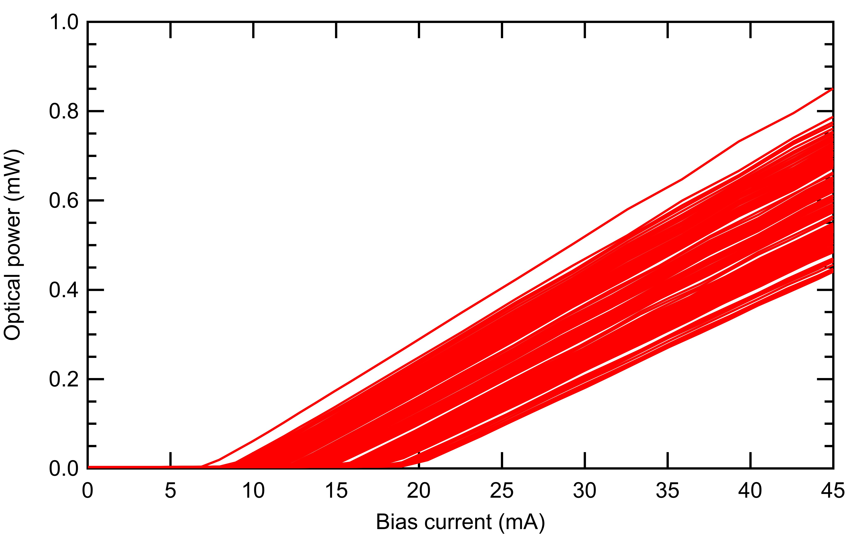
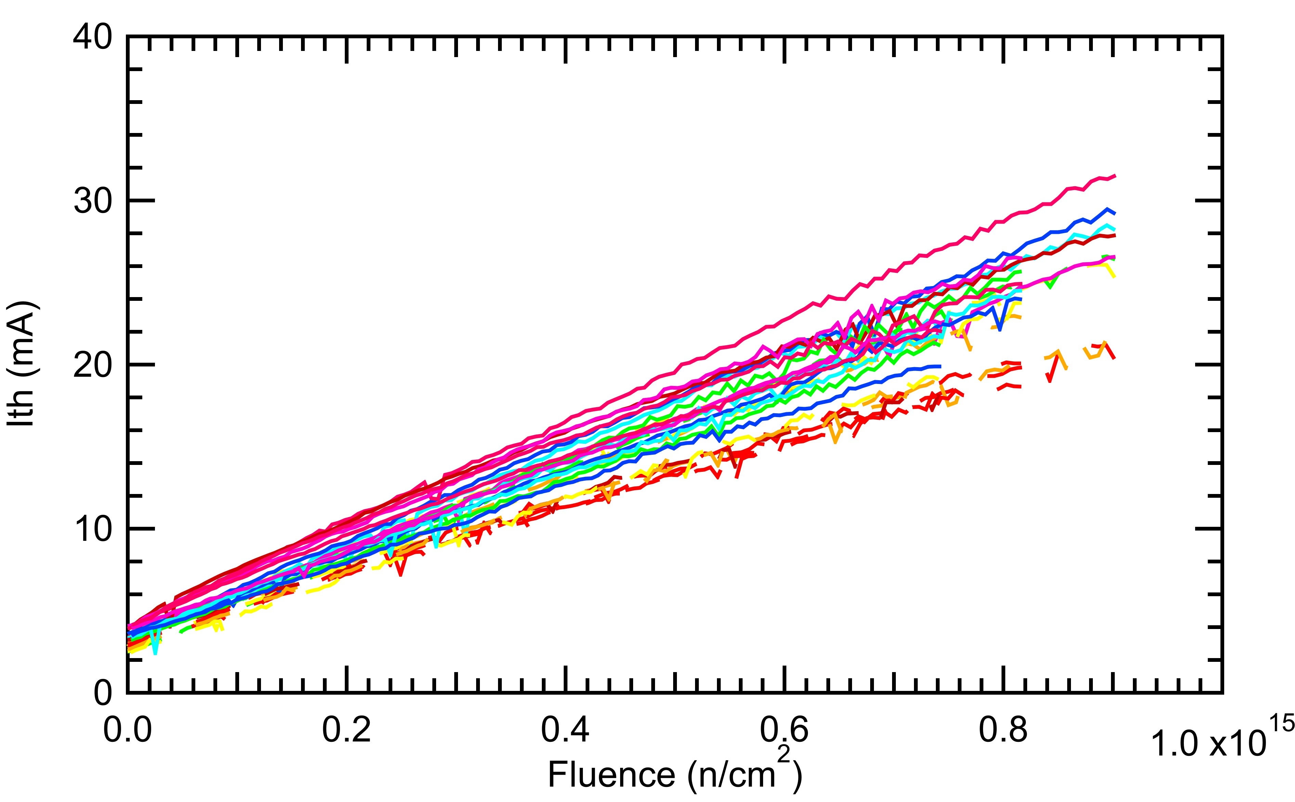
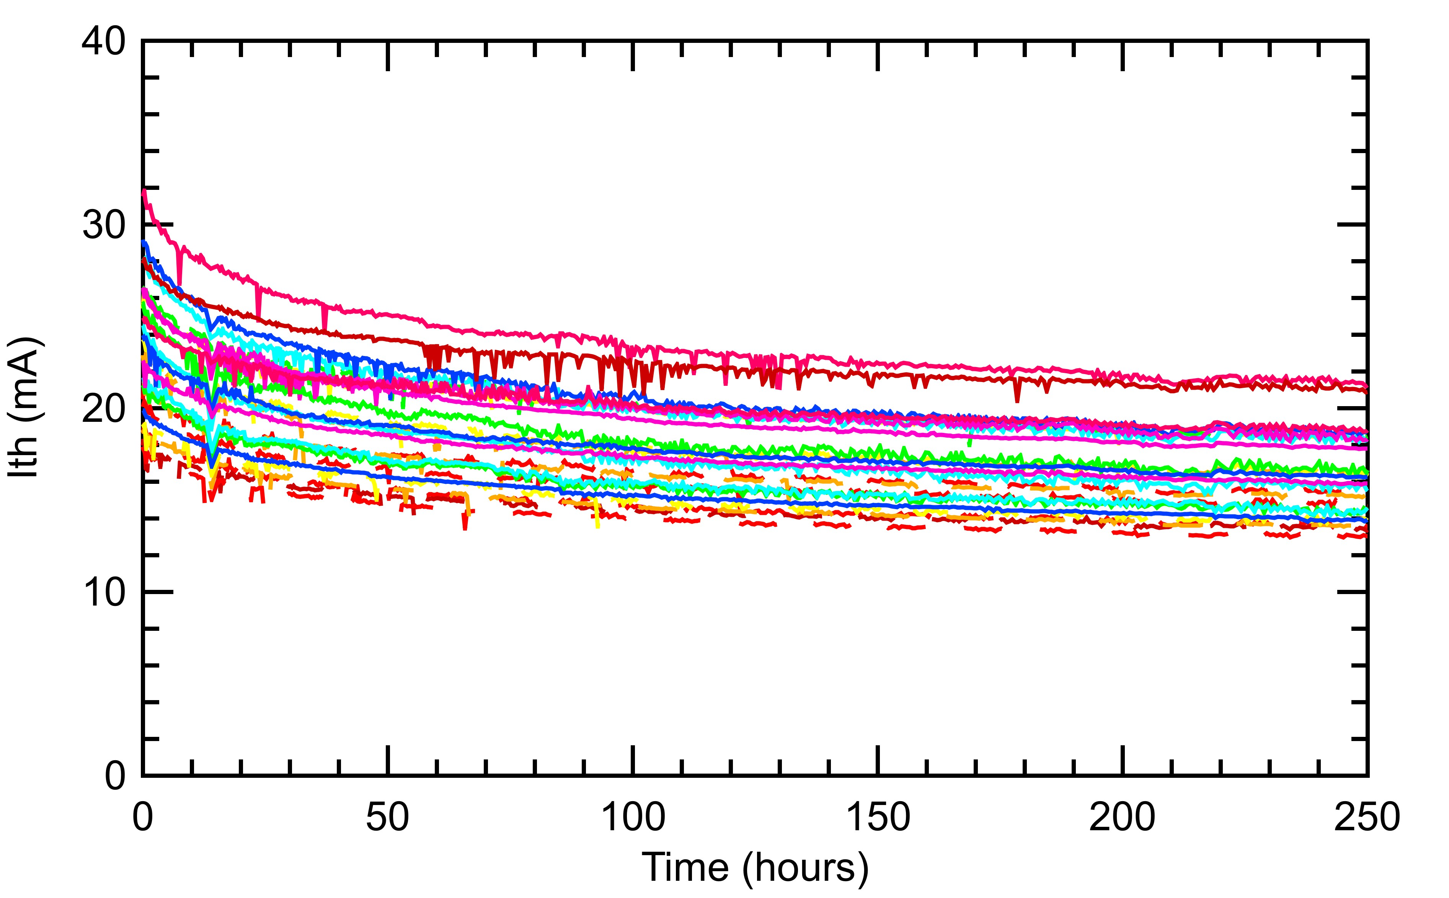
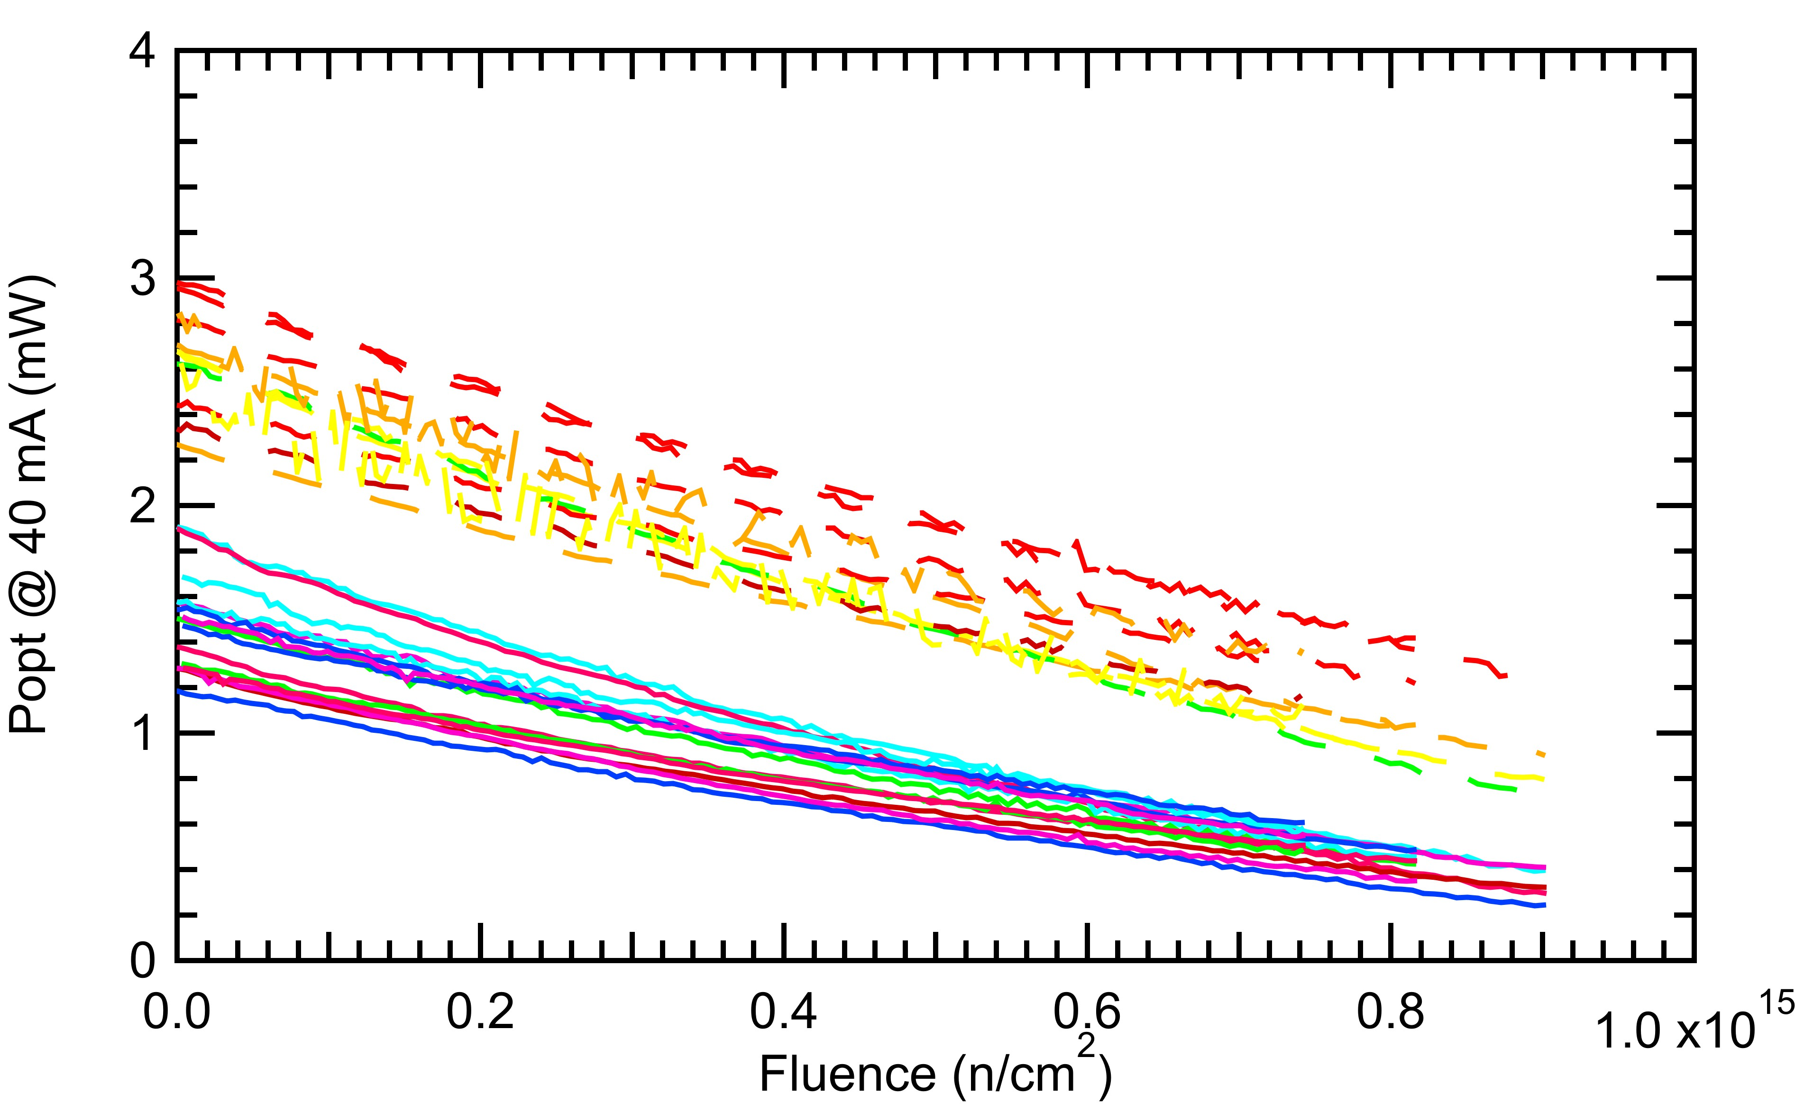
Displacement damage 1/2
Fluence
Moderate increase of threshold current for all tested devices
Full damage compensation possible adjusting bias current
Annealing reduces radiation damage
~ halves the effect in 10 years lifetime

Slide 12
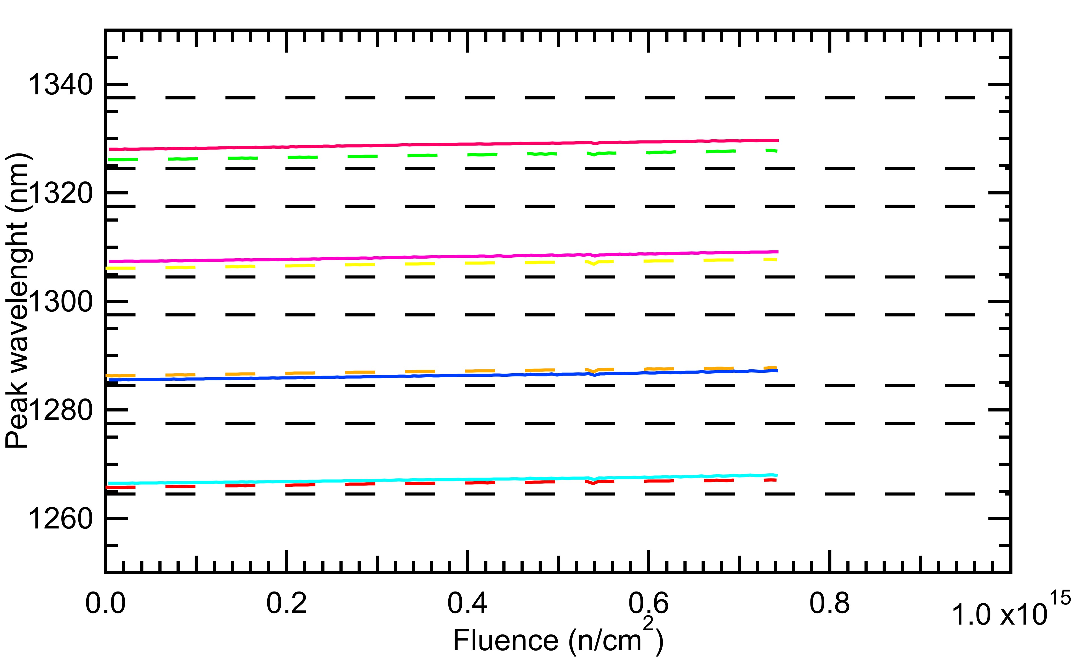
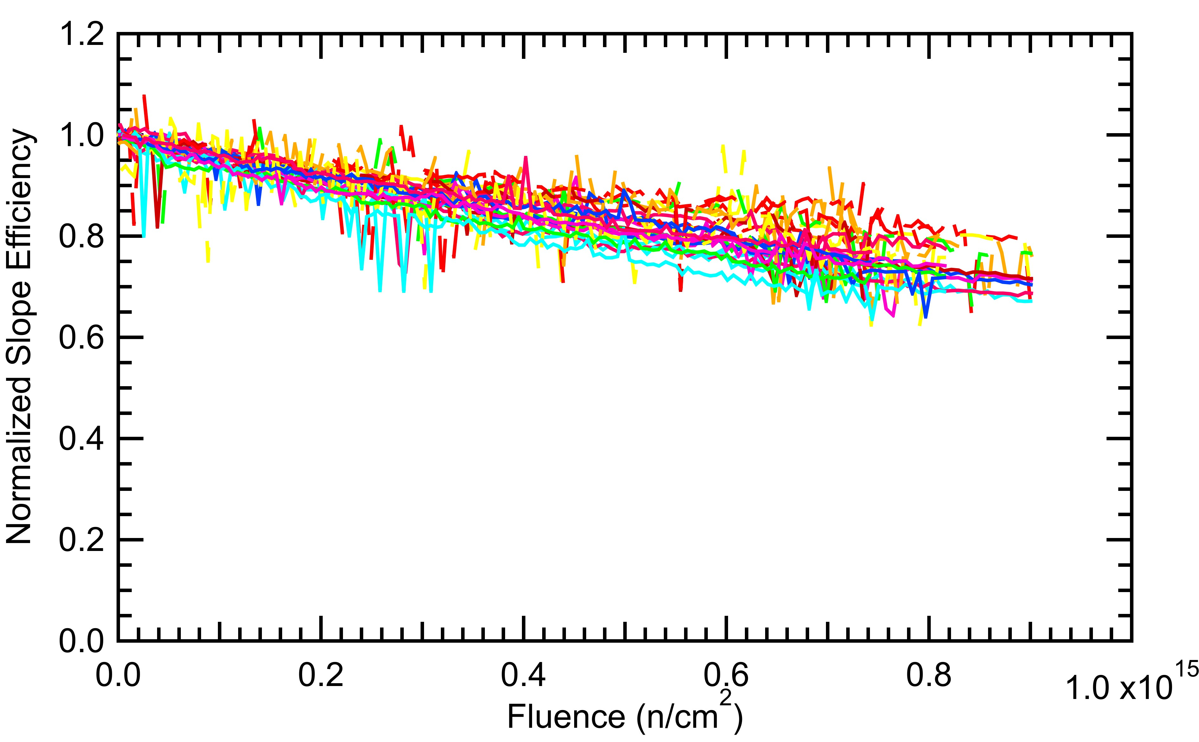
Displacement damage 2/2
10 days annealing
Negligible central wavelength shift
Laser peak wavelength within the CWDM Passband
Moderate slope efficiency decrease
Negligible optical modulation amplitude penalty within the specification radiation levels

Slide 13
Edge-emitting Laser radiation tolerance
Two suitable Laser types showing moderate penalty due to displacement damage have been identified
TID test for optical components into TOSA package to be performed
Further radiation tests required during production volume procurement
e. g. opto die wafer qualification

Slide 14
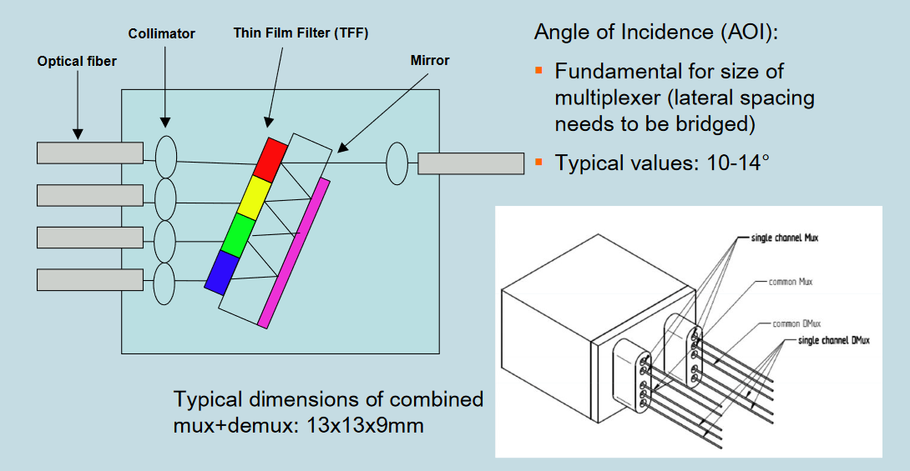
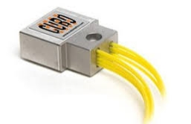
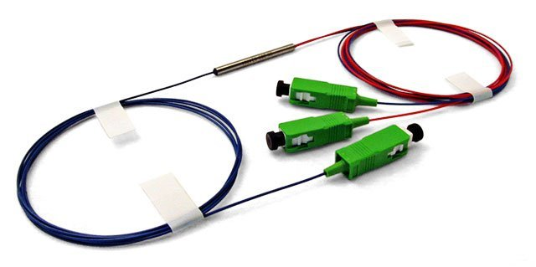
Coarse Wavelength Division Multiplexing
Based on optical MUX/DEMUX
passive bidirectional component
4x10 Gb/s on a single fiber
~ 2 dB insertion loss (4ch MUX)
Radiation tolerance to be investigated
Ch1
1270 nm
Ch2
1290 nm
Ch3
1310 nm
Ch4
4 x 10 Gb/s on a single fiber
1330 nm

Slide 15
Summary and further work
Common solution for accelerator instrumentation optical links
based on the versatile link framework
targeting 10.24 Gb/s upstream operation
4 channel wavelength division multiplexing scheme (CWDM)
compatible with next generation rad-hard chipset for optical data links (LpGBT)
Project status
demonstration of 10.24 Gb/s upstream operation
Laser driver (GBLD) insensitive to TID in the specification range
moderate displacement damage of CWDM Edge-Emitting Lasers
Next steps
radiation tolerance validation of CWDM optical MUX
solutions for standard SFP cage compatibility
defining of final link architecture
moving towards parts procurement, production and qualification

Slide 16
Radiation hardness in single-mode optical links for Accelerator Instrumentation
Carmelo Scarcella
Indico link: https://indico.cern.ch/event/760345/

Slide 17
Backup slides

Slide 18
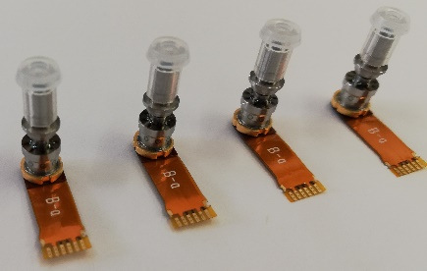
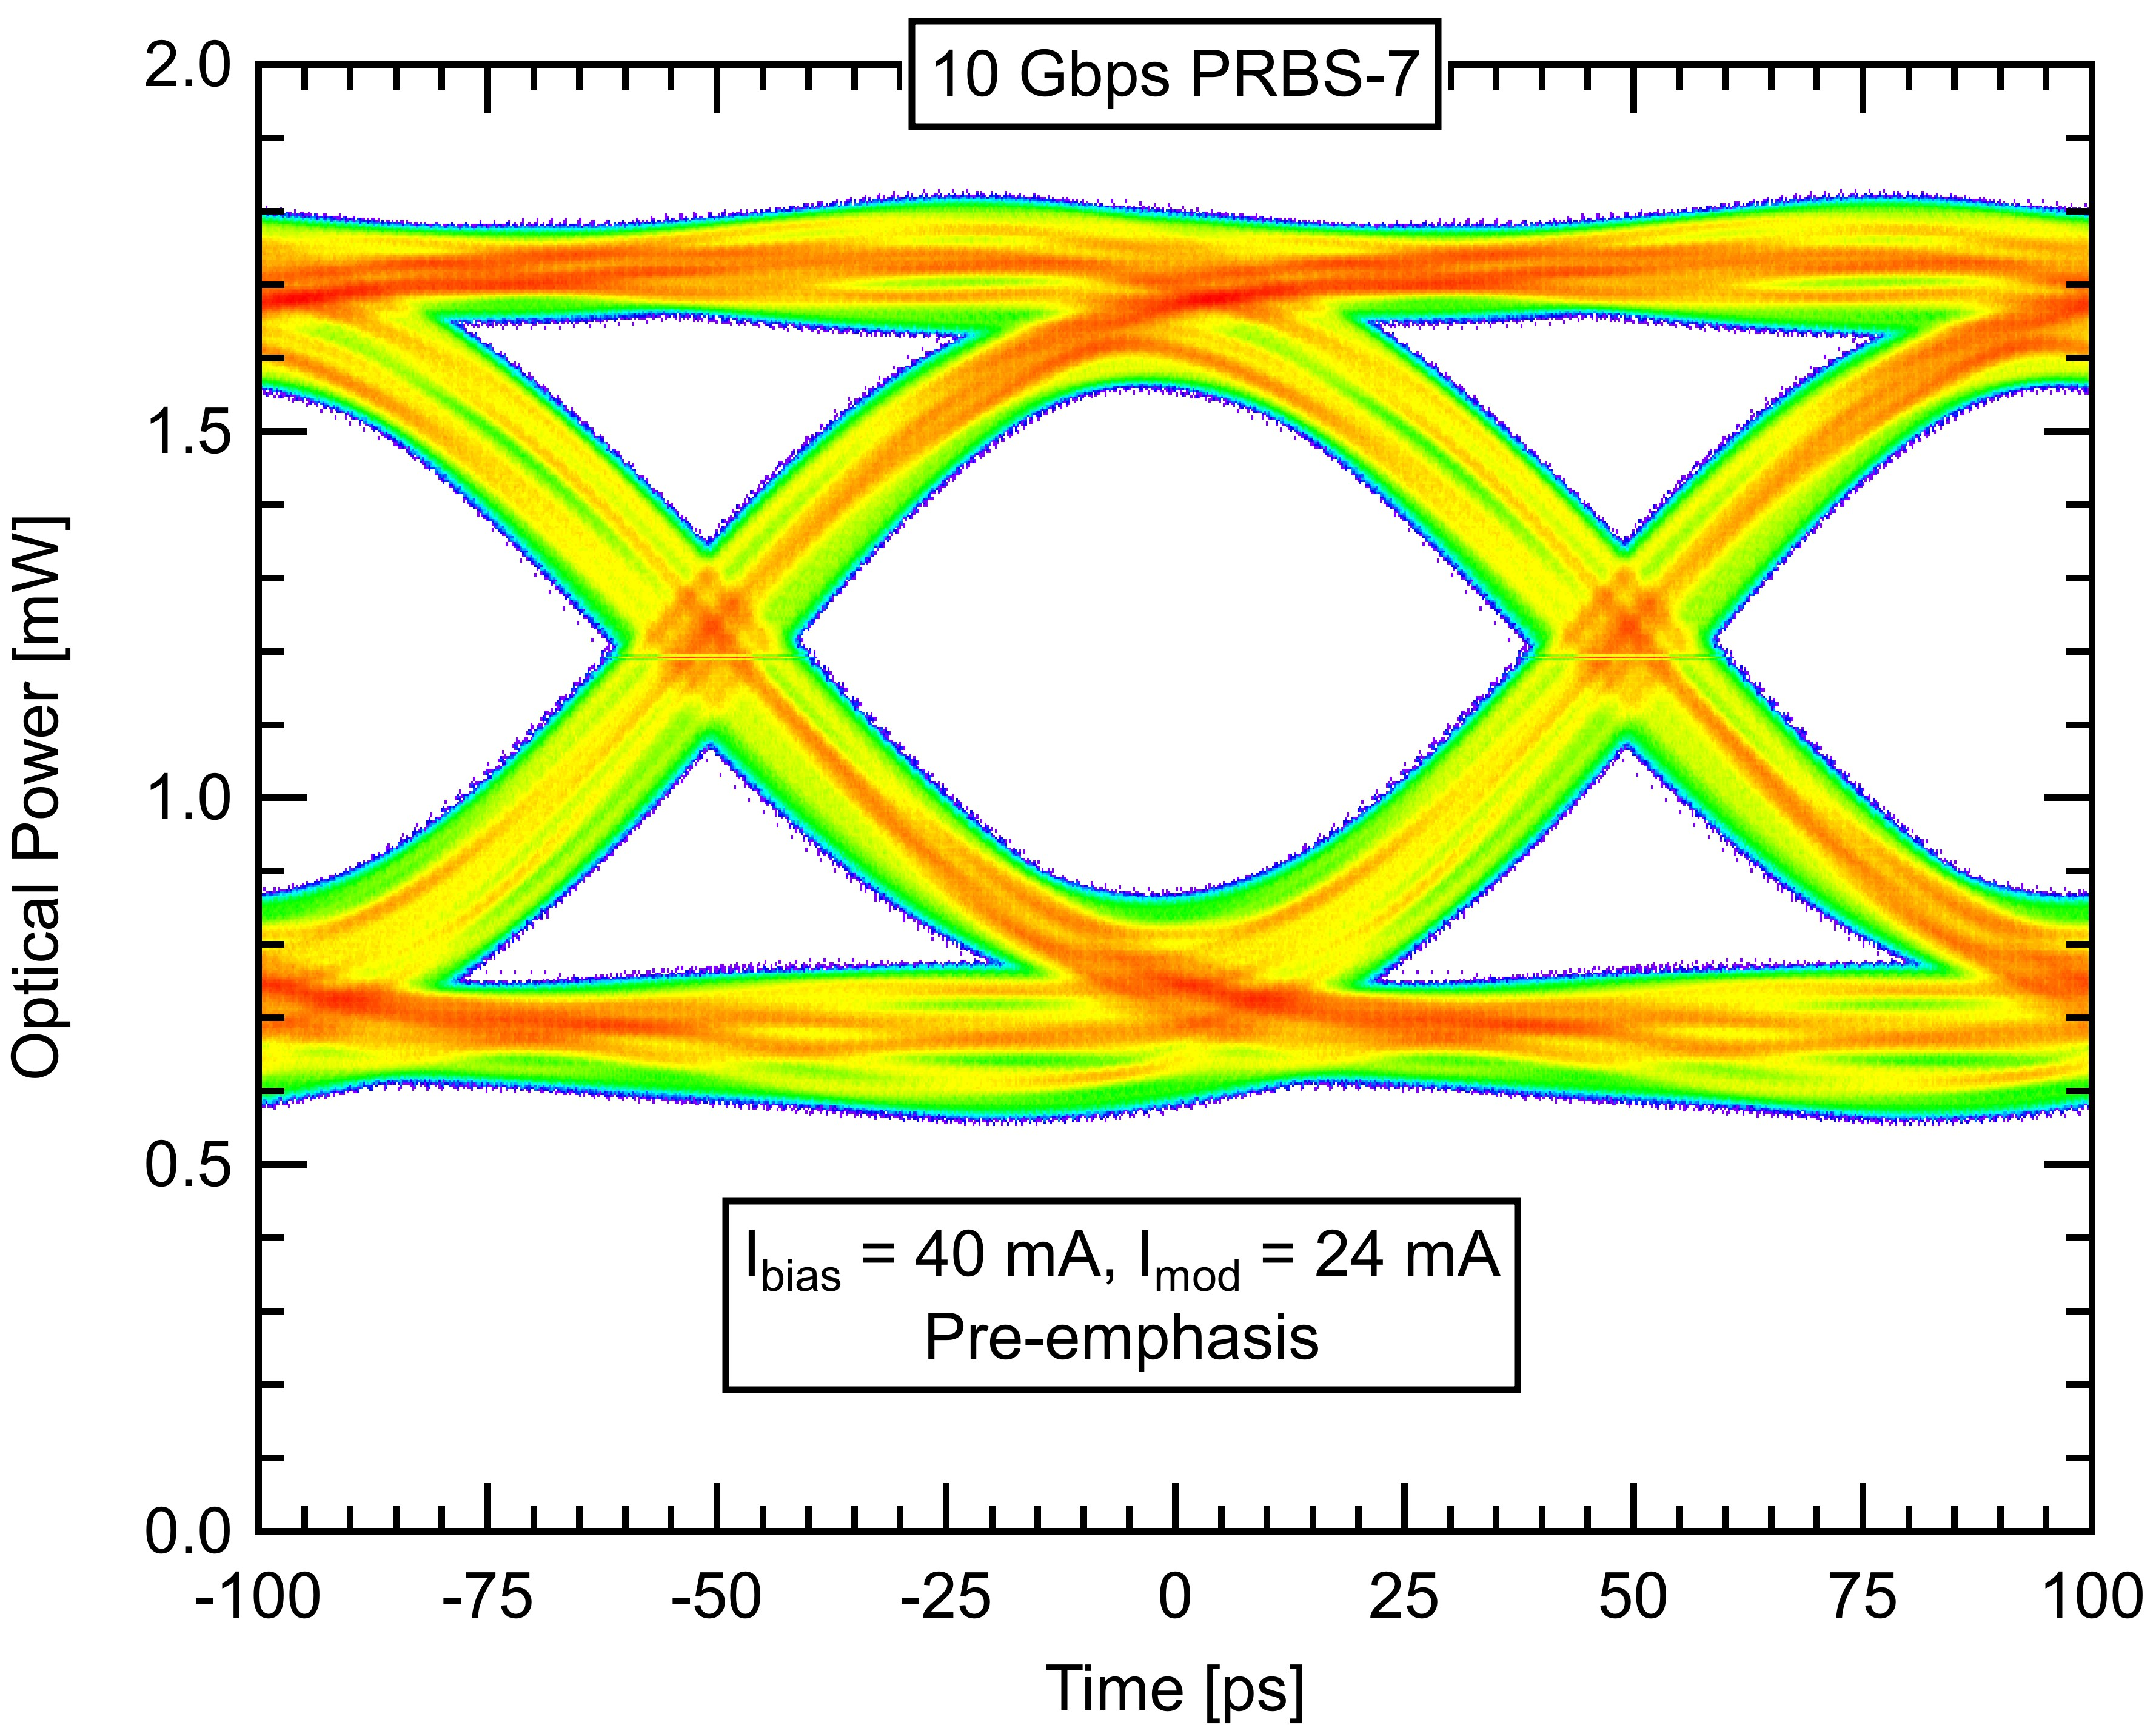

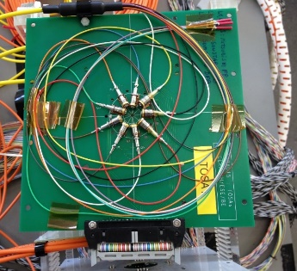
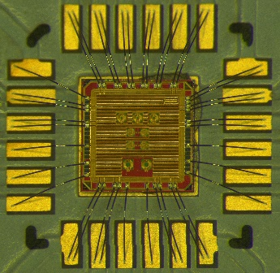

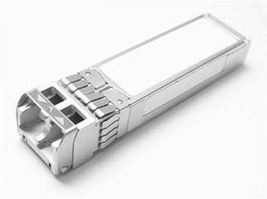
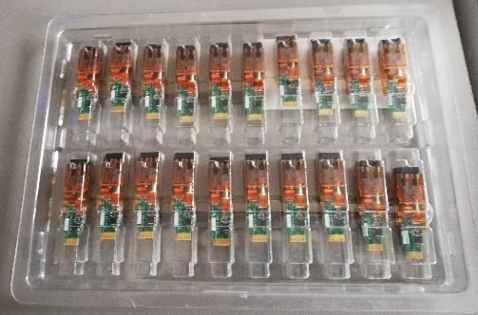

Summary and further work
CWDM COTS EEL procurement
10.24 Gb/s uplink operation
Displacement damage EEL 5 · 10¹⁴ n/cm² MeV neutrons fluence
GBLD Laser driver TID test
Progress
to date
CWDM MUX radiation tolerance
Standard SFP cage compatibility
Link specs definition and production
Next
steps

Slide 19
CWDM Single-mode Versatile link
Common solution for accelerator instrumentation optical links
based on the versatile link framework
targeting 10.24 Gb/s upstream operation
4 channel wavelength division multiplexing scheme (CWDM)
compatible with next generation rad-hard chipset for optical data links (LpGBT)
Project status
demonstration of 10.24 Gb/s upstream operation
Laser driver (GBLD) insensitive to TID in the specification range
moderate displacement damage of CWDM Lasers
Next steps
radiation tolerance validation of CWDM optical MUX
solutions for standard SFP cage compatibility
defining of final link architecture
moving towards parts procurement and production
Ch1
1270 nm
Ch2
1290 nm
Ch3
1310 nm
Ch4
4 x 10 Gb/s on a single fiber
1330 nm

Slide 20
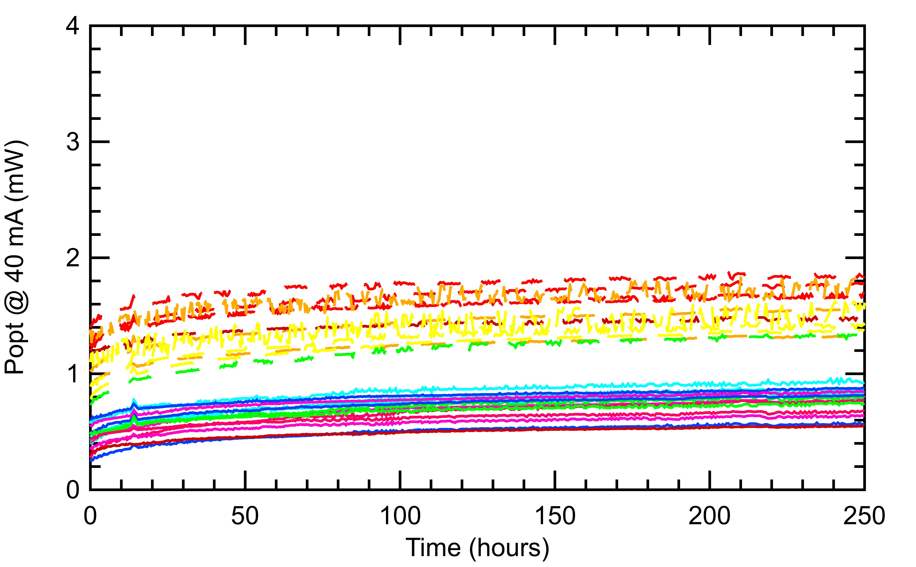
Displacement damage 1/2
Fluence
Moderate increase of threshold current for all tested devices
Full compensation bias current compensation
~ 10 days annealing

Slide 21
10 Gbps VTx operation
PCB
TOSA
All evaluated TOSAs rated for 10 Gbps operation
Custom rad-hard ASIC – GBLD V4.2
I_{bias} = 2 ÷ 43 mA
I_{modulation} = 4 ÷ 24 mA
I_{emphasis} = 0 ÷ 24 mA
T_{emphasis} = 60 ÷ 90 ps
TX
Laser Diode
Laser Driver
edge
connector
ROSA
I²C
RX
PIN + TIA
Enhancing the frequency response
I_{Laser}
T_{emp}
I_{emp}
I_{bias}
I_{mod}
Time

Slide 22
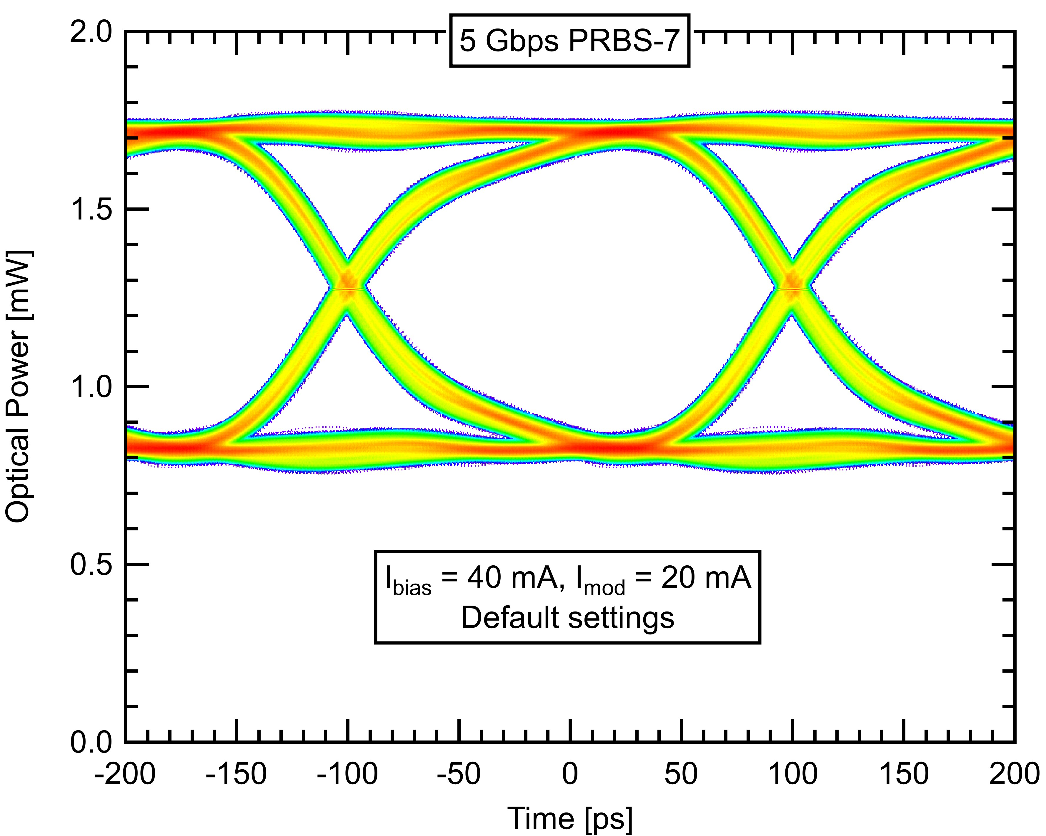
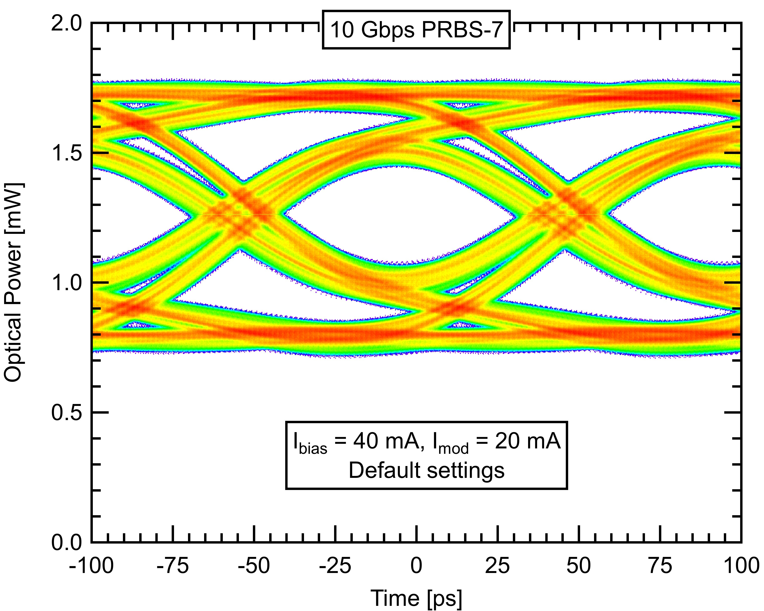
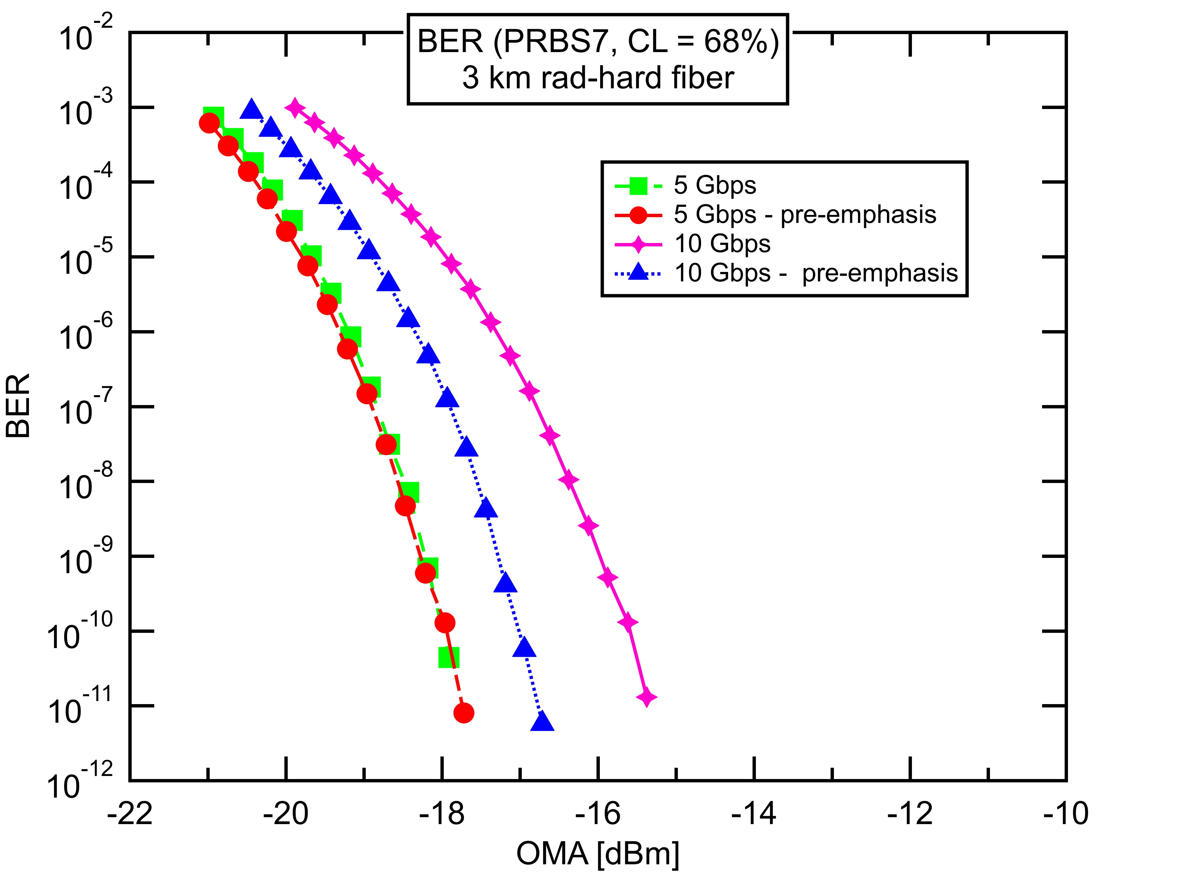
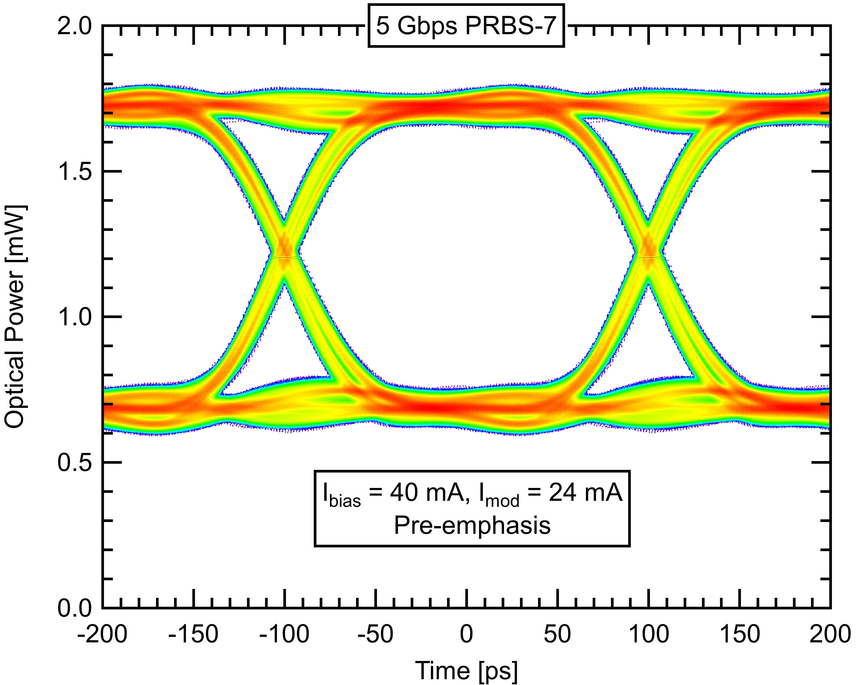
Uplink lane rate
5 Gb/s
10 Gb/s
Applications requiring high data rate can run the uplink at 10.24 Gb/s using pre emphasis on rising/falling edges
10.24 Gb/s is compatible with next generation rad-hard serialiser/deserialiser LpGBT

