Slide 1


ETH to fiber converters and
fiber bundle radiation hardness
tests at CHARM and IRMA
BE-BI-PM
Ack. S.Danzeca*, C. Cangialosi*, J. Lendaro*, H. Desjonqueres**, S. Poirier** (* CERN, ** IRMA-CEA Saclay)
RADWG Meeting 13th December 2018 D.Celeste BE-BI-PM

Slide 2

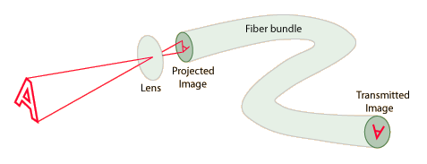

Introduction
Beam profile imaging nowadays: BTV – Vidicon
  Advantages:
    Most Rad Hard so far…
    No active components inside.
  Drawbacks:
    Limited life.
    Limited sensitivity (observation instruments).
    Issues of procurement (no production since > 5years, still ≈100 pieces in stock).
Beam profile imaging upgrade: imaging fiber system
  Principle: Transport an image away from a high radiation
  level area up to the camera located in a ‘safer’ place.
  Advantages: Increased life time.
  Procurement of 2x2m and 2x10m long/bunch of 10k fibers.
Radiation hardness tests on:
1. Digital cameras @ CHARM
(RADWG 13th Avril 2017, S. Burger)
2. Eth/fiber converters @ CHARM
3. Fiber bundle @ IRMA
(RADWG 23rd May 2018, D. Celeste)
Camera
RADWG Meeting 13th December 2018 D.Celeste BE-BI-PM

Slide 3
Summary
Introduction
Tests at CHARM: introduction and setup
Results on ethernet to fiber converters RadHard test
Tests at IRMA introduction and setup
Results on fiber bundle RadHard test
Conclusions
RADWG Meeting 13th December 2018 D.Celeste BE-BI-PM

Slide 4

Tests at CHARM: introduction and setup (1)
Increase of the use of high performance digital cameras in BI.
Radiation effect issue mitigated with optical line, shielding and RadHard innovation.
Distance to its control front end.
The Gigabit Ethernet allows up to 100m connections.
Not enough in the case of the SPS BTV dump future camera based (BTV) system.
Ethernet to Optical Fiber converter
Ethernet
(max 100m)
Dual Fibre SC single mode
Ethernet
Digital Camera
Eth/fibre
1G/Single ch.
Eth/fibre
1G/Single ch.
PowerPC, Ethernet network, etc.
As SPS machine…test in CHARM facility
RADWG Meeting 13th December 2018 D.Celeste BE-BI-PM

Slide 5
Tests at CHARM: introduction and setup (2)
Request:
  To reach approximately 50 Gy TID
  RUN1: from 08/08/2018 to 14/08/2018
  RUN2: from 16/08/2018 to 21/08/2018
24GeV
~4E11p
400ms spill
Every ~30s
Monitoring tool by CHARM
Extract dose/HEH/1MeV eq. fluence
Location of the modules
RADWG Meeting 13th December 2018 D.Celeste BE-BI-PM

Slide 6
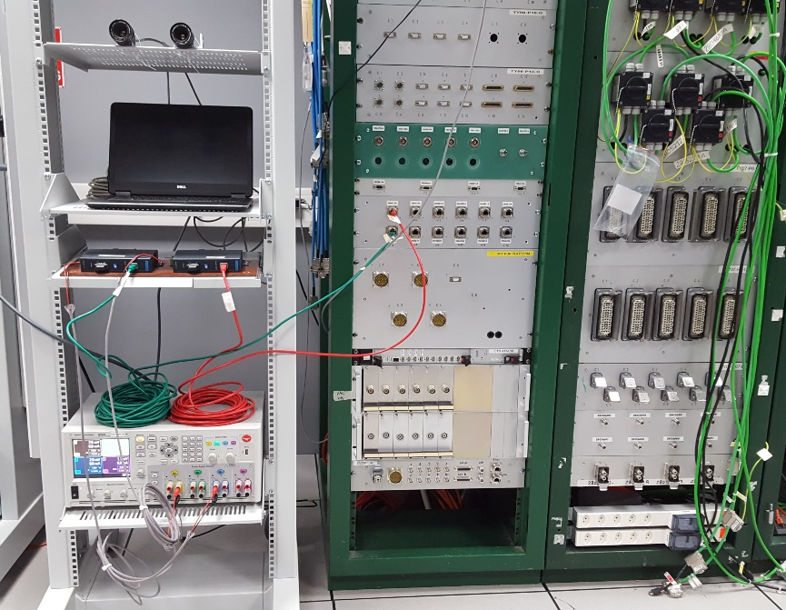
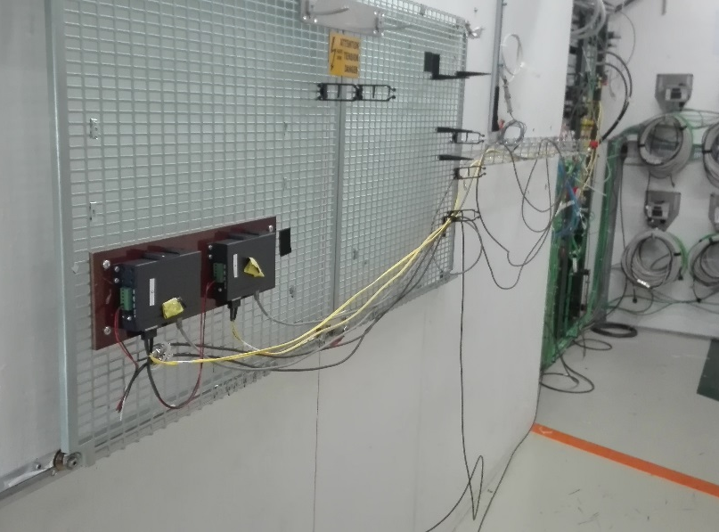
CHARM installation
Layout for Ethernet/Fibre module irradiation test @ CHARM
Summary of cables and fibres needed
Safe area
Radiation area CHARM G0
Function | Desc. | Connector | Qty
Ethernet |  | RJ-45 | 10
Power Supply1 | +12V | 2 wires or coax | 2
Fibre type1 | SC Single Mode | SC type fiber connector (EKI-2741SX/LX) | 2x2
Ethernet
Digital Camera
Ethernet
Eth/fibre
1G/Single ch.
Eth/fibre
1G/Single ch.
x2
Fibre type 1
Power supply1
‘GUDE‘ power switch CTRL
RADWG Meeting 13th December 2018 D.Celeste BE-BI-PM

Slide 7
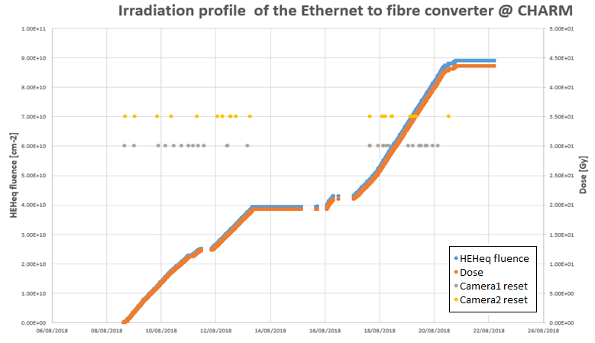
CHARM results (1)
Test procedure:
Image acquisitions every minute
Power cycles at each connection loss
Module2: 22 failures
Module1: 28 failures
Analysis:
Logging cameras
Logging GUDE power switch
Checking connection failures
RADWG Meeting 13th December 2018 D.Celeste BE-BI-PM

Slide 8
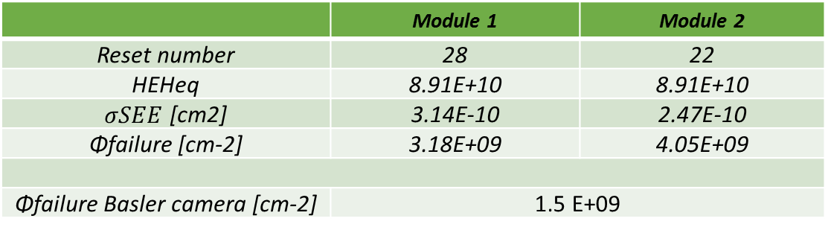
CHARM results (2)
Average impact on modules per spill:
Parameter Value
POT [#] | 4.64973 E+11
Dose [Gy] | 6.71596 E-04
1 MeV Neutron eq. Fluence [cm⁻²] | 1.629182257 E+07
HEH eq. Fluence [cm⁻²] | 1.372112079 E+06
SETUP STILL WORKING AT
THE END OF THE TWO RUNS
Results module power cycles:
OK!
 | Module 1 | Module 2
Reset number | 28 | 22
HEHeq | 8.91E+10 | 8.91E+10
$σSEE$ [cm2] | 3.14E-10 | 2.47E-10
Φfailure [cm-2] | 3.18E+09 | 4.05E+09
Φfailure Basler camera [cm-2] | 1.5 E+09
RADWG Meeting 13th December 2018 D.Celeste BE-BI-PM

Slide 9
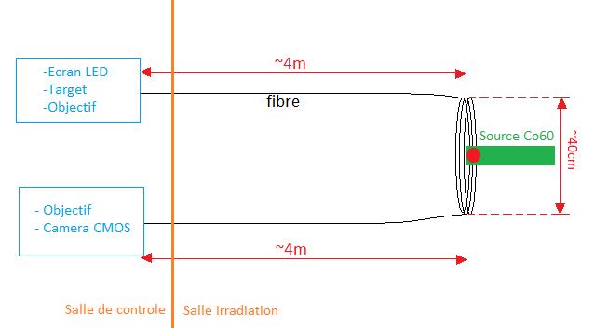
Tests at IRMA: introduction and setup
Simulating 10 years of operation of fiber bundle
Choice of gamma radiation
On-line results to monitor behaviour
Isotropic ⁶⁰Co source facility
Dose rate to reach at least 500 kGy total dose
Reasonable measurement time (days/month)
Reasonable cost
IRMA facility at CEA Saclay
RADWG Meeting 13th December 2018 D.Celeste BE-BI-PM

Slide 10
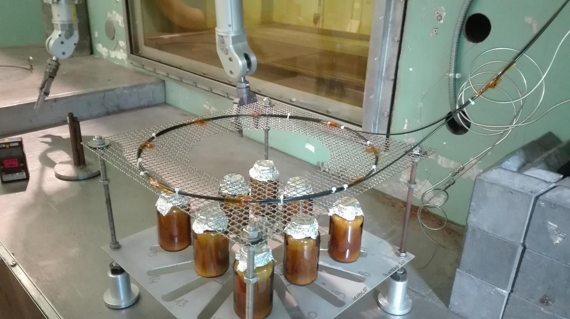
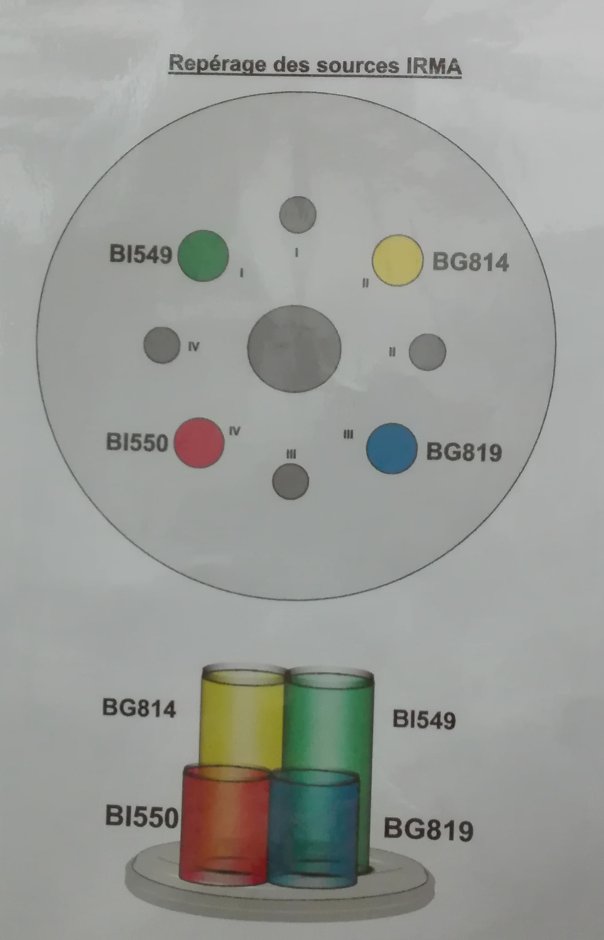
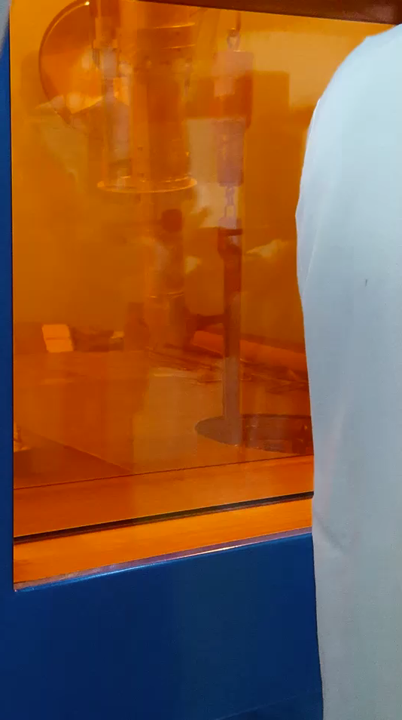
IRMA introduction and setup (2)
Date/Time Integrated Dose [Gy]
Start acquisition: 10/09/2018 14:41:03 | 0
Start irradiation: 10/09/2018 15:14:05 | 0
Stop irradiation: 18/09/2018 15:14:31 | 694.076 E+03
Stop Acquisition: 19/09/2018 14:36:25 | 694.076 E+03
Dose Rate = 3.6kGy/h
Irradiation Time = 8 d
Relaxation time = 1 d
Acq. Image delay = 15’
Temperature = 24-27 °C
RADWG Meeting 13th December 2018 D.Celeste BE-BI-PM

Slide 11
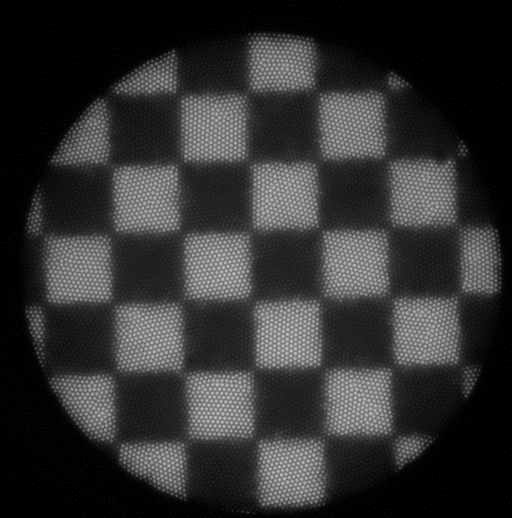
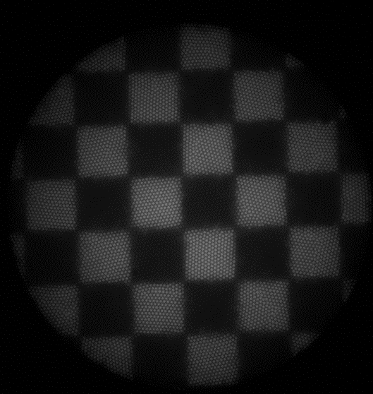
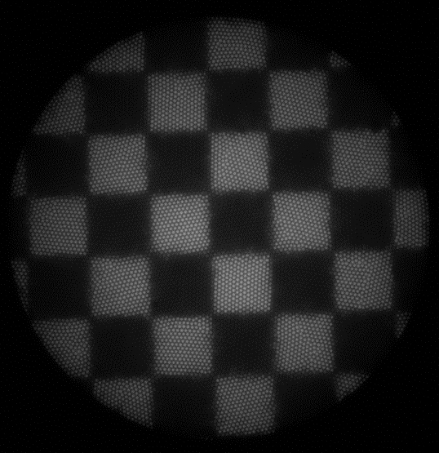
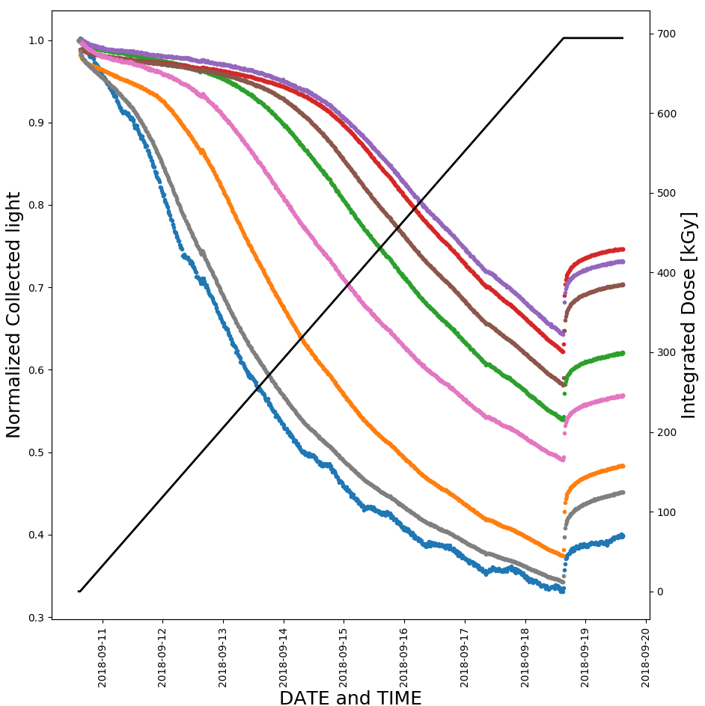
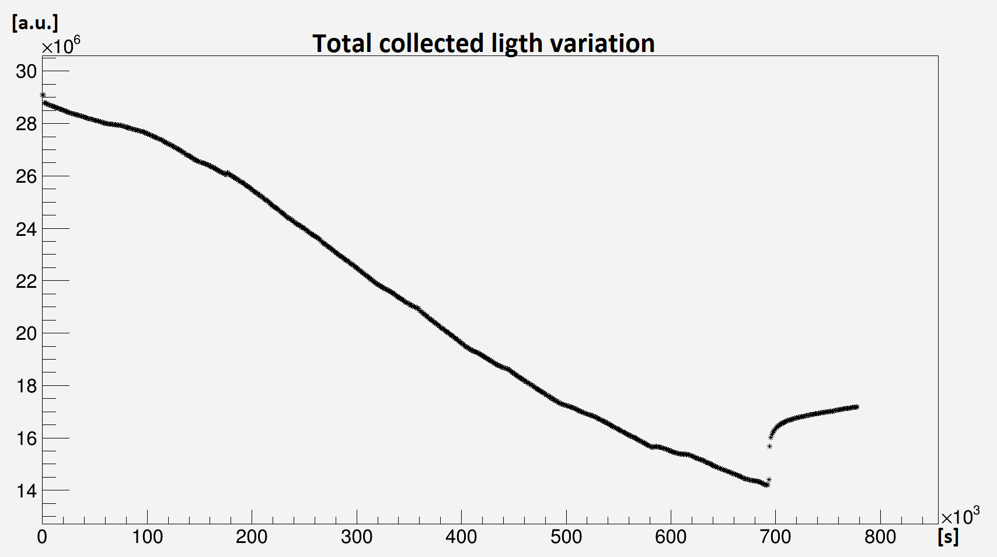
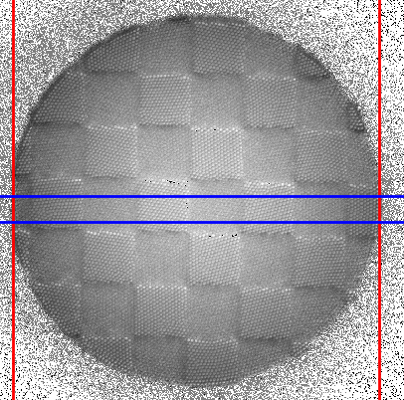
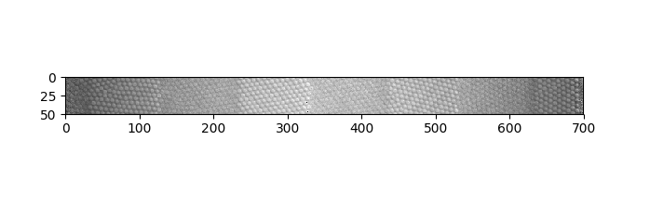
IRMA results
1
2
3
1
3
Before Irradiation (0 Gy) After Irradiation (700 kGy) After relaxation (700 kGy)
2
NORMALIZATION
RADWG Meeting 13th December 2018 D.Celeste BE-BI-PM

Slide 12
Conclusions
Ethernet to fiber radiation hardness test:
Single events can stop camera acquisitions
Power cycles reset correctly the system
System keeps working up to 45 Gy TID
Shielding for ETH to fiber converters foreseen
Failure cross section lower than cameras -> Non limiting factor
Fiber bundle radiation hardness test:
700 kGy TID reached in 8 days
Integrated light loss around 50%
Non-uniform light loss -> to be investigated
Temperature effects
Still able to reconstruct a qualitative image
RADWG Meeting 13th December 2018 D.Celeste BE-BI-PM

Slide 13
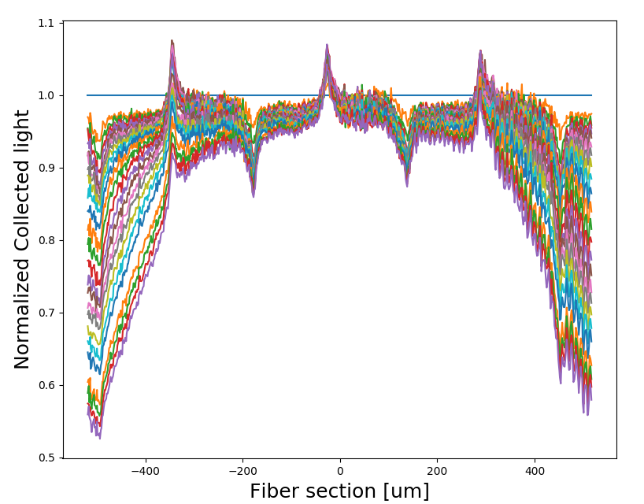
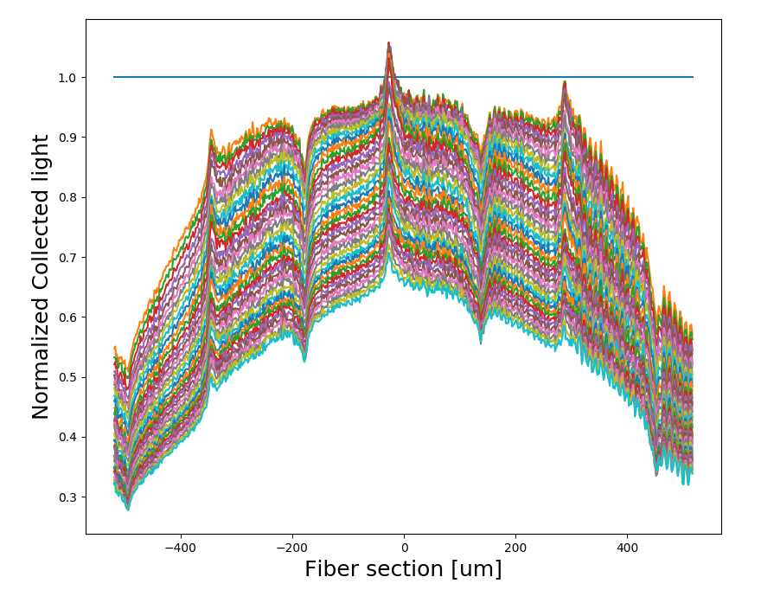
IRMA results (2)
Analysis:
Images selected every 10 kGy
From Day 3 to Day 8
From 240 kGy to 700 kGy
Normalized to reference
Results:
Center starts decreasing faster
down to 70 %
Edges down to 30 %
Analysis:
Images selected every 10 kGy
Up to Dtot = 240 kGy (3 days)
Normalized to reference
Results:
Center stable
Edges down to 50%
RADWG Meeting 13th April 2017 S.Burger BE-BI-PM

Slide 14
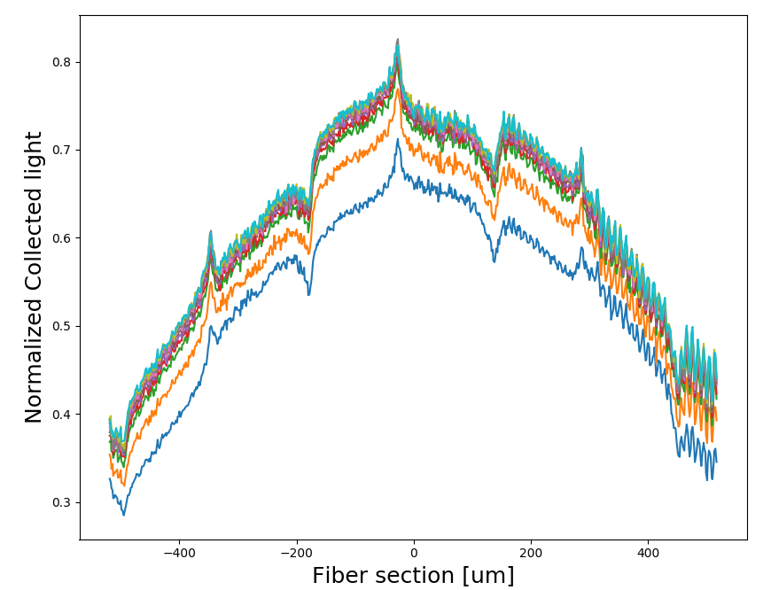
Relaxation time profiles

Slide 15
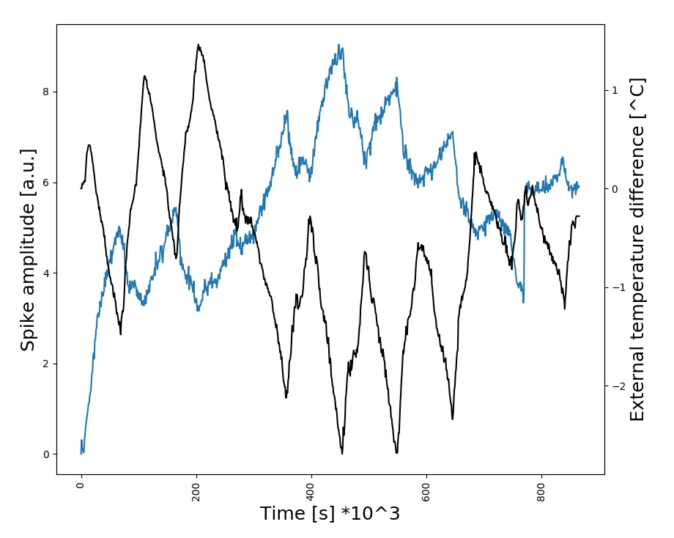
Spikes vs Temperature

Slide 16
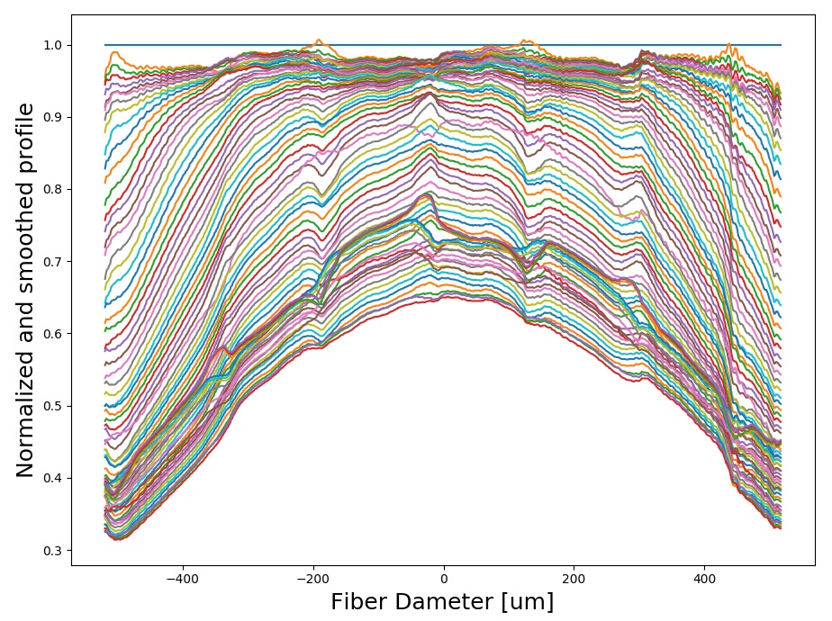
Temperature corrected profiles

