Slide 1
Radiation hardness of pressure sensors for 0-100 mbar range
Michal Les, Juan Casas-Cubillos
Indico link: https://indico.cern.ch/event/760345/

Slide 2
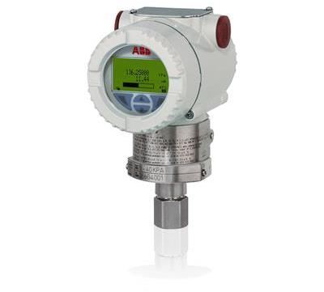
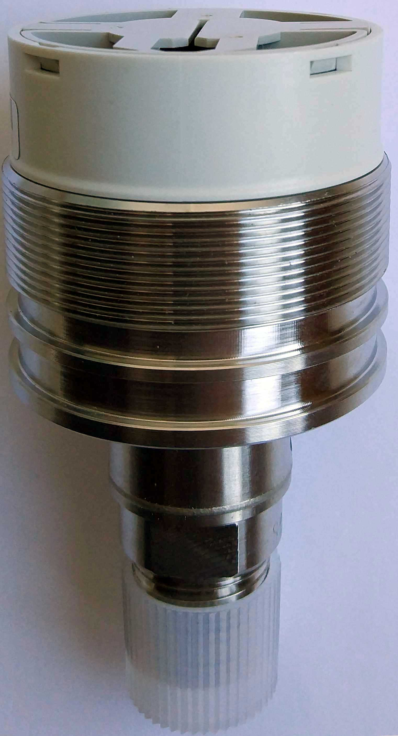
Sensor overview
ABB 266AST 0-60 mbar absolute sensor
Same technology for differential and gauge sensors up to 600 bar
ABB piezoresitive sensor with a bridge
Striped from any electronics
Originally thermodiode for temperature compensation
PT1000- additional sensor (radiation resistant)
Active sensor: 0.04% or 0.025%
Passive with cable: ~0.3%

Slide 3
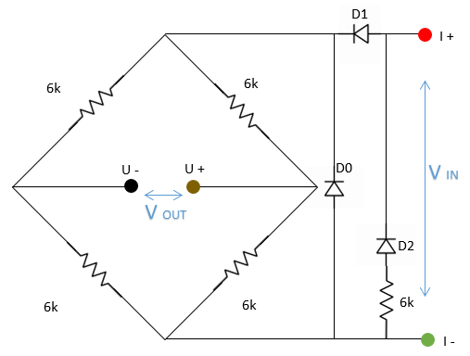
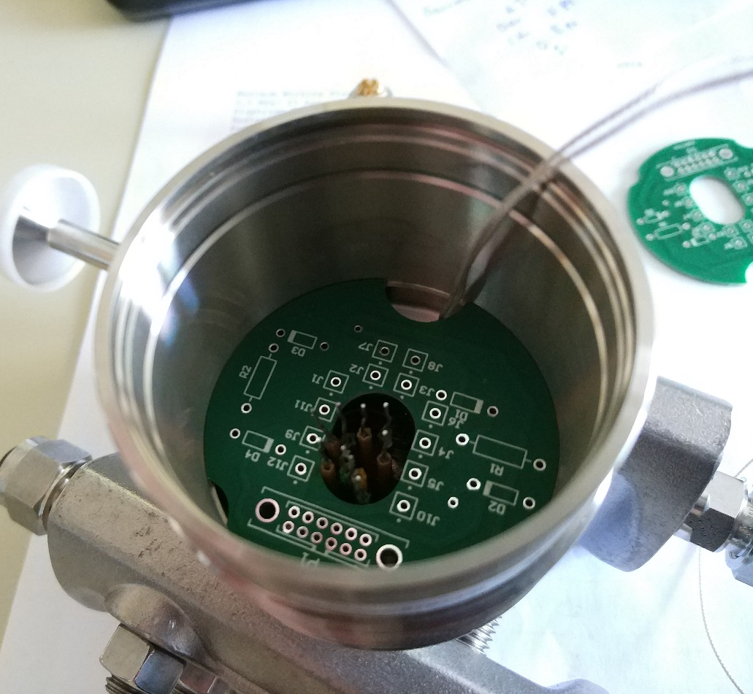
Additional PCB
D0 is originally inside the sensor and cannot be removed
WordFip card cannot measure bridge with D0 because it measure resistance for positive and negative current and if current is too big it rises error
In new configuration measurement for negative current gives Vout=0 and not affect measurement significantly

Slide 4
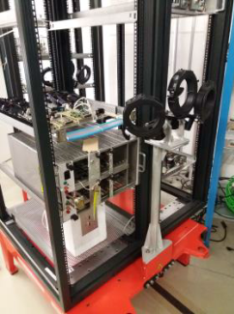
First radiation test - Charm
Two sets with sensors
One for 3 weeks
Second for 2 weeks
Pressure changed by temperature according to nRT=pV
Radiation ~3.57Gy/h
Total dose 1800Gy

Slide 5
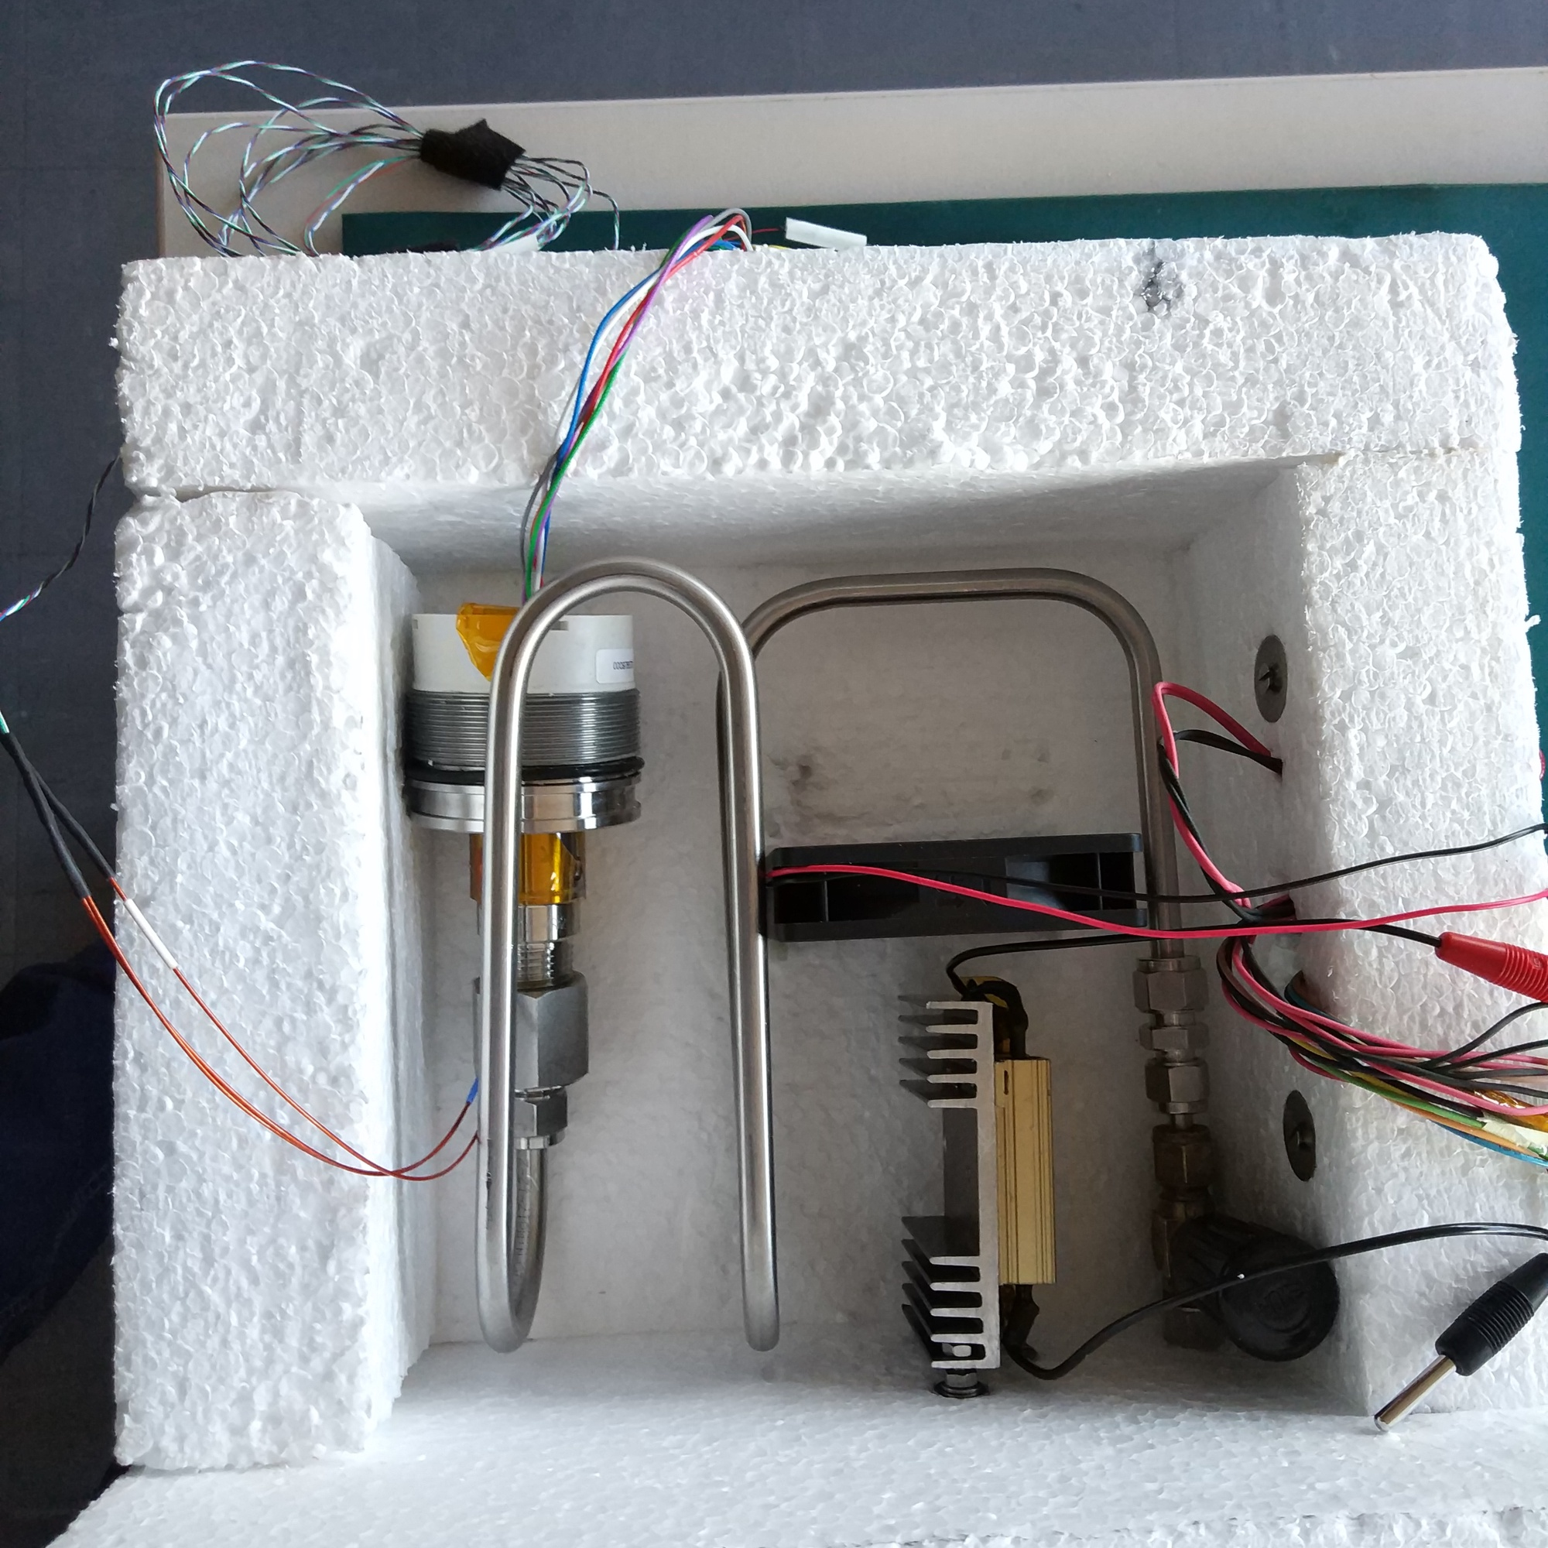
Charm setup
EPS for thermal insulation
Electrical connection
Resistor heater with fan for distributing heat
Sensor
Piping for Volume
Valve: closed and with cap at the end

Slide 6
CHARM results
Not stable pressure reference spoiled results. Probably because of leakage or outgasing. Outgasing would explain non ideal gas behavior
But sensor is still better than 2% with ~1800Gy which is probably better

Slide 7
Second radiation - Co60
Two ABB in front of Co60 - 55.88 Gy/h
One ABB very close but out of radiation area – 25 mGy/h
Low pressure test bench and MKS baratron reference outside radiation room
Testing full range 0-60 mbar but in stable temperature 22,5 ̊ C

Slide 8
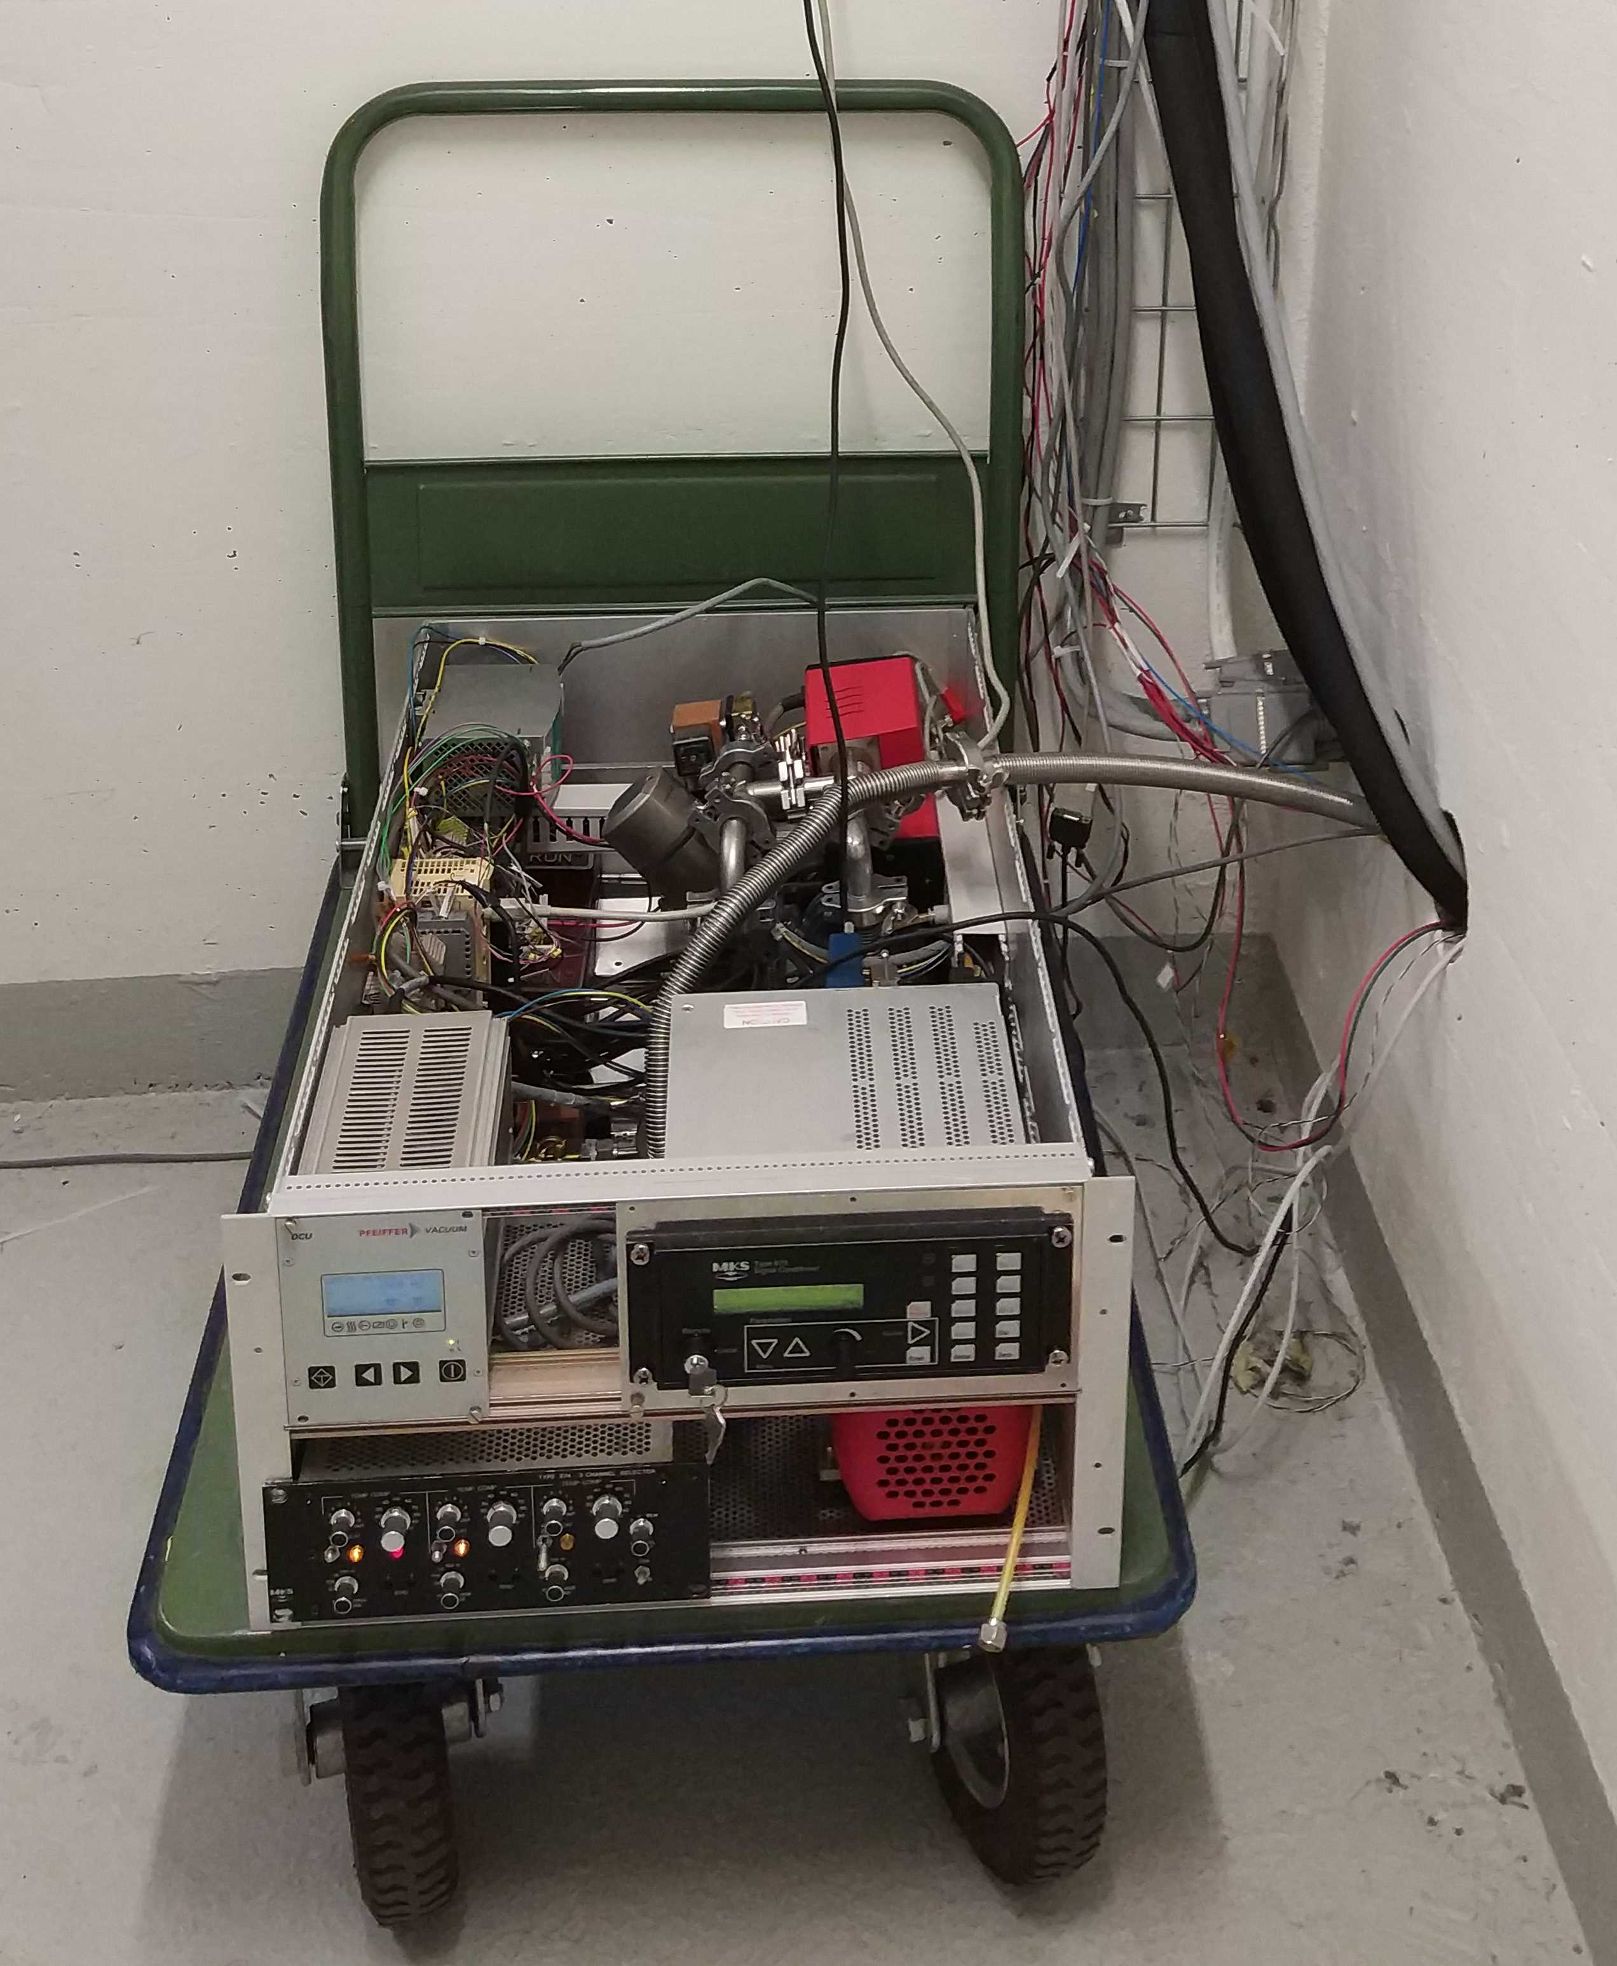
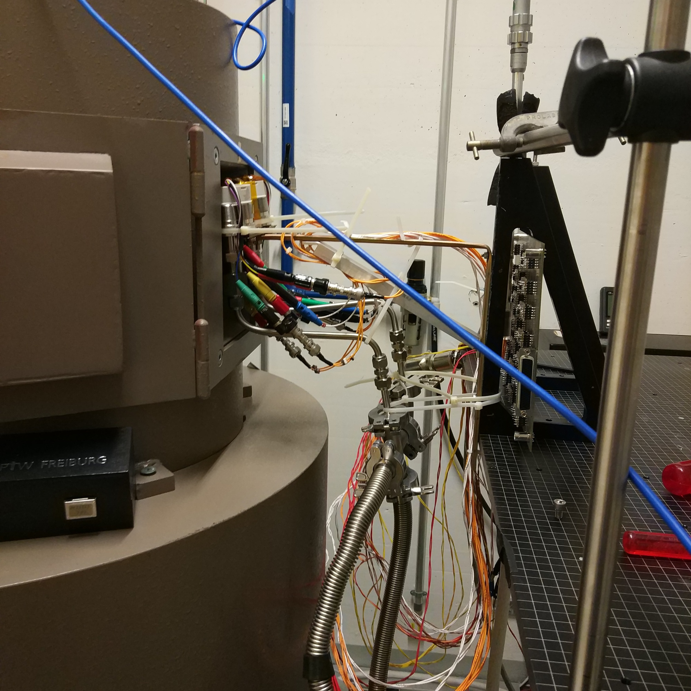
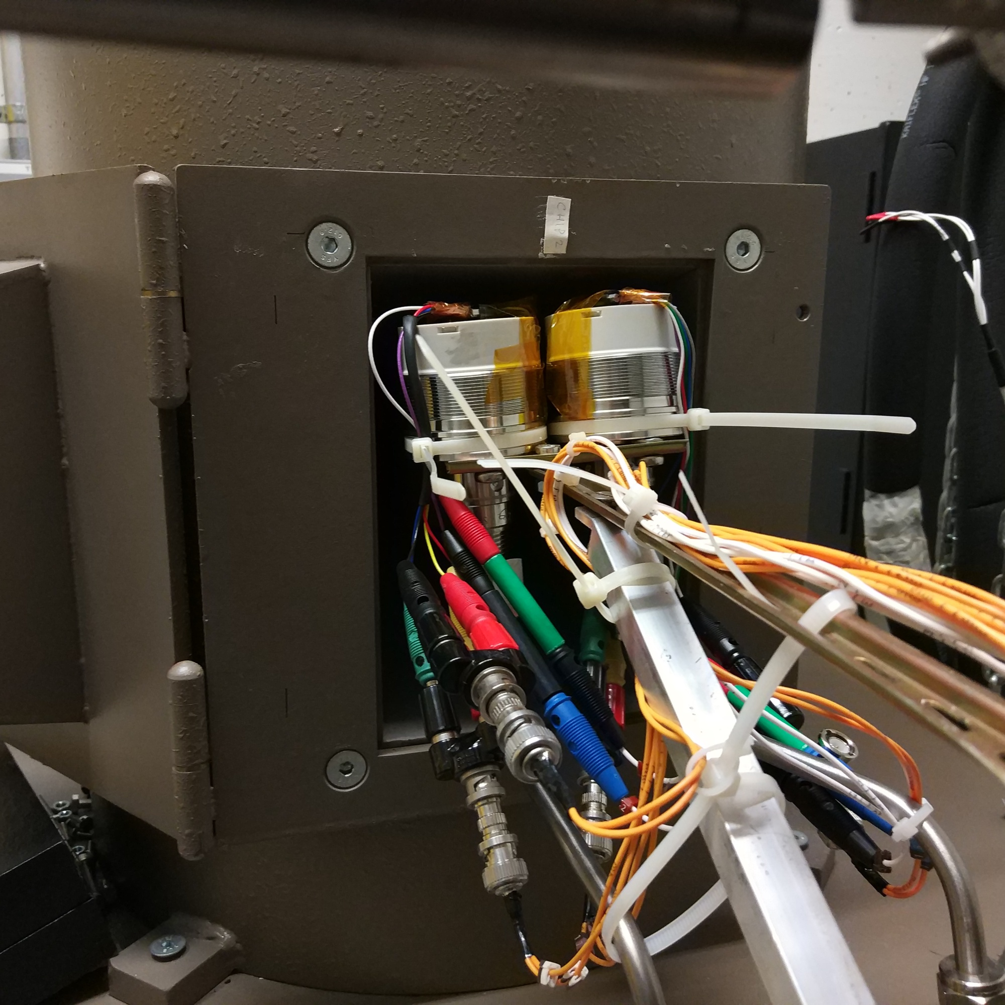
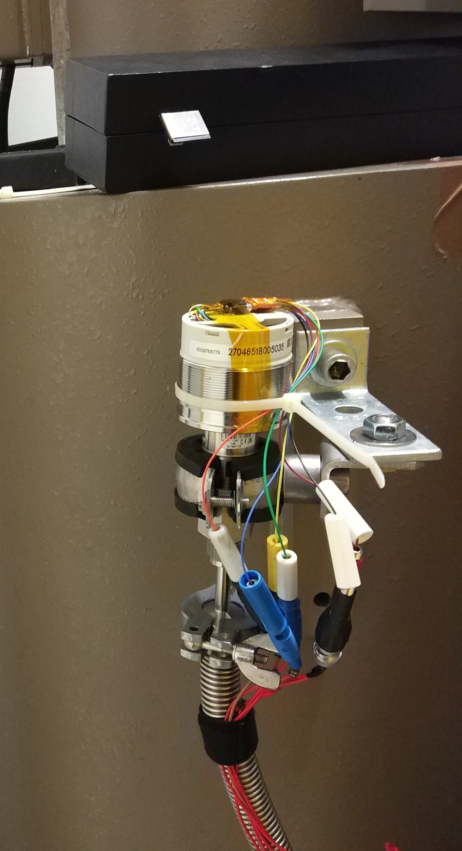
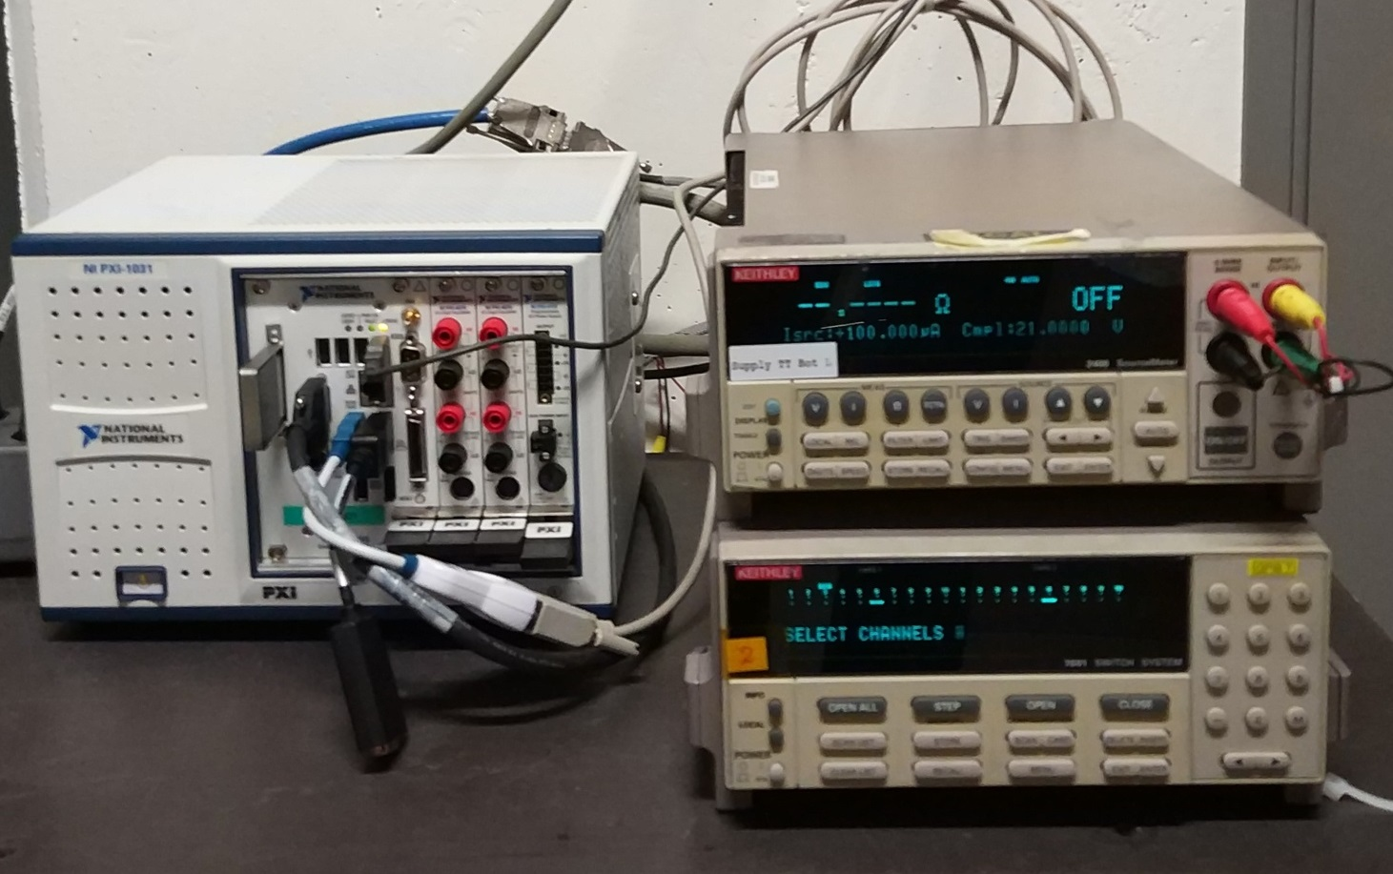
Co60 setup
Radiated sensors
Test bench with
MKS baratron reference
Reference ABB
Acquisition

Slide 9
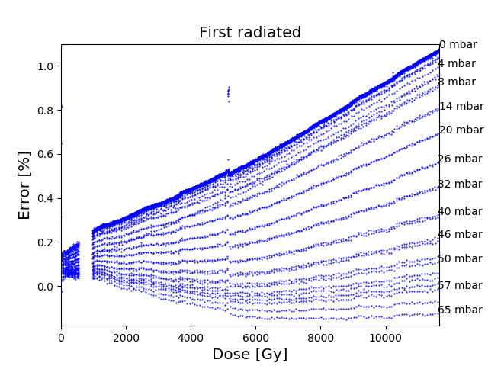
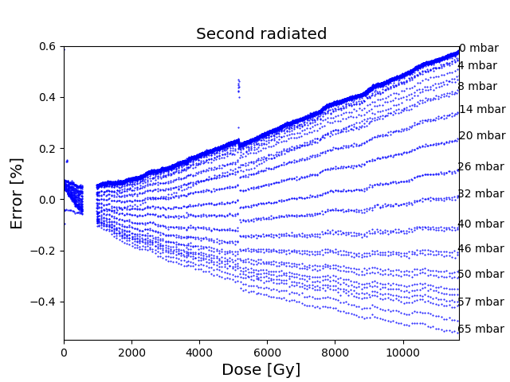
Error against received dose
Error vary for different pressure
Both sensor behaves similar but one is almost symmetric and another has bigger error close to 0 mbar
Asymmetry and nonlinearities may be result of conditioning by third degree polynomial
Polynomial depends with temperature but it this test it was stable enough

Slide 10
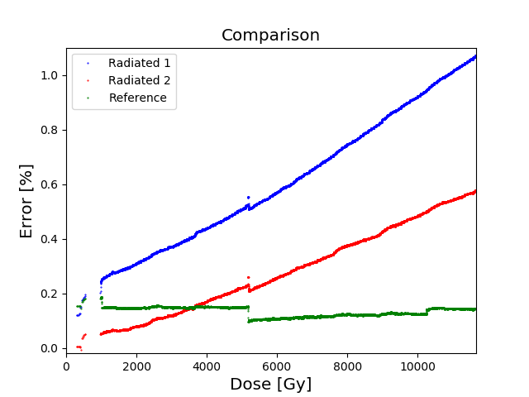
Co60 comparison to reference
Total dose:11.47 kGy with dose rate: 55.88 Gy/h
Error increased from ~0.2% -> ~1.1%
Error function could be more less approximated by line
Error stays constant when radiation is terminated

Slide 11
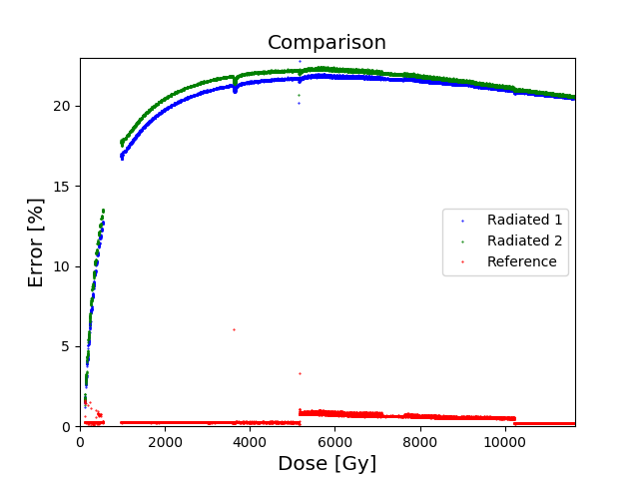
Co60 thermodiodes
Thermodiodes used originally for temperature compensation cannot be used for reliable temperature measurement in radiation
Diodes saturate with dose but still error is enormous
Error stays constant after stopping radiation

Slide 12
Conclusions
ABB pressure sensors can be used in high LHC radiation but with limited accuracy
To achieve sufficient accuracy it is needed to add another temperature sensor e.g. PT1000

Slide 13
Questions

