Slide 2
From Accelerators to Space Applications: Projects within the collaboration agreement with CNES
Nourdine KERBOUB (CERN)
Diego Di Francesca, Julien Mekki, Emmanuelle Aubert, Paul Peronnard, Yacine Kadi, Rubén Garcia Alia, Salvatore Danzeca, Sylvain Girard, Hicham El Hamzaoui, Markus Brugger

Slide 3


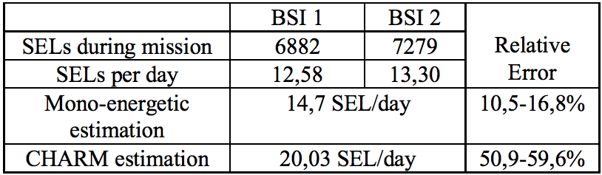
Comparison of CHARM estimation and in-flight measurement
Main goal : Investigate the relevance of CHARM to reproduce the LEO orbit dominated by trapped protons within the radiation hardness assurance.
Context : A SRAM memory (Brillance SemiConductor) with very low LET threslhold is placed in a CNES satellite in LEO orbit (1336km,61°) and monitored to detect SELs. On ground :
A CHARM measurement gives the HEH cross section.
  Mixed field estimation of the SEL rate
Mono-energetic measurement
  Standard estimation of the SEL rate
Results presented as oral presentation at RADECS 2018, under review process for IEEE TNS
Relative good agreement of the CHARM estimation with respect to space measurement

Slide 4
NIMPH Cubesat: A CERN payload to be flown in LEO orbit
NIMPH: Nanosatellite to Investigate Microwave and Photonics Hardware
Main goal : Evaluate the behaviour of an EDFA (Erbium doped Optical fiber amplifier).
The fiber is meant to be subject of harsh environment (20krad) in LEO orbits during 2years and monitored by radfets from LAAS’s (Toulouse) and CERN’s payloads.
Payload developped by CERN for CELESTA cubesat adapted from the RADMON system used in LHC and CERN’s tunnels.
Main features - Measurement of the radiation environment by means of its effects on electronics:
  TID through Radfets
  HEH flux through SRAMs memories
  1MeV.neutrons equivalent fluence with PIN diodes
More informations here : https://cds.cern.ch/record/2276097 (Rafaello Secondo’s thesis - Datasheet available soon)

Slide 5
Optical sensing : A future dosimeter for Space and Accelerator applications
Project included in the cooperation agreement between CNES/CERN signed in 2017.
Currently in strong collaboration with Hubert Curien laboratory (Saint-Etienne,France)
CNES R&D study on-going led by the Hubert Curien laboratory
Developpement of a New dosimeter using optical sensing suitable for :
  Space application in CNES projects
  Monitoring of the radiation level in CERN accelerators and facilities.
Annual R2E meeting
12/12/2018
12/12/2018

Slide 6
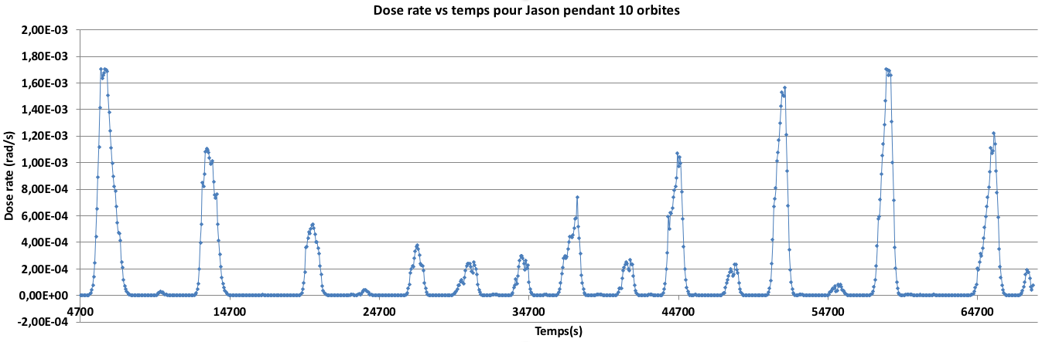
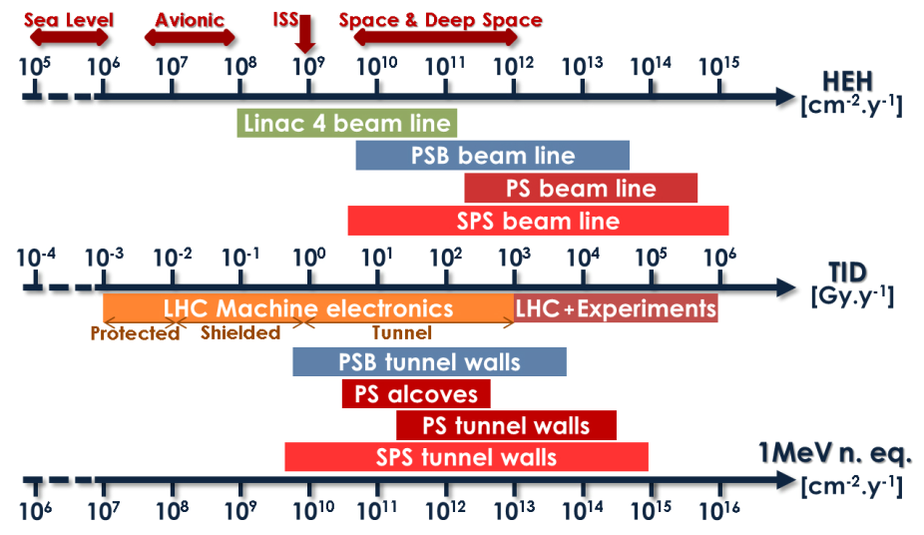
Specifications definition
Steps followed:
- CNES needs → Specifications
- CERN needs → Specifications
- Experimental measurements
➔ Overlaps between CNES and CERN needs
Example of variations of dose rate seen along orbite
Annual R2E meeting
12/12/2018

Slide 7
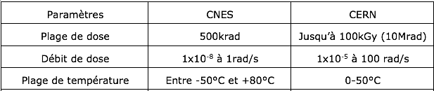
Preliminary specifications of the expected dosimeter
CNES needs mainly driven by low dose rate measurement whereas CERN needs are meanly driven by a high Dose range measurement ability.
Overlap between the CERN/CNES needs.
Annual R2E meeting
12/12/2018

Slide 8
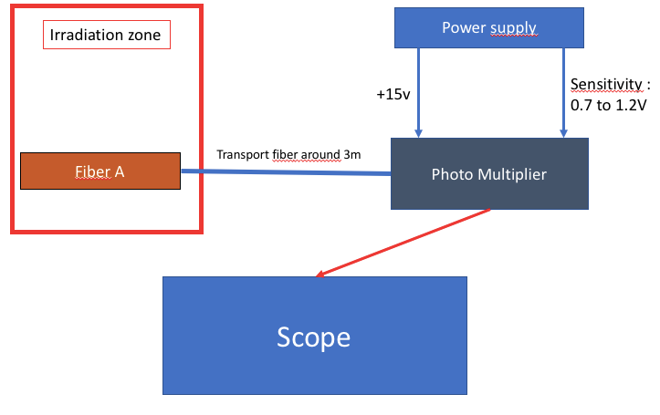
Technology actually identified and under investigation:
Radiation Induced luminescence (RIL) : Light is emitted by the fiber itself under irradiation and
guided towards a detector. The power of the light is proportional to the dose rate.
➔ technology already used (medicine) and with recent breakthrough in material design
➔ Allows simple & miniaturized setup (one detector) with low energy consumption
Schematic of the current setup
Very simple setup in terms of complexity
Annual R2E meeting
12/12/2018

Slide 9

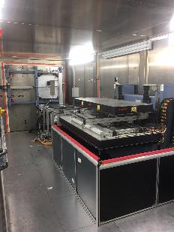


Optical sensing – Status of the project
Work carried out :
- Definition of an experimental setup
- Experiment campaigns in several facilities :
- Saint-Etienne, X-rays (Jan 2018)
- ChipIR (Oxford,UK), High Energy Neutrons (March 2018)
- Grenoble ILL, Low energy neutrons, (March 2018)
- CERN, Cobalt 60 gamma (May 2018)
- TRIUMF, Protons, Vancouver, Canada (April 2018)
Results :
- Very simple and low-cost setup
- Good sensitivity and linearity of the tested new materials (nitrogen,cerium,copper... Etc)
- Low dose rate measurement promising (40uGy/s under X-rays ➔ limited by the
irradiation facility)
- Still big margins (material, detector, signal processing) to improve the performance
Annual R2E meeting
12/12/2018

Slide 10
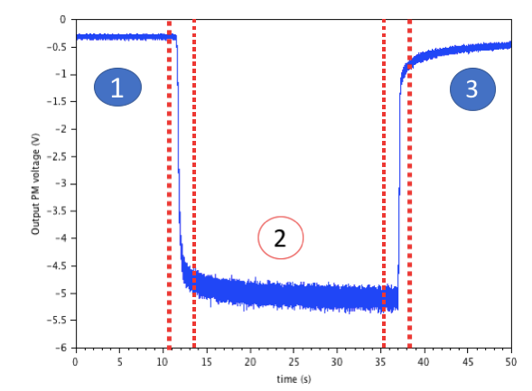
Optical sensing – performance
Typical results (X-rays, room temperature)
Accessible time resolution: ~ 1ms (limited by the lifetime of the luminescence)
Knowing the time duration ➔ dose can be easily deduced too through RIL
12.5gy/s
40uGy/s
Delta (V)
Dose rate (gy/s)
Annual R2E meeting

Slide 11
Conclusion and Outlooks
CNES and CERN needs are overlapping
CNES R&T on-going with Lab Hubert Curien
Promising results already fulfilling the high dose rate requirements, and getting close to the low dose rate ones.
Outlooks:
Improvement to be carried out on the RIL setup (noise, optical looses, etc…)
Large Investigation to be carried out on other availables technologies potentially meeting the requirements.
On-going investigations on RIL setup and additionnal characterization of differents samples potentially interesting for this application.
Annual R2E meeting

Slide 12
Thanks for your attention !
Annual R2E meeting

