Slide 1
New BCMS transverse beam control - low-chromaticity and TFB
Acknowledgements: G. Sterbini, M. Kaitatzi, PS operations crew
LIU-PS Beam Dynamics Working Group
27 September 2018
A. Huschauer

Slide 2
Motivation
LIU baseline crucially relies on bunches with large longitudinal emittance at PS injection
  Decreased maximum space charge tune shift for identical beam parameters as today
  Increased chromatic tune spread due to large natural chromaticity
To correct the large chromatic tune spread operation at ideally zero chromaticity on the injection flat bottom has been envisaged
This furthermore requires to uncouple the machine and stabilise the beam with the TFB on the flat bottom against head-tail instabilities

Slide 3
Chromaticity correction
Historically the PFW have been used to correct chromaticity at high-energy
  From negative values (natural chromaticity Q_{x}’ = -5, Q_{y}’ = -7 ) before transition energy
  To slightly positive values (Q_{x,y}’ ≈ 1) after transition crossing
  Correction is nowadays performed in 5CM
Correction at low-energy
  Performed in 3CM to maintain linearity of the machine
  Therefore less controllable parameters → zero chromaticity not achievable

Slide 4
Chromaticity correction
Head-tail instabilities only occurring in the horizontal plane
  Focus on horizontal chromaticity reduction
  Nevertheless significant vertical reduction achieved as well
Current setup leads to an even slightly positive horizontal chromaticity
  Extremely unstable system
  TFB indispensable for operation under these circumstances

Slide 5
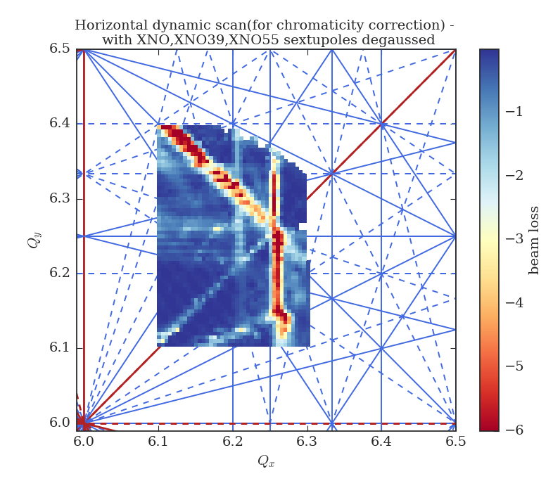
Attempt to use new sextupoles for chromaticity correction
A pair of sextupoles has recently been installed in SS60 and SS94
  SSs with large vertical 𝛽-function
  Both magnets powered in series
Chromaticity correction in both planes in principle achievable using also MTE sextupoles in SS39 and SS55
  SSs with large horizontal 𝛽-function
  Independently powered elements
Tune diagram measurements showed very strong resonance excitation
  Result shown for only ¼ of the required correction
Unacceptably high losses on the operational BCMS beam using XNO**
M. Kaitatzi

Slide 6
Skew quadrupole settings
Globally decoupling the machine with skew quadrupoles based on closest tune approach
Recent optics studies confirm that such a global correction also works well locally
Previous operational skew settings
  PR.QSKODD = -0.30 A
  PR.QSKEVEN = 0.30 A
Settings to decouple the lattice

Slide 7
Tune correction
Stable horizontal tune along the low-energy plateaus advisable to simplify TFB operation
Using the PFW at low-energy requires an additional iteration on the tune correction

Slide 8
TFB settings
Stable tune allows the frequency of the TFB to be controlled by knob rather than function
Only the gain is controlled by function
  High gain to damp injection oscillations
  Lower horizontal gain in-between and after injections to act against instabilities
  Apart from injection no vertical feedback is required

Slide 9
Beam loss along the cycle
With proper functioning TFB beam loss is identical (negligible) to previous operational setup
Failure of the TFB system however rapidly leads to almost complete beam loss

Slide 10
Conclusion and outlook
New transverse beam control used since LHC fill 7123
TFB system is crucial for this new beam production scheme
  Performance has been very reliable so far
Important step towards the LIU era for LHC beams in the PS
Emittance measurements with WS indicate slightly smaller (≈ 10%) emittances in the PS
  Measurements in the SPS and LHC show comparable results to previous operational cycle
  No clear evidence of gain in luminosity in the LHC
  To be further analysed during LS2 with larger statistics
Further steps to be performed:
  PFW in 5CM to reach zero chromaticity
  Implementation on the LHC standard beams

Slide 11
THANK YOU FOR YOUR ATTENTION!

