Slide 1
Closed orbit distortion caused by the 80 MHz fast tuner
LIU-PS Beam Dynamics Working Group
27 September 2018
A. Huschauer, C. Rossi, C. Vollinger

Slide 2
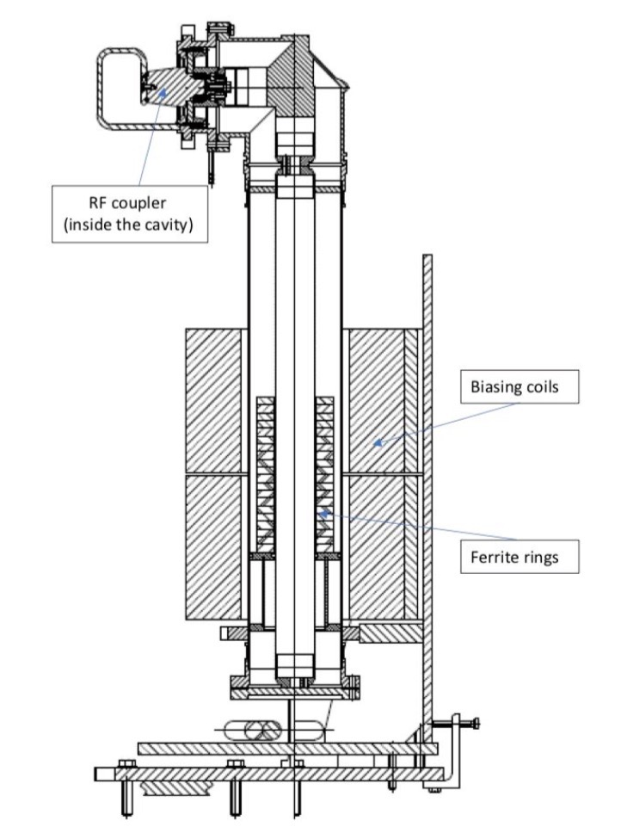
Introduction
Fast tuning of 80 MHz cavities between proton and ion operation envisaged for after LS2
Actual tuning of 80 MHz cavities will be achieved by applying magnetic field to the shown ferrite rings using a solenoid
A prototype fast tuner has been installed in SS08 (EDMS 2004437)
To investigate the closed orbit distortion caused by the fringe field of the solenoid an MD has been performed

Slide 3
Impact on ion operation I
Closed orbit distortion expected to be maximum on the ion injection flat bottom
MD performed by repeatedly switching the solenoid ON and OFF at maximum current (400 A) while recording the orbit
Maximum impact (≈ 2 mm peak-to-peak excursion) observed in the vertical plane
  Change of horizontal orbit also visible, but much smaller distortion compared to the vertical plane

Slide 4
Impact on ion operation II
Impact on the closed orbit very reproducible
Vertical kick clearly more important than the horizontal one

Slide 5
Impact on proton operation I
Impact also clearly visible on the flat bottom of an LHC proton cycle
Distortion in the vertical plane again clearly more important
Horizontal effect seemed also to be influenced by a change of the MRP (energy?)

Slide 6
Conclusion
Clear closed orbit distortion due to the fast tuner of the 80 MHz cavities observed
Impact in the vertical plane more severe than in the horizontal one
The integrated vertical kick is in the order of 290 μTm, in agreement with measurements on both ion and proton beams
In principle the effect can be compensated by performing an orbit correction, but mu-metal shielding should be foreseen to eliminate the impact of the fringe field on the beam as much as possible

Slide 7
THANK YOU FOR YOUR ATTENTION!

