Slide 1


A strange program for the LHC
Diego Martínez Santos
GAIN
(on behalf of the LHCb Collaboration)

Slide 2
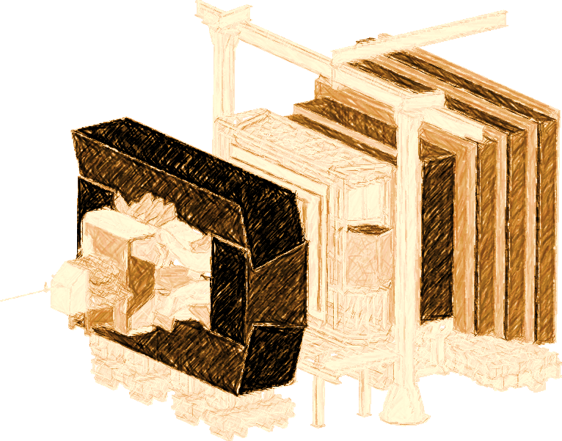
Introduction
LHCb experiment at LHC
  Designed mostly for b and c decays
    → low trigger efficiency otherwise
  But there is also an ~infinite strangeness production at LHC (kaon xs ~ 1.2 barn)
  Infinite production times zero efficiency requires L’Hopital
    In 2011 we managed to get world best result in K_{S} → μμ
  Major improvements in the trigger for s decays done for Run-II (2016-2018), and ongoing for Upgrade (>=2021)

Slide 3
Strangeness decays
So far a kaons provided showed great success on indirect searches: c, b, t , CKM …
High theoretical interest, most notably to test departures from MFV paradigm (eg, flavor generic)
From G. Isidori KAON’16
For details see
G.Isidori , Y. Nir, G. Perez
arXiv:1002.0900v2
Useful to understand “Hints” for BSM in b sector
  Eg: deviations in b→sµµ: are they replicated in s → dµµ?
Potentially immense samples : high(est) ultimate experimental precision
Y ➔ interesting
N ➔ interesting

Slide 4

Trigger system: status and prospects
L0 (Hardware)
Main bottleneck for K. Can’t be changed
HLT1 (Software)
Not designed for K, but flexible.
K triggers being implemented
HLT2 (Software)

Slide 5
Trigger system: status and prospects
L0 (Hardware)
Main bottleneck for K. Can’t be changed
HLT1 (Software)
Not designed for K, but flexible.
K triggers being implemented
HLT2 (Software)
ε(2011-2012) ~ 1-2%
ε(Run-II) improved HLT1,2 ~ 18%
Maximum possible ~30% (L0 won’t allow more)

Slide 6


Trigger system: status and prospects
L0 (Hardware)
Main bottleneck for K. Can’t be changed
HLT (Software)
LHCb
Upgrade
HLT1 (Software)
Not designed for K, but flexible.
K triggers being implemented
HLT2 (Software)
(Note: This logo may not be official)
ε(2011-2012) ~ 1-2%
ε(Run-II) improved HLT1,2 ~ 18%
Maximum possible ~30% (L0 won’t allow more)

Slide 7
Trigger system: status and prospects
L0 (Hardware)
Main bottleneck for K. Can’t be changed
HLT (Software)
LHCb
Upgrade
HLT1 (Software)
Not designed for K, but flexible.
K triggers being implemented
HLT2 (Software)
(Note: This logo may not be official)
ε(2011-2012) ~ 1-2%
ε(Run-II) improved HLT1,2 ~ 18%
Maximum possible ~30% (L0 won’t allow more)
ε(Upgrade) ~ 80-100%?
Simulation studies show that rate would be under control
V. Chobanova et al,
CERN-LHCb-PUB-2016-017

Slide 8
K_{S}→μμ full Run-I analysis
EPJC, 77 10 (2017) 678

Slide 9
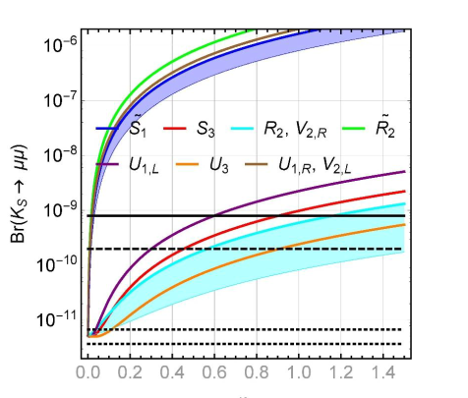
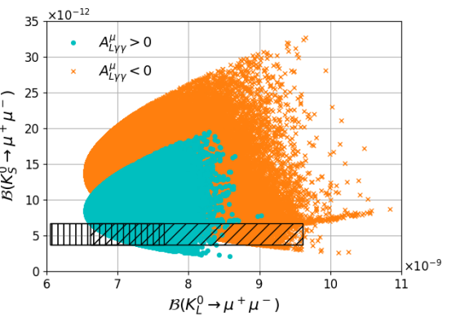
K_{S}→μμ: motivation
SM prediction: BR(K_{S} → µµ) = (5.18 ± 1.50_{LD} ± 0.02_{SD} )x10⁻¹²
JHEP05(2018) 024 , JHEP 0401 (2004) 009, NPB 366 (1991) 189
K_{S} → µµ sensitive to different physics than K_{L} → µµ, NP can be bigger than SM by ~1 order of magnitude or even more
Example of a SUSY scenario from
V.Chobanova et al., JHEP05(2018) 024
Leptoquark scenarios from Bobeth & Buras, JHEP02(2018)101

Slide 10
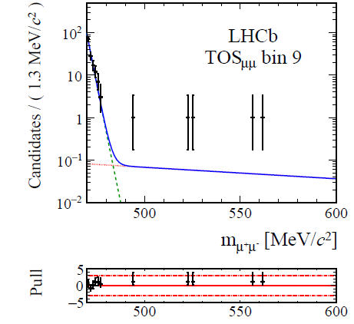
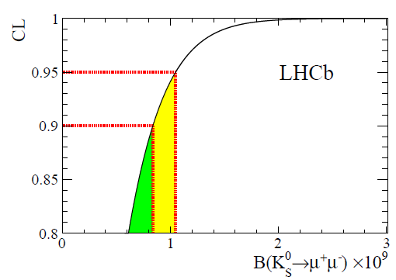
K_{S}→μμ full Run-I analysis
EPJC, 77 10 (2017) 678
Event yield extracted from a maximum likelihood fit in BDT categories
Yield translated to BR via normalization to K_{S}→ππ decays
K_{S} → ππ is also the main background: muon identification BDT trained against it
Upper limit obtained integrating the posterior probability, combined 2011+2012
BR< 8 (10)x10⁻¹⁰
@90(95)%CL
K_{S}→ππ
combinatorial

Slide 11
K_{S}→μμ prospects
Extrapolating from Run-I result
Full Run-II analysis ongoing: expected to improve by a factor 3 to 10 Run-I’s sensitivity
Future: start to investigate tagged decays, which would allow to access NP in the K_{S}-K_{L} interference
[D’Ambrosio&Kitahara PRL 119, 201802 (2017)]
LHCb-upgrade
Phase-II-upgrade?
Very high ultimate precision: could well become the strongest limit on a BR by an LHC experiment

Slide 12
Σ→pμμ full Run-I analysis
LHCb-PAPER-2017-049 Phys. Rev. Lett. 120, 221803 (2018)

Slide 13
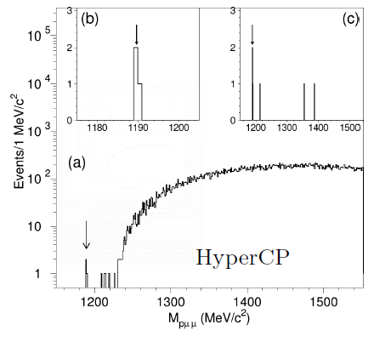

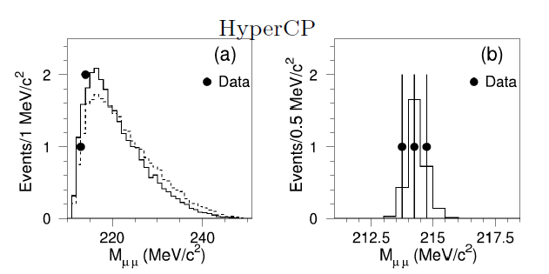
The HyperCP evidence
The HyperCP collaboration found evidence for Σ→pμμ decays, and provided a BR:
Consistent w/ SM: 1.6 < BR[x10⁻⁸] < 9
X G He et al, PRD 72 (2005) 074003
This evidence had wide relevance since all 3 observed events had the same dimuon invariant mass (214 MeV)
Suggested the existence of a new neutral particle at that mass

Slide 14
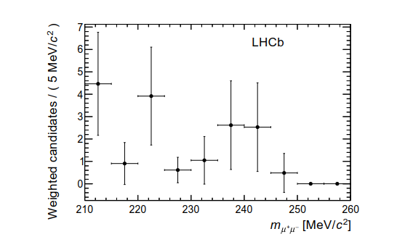
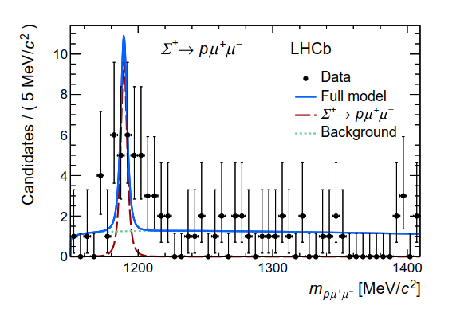
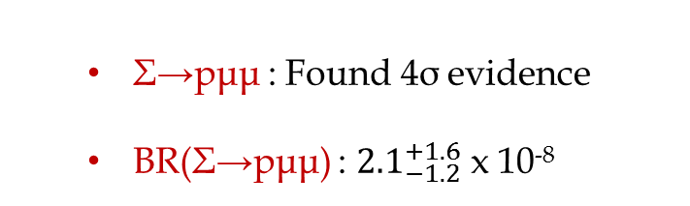
Σ→pμμ full Run-I analysis
LHCb-PAPER-2017-049
arXiv:1712.08606
  Σ→pμμ : Found 4σ evidence
  BR(Σ→pμμ) : ${2.1}_{−1.2}^{+1.6}$ x 10⁻⁸
  X→ μμ : Found no evidence for the 214 MeV particle. Upper limit for the resonant channel: 1.2x10⁻⁸ @95% CL
10y ago we thought this channel was ~impossible and instead now we are even thinking on an amplitude analysis….

Slide 15
K_{S} →π⁰μμ sensitivity study
CERN-LHCb-PUB-2016-017

Slide 16
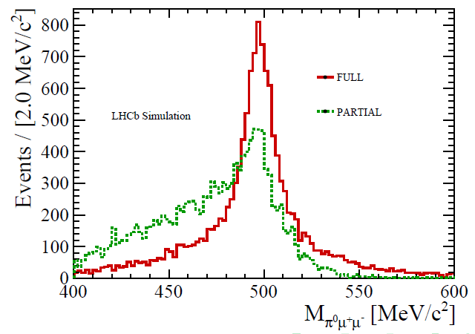
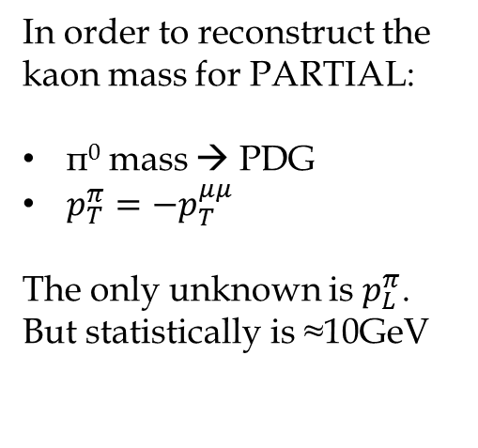
K_{S} →π⁰μμ sensitivity study
V. Chobanova et al,
LHCb-PUB-2016-017
K_{S} →π⁰μμ is searched for in two channels:
  π⁰ (→ γγ) μμ: hereafter FULL (low eff.)
  π⁰ μμ: hereafter PARTIAL
In order to reconstruct the kaon mass for PARTIAL:
π⁰ mass → PDG
$p_{T}^{π}={−p}_{T}^{μμ}$
The only unknown is $p_{L}^{π}$. But statistically is ≈10GeV
π⁰
μμ
p
p
Much more bkg than Ks→μμ, but also 1000x more signal

Slide 17
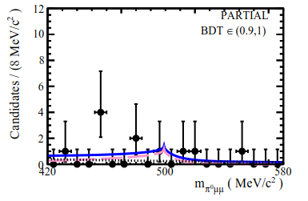
K_{S} →π⁰μμ sensitivity study
V. Chobanova et al,
LHCb-PUB-2016-017
Normalize yields to K_{S} →ππ → sensitivity to BR
2015 Data , 0.77 pb⁻¹
LHCb-upgrade
Phase-II-upgrade? →
Much more bkg than K_{S}→μμ, but also 1000x more signal

Slide 18
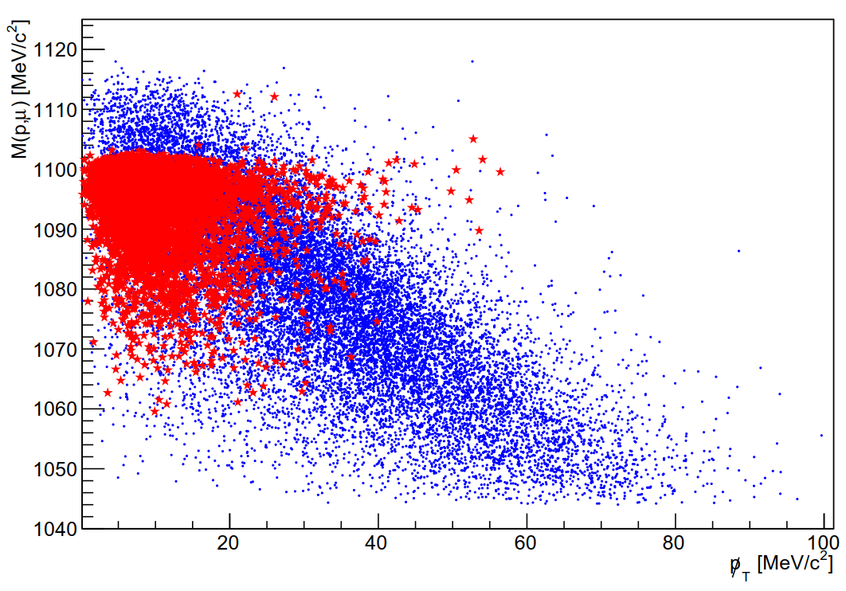
Ongoing/future studies
arXiv:1808.03477 [hep-ex]
Semileptonic Hyperon Decays (SHD)
Very interesting in view of LUV hints in semileptonic B decays
Many muonic modes have still very poor precision (20%, 100%)
☺ High BR (10⁻⁴): Massive yields in LHCb acceptance
☹ Challenging peaking backgrounds:
For each
B1 → B2 μν there is always a
B1 → B2π (inc. →B2μv)
1808.03477
Λ→pπ
Λ→pμν
☺ Can be separated in search planes

Slide 19
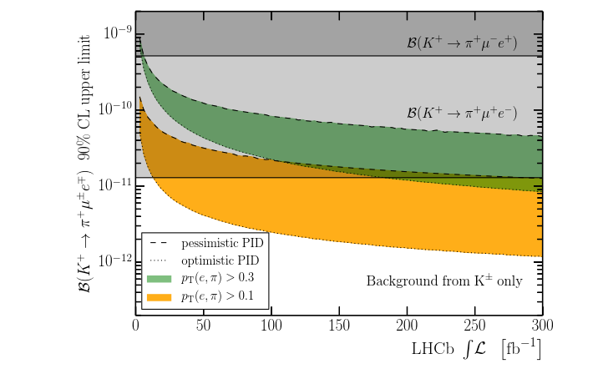
Ongoing/future studies
arXiv:1808.02006 [hep-ex]
Semileptonic Hyperon Decays (SHD)
LFV
1808.02006
LHCb can do:
K_{S} → eμ
K⁺ → π⁺μ⁻e⁺
Maybe K⁺ → π⁺μ⁺e⁻
Competition w/ NA62 to be clarified

Slide 20
Ongoing/future studies
Semileptonic Hyperon Decays (SHD)
LFV
Tagged kaons
K⁺ mass in K → 3π (ongoing) (Also under study sensit. K⁺ → π⁺μμ vs NA62 )
K_{S} → X⁰μμ, (X whatever neutral system: eg γ) (ongoing)

Slide 21
Ongoing/future studies
Semileptonic Hyperon Decays (SHD)
LFV
Tagged kaons
K⁺ mass in K → 3π
K_{S} → X⁰μμ, (X whatever neutral system: eg γ)
K_{S} → X⁰πμ (X whatever neutral system: eg sterile neutrino)
ΔS = 2
Workshop in 2013 and 2017 to discuss with TH community
https://indico.cern.ch/event/280883/overview
https://indico.cern.ch/event/590880/timetable/#20170426

Slide 22
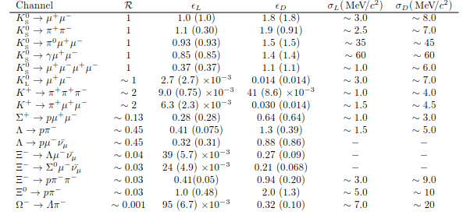
Ongoing/future studies
* More details in: arXiv:1808.03477 [hep-ex]
eff/eff(K_{S})
w/ Downstream tracks
Mass resolution
Xs/Xs(K_{S})
eff/eff(K_{S})

Slide 23
Conclusions
s decays are awesome
  High interest for BSM
  Ultimate experimental precision ~ 10⁻¹¹ -10⁻¹²
There is an LHCs community in the LHCb village
  Trigger is constantly improving
  We aim for LHCb upgrade to reach efficiencies s as high as for b’s
Available measurements for: Σ→pμμ, BR(K_{S} → µµ)
Published prospects for K_{S} →π⁰μμ , K_{S} →π⁺π⁻ee
Run-II (2016-2018) data analysis ongoing Σ→pμμ, K_{S} → µµ, K_{S} → (γ/π⁰)µµ...
Some more channels in our TODO list
Workshops to discuss with the TH community

Slide 24
Backup

Slide 25
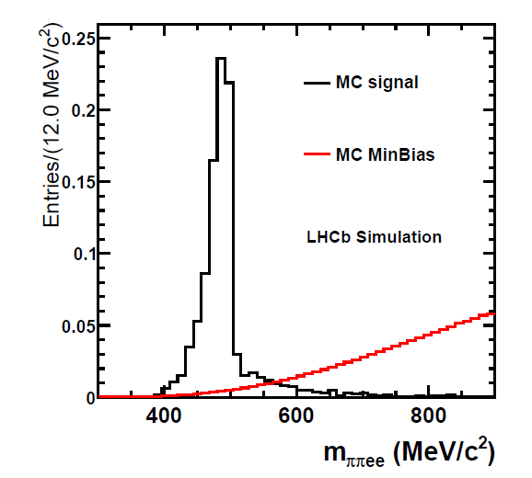

K_{S} →π⁺π⁻ee sensitivity study
C.Marin et al,
LHCb-PUB-2016-016
Based on simulation:
Expected a signal yield of
$${N=120}_{−100}^{+280}$$
For the full Run-I dataset
Expected background yield is not well known yet

Slide 26
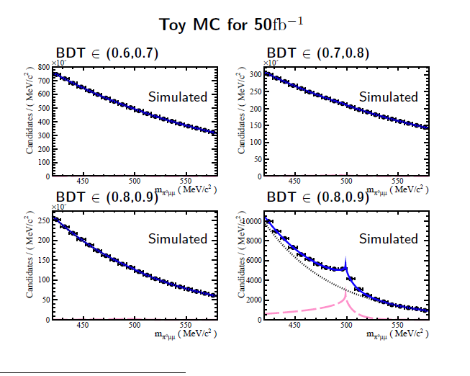

Slide 27
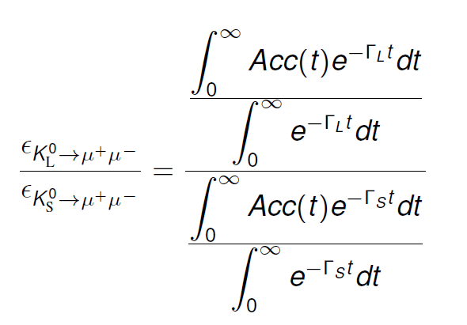


Lifetime acceptance and K_{L}→μμ background
K_{L} and K_{S} are distinguishable only by the decaytime…
… and that is in theory. In practice, LHCb decaytime acceptance is not great for kaons
$$ε\left(t\right)\sim e^{−βt}$$
With β $≳$ 5xΓs (>> Γ_{L}).
This makes the two lifetime distributions to look similar
But the overall efficiency ratio is of course different
And makes K_{L} →μμ to become a negligible background for the current level of precision
But can be relevant when we approach the 10⁻¹¹ level
= O(10⁻³)

Slide 28
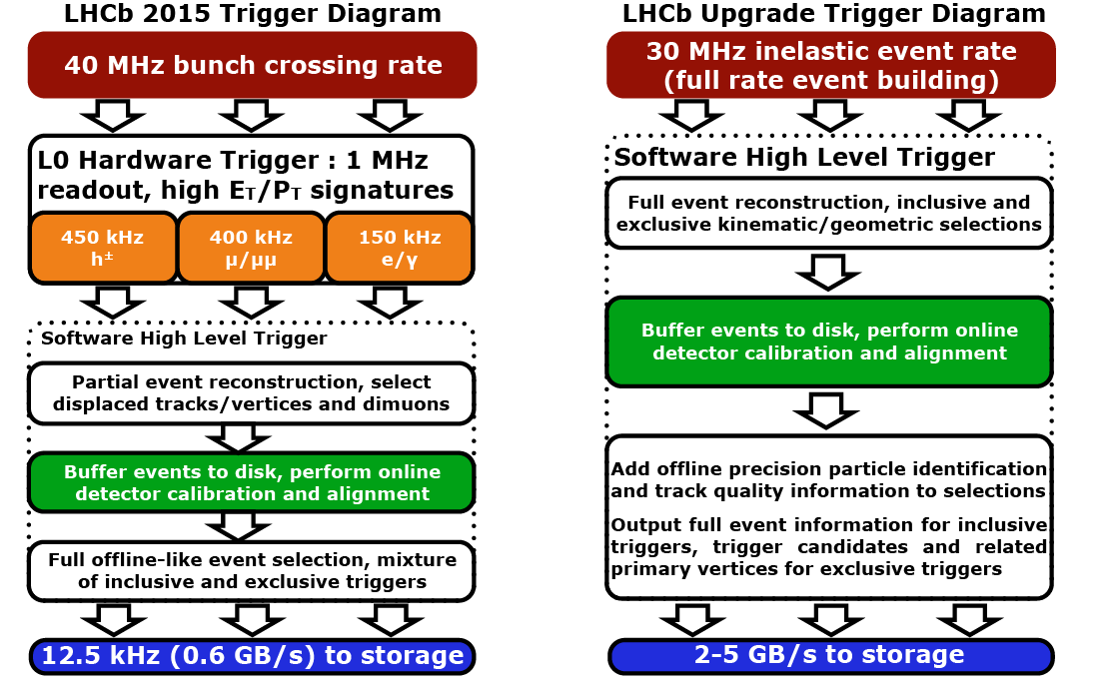

Slide 29


Normalization of event yield
Converting a signal yield into a branching ratio
$K_{s}^{0}$ production crossection
Absolute efficiency
$$Ν\left(K_{s}^{0}→πμμ\right)=σ\left(K_{s}^{0}\right)ΒR\left(K_{s}^{0}→πμμ\right)εL$$
Integrated luminosity

Slide 30
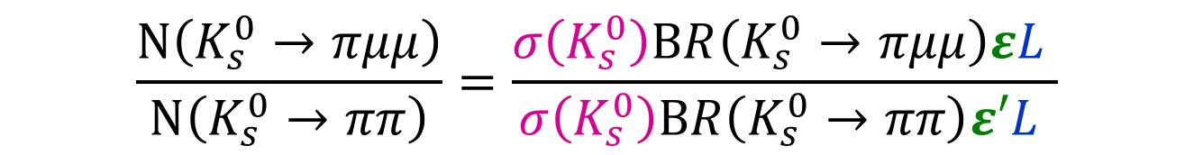
How? (normalization of event yield)
Converting a signal yield into a branching ratio
$K_{s}^{0}$ production crossection
Absolute efficiency
$$Ν\left(K_{s}^{0}→πμμ\right)=σ\left(K_{s}^{0}\right)ΒR\left(K_{s}^{0}→πμμ\right)εL$$
Integrated luminosity
$$\frac{Ν\left(K_{s}^{0}→πμμ\right)}{Ν\left(K_{s}^{0}→ππ\right)}=\frac{σ\left(K_{s}^{0}\right)ΒR\left(K_{s}^{0}→πμμ\right)εL }{σ\left(K_{s}^{0}\right)ΒR\left(K_{s}^{0}→ππ\right)ε′L }$$
Introduce in the ntuples a $K_{s}^{0}→ππ$ decays counter
Very well known
(69.20±0.05)%

Slide 31
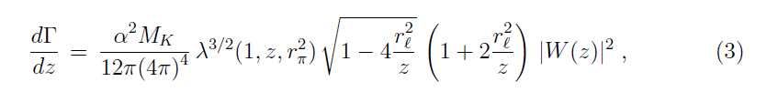

Dilepton mass distribution
Take formulae from hep-ph/9808289
z= m² ➔ dΓ/dm = 2m dΓ/dz

Slide 32
Remind of Bmm sensitivity

Slide 33
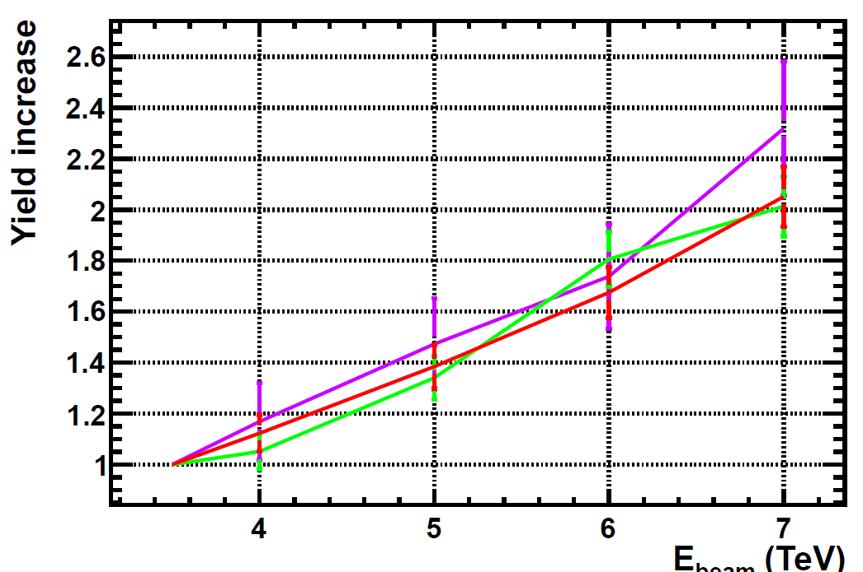
B mesons
We check that we get right the expected increase of B meson yields (i.e, a factor ~2)
B0s
B0d
B+/-

Slide 34
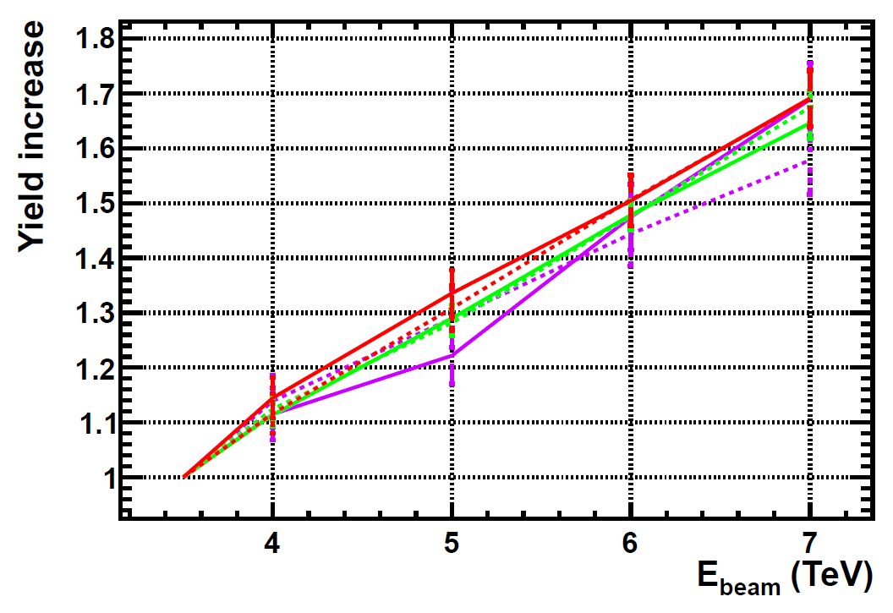
D mesons
For D mesons the increase is slightly smaller (~1.6- 1.7)
D+
D-
D0
Ds

Slide 35
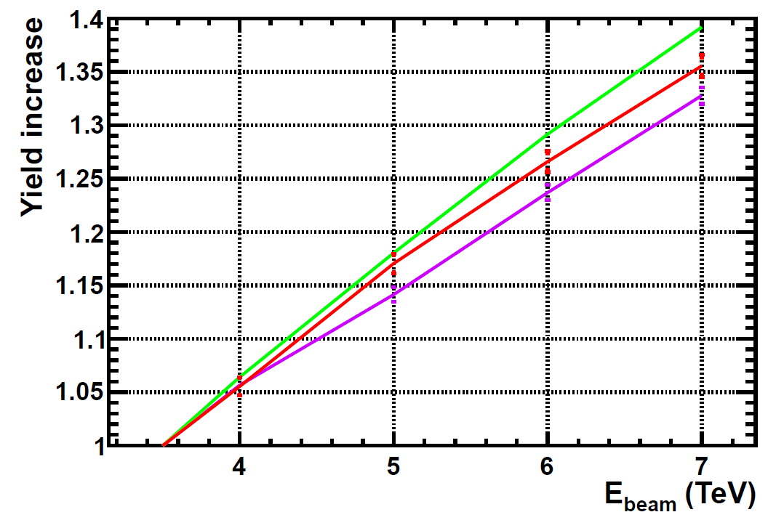
Strange particles
Increase for most of them is ~40%
A bit less for baryons (note: baryons, not anti-baryons)
However, the momentum is also different w.r.t 7 TeV.
K⁰s, K⁰_{L} ,K^{+/-/0}, φ(1020), K*
As well as anti baryons
Σ
Λ
In particular, for the K0s decaying in the VELO the increase is “only” ~30% → This is the number we really care for Ks → μμ studies

Slide 36
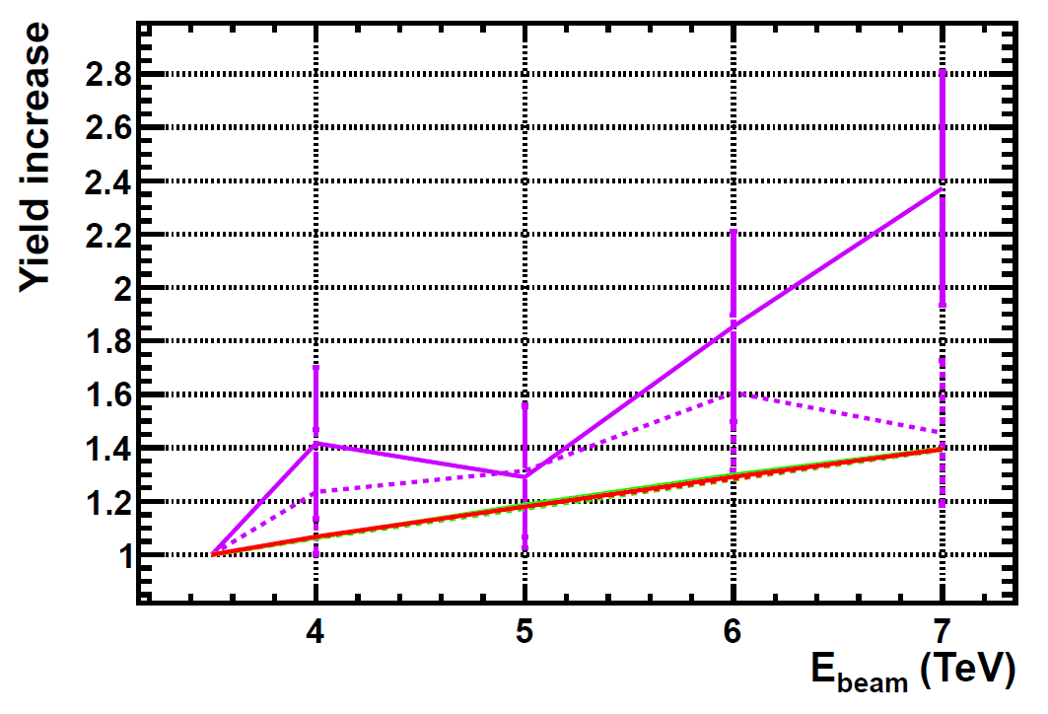
Leptons
Increase in tau yiled consistent with ~ 2 , expected by the fact that most of them come from b’s and c’s
Check with more stats if the asymmetry +/- is still there
τ+
τ-
Electrons, muons

Slide 37
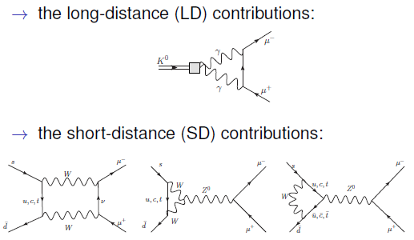

Slide 38
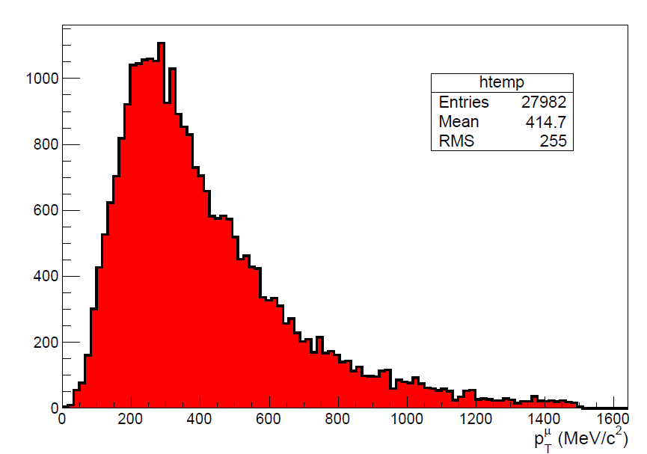

Slide 39
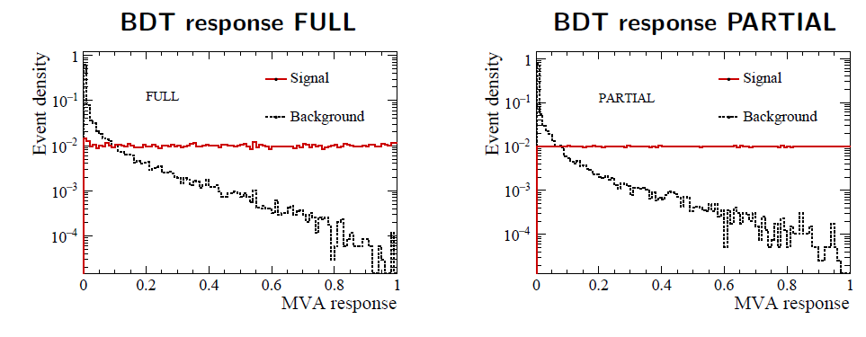
K_{S} →π⁰μμ sensitivity study
The background discrimination
V. Chobanova et al,
CERN-LHCb-PUB-2016-017
As usual: BDT trained against combinatorial background
Specific backgrounds: K_{S} →ππ, K_{L}→πππ, K_{S/L} →μμγγ (negligible)
Don’t affect the sensitivity estimate

Slide 40
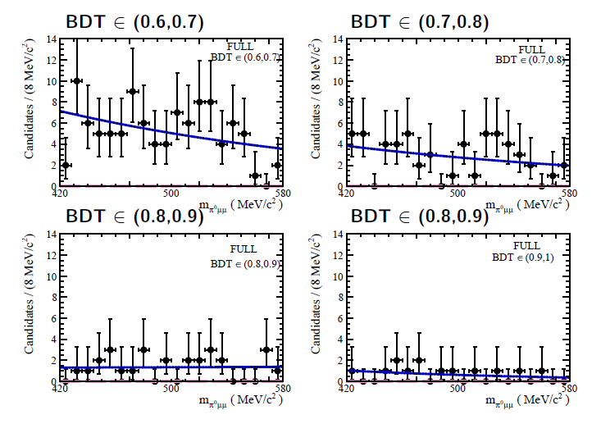
K_{S} →π⁰μμ sensitivity study
Fit, FULL
V. Chobanova et al,
CERN-LHCb-PUB-2016-017

Slide 41
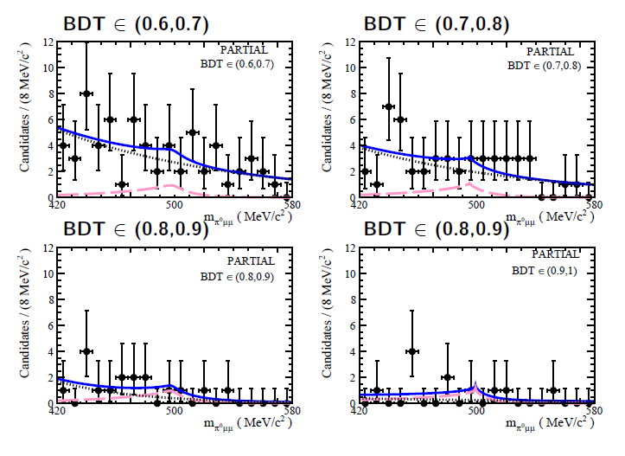
K_{S} →π⁰μμ sensitivity study
Fit, PARTIAL
V. Chobanova et al,
CERN-LHCb-PUB-2016-017

Slide 42
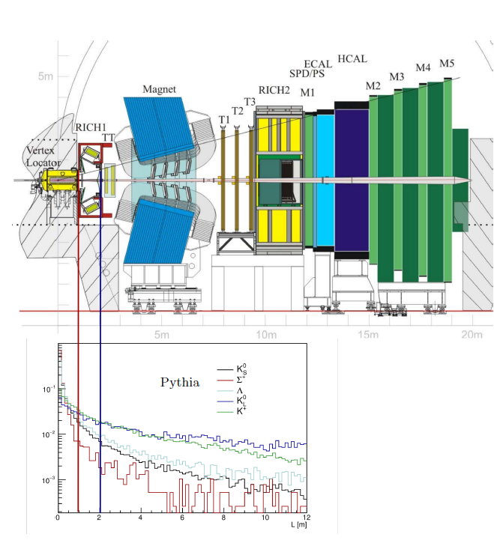
Strangeness production/detection at LHCb
The pp collisions @ LHC produce a ‘kaon flux’ of 10¹³ K_{S} per fb⁻¹ of luminosity in the LHCb acceptance
Charged decay products can be reconstructed using Long Tracks or Downstream Tracks
We use Long Tracks for RnS
Downstream will be investigated (extra yield, but worse reconstruction quality)
K_{L} , K_{S} produced in equal amounts. Acceptance ratio is ~2x10⁻³
(for Long Tracks)

Slide 43
Ongoing stuff
LHCb Fictitious
BR(K_{S} →X⁰μμ )
90% CL exclusion
X
γ
π⁰
m_{X}

Slide 44
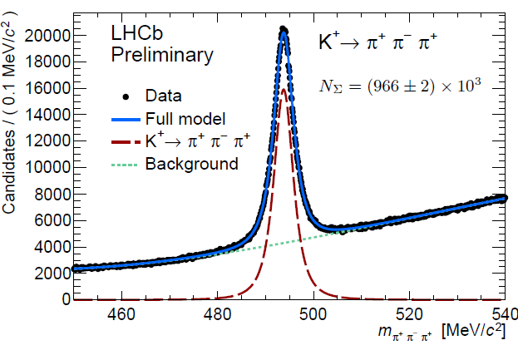
K⁺ studies
Large samples of charged kaon decays are available
K⁺ mass is not very well known
K⁺→πμμ ?

Slide 45
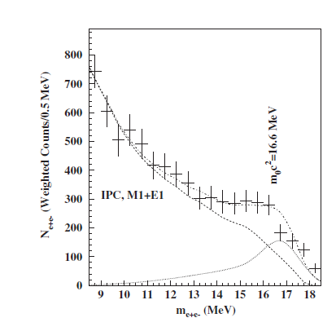
K_{S} →X⁰μμ
The K_{S} →π⁰μμ PARTIAL analysis can be recasted for general/inclusive K_{S} →X⁰μμ. With X being whatever neutral system:
  K_{S} →γμμ. Can also be completed with photon reconstruction
  K_{S} →(l+l-)μμ. Some of them are also being searched for explicitly
  Some exotic, eg, 17 MeV neutral boson of Phys. Rev. Lett. 116, 042501 (2016)
Limits can be provided as a function of X⁰ mass
LHCb Fictitious
BR(K_{S} →X⁰μμ )
90% CL exclusion
X
γ
π⁰
m_{X}

Slide 46
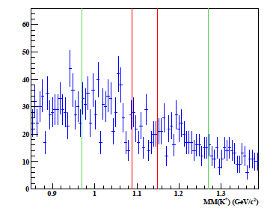
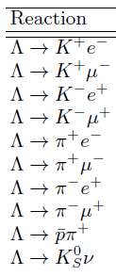
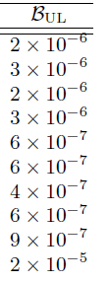
B and L violation (very low priority)
CLAS collaboration (Jefferson Lab):
Limits on B and L violation
We can easily do many of CLAS’ decays
…as well as others:
Σ→ 3μ
Λ→ π3μ
…and many other crazy (J conserving) combinations.
Currently very low priority, since we assume that BSM contributions can only be as much as BR ~10⁻⁵⁶
arXiv:1507.03859 [hep-ex]

Slide 47
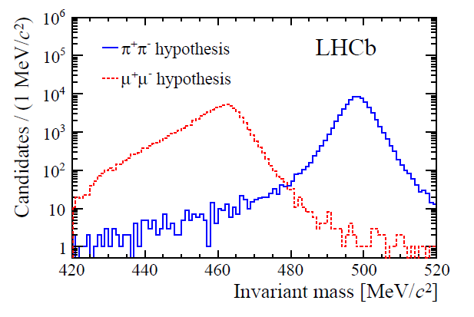
K_{S}→μμ full Run-I analysis
arXiv:1706.00758 [hep-ex]
Analysed full Run-I (2011-2012) data
Events classified using a BDT trained against combinatorial background
Dedicated muon identification algorithm trained against K_{S}→ππ
Mass resolution 4 MeV
Background
K_{L}→μμ negligible: (down to 10⁻¹¹ precision)
K→πμν : negligible
Λ→ pπ removed by a cut in the Armenteros-Podolanski plot.
Combinatorial background
K_{S}→ππ double misid

Slide 48
K_{S} →π⁺π⁻ee sensitivity study
C.Marin et al,
CERN-LHCb-PUB-2016-016
Based on simulation:
Expected a signal yield of
$${N=120}_{−100}^{+280}$$
For the full Run-I dataset
Expected background yield is not well known yet

Slide 49

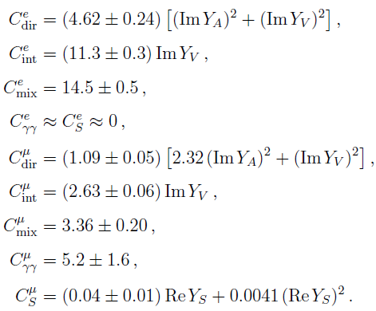
Why? (K_{S} → π⁰μμ and SM errors on K_{L} → π⁰μμ)
Dominant uncertainty, that makes difficult potential BSM interpretation of K_{L} → π⁰μμ
It comes from the experimental uncertainty on BR(K_{S} → π⁰μμ) measured by NA48
NA48
~50% relative error
Improved measurements of BR(K_{S} → π⁰μμ) will translate into improved BSM constraints from K_{L} → π⁰μμ

