Slide 1

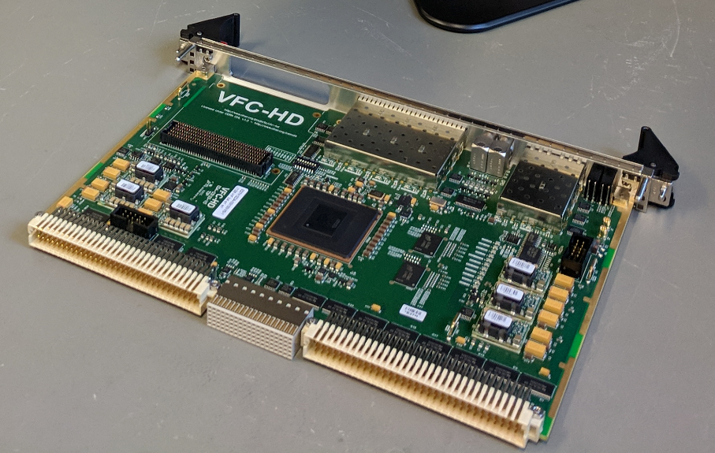
VFC-HD Test-Bench
M. A. Stachon, M. Gonzalez Berges, M. Saccani, S. Eitelbuß,
V. Schramm, W. Viganò
7 November 2018

Slide 2

Agenda
Introduction
Objectives
Test methodology and results
Firmware implementation
Software implementation
Asset management

Slide 3
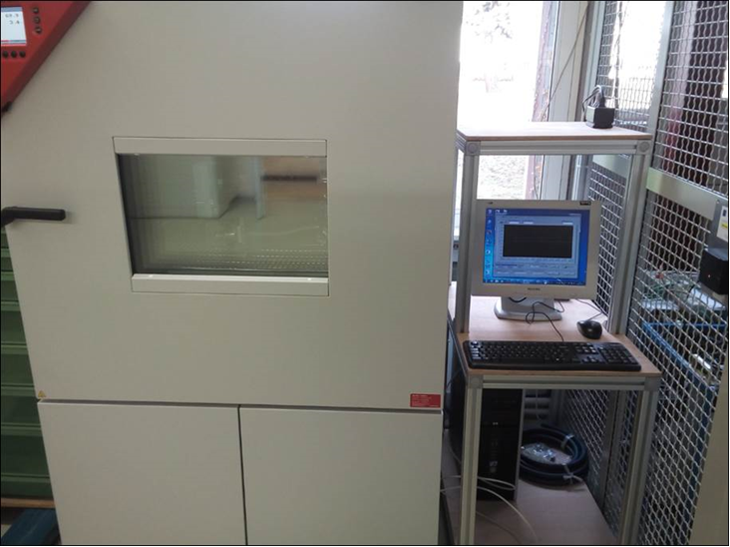
Introduction 1/2
1150 x VFC-HD boards under production long 2018 – 2019.
Steps done to create the full VFC-HD test structure:
  Procurement of a climatic chamber with size compatible with a VME crate size.
  Modification of the climatic chamber internal structure for an easier board extraction.
  Installation of a climatic chamber control station.
  Procurement and installation of 8 VME crates + cooling systems and their installation in 2 x 42U racks.
  Equipment of an external barrack with shelves, power and Ethernet sockets.
  Procurements of SFP loopbacks, optical patchcords, custom cables, etc…
  ….

Slide 4
Introduction 2/2
1150 x VFC-HD boards under production long 2018 – 2019.
Steps done to create the full VFC-HD test structure:
  ….
  Assembling of custom boards for the P0 test.
  Implementation of a dedicate test firmware.
  Implementation of a dedicate test software.
  Implementation of a logging structure.
  Implementation of a asset management structure.

Slide 5

Objectives
Functional, environmental validation.
Control of manufacturing quality.
Screen for early failures.
Assessment of the reliability.
Device registration & follow-up (Asset Management).

Slide 6
Test methodology

Slide 7
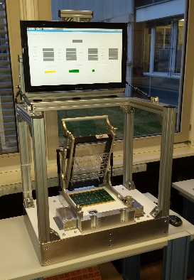
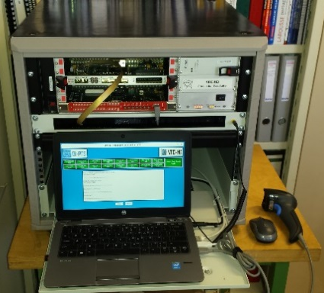

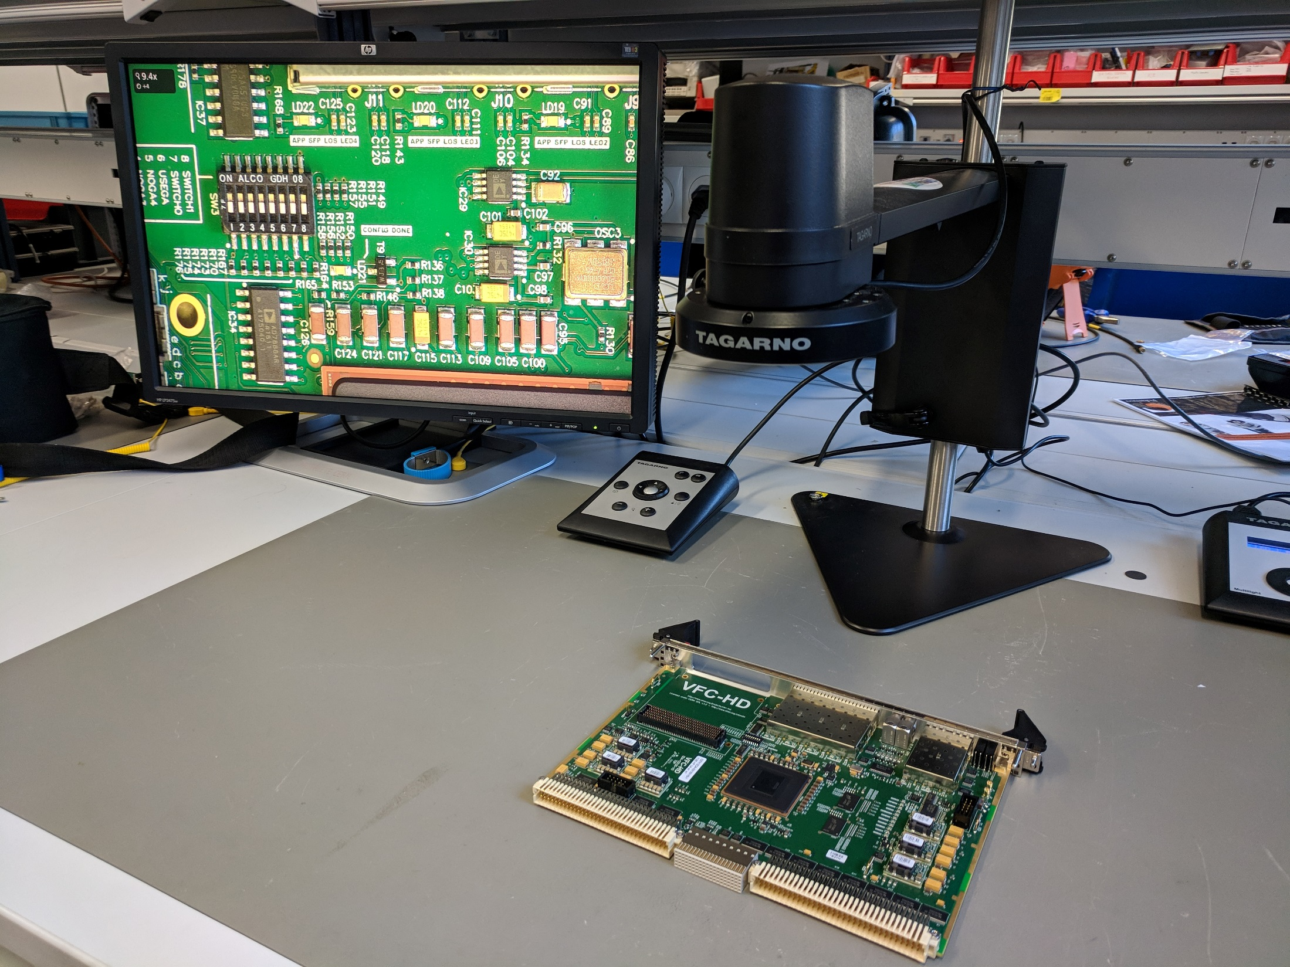
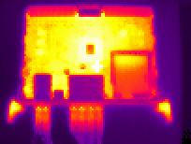

Test Methodology and Results
Design
Production & Tests
Component Test
Assembly & Production
A-610 Class 3
Inspection
Functional Test
Reception Tests
Visual Inspection
Validation Tests
Cycling Tests
High-Temp Test
Cycling Burn-In
Run-In
Installa-tion

Slide 8
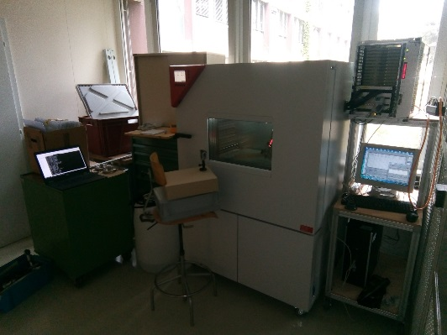
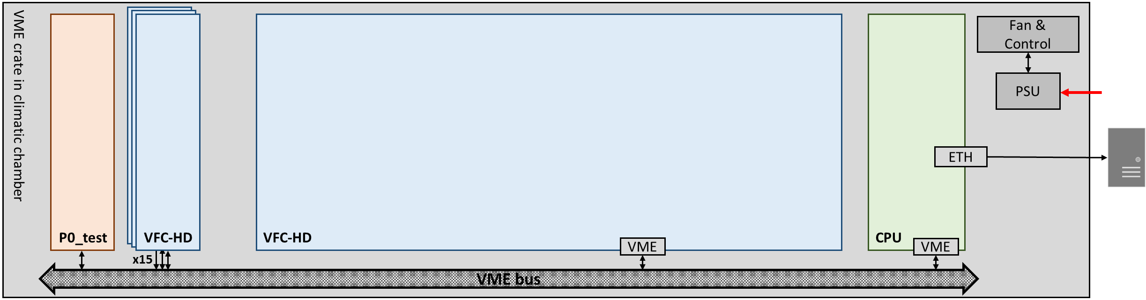
Test Methodology and Results
Test Setup:
Full VME crate inside climatic chamber
Up to 16 DUTs pluggable
Test firmware surveys all functionalities
Results stored on NXCALS
Software application provides constant access

Slide 9
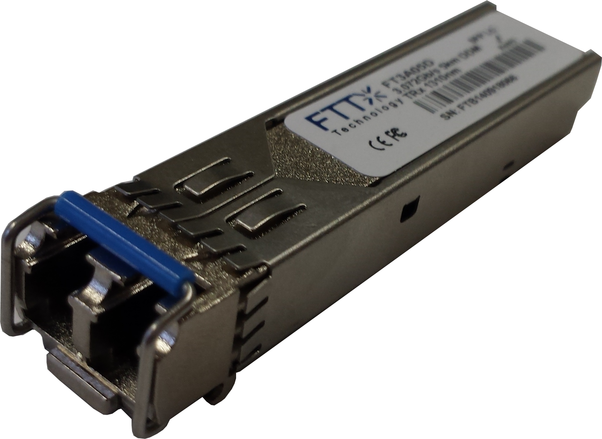
Test Methodology and Results
Temperature/Humidity Validation:
11 tests validated the VFC-HD at varying temperature [5:55°C] & humidity [:90%]
  Sample size: 2x pre-series
    Each with 1x FMC loopback & 6x SFP loopbacks in different configurations
  No board failures, only once a short period of EEPROM errors* which recovered
  However, various errors of the FMC and SFP fibre loopbacks:
    FMC errors at elevated temperatures*
    SFP errors above 40°C FT3A05D by FTTx Technology
      Proportional to temperature rise
    *under investigation

Slide 10
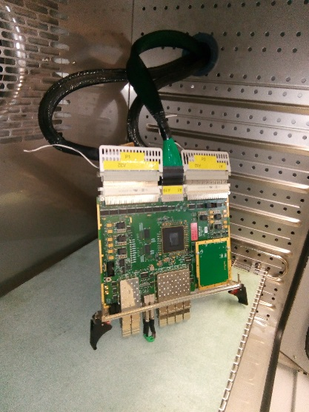
Test Methodology and Results
High Temperature Test:
Test to validate design limits (and above) & to trigger possible failure mechanisms
2 boards tested up to 70°C
1 board tested up to 100°C
FPGA internal temperature reached 127°C
  T_{junction_max} = 125°C (85°C recommended)
  Throughout stable communication
No hardware failures occurred
  Robust design & production

Slide 11
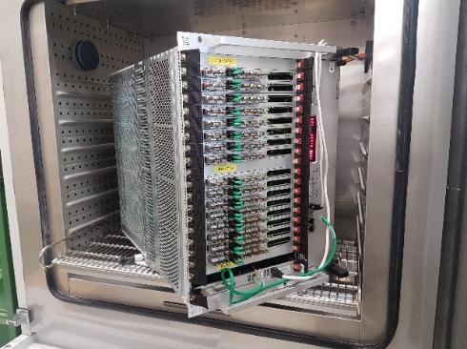
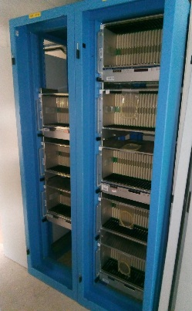
Test Methodology and Results
Reception Inspection & Burn-In/Run-In:
Visual inspection revealed production issues which are being corrected:
First crate started burn-in on the 01.11.2018
  32 VFC-HD already temperature cycled
Already three failures discovered:
  I²C-Programmable Quad Clock Generator (IC24) – under investigation
  2x I²C-Bus short – e.g. Multiplexer (IC35) pins short by remaining solder flux
    Triggered by humidity cycling after certain time
Run-In tests are about to start
Cleanliness
Handling (scratches, packaging, …)
Tolerances
Documentation
More info during BI Seminar 11.01.19

Slide 12
Firmware implementation

Slide 13
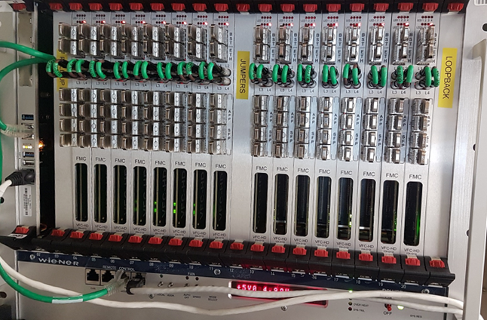
Hardware Implementation
Hardware Setup
VME Crate
  1 CPU
  16 VFC-HD
  1 P0 pull-up board
  1 P0 jumper board
  1 P0 loopback board
Accessories per VFC-HD
  2 LEMO loopbacks
  6 SFP electrical or optical loopbacks
  1 loopback mezzanine

Slide 14
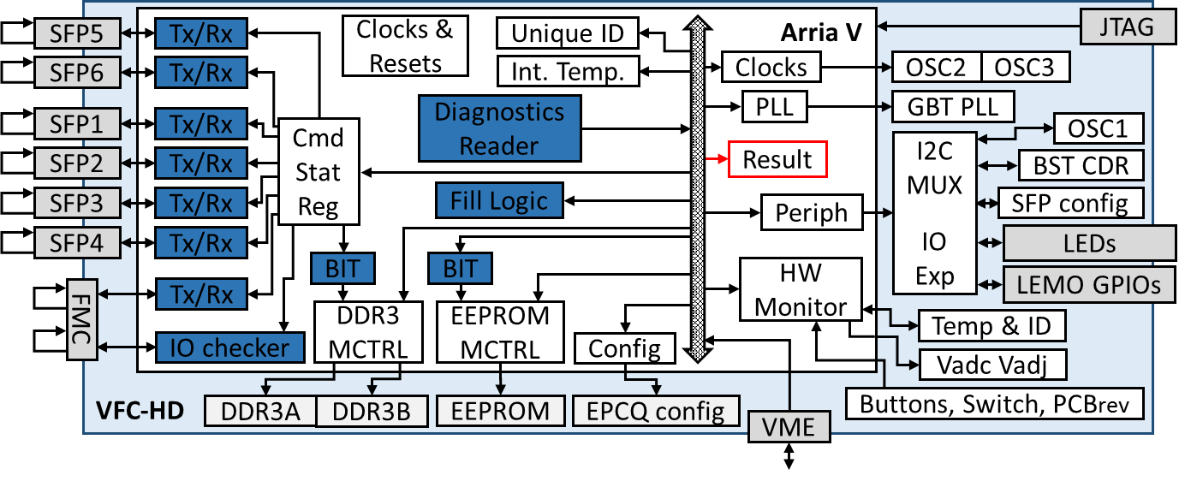
Firmware Implementation
VFC-HD_BIT: Built-in Test
All functions tested in parallel
No need of software
Test result : ~1kB in a single block (status, errors, counters and CRC32)
TESTS
6 SFP @ 2.5Gbps & BST CDR | ArriaV Unique ID and temperature
10 FMC HSSL @ 2.5Gbps | Feedback clocks
FMC input clocks GPIO, JTAG and I2C | LEMO, LEDs, SFP status
3 onboard oscillators (+I2C & DAC) | Voltage ADC
reference PLL (+I2C) | VME IRQ
DDR3, EEPROM, Config Flash | One wire sensor
Fill Logic (80%LE, 60%MACC, 75%BRAM) | P0 connector (daisy chain, P0HW, TTL clocks, BLMIN)
VME Bus + GA | DIP switch, button, PCBrev, Testio

Slide 15
Software implementation

Slide 16
FESA
Design
  1 FESA device per VFC-HD under tests (BOVFCHD)
    Uses BLT for data transfer (initial issues with A25s solved)
  Global device/crate
    Commands (start/stop tests, start/stop publications)
    Configuration
Cyclic reading
  Burn in: 1 second
  Run in: 30 seconds
Interrupts
  Under development

Slide 17
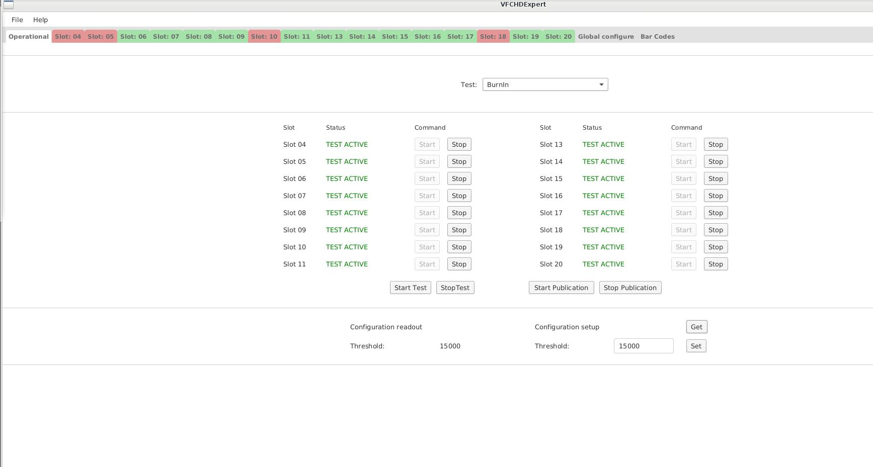
Expert Application (JavaFX) - Overview

Slide 18
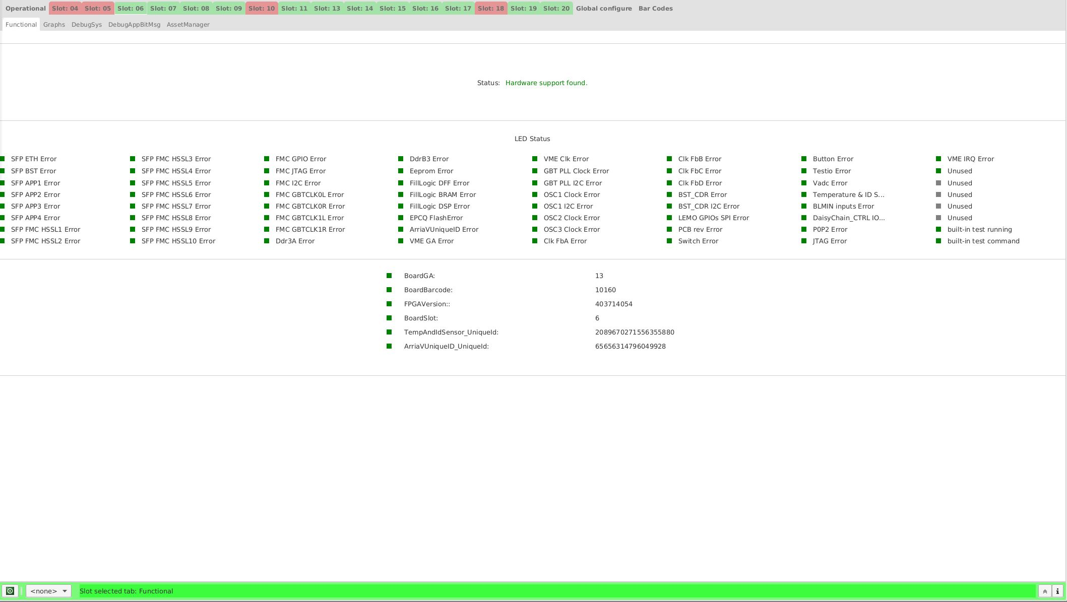
Expert Application (JavaFX) – Details OK

Slide 19
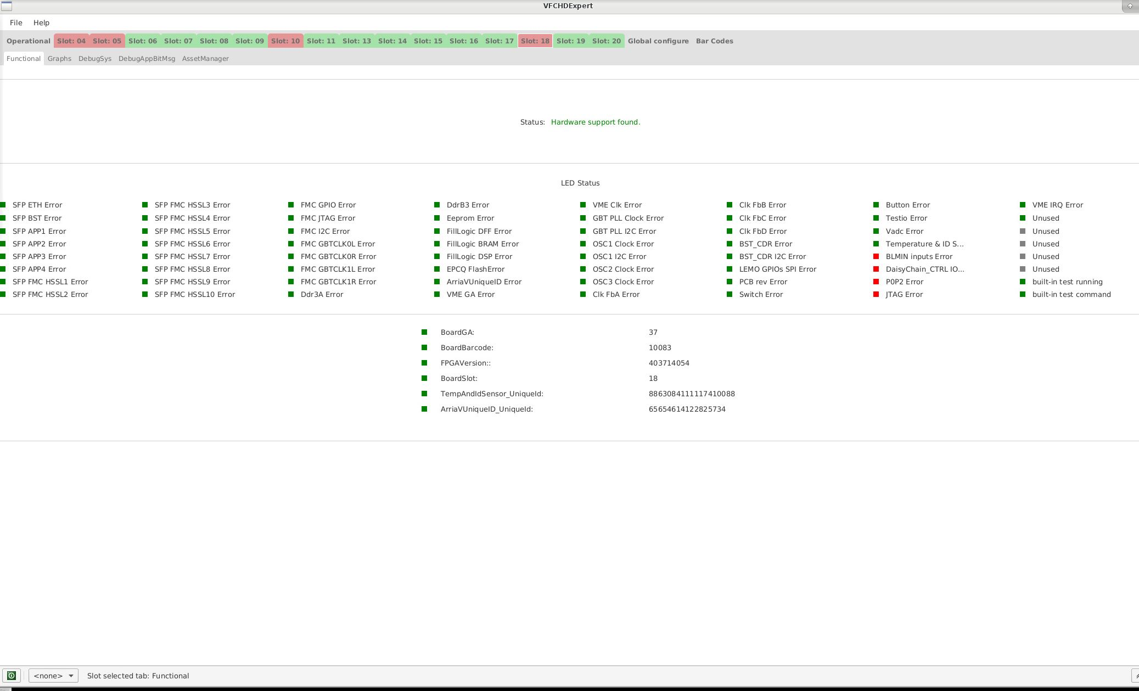
Expert Application (JavaFX) – Details Not OK

Slide 20
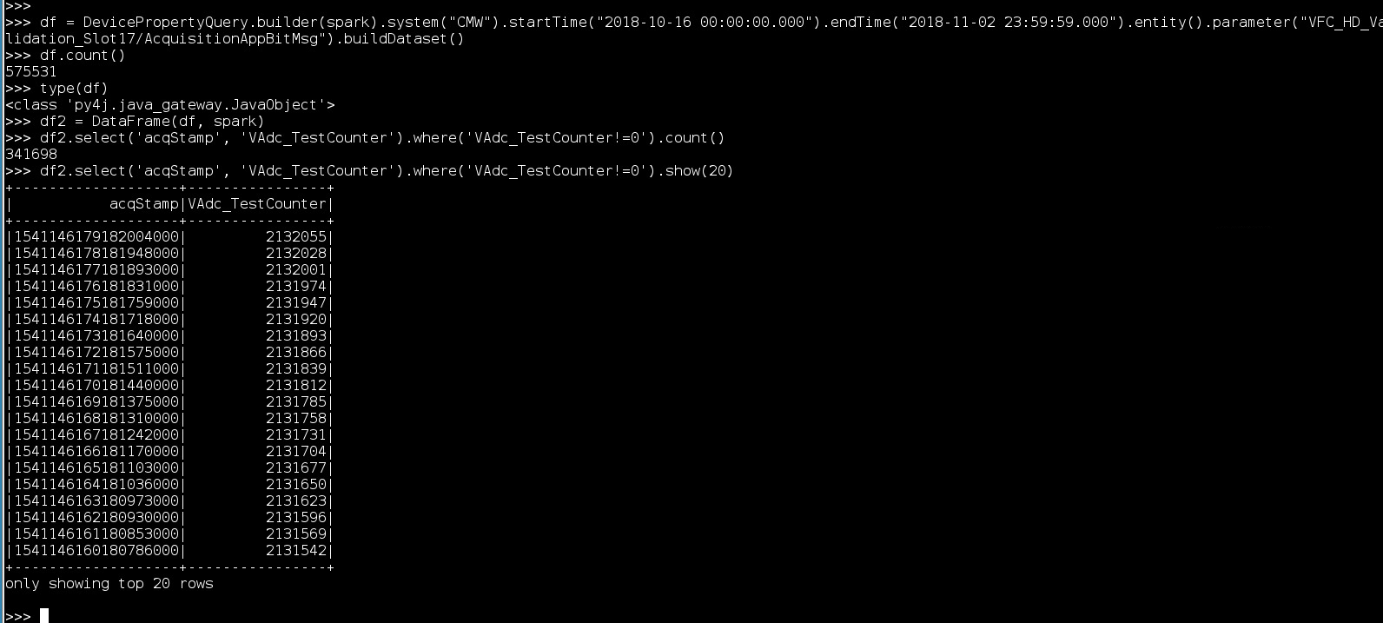
Logging of results
NXCALS chosen after discussion with BE-CO
  Good availability + avoid future data migration
  Performance
    Burn-in: ~20 KB/s [~10.5 GB total]
    Longterm: ~5 KB/s [~5 GB total]
Spark for queries
  Java API in the future
  No plans for Timber

Slide 21
Development Process - Agile
Started with few requirements
Weekly meetings BL – SW
  Refine requirements
  Follow up issues
  Demos
Semi-automatic generation of FESA design
  21 versions of register map file
  Ad-hoc Python scripts (future look at Cheby)

Slide 22


Asset management
For VFC-HD validation!
Assets Registration
Manufacturing follow up
Maintenance
TREC (Radiation traceability)
…
Functional Positions
Systems Configuration
…

Slide 23
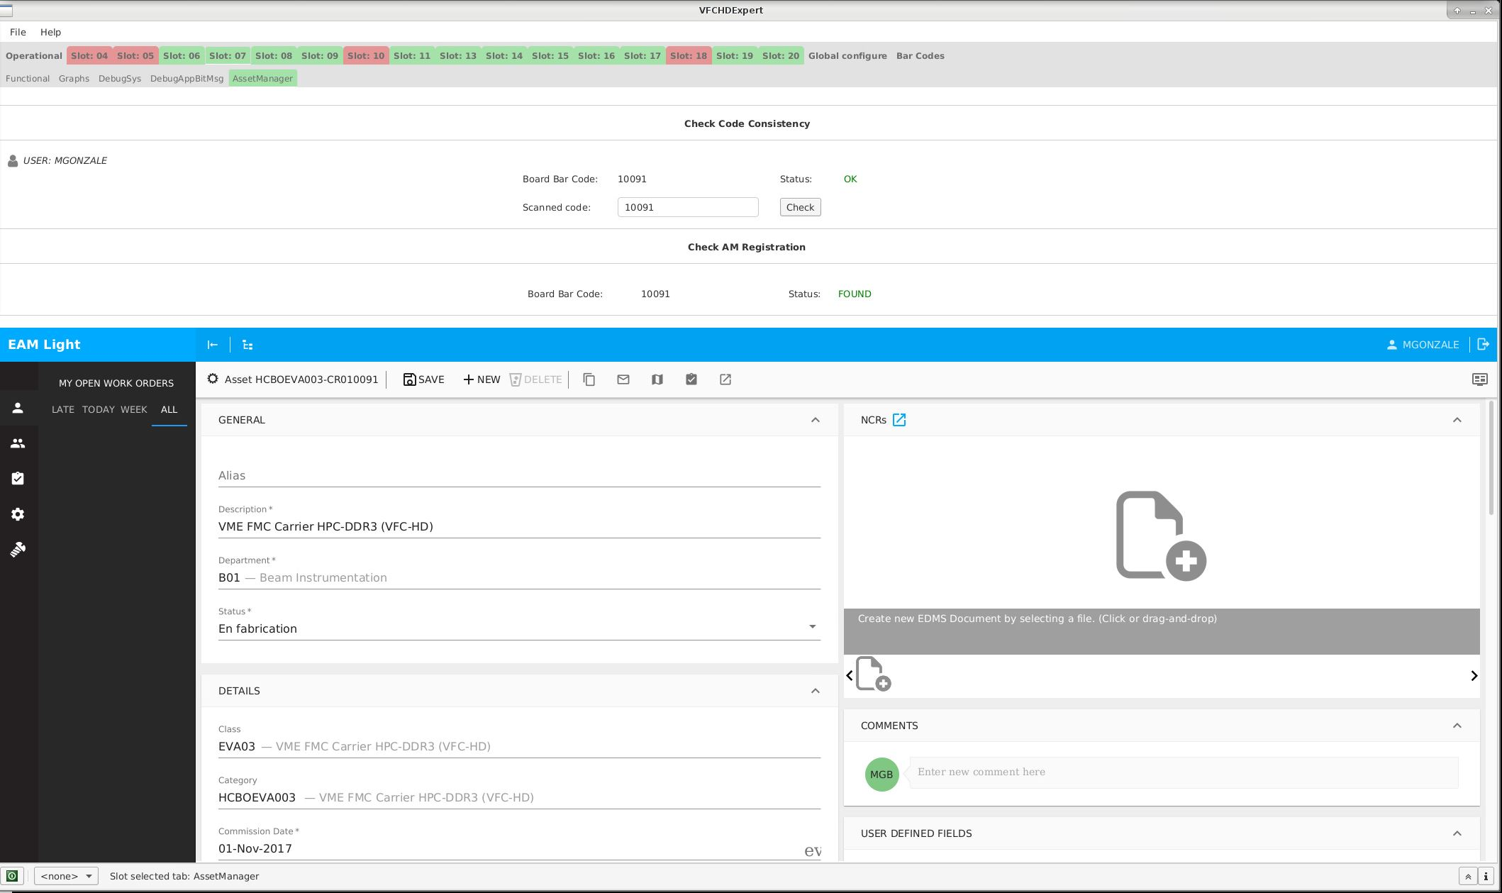
Link from Expert GUI
Check Infor EAM Registration / Offer registration
Infor EAM data for selected board

Slide 24
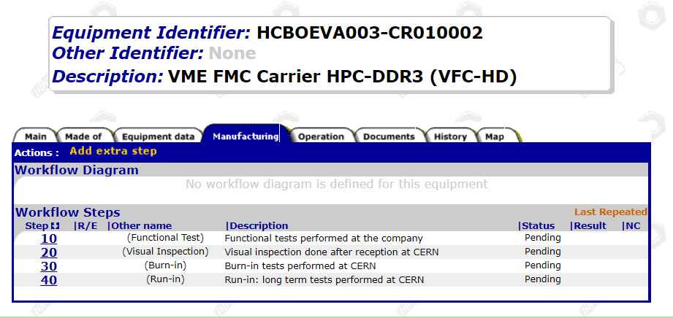
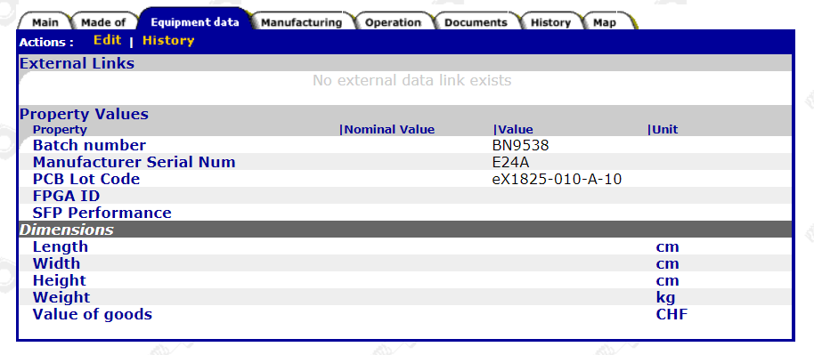
MTF
Manufacturing steps
  Tracking non-conformities
Custom fields
Import of tests results from manufacturer
  On going
Status Report
  https://edms5.cern.ch/pls/asbuilt/mtf.load_criteria?cookie=21297622&p_ucr_code=675

Slide 25
Conclusions and outlooks
Test bench and software application can be re-used.
Boards are tracked during the full life cycle.
Test methodology proved to be useful:
  Identified several fault types.
  Production feedbacks led to improvement of manufacturing processes.
  Burn-in already revealed 3 boards failures.

Slide 26
Thank you very much for your attention!

