Slide 1
LHC Interlocked BPM
Renovation
07.11.2018 BI-TB meeting
Irene Degl’Innocenti, Jan Pospisil, Manfred Wendt, Andrea Boccardi, Michele Bozzolan
BE-BI-BP, CERN

Slide 2
Outline
Introduction:
  LHC Interlock BPM system
  The current system limits
The proposed architecture:
  Front-end concept
  Digital acquisition chain options
Preliminary beam results
Doublet simulation
Carrier Upgrade
Status

Slide 3
Introduction: LHC Interlock BPM system
Beams
BPM dedicated for machine protection purposes
  Beam dump protection
  Safe beam extraction
Real time, bunch-by-bunch,
failsafe system on both beams
Dump
16 interlock
BPM channels
2 planes
2 beams
2 locations
2x redundancy

Slide 4
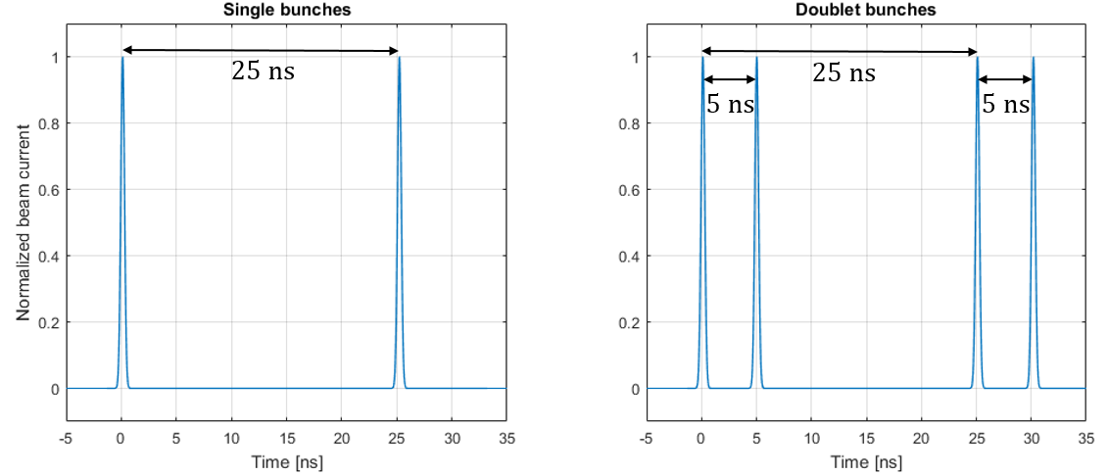
Introduction: Current System Limits
Wide Band Time Normalizer
Bunch-spacing of 25 ns required: No doublet bunches measurements
Intensity dependent offset
  Can generate false trigger
Sensitive to reflections → Historically switching sensitivity
  Problem resolved by adding absorptive filter.
  False trigger caused by fat pilots
  (wrong sensitivity settings).

Slide 5
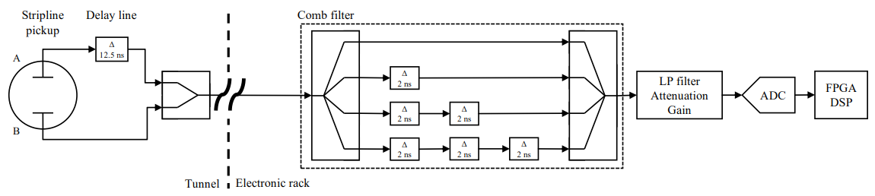
The Proposed Architecture
Time-multiplexing: single processing chain for both electrodes
Comb-filter: signal extension
Direct signal digitization
Processing in FPGA

Slide 6
The Proposed Architecture: Front-end Concept
25 ns
Delay 12.5 ns
Beam
25 ns
Delay 2 ns
LP filters
Stripline pick-up
Filter output
Tunnel
Electronics rack
Image: Jan Pospisil

Slide 7
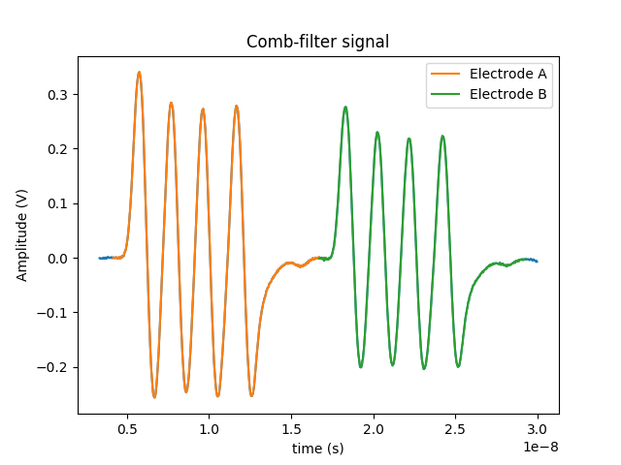
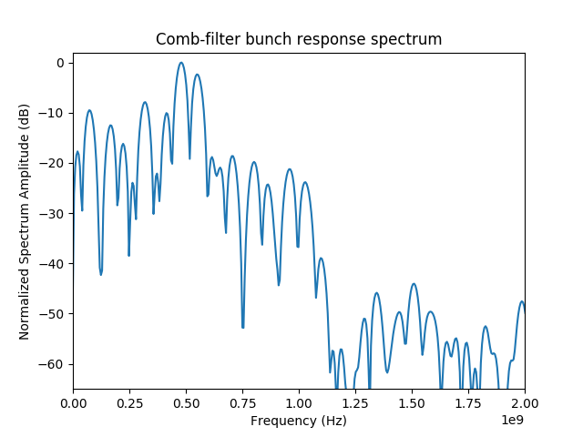
The Proposed Architecture: Digital Acquisition Chain
LHC P5, USC55, BPMSY4L5 (Stripline)
1.24e11 Bunch Intensity
Acquired with 8 bit – 18 GHz scope

Slide 8
The Proposed Architecture: Digital Acquisition Chain
ADC Mezzanine
VFC board
FMC
Comb Filter
ADC
FPGA
ADC
ADC
ADC sampling frequency bounded by FPGA transceivers max lane rate (6.5536 Gbps on VFC-HD).
Two mezzanines under test:
  Vadatech FMC225: 12 bits (8.8 ENOBS) up to 4 Gsps → operating @ 3.2 Gsps
  HTG-FMC-14ADC: 14 bits (9.6 ENOBS) up to 3 Gsps → operating @ 2.6 Gsps

Slide 9
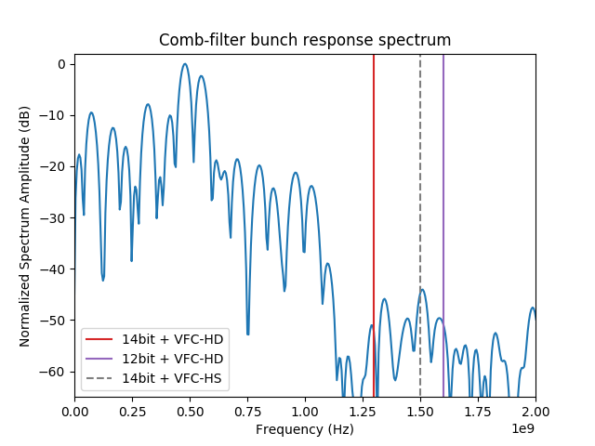
The Proposed Architecture: Digital Acquisition Chain
LHC P5, USC55, BPMSY4L5 (Stripline)
1.24e11 Bunch Intensity
Acquired with 8 bit – 18 GHz scope

Slide 10
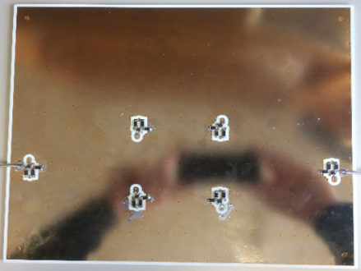
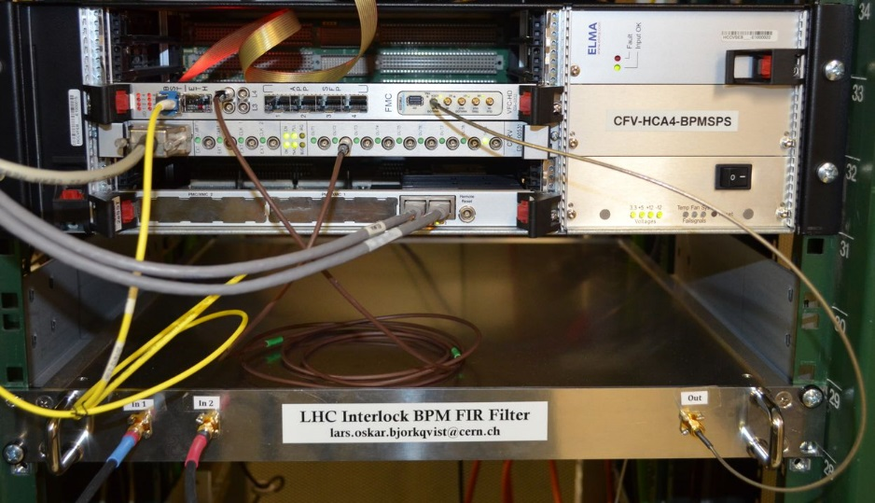
Beam Results : measurements set-up
Att
Att
Comb Filter
VFC-HD
Memory
ADC
LHC P5, USC55
BPMSY4L5 Beam 2
Att
50 Ω
Emulation of intensity and displacement
Decoupled from beam motion
ADC configurations:
  Vadatech 12bit @3.2 Gsps, beam asynchronous and beam synchronous;
  Vadatech 15bit @4 Gsps, decimated by 8, IQ modulation at 500 MHz
  HTG 14bit @2.6 Gsps

Slide 11
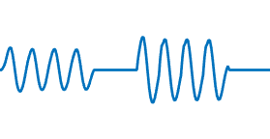
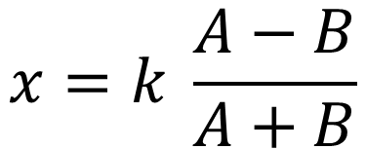
Beam Results : position estimation algorithm
Electrode signal power estimation and Delta/Sigma normalization to extract the displacement x:
$$x=k \frac{A−B}{A+B}$$
A
B
Signal power estimation by Root Mean Square (RMS) algorithm
  Best resolution results in simulation by now
  Further solutions are under study

Slide 12
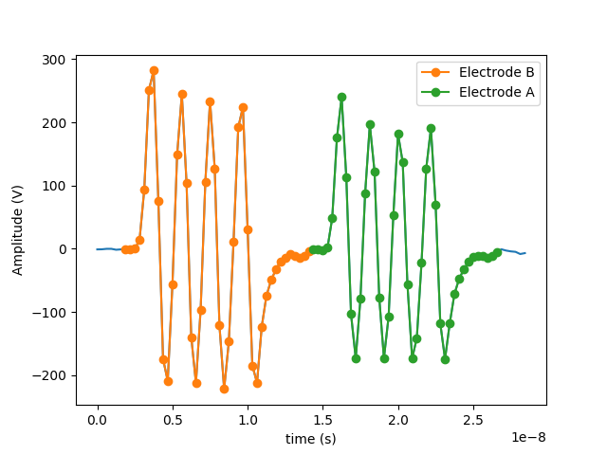
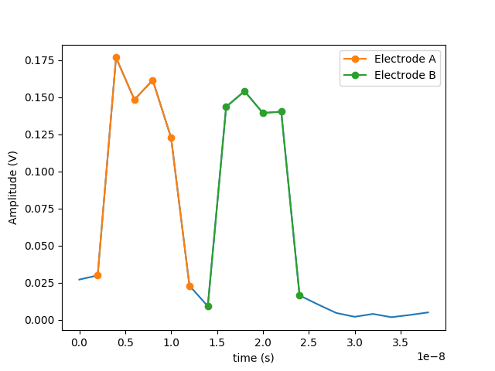
Beam Results: (1) Vadatech 12 bit @3.2 Gsps
Comb-filter bunch response after digitization
40 – 12bit samples per electrode
Beam Asynchronous:
<20 um bunch-by-bunch offset variation due to the sampling time shift difference between the two electrodes
Beam Synchronous:
sampling clock generated from RF cavities 40 MHz, the offset variation is then fixed with a given beam energy

Slide 13
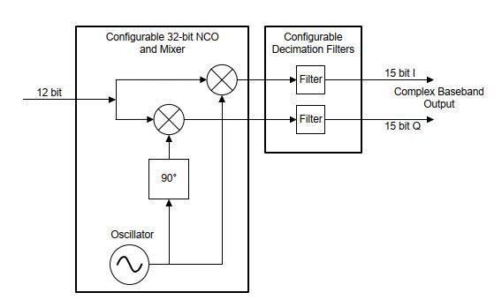
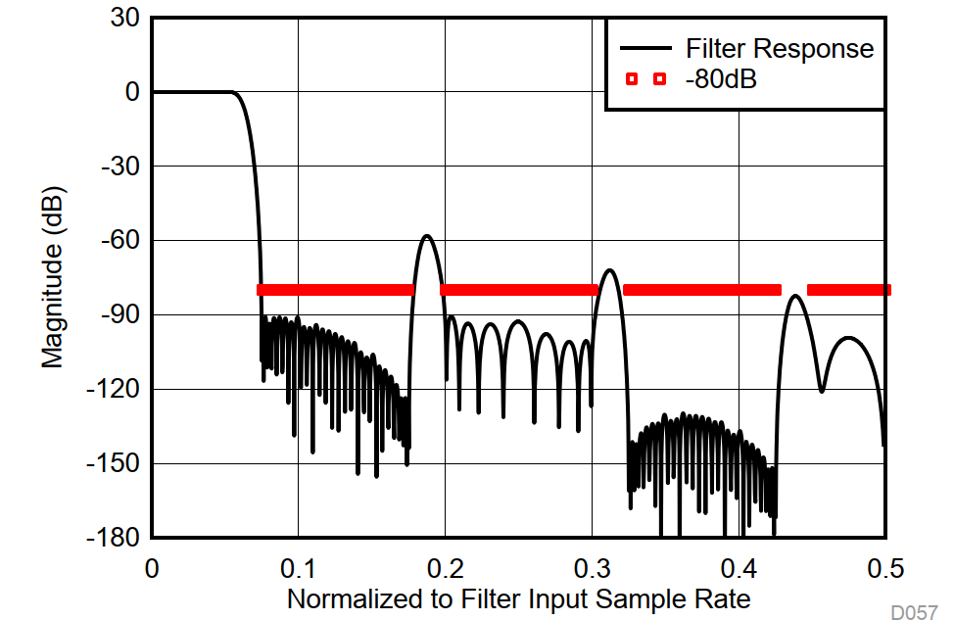
Beam Results : (2) Vadatech 15 bit IQ @4 Gsps 8-DDC
DDC Block Diagram
Decimate by 8 – Stopband response
NCO (500 MHz) + Digital Down Converting Filter (factor 8) embedded in the chip:
  NCO @ 500 MHz, decimation factor 8, IQ 15 bit
DDC filter too narrow, time response bigger than comb filter response

Slide 14
Beam Results : (2) Vadatech 15 bit IQ @4 Gsps 8-DDC
Comb-filter bunch response after digitization
Decimate by 8 – Stopband response
NCO (500 MHz) + Digital Down Converting Filter (factor 8) embedded in the chip:
  NCO @ 500 MHz, decimation factor 8, IQ 15 bit
DDC filter too narrow, time response bigger than comb filter response

Slide 15
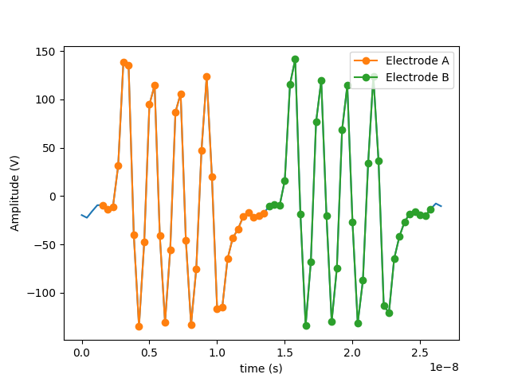
Beam Results : (3) HTG 14 bit @2.6 Gsps
Comb-filter bunch response after digitization
32.5 - 14bit samples per electrode
Beam asynchronous
DDC options under study
Higher frequency with VFC upgrade

Slide 16
Beam Results : Position Resolution Results
Intensity is scaled in order to cover the full ADC range with maximum intensity (2e11) and displacement (± 7.5 mm).

Slide 17
Beam Results : Position Error Offset
Mean value of Position Error for the ADC 14bit @2.6 Gsps
Intensity independent
Intensity is scaled in order to cover the full ADC range with maximum intensity (2e11) and displacement (± 7.5 mm).

Slide 18
Doublet Simulation: Singlet vs. Doublet
25 ns
25 ns
A₂+
A₂-
A+
A-
A₁+
A₁-
Signals are overlapped
Detection of free-overlap samples
One Singlet Bunch
One Doublet Bunch (two sub-bunches)

Slide 19
Doublet Simulation: Singlet vs. Doublet
25 ns
25 ns
A+
A-
Signals are overlapped
Detection of free-overlap samples
RMS on one exact period
  4 time less samples than in the singlet case
One Singlet Bunch
One Doublet Bunch (two sub-bunches)

Slide 20
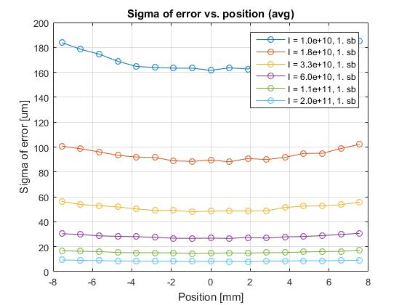
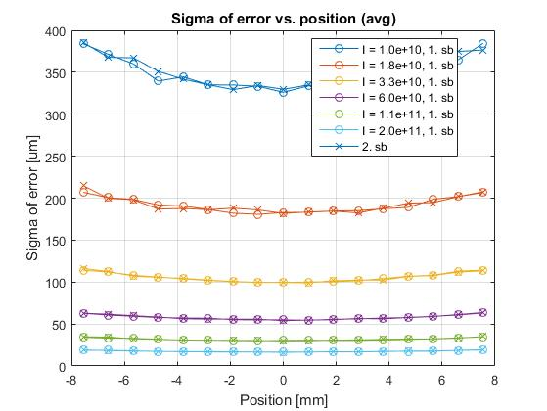
Doublet Simulation: Singlet vs. Doublet
Signals are overlapped
Detection of free-overlap samples
RMS on one exact period
  4 time less samples than in the singlet case
  Half the resolution
One Singlet Bunch
One Doublet Bunch (two sub-bunches)

Slide 21
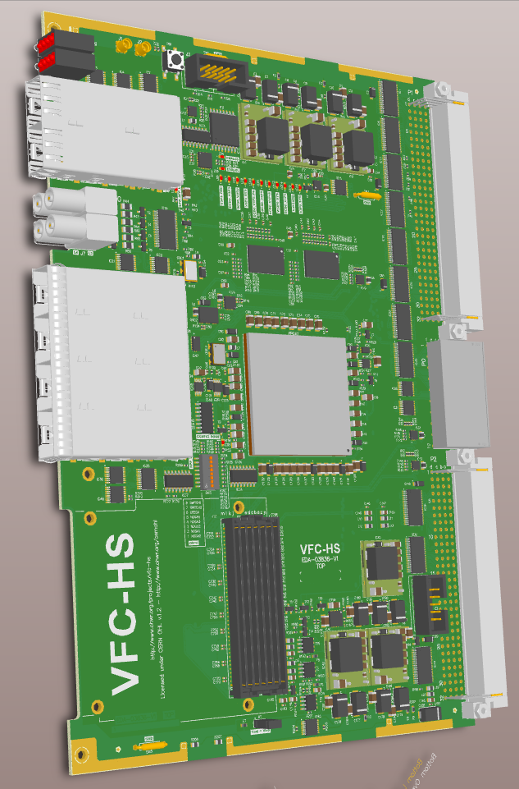
Carrier Upgrade: VFC-HS
Upgrade of VFC-HD:
  FMC+ connector
  Faster Xcvrs (10 Gbps)
Higher price
  3 kCHF vs. 1k2 kCHF
Schematics done, layout nearly done
https://www.ohwr.org/projects/vfc-hs

Slide 22
Carrier Upgrade: iBPM Price/Resolution Variants
Carrier | Mezzanine | Sampling Speed [GSPS] | Chips | VME Cards | Expected Resolution [µm] ^{*)} | Est. Price [kCHF]
 |  |  |  |  |  | Per Channel | Total
VFC-HD | Vadatech FMC225 | 3.2 | 1x ADC 1x DAC | 20 | 200 | 8.4 | 168
VFC-HD | HTG 14ADC-16DAC | 2.6 | 1x ADC 1x DAC | 20 | 130 | 7.9 | 158
VFC-HS | HTG QUAD-14ADC | 3.0 | 2x ADC no DAC | 10 | 120 | 5.9 | 118 ^{**)}
16 channels + 4 spare = 20 channels total
CHF ~ USD
VFC-HD: 1.2 kCHF, VFC-HS: 3 kCHF (estimation)
^{*)} Single bunch, I = 1e10
^{**)} Plus VFC-HS development (~ 50 kCHF)

Slide 23
Status
Analogue front-end:
  Balanced power combiner and PCB delay lines prototypes are finished.
  Still is to discuss the need of an anti-aliasing filter and an amplifier stage before the digitization.
Digital chain:
  To define system configuration (mezzanine + carrier).
  To define algorithm and firmware implementation.
Full system goal: fully functional prototype by the end LS2

