Slide 1
Effect of civil engineering work on LHC and implications for HL-LHC
D. Gamba, M. Schaumann, R. Corsini,
Many inputs from previous works of M. Guinchard, J. Wenninger, P. Fessia, D. Valuch, et al.
132th HiLumi WP2 Meeting – 02/10/2018

Slide 2
Outline
Disclaimer: work in progress…
Optics sensitivity: LHC vs HL-LHC
  Impact on orbit separation at IPs
  Impact on orbit at collimators
  Impact on orbit at pickups
Ground motion observed in the LHC
  2017 and 2018
  Trying to get some numbers out of observations
Note:
Follow up of topic presented a few times, e.g.:
  M. Schaumann – Aug 2018 link
  D. Gamba et al. – Apr 2018 link
  D. Gamba et al. – IPAC2018 link
  D. Gamba et al. – Jul 2017 link
  M. Fitterer et al. – Apr 2015 link
Many other references available on my page

Slide 3
Optics sensitivity: assumptions
Equal uncorrelated ground motion distributed along the whole machine with same amplitude
  Main players are triplets in IP1/5
Assuming all perturbations induce simply a closed orbit variation (f << f_{rev}).
Beam/optics parameters
  LHC: ε_{N} 2 (3.75) µm; 6.5 TeV; β* 30 (40) cm
  HL-LHC: ε_{N} 2.5 µm; 7 TeV; 15 cm β*

Slide 4
Optics sensitivity: summary tables
Amplification factors from magnet motion to IP orbit separation
  New LHC values assuming ε_{N} = 2 µm and ATS optics β* = 30 cm
  Old LHC values assuming ε_{N} = 3.75 µm and ATS optics β* = 40 cm
 | IP1 [σ*_{beam}/µm] |  | IP5 [σ*_{beam}/µm] |  | IP2 [σ*_{beam}/µm] |  | IP8 [σ*_{beam}/µm]
 | Δx | Δy | Δx | Δy | Δx | Δy | Δx | Δy
LHC all quads | 0.536 0.360 | 0.440 0.274 | 0.527 0.360 | 0.443 0.375 | 0.231 0.175 | 0.252 0.177 | 0.290 0.176 | 0.368 0.185
LHC IR1/5 only | 0.516 0.353 | 0.419 0.264 | 0.516 0.354 | 0.419 0.294 | 0.120 0.082 | 0.131 0.075 | 0.172 0.049 | 0.288 0.072
HL-LHC all quads | 0.721 | 0.758 | 0.719 | 0.755 | 0.269 | 0.367 | 0.341 | 0.592
HL-LHC IR1/5 only | 0.703 | 0.736 | 0.704 | 0.735 | 0.211 | 0.331 | 0.235 | 0.550
Meaning: if all quadrupoles in LHC oscillate randomly uncorrelated by 1 µm rms, then the B1-B2 orbit separation at IP1 is 0.536 σ_{beam} in H and 0.44 σ_{beam} in V
Partially from 119th WP2 meeting (link)

Slide 5
Optics sensitivity: summary tables
Impact at primary collimators (max rms orbit excursion at any TCP)
  New LHC values assuming ε_{N} = 2 µm and ATS optics β* = 30 cm
  Old LHC values assuming ε_{N} = 3.75 µm and ATS optics β* = 40 cm
 | B1 |  |  |  | B2
 | [σ_{beam}/µm] |  | [µm/µm] |  | [σ_{beam}/µm] |  | [µm/µm]
 | Δx | Δy | Δx | Δy | Δx | Δy | Δx | Δy
LHC all quads | 0.316 0.205 | 0.273 0.207 | 99 | 63 | 0.337 0.212 | 0.268 0.169 | 71 | 57
LHC IR1/5 only | 0.294 0.179 | 0.245 0.187 | 92 | 52 | 0.316 0.189 | 0.231 0.146 | 67 | 49
HL-LHC all quads | 0.393 | 0.454 | 133 | 130 | 0.418 | 0.227 | 95 | 50
HL-LHC IR1/5 only | 0.367 | 0.425 | 123 | 120 | 0.394 | 0.195 | 90 | 43
Meaning: if all quadrupoles in LHC oscillate randomly uncorrelated by 1 µm rms, then the rms orbit at the most sensitive TCP is 0.316 σ_{beam} in H and 0.273 σ_{beam} in V
Note: σ_{beam} given without considering dispersion.
Partially from 119th WP2 meeting (link)

Slide 6
Optics sensitivity: summary tables
Impact at pickups (max orbit excursion at any pickup, e.g. as for TCP)
 | ADT pickup |  |  |  | Q1 BPM IP1/5
 | B1 [µm/µm] |  | B2 [µm/µm] |  | B1 [µm/µm] |  | B2 [µm/µm]
 | Δx | Δy | Δx | Δy | Δx | Δy | Δx | Δy
LHC all quads | 57 | 55 | 56 | 66 | 125 | 204 | 180 | 179
LHC IR1/5 only | 52 | 49 | 50 | 61 | 102 | 182 | 159 | 156
HL-LHC all quads | 96 | 130 | 92 | 126 | 208 | 257 | 280 | 217
HL-LHC IR1/5 only | 84 | 115 | 82 | 118 | 178 | 224 | 248 | 184
 | “ARC” BPMs
 | B1 [µm/µm] |  | B2 [µm/µm]
 | Δx (Quad) | Δy (Quad) | Δx (Quad) | Δy (Quad)
LHC all quads | 84 (6L7) | 86 (11R5) | 87 (6R7) | 92 (11L5)
LHC IR1/5 only | 76 (6L7) | 80 (11R5) | 82 (6R7) | 86 (11L5)
HL-LHC all quads | 123 (6L1) | 130 (9R4) | 162 (6R5) | 130 (8R2)
HL-LHC IR1/5 only | 108 (6L1) | 115 (9R4) | 146 (6R5) | 121 (8R2)
Indicates which is the most sensitive pickup

Slide 7
Main observations
HL-LHC (15cm β*) will be about 2 times more sensitive to quadrupoles vibrations than LHC (40cm β*; 3.75).
  but if we consider present LHC performance (30cm β*; 2.00), the difference is clearly reduced.
Dominant quadrupoles are the triplets in IP1/5
Oscillations of the order of 1 µm should show up very easily in our instrumentation.

Slide 8
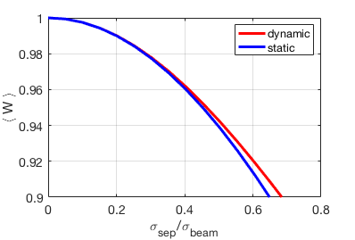
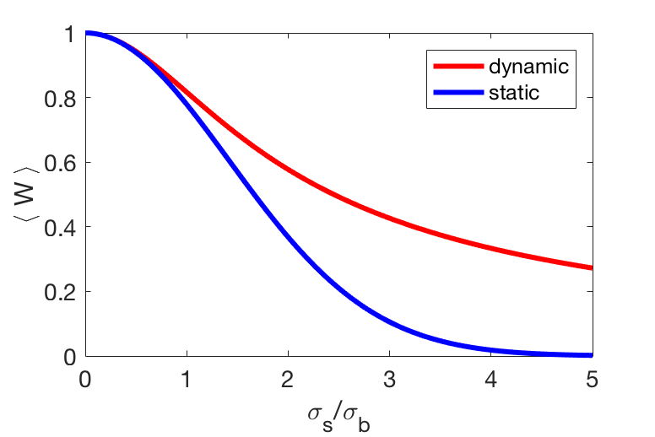
Instantaneous* Luminosity reduction [1]
Factor due to “static” orbit separation (d₂-d₁)
Factor due to “dynamic” orbit separation σ_{s}
i.e. assuming beam separation is oscillating around zero.
* Instantaneous compared to LHC fill, integrated compared to revolution frequency
[1] Concept of Luminosity, W. Herr and B. Muratori, (CERN-2006-002)
Partially from 99th WP2 meeting (link)

Slide 9
Summary: impact on observables
Luminosity loss [%] | 1 |  | 10 |  | ~2
 | LHC | HL-LHC | LHC | HL-LHC | HL-LHC
Orbit sep. IP1/5 [σ_{beam}] | 0.2 |  | 0.68 |  | 0.29
Necessary quad. motion rms [μm] | 0.39 | 0.27 | 1.33 | 0.93 | 0.39
rms orbit @TCP [σ_{beam}] | 0.12 | 0.12 | 0.42 | 0.40 | 0.17
rms orbit @TCP [μm] | 36 | 34 | 122 | 114 | 48
rms orbit @ADT pickups [μm] | 24 | 32 | 81 | 110 | 46
rms orbit @Q1 BPMs [μm] | 71 | 68 | 242 | 231 | 97
rms orbit @11L5 BPM [μm] | 34 | 40 | 114 | 136 | 57
Numbers computed assuming IP1/5 triplet only source of perturbation.
  Assuming both IP triplets oscillate by the same rms amplitude in one plane only.
  If only one triplet oscillates => sqrt(2) more quadrupole motion needed to give same effect.
A reasonable threshold is 1% instantaneous luminosity loss, which correspond to about 0.4 (LHC) or 0.3 (HL-LHC) μm triplet motion.
An event causing 1% instantaneous luminosity loss in LHC would cause a 2% luminosity loss in HL-LHC
Notes:
Exp. magnetic rms motion [μm] computed as Beam_sigma_separation/max(ampliFactorTableIP)

Slide 10
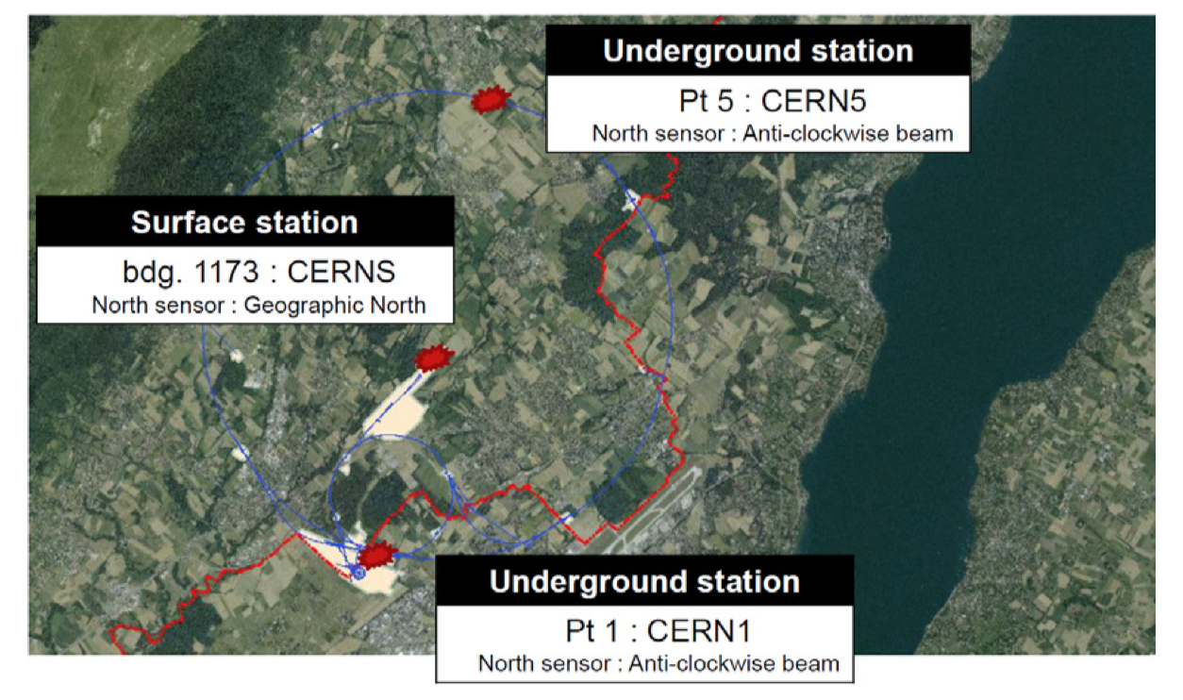
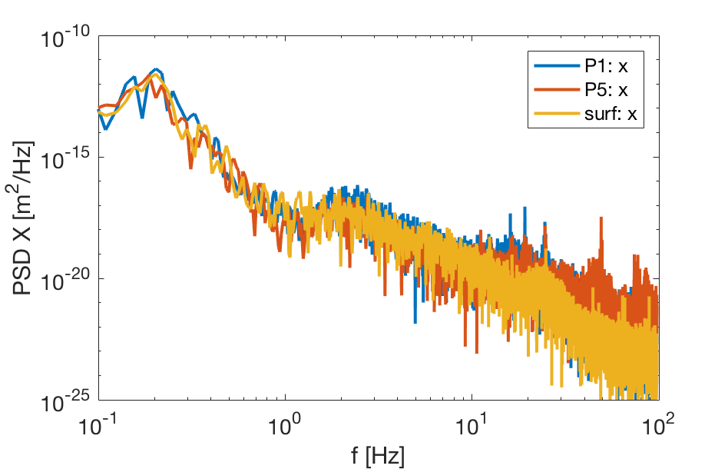
Ground motion observations in LHC
M. Guinchard, Oct. 2017 link
Geophones are logging data since 2017
Data logged into Timber in the form of PSD
15 May 2018: Official start of HL-LHC excavation works.
  2018 run is the occasion to see perturbation on the beam due to ground motion
  It could allow us to see if our expectations for HL-LHC are correct.

Slide 11
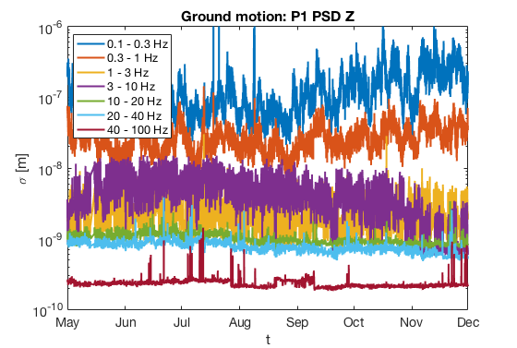
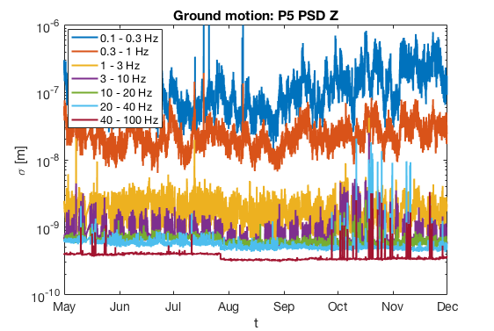
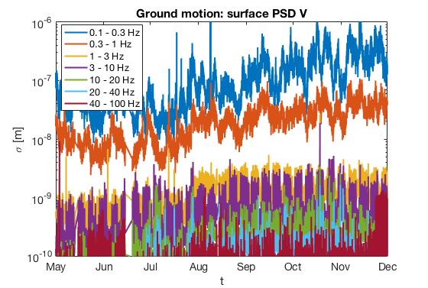
Integrated PSD along 2017 (1/5/17 – 1/12/17)
PSDs integrated over range of frequencies:
Low frequency (f < 1 Hz) levels very correlated between P1/5 and surface
Some more activity in Oct./Nov. in P5
From 99th WP2 meeting (link)
Notes:
\sigma^2(f_0 < f < f_1) = \int_{f_0}^{f_1} p(f) \mathrm{d}f

Slide 12
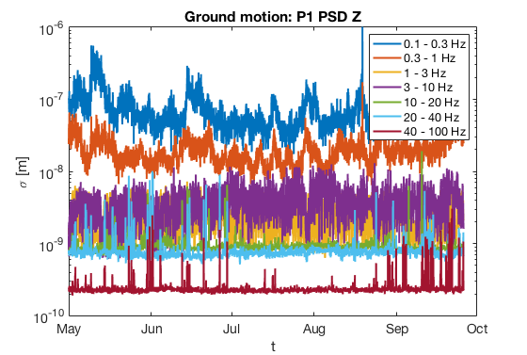
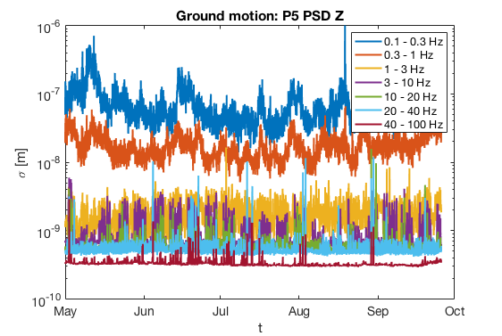
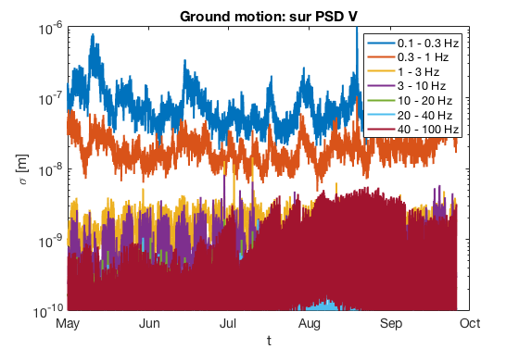
Integrated PSD along 2018 (1/5/18 – 26/09/18)
Overall, similar levels as in 2017.
More noise in the 40-100 Hz range on surface.
More spikes along the year in both P1 and P5 at f > 20 Hz, but not necessary linked with HL-LHC works
  (official start wasMay 15th)
Notes:
\sigma^2(f_0 < f < f_1) = \int_{f_0}^{f_1} p(f) \mathrm{d}f

Slide 13
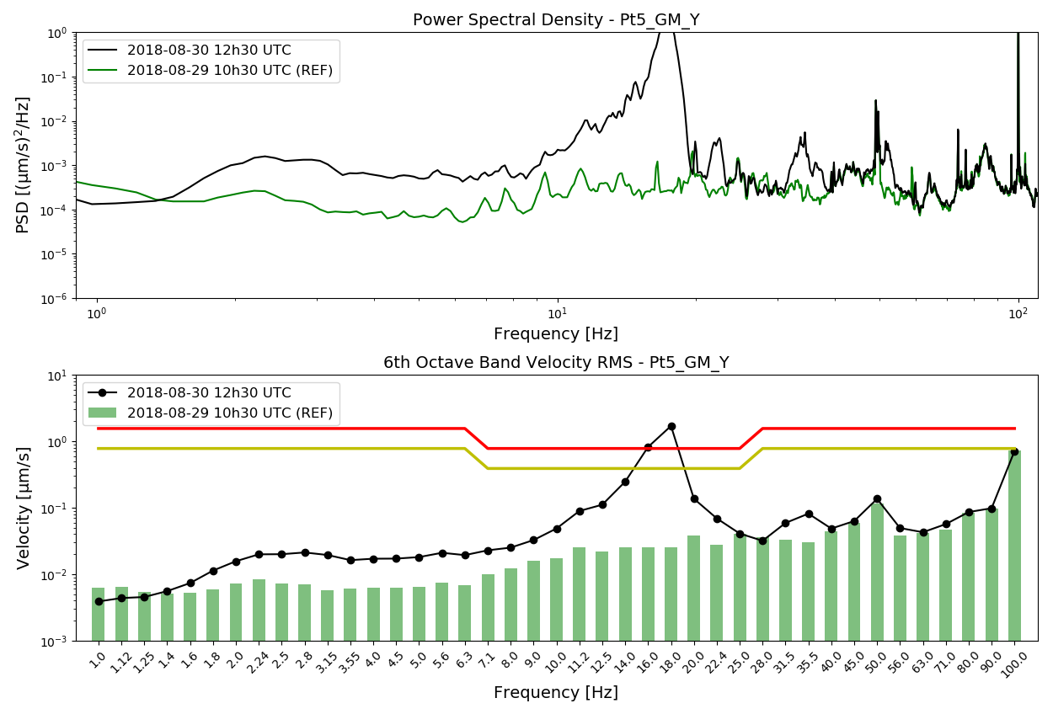
Warning from EN-MME, e.g. 30/08/2018
Alarm system set up by M.Guinchard and L.G.Scislo (EN-MME) to eventually stop the excavation works if ground motion exceeds safety level (see also M.Fitterer – link)
Stop working level
Warning level
Courtesy L. G. Scislo
Notes:
Thanks to previous works from M.Fitterer (e.g. link) in collaboration with M.Guinchard (EN-MME) continuous observations of ground motion levels have been setup and a warning+stop excavation works is fired if expected magnet motion approaches 1 μm

Slide 14
Warnings fired by EN-MME
Point 1
  30/08/18: 5:40 - 7:00 -> No Beam at this time
  10/09/18: 6:30 - 7:00 -> Stable Beam (Fill 7145)
    To be looked at!
  11/09/18: 5:50 - late morning -> No Beam
Point 5
  04/06/18: around 08:11 -> Stable Beam (Fill 6757)
    Analyzed by Michaela
  22/06/18: 08:00 and 11am -> No Beam
  13/07/18: Day -> Stable Beam (no ATLAS lumi) (Fill 6919)
    Analyzed by Michaela
  30/08/18: 5:50-8:00 and 12:30-13:20 -> Stable Beam (Fill 7105)
    Seen by Michaela
  03/09/18: 7:00 - 7:25 -> Stable Beam (Fill 7122)
    To be looked at!
  04/09/18: 6:43 - 7:10 -> Stable Beam (Fill 7124)
    To be looked at!

Slide 15
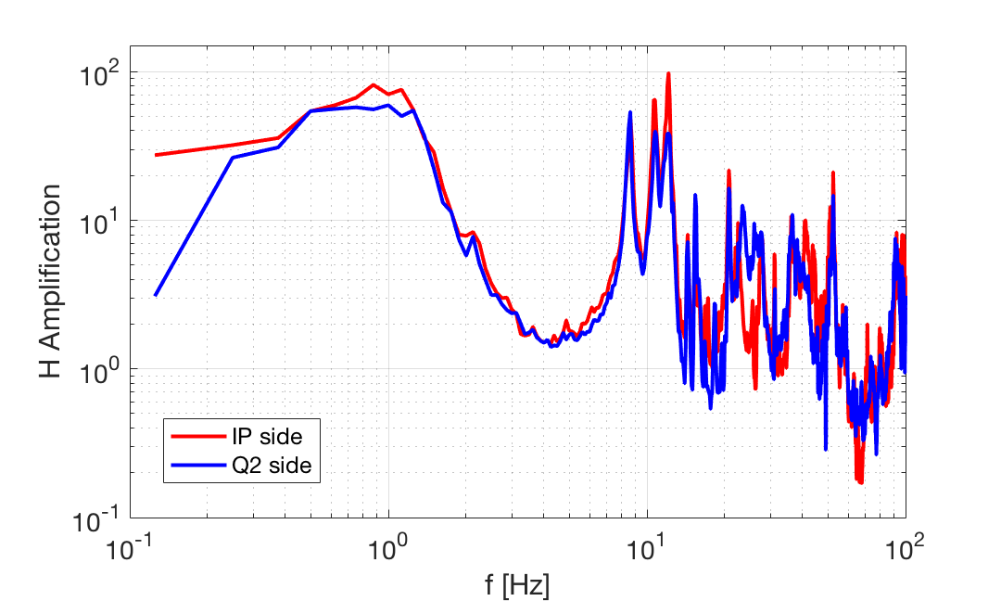
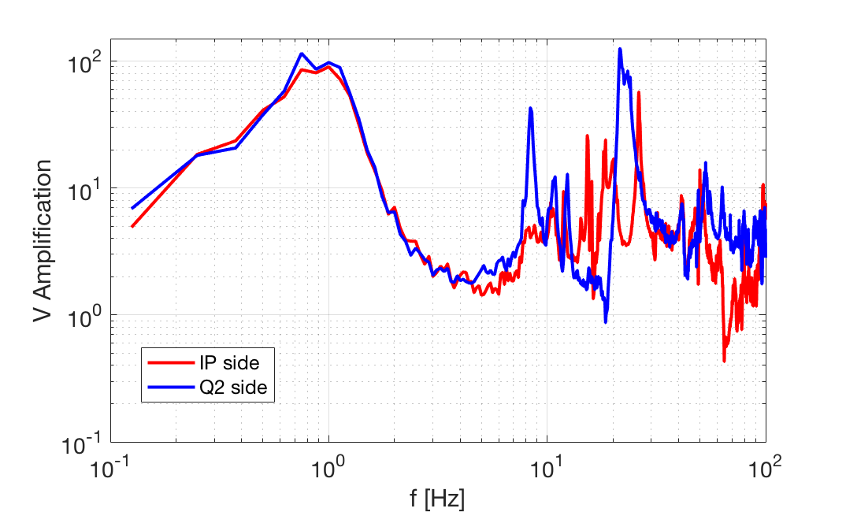
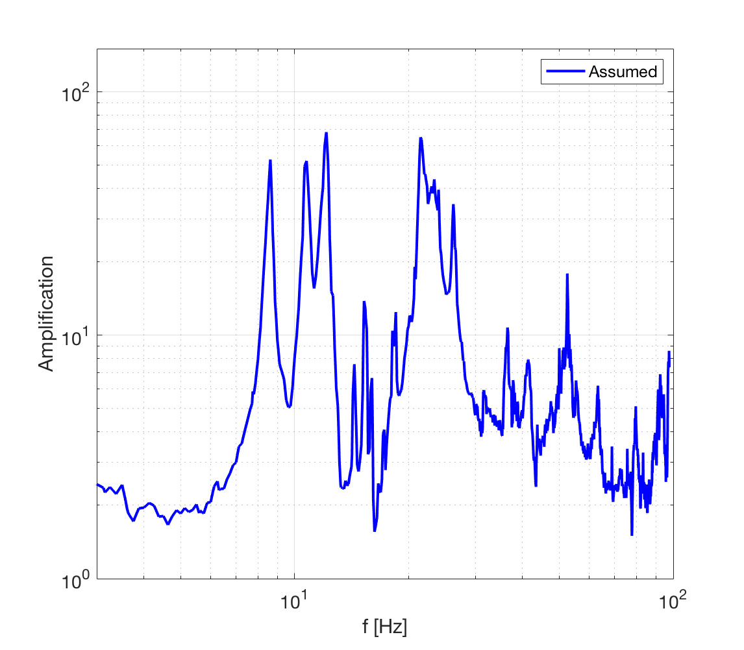
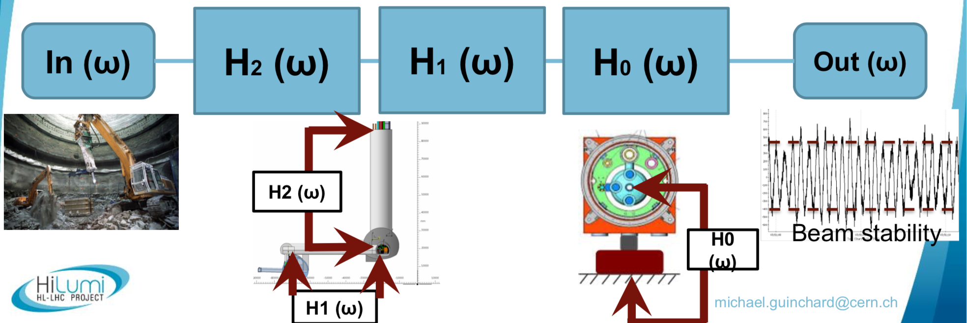
Digression: amplification of Q1 assembly
Considering mean between “IP side” and “Q2 side”.
Considering the max between vertical and horizontal amplifications.
Only f > 3 Hz:
Measured on Q1 spare assembly in SM18
  See for example M. Guinchard, Oct 2017, link
Only “valid” for f > 3 Hz
  Response below 3 Hz is unknown

Slide 16
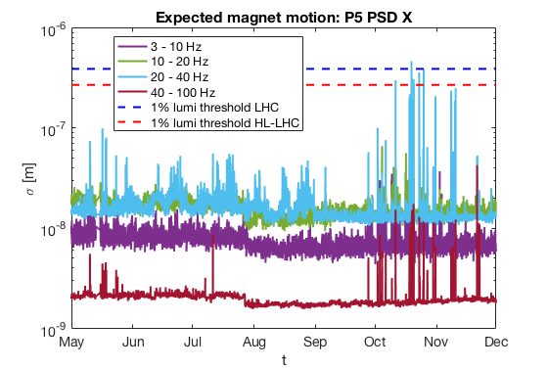
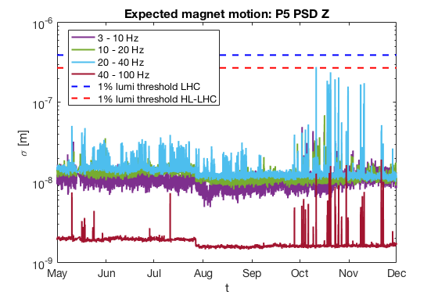
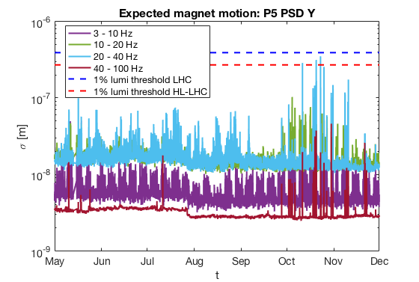
Integrated PSD along 2017 – P5 (1/5/17 – 1/12/17)
geophone in P5, all directions
Integrated spectra amplified by measured Q1 “max” transfer function
Some activity getting close to “1% luminosity threshold” in Oct-Nov 2017.
  Did not observed any luminosity losses, but maybe not careful enough analysis.
Notes:
\sigma^2(f_0 < f < f_1) = \int_{f_0}^{f_1} p(f) \mathrm{d}f

Slide 17
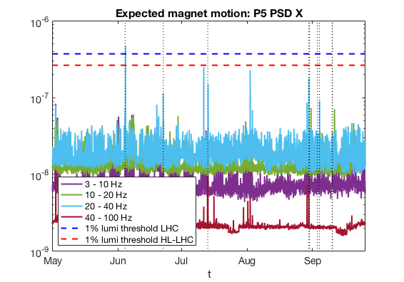
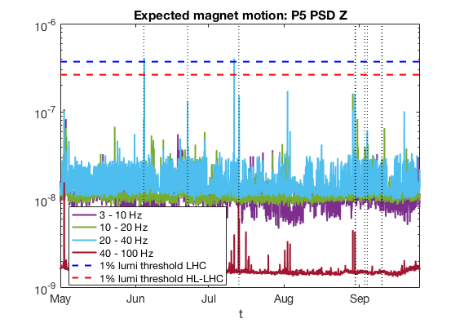
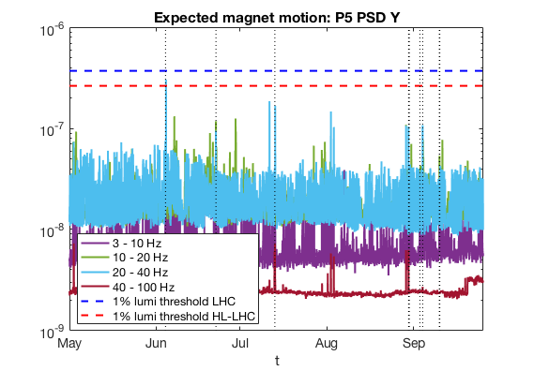
Integrated PSD along 2018 – P5 (1/5/18 – 26/09/18)
geophone in P5, all directions
Highlight of “warnings” by EN-MME
  Vertical dashed lines
  The correspond to spikes in the 20-40 Hz frequency range.
    Not a surprise! It should be the same “data”
Notes:
\sigma^2(f_0 < f < f_1) = \int_{f_0}^{f_1} p(f) \mathrm{d}f

Slide 18
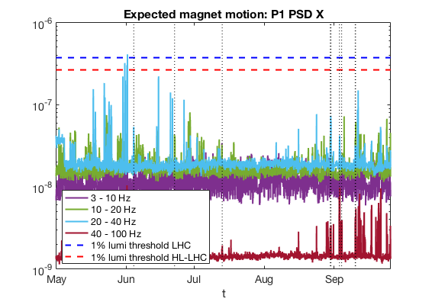
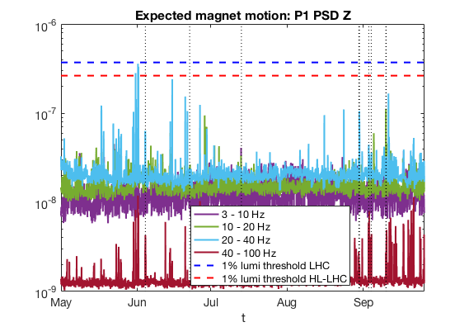
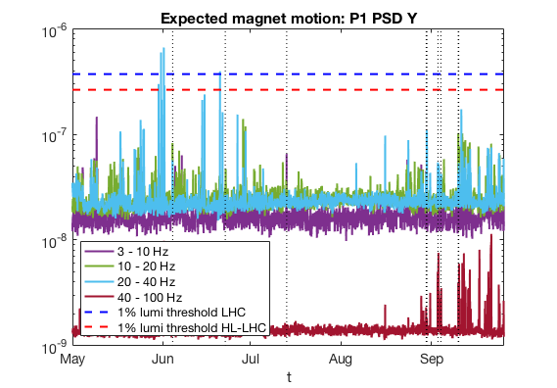
Integrated PSD along 2018 – P1 (1/5/18 – 26/09/18)
geophone in P1, all directions
“high” activity in the 10-20 Hz and 20-40 Hz band at different times.
  Not sure if they did/didn’t trigger an EN-MME alarm.
Generally quieter 20-40 Hz band
Notes:
\sigma^2(f_0 < f < f_1) = \int_{f_0}^{f_1} p(f) \mathrm{d}f

Slide 19
Additional warnings from previous plots
Point 1
  30/05/18: around 13:00-> Beam (no lumi drops) fill 6741
  31/05/18: around 9:00 -> No beam
  31/05/18: around 14:00 -> No beam
  01/06/18: around 08:00 -> Beam fill 6749
  01/06/18: around 13:00 -> Beam fill 6749
  15/06/18: around 7:00 -> no interesting beam (fill 6799)
  11/09/18; around 14:00 -> some noise, no interesting beam -> fill 7147
Point 5
  11/10/17: around 8:00 Beam fill 6291
  19/10/17: around 8:00 -> Beam fill 6308
  20/10/17: around 9:00 -> Beam fill 6311
  23/10/17: around 9:00 -> no beam
  25/10/17: around 12:00 -> no beam
  31/10/17: around 11:00 -> no beam
  11/07/18: around 13:00 -> no beam
  02/08/18: around 12:00 -> no beam

Slide 20
Summary of possibly interesting fills
Point 1
  30/05/18: 13:00 -> fill 6741
  01/06/18: 08:00-13:00 -> fill 6749
  10/09/18: 6:30-7:00 -> fill 7145
Point 5
  11/10/17: around 8:00 Beam fill 6291
  19/10/17: around 8:00 -> Beam fill 6308
  20/10/17: around 9:00 -> Beam fill 6311
  04/06/18: 08:11 -> Fill 6757
    Already presented by Michaela
  13/07/18: Day -> Fill 6919
    Already presented by Michaela
  30/08/18: 5:50-13:20 -> Fill 7105
  03/09/18: 7:00 - 7:25 -> Fill 7122
  04/09/18: 6:43 - 7:10 -> Fill 7124
I will also consider those fills for the time being.

Slide 21
Possible beam observables
Luminosity (e.g. 'ATLAS:LUMI_TOT_INST’)
  Probably the most sensitive observable.
Beam intensity (e.g. 'LHC.BCTDC.A6R4.B1:BEAM_INTENSITY_ADC24BIT’)
  Very high dynamic range due to intensity variation along fill.
BLM integrated losses (e.g. 'LHC.BLM.LIFETIME:B1_CALIBRATED_LOSS’)
  Very sensitive signal, with beam intensity one can have ratio of losses.
ARC BPMs (e.g. ‘LHC.BOFSU:POSITIONS_H’)
  Position acquired at 25 Hz, but available only as mean over 1 s
DOROS BPMs (e.g. 'LHC.BPM.1L1.B1_DOROS:POS_H’)
  Could acquire at much higher frequency, but also normally logging average over 1 s.
  Logging of spectra requested by Michaela, will happen soon.
BBQ (e.g. 'LHC.BQBBQ.CONTINUOUS.B1:ACQ_DATA_H’)
  A lot of spectra, not amplitude calibrated.
  Maybe interesting the logged Eigen-modes (e.g. ‘:EIGEN_AMPL_1’) to detect jumps.
ADT (e.g. 'ADTH.SR4.B1:SPECTRUM_HB1’)
  A lot of spectra, might be possible to get an amplitude calibration.
  Maybe interesting the transverse activity (e.g. ‘:TRANSVERSEACTIVITY_HB1’), but it contains only the “high-frequency” activity.

Slide 22
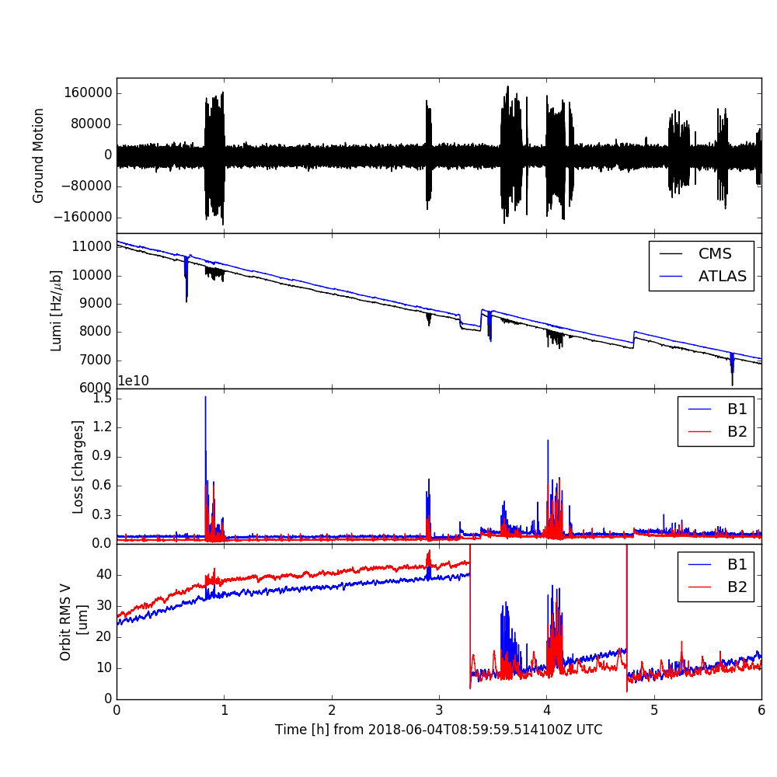
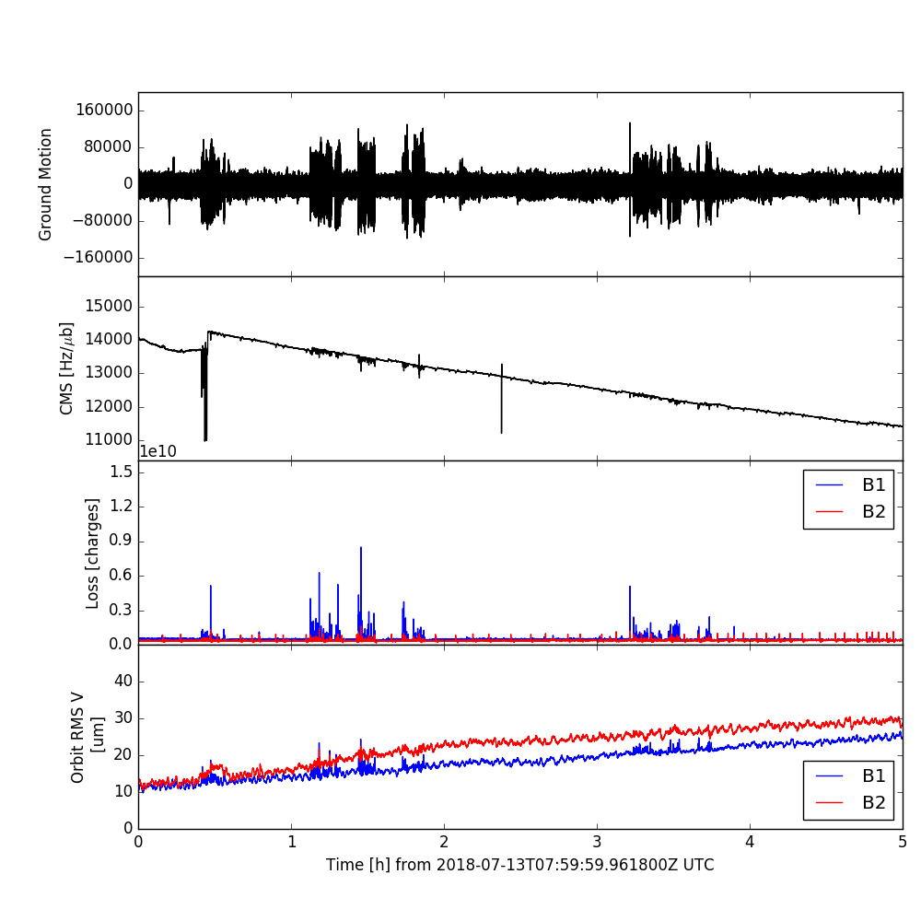
Main Events Overview presented by M. Schaumann
Fill 6757
(4/06/2018)
Fill 6919
(13/07/2018)
Ground motion
Luminosity
BLM Losses
Vertical RMS Orbit
Beta* levelling steps and new orbit reference
Same scales on all plots
Fill 6757 higher excitation amplitude
  stronger effect on beams
  higher losses, deeper luminosity dips, higher vertical RMS orbit
From: Observation on HL-LHC CE vibration on the beam, M. Schaumann (link)

Slide 23
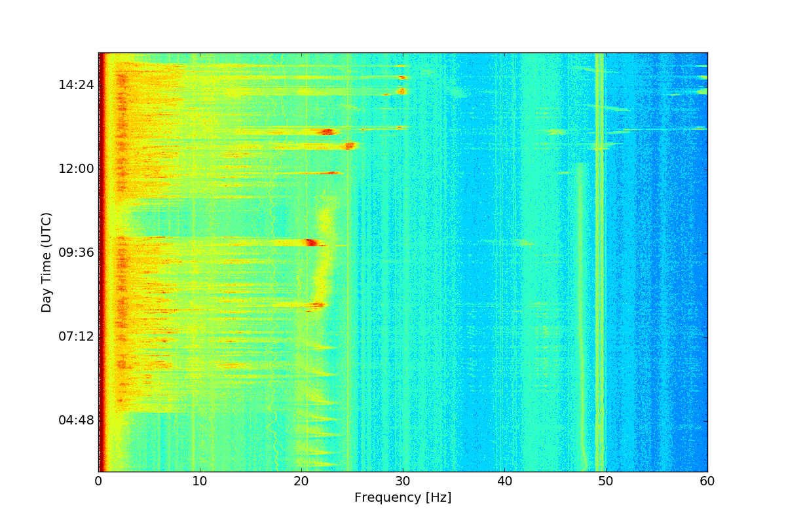
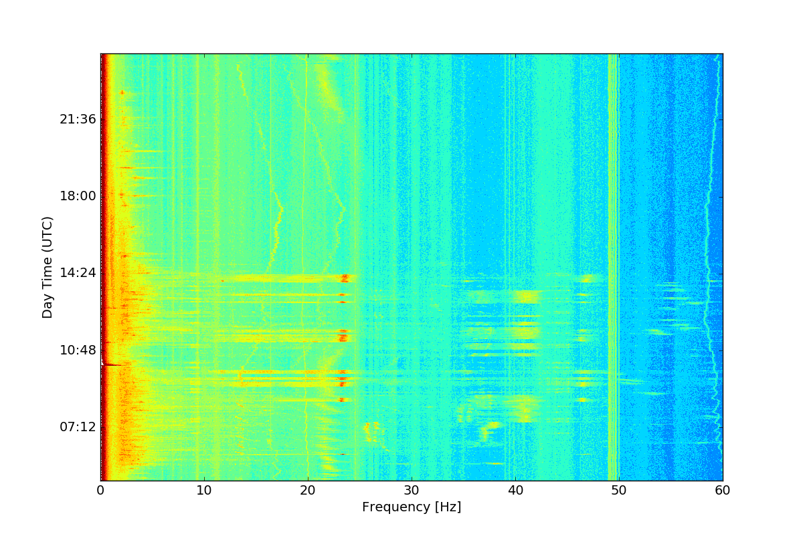
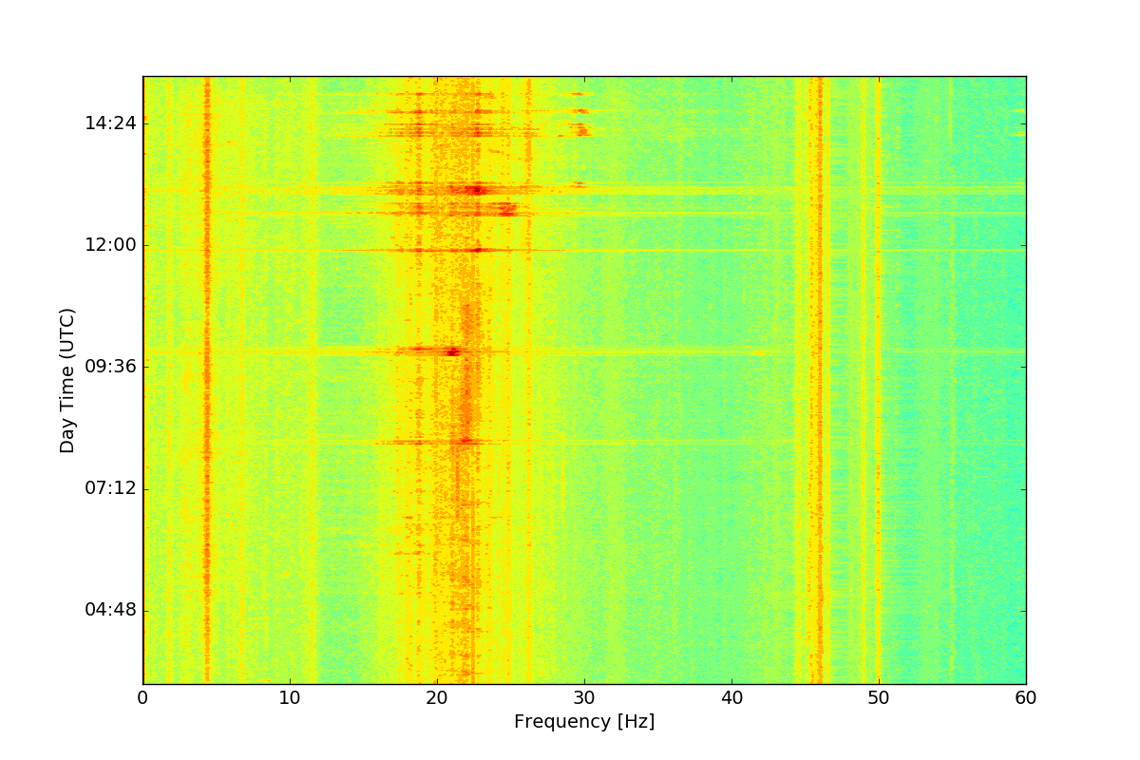
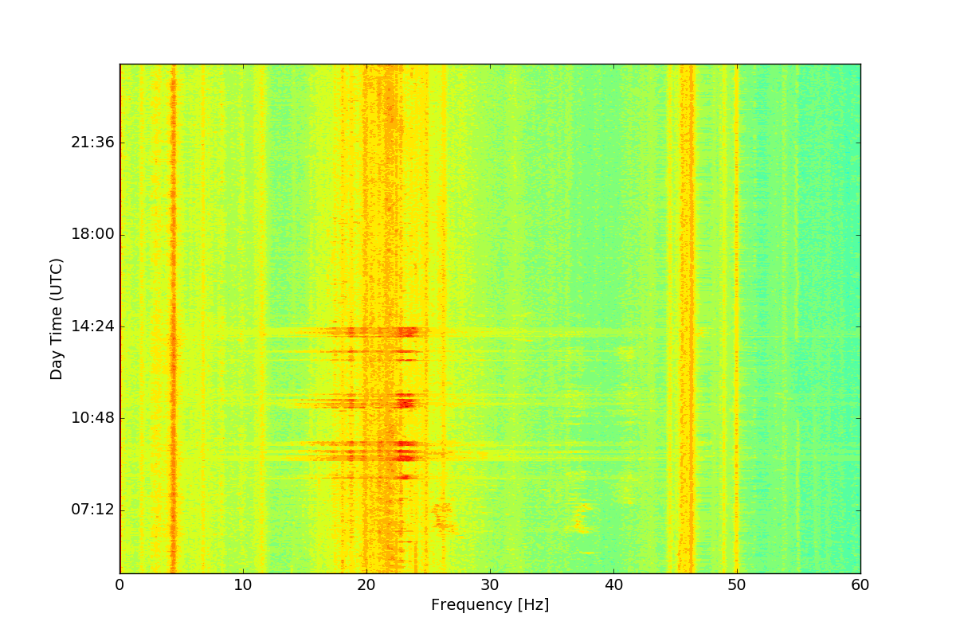
GM and Beam Spectrum Evolution
Fill 6757 (June)
Geophone
Fill 6919 (July)
30Hz
25Hz
46Hz
23Hz
41Hz
21Hz
22Hz
13Hz
ADT B1V
30Hz
25Hz
46Hz
23Hz
41Hz
21Hz
22Hz
From: Observation on HL-LHC CE vibration on the beam, M. Schaumann (link)

Slide 24
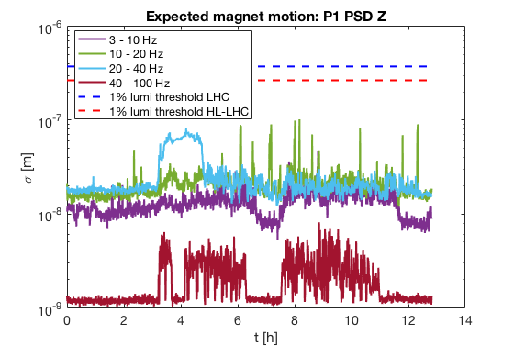
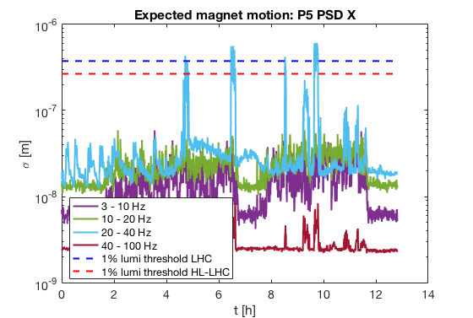
Fill 6757 (June)
Looking at PSDs amplified and integrated during STABLE beams
No relevant ground motion measured in P1
Sizable ground motion in P5 above “1% luminosity loss threshold”

Slide 25
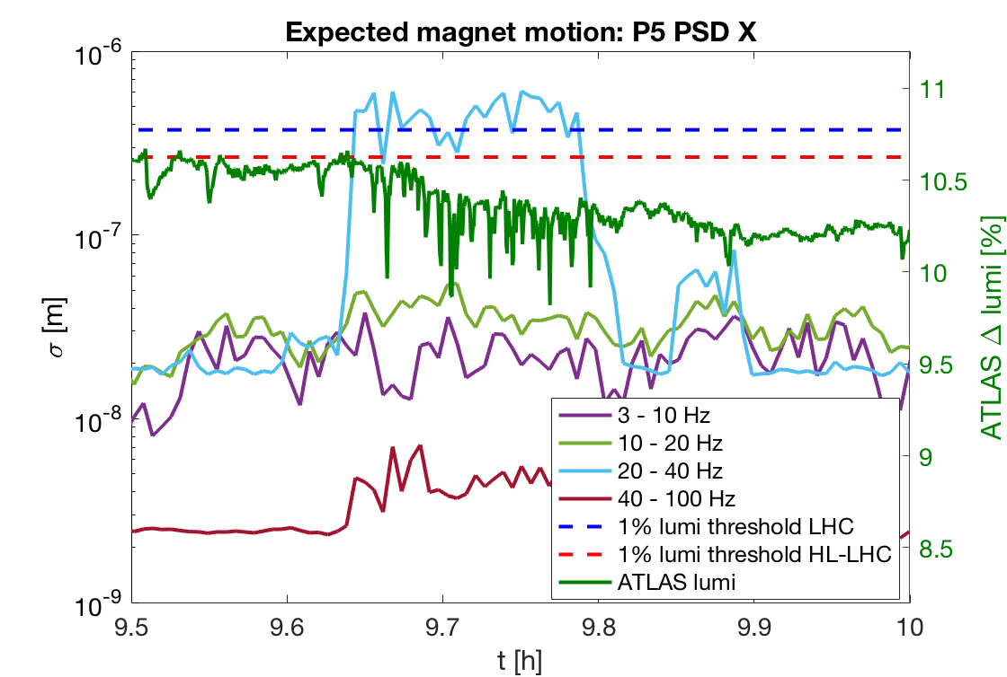
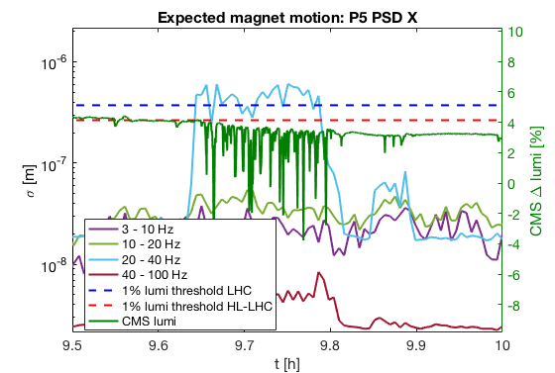
Fill 6757 (June)
Zoom over a certain time. Comparison of ground motion (left scale) and luminosity variation (right scale).
Variation w.r.t. fitted exponential decay along fill.
Both CMS and ATLAS luminosities seems to be affected.
  CMS much more sensitive (a few % peaks compared to < 1%)
  Could be possible if only vertical plane is mainly affected…

Slide 26
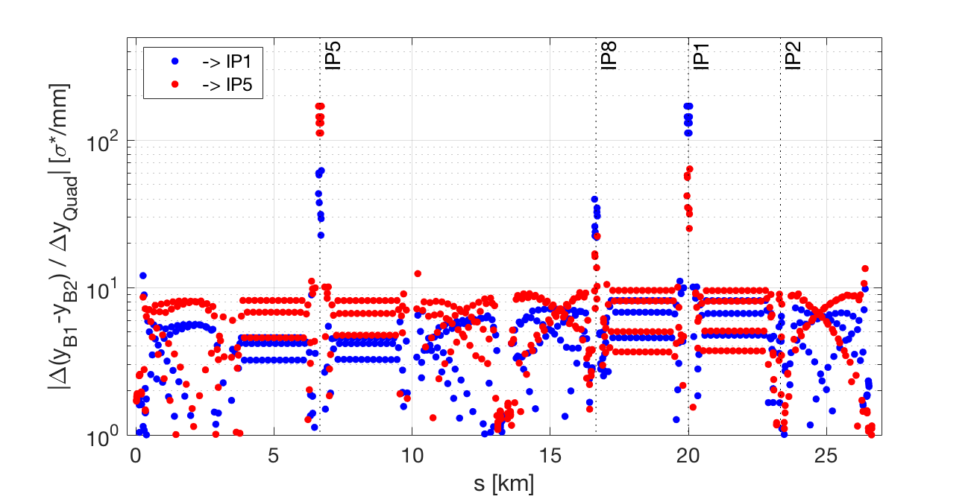
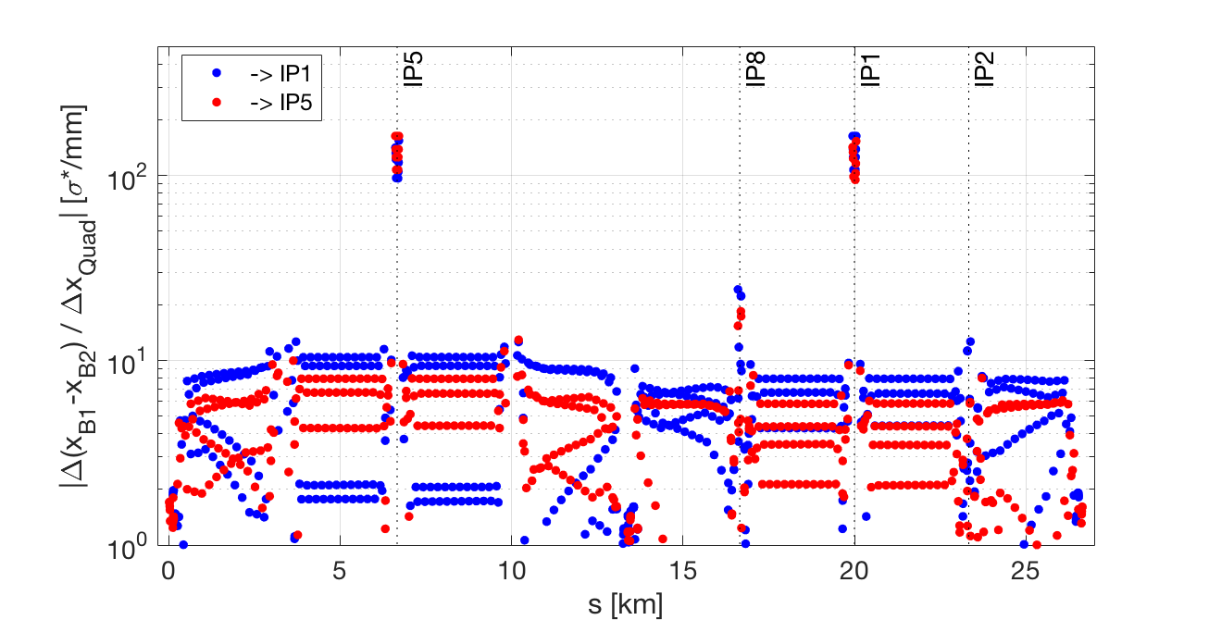
Beam Separation at IP1/5 due to Quadrupole Offset
Assumption:
30cm optics, 2um emittance
Vertical
Vertical offset of triplet in IP5 introduces a larger orbit effect in the IP5 compared to IP1 and vice versa
Horizontal
Horizontal offset of triplet in IP1/5 introduces a similar orbit effect in the both IPs.
From: Observation on HL-LHC CE vibration on the beam, M. Schaumann (link)

Slide 27
Back to optics sensitivity tables
Amplification factors from magnet motion to IP orbit separation
 | IP1 [σ*_{beam}/µm] |  | IP5 [σ*_{beam}/µm] |  | IP2 [σ*_{beam}/µm] |  | IP8 [σ*_{beam}/µm]
 | Δx | Δy | Δx | Δy | Δx | Δy | Δx | Δy
LHC all quads | 0.536 | 0.440 | 0.527 | 0.443 | 0.231 | 0.252 | 0.290 | 0.368
LHC IR1/5 only | 0.516 | 0.419 | 0.516 | 0.419 | 0.120 | 0.131 | 0.172 | 0.288
LHC IR5 only | 0.346 | 0.128 | 0.383 | 0.399 | 0.028 | 0.099 | 0.100 | 0.126
HL-LHC all quads | 0.721 | 0.758 | 0.719 | 0.755 | 0.269 | 0.367 | 0.341 | 0.592
HL-LHC IR1/5 only | 0.703 | 0.736 | 0.704 | 0.735 | 0.211 | 0.331 | 0.235 | 0.550
HL-LHC IR5 only | 0.517 | 0.544 | 0.477 | 0.497 | 0.189 | 0.268 | 0.175 | 0.375
If we consider only one triplet we should get a sqrt(2) smaller impact, with the exception of the vertical plane in LHC where the “remote” impact is smaller.
Partially from 119th WP2 meeting (link)

Slide 28
Back to optics sensitivity tables
Impact at primary collimators (max rms orbit at any TCP)
 | B1 |  |  |  | B2
 | [σ_{beam}/µm] |  | [µm/µm] |  | [σ_{beam}/µm] |  | [µm/µm]
 | Δx | Δy | Δx | Δy | Δx | Δy | Δx | Δy
LHC all quads | 0.316 | 0.273 | 99 | 63 | 0.337 | 0.268 | 71 | 57
LHC IR1/5 only | 0.294 | 0.245 | 92 | 52 | 0.316 | 0.231 | 67 | 49
LHC IR5 only | 0.222 | 0.231 | 70 | 49 | 0.234 | 0.161 | 50 | 35
Impact at arc BPMs
 | B1 [µm/µm] |  | B2 [µm/µm]
 | Δx (Quad) | Δy (Quad) | Δx (Quad) | Δy (Quad)
LHC all quads | 84 (6L7) | 86 (11R5) | 87 (6R7) | 92 (11L5)
LHC IR1/5 only | 76 (6L7) | 80 (11R5) | 82 (6R7) | 86 (11L5)
LHC IR5 only | 53 (11R7) 49 (6L7) | 62 (6L7) 58 (11R5) | 66 (6L2) 62 (6R7) | 69 (6R5) 61 (11L5)

Slide 29
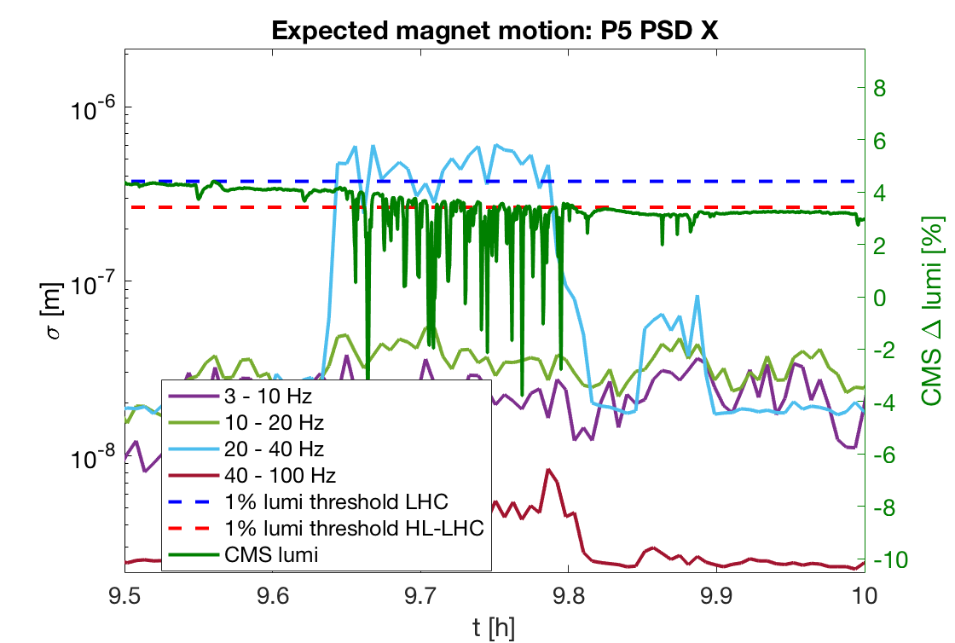
Some numbers from fill 6757 (June)
Mean = 0.45 μm
Peak = 7.8 %
Peak = 0.8 %
Seen about 0.45 μm rms “magnetic center” motion in P5.
Assuming to be vertical motion only, this correspond to
  3σ magnetic motion (0.45*3=1.35 um) would give
    6.6% max luminosity loss @ CMS
    0.7% max luminosity loss @ ATLAS
  0.1 sigma (29 μm) rms orbit @ TCP
  19 μm rms orbit @ ADT
  58 μm rms orbit @ Q1 BPMs
  27 μm rms orbit @ ARC BPMs -> compatible with observations:
Fill # | Obs. GM rms [µm] |  | Lumi loss peak [%] Obs. (Exp.) |  | Losses Obs | Orbit [µm/µm]
 | P1 | P5 | ATLAS | CMS |  | ARC | Q1
6291 |  | n.a.
6308 |  | n.a.
6311 |  | n.a.
6741 |  | n.a.
6749 |  | n.a.
6757 | n.a. | 0.45 | 0.8 (0.7) | 7.8 (6.6) | 3e-5
6919 | n.a.
7105 | n.a.
7122 | n.a.
7124 | n.a.
7145 |  | n.a.

Slide 30
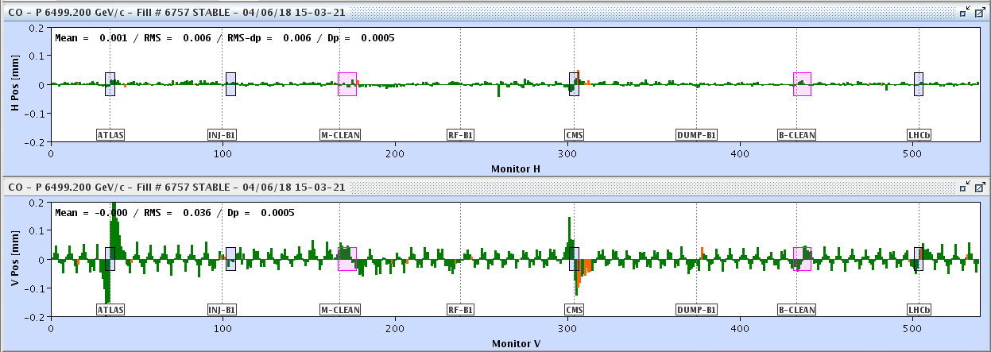
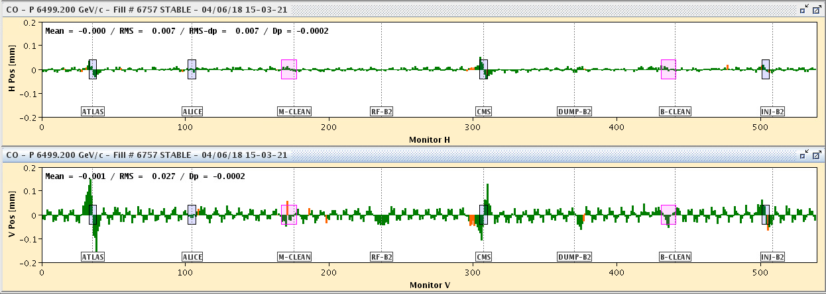
Orbit Example during Excitation Fill 6757
Vertical oscillation with arc amplitudes of 60um.
+/- 200um
04/06/2018 13-03-21 (UTC)
From: Observation on HL-LHC CE vibration on the beam, M. Schaumann (link)
15.08.2018
30

Slide 31
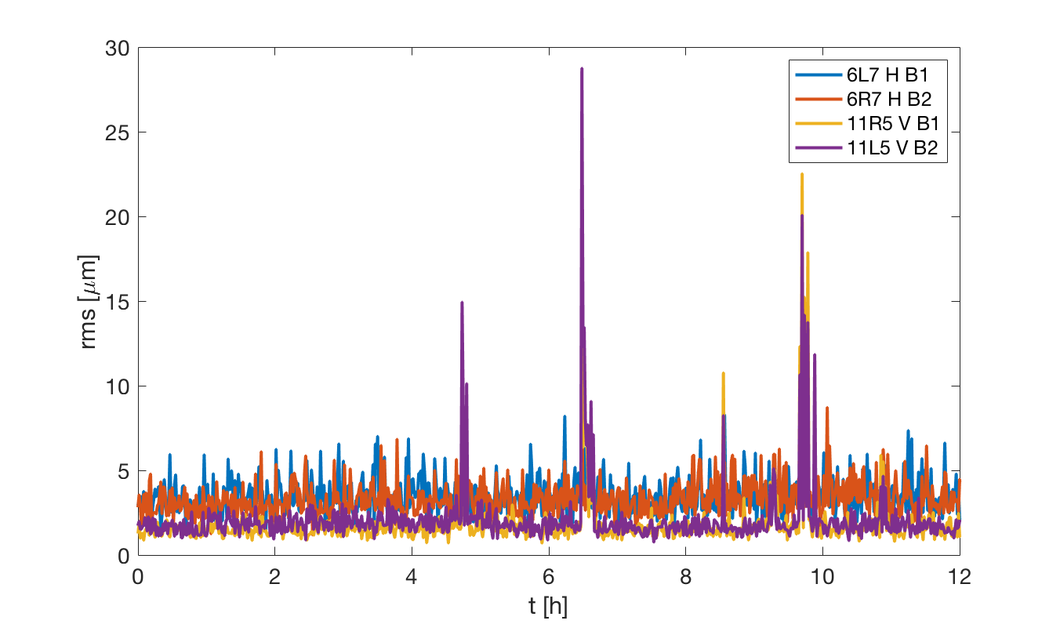
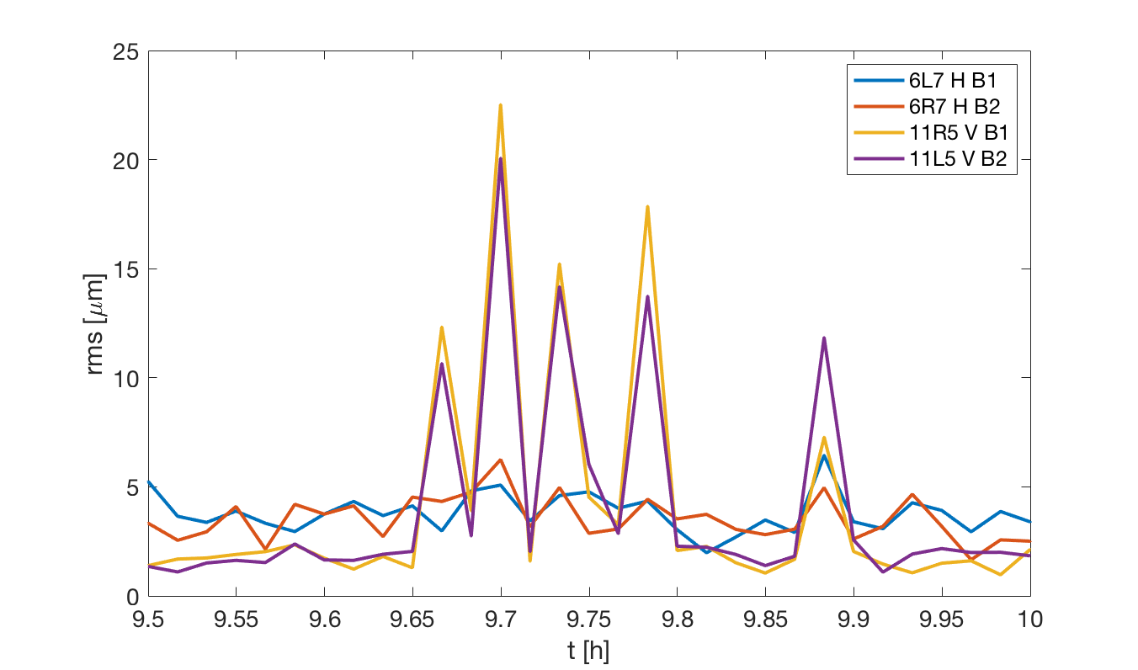
Orbit Example during Excitation Fill 6757
From ARC orbit data, std over 25 Hz data
31

Slide 32
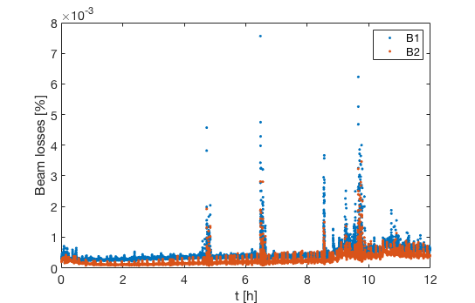
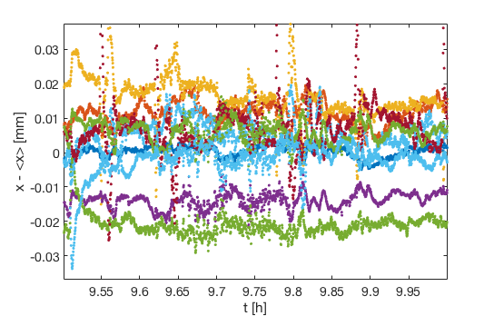
Some numbers from fill 6757 (June)
A few 10^-5 losses measured.
  Under investigation if it is possible to associated a number to orbit jitter at collimators.
Some disturbances of the logged orbit at Q1 DOROS BPM
  No clear signal expected since BPMs are integrating over 1 s and motion is at frequencies of the order of 20 Hz.
Now investigating if ARC BPMs are already storing in Timber some useful information
  E.g. rms measured over 25 Hz data.

Slide 33
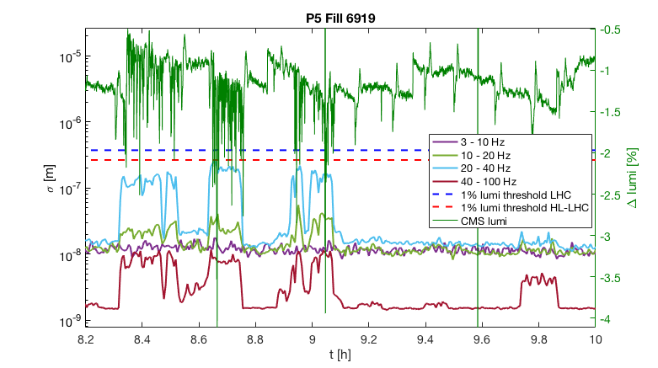
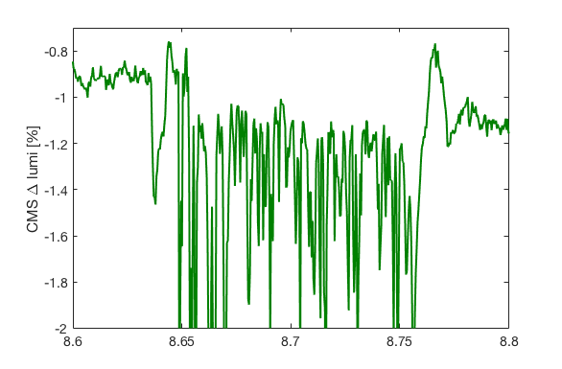
Fill 6919 (July)
Std = 0.4 %
Peak = 3.2 %
Seen about 0.2 μm rms magnetic center motion. Expected:
  1.4% peak luminosity loss @ CMS (0.15% @ ATLAS)
  0.04 sigma (13 μm) rms orbit @ TCP
  9 μm rms orbit @ ADT
  12 μm rms orbit @ ARC BPMs
  26 μm rms orbit @ Q1 BPMs

Slide 34
Conclusions
Actual LHC is very close to HL-LHC in terms of sensitivity to ground motion.
  Still, main players remain the IP1/5 triplets.
Ground motion activity due to HL-LHC civil works showed up into beam signals.
  From July 2018, 11 days with multiple alarms linked to surface activity [M.Guinchard]
  Events caused luminosity loss dips of the order of a few, mainly at CMS.
    Hardly noticeable for typical LHC operation.
    In HL-LHC they would be slightly more visible.
  Observed signals are compatible with measured transfer function of triplets.
    Important to measure HL-LHC triplet transfer function.
    Simulations by D.Ramos and M. Martos ongoing.
ADT spectra compatible with ground motion spectra.
  Another confirmation of the measured Q1 transfer function.
  Trying now to see if we could get a “number” on the observed motion
Other fills/signals under analysis.
  Triplet in P1 seems to less sensitive to measured ground motion
    More rigid? Geophone “too sensitive”? Different ground?
- Thanks for your attention and comments -
Notes:
Mario Vicente Oliver Martos <mario.vicente.oliver.martos@cern.ch>

Slide 35
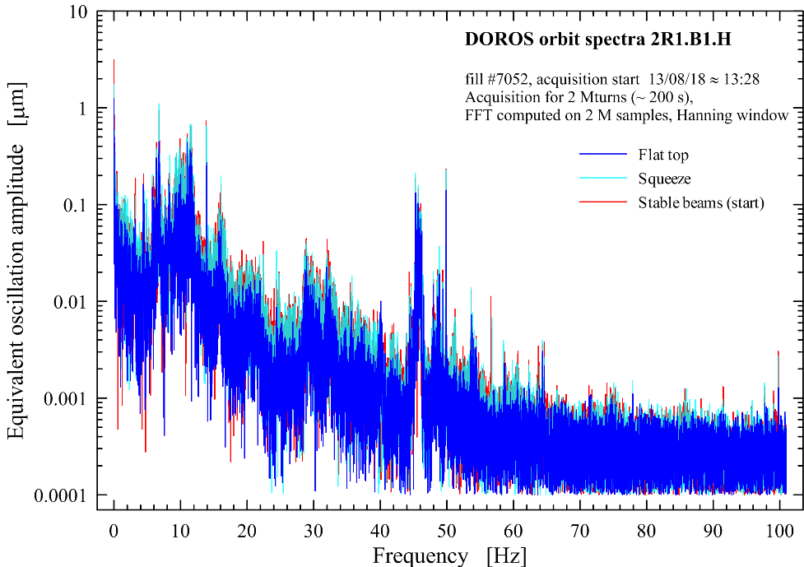
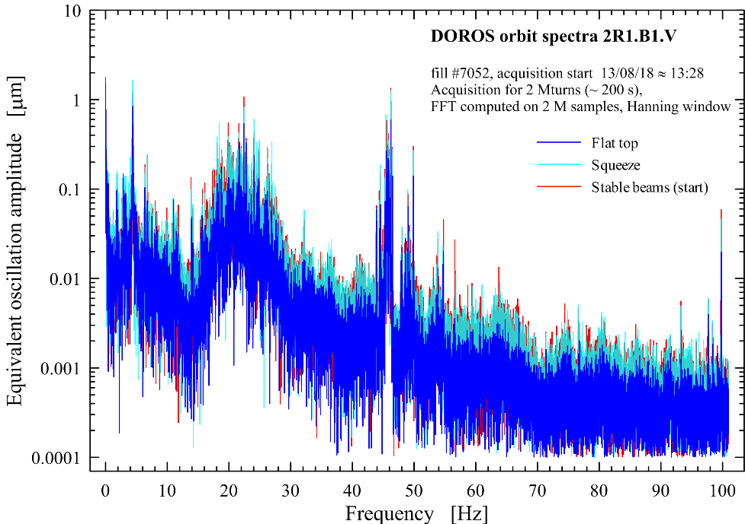
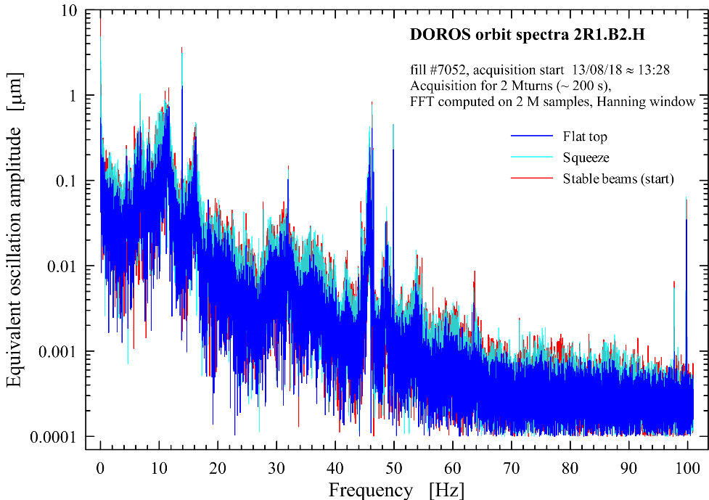
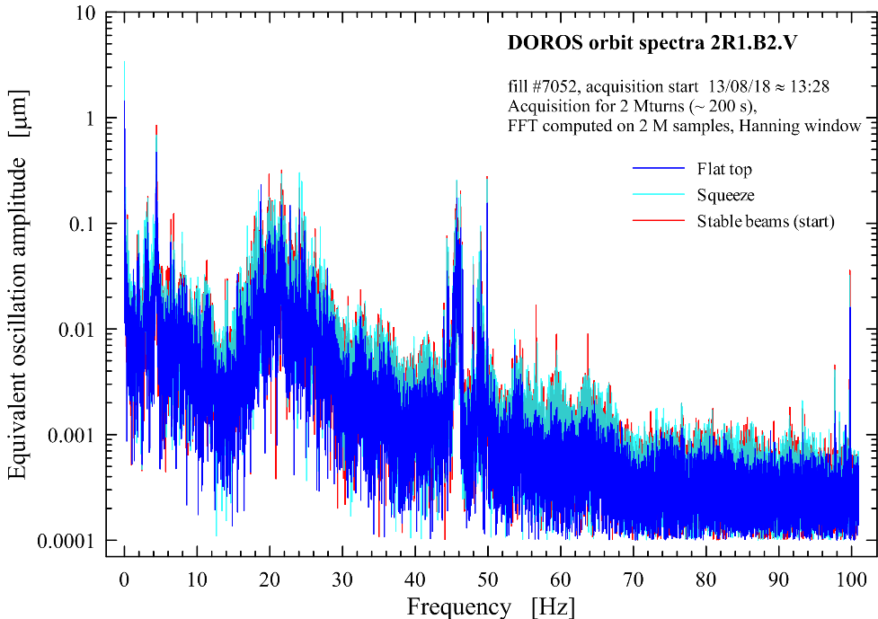
2 Mturn orbit spectra @ 2R1, from FT to SB fill 7052
fill #7052, 13/08/18
2 Mturn spectra, Hanning window
fill #7052, 13/08/18
2 Mturn spectra, Hanning window
fill #7052, 13/08/18
2 Mturn spectra, Hanning window
fill #7052, 13/08/18
2 Mturn spectra, Hanning window
M. Gasior, J.Olexa, CERN-BE-BI

Slide 36
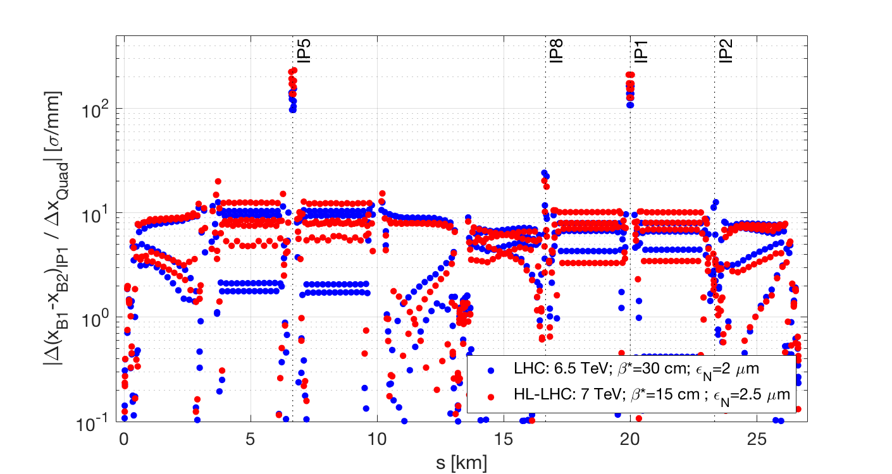
Looking at the whole machine: impact on IP1
Horizontal B1-B2 separation at IP1
Non-local effect
HL-LHC slightly more sensitive than actual LHC

Slide 37


Impact of quad misalignment on closed orbit
Expected B1 closed orbit variation at IP5:
Computed for LHC @
ε_{N}=3.75 µm; β*=45 cm
Higher β in the ATS arcs
Q3
Q2b
Q2a
Q1
Design HL-LHC up to x2 more sensitivity to errors than design LHC to be expected
From 119th WP2 meeting (link)
Notes:
\frac{\Delta x_{IP}}{\sqrt{\beta^* \epsilon_g} \Delta x_q} = \frac{\sqrt{\beta_q} (K1L)_q}{\epsilon_g}
\frac{\cos(2 \pi \phi_{q*} - \pi Q_x)}
{2\sin(\pi Q)}

Slide 38

Note: correlated IR motion
Computed for LHC @
ε_{N}=3.75 µm; β*=40cm
Impact of a wave propagating along the local IR1 or remote IR5 on IP1 orbit separation: amplification factor as a function of λ
HL-LHC Uncorr.
LHC Uncorr.
Typical wave speed measured in the CERN tunnels:
  990 m/s (shear); 2200 m/s (pressure)
f below a few Hz (most likely f to be correlated) have “small” amplification factor w.r.t. fully uncorrelated case.
From 119th WP2 meeting (link)

