Slide 1


Effects of flux jumps on emittance blow-up
Jaime Maria Coello de Portugal – Martinez Vazquez

Slide 2
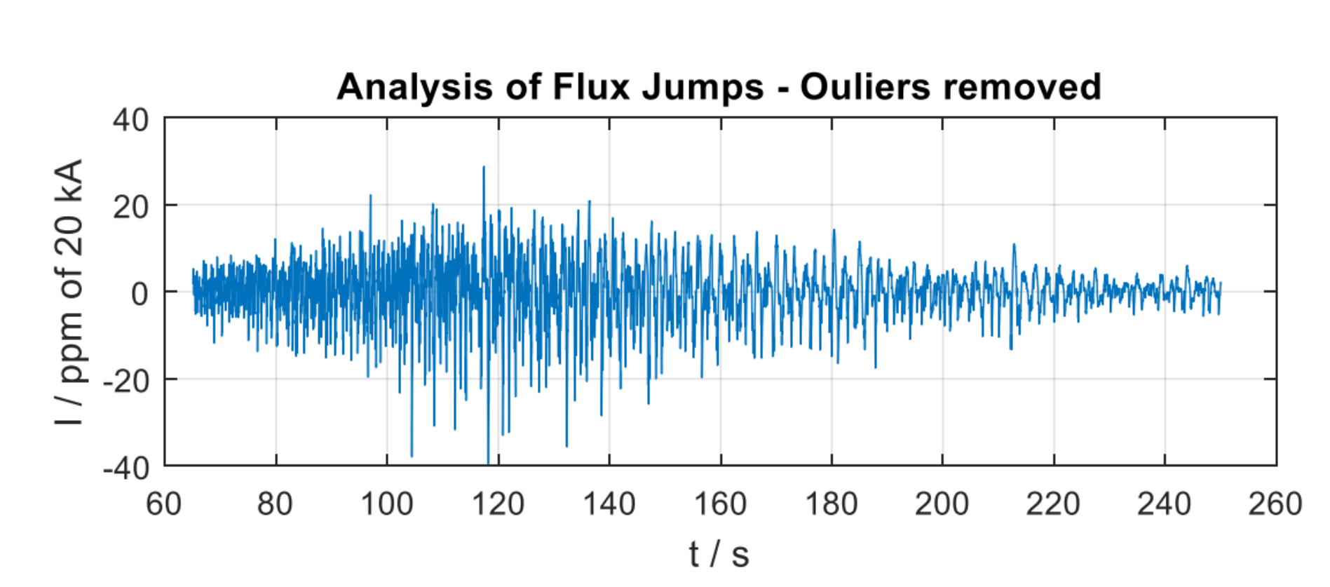
Flux jumps simulations
Unstable behaviour shown by all type II superconductors when subjected to a magnetic field.
We have only very preliminary measurements* that show:
Flux jumps happen only during the early ramp (up to around 50% energy).
  Simulate injection and middle of the ramp (3725 GeV with 1m optics).
Measurements show about 30ppm of rated intensity.
  This 30 ppm intensity will be assumed in this study.
*Very preliminary measurements and plots by Michele Martino

Slide 3
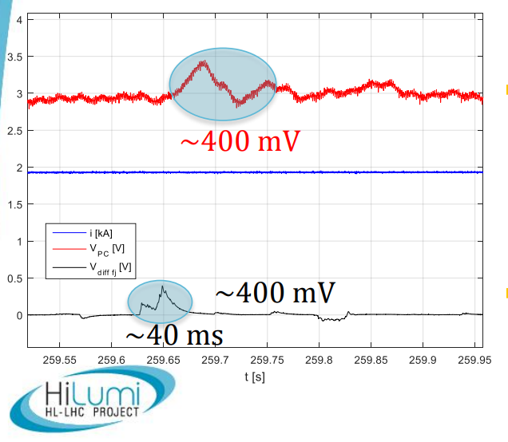
Flux jumps simulations
The very preliminary measurements* also show:
Time scale of a flux jump seems to be “few tens of ms”.
  Between 10 and 60ms will be taken in to account.
It is unclear if the effect will show up at circuit or magnet level.
  Simulate both cases: jumps in the circuit and jumps in individual magnets.
*Very preliminary measurements and plots by Michele Martino

Slide 4
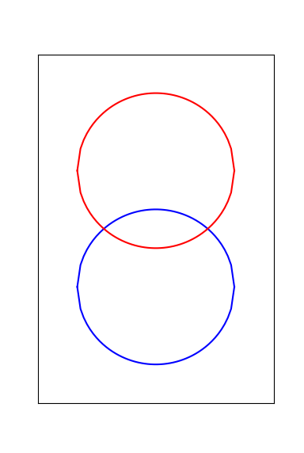

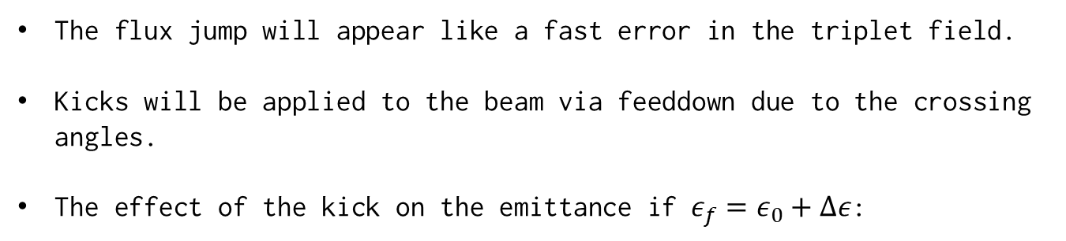
Flux jumps kick: Effect of dipolar component
The flux jump will appear like a fast error in the triplet field.
Kicks will be applied to the beam via feeddown due to the crossing angles.
The effect of the kick on the emittance if $ε_{f}=ε_{0}+Δε$:
Before kick After kick
X’
$$ε_{f}=ε_{0}+{β_{Q}\left(Δkl∙x_{co}\right)}^{2}$$
This is the effect taken into account in the study.
X

Slide 5
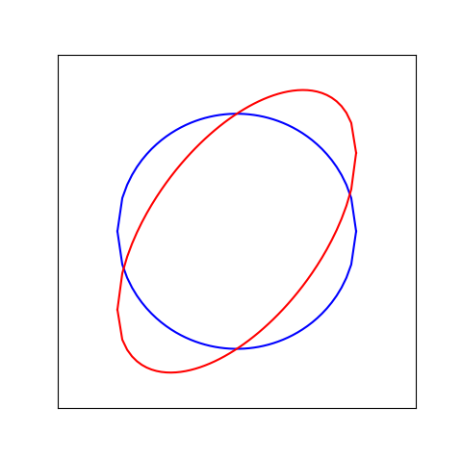
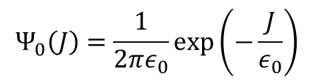
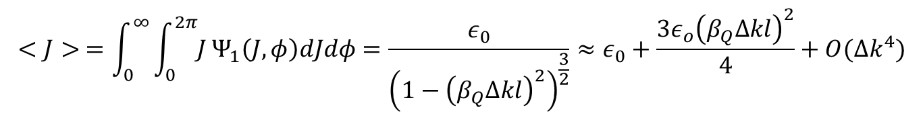
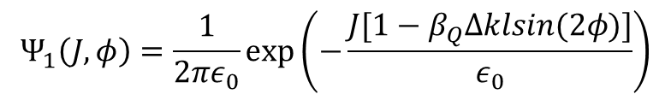


Flux jumps kick: Effect of quadrupolar component
In quadrupoles the flux jump will appear as a fast change in the strength of the quadrupole $Δkl$.
If $ε_{0}$ is the initial emittance and we start with a distribution $Ψ_{0}(J)$:
$$Ψ_{0}\left(J\right)=\frac{1}{2πε_{0}}\exp\left(−\frac{J}{ε_{0}}\right)$$
$J→\frac{1}{2β}\left[x^{2}+{\left(p+β_{Q}Δklx\right)}^{2}\right]≈J[1−β_{Q}Δklsin(2φ)]$
Transforming J for a quadrupolar kicks:
The distribution after the kick:
Before kick After kick
$$Ψ_{1}\left(J, φ\right)=\frac{1}{2πε_{0}}exp⁡\left(−\frac{J[1−β_{Q}Δklsin(2φ)]}{ε_{0}}\right)$$
Averaging the action:
$$Δε$$
$$<J> =\int_{0}^{∞}{\int_{0}^{2π}{J}}Ψ_{1}\left(J, φ\right)dJdφ=\frac{ε_{0}}{{\left(1−{\left(β_{Q}Δkl\right)}^{2}\right)}^{\frac{3}{2}}}≈ε_{0}+\frac{{3ε}_{o}{\left(β_{Q}Δkl\right)}^{2}}{4}+O({Δk}^{4})$$
X’
Looks small compared with dipolar kick -> ignored in this study.
X

Slide 6
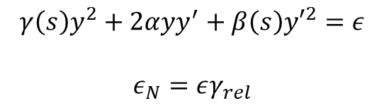
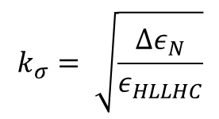
Flux jumps simulations
Assumed a jump of $30⋅{10}^{−6}$ in the field of the IR magnets relative to nominal.
Used MAD-X to compute a Twiss of the IR with the flux jumps applied computed emittance as:
$$γ\left(s\right)y^{2}+2αyy^{′}+β\left(s\right){y′}^{2}=ε$$
$$ε_{N}=εγ_{rel}$$
Then used the nominal emittance of HL-LHC $ε_{HLLHC}=2.5μm$ to compute the kick in $σ$:
$$k_{σ}= \sqrt{\frac{Δε_{N}}{ε_{HLLHC}}}$$
Simulations made magnet-by-magnet and circuit-by-circuit.
Studied only IP1 (identical to IP5 with horizontal crossing)

Slide 7
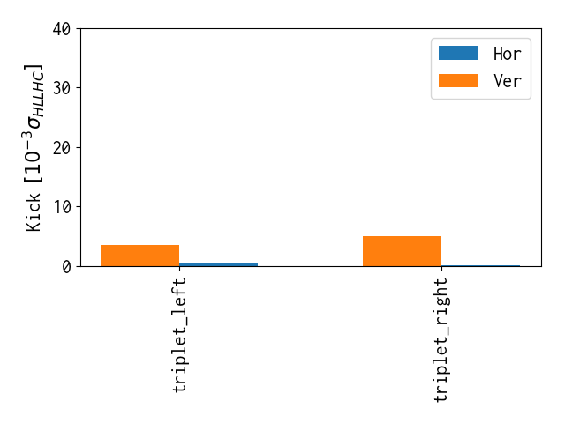
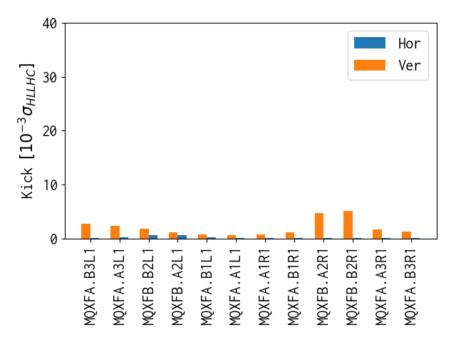
Flux jumps kick at 450GeV and injection optics
Circuits
Individual magnets
For 0.45TeV and injection optics.
30 ppm intensity.

Slide 8
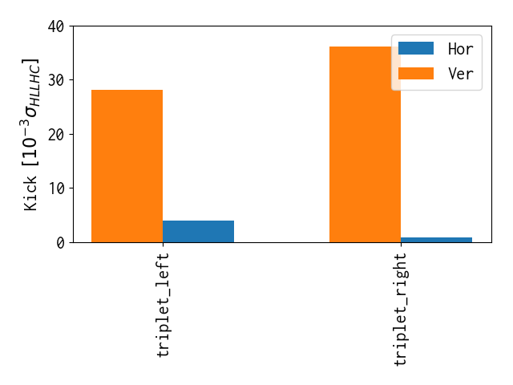
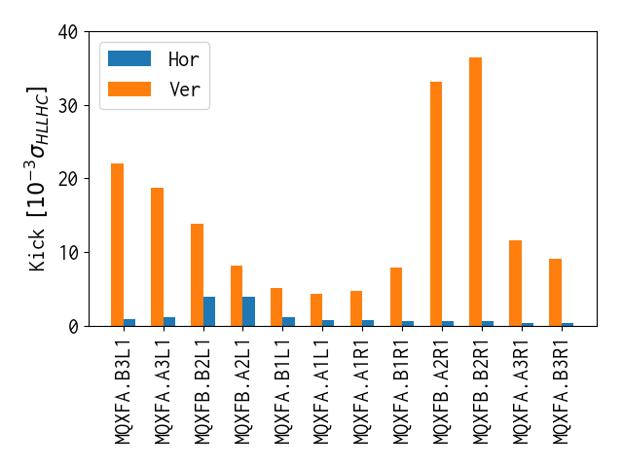
Flux jumps kick at 3.2TeV and 1m optics
Circuits
Individual magnets
For 3.2TeV and 1m optics.
30 ppm intensity.

Slide 9
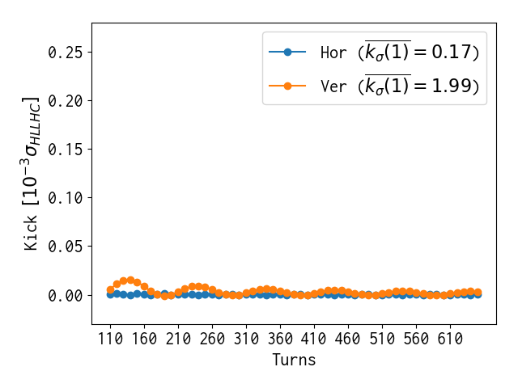
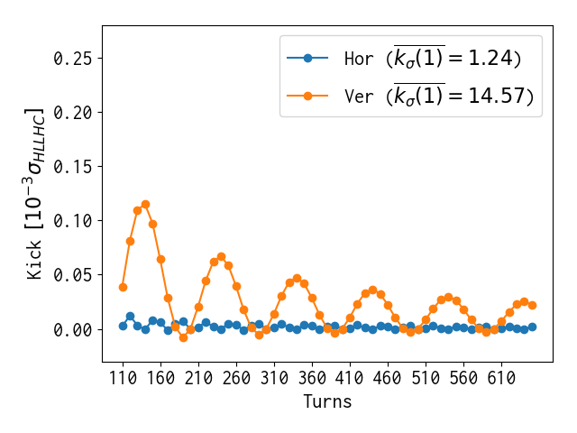
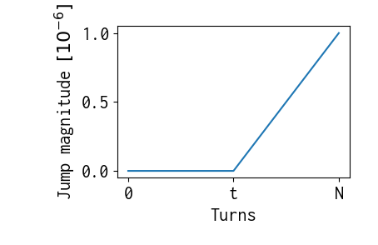
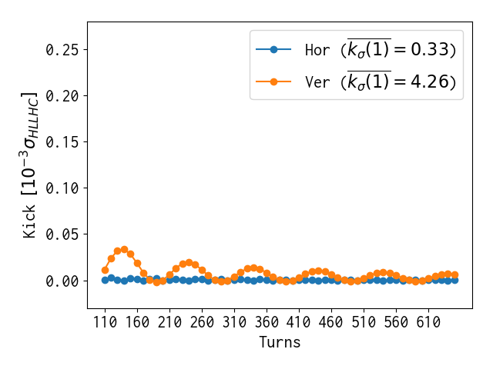
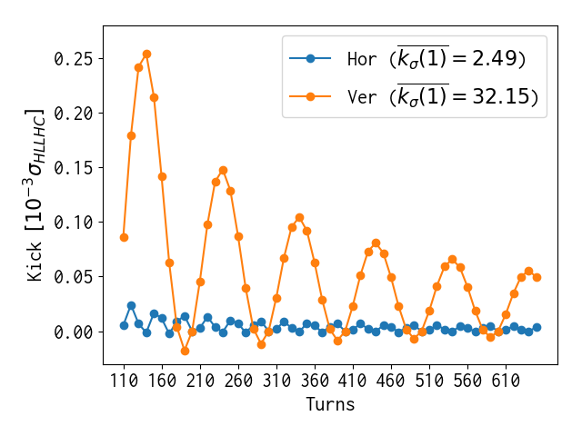

Flux jumps simulations
Assuming all quadrupoles are equally likely to have a flux jump.
If the ${30⋅10}^{−6}$ kick develops over N turns assuming a linear increase starting at t:
Plotting only 1 every 10 turns.
The kick develops during “few tens of ms”, here from 10 to 60:
Injection
3.7 TeV with 1m
Quadrupoles
Jump Magnitude
Circuits

Slide 10
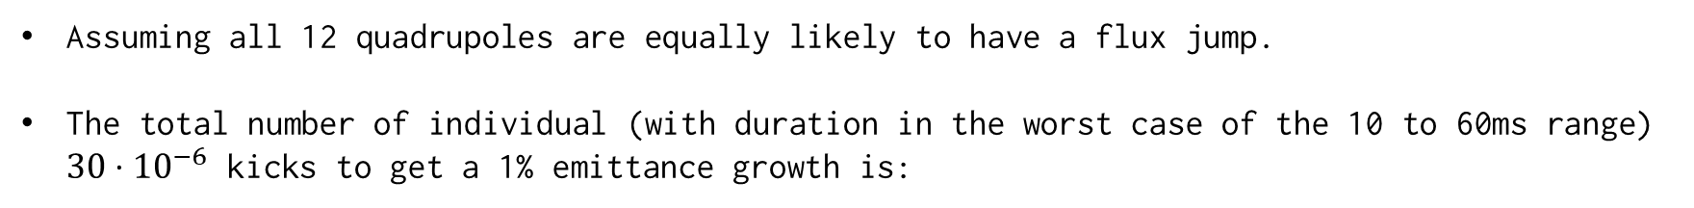
Flux jumps simulations
Assuming all 12 quadrupoles are equally likely to have a flux jump.
The total number of individual (with duration in the worst case of the 10 to 60ms range) $30⋅{10}^{−6}$ kicks to get a 1% emittance growth is:
 | Horizontal | Vertical
Magnets Inj. | 60992 | 6384
Circuits Inj. | 31542 | 2976
Magnets 3.7 TeV | 8336 | 871
Circuits 3.7 TeV | 4142 | 395

Slide 11
Flux jumps simulations
These presentation is based on very preliminary measurements (this same morning more accurate measurements are being performed)
Assuming jumps of 30 ppm that affect the whole triplet in the middle of the ramp of around ~110 turns length (10ms) -> 395 individual flux jumps will cause a 1% emittance growth.
At injection flux jumps cause smaller emittance growth.

