Slide 1


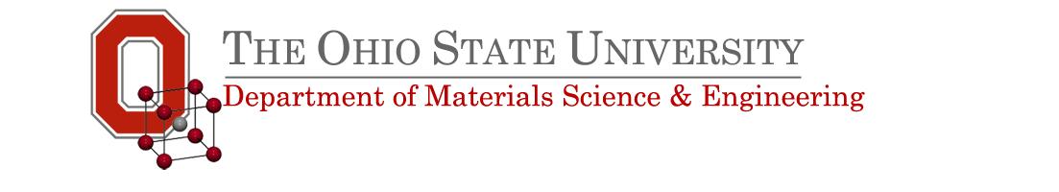

Microstructure and enhanced engineering critical current density of AIMI MgB₂ strands processed with low temperature and long time
M3Or3B-03
F. Wan
M. D. Sumption
D. L. Zhang
and E. W. Collings
M.A. Rindfleisch

Slide 2
Outline
1. Purpose
2. Experimental results
1) Monofilamentary AIMI Strand
- Microstructural analysis
- Transport Critical Current Density
2) Multifilamentary AIMI Strand
- I_{C}, J_{C} and Filament number
- Microstructural analysis
- Transport J_{C} and H. T. Condition
- Transport J_{C} and Dy₂O₃ Doping
3. Concluding summary

Slide 3
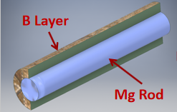
Purpose
Mg-Reactive-Liquid-Infiltration (Mg-RLI)/Internal-Magnesium-Diffusion (IMD) [1] processed MgB₂ wire obtained high transport J_{C}s
Notes:
[1] World scientific series in applications of superconductivity and related phenomena-MgB2 superconducting wires, pp. 315-340 (2016)

Slide 4
Purpose
Our group/HTR developed Mg-RLI-processed strand by optimizing strand architecture and selecting better raw materials.
Advanced-internal-magnesium-infiltration
(AIMI) strand.
H. T. Condition: 675 ºC/1 ~ 4 h
Testing the transport J_{C} of AIMI strands heat-treated with 625ºC and 8 ~ 64 hours

Slide 5
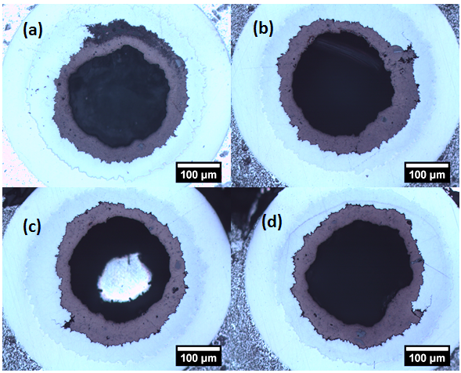
Monofilamentary Strand: Mg Infiltration
OD: 0.55 mm
2mol% C-doped B
Heating Temperature
625 ºC
B-rich Phase
Nb
Monel
8 h
16 h
Partial Infiltration
MgB₂
Full Infiltration
32 h
64 h
Full Infiltration
Full Infiltration

Slide 6
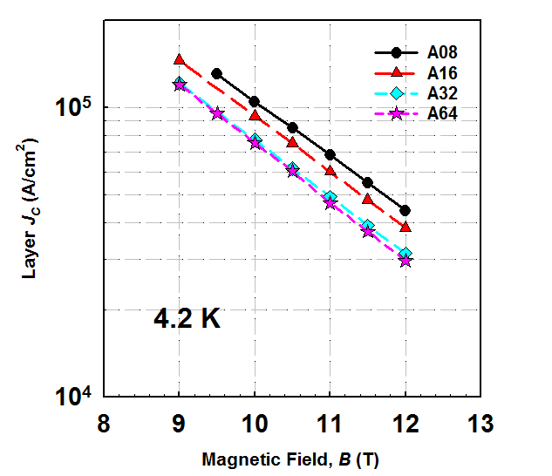
Transport Layer J_{C} versus Heating time
16 h
8 h
32 h ~ 64h
Layer J_{C} = I_{C}/Area_{MgB2 Layer}

Slide 7
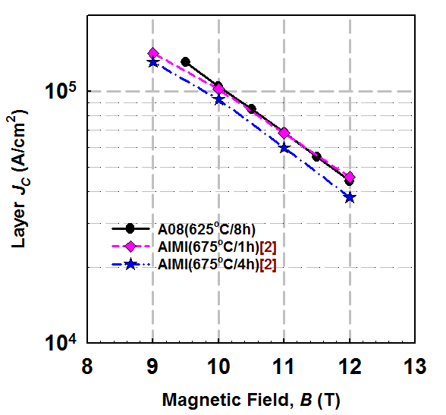
Layer J_{C} versus Heating Temperature
625 ºC
8 h
675 ºC
1 ~ 4 h
Notes:
[2] Li GZ et al Superconductor Science and Technology, volume 25, 11 2012

Slide 8
Multifilamentary AIMI
MgB₂ Strands
Multi stands have better electrical and thermal stability than mono strands
OD: 0.83 ~ 1.01 mm
Chemical Barrier/Outer Sheath: Nb/Monel or SS

Slide 9
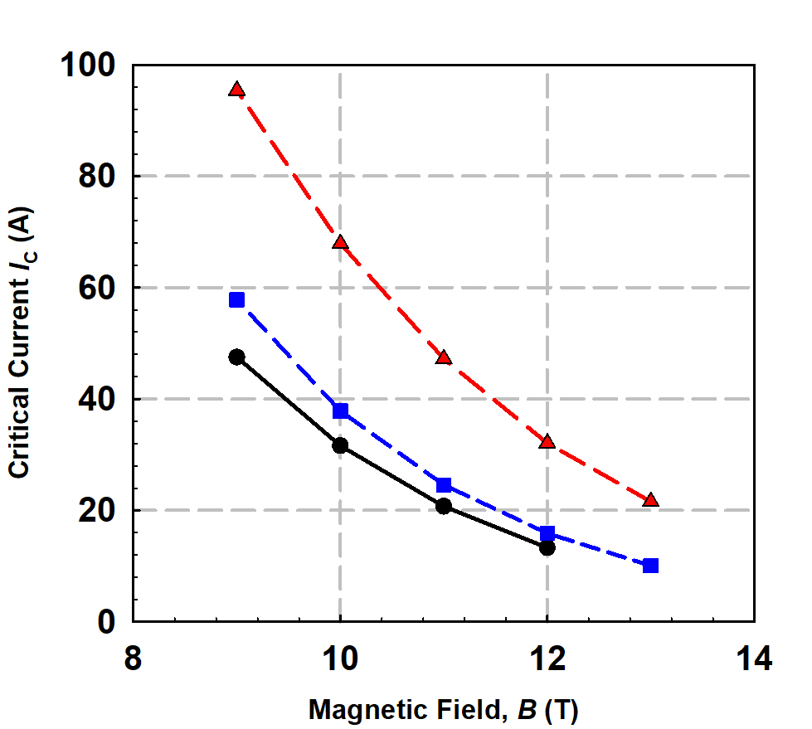
I_{C} versus Filament Number
I_{C}s of multi strands are higher than those of mono strands due to larger MgB₂ area
6
4.2 K
18
625ºC
8h
Mono

Slide 10
Engineering J_{C}
J_{E} = I_{C}/Area_{whole strand}= Layer J_{C} * Fill Factor
Fill Factor = MgB₂ Layer Area/ Whole strand Area

Slide 11
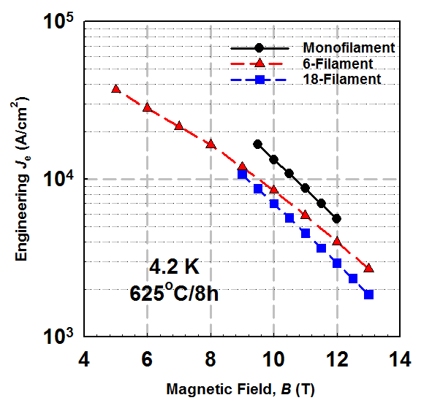
Transport Je versus Filament Number
Filament Number | Fill Factor %
1 | 12.8
6 | 9.5
18 | 11.5
Mono
6
18

Slide 12
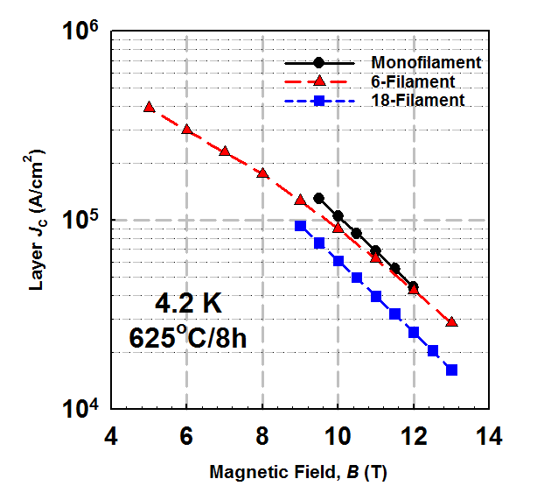
Layer J_{C} versus Filament Number
Filament Number | 10 T Layer J_{C} ( 10⁴A/cm²)
1 | 10.4
6 | 8.99
18 | 6.09

Slide 13
Microstructural Analysis – 18-filamentary Strand
B-rich phases were distributed in MgB₂ matrix
Area | Mg : B | Phase
Area 1 | 1 : 2.42 | MgB₂ + B-rich
Area 2 | 1 : 4.54 | B-rich
Area 3 | 1 : 2.05 | MgB₂
Area 4 | 1 : 3.28 | B-rich
625ºC/08h

Slide 14
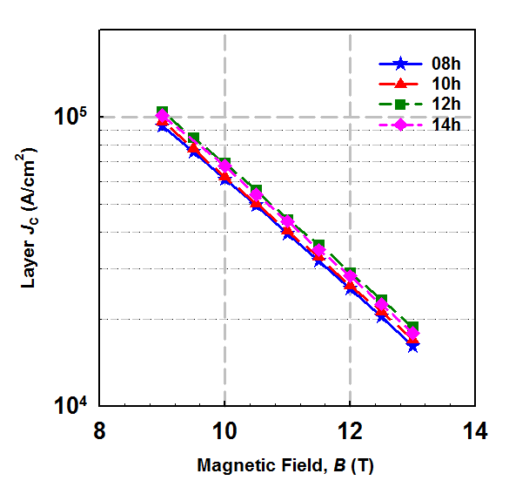
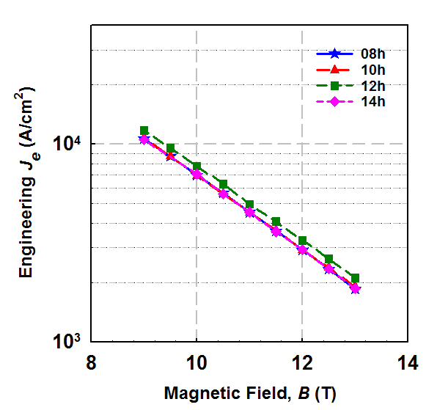
Transport J_{C} versus Heating Time
18 Filaments
625 ºC
Heating time:8 ~ 14 hours

Slide 15
Dy₂O₃/C Co-doping for
18-filamentary AIMI Strands

Slide 16
Dy₂O₃ Doping
Dy₂O₃ doping level: 2wt% based on B
625 ºC/8 h
625 ºC/14 h

Slide 17
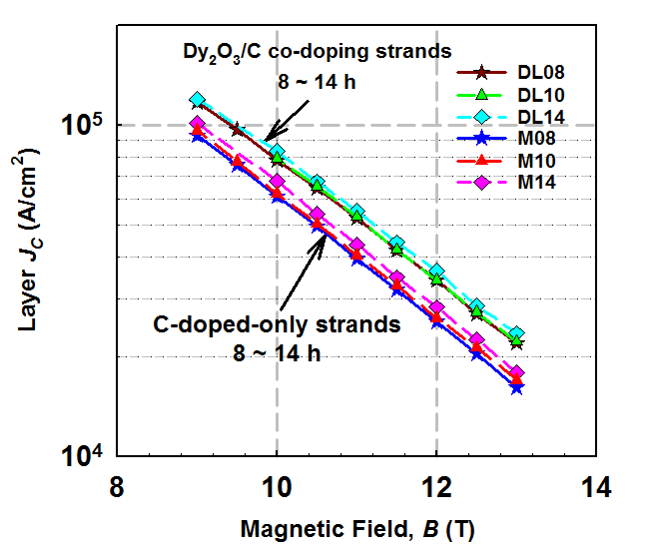
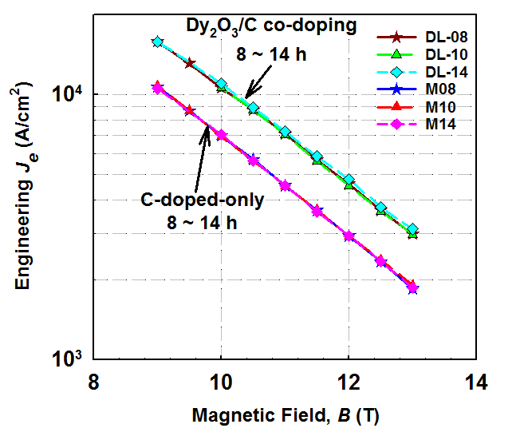
Dy₂O₃ Doping
MgB₂ short straight wires (5 cm)
Heating Temperature: 625 ºC
Diameter: 0.83 ~ 0.84 mm
At 4.2 K, 10 T
I_{C} = 60 A
J_{e} = 1.06 × 10⁴ A/cm²

Slide 18
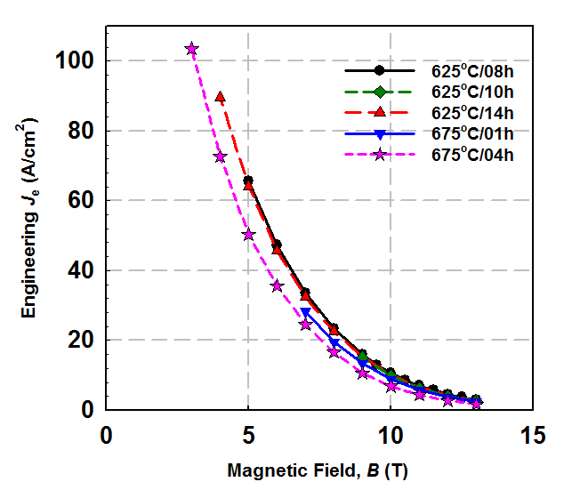
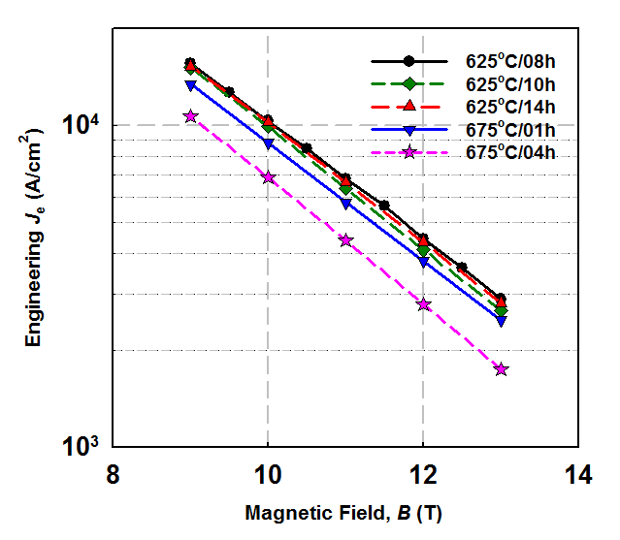
Dy₂O₃ Doping
5 T
I_{C} = 350 A
J_{e} > 60 kA/cm²
MgB₂ Spiral (1 m)
Diameter: 0.83 ~ 0.84 mm
J_{e} (kA/cm²)
625ºC
8 ~ 14h
675ºC
1 ~ 4h

Slide 19
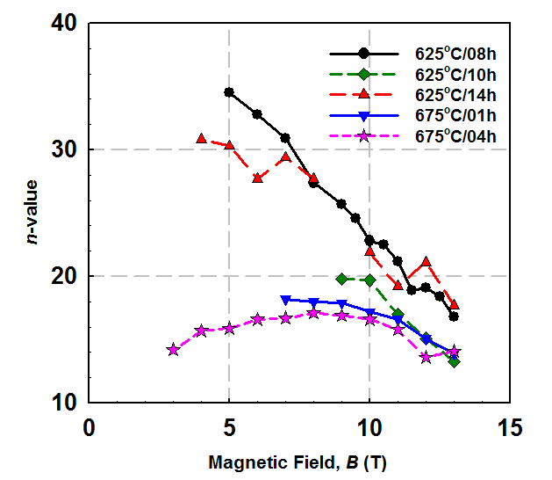
Dy₂O₃ Doping
Uniform MgB₂ layer in
low temperature strand
625ºC
8 ~ 14h
625ºC
8h
675ºC
1 ~ 4h

Slide 20
Dy₂O₃ Doping
675 ºC/4 h
Continuous B-rich layer

Slide 21
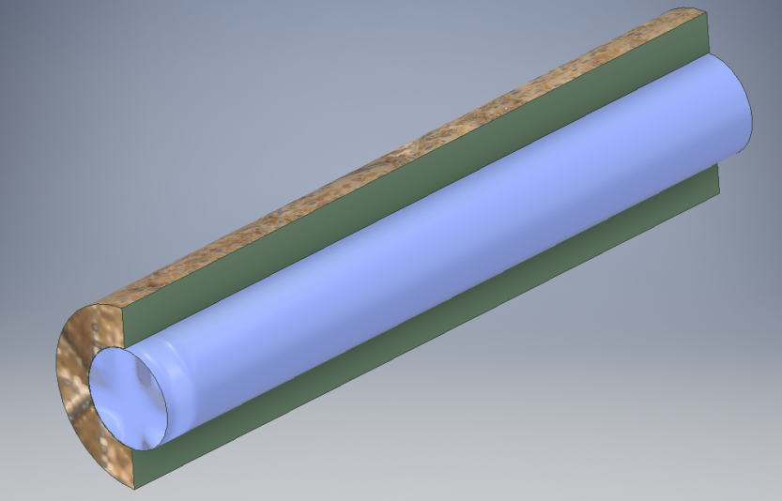
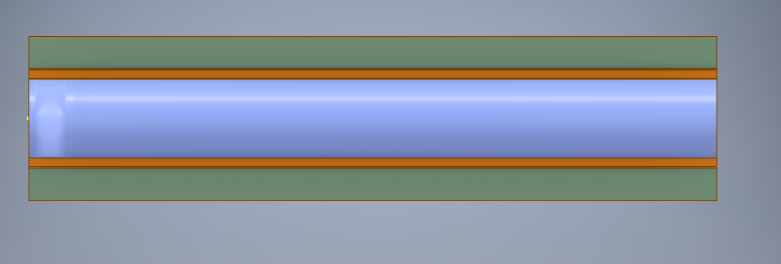
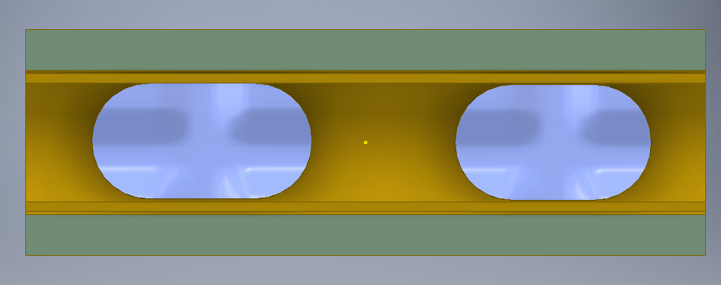
Mg Infiltration into B layer
B Layer
Mg Rod
MgB₂ Layer
The molten Mg rod shrinked to several liquid Mg droplets to obtain a minimum surface area possible.
Liquid Mg droplets

Slide 22
Mg Infiltration into B Layer
Molten Mg “left” its original place

Slide 23
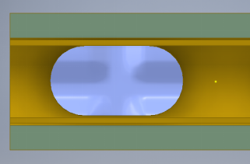

Mg infiltration into B layer
B-rich Layer
MgB₂ Layer

Slide 24
Concluding summary
Monofilamentary AIMI MgB₂ strands processed with low temperature and long time can obtain same transport properties as the strand processsed with high temperature.
Multifialmentary AIMI MgB₂ strands have suppressed transport J_{C}s due to precence of B rich phases distributed in MgB₂ matrix.
Dy₂O₃ doping can significantly enhance the transport properties of multifilamentary MgB₂ strands.
Low heating temperature induces the formation of relative uniform MgB₂ layer in AIMI strands.

Slide 25
Acknowledgements
This work was funded by the NIH grant

