Slide 1
Cryogenic system configurations to cool superconducting radio frequency cavities at 2 K
07/22/2019
Dhananjay Ravikumar

Slide 2
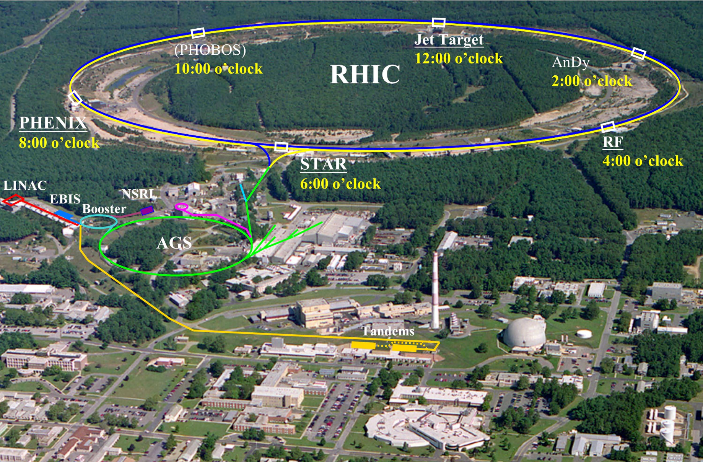
The Relativistic Heavy Ion Collider (RHIC)

Slide 3
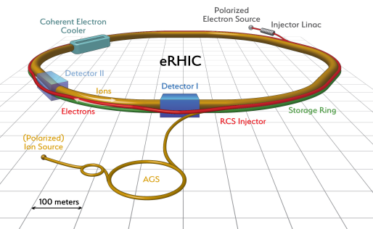
Upgrading the RHIC: eRHIC

Slide 4
Designing a Quiet Helium Source:
Problem description
Microphonics – What is it?
Sources
Cryogenic contribution
At 2 K
Two phase flow
Pressure fluctuations
Around 4K
Fast (> 1Hz) pr change 0.01 – 0.05 mbar → detuning of ~20 Hz

Slide 5
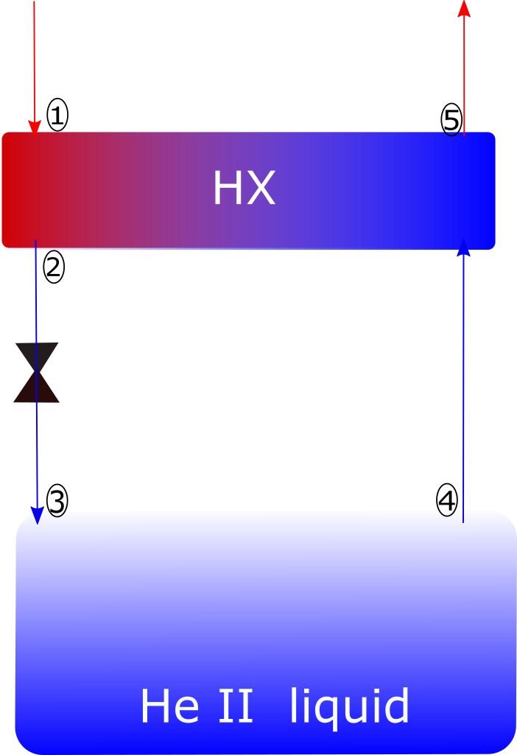
Mitigating flow induced microphonics
4.5 K, 3 bar supply
2 K, saturated vapor
SRF Cavity

Slide 6
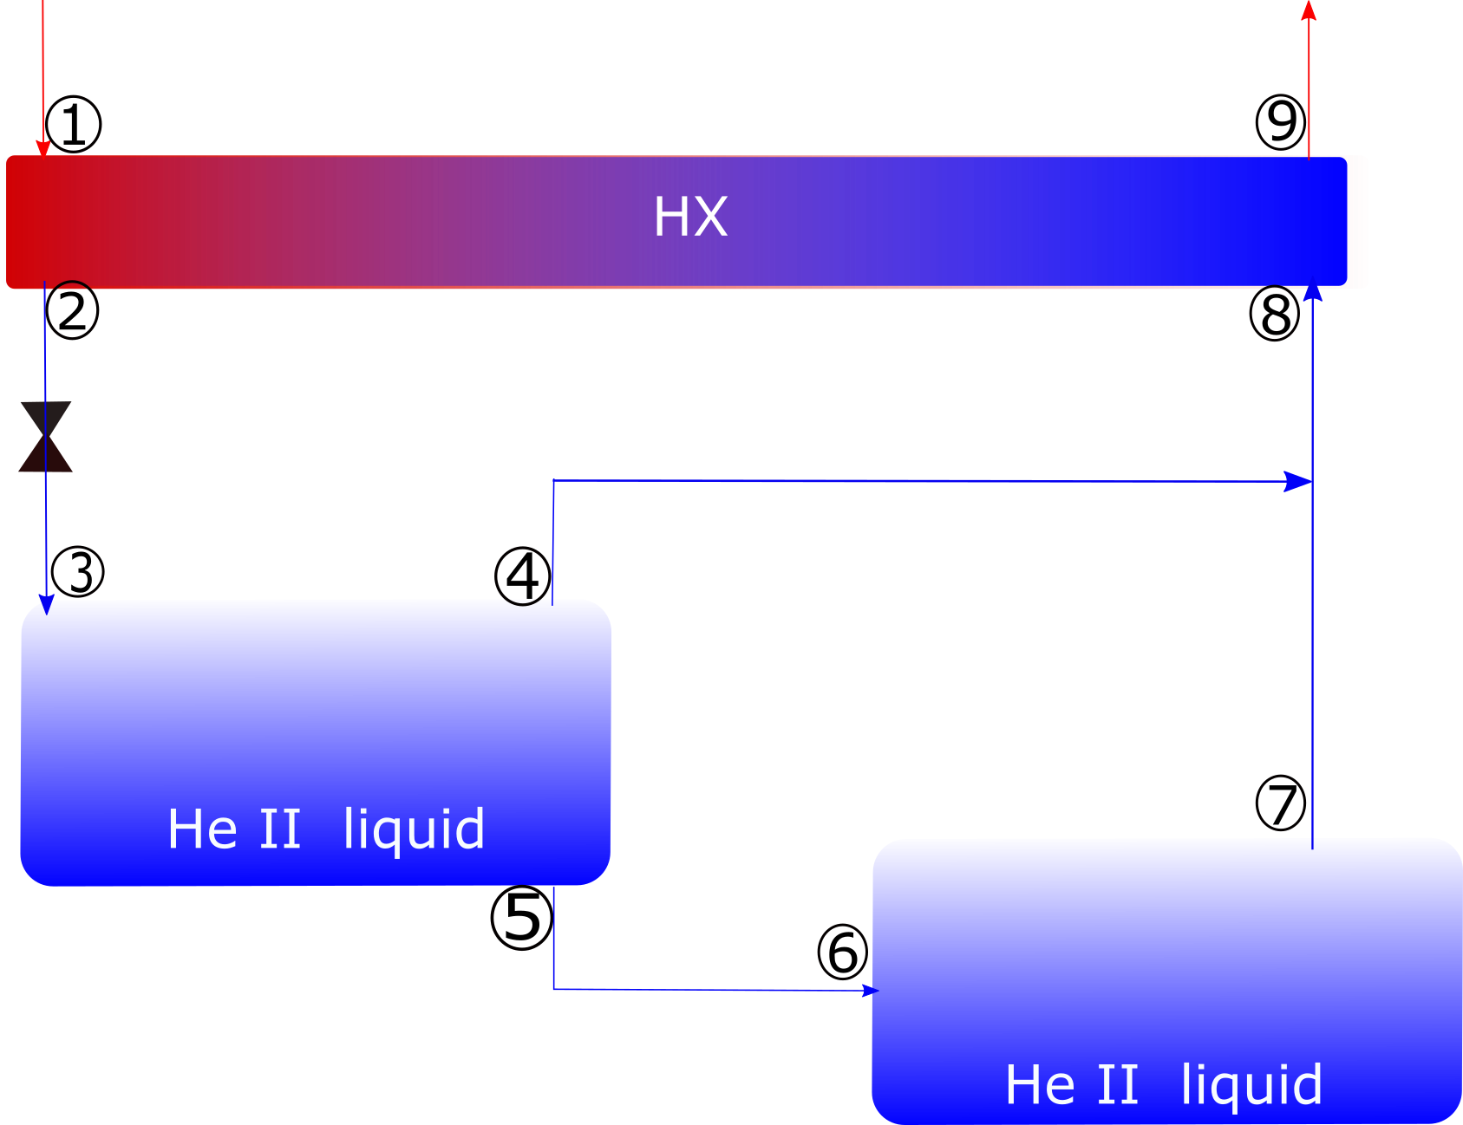
Dual bath single temperature system
4.5 K, 3 bar supply
2 K, saturated vapor
2 K, saturated vapor
SRF Cavity

Slide 7
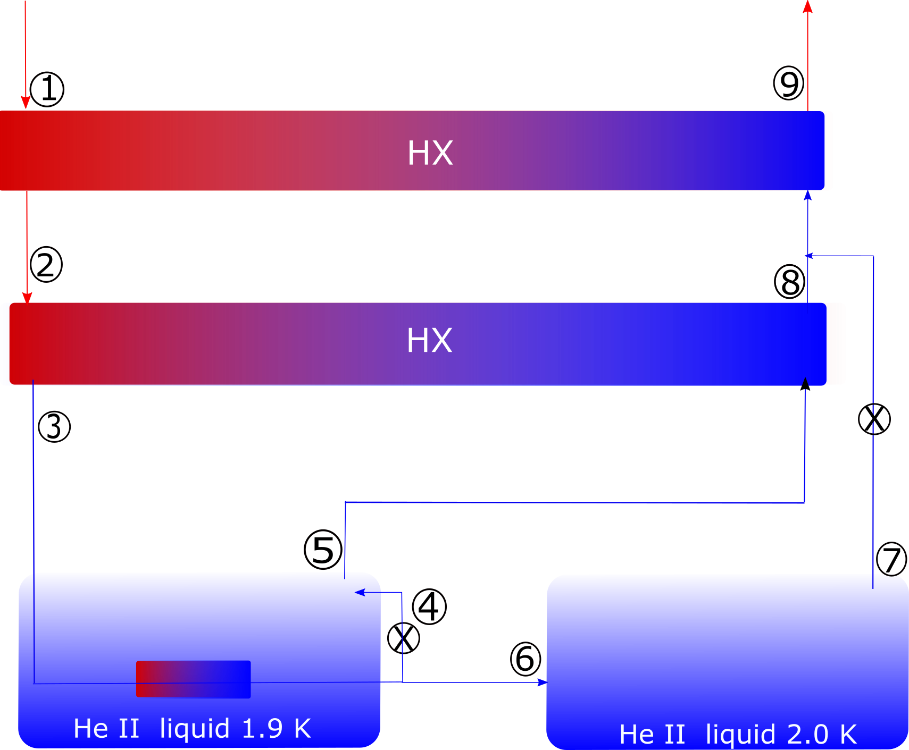
Dual bath dual temperature system
4.5 K, 3 bar supply
1.9 K, saturated vapor
2 K, saturated vapor
SRF Cavity

Slide 8
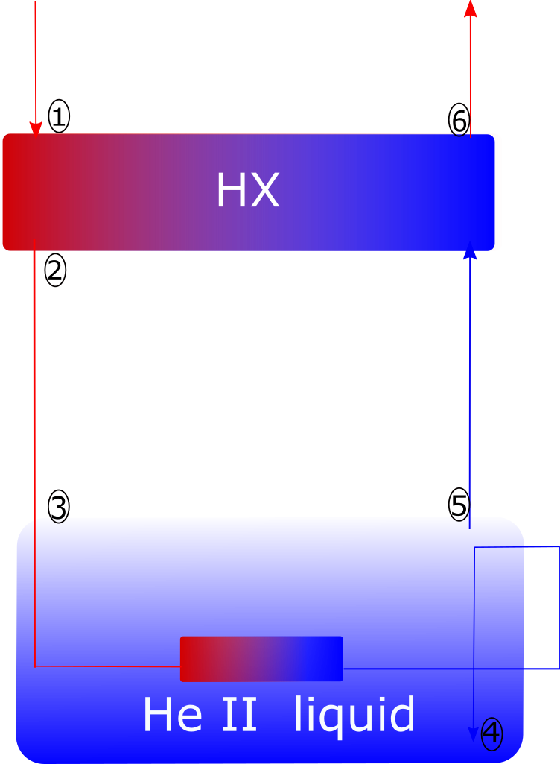
Quiet Helium Source (QHS)
Can completely suppress vapor generation if properly engineered
Liquid head needs to be calibrated depending on the inlet enthalpy
Liquid head is very sensitive to inlet enthalpy
When the supply is at 4.5 K, 3 bar, a head of 5m is required to completely suppress vapor
Workaround:
  Throttle the flow upstream of the subcooler,
  In the right range, J-T effect increases temperature.
  More heat can be transferred across the subcooler as a result.
  Other option would be to add a phase separator and supply saturated liquid at 4.5 K at point 1.
Manuscript submitted to Cryogenics

Slide 9
Future work
Performing feasibility studies on heat exchanger sizes and approach
Incorporating the QHS design in eRHIC cryomodule designs
Performing experiments to test the QHS principle.

