Slide 1



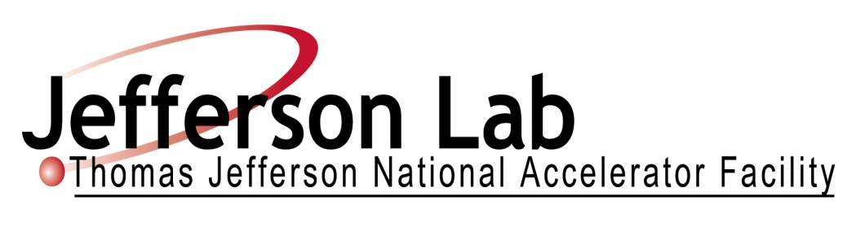
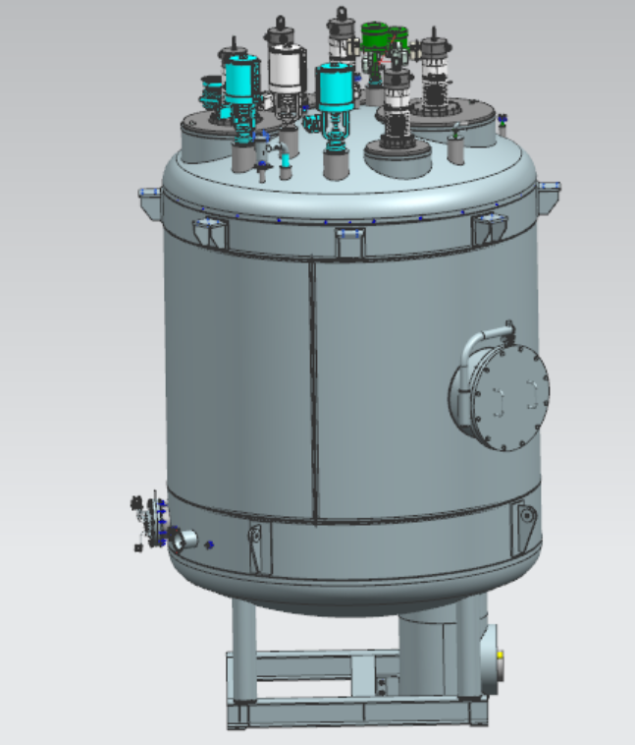
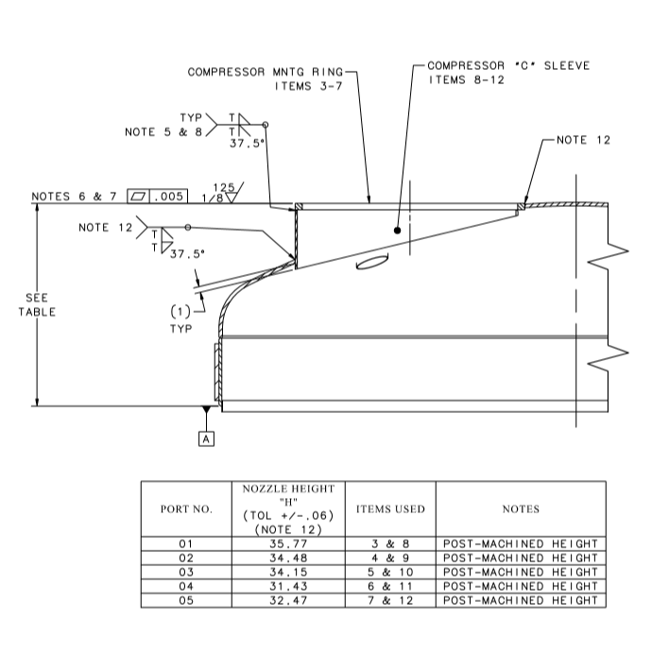
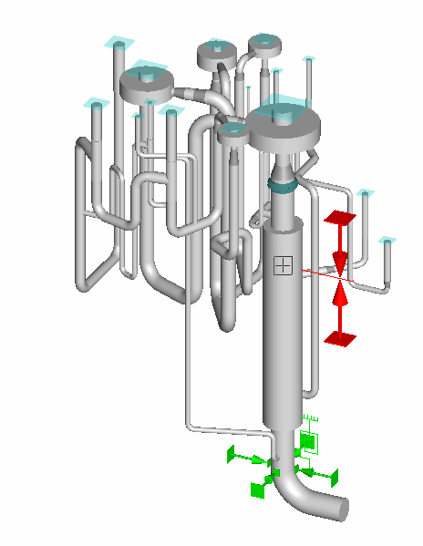
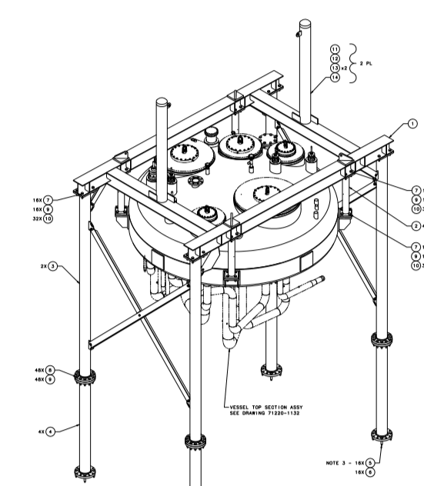
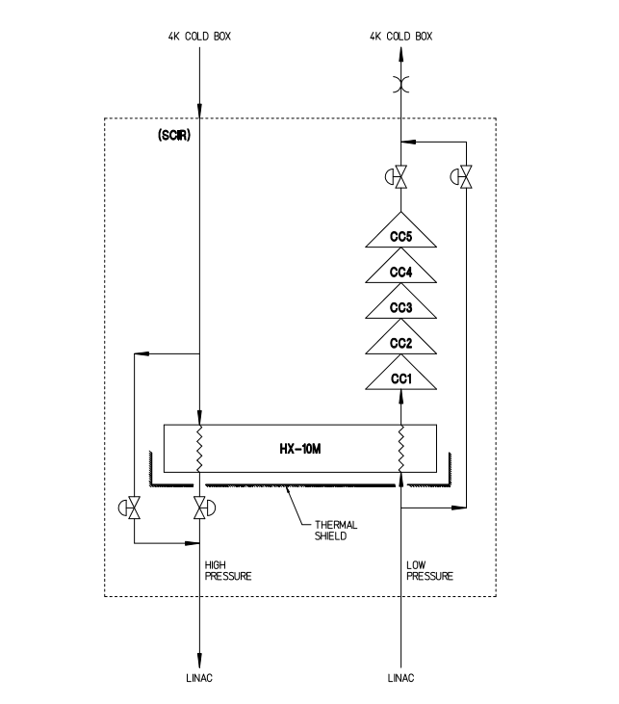
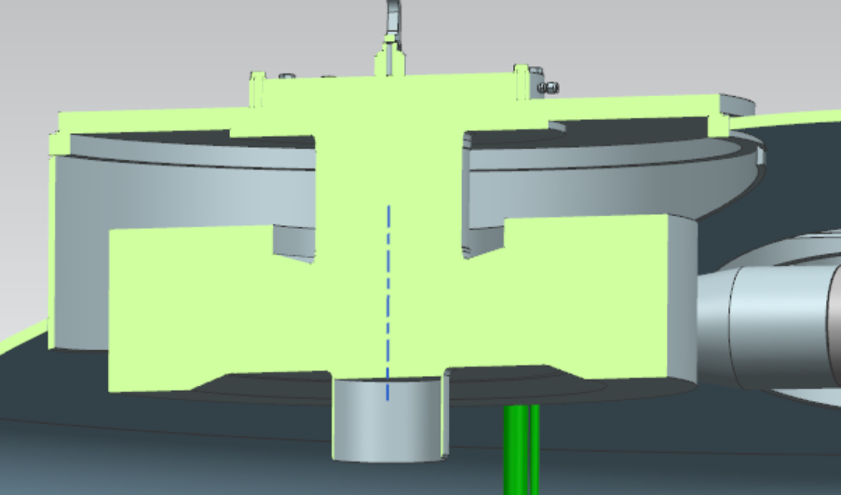
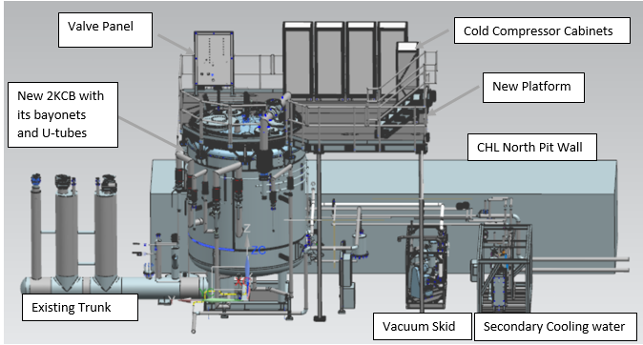
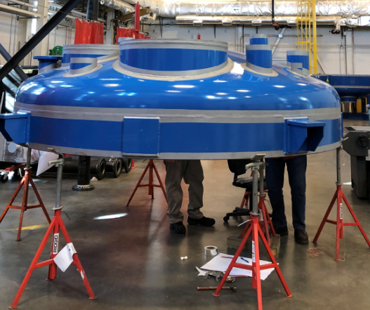
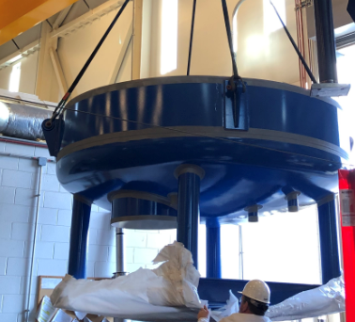
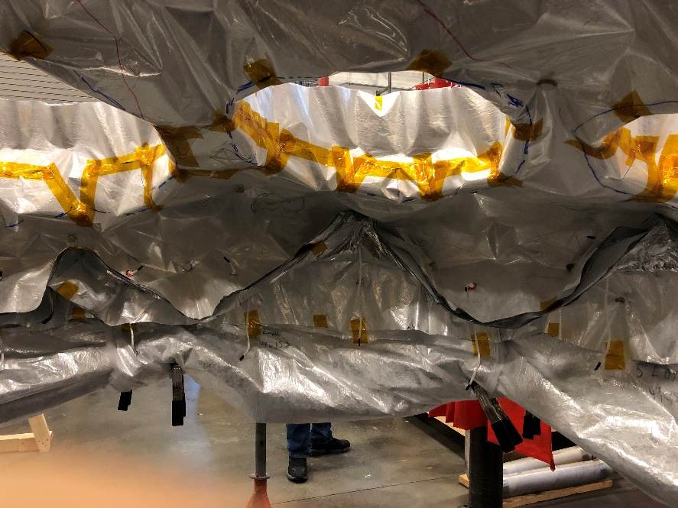
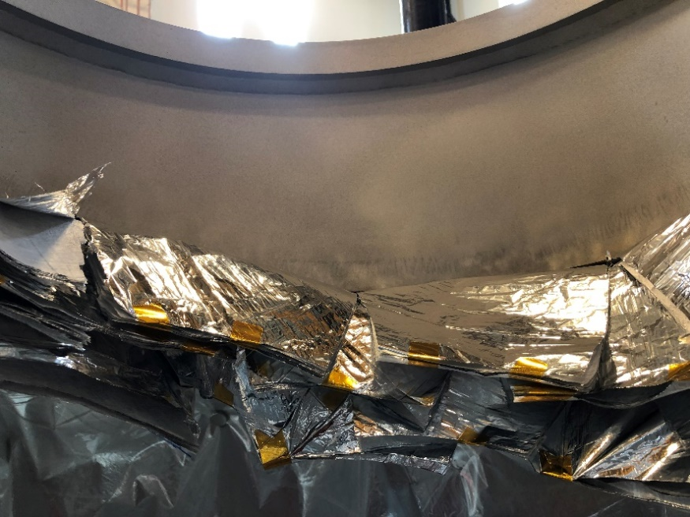
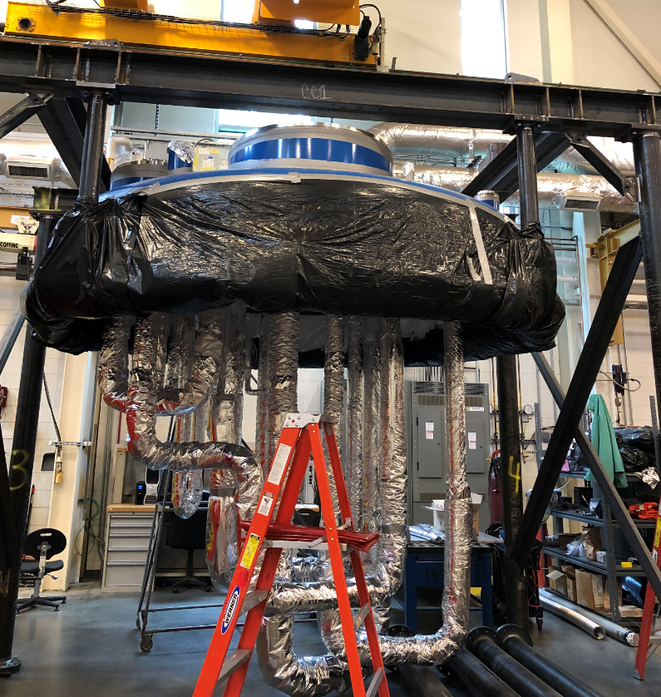
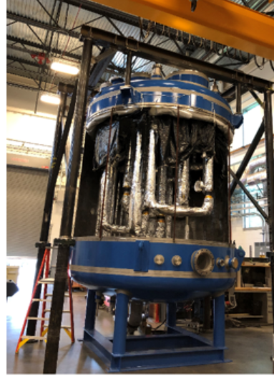
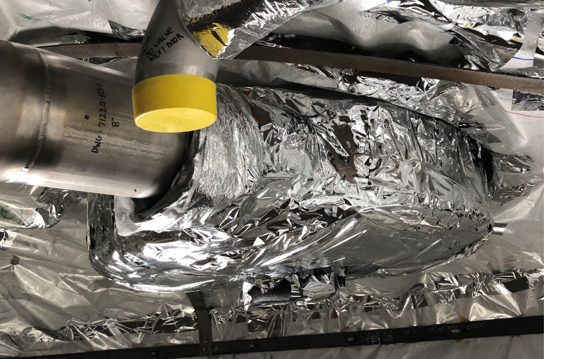
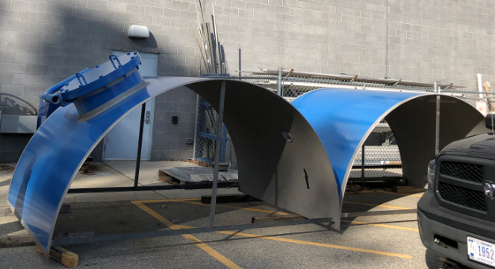
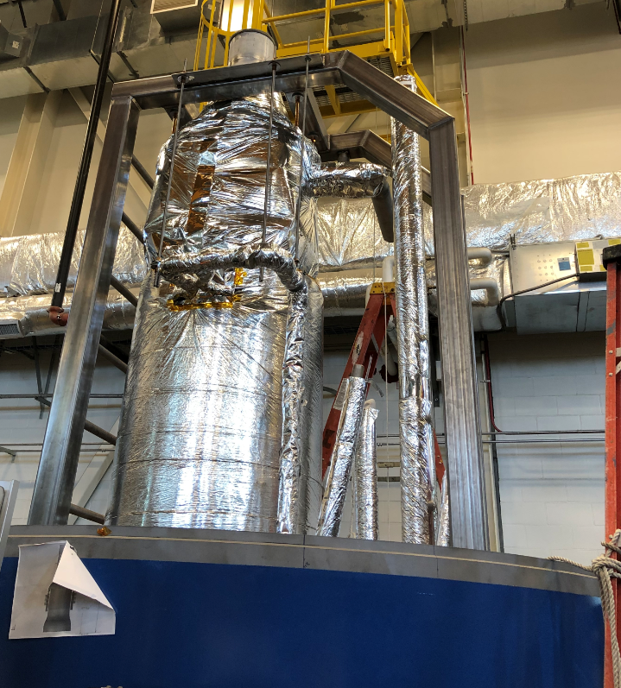
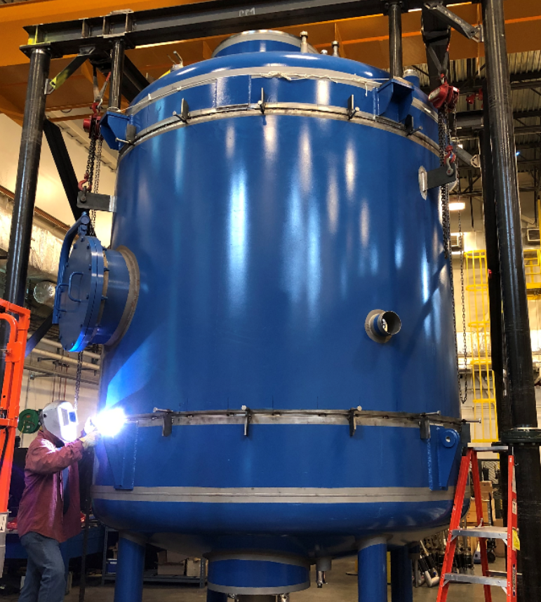
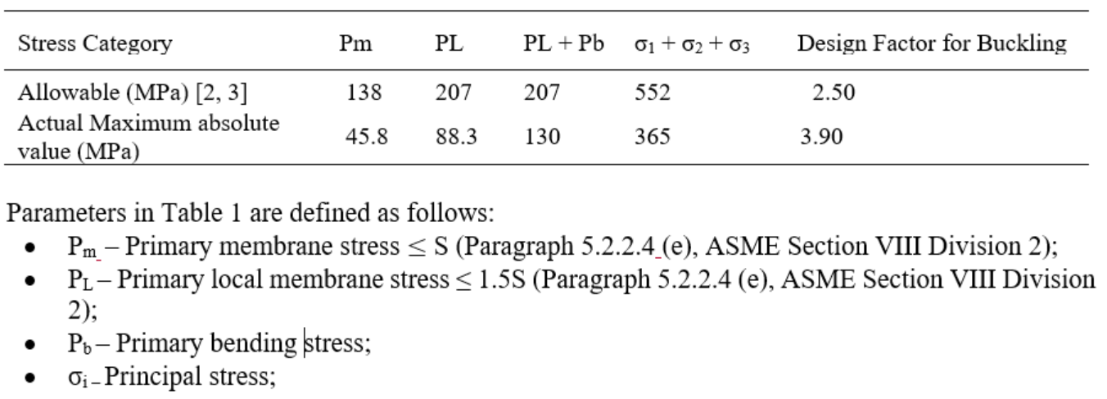
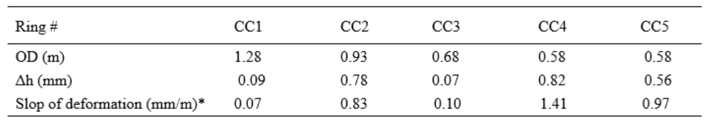
JLAB CHL 2K COLD BOX REPLACEMENT
C2Po1G-05 [41]
S Yang, K Dixon, N Laverdure, R Norton, C Butler, C MacDuffie, D Rath, R Brown, S Thompson, J Creel,
T. Renzo, R Sprouse, N Hasan
Abstract— A new sub-atmospheric cold box (SC1R), which hosts five technologically superior, water-cooled compressors and one similar 4K-2K refrigeration recovery heat exchanger, was proposed in July 2017, to replace the existing 2K cold box. The design of the new 2K cold box and the external support system has been completed, allowing the project to enter the fabrication and assembly phase, which will be completed at JLAB. The CHL warm up is scheduled in May 2020. The installation of the SC1R 2K cold box and external support system is projected to start at the end of June 2020, and the commissioning will start at the end of October 2020.
Authored by Jefferson Science Associates, LLC under U.S. DOE Contract No. DOE-AC05-060R23177.
Figure A. SC1R 2K Cold Box Flow Diagram
Fig. 1 JLAB CHL SC1R 2K cold box vessel. The 2K cold box vessel was designed to meet ASME BPVC Section 8 Div. 1. Finite element analysis (FEA) was performed according to Part 5, ASME VIII Div. 2 to check the mechanical integrity of the cold box vessel.
Fig. 2 Each cold compressor attaches to the cold box via a mounting plate and an unusual nozzle design that eliminates the need for an inverted, potentially water-accumulating well. The design allows just enough shell clearance for the compressor scroll casings.
Fig. 3 All piping was designed in accordance with ASME B31.3 – 2017 Process Piping. The minimum pipe length between the cold compressors was determined by a time constant. Bentley AutoPIPE was used to perform the flexibility analysis.
Figure 4 The lifting / assembly fixture is for erecting the top subassembly as well as integrating the top and bottom subassemblies. It was designed to meet the ASME BHT-1-2017 Below-the-Hook Lifting Devices.
Fig. B SC1R 2K Cold Box Overall Layout
Table A. Allowable and Actual Maximum Absolute Values of Stresses per ANSYS 19.2
Fig. 5 The insulation vacuum vessel was fabricated by an outside contractor and shipped to JLab as four subassemblies: top head subassembly, bottom head subassembly, and two shells with manway and other penetrations. Test fitting of each component to its mating piece was performed by the contractor who provided indelible match marks across all joints between subassemblies.
Fig. 6 MLI Insulations. The superinsulation consists of low-emissivity Mylar layers placed between low-conductivity spun-bonded polyester layers. Thirty layers of MLI are applied to the cold surfaces and twenty layers of MLI cover the internal surface of vacuum shell and surfaces of internal frame.
Fig. 7 Completed top and bottom subassemblies. The top section assembly includes MLI blankets and their supports, five MLI insulated cold compressors, valves, bayonet, and 2K helium internal pipe spools. The bottom section assembly includes the internal support frame, the heat exchanger, stainless steel thermal panel, nitrogen and 4K helium pipe spools.
Fig. 8 Integrated top and bottom subassemblies with installed half shell. It started at the end of May 2019. Since then, all helium and nitrogen pipe spools have been installed and leak tested, temperature diodes have been affixed and wired, all pressure tap tubing has been installed, and one of the half shells (with a manway section) has been tacked into place.
Table B. Displacement in Vertical Direction of Casing Mounting Ring under Normal Operation per ANSYS 19.2
Conclusion - The design of the JLAB CHL SC1R 2K cold box, cryogenic and warm piping system and lifting fixture conform to the code requirements specified in ASME VIII, ASME B31.3, and ASME BTH-1-2017. The insulation vacuum vessel was fabricated by an outside contractor and shipped to JLAB as four components. JLAB is responsible for the rest of the fabrication. It was projected to be completed by the end of December 2019. However, based on the current progress, the fabrication may be completed no later than the end of October 2019. The project is ahead of schedule and below cost at this point.
*The maximum flatness requirement from the cold compressor supplier is 5 mm/m.
Presented at Cryogenic Engineering Conference and International Cryogenic Materials Conference, 2019 July 21 – July 25, Hartford, Connecticut; Poster ID: C2Po1G-05 [41]

