Slide 1

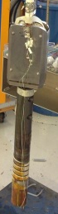
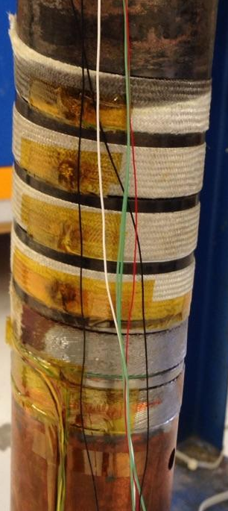
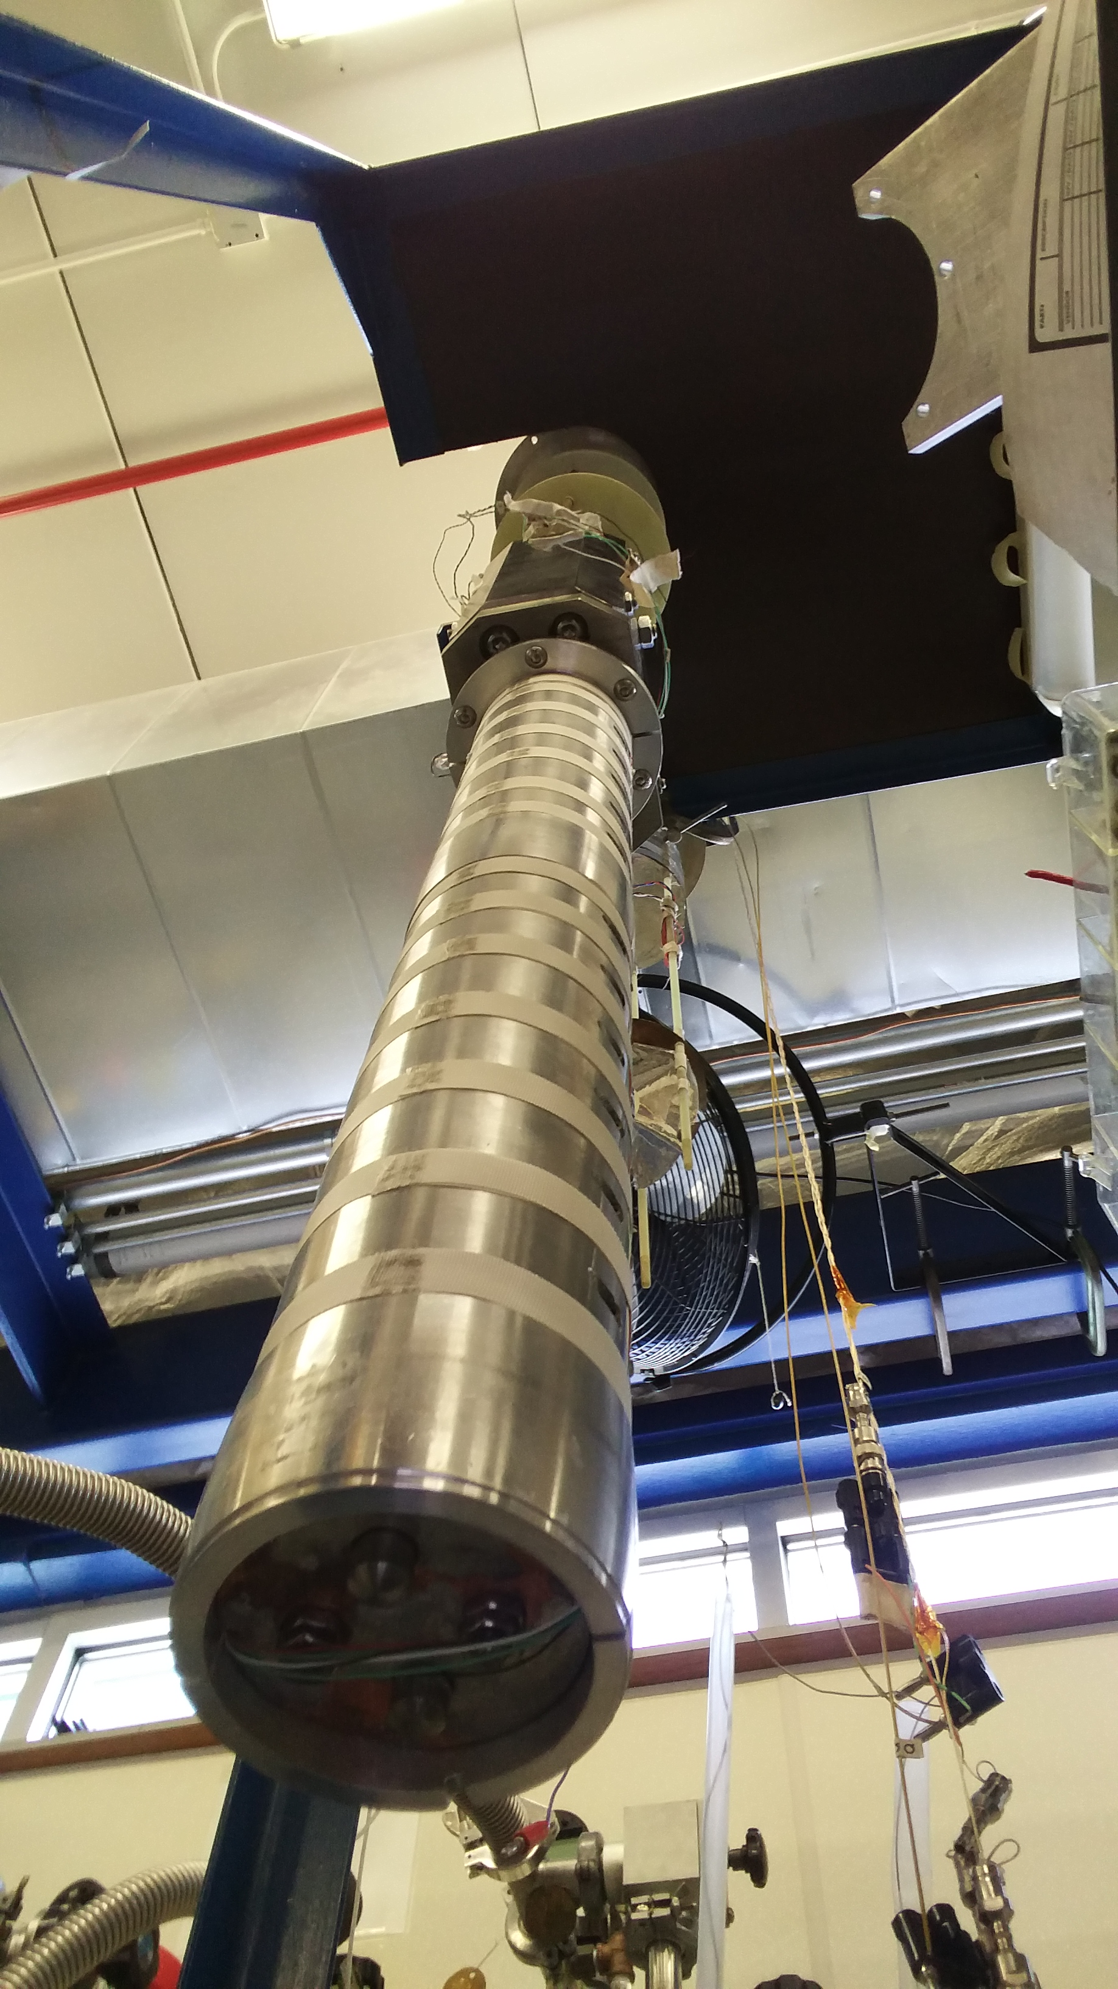
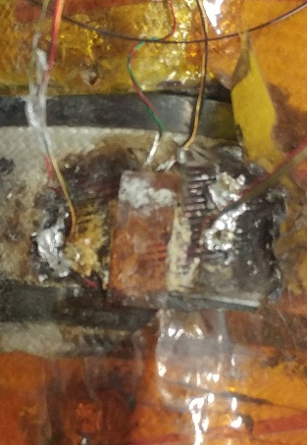
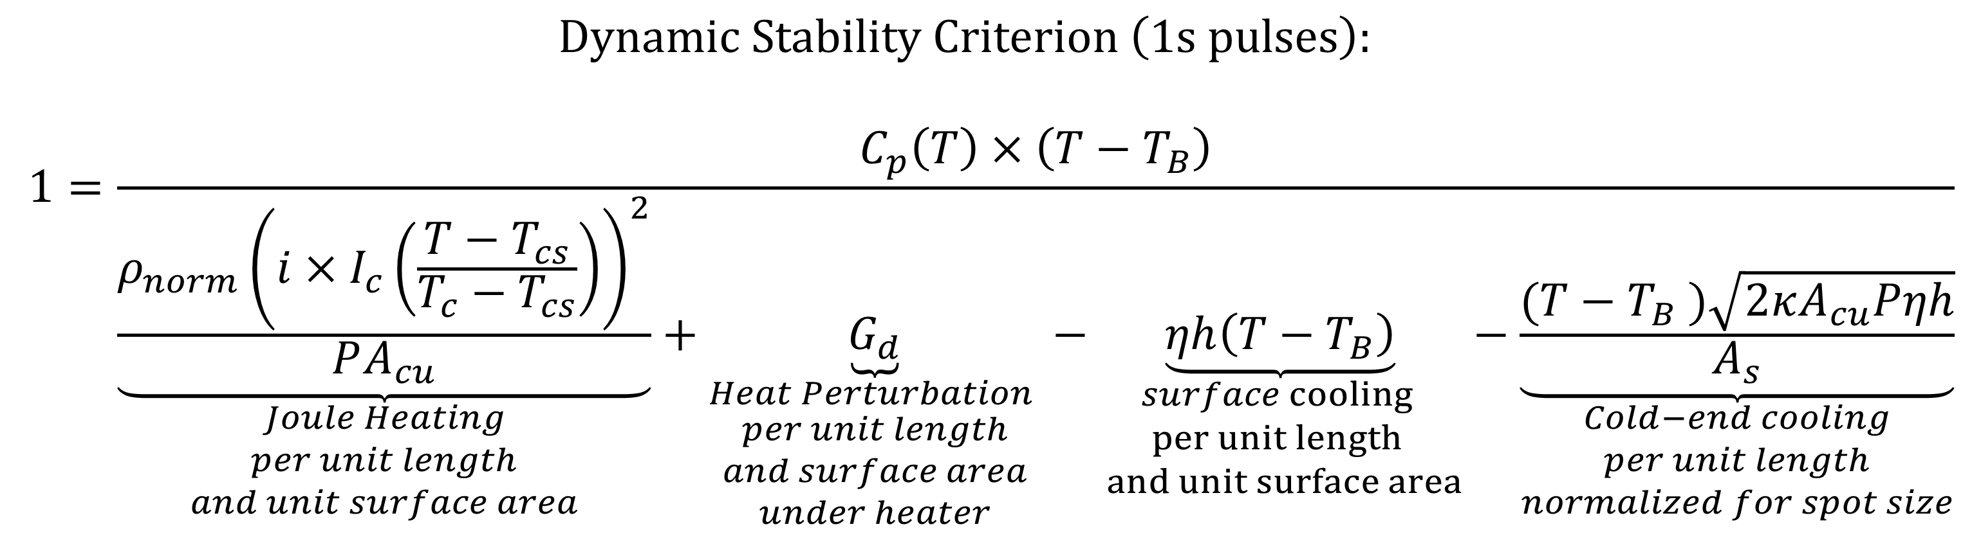
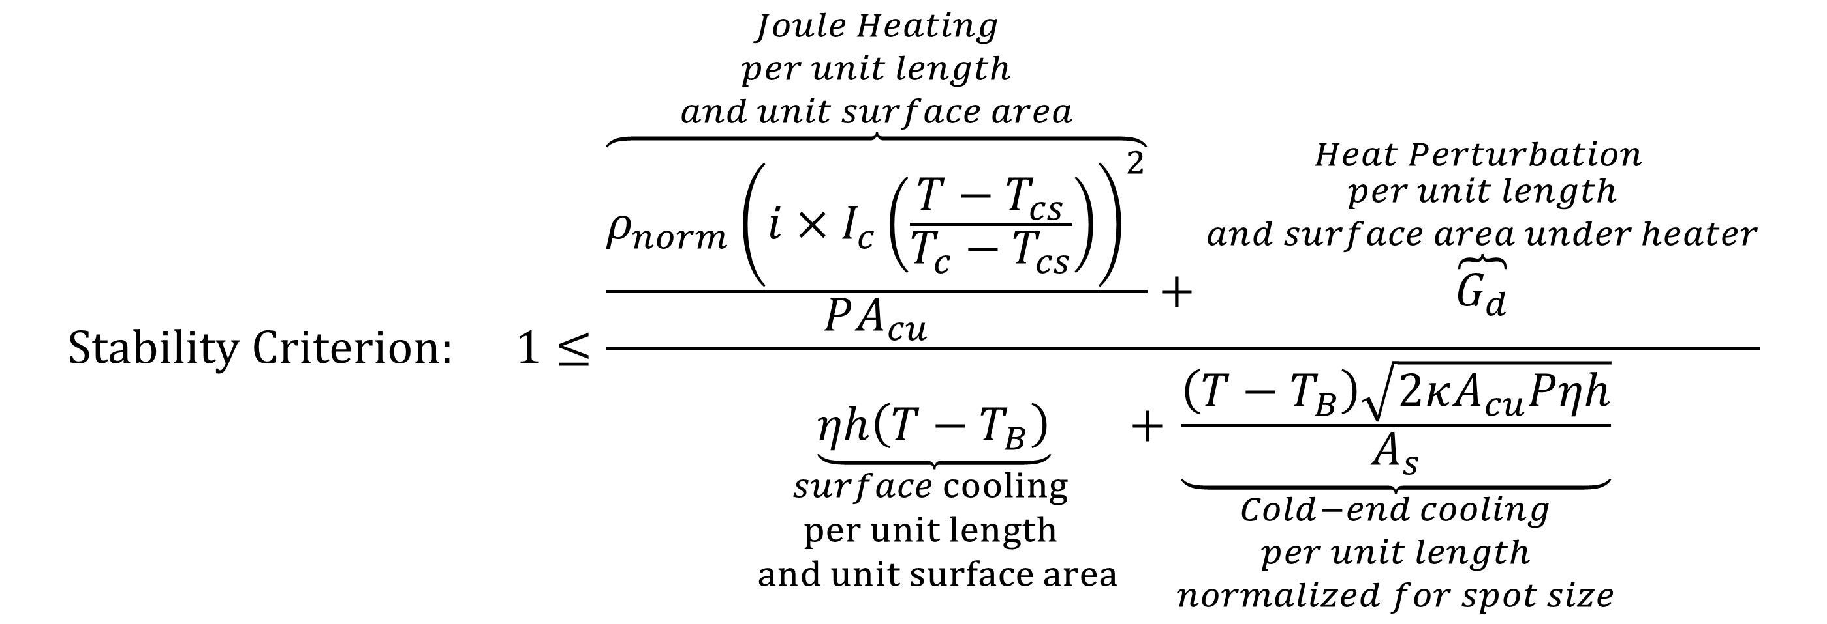
M2Po2E-01 [49] – LTS Cables - Fabrication and Characterization
Assessment of stability of fully-excited Nb3Sn Rutherford cable with modified ICR at 4.2 K and 12 T using a superconducting transformer and solenoidal magnet
C. J. Kovacs¹, M. D. Sumption¹, E. Z. Barzi², A. V. Zlobin², M. Majoros¹
¹ Center for Superconducting & Magnetic Materials (CSMM), Department of Materials Science & Engineering, The Ohio State University, USA
² Applied Physics and Superconductivity Technology Division (APS-TD), Fermi National Accelerator Laboratory, USA
Introduction
Fermilab spiral bifilar probe with 30 kA superconducting transformer: full-excitation stability measurements at 4.2 K with applied fields up to 14 T.
Rutherford cable dynamic thermal stability model
Multiple conductor options exist for next-generation high field accelerator magnets. Whether or not a hybrid, it is likely these magnets will incorporate Nb₃Sn Rutherford cable.
The performance targets of the next-generation dipoles hasn’t been reached yet for a Nb₃Sn magnet.
It will be important to have a low-cost, fast turn around measurement program to measure the full excitation J_{c} and stability performance of Nb₃Sn Rutherford cable magnet scale composite.
Ideally, this measurement program could include many partners in universities and national labs by requiring lower cost and smaller footprint infrastructure.
In this research, a low-cost measurement system described in [1] was modified to handle additional instrumentation to perform stability measurements of fully excited Nb₃Sn Rutherford cable in a LHe bath with applied fields up to 14 T.
The stability diagram generated from the experimental runs was compared to a theoretical analytical stability model.
$$Dynamic Stability Criterion \left(1s pulses\right):$$
$$1=\frac{C_{p}\left(T\right)×\left(T−T_{B}\right)}{\underset{\begin{aligned}Joule Heating \\ per unit length \\ and unit surface area\end{aligned}}{\underbrace{\frac{ρ_{norm}{\left(i×I_{c}\left(\frac{T−T_{cs}}{T_{c}−T_{cs}}\right)\right)}^{2}}{PA_{cu}}}}+\underset{\begin{aligned}Heat Perturbation \\ per unit length \\ and surface area \\ under heater\end{aligned}}{\underbrace{G_{d}}}−\underset{\begin{aligned}surface cooling \\ per unit length \\ and unit surface area\end{aligned}}{\underbrace{ηh\left(T−T_{B}\right)}}−\underset{\begin{aligned}Cold−end cooling \\ per unit length \\ normalized for spot size\end{aligned}}{\underbrace{\frac{(T−T_{B} )\sqrt{2κA_{cu}Pηh}}{A_{s}}}}}$$
The Teslatron II measurement station at Fermilab has a 77 mm bore solenoid which can apply fields of 14-16 T at 4.2 K and 2.2 K respectably.
A spiral bifilar sample holder which is coupled with a 60-multiplication factor NbTi superconducting transformer was designed to reduce the integrated Lorentz forces on the probe and magnet assembly.
The cable was insulated with S-glass braided sheath but remained unimpregnated and therefore was in good contact with the liquid Helium.
Voltage taps were soldered near a strain gauge used to generate heat perturbations.
C_{p} calculated from experimental data fit from PPMS data from Nb₃Sn strand at 12 T [3]
Full-excitation thermal stability measurement results
Nb₃Sn strand and cable specifications
Strand Type | Oxford RRP
Stack design | 132/169
Ternary Element (?) | Ti
Production year | 2012
Diameter, d, [mm] | 0.7
I_{c} (4.2 K, 12 T), [A] | 449
J_{c} (4.2 K, 12 T), [A/mm²] | 2649
I_{c} (4.2 K, 15 T), [A/mm²] | 219
J_{c} (4.2 K, 15 T), [A/mm²] | 1297
Twist pitch, [mm] | 13
Cu fraction, λ, [%] | 56.0
RRR (273 K/20 K) | 153
HT dwell step | 210 °/72 h + 400 °C/48 + 640 °C/50 h
Rutherford cable steady state thermal stability model
$$Stability Criterion: 1≤\frac{\overset{\begin{aligned}Joule Heating \\ per unit length \\ and unit surface area\end{aligned}}{\overbrace{\frac{ρ_{norm}{\left(i×I_{c}\left(\frac{T−T_{cs}}{T_{c}−T_{cs}}\right)\right)}^{2}}{PA_{cu}}}}+\overset{\begin{aligned}Heat Perturbation \\ per unit length \\ and surface area under heater\end{aligned}}{\overbrace{G_{d}}}}{\underset{\begin{aligned}surface cooling \\ per unit length \\ and unit surface area\end{aligned}}{\underbrace{ηh\left(T−T_{B}\right)}}+\underset{\begin{aligned}Cold−end cooling \\ per unit length \\ normalized for spot size\end{aligned}}{\underbrace{\frac{\left(T−T_{B}\right)\sqrt{2κA_{cu}Pηh}}{A_{s}}}}}$$
Conclusions
Cable | T1
Strand Count | 40
Core (?) | Yes
Core width, [mm] | 9.5
Lay angle, [degrees] | 16.8
Width, [mm] | 14.7
Thickness (mid), [mm] | 2
A steady state analytical stability model for cables in liquid cryogen derived in Kovacs et al. was modified to determine stability of the Nb₃Sn Rutherford cable in LHe [2].
The resistivity of the stabilizer is mostly constant over the temperatures of concern and determined from RRR.
h is chosen to be 10 kW/m²K < 5.2 K and 1 kW/m²K ≥ 5.2 K.
T_{cs} = 4.52 K is chosen as when the surface cooling equals the joule heating at T = 5.2 K.
The model below assumes current sharing at soldered junctions, a linear I_{c} versus T, and a flat sloped temperature gradient from cold-end cooling.
A laboratory scale system was modified to determine stability of a fully excited Nb₃Sn Rutherford cable.
A steady state analytical model and dynamic analytical model resulted in similar values as experimental data, but they were not able to capture the I/I_{c} stability relationship.
References
[1] E. Barzi et al. “Superconducting Transformer for Superconducting Cable Tests in a Magnetic Field” AIP Conference Proceedings, 1218, pp.421-428 (2010)
[2] C.J. Kovacs, M. Majoros, M.D. Sumption, and E.W. Collings, “Quench and stability of Roebel cables at 77 K and self-field: minimum quench power, cold end cooling, and cable cooling efficiency,” Cryogenics, 95, pp.57-63 (2018)
[3] C.S. Myers, M.A. Susner, L. Motowidlo, J. Distin, M.D. Sumption, and E.W. Collings, “Specific heats of composite Bi2212, Nb₃Sn, and MgB₂ wire conductors”, IEEE Trans. Appl. Supercond., 23, 3, (2013)
Acknowledgments
This work was supported by the U.S. Department of Energy, Office of Science Graduate Student Research Program (SCGSR)

